Slide 1

CRYPTOCURRENCY
CRYPTOGRAPHY COURSE
Laura Martin Ybañez 100496895
Nuria Calle Carpintero 100497015
Leyre Ruiz de Alegria Bravo 100497014
Notes:
1. Table of contents
2. Introduction
3. Our company
4. Our team
5. Problem
6. Them vs. us
7. Solution
8. SWOT analysis
9. Product overview
10. Our plans
11. Product demo
12. Traction
13. Case study
14. Reviews
15. Awards
16. Market size
17. Target
18. Competitors
19. Business model
20. Timing
21. Predicted growth
22. Investment

Slide 2
Table of Contents
01
02
03
04
05
HISTORY
HOW IT WORKS
FUTURE
TYPES
SECURITY

Slide 3

WHAT IS CRYPTOCURRENCY?
Cryptocurrencies are digital tokens. They enable individuals to make online transactions. They do not have a legislated value, it depends on the demand.
EXAMPLES: Bitcoin, Ether

Slide 4
VALUE OF BITCOIN
$70,000
Mid-2021
2022
End of 2021
$30,000
$35,000

Slide 5
01
HISTORY OF CRYPTOCURRENCY

Slide 6
2008 CRISIS
Satoshi Nakamoto
Bitcoin
El salvador- Legal tener
LEHMAN BROTHERS Bankrupcty
October 2008 Presents Bitcoin: facilitate online payments
January 3, 2009 First block of 50 bitcoins
September 7, 2021

Slide 7
Prehistory
eCash, DigiCash
b-money
1980s and 1990s, David Chaum Preserve confidentiality of data in economy transactions
1998, Wei Dai Authenticate transactions

Slide 8
02
HOW IT WORKS

Slide 9
BLOCKCHAIN
MINERS
Blocks linked to others with dates and data.
Parts of the nodes

Slide 10
03
TYPES OF CRYPTOCURRENCY

Slide 11

BITCOIN
Original cryptocurrency
ETHEREUM
Potential applications
TETHER
Stablecoins, reduce volatility
BINANCE COIN
Trading and fee payments on Binance
XRP
XRP Ledger Consensus Protocol

Slide 12
04
FUTURE OF CRYPTOCURRENCY

Slide 13
Regulations
Protecting investors
Preventing money laundering
Ensuring financial stability

Slide 14
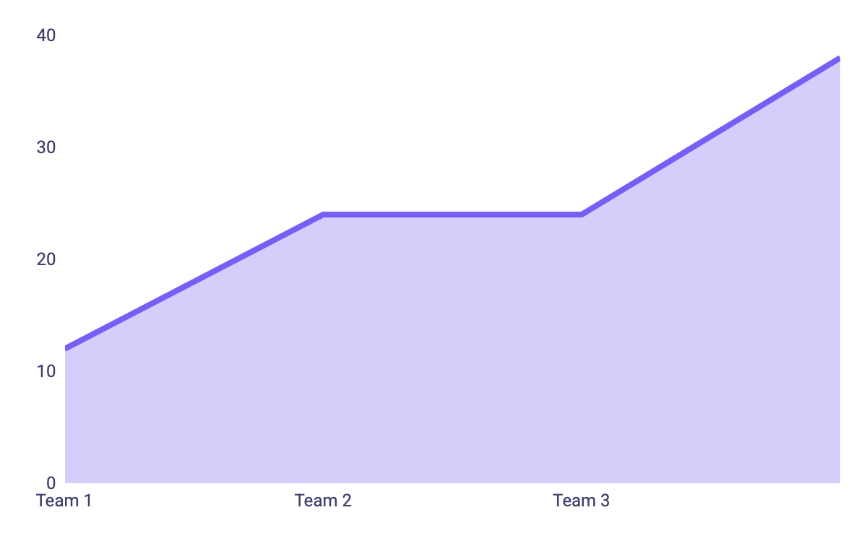
Predicted Growth
2022
100
Market crashed
50
2023-ON
25
Grow and mature
00
2021
2022
2023
2024

Slide 15
05
SECURITY

Slide 16
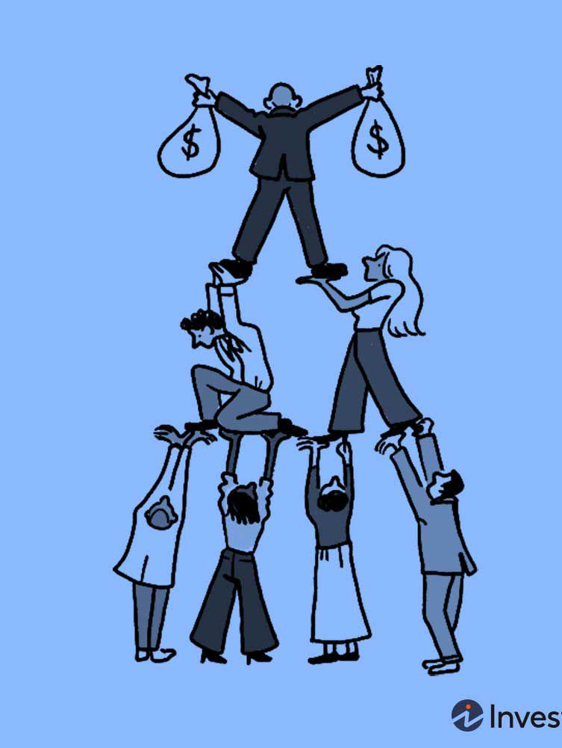


Cryptocurrency scams
Virtual Ponzi schemes
Fake websites
“Celebrity” endorsements

Slide 17
Tips to invest in cryptocurrency
Research exchanges
Know how
to store it
Diversify your investments

Slide 18
Thank you!

