Slide 1
Inverse Design for Generating Initial Conditions in Scientific Simulations
Leslie Horace∗, Christin Whitton†, Vanessa Job†,
William Jones‡, Nathan DeBardeleben†
∗College of Computing, Georgia Institute of Technology, Atlanta, GA, USA
†High Performance Computing Design, Los Alamos National Laboratory, Los Alamos, NM, USA
‡Department of Computing Sciences, Coastal Carolina University, Conway, SC, USA
LA-UR-25-31047
November 17, 2025  SC25 AI4S Workshop  St. Louis, MO

Slide 2
Outline
Motivation
Case Studies
Model Specification
Training and Inference
Experimental Setup
Model Performance
Generated Results
Conclusions and Next Steps
Contact Information

Slide 3
Motivation & Objective
Scientific modeling involves solving for outputs from a set of initial conditions.
It is often desirable to know what initial conditions lead to a specific output?
This presents a difficult combinatorial, optimization problem:
Given an output, what distinct sets of initial conditions produce it?
Our goal was to develop a machine learning surrogate model that generates N sets of initial conditions that reproduce a desired simulation output.
Solving a generative, many to one, inverse problem.

Slide 4
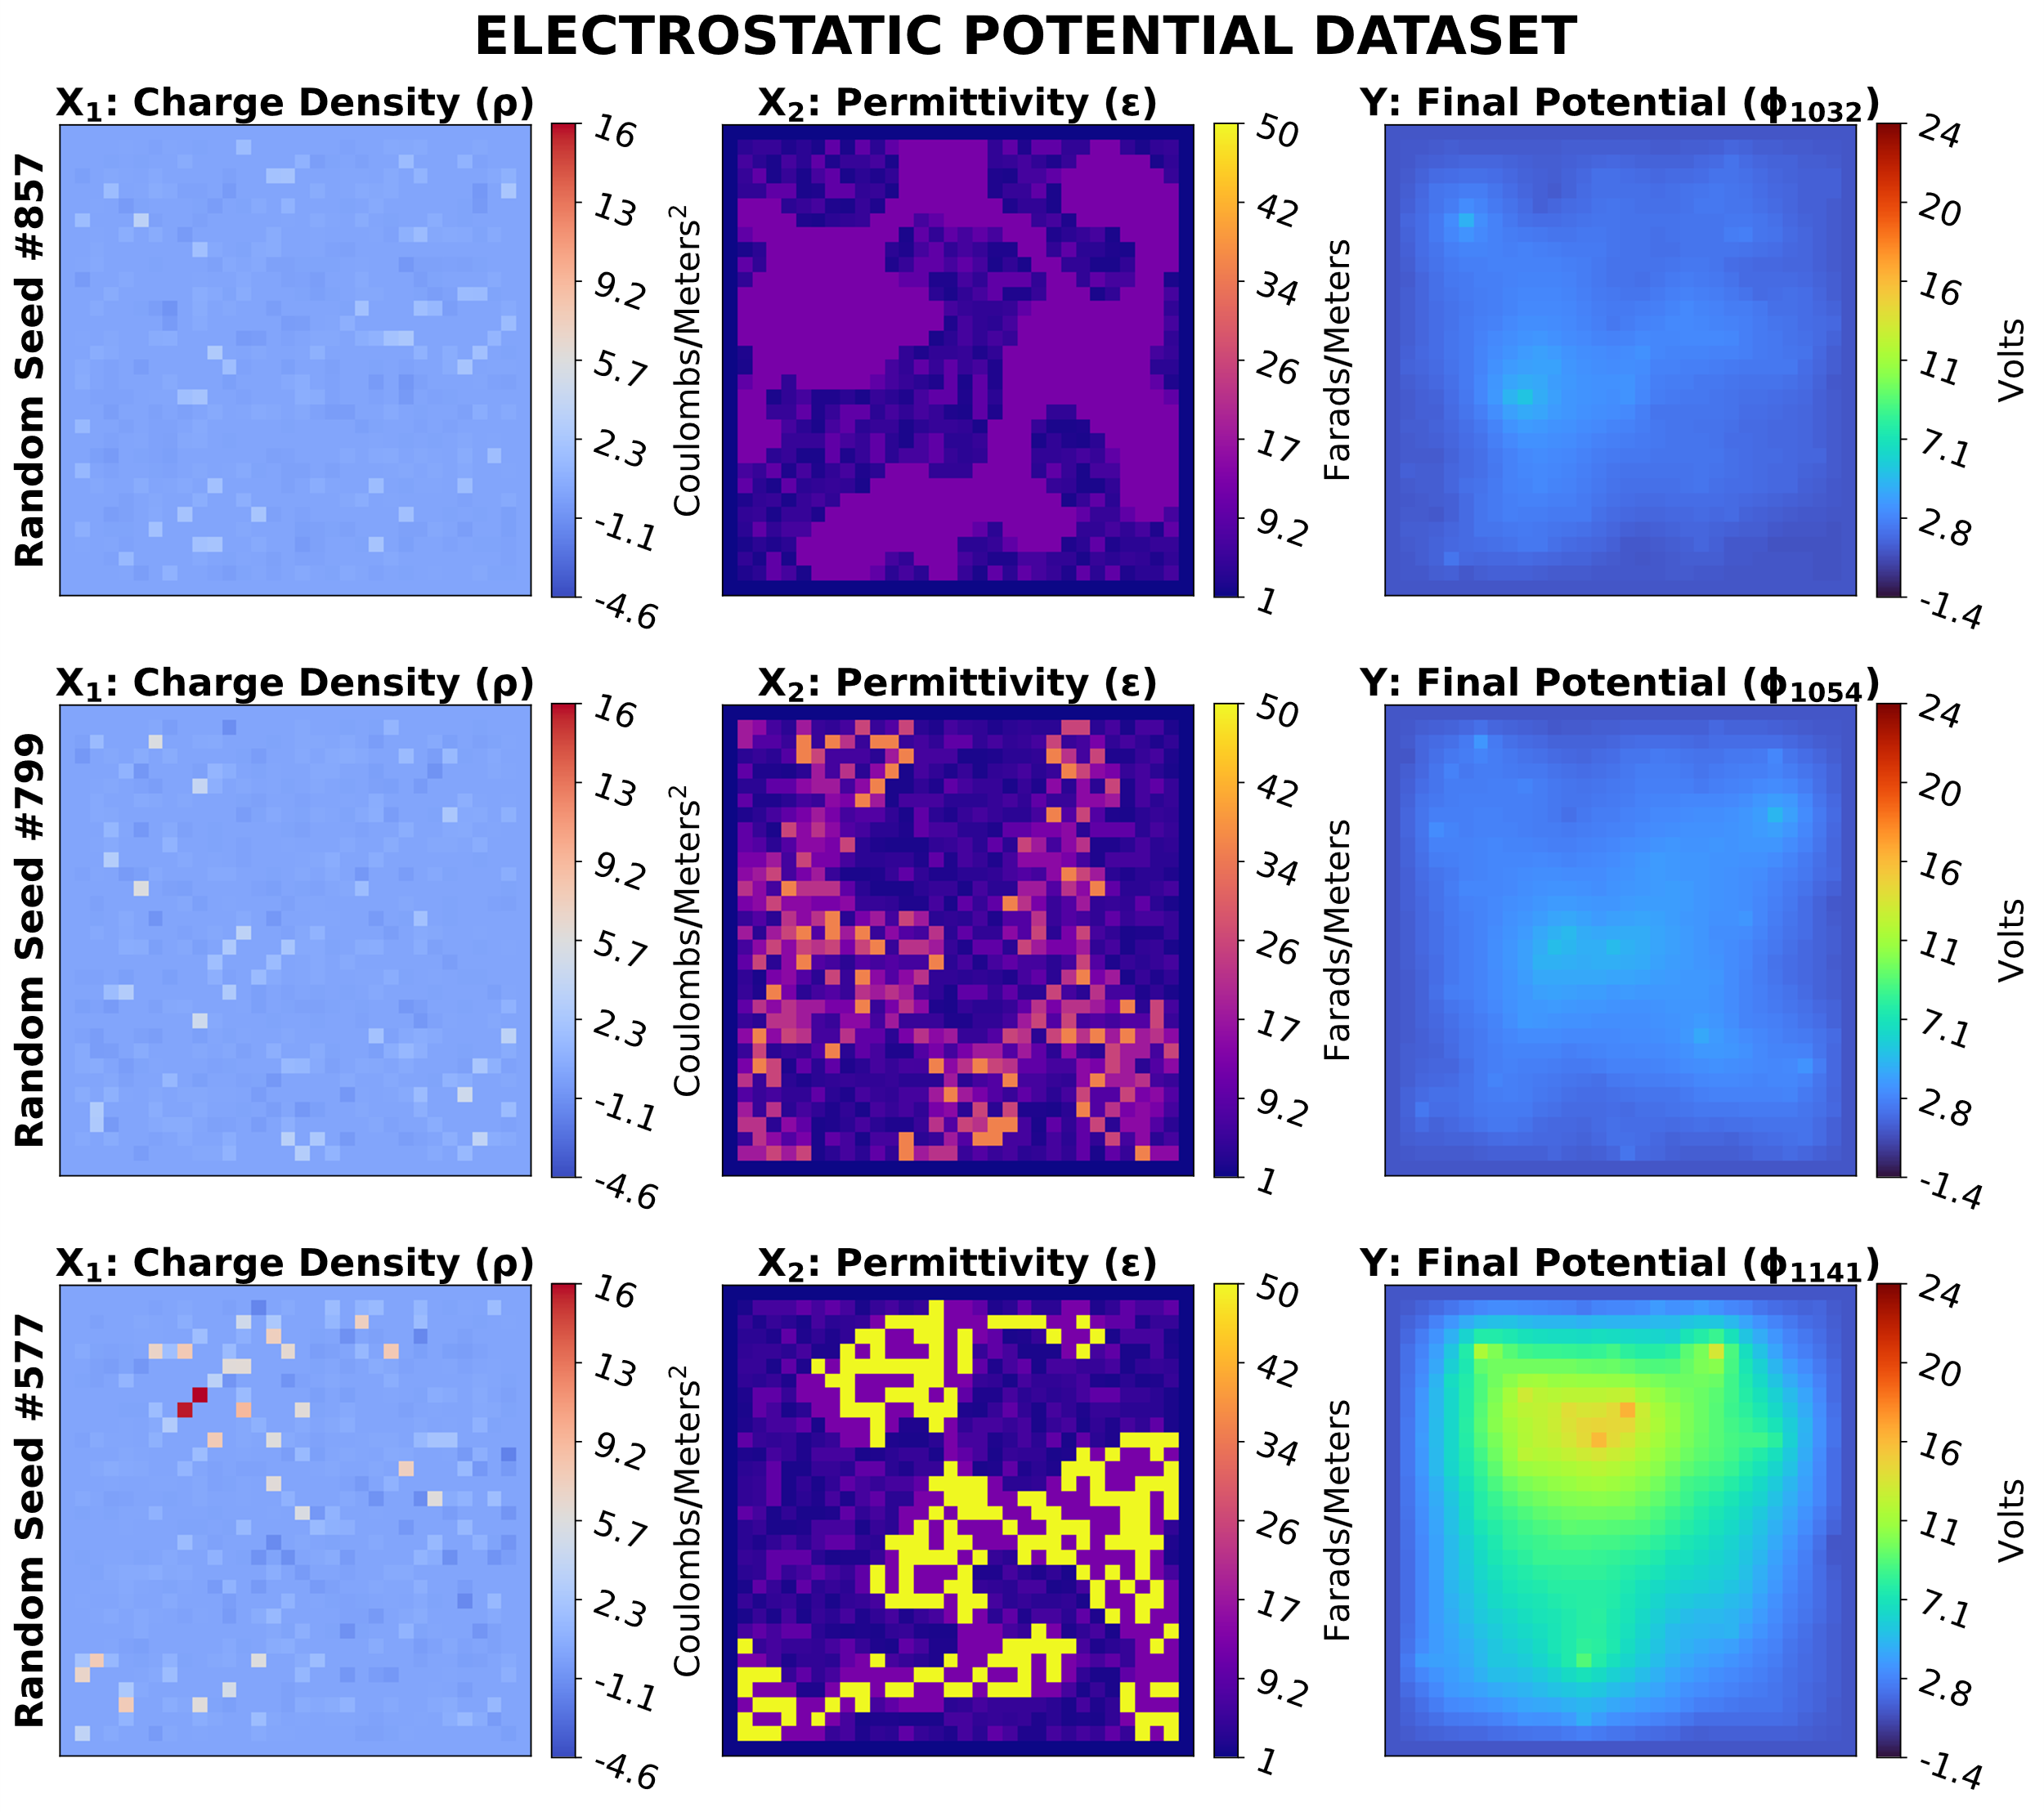
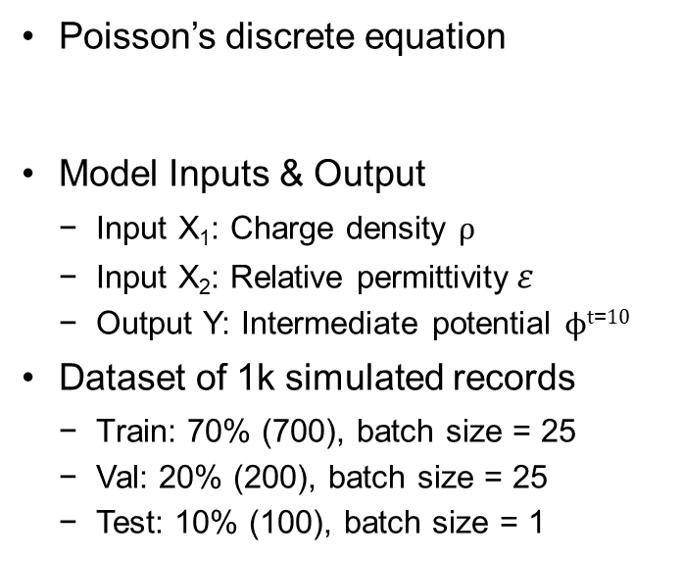
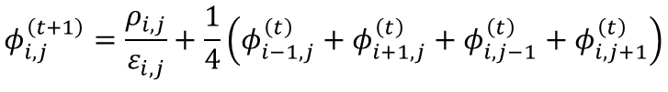
Electrostatic Potential
Poisson’s discrete equation
Model Inputs & Output
Input X₁: Charge density $ρ$
Input X₂: Relative permittivity$ε$
Output Y: Intermediate potential $ϕt\text{=}10$
Dataset of 1k simulated records
Train: 70% (700), batch size = 25
Val: 20% (200), batch size = 25
Test: 10% (100), batch size = 1
$$φ_{i,j}^{\left(t+1\right)}=\frac{ρ_{i,j}}{ε_{i,j}}+\frac{1}{4}\left(φ_{i−1,j}^{\left(t\right)}+φ_{i+1,j}^{\left(t\right)}+φ_{i,j−1}^{\left(t\right)}+φ_{i,j+1}^{\left(t\right)}\right)$$
Note: Standardized images on the right show the final timestep instead of t=10 for visual clarity.
Dataset Link:
https://oceans11.lanl.gov/electrostaticEquations/

Slide 5
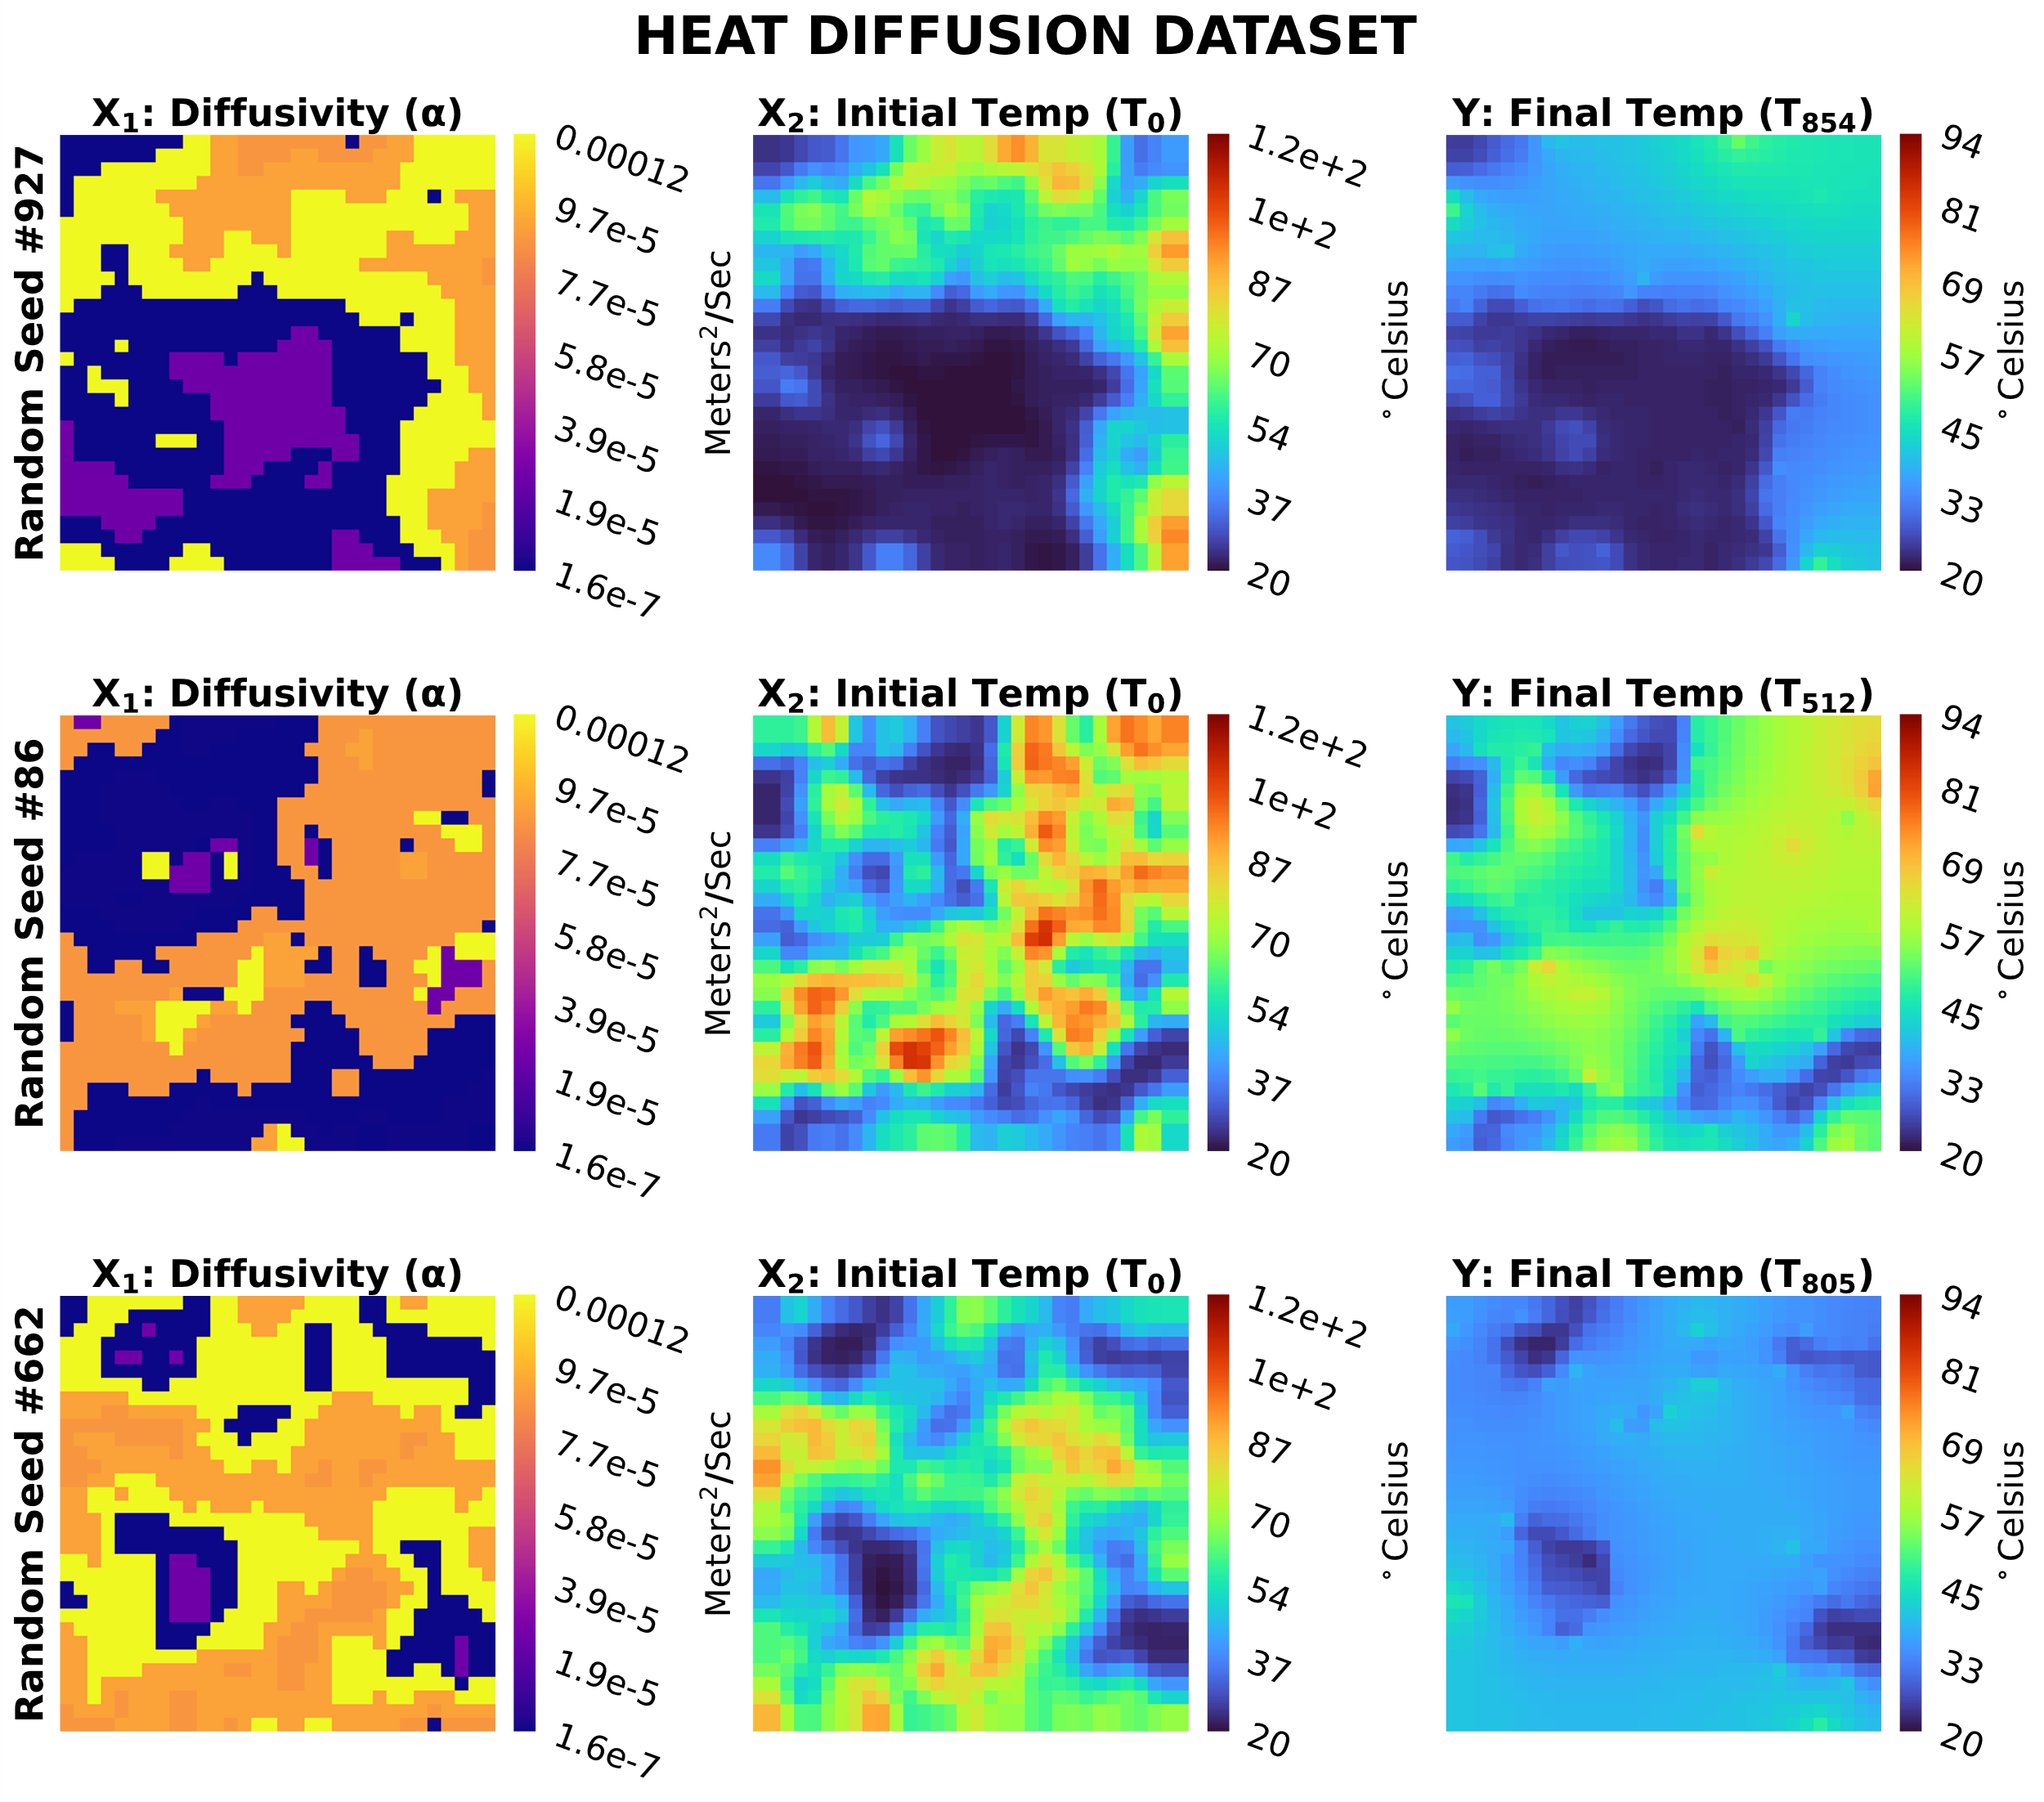
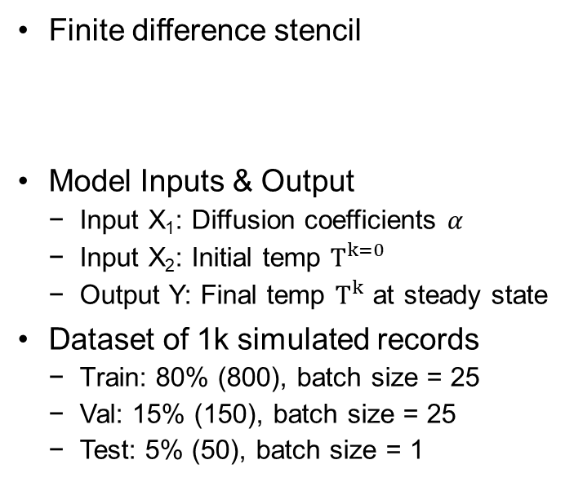
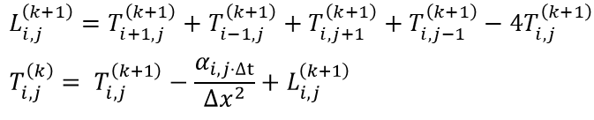
Heat Diffusion
Finite difference stencil
Model Inputs & Output
Input X₁: Diffusion coefficients 𝛼
Input X₂: Initial temp $T^{k=0}$
Output Y: Final temp $T^{k}$ at steady state
Dataset of 1k simulated records
Train: 80% (800), batch size = 25
Val: 15% (150), batch size = 25
Test: 5% (50), batch size = 1
$$L_{i,j}^{\left(k+1\right)}=T_{i+1,j}^{\left(k+1\right)}+T_{i−1,j}^{\left(k+1\right)}+T_{i,j+1}^{\left(k+1\right)}+T_{i,j−1}^{\left(k+1\right)}−4T_{i,j}^{\left(k+1\right)}$$
$$T_{i,j}^{\left(k\right)}= T_{i,j}^{\left(k+1\right)}−\frac{α_{i,j⋅∆t}}{∆x^{2}}+L_{i,j}^{\left(k+1\right)}$$
Dataset Link: https://oceans11.lanl.gov/heatEquations/

Slide 6
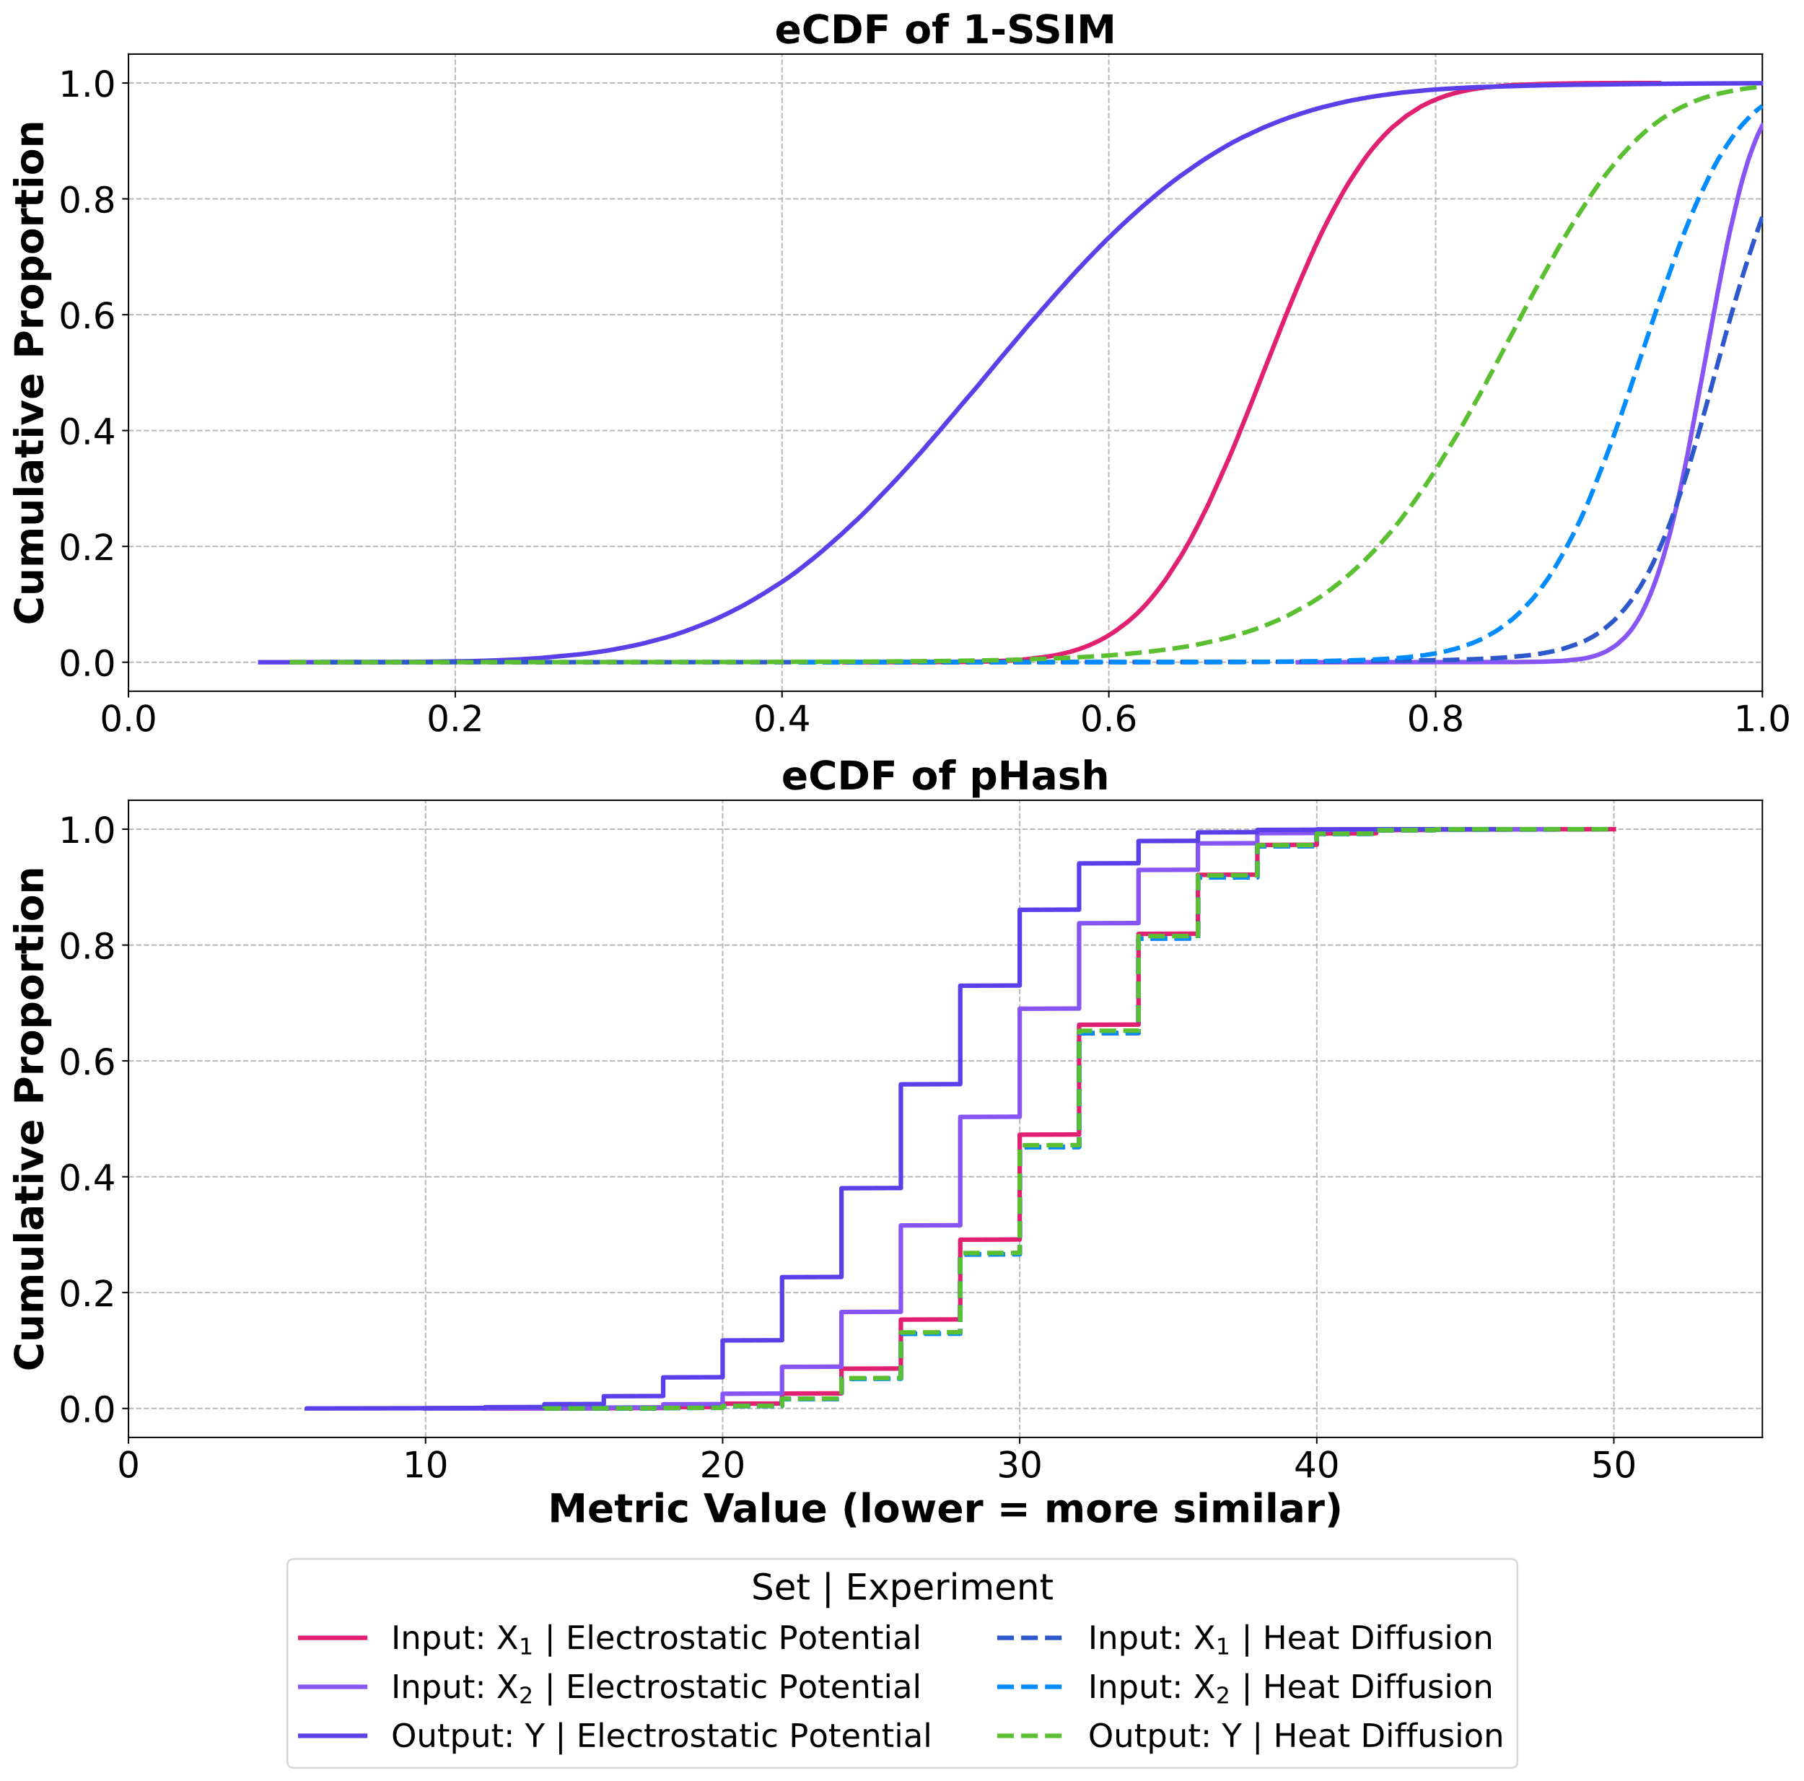
Dataset Diversity
Sample diversity was quantified for all {X₁​, X₂​, Y} within the same set
Perceptual differences are measured via 1-SSIM and pHash distances
The high metric values show good variability between samples
Electrostatic Output Y was the least diverse set, but this is explainable as it represents only 10 simulated timesteps

Slide 7
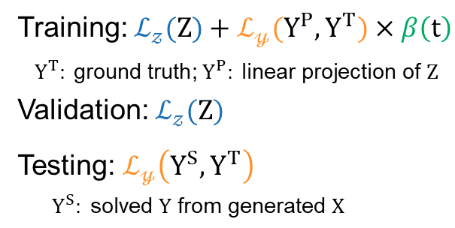
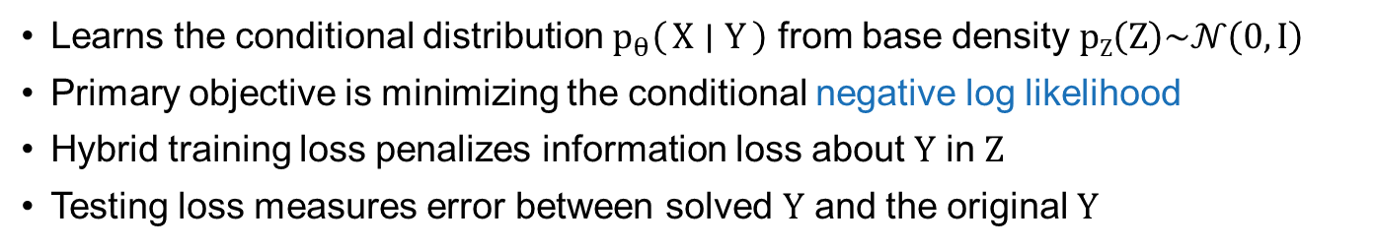
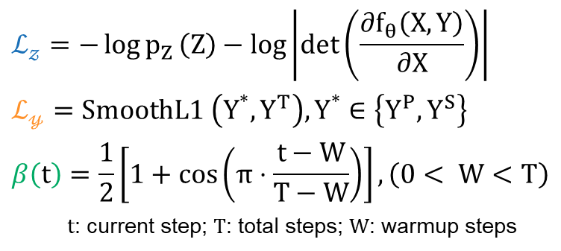
Conditional Normalizing Flow Model
Learns the conditional distribution $p_{θ}\left(X ∣ Y\right)$ from base density $pZ\left(Z\right)\sim 𝒩\left(0,I\right)$
Primary objective is minimizing the conditional negative log likelihood
Hybrid training loss penalizes information loss about $Y$ in $Z$
Testing loss measures error between solved $Y$ and the original $Y$
Loss Functions
Loss Terms
$$ℒ_{𝓏}=−\log{p_{Z}}\left(Z\right)−\log\left|\det\left(\frac{∂f_{θ}\left(X,Y\right)}{∂X}\right)\right|$$
$$ℒ_{𝓎}=SmoothL1 \left(Y^{∗},Y^{T}\right),Y^{∗}∈\left\{Y^{P}, Y^{S}\right\}$$
$$β\left(t\right)=\frac{1}{2}\left[1+\cos\left(π⋅\frac{t−W}{T−W}\right)\right],\left(0< W<T\right)$$
$t$: current step; $T\text{: }\text{total} \text{steps}\text{;}$ $W\text{:} \text{warmup} \text{steps}$
Training: $ℒ_{𝓏}(Z)+ℒ_{𝓎}(Y^{P},Y^{T})×β\left(t\right)$
$Y^{T}: \text{ground} \text{truth}$;${ Y}^{P}: \text{linear} \text{projection} \text{of} Z$
Validation: $ℒ_{𝓏}(Z)$
Testing: $ℒ_{𝓎}\left(Y^{S},Y^{T}\right)$
$$Y^{S}: \text{solved} Y \text{from} \text{generated} X$$

Slide 8
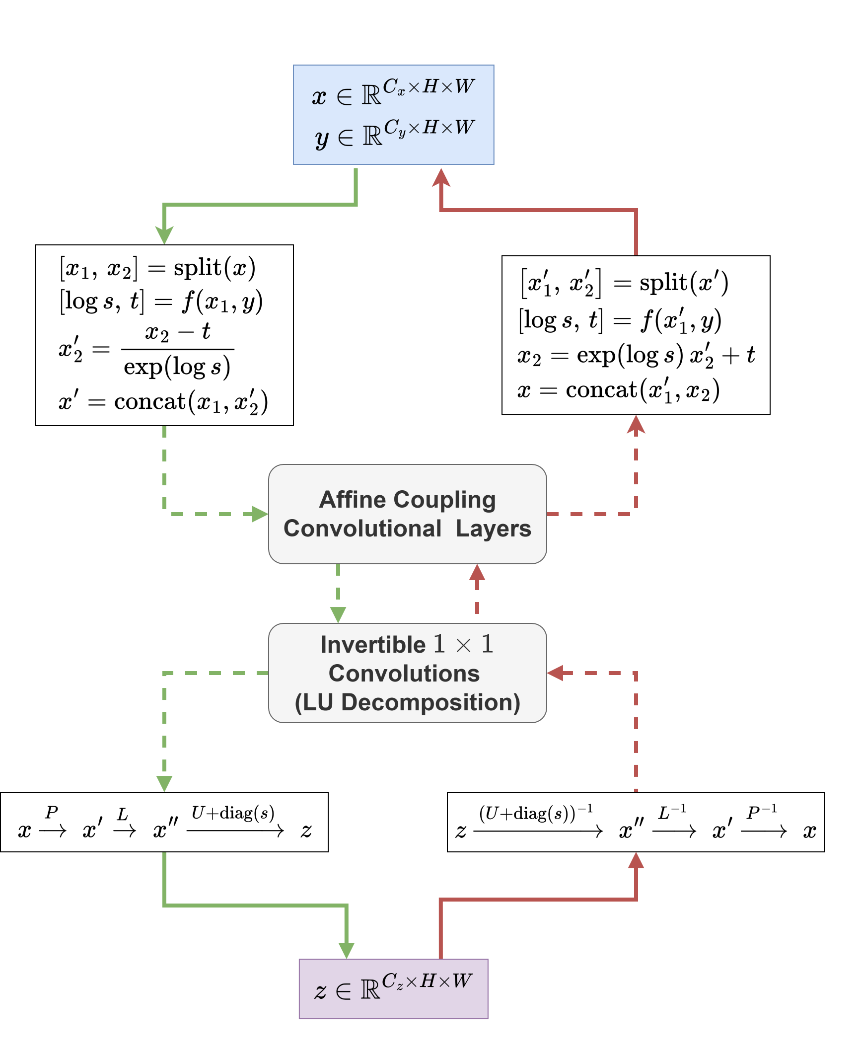
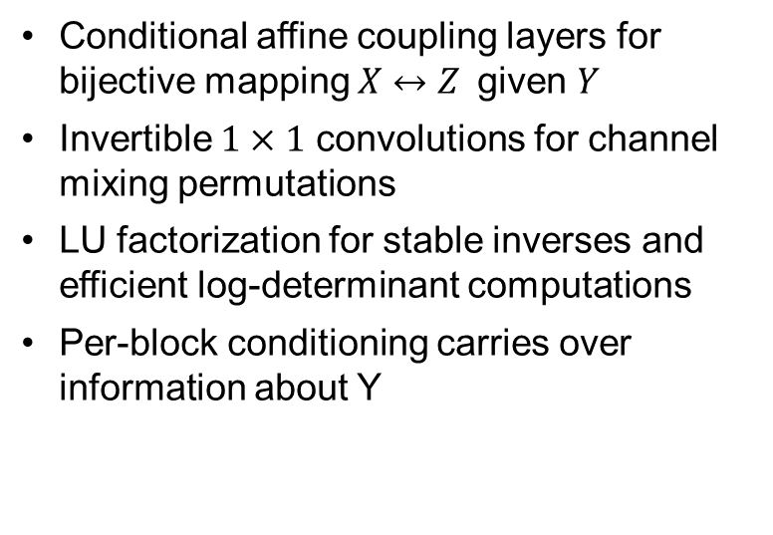
Block Architecture
Conditional affine coupling layers for bijective mapping $X↔Z$given $Y$
Invertible $1×1$ convolutions for channel mixing permutations
LU factorization for stable inverses and efficient log-determinant computations
Per-block conditioning carries over information about Y
Please refer to the paper for more details.

Slide 9
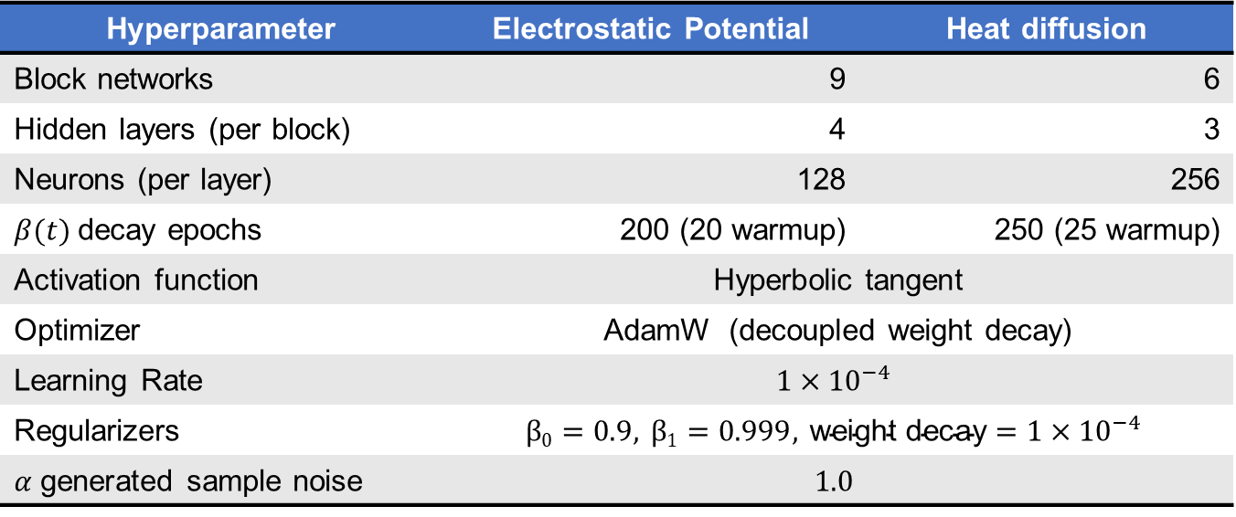
Experiment Hyperparameters
Hyperparameter | Electrostatic Potential | Heat diffusion
Block networks | 9 | 6
Hidden layers (per block) | 4 | 3
Neurons (per layer) | 128 | 256
$β(t)$decay epochs | 200 (20 warmup) | 250 (25 warmup)
Activation function | Hyperbolic tangent
Optimizer | AdamW (decoupled weight decay)
Learning Rate | $$1×{10}^{−4}$$
Regularizers | $$β0=0.9, β1=0.999, \text{weight} \text{decay}=1×{10}^{−4}$$
𝛼 generated sample noise | $$1.0$$

Slide 10
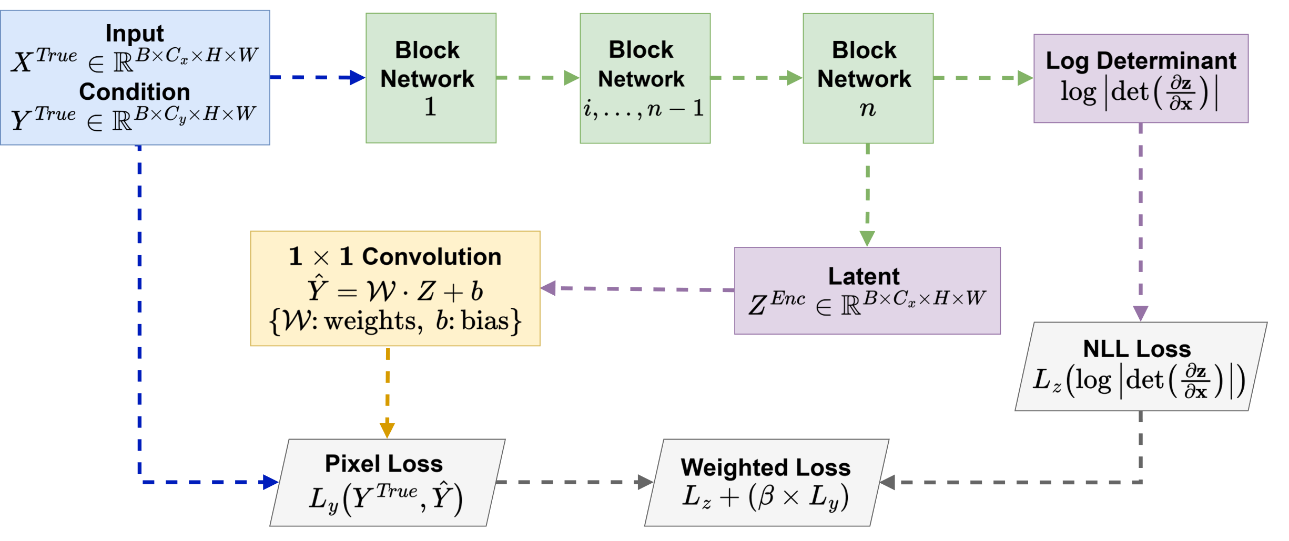
Training Workflow
Encodes $\left(X, Y\right) \text{↦} Z$, transforming prior $p\left(Z\right)$ into conditional distribution $pθ(X | Y)$.

Slide 11
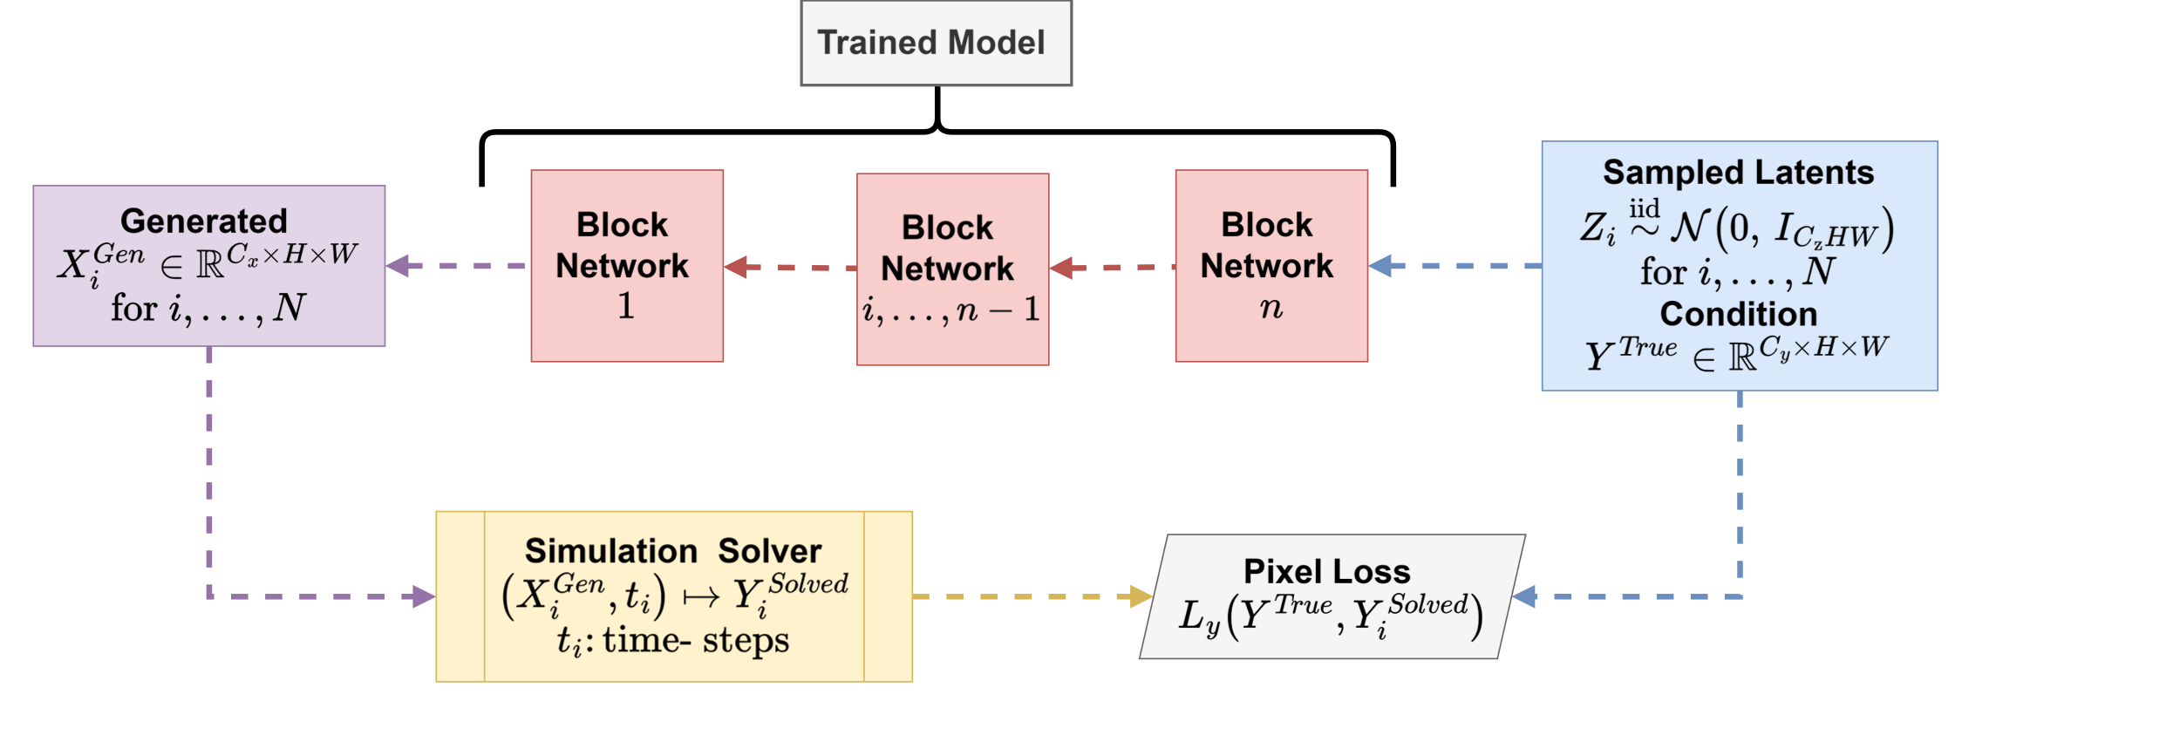
Inference Workflow
Decodes $Xi$ from sampled latent $Zi$ and confirms $Xi$ solves to the desired $Y$.

Slide 12
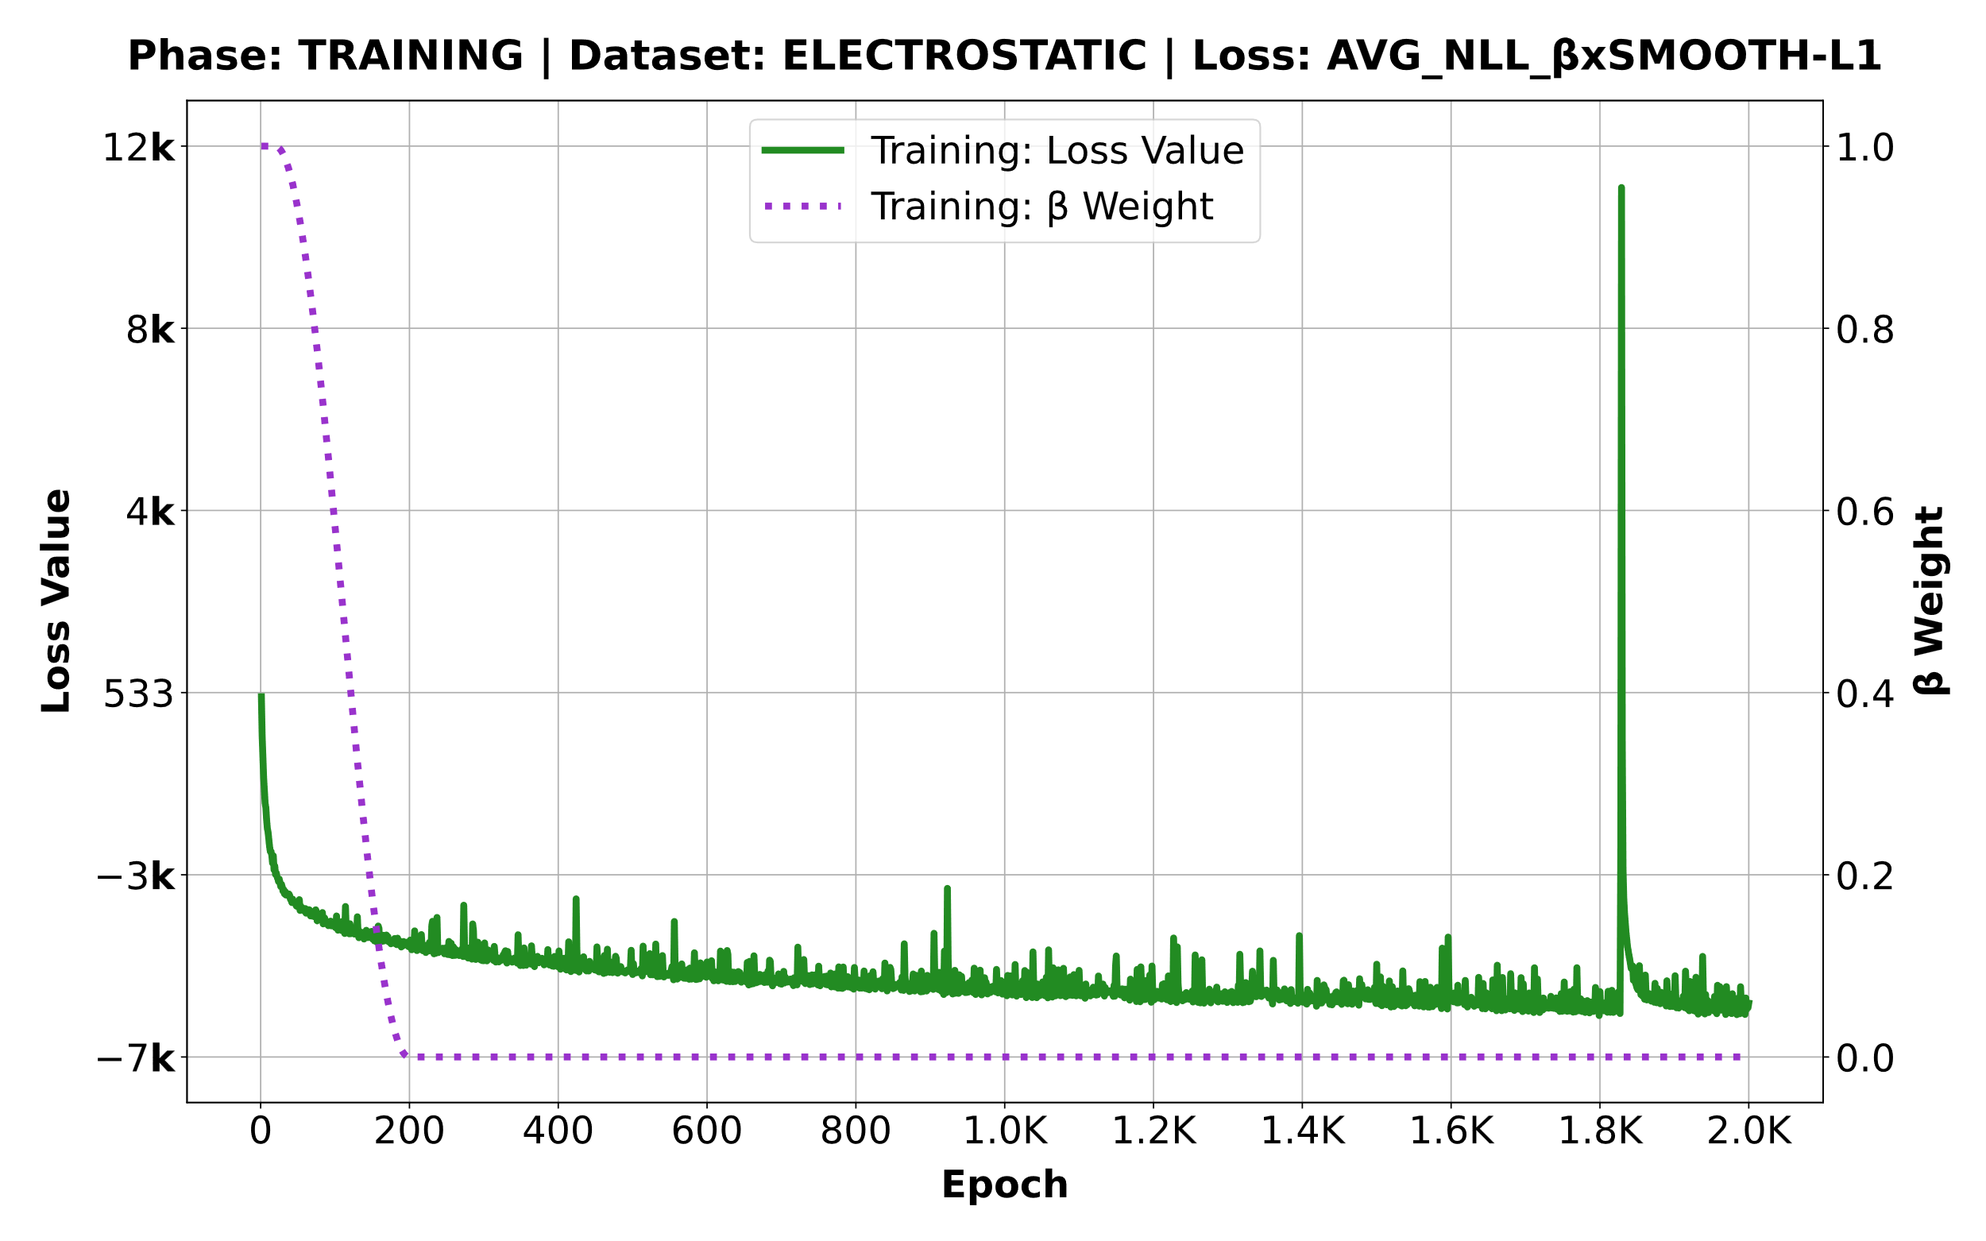
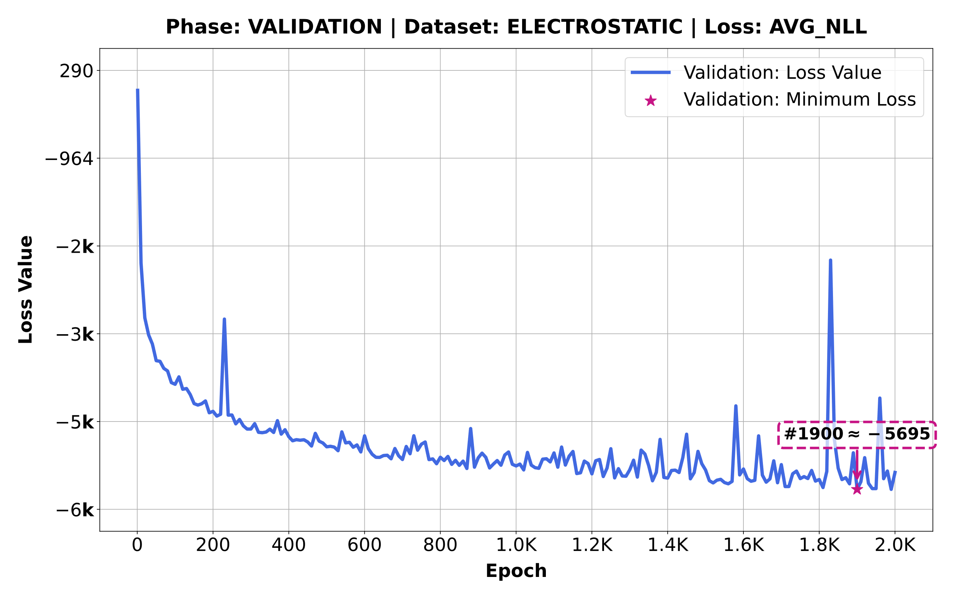
Model Performance: Electrostatic Potential
The model converges at epoch 1900 with validation loss ~5695.

Slide 13
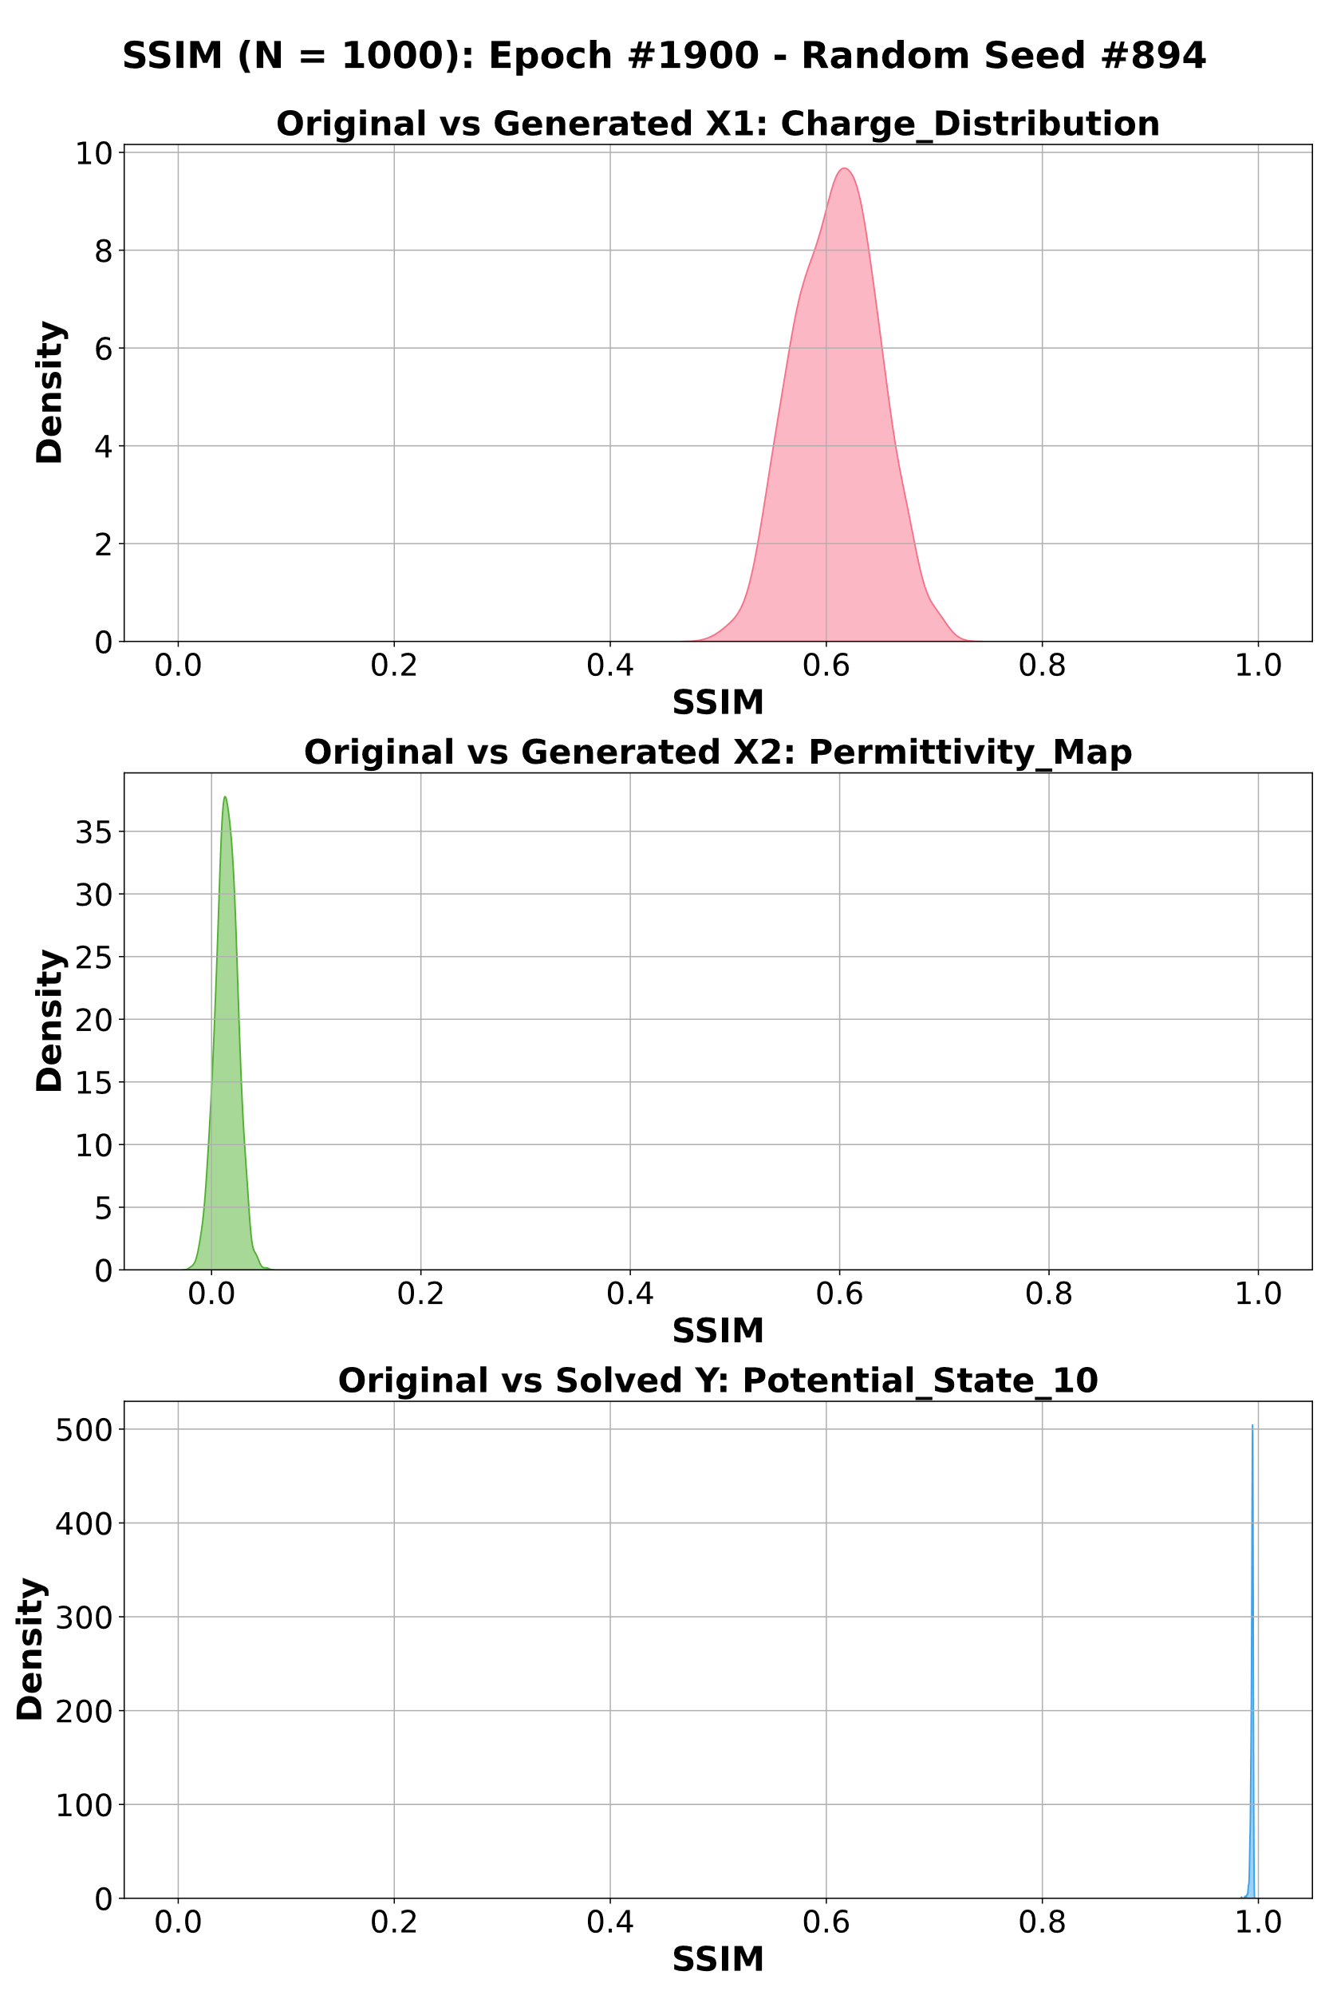
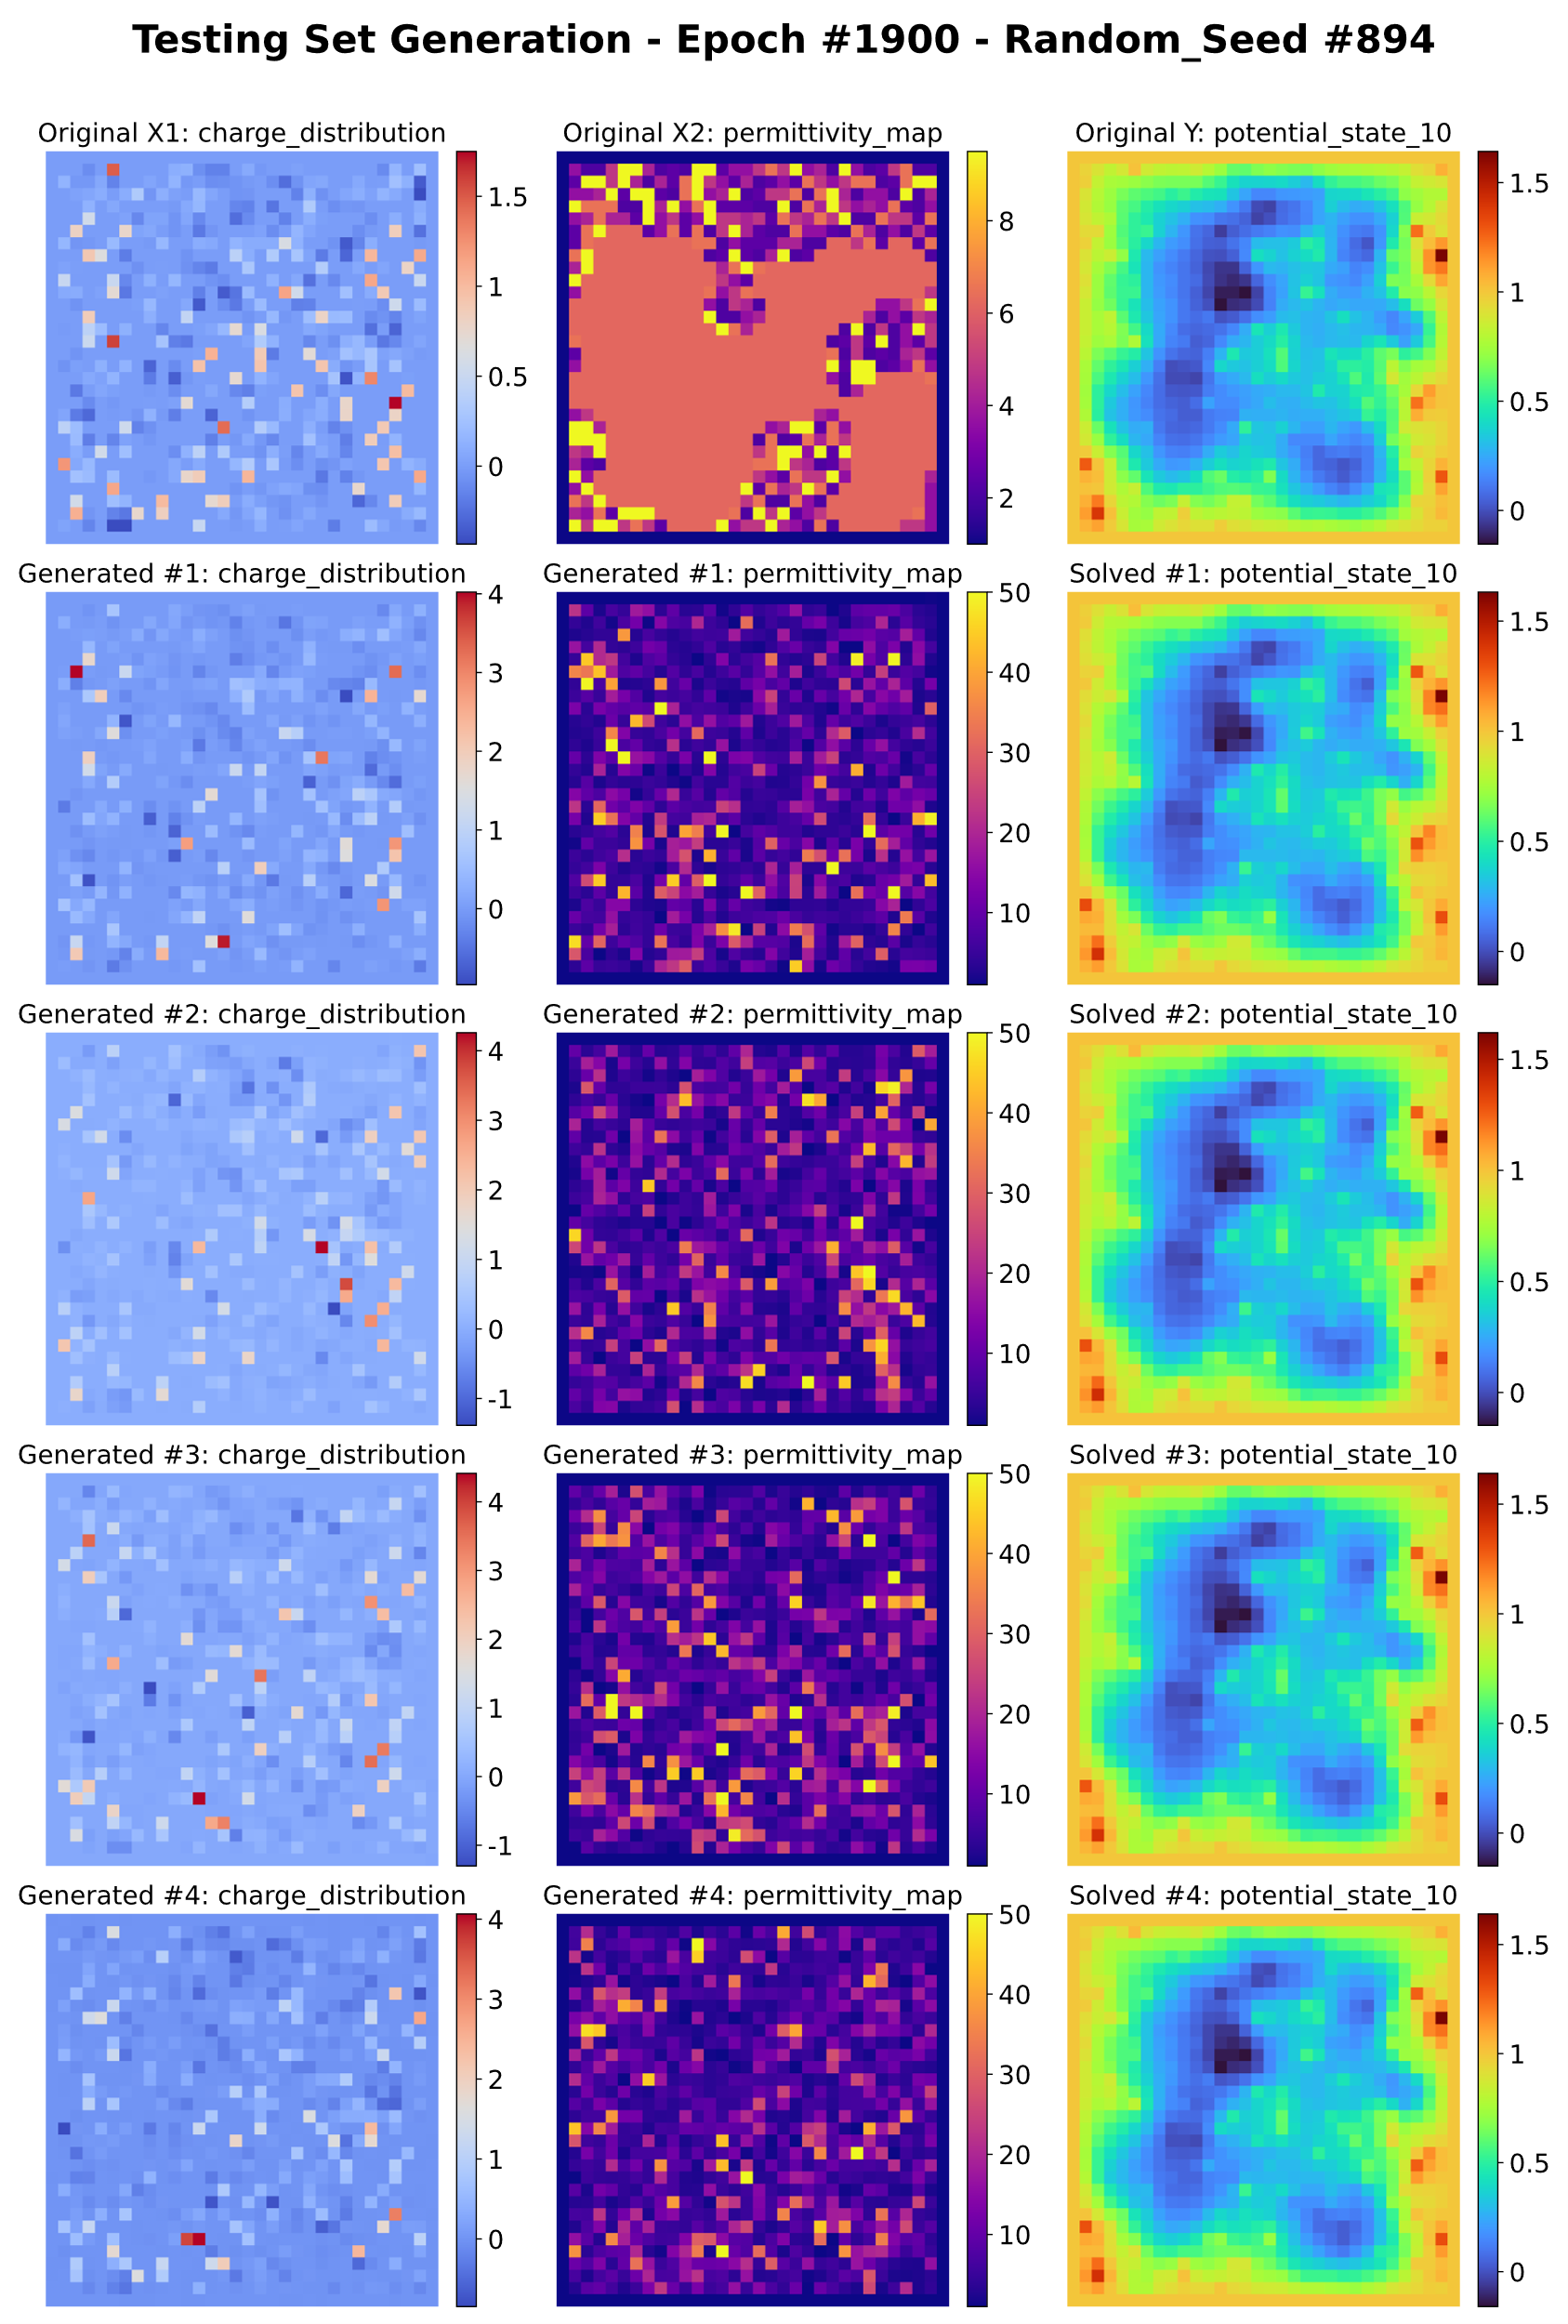
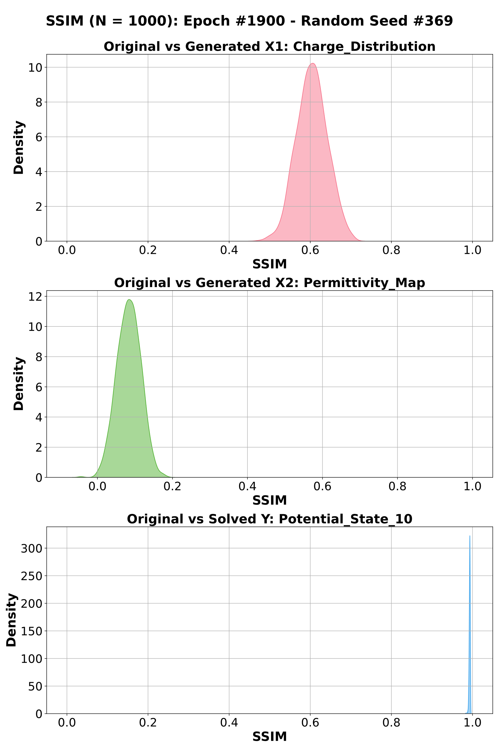
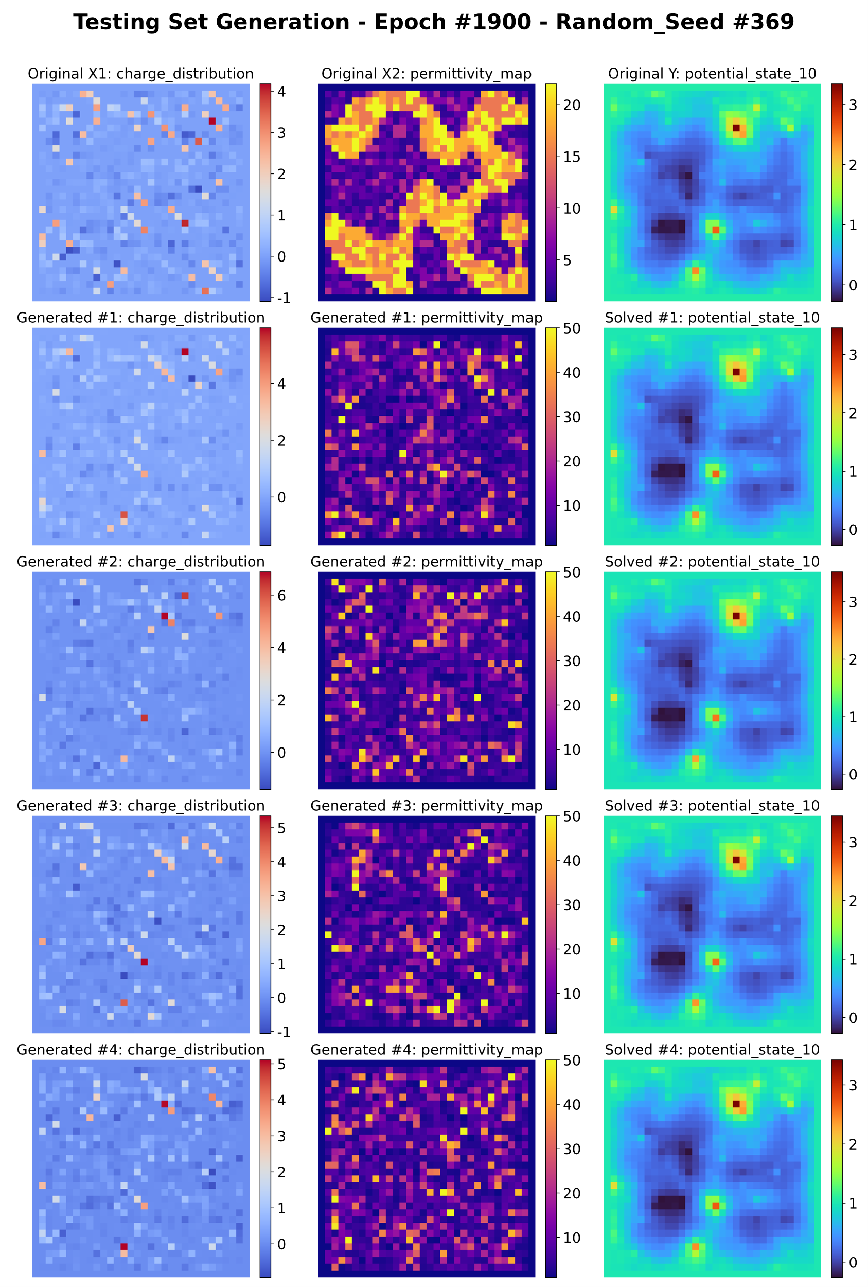
Generated Samples: Electrostatic Potential
Generated 1000 inputs per testing sample with the best trained model state (lowest validation loss).

Slide 14
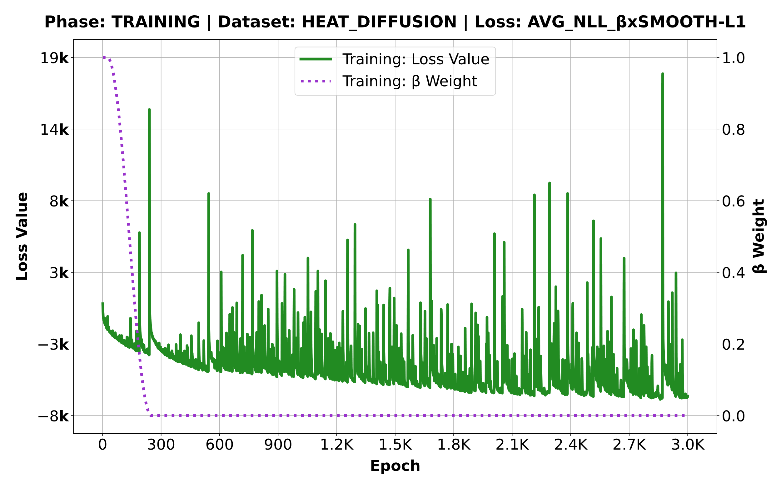
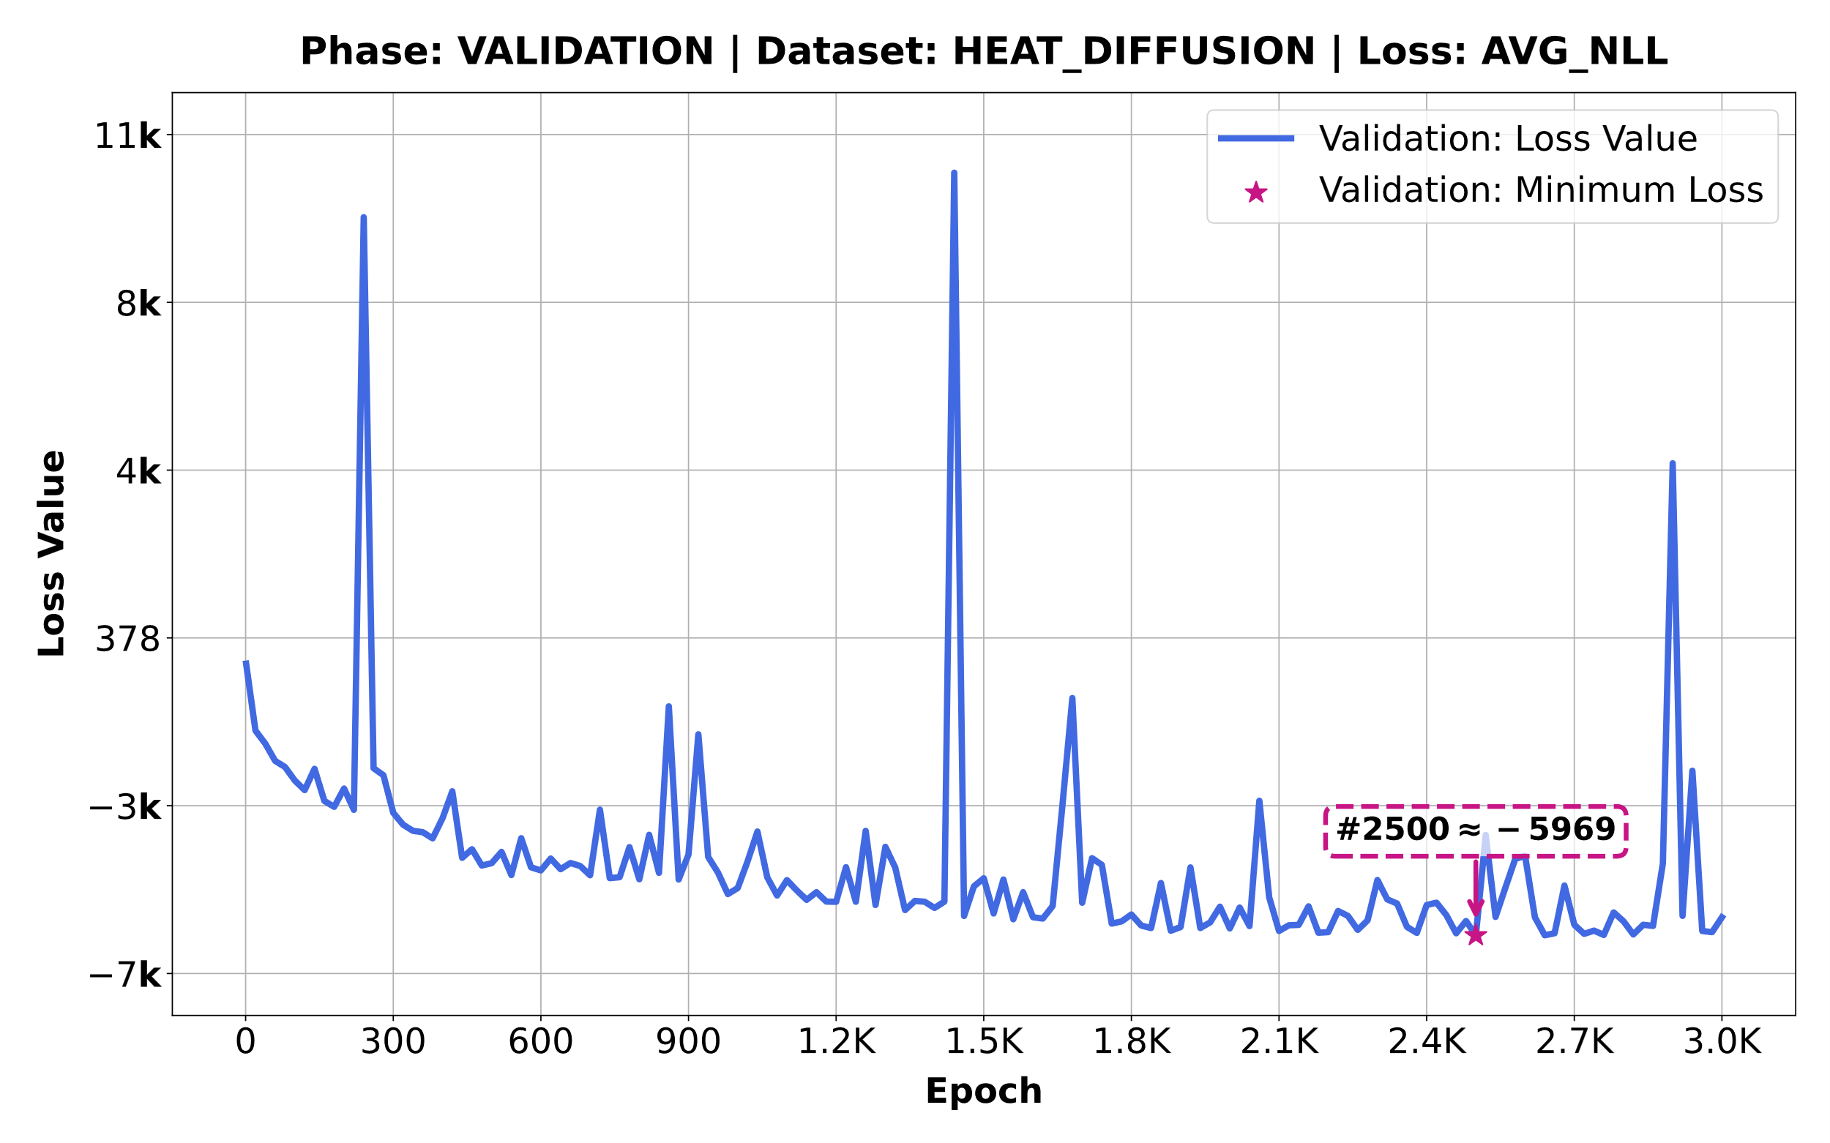
Model Performance: Heat Diffusion
Training is less stable due to outliers/noise in mini-batches but still converges at epoch 2500.

Slide 15
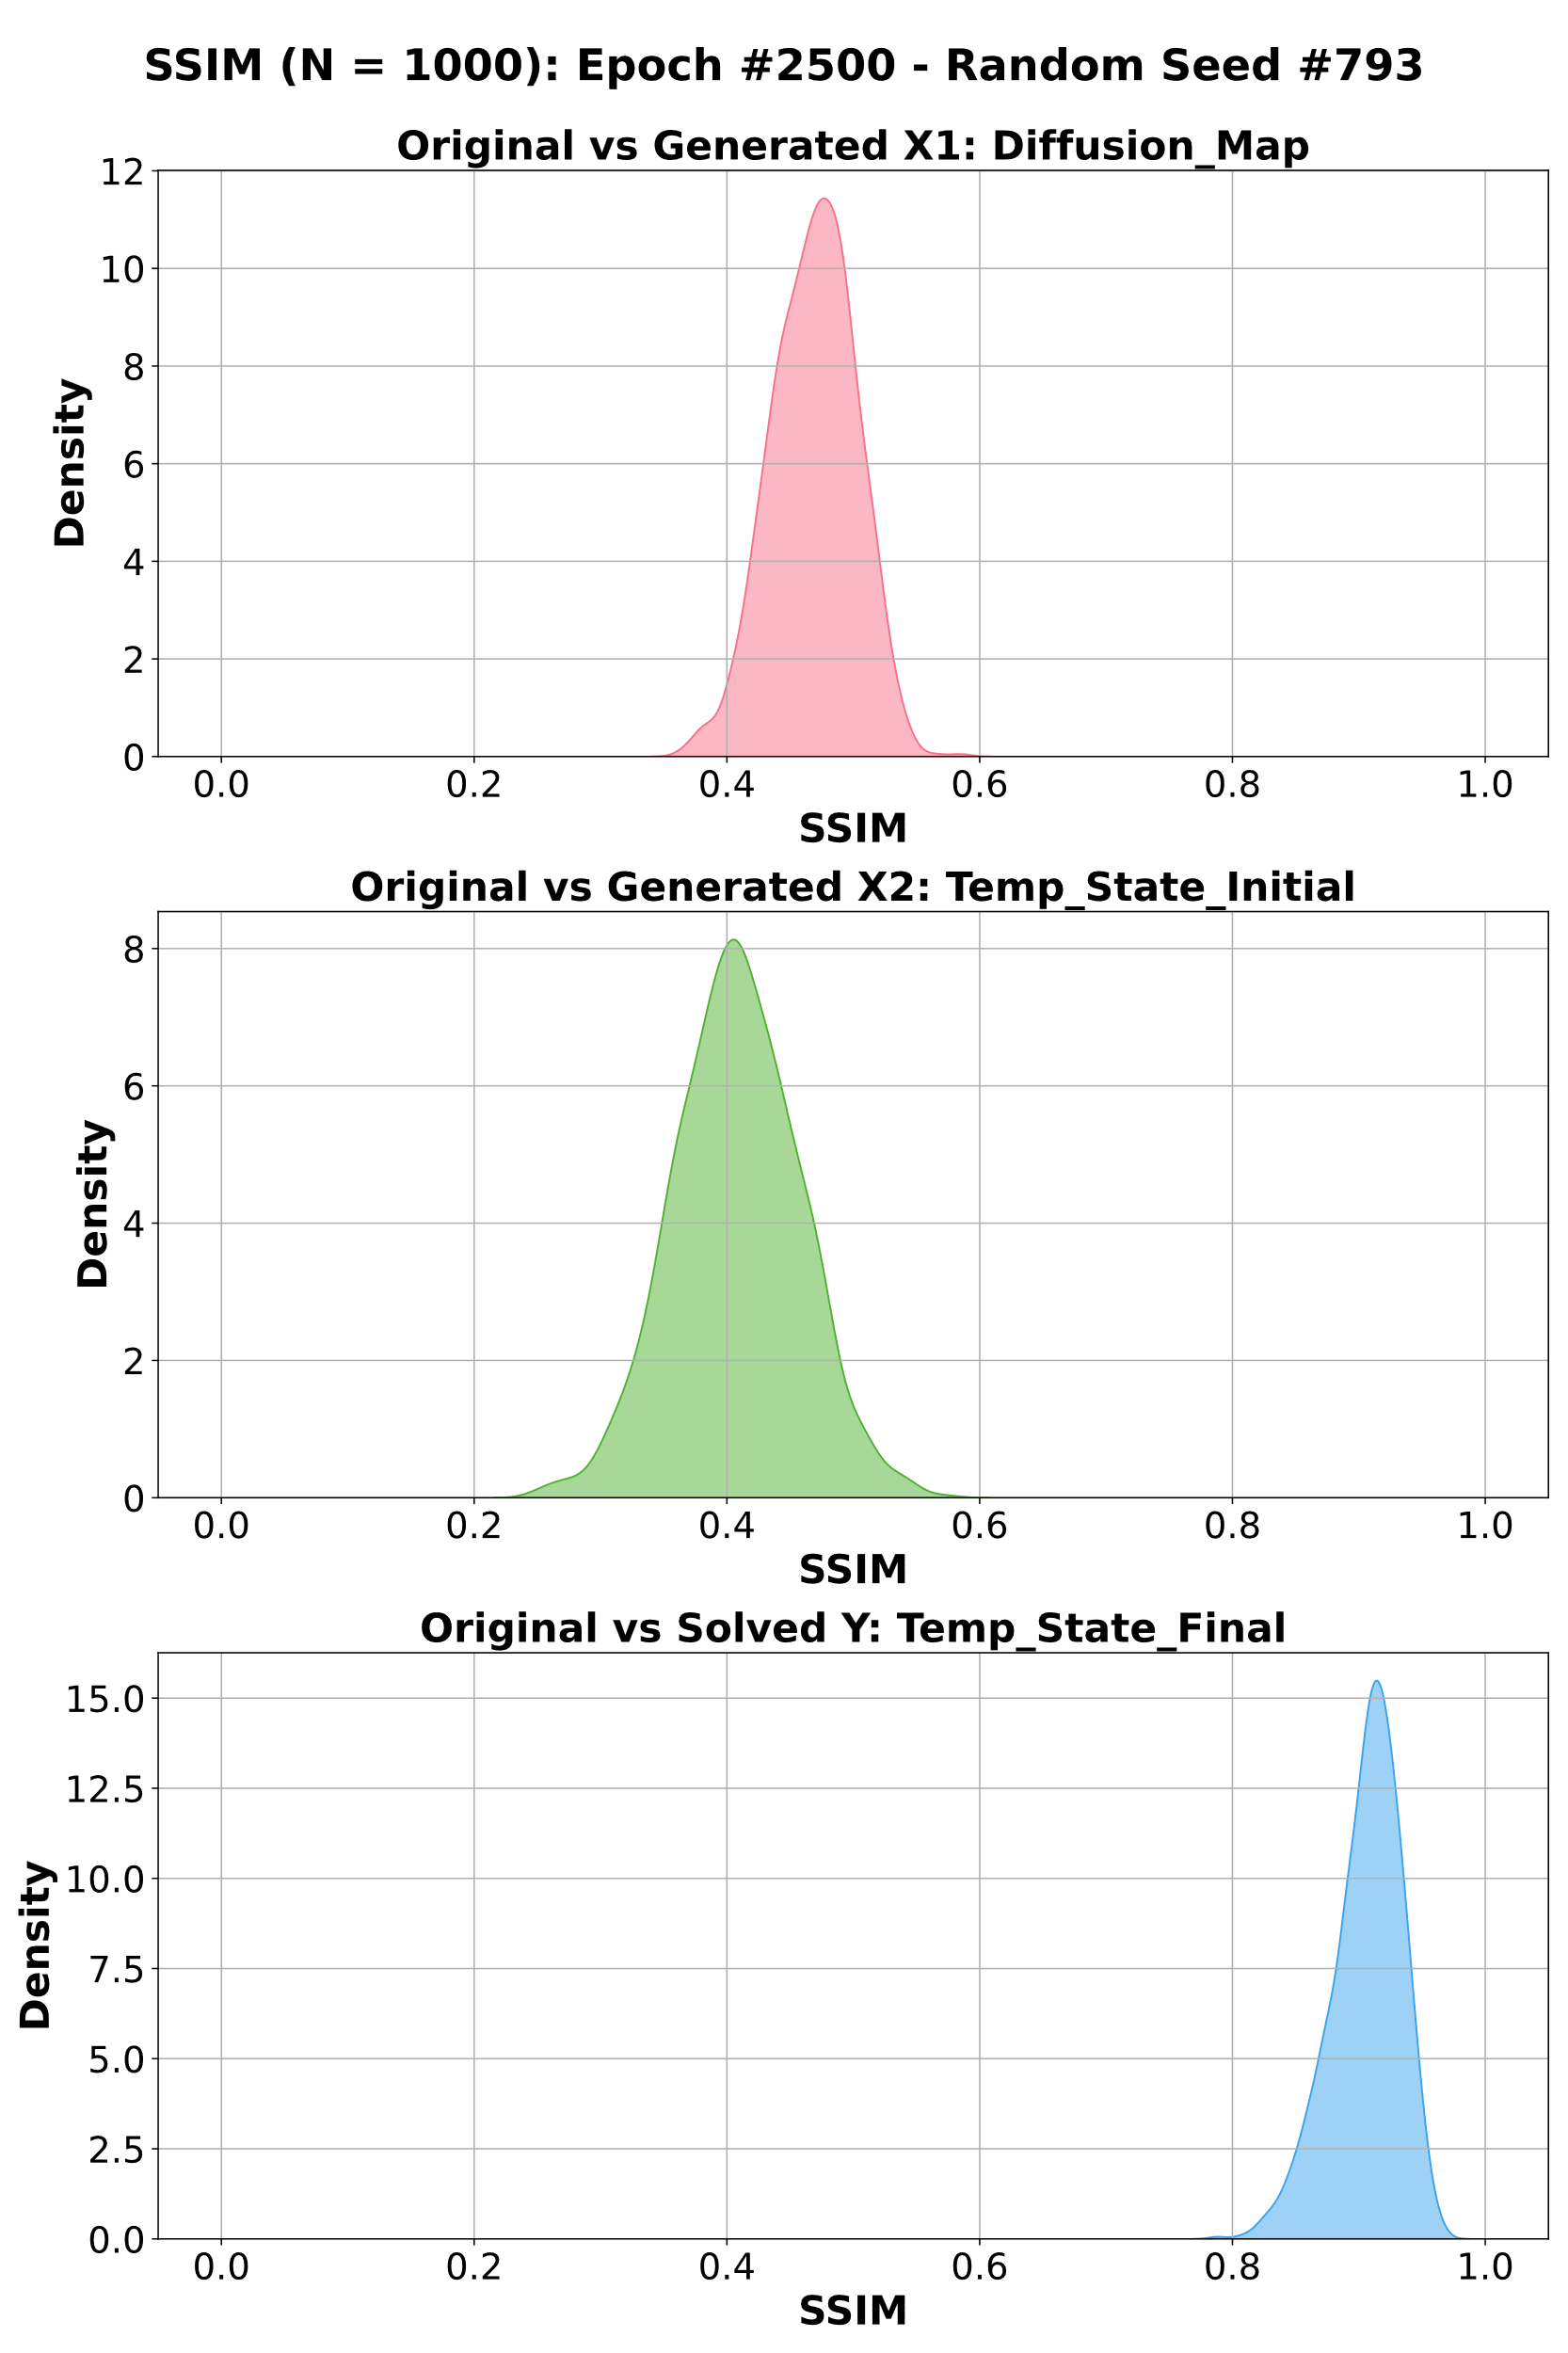
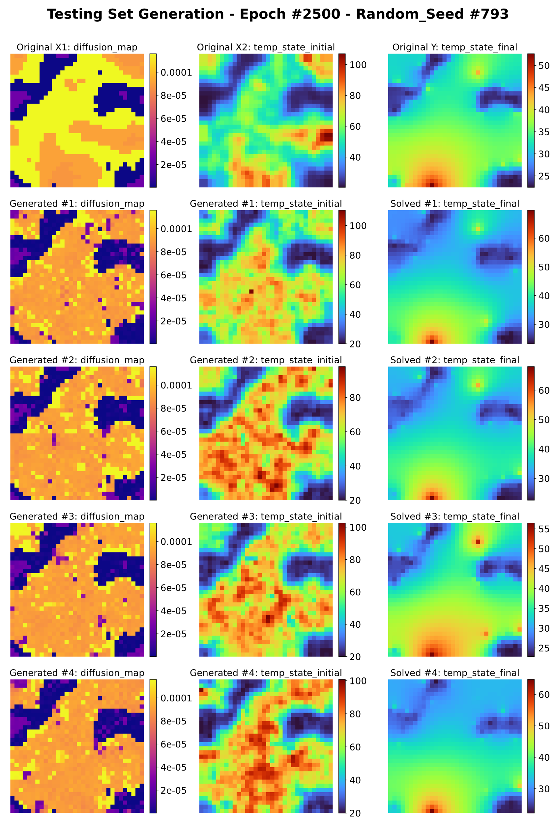
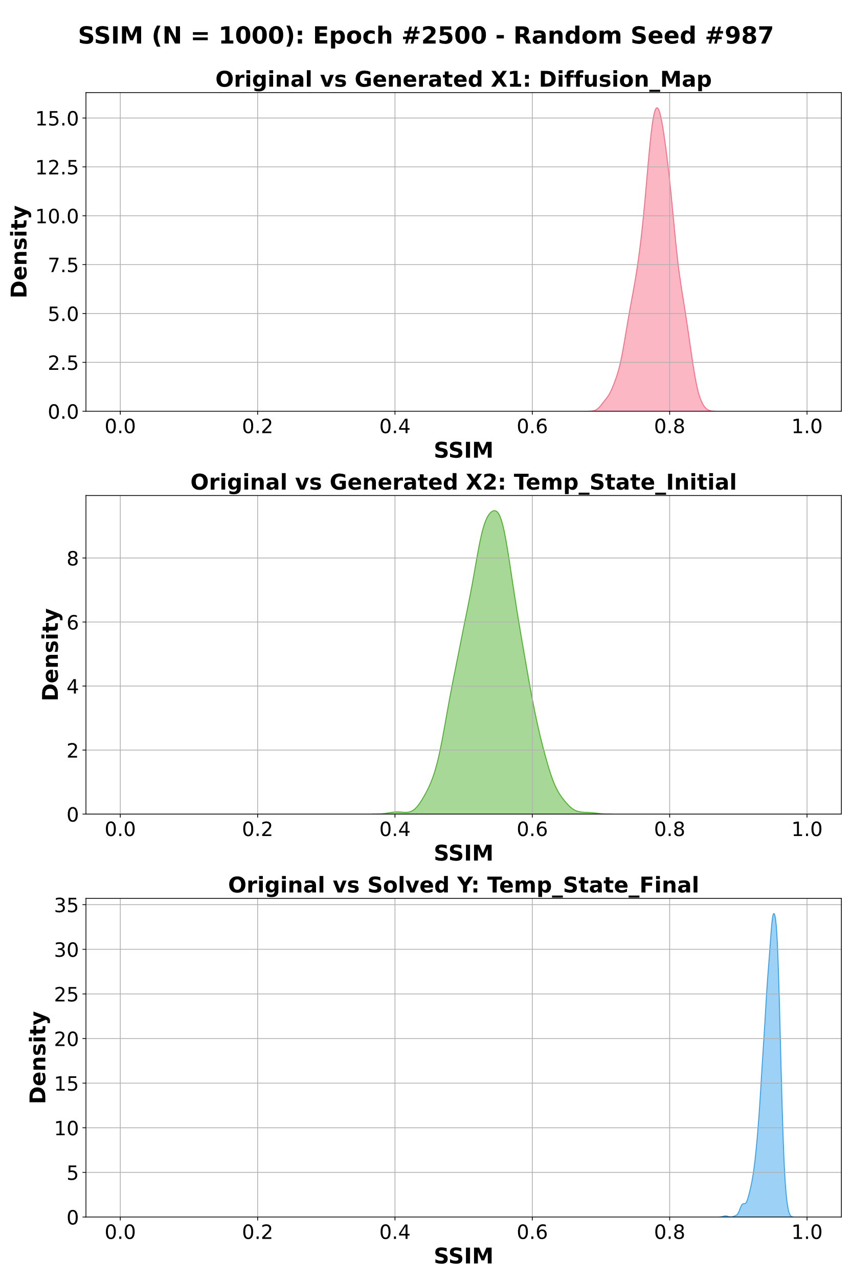
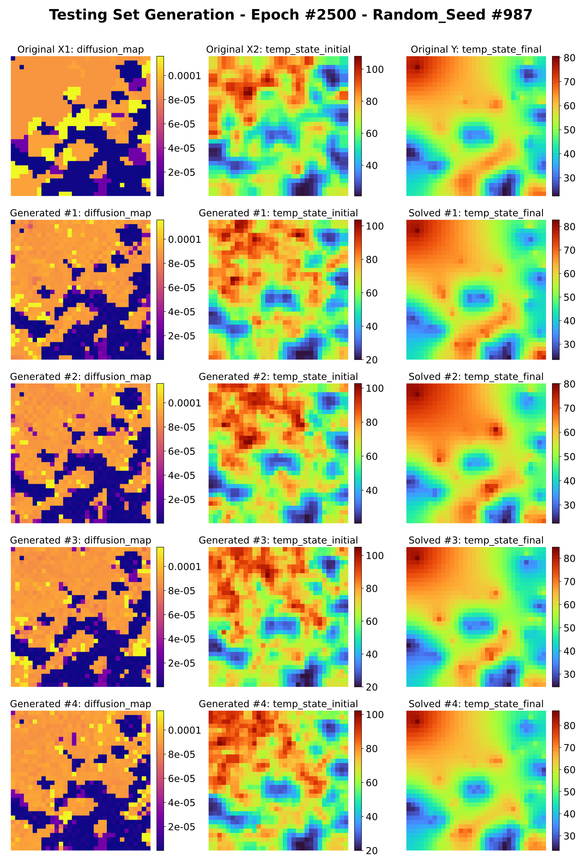
Generated Analysis: Heat Diffusion
SSIM distributions of 1000 inputs per testing sample with the best trained model state (lowest validation loss).

Slide 16
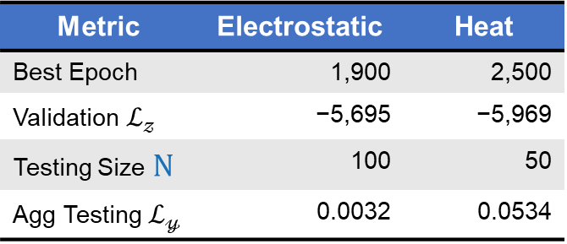
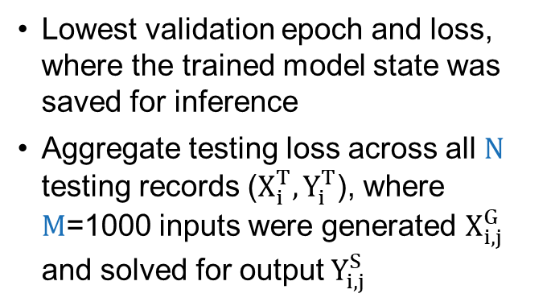
Results Summary
Metric Descriptions
Best Model Results
Lowest validation epoch and loss, where the trained model state was saved for inference
Aggregate testing loss across all N testing records ($X_{i}^{T},Y_{i}^{T}$), where M=1000 inputs were generated $X_{i,j}^{G}$ and solved for output $Y_{i,j }^{S}$
Metric | Electrostatic | Heat
Best Epoch | 1,900 | 2,500
Validation $ℒ_{𝓏}$ | −5,695 | −5,969
Testing Size N | 100 | 50
Agg Testing $ℒ_{𝓎}$ | 0.0032 | 0.0534
Aggregate Testing $ℒ_{𝓎}=\frac{1}{N×M}\sum_{i=1}^{N}{\sum_{j=1}^{M}{SmoothL1\left(Y_{i,j }^{S},Y_{i}^{T}\right)}}$

Slide 17
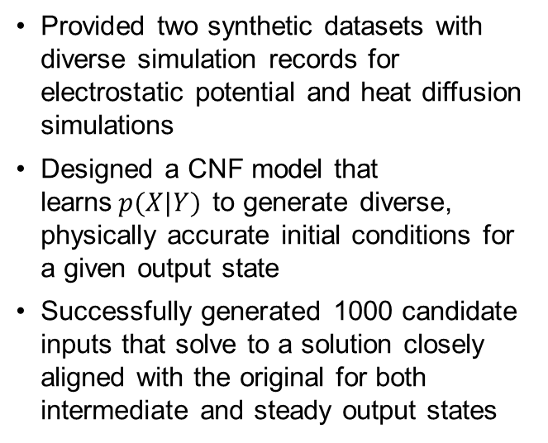
Conclusion
Key Takeaways
Current & Next Steps
Provided two synthetic datasets with diverse simulation records for electrostatic potential and heat diffusion simulations
Designed a CNF model that learns$p(X|Y)$ to generate diverse, physically accurate initial conditions for a given output state
Successfully generated 1000 candidate inputs that solve to a solution closely aligned with the original for both intermediate and steady output states
Train the model with datasets from simulating interactions with real world material properties (e.g., material fracturing)
Explore generating inputs for non-linear and unsteady inverse problems (e.g., reaction-diffusion systems)
GPU/RAM Profiling and optimization of runtime performance and resource consumption

Slide 18

Thank you for attending!
Questions?
Coauthors
Presenter / Author
Christin Whitton
Los Alamos National
Laboratory
cwhitton@lanl.gov
Leslie Horace
Georgia Institute of
Technology
lhorace3@gatech.edu
Vanessa Job
Los Alamos National
Laboratory
vjob@lanl.gov
Funder / Coauthor
Nathan DeBardeleben
Los Alamos National
Laboratory
ndebard@lanl.gov
William Jones
Coastal Carolina
University
wjones@coastal.edu
Paper Resources Page

Slide 20
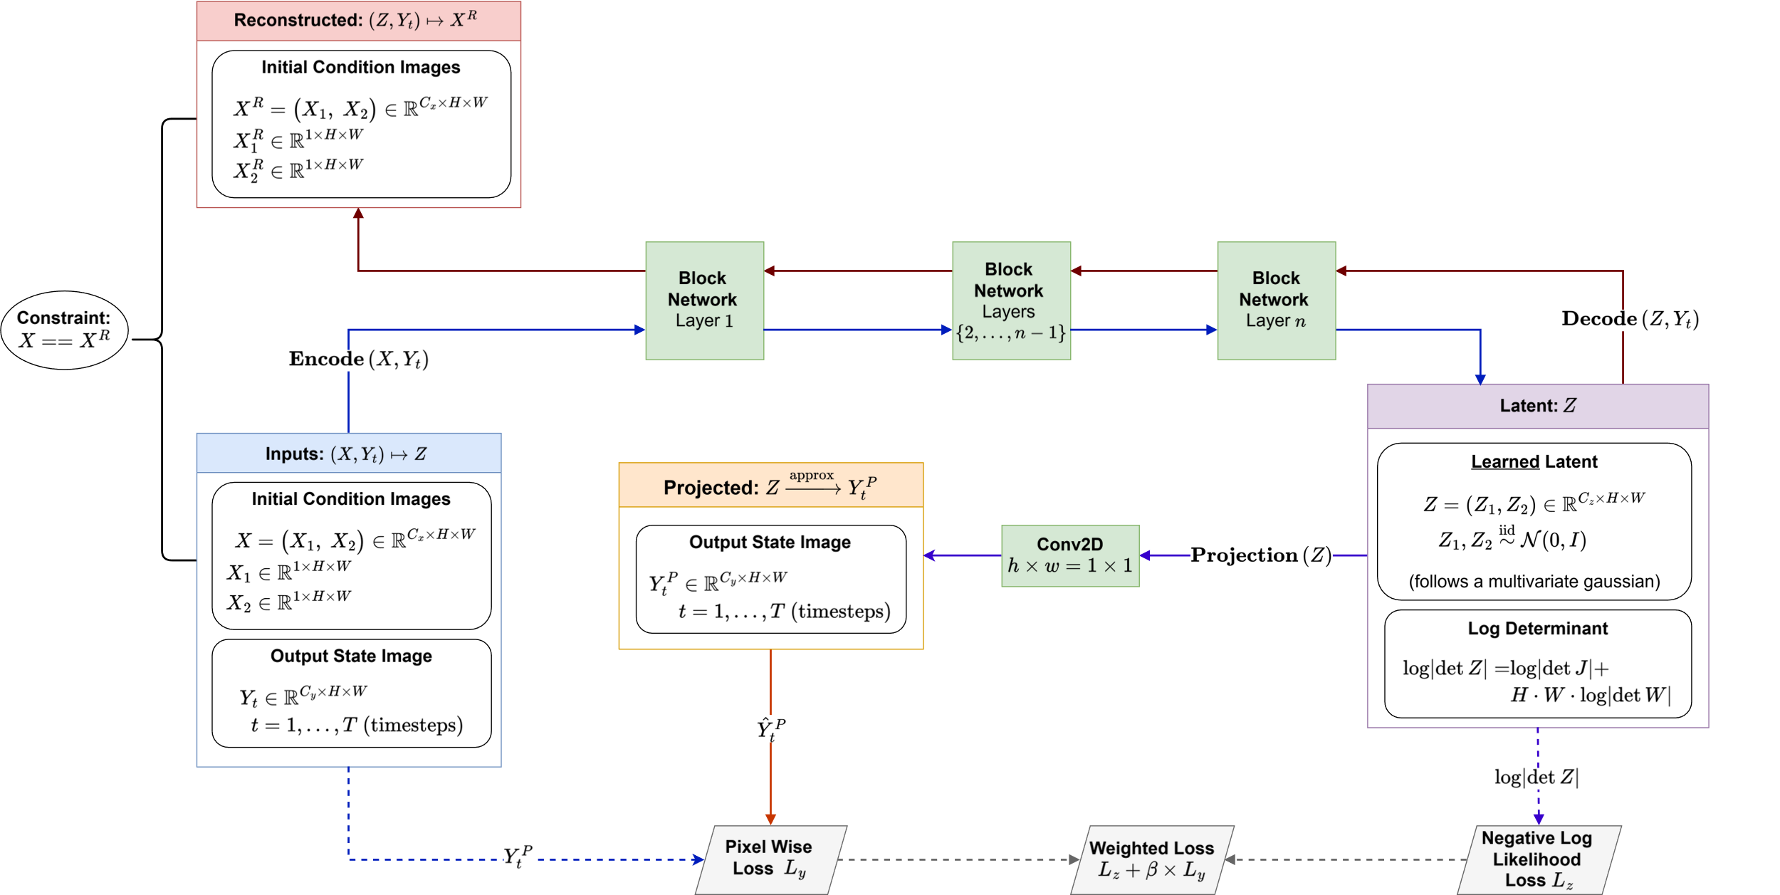
Training Workflow: Expanded Version

Slide 21
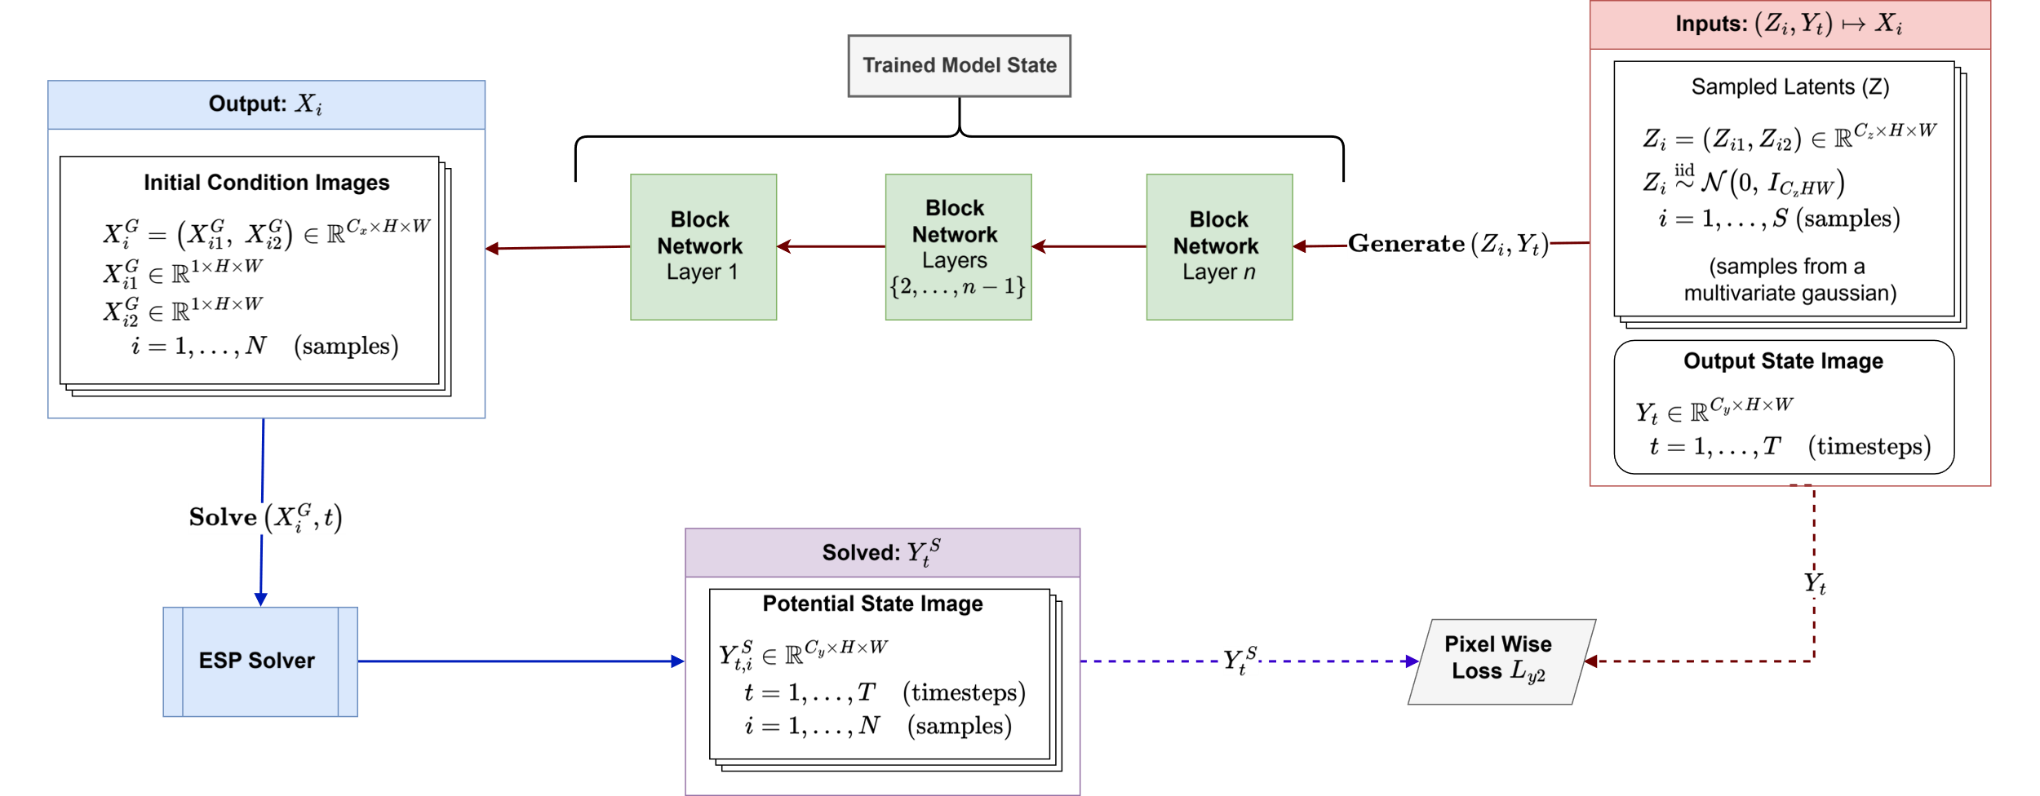
Inference Workflow: Expanded Version

Slide 22
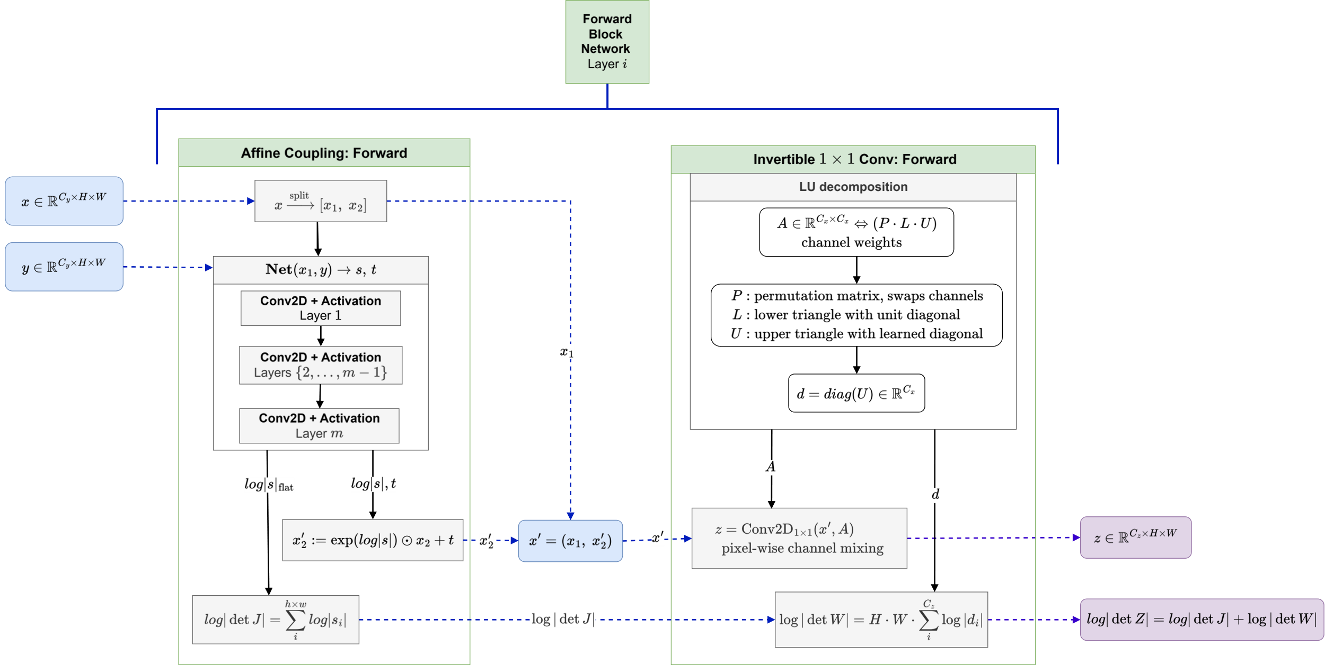
Block Network: Forward Single Pass

Slide 23
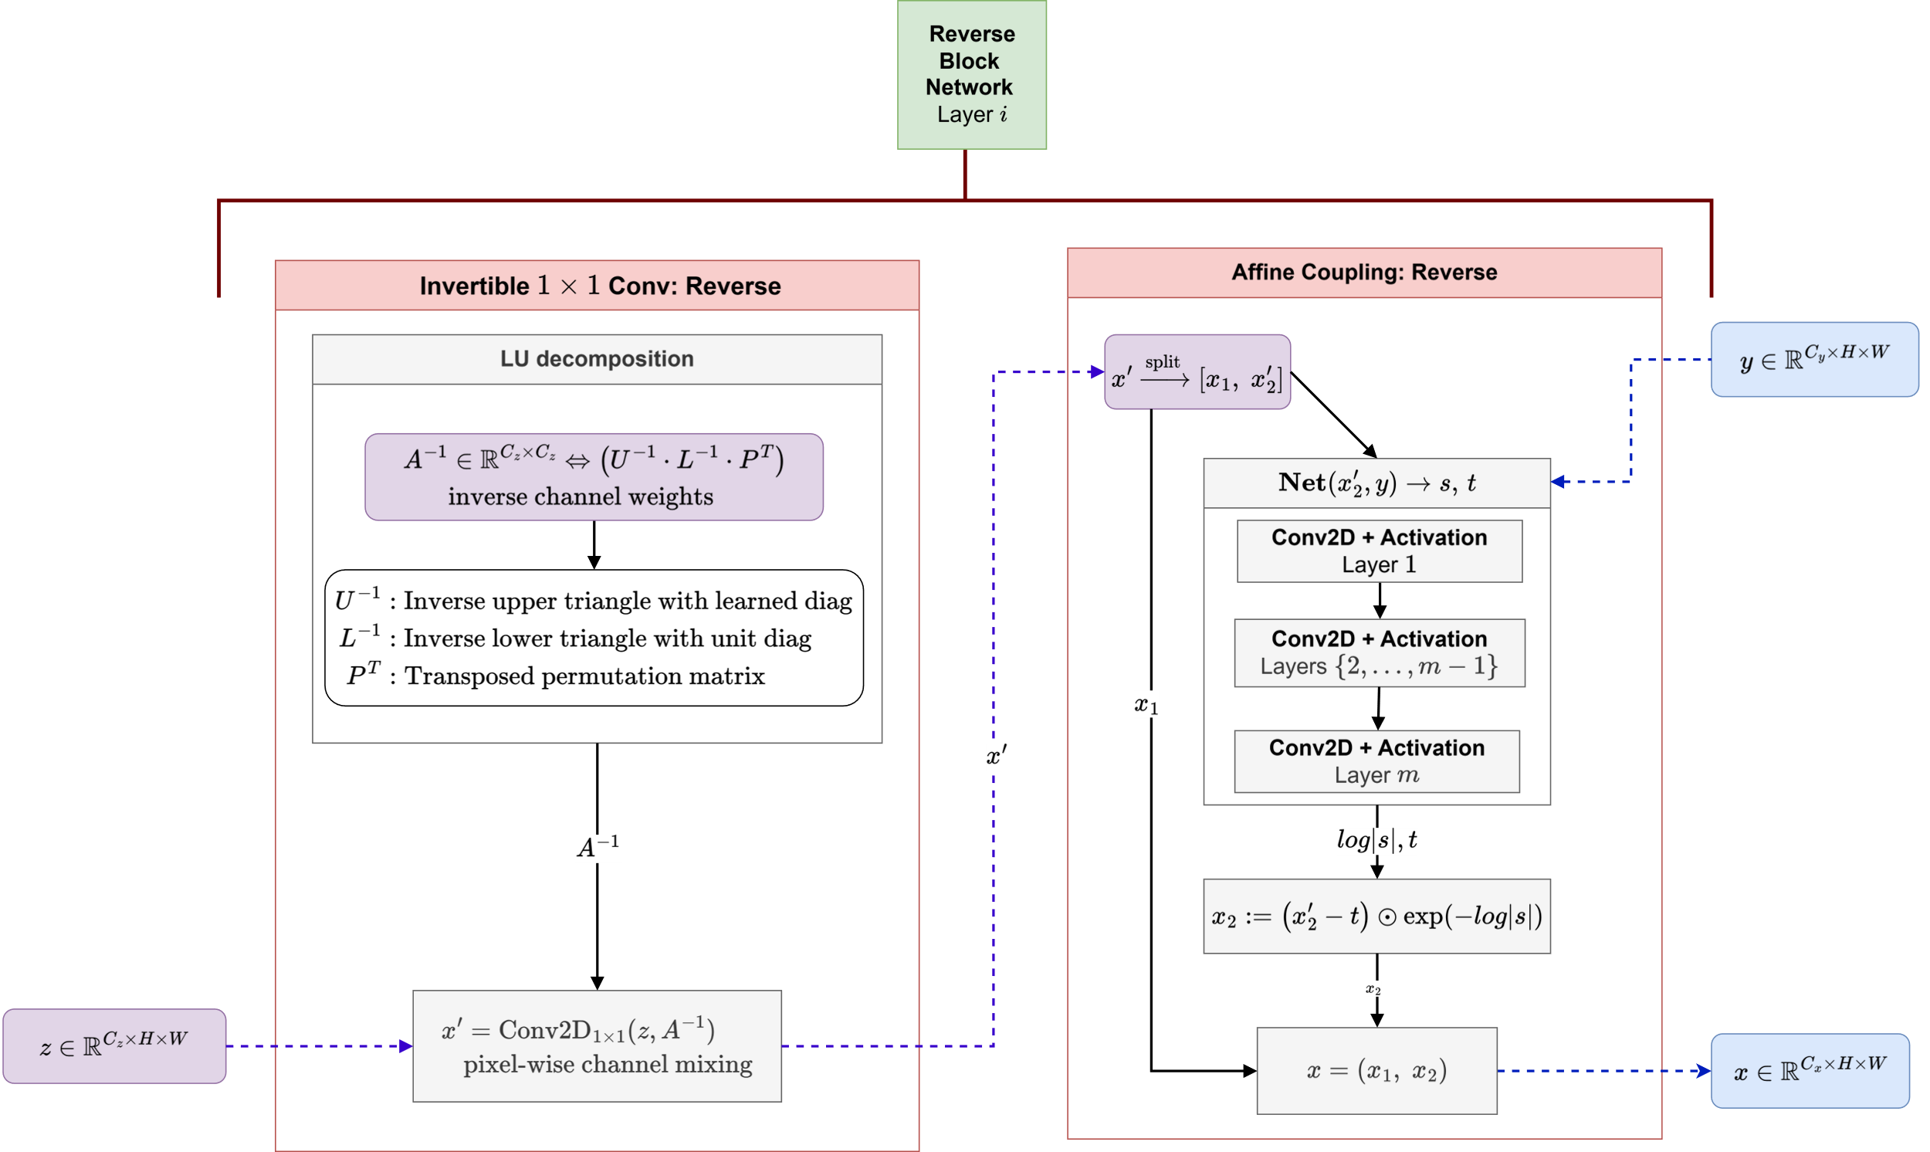
Block Network: Reverse Single Pass

