Slide 1



SMART INDIA HACKATHON 2026
TITLE PAGE
  Problem Statement ID – SIH26056
  Problem Statement Title- Development of a Real-time Airfare Price Index for India
  Theme- Travel and Tourism
  PS Category- Software
  Team ID-
  Team Name – The Phantom Troupe

Slide 2
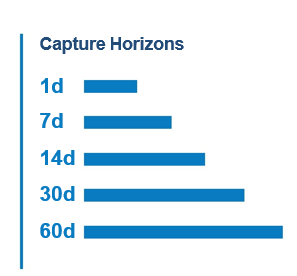
IDEA TITLE
The Phantom Troupe
Proposed Solution -
An automated, high-frequency data pipeline that extracts volatile flight prices to compute a drift-free, real-time macroeconomic inflation index.
How it Addresses the Problem –
Replaces MoSPI's lagging manual data collection with automated scraping. It neutralizes the mathematical "chain drift" caused by extreme airline pricing volatility.
Innovation and Uniqueness -
Completely bypasses enterprise Web Application Firewalls (WAFs) using TLS fingerprint impersonation. Uses the Rolling Year GEKS-Törnqvist (RYGEKS-T) formula, the exact standard used by Eurostat and the UK ONS, rather than flawed basic averages.
@SIH Idea submission- Template
2

Slide 3
TECHNICAL APPROACH
The Phantom Troupe
Technologies to be used –
Methodology and Process –
Extraction –
curl_cffi (Chrome TLS impersonation) and camoufox (OS-level JavaScript bypass).
Ingest T+1 to T+45 prices across DGCA-weighted routes via our evasion layer.
Pipeline and Storages –
Polars (multithreaded cleaning) and TimescaleDB (hypertables and continuous aggregates for speed).
Clean data via Polars and insert into TimescaleDB.
Calculate the RYGEKS-T index with a Mean Splice.
Math and Backend –
Python (custom RYGEKS-T script + traditional ARIMA forecasting), FastAPI.
Serve data to a React UI featuring a deterministic policy simulator.
Frontend –
React 18 + TypeScript + Vite + Tailwind CSS
@SIH Idea submission- Template
3

Slide 4
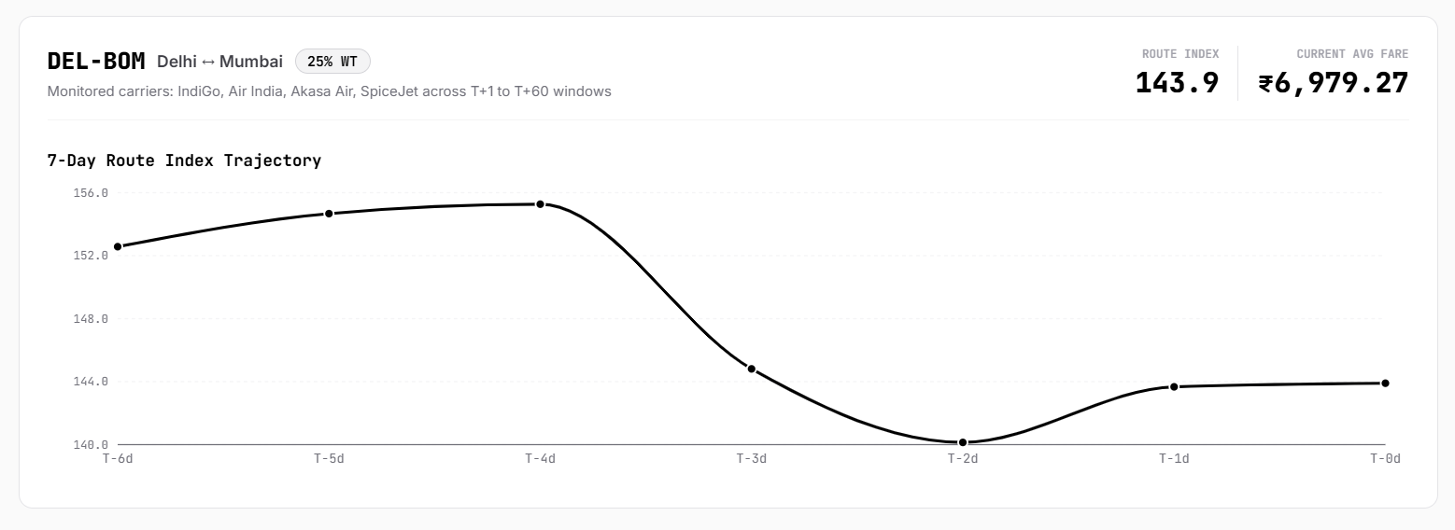
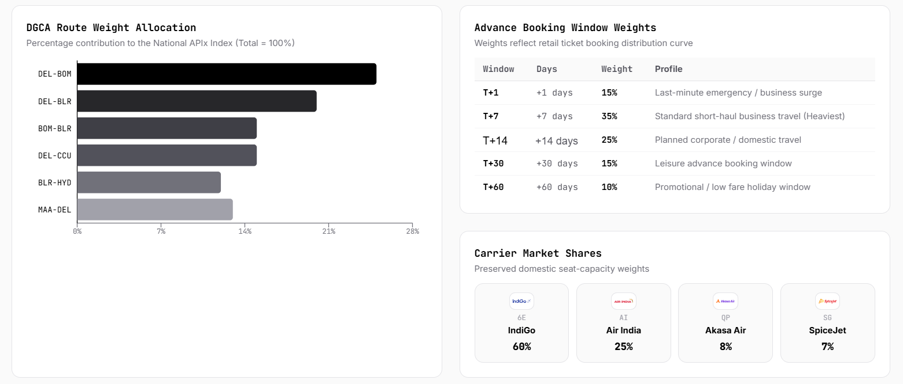
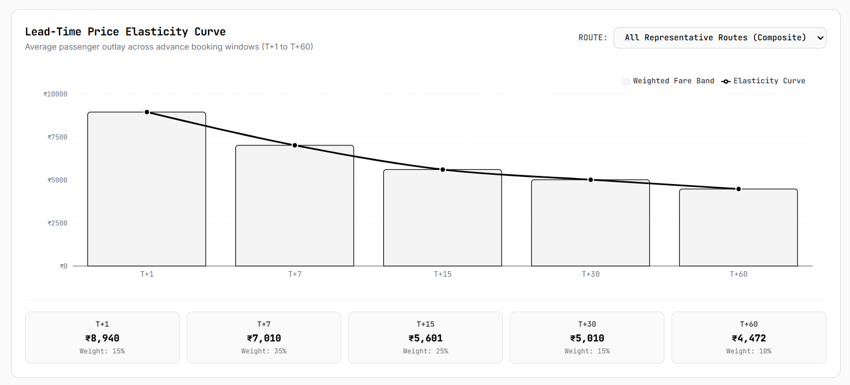
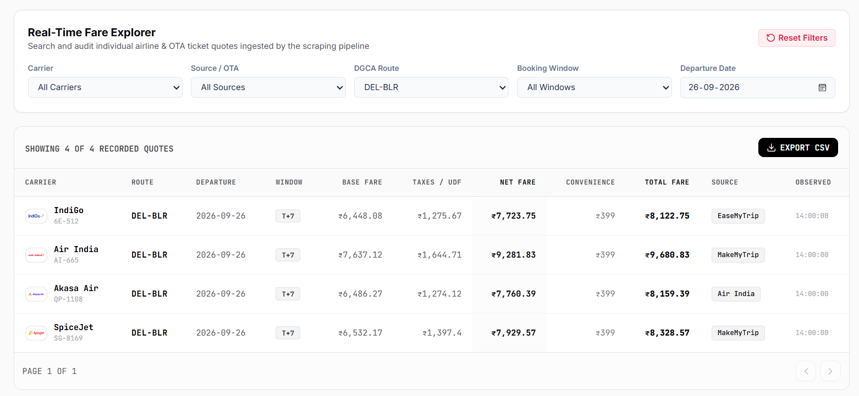
The Phantom Troupe
Social Impact
Provides the RBI with hyper-accurate, real-time inflation data, enabling reactive monetary policy that stabilizes the broader economy.
Empowers the government to mathematically track price manipulation and accessibility issues on remote flight routes (Category II/III Route Dispersal Guidelines)
@SIH Idea submission- Template
@SIH Idea submission- Template
4

Slide 5
Define Problem & Objective
Set Success Criteria
Build Prototype
Test & Validate
Decide Next Steps
Proof of Concept
The
Phantom
Troupe
Solution
OTA A
Airline X
OTA
Firewall
CAPTCHA
Mospi Analytics
Routing
@SIH Idea submission- Template
@SIH Idea submission- Template
5

Slide 6
FEASIBILITY AND VIABILITY
The
Phantom
Troupe
Feasibility
Viability
WAF Penetration: Achieving high-frequency data extraction is entirely technically feasible. By bypassing standard HTTP client limitations and utilizing curl_cffi for TLS impersonation, the system penetrates enterprise firewalls at the cryptographic level.
High-Velocity Processing: Handling millions of flight pricing records without system bloat is resolved via TimescaleDB hypertables and continuous aggregates, ensuring the database scales infinitely while dashboard queries remain instantaneous.
Econometric Computation: Implementing the Rolling Year GEKS-Törnqvist (RYGEKS-T) formula in standard Python requires very low compute power compared to heavy machine learning, meaning the real-time index can be generated deterministically on standard government servers.
Challenge: Continuous WAF Evolution. Airlines constantly deploy updates to bot-mitigation software (e.g., Cloudflare, Akamai).
API and Schema Volatility. Online Travel Aggregators (OTAs) frequently redesign their interfaces, which traditionally breaks ingestion pipelines.
Overcoming Strategy: The impersonation layer is designed to be easily patched. As WAFs evolve, the cryptographic profiles are simply updated to match the exact TLS handshakes of the newest consumer web browsers, maintaining permanent network access.
A strictly decoupled data architecture. The extraction engine is completely isolated from the Polars cleaning pipeline. If an OTA changes its layout, engineers only update a tiny, modular parsing script rather than rebuilding the entire application.
@SIH Idea submission- Template
6

Slide 7
IMPACT AND BENEFITS
The Phantom Troupe
Potential impact on the target audience
Benefits of the solution
MoSPI and RBI economists gain a real-time, non-revisable inflation indicator and a deterministic 14-day statistical outlook with zero manual collection effort.
Economic: Upgrades inflation tracking to international apex statistical standards.
Analytical: Features a deterministic algebraic simulator. You can input a 10% aviation fuel tax hike and instantly see the proportional mathematical transmission into the base fare index.
Policymakers can track price manipulation and accessibility on remote routes.
Reactive, evidence-based monetary policy strengthens broader economic stability.
@SIH Idea submission- Template
7

Slide 8
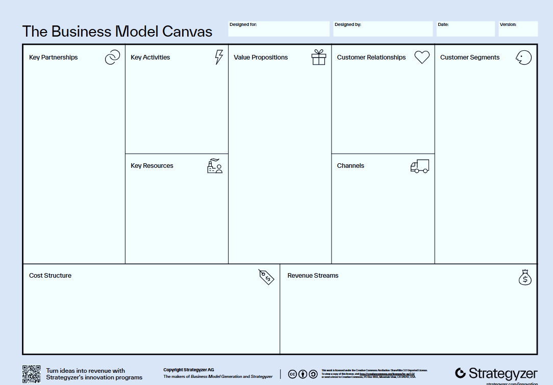
Business Model Canvas
The
Phantom
Troupe
MoSPI (National Statistical Office), DGCA, Ministry of Civil Aviation.
High-frequency web extraction, econometric processing, API hosting.
Real-time, mathematically drift-free airfare inflation tracking and deterministic policy simulation.
B2G (Business to Government), seamless integration via FastAPI.
Government policymakers, NSO statisticians, RBI analysts.
Residential IP proxies, time-series database infrastructure, custom econometric scripts.
Direct deployment to MoSPI intranet, secure API gateway.
@SIH Idea submission- Template
@SIH Idea submission- Template
8

Slide 9
National Scheme Alignments
The Phantom Troupe
1. Government / National Alignment
• Connect your solution with national missions:
• Digital India
• Smart Cities Mission
• Atmanirbhar Bharat
• Swachh Bharat / Green India
• AI for India 2.0
@SIH Idea submission- Template
@SIH Idea submission- Template
9

Slide 10
RESEARCH AND REFERENCES
The Phantom Troupe
  Details / Links of the reference and research work
@SIH Idea submission- Template
10

