Slide 1



SMART INDIA HACKATHON 2026
TITLE PAGE
  Problem Statement ID – SIH26056
  Problem Statement Title- Development of a Real-time Airfare Price Index for India
  Theme- Travel and Tourism
  PS Category- Software
  Team ID-
  Team Name – The Phantom Troupe

Slide 2
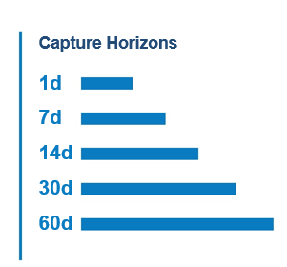
IDEA TITLE
The Phantom Troupe
Proposed Solution -
An automated, high-frequency data pipeline that extracts volatile flight prices to compute a drift-free, real-time macroeconomic inflation index.
How it Addresses the Problem –
Replaces MoSPI's lagging manual data collection with automated scraping. It neutralizes the mathematical "chain drift" caused by extreme airline pricing volatility.
Innovation and Uniqueness -
Completely bypasses enterprise Web Application Firewalls (WAFs) using TLS fingerprint impersonation. Uses the Rolling Year GEKS-Törnqvist (RYGEKS-T) formula, the exact standard used by Eurostat and the UK ONS, rather than flawed basic averages.
@SIH Idea submission- Template
2

Slide 3
TECHNICAL APPROACH
The Phantom Troupe
Technologies to be used –
Methodology and Process –
Ingest T+1 to T+45 prices across DGCA-weighted routes via our evasion layer.
Clean data via Polars and insert into TimescaleDB.
Calculate the RYGEKS-T index with a Mean Splice.
Serve data to a React UI featuring a deterministic policy simulator.
Extraction –
curl_cffi (Chrome TLS impersonation) and camoufox (OS-level JavaScript bypass).
Pipeline and Storages –
Polars (multithreaded cleaning) and TimescaleDB (hypertables and continuous aggregates for speed).
Math and Backend –
Python (custom RYGEKS-T script + traditional ARIMA forecasting), FastAPI.
Frontend –
React 18 + TypeScript + Vite + Tailwind CSS
@SIH Idea submission- Template
3

Slide 4
The Phantom Troupe
Screenshots of app/website/hardware simulation.
• Show before vs after effect. • If possible, add QR code linking to your prototype/demo video.
Social Impact
• Highlight how it improves lives at scale:
• Rural accessibility
• Education, healthcare, agriculture support
• Women empowerment, inclusivity for differently-abled
• Judges love solutions that are not only techy but human-centered.
@SIH Idea submission- Template
@SIH Idea submission- Template
4

Slide 5
Proof of Concept
The
Phantom
Troupe
  Define Problem & Objective: Automate airfare CPI collection for MoSPI without triggering WAF blocks or creating statistical chain drift.
  ​Set Success Criteria: Zero 403 network blocks; 0% chain drift over a 25-month rolling window; sub-second dashboard query speeds.​
  Build Prototype: Deploy curl_cffi routing; configure TimescaleDB; code the RYGEKS-T algorithm; build the React dashboard.
  ​Test & Validate: Backtest our mathematical index against official MoSPI historical data; stress-test WAF evasion against live Cloudflare-protected OTA endpoints.​
  Decide Next Steps: Expand the DGCA route matrix; prep the API for secure government deployment.
@SIH Idea submission- Template
@SIH Idea submission- Template
5

Slide 6
FEASIBILITY AND VIABILITY
The
Phantom
Troupe
  2. Viability
  Challenge: Continuous WAF Evolution. Airlines constantly deploy updates to bot-mitigation software (e.g., Cloudflare, Akamai).
  Overcoming Strategy: The impersonation layer is designed to be easily patched. As WAFs evolve, the cryptographic profiles are simply updated to match the exact TLS handshakes of the newest consumer web browsers, maintaining permanent network access.
  Challenge: Network Infrastructure & IP Bans. Monitoring the entire national DGCA route network requires massive request volume, leading to standard data-center IP bans.
  Overcoming Strategy: Integrating the extraction router with a commercially scaled, session-sticky residential proxy network. This mathematically neutralizes rate-limits by matching the IP geolocation directly to the browser TLS fingerprint.
  1. Feasibility
  WAF Penetration: Achieving high-frequency data extraction is entirely technically feasible. By bypassing standard HTTP client limitations and utilizing curl_cffi for TLS impersonation, the system penetrates enterprise firewalls at the cryptographic level.
  High-Velocity Processing: Handling millions of flight pricing records without system bloat is resolved via TimescaleDB hypertables and continuous aggregates, ensuring the database scales infinitely while dashboard queries remain instantaneous.
  Econometric Computation: Implementing the Rolling Year GEKS-Törnqvist (RYGEKS-T) formula in standard Python requires very low compute power compared to heavy machine learning, meaning the real-time index can be generated deterministically on standard government servers.
@SIH Idea submission- Template
6

Slide 7
IMPACT AND BENEFITS
The Phantom Troupe
Potential impact on the target audience
MoSPI and RBI economists gain a real-time, non-revisable inflation indicator and a deterministic 14-day statistical outlook with zero manual collection effort.
Policymakers can track price manipulation and accessibility on remote routes.
Reactive, evidence-based monetary policy strengthens broader economic stability.
  Benefits of the solution
  Economic: Upgrades inflation tracking to international apex statistical standards.
  Analytical: Features a deterministic algebraic simulator. You can input a 10% aviation fuel tax hike and instantly see the proportional mathematical transmission into the base fare index.
@SIH Idea submission- Template
7

Slide 8
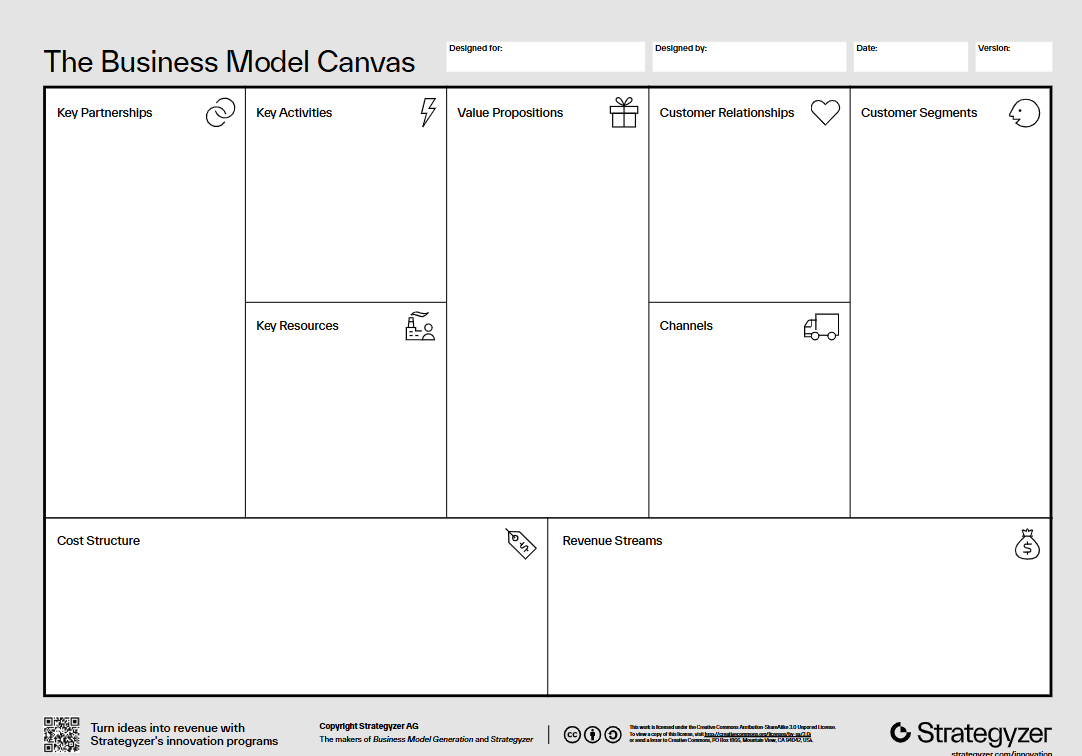
Business Model Canvas
The
Phantom
Troupe
MoSPI (National Statistical Office), DGCA, Ministry of Civil Aviation.
High-frequency web extraction, econometric processing, API hosting.
Real-time, mathematically drift-free airfare inflation tracking and deterministic policy simulation.
B2G (Business to Government), seamless integration via FastAPI.
Government policymakers, NSO statisticians, RBI analysts.
Residential IP proxies, time-series database infrastructure, custom econometric scripts.
Direct deployment to MoSPI intranet, secure API gateway.
@SIH Idea submission- Template
@SIH Idea submission- Template
8

Slide 9
National Scheme Alignments
The Phantom Troupe
1. Government / National Alignment
• Connect your solution with national missions:
• Digital India
• Smart Cities Mission
• Atmanirbhar Bharat
• Swachh Bharat / Green India
• AI for India 2.0
@SIH Idea submission- Template
@SIH Idea submission- Template
9

Slide 10
RESEARCH AND REFERENCES
The Phantom Troupe
  Details / Links of the reference and research work
@SIH Idea submission- Template
10

