Slide 1

Leslie Francis |My Journey
Principal Consultant, Manager
Sr Data and Business Intelligence Engineer
Developer
Solutions Architect
2004-2008
2008-2013
2013-2022
2022-Present
SAS, Accenture
Built a fraud detection POC that became a revenue-generating product, driving multi-million-dollar sales.
Delivered SAS Analytics Solutions, Uncovering Consumer Spend in Credit Cards
Barclays
Led Credit Risk Management Solution Implementation for Absa Bank, South Africa
Led Cross-Border Project Teams; Ensuring Timely Execution.
Designed and Implemented Data Pipelines for ML Solutions.
SAS
Supported Sales Team with POCs and Demos
Led cross-functional teams delivering ML solutions with $10M+ savings impact.
Patented Data Ingestion Solution – Accelerated Development Across Hundreds of Projects
Managed team of 10+ data engineers and scientists
Amazon
Built Agentic, RAG apps and analytics dashboards that cut response times and drove growth.
Launched exec-facing Page0 dashboard to drive data-backed funding decisions.
Delivered Data Pipelines in Petabyte Scale

Slide 2

Reimagining Credit Analysis: Automating Investment-Grade Memos with AI and Moody’s Data
Transforming financial analysis with AI
Leslie Francis

Slide 3






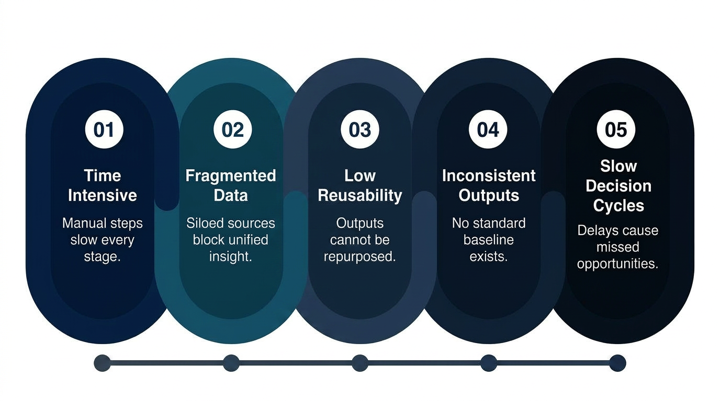
Current State: Manual Credit Analysis Workflow is Fragmented and Inefficient
Entity Identification
Identify Issuer/Legal Entity
Map subsidiaries, guarantors
Retrieve identifiers
Establish coverage universe
Data Collection
Financial Statements
Credit ratings & Market data
Industry & macroeconomic reports
News, filings, earnings call transcripts
Financial Analysis
Ratio calculations
Trend analysis
Peer benchmarking / comps
Cash flow & debt structure analysis
Credit Memo Creation
Drafting investment-grade credit memo
Creating charts, tables, narratives
Consolidating insights from all sources
Iterative review & stakeholder feedback
Qualitative Assessment
Business model evaluation
Management quality & governance
Competitive positioning
Industry outlook & regulatory risks
Credit Risk Modeling & Analysis
Default probability estimation
Stress testing & scenario modeling
Rating rationale alignment
Identification of key risk drivers

Slide 4
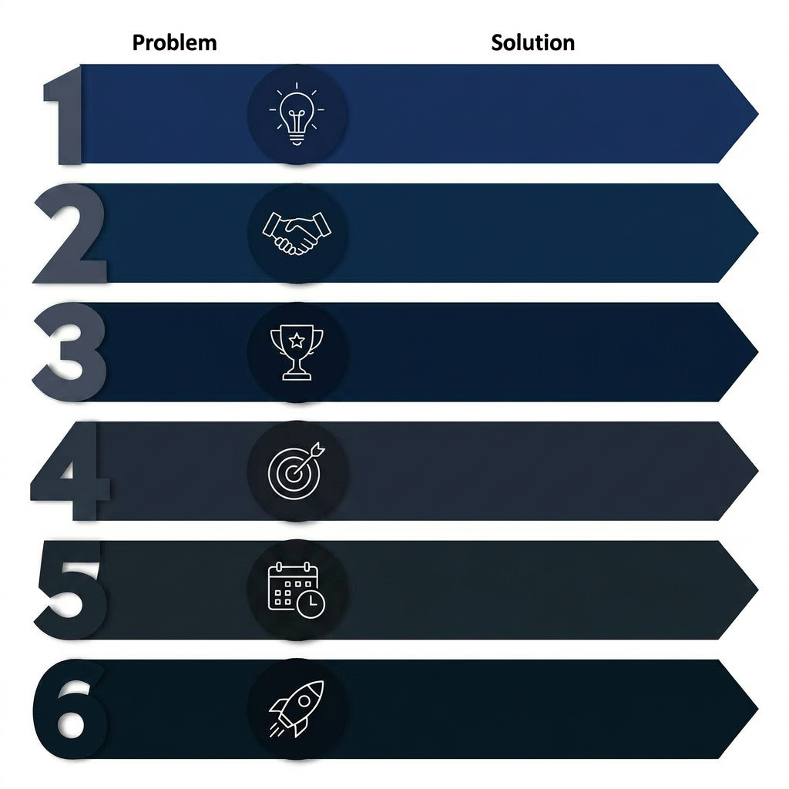
Automating Credit Memo Creation: Moody’s Data + MCP-Based Agentic Workflow
Entity Creation
Orbis API : Resolve Issuer, hierarchy identities.
Map Subsidiaries & Exposures.
Data Collection
Data Hub API : Ratings, NewsEdge, Research feeds.
External Connectors (SEC Filings, Transcripts).
Financial Analysis
Financial Metric API : Standardized Financials + Ratios feeds. Peer Benchmarking. Historical + Forecast data.
Qualitative
Assessment
Research/News API : NLP Based Summarization.
Extract Themes: Strategy, Competition, Risks.
Credit Risk Analysis
EDF-X API : Probability of Default. Implied Ratings
Early Warning Signals.
Memo Creation
LLM Powered Synthesis: Combines all API outputs.
Generates Custom Structured Credit Memos.

Slide 5

Demo

Slide 6





Transforming Credit Analysis: From Manual Process to Intelligent Automation
Efficiency gains
60–80% reduction in manual research time
Credit memos generated in minutes vs. days
Analysts focus on insight, not data gathering
Consistent Quality
Standardized credit evaluation framework
Reduced analyst bias and variability
Always aligned with Moody’s latest data
Better Insights
Real time access to PD and risk signals
Continuous monitoring vs point in time analysis
Early identification of deteriorating credits
Impact
Faster deal underwriting & approvals
Increased deal throughput
Improved risk-adjusted returns
Moodys Strategic Value
Moodys as workflow platform and not just a data provider
Enables Agentic AI native consumption of Moody’s data
A Credit Analysis Co-pilot product

Slide 7

Questions

