Slide 1
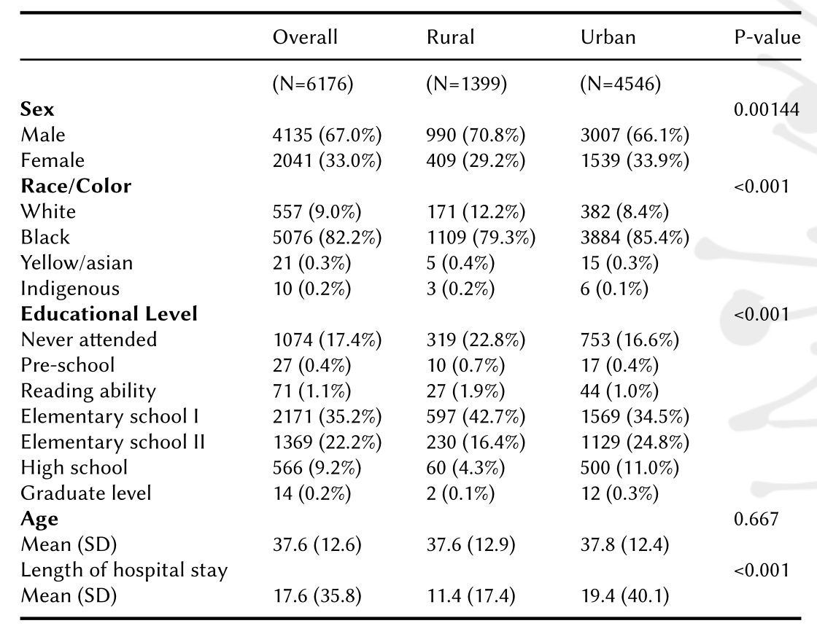
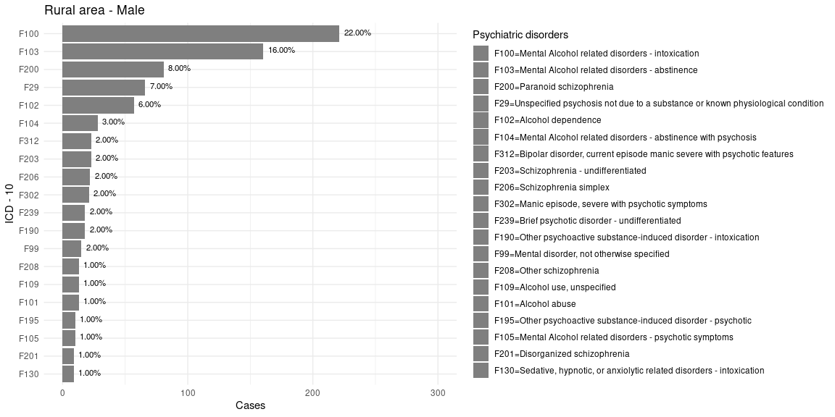
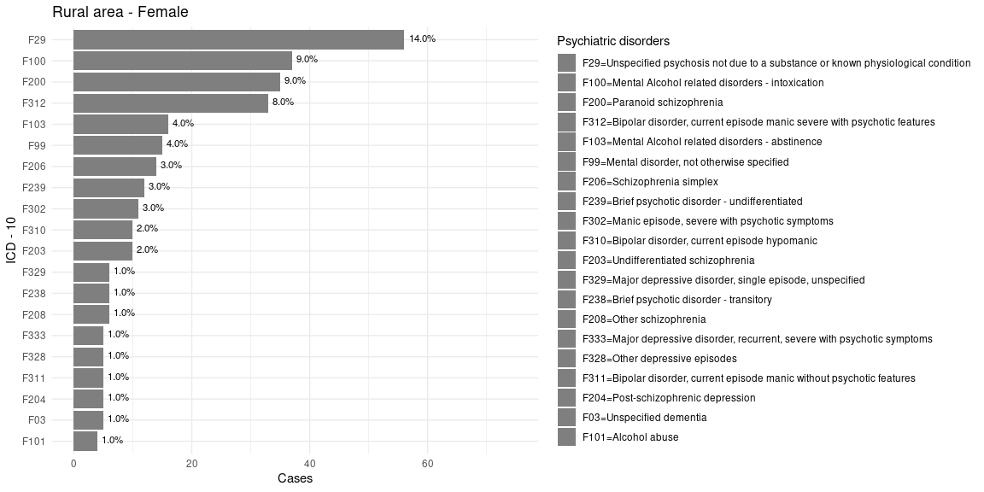
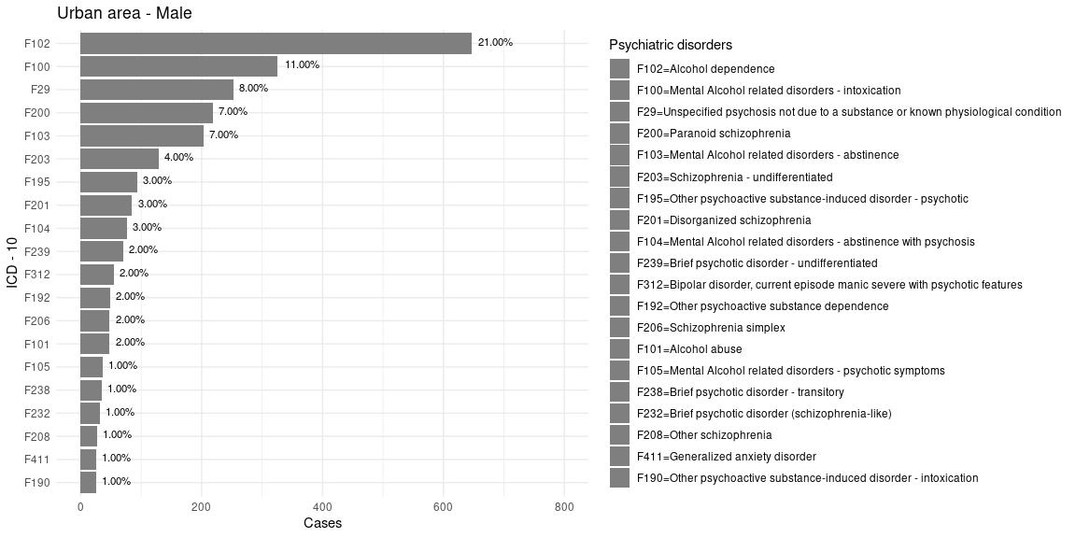
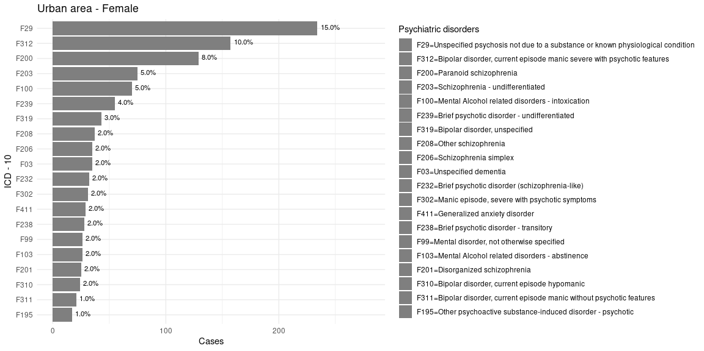
Mental Disorder hospitalizations in Rural and Urban Areas of a Brazilian State
Araujo, Jacyra¹; Castro-de-Araujo, Luis; Rodrigues, Elisângela; Machado, Daiane; Xavier, Erika; Alves, Flávia; Gomes, Oséas; Barreto, Maurício
Introduction
Discussion
Multimorbidity (MM) is associated with great burden to the health system. People with mental disorders (MD) have a high prevalence of MM in addition to worse quality of life, more treatment costs and premature death¹. Half of the world’s population lives in urban areas and is expected to grow to 68% by 2050². Urban areas have greater social instability and higher violence prevalence, pollution and noise³
Mood disorders have heterogeneous results with studies showing higher incidence of depression in urban areas^{4,6}and a Canadian study that found no difference in incidence⁵.Previous studies on psychosis show a linear growth in incidence with urbanization and a 2.37 times greater risk of psychosis⁷ in cities. On Substance abuse, we find studies with no difference in prevalence on pooled results collected in high income countries⁸ and similar incidence of alcohol dependence among urban and rural residents of the US⁹
Most of the world’s population lives in low-income countries ¹⁰ and urbanization in these countries happened faster and more chaotic¹¹
AIM
To compare psychiatric hospitalizations between residents of urban and rural areas in a large population, contributing to fill the gap in studies in this area in low-income countries
Acute alcohol intoxication was the 2nd cause of hospitalization for rural women (9%) and the 5th cause for urban women
3% incidence of abuse and 9% dependence in the Brazilian population in Brazil¹²
AUD related to low income and close incidence in rural and urban areas in Brazil¹², AUD was the most frequent diagnosis among urban and rural men
Previous epi study in Salvador showed a higher risk of harmful use of alcohol among individuals with higher income and educational level¹³
F10-F19 ICD-10 had more subsequent hospitalizations for clinical conditions (68%), mainly for hypertension and cirrhosis caused by alcohol.
Our findings diverge to what was reported in the past. Trends have changed?
Huge burden of alcohol abuse and alcohol consumption on the public health system, with direct (intoxication, withdrawal symptoms) and indirect clinical consequences.
High alcohol use among rural women.
1. Amy M. Kilbourne et al., “Improving Physical Health in Patients with Chronic Mental Disorders: Twelve-Month Results from a Randomized Controlled Collaborative Care Trial,” J. Clin. Psychiatry 78, no. 01 (January 2017): 129–37,
2. WHO, “Urban Health,” Urban Health (Healthy Cities) in the Western Pacific (https://www.who.int/westernpacific/health-topics/urban-health, 2021).
3. J. Peen et al., “The Current Status of Urban-Rural Differences in Psychiatric Disorders,” Acta Psychiatrica Scandinavica 121, no. 2 (February 2010): 84–93
4. Dan Blazer, “Psychiatric Disorders: A Rural/Urban Comparison,” Arch Gen Psychiatry 42, no. 7 (July 1985): 651
5. S. V. Parikh et al., “Mood Disorders: Rural/Urban Differences in Prevalence, Health Care Utilization, and Disability in Ontario,” Journal of Affective Disorders 38, no. 1 (April 1996): 57–65
6. Peen et al., “The Current Status of Urban-Rural Differences in Psychiatric Disorders.”
7. Evangelos Vassos et al., “Meta-Analysis of the Association of Urbanicity with Schizophrenia,” Schizophrenia Bulletin 38, no. 6 (November 2012): 1118–23
8. Peen et al., “The Current Status of Urban-Rural Differences in Psychiatric Disorders.”
9. Mark A Dixon, “Alcohol Use Patterns Among Urban and Rural Residents,” Alcohol Research: Current Reviews 38, no. 1 (2016): 9.
10. WHO, “Urban Health.”
11. Mark R. Montgomery, “The Urban Transformation of the Developing World,” Science 319, no. 5864 (February 2008): 761–64.
12. Ronaldo Laranjeira et al., “Alcohol Use Patterns Among Brazilian Adults,” Rev. Bras. Psiquiatr. 32, no. 3 (November 2009): 231–41,
13. Naomar Almeida-Filho et al., “Alcohol Drinking Patterns by Gender, Ethnicity, and Social Class in Bahia, Brazil,” Rev. Saúde Pública 38, no. 1 (February 2004): 45–54,
Left. Main clinical and demographic characteristics of patients with hospital admittance for psychiatric disorders of the sample. Group comparison was performed using chi-2 tests for the categorical variables and ANOVA for the continuous variables.
Below. Frequency of main conditions.
Methods
Observational, cross-sectional study with administrative data of hospital admissions in cities in the state of Bahia in Brazil from 01/2008 to 03/2017. Data were linked to Cadastro Unico (Brazilian register with all beneficiaries of any social support in the country).
399 cities were included (out of 415)
6176 adults were admitted for psychiatric treatment from 2008 to 2017
1. Center of Data and Knowledge Integration for Health | Salvador | Brazil. Funding: Medical Research Council – UK. Grant no. MC_PC_MR/T03355X/1

