Slide 1
PPC
APPLICATION
FpgaComms
Embedded
Process
/cmdqtx
/cmdqrx

Slide 2
PPC
APPLICATION
FpgaComms
PPC SHIM
EMBEDDED SHIM
Embedded
Process
/cmdqtx
/cmdqtx
/cmdqrx
/cmdqrx

Slide 3
TYPE
0x43 = Command
0x52 = Reply
0x45 = Event
0x4D = Matlab
0x54 = Text
0x4C = Log
TYPE
spare
LENGTH
DATA
'LENGTH' bytes
NOTE: 'TYPE' byte used for message routing

Slide 4
0x54
0xXX
0x000C
“Hello World!”
12 bytes

Slide 5
0x43
0xXX
LENGTH
COMMAND
VARIABLE
VALUE
'LENGTH' bytes
...
VARIABLE
VALUE

Slide 6
ENUM storage (1 byte):
VAR
INT, FLOAT (4 bytes, first is MS):
VARIABLE
COMPLEX (2 floats, first is I second Q):
VARIABLE (I)
VARIABLE (Q)

Slide 7
0x52
0xXX
LENGTH
VARIABLE
VALUE
...
'LENGTH' bytes
VARIABLE
VALUE

Slide 8
Channel 2 : PPC → uBlaze (Single PDUs)
Send Control:
SD
RTS
0xA00:
CHAN2: SEND CTRL
0xA02:
CHAN2: RECEIVE CTRL
PPC
uBlaze
0xA04:
CHAN2: DATA ….
Receive Control:
RD
RTR
PPC
uBlaze
0xA7E:
Channel 1 : PPC ← uBlaze (PDU FIFO)
Send Control:
Write Ptr
0xA80:
CHAN1: SEND CTRL
PPC
0xA82:
CHAN1: RECEIVE CTRL
uBlaze
0xA84:
CHAN1: DATA ….
Receive Control:
Read Ptr
PPC
uBlaze
0xBDE:

Slide 9
Channel 2 : PPC → uBlaze (Single PDUs)
PPC
SEND:RTS=0
SEND:SD=1
uBlaze
RECEIVE:RTR=0
RECEIVE:RD=1
IDLE
IDLE
INIT
SEND:RTS=1
SEND:SD=0
WAIT RTS
SEND:RTS!=1
RECEIVE:RTR=1
RECEIVE:RD=0
WAIT RTR
RECEIVE:RTR!=1
(write data)
SEND:RTS=0
SEND:SD=1
WAIT SD
SEND:SD!=1
WAIT RD
RECEIVE:RD!=1
RECEIVE:RTR=0
RECEIVE:RD=1
(done with sent data)

Slide 10
Channel 1 : PPC ← uBlaze (PDU FIFO)
PPC
uBlaze
RESYNC
RESYNC
DATA TO
READ
DATA TO
WRITE
WRITE-PTR > READ-PTR
(write data into buffer)
WRITE-PTR += num words written
PROCESS
DATA
(read in data)
READ-PTR += num words read
WRITE DATA

Slide 11
Channel 1 : Resync
PPC
uBlaze
RESYNC
RESYNC
WRITE-PTR = RESET_REQ (-2)
WAIT RESET
ACK
READ-PTR != RESET_ACK
READ-PTR != RESET_ACK
READ-PTR = RESET_ACK (-1)
WAIT RESET
ACK
WRITE-PTR = RESET_ACK (-1)
WRITE-PTR not valid
WAIT RESET
RELEASE
READ-PTR != RESET_RELEASE
READ-PTR = RESET_RELEASE (0)
WRITE-PTR = RESET_RELEASE (0)
RESYNC
DONE
RESYNC
DONE
RESYNC REQUIRED
RESYNC REQUIRED

Slide 12
DpdMsg
PimMsg
DpdTokens
PimTokens
DpdComms
PimComms
IFpgaMsg
FpgaComms
IFpgaPdu
FpgaCommsFromPpc
FpgaCommsToPpc

Slide 13
registered reply handler
An Object
FpgaCommsToPpc
IFpgaMsg creator
client
REPLY
IFpgaMsg handler
EVENT
LOG

Slide 14
registered reply handler
An Object
FpgaCommsToPpc
IFpgaMsg creator
client
REPLY
2
IFpgaMsg handler
4
1
EVENT
LOG
3
IFpgaMsg

Slide 15
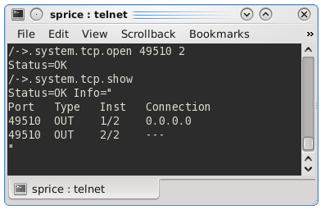
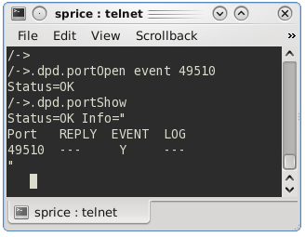
TcpPortIo
49510
DpdComms
server1
server2
client1

