Slide 1
TAC Annual Review
OpenDSM

Slide 2

Current Activity
Status
The current activity of the project, including releases, adoption, and committer/contribution growth and diversity.
Releases:
1.2.7
Most contributions from Recurve, Two outside contributors
Several organizations interested in OpenDSM beyond contributors:
National Renewable Energy Laboratory (NREL)
CLEAResult, DNV, Enerva, E Source, WattCarbon, Resilient Edge, Evergreen Energy
OpenEAC

Slide 3
Current Activity
Status
Completed working group initiative - Hourly model (accepted)
Automatic segmentation of day type (summer work day, fall weekend, etc)
Adds solar irradiance for solar PV generation buildings
Adaptive downweighting of outliers during model fit for each building
5x faster than previous hourly model
Working group attendees peaked at ~50, regularly 20
Working group currently on hiatus

Slide 4
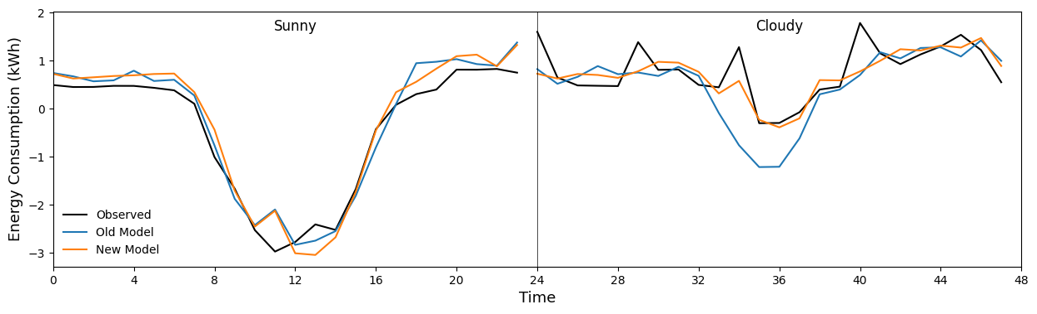
Current Activity
Status
Test data
Old model: Good on sunny days because majority of training data is sunny
New model: Good on both sunny and cloudy days

Slide 5
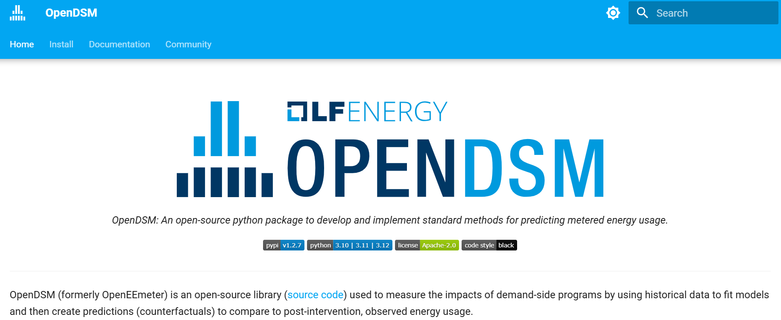
Current Activity
Status
New comprehensive website: opendsm.energy

Slide 6
Current Activity
Status
The current activity of the project, including releases, adoption, and committer/contribution growth and diversity.
While models and documentation have been improving
Scale of use continues to grow and is stepping outside of just "performance" based programs
In 2024-2028, CA energy efficiency programs must be measured where "feasible or cost effective"
TECH Clean California Best Practices Report: OpenDSM is foundational although not explicitly called out
Upper Peninsula Power Company (UPPCO, Michigan) measured savings pilot in early stages
Utilized in various programs in the western United States that cannot be disclosed
Performance-based regulations are back in vogue and open source is frequently a component of that

Slide 7
Requirements - Early Adoption
Status
Assessment of whether the project is fulfilling the requirements for the project to remain at its current stage [incubation], or be considered for a different stage
Demonstrate growth in the project’s community, including
Growth in the number of commits to the project, number of project committers, and organizational diversity of contributions and committers (29 unique comitters, 3 + organizations). ✅
Production or planned production use of the project by at least two independent end users which, in the TAC’s judgment, are of adequate quality and scope. ✅
Technical Governance of the project is operational, as measured by:
A Technical Steering Committee with at least 5 members and a chairperson elected by the members, holding regular open meetings. [ Have 5 members, TS acting as chair ]
Achievement of the OpenSSF Best Practice badge at the 'Silver' Level (87%)

Slide 8
Requirements - Early Adoption
Status
Assessment of whether the project is fulfilling the requirements for the project to remain at its current stage [incubation], or be considered for a different stage
Development of a growth plan, to be done in conjunction with their project mentor(s) at the TAC. This plan should address the following points: [ - ]
Since these metrics can vary significantly depending on the type, scope, and size of a project, the TAC has final judgment over the level of activity that is adequate to meet these criteria.
Release plans for the next 18 months.
Target end-users.
Identification of any regulatory or standards body requirements for deployment, and plans for implementation.
Plans for growth of project contributors and committers to support the growth plan.
Identification of any infrastructure resources needed to fulfill the growth plan.
Presentation to the TAC of the project’s growth, technical governance, and growth plan. [ - ]
Receive the affirmative majority vote of the TAC and Governing Board [ - ]

Slide 9
Feedback
Status
Feedback on its experience as an LF Energy project, including benefits from being an LF Energy project and areas that the TAC and LFE staff can better support the project.
Experience as an LF Energy project has been positive.
Support in explaining open-source and its value to our industry
Provides reference point of "acceptance" for the market
Provides access point for the industry from a trusted source
Policy positioning for open-source transparency
Help with the website (domain, hosting videos, cookies, etc)

