Slide 1
Annual Review for
PROJECT NAME

Slide 2
Instructions (REMOVE SLIDE IN FINAL)
Please use this deck in preparation for your project’s annual review. Depending upon your project’s stage, the review will have different points.
Incubation project:
Review of progress towards Early Adoption Stage
Early Adoption project:
Review of progress towards Graduated Stage
Graduated project:
Review of project maintaining positive growth and adoption
Please use the appropriate section in this deck for building the review deck. Add additional slides for addressing specific review points.
Deck must be submitted to the TAC no later than 1 week prior to the TAC meeting. When submitting, provide a few bullet points of key items to share with the TAC.

Slide 3
brief project description
Pull ‘Description’ from project card at landscape.lfenergy.org
Description
Links
Pull ‘Use Case’ from project card at landscape.lfenergy.org
Pull all links from project card at landscape.lfenergy.org

Slide 4
Incubation Project review criteria
To be considered for the Incubation Stage, the project must meet the following requirements:
Have achieved and maintained an OpenSSF Best Practices Badge at the ‘Passing’ level.
Have an open and documented technical governance, including:
A README file in each code repository, welcoming new community members to the project and explaining why the project is useful and how to get started (follow the guidelines at the README checklist to create an excellent README file).
A GOVERNANCE file that documents the project’s technical governance (template).
All current Technical Steering Committee members specified in the ‘Technical Steering Committee (TSC)’ committee in LFX Project Control Center (details on how this should be set up are here).
A CODEOWNERS or COMMITTERS file to define individuals or teams that are responsible for code in a repository, as well as documenting current project owners and current and emeritus committers ( template )

Slide 5
Incubation Project review criteria ( continued )
Documentation of the architecture (aka high-level design) of the software produced by the project (aligns with this OpenSSF Best Practices Silver badge requirement).
A documented roadmap that describes what the project intends to do and not do for at least the next year (aligns with this OpenSSF Best Practices Silver badge requirement).
Community and contributor growth assessment using the data from LFX Insights. Specific metrics that will be reviewed are.
Current number of contributors, committers, and different organizations contributing to the project.
Flow of commits / merged contributions
A credible plan for developing a thriving user community, particularly expanding the number of committers and contributors to the project.
An outline of the plan for the project to complete the requirements for the Early Adoption stage.

Slide 6
Early Adoption Project review criteria
To be considered for the Early Adoption stage, the project must meet the following requirements:
Demonstrate growth in the project’s community, including
Growth in the number of commits to the project, the number of project committers, and the organizational diversity of contributions and committers.
Production or planned production use of the project by at least two independent end users, which, in the TAC’s judgment, are of adequate quality and scope.
Technical Governance of the project is operational, as measured by:
A Technical Steering Committee with at least five members and a chairperson elected by the members, holding regular open meetings (aligns with OpenSSF Best Practices Gold badge requirement)
Achievement of the OpenSSF Best Practice badge at the ‘Silver’ Level
Development of a growth plan, to be done in conjunction with their project mentor(s) at the TAC. This plan should address the following points:
Release plans for the next 18 months.
Target end-users.
Identification of any regulatory or standards body requirements for deployment and implementation plans.
Plans for the growth of project contributors and committers to support the growth plan.
Identification of any infrastructure resources needed to fulfill the growth plan.
Since these metrics can vary significantly depending on the type, scope, and size of a project, the TAC has final judgment over the level of activity that is adequate to meet these criteria.

Slide 7
Early Adoption/Graduation Project review criteria
To graduate from Incubation or Early Adoption status, or for a new project to join with Graduated status, a project must meet the Early Adoption stage criteria plus:
Achievement of the OpenSSF Best Practices badge at the ‘Gold’ level.
Have fulfilled or are on track to complete the growth plan defined in the Early Adoption stage proposal.
Have a healthy number of contributions or committers from at least three organizations, with any single organization not composing more than 50% of the contributions or committers. Committers must be identified within the project in a COMMITTERS file.
Have a public list of project adopters for at least the primary repo (e.g., ADOPTERS.md or logos on the project website).

Slide 8
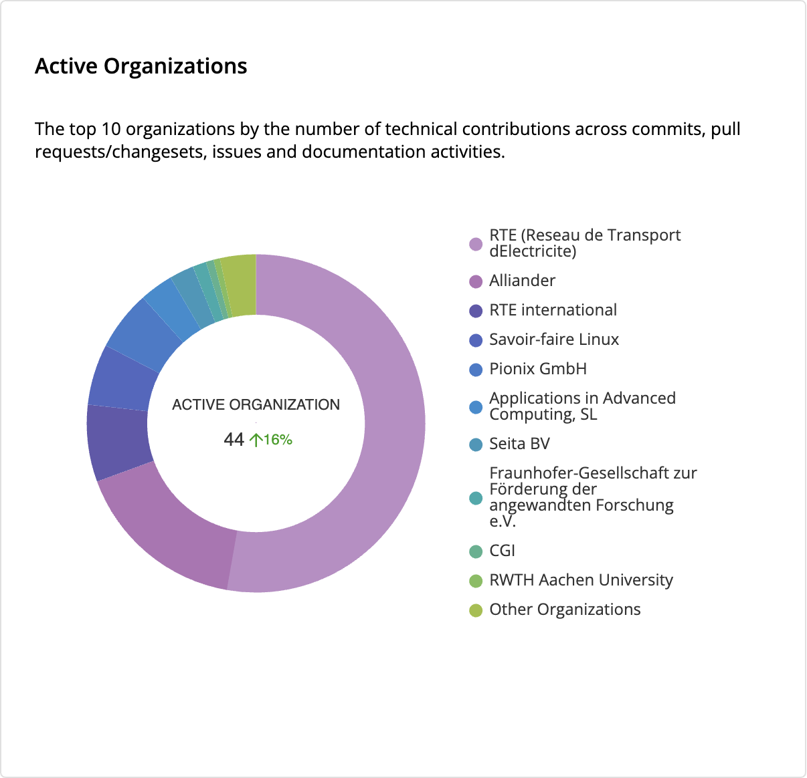
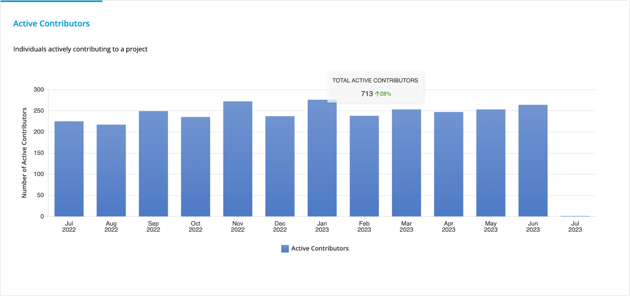
Contributions
UPDATE FROM LFX INSIGHTS

Slide 9
Organizations contributing and/or using in production
Provide list of organizations, with logos if available

Slide 10
Key Achievements in the past year

Slide 11
Areas the project could use help on

Slide 12
Feedback on working with LF Energy

