Slide 1
Annual Review for
PROJECT NAME

Slide 2
Instructions (REMOVE SLIDE IN FINAL)
Please use this deck in preparation for your project’s annual review. Depending upon your project’s stage, the review will have different points.
Incubation project:
Review of progress towards Early Adoption Stage
Early Adoption project:
Review of progress towards Graduated Stage
Graduated project:
Review of project maintaining positive growth and adoption
Please use the appropriate section in this deck for building the review deck. Add additional slides for addressing specific review points.
Each project has 20 minutes for both their presentation and Q/A, so plan your presentation accordingly.

Slide 3
brief project description
Project Slide from High Level Overview Deck - request at servicedesk.lfenergy.org

Slide 4
Incubation Project review criteria
To be considered for the Incubation Stage, the project must meet the following requirements:
Have an open and documented technical governance, including:
A LICENSE file in every code repository, with the license chosen an OSI-approved license.
A README file welcoming new community members to the project and explaining why the project is useful and how to get started.
A CONTRIBUTING file explaining to other developers and your community of users how to contribute to the project. The file should explain what types of contributions are needed and how the process works.
A CODEOWNERS or COMMITTERS file to define individuals or teams that are responsible for code in a repository; document current project owners and current and emeritus committers.
A CODE_OF_CONDUCT file that sets the ground rules for participants’ behavior associated and helps to facilitate a friendly, welcoming environment. By default projects should leverage the Linux Foundation Code of Conduct unless an alternate Code of Conduct is approved prior.
A RELEASE file that provides documentation on the release methodology, cadence, criteria, etc.
A GOVERNANCE file that documents the project’s technical governance.
A SUPPORT file to let users and developers know about ways to get help with your project.
Complete and approve the Technical Charter and agree to transfer any relevant trademarks to The Linux Foundation or its affiliate, LF Projects, LLC, and to assist in filing for any relevant unregistered ones.

Slide 5
Incubation Project review criteria ( continued )
Have achieved and maintained an OpenSSF Best Practices Badge at the ‘Passing' level.
Have had a successful license scan with any critical issues remedied.
Have a defined project mission and scope
The project's functional architecture is built out in the LF Energy ArchiMate tool.
An overview of the project’s architecture and features defined.
The project roadmap defined, which should address the following questions.
What use cases are possible now?
What does the next year look like in terms of additional features and use cases covered?
Community and contributor growth assessment
The current number of contributors and committers, and the number of different organizations contributing to the project.
Demonstrate a sustained flow of commits / merged contributions
A credible plan for developing a thriving user community, in particular expanding the number of committers and contributors?
An outline of the plan for the project to complete the requirements for the Early Adoption stage
Receive the affirmative majority vote of the TAC.

Slide 6
Early Adoption Project review criteria
To be considered for the Early Adoption stage, the project must meet the following requirements:
Demonstrate growth in the project’s community, including
Growth in the number of commits to the project, number of project committers, and organizational diversity of contributions and committers.
Production or planned production use of the project by at least two independent end users which, in the TAC’s judgment, are of adequate quality and scope.
Technical Governance of the project is operational, as measured by:
A Technical Steering Committee with at least 5 members and a chairperson elected by the members, holding regular open meetings.
Achievement of the OpenSSF Best Practice badge at the 'Silver' Level
Development of a growth plan, to be done in conjunction with their project mentor(s) at the TAC. This plan should address the following points:
Since these metrics can vary significantly depending on the type, scope, and size of a project, the TAC has final judgment over the level of activity that is adequate to meet these criteria.
Release plans for the next 18 months.
Target end-users.
Identification of any regulatory or standards body requirements for deployment, and plans for implementation.
Plans for growth of project contributors and committers to support the growth plan.
Identification of any infrastructure resources needed to fulfill the growth plan.
Presentation to the TAC of the project’s growth, technical governance, and growth plan.
Receive the affirmative majority vote of the TAC and Governing Board

Slide 7
Early Adoption/Graduation Project review criteria
To graduate from Incubation or Early Adoption status, or for a new project to join with Graduated status, a project must meet the Early Adoption stage criteria plus:
Have a defined governing body of at least 5 or more members (owners and core maintainers), of which no more than 1/3 is affiliated with the same employer. In the case there are 5 governing members, 2 may be from the same employer.
Have fulfilled or are on track to complete the growth plan defined in the Early Adoption stage proposal.
Have a healthy number of contributions or committers from at least three organizations, with any single organization not composing more than 50% of the contributions or committers. Committers must be identified within the project in a COMMITTERS file.
Have a public list of project adopters for at least the primary repo (e.g., ADOPTERS.md or logos on the project website).
Achievement of the OpenSSF Best Practices badge at the 'Gold' level.
Present to the TAC and the Governing Board on the fulfillment of these requirements.
Receive a ⅔ majority vote from the TAC and a majority vote of the Governing Board to move to the Graduated stage. Projects can move directly from Incubation to Graduated status if they can demonstrate sufficient maturity and have met all requirements.

Slide 8
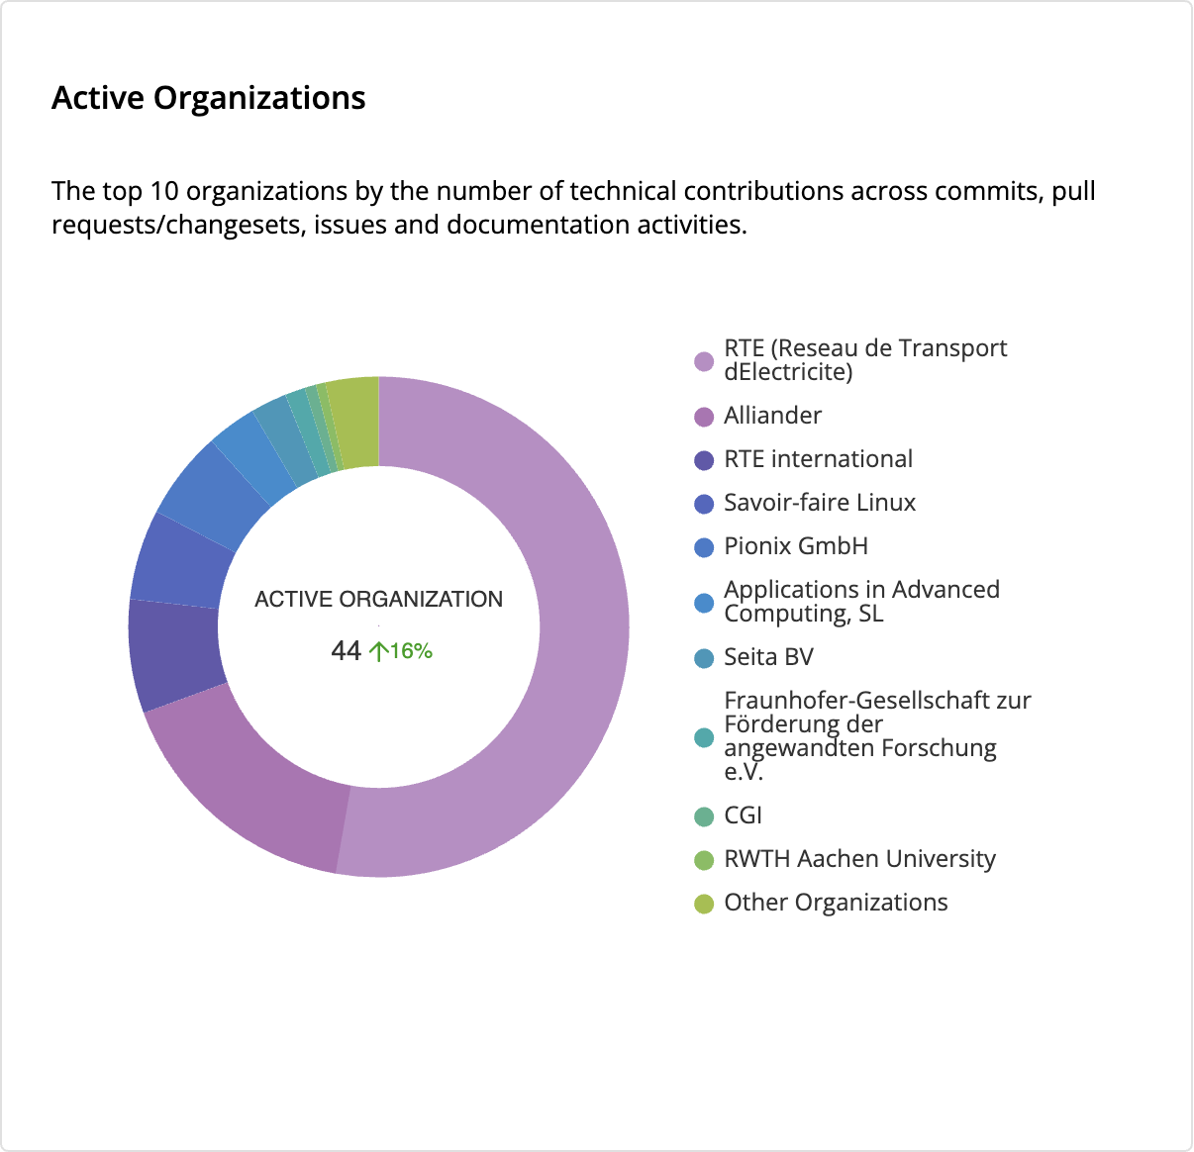
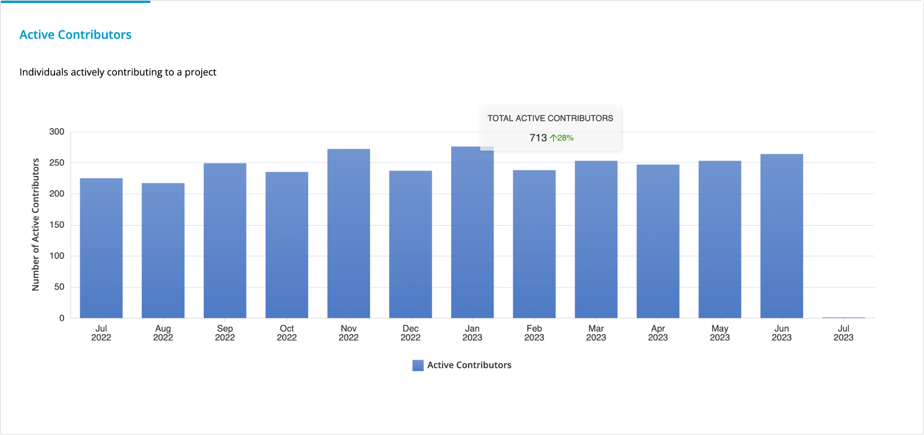
Contributions
UPDATE FROM LFX INSIGHTS

Slide 9
Organizations contributing and/or using in production
Provide list of organizations, with logos if available

Slide 10
ArchiMate Architecture Diagram
Pull diagram from https://github.com/lfenergyarchitecturemodel

Slide 11
Key Achievements in the past year

Slide 12
Areas the project could use help on

Slide 13
Feedback on working with LF Energy

