Slide 1
Annual Review for
SOGNO

Slide 2
SOGNO
Brief Description:
SOGNO creates plug-and-play, cloud-native, micro-services to implement next generation of data-driven monitoring and control systems for grid automation. It simplify the life of utilities by enabling them to optimize their network operations through open source to deliver cost-effectively, and seamless, secure power supply for their customers. SOGNO introduces the idea of grid automation as a modular system in which components can be added through time. This is in opposition to classical monolithic solutions.
TSC Chairperson:
Antonello Monti (amonti@eonerc.rwth-aachen.de)
TSC Members and Affiliations:
Juan Adolfo Galeano, Florian Oppermann, Sanket Gaikwad, Sreejith Pananchickal, Leonardo Carreras (RWTH Aachen University)
Varshitha Ramanna, Pranav Kulkarni, Beyza Cizmeci, Varshitha Chamanahalli (Fraunhofer FIT)
Markus Mirz (PSI), Roberto Raffo (Google), Alberto Patrizi (ARETI)
Holger Blasum (UrStrom Bürgerenergie eG)
Key Links:
GitHub: https://github.com/sogno-platform
Website: https://www.lfenergy.org/projects/sogno/
Artwork: N/A
Mailing lists:
https://lists.lfenergy.org/g/SOGNO-TSC
OpenSSF Best Practice Badge URL:
https://www.bestpractices.dev/en/projects/5627

Slide 3
















Organizations/projects contributing/using SOGNO

Slide 4
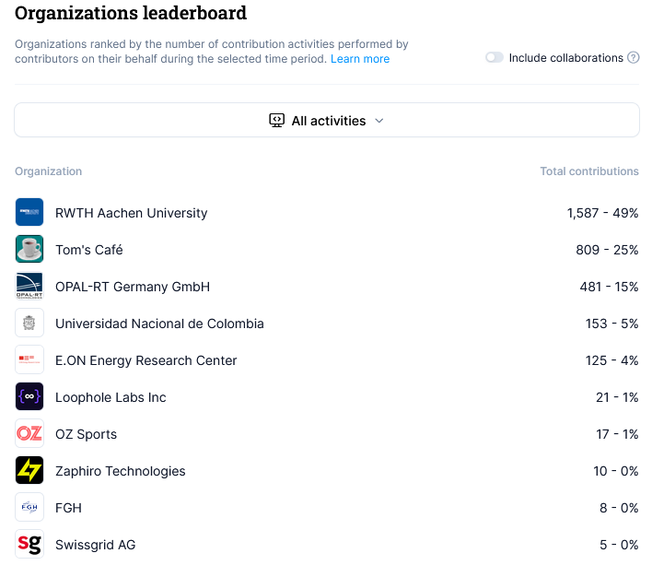
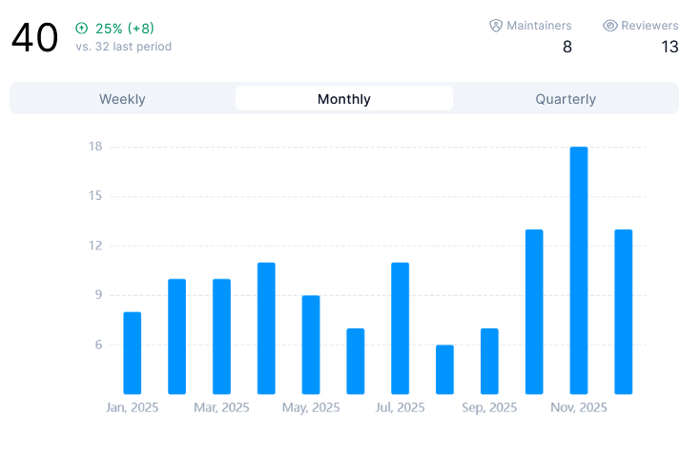
Contributions:

Slide 5
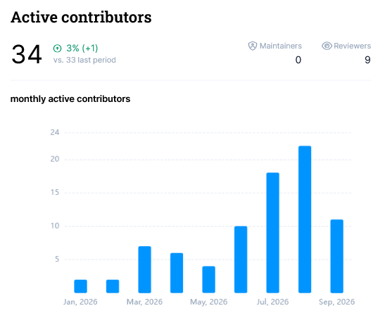
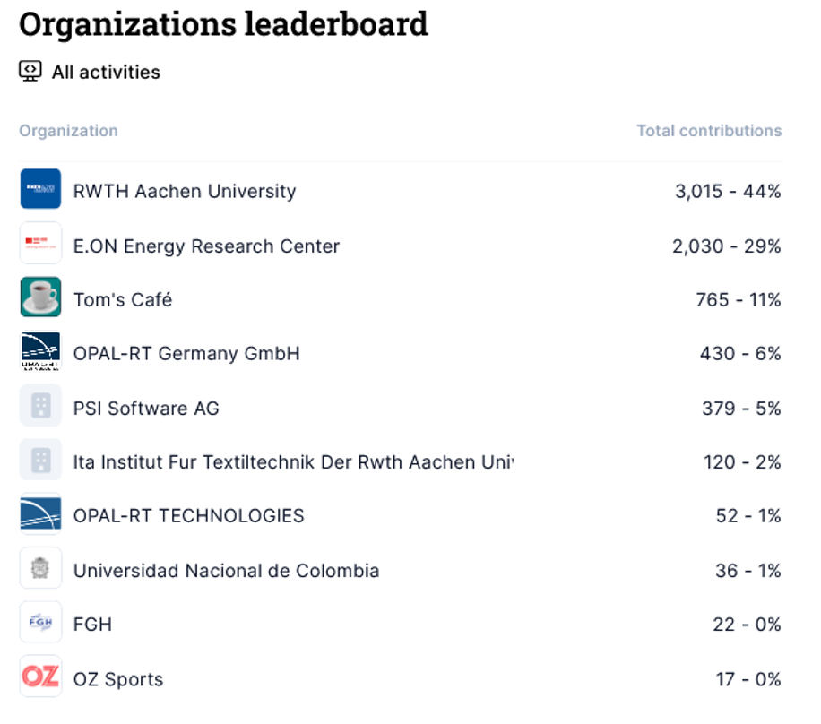
Contributions:

Slide 6
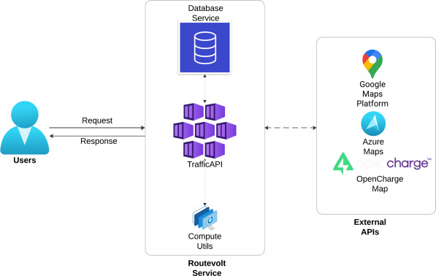
Key Achievements in the past year
Routevolt: New Service
Is being used as real-time traffic endpoint for evrich. (Advanced estimation of arrival SOC and time calculations to charging points)
Software paper published in Elsevier Software Impacts journal
Now available in SOGNO repo.
DOI: https://doi.org/10.1016/j.simpa.2026.100837

Slide 7
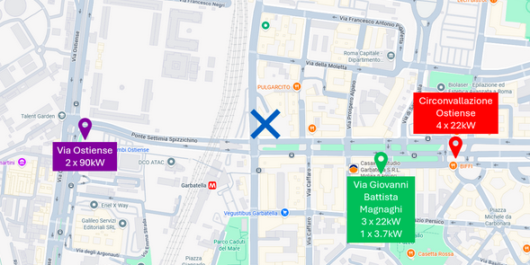
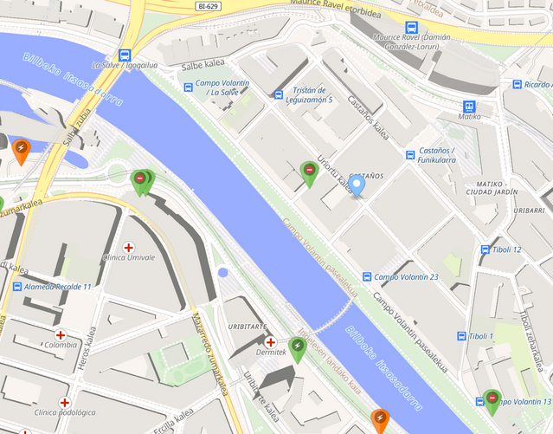
Key Achievements in the past year
Evrich & routevolt: Conducted two demos within two EU projects
FLOW: Rome demo
  Management of 3 charging stations with total 7 charging ports, helping assess the impact of optimized station selection on reducing charging-related loads by comparing baseline and integrated consumption levels with ARETI.
BeFlexible: Bilbao demo
  Optimized CP recommendations throughout the 24 h, aiming to improve energy distribution and reduce congestion through a before-and-after analysis of demand patterns with i-de.

Slide 8
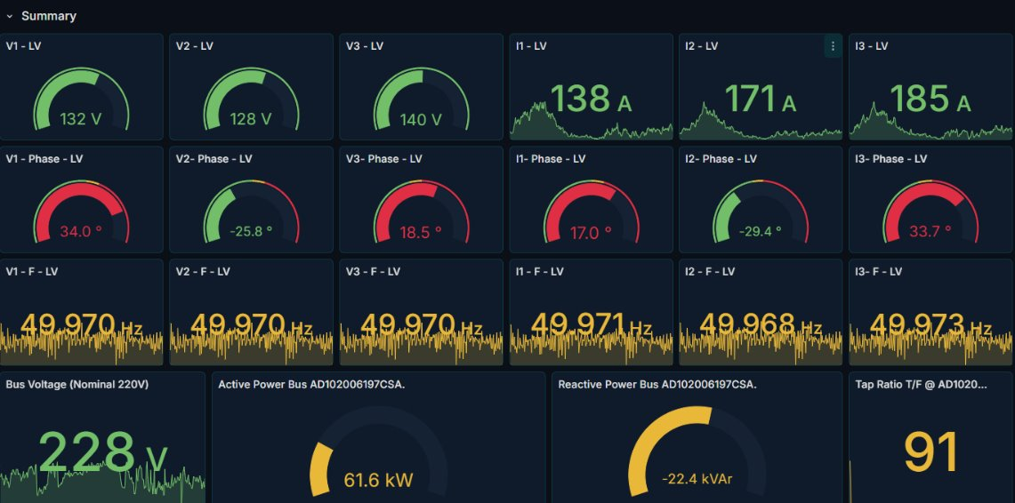
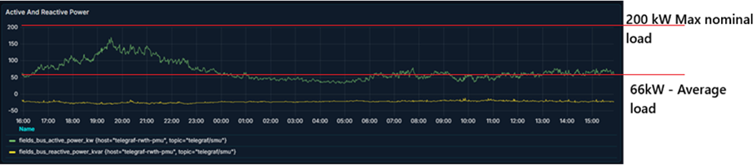
Key Achievements in the past year
Pyvolt and PMU based observability demonstrated in the field
BeFlexible: Rome demo
The pyvolt was used with a low cost pmu devoloped by RWTH Aachen. This was used in a secondary substation in Rome with ARETI. The data streamed was used for state estimation, improving the observability and congestion detection.

Slide 9

Key Achievements in the past year
Proloaf Upgrade
Improved handling of time features
Preprocessing steps to create generalizable model (needs evaluation)
Various QOL improvements
Integration as Event based Service in OpenEnergyTwin
Parallel Training now possible
PyMFM Upgrade
  Handling of life battery data
Various QOL improvements
  Major code restructuring (under review)

Slide 10
Key Achievements in the past year
Evrich Upgrade
Helm Version (unreleased)
Improved Simulation allowing Experiment chains and comparison of scenarios (unreleased)
Pipeline Prototype
  Prototype for eventbased architecture.
  Based on Kafka
  Forecasting integrated
  Docker, K8s, Helm
  OIDC under review

Slide 11

Key Achievements in the past year
DPsim
Projects: SEGURO, HYPOWER, CRETE VALLEY
New Release: v1.2.1 on Dec 2025
Available for Linux in PyPI and from source in Github
Simulation Models
State-Space-Nodal component models added, Ph1 and Ph3 line models for Diakoptics
Real-Time & VILLAS Enhancements
Decoupling line EMT models for co-simulation
Workflow & CI/CD Upgrades
Improvements in PyPI publishing, addition of nix build and optimization of container builds.
Testing & Examples
Easy access for user tests with myBinder including VILLASnode support (badge in the landing page of the repository), example Notebooks updated for new models.
Code Quality & Maintenance
Coverage testing added, workflow tests with pre-commit, documentation updates.
Security Aspects
Trusted publisher added to PyPI and TestPyPI. Progressive dependence upgrades.

Slide 12
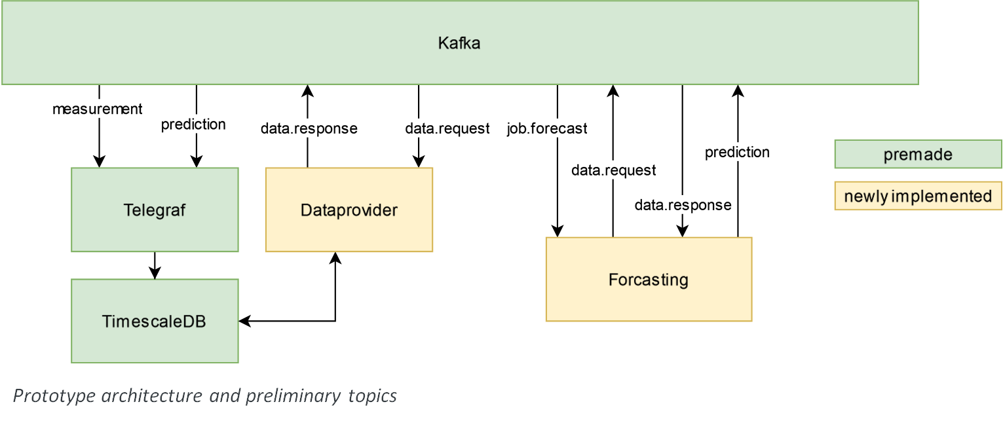
Key Achievements in the past year
Continuing adapting the data Architecture (Prototype)
Prototype
  Unified way of data and task exchange
  Expect to tie disparate SOGNO services together
Workers are always available
Central data storage
Both data and tasks come via Kafka
Services request missing data,
Providers fulfil requests autonomously

Slide 13
Key Achievements in the past year
InterSCADA (EU project)
  Develop an open-source software framework for modular SCADA platform.
    Checking orchestration mechanism to onboard new microservices. Discussing licensing. There are currently 9 functional microservices.
  Help grid operators maintain system stability in increasingly hybrid AC/DC power grids
OpenEnergyTwin (OFFIS, RWTH, and Fraunhofer):
  Integrated Proloaf into OET platform.
  Advance GUI for visualization of high and low voltage scenario.
  Project Phase 1 successfully delivered.
  Preparation for Phase 2.
  OET results to be used to enhance SOGNO core

Slide 14
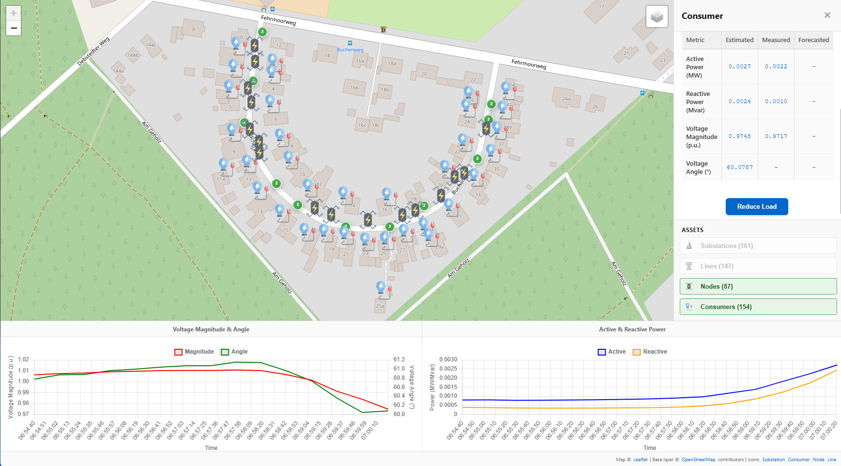
Key Achievements in the past year
OpenEnergyTwin (OET) – Phase 1
The human-machine interface auto-drawing topological data and visualizing key live parameter

Slide 15
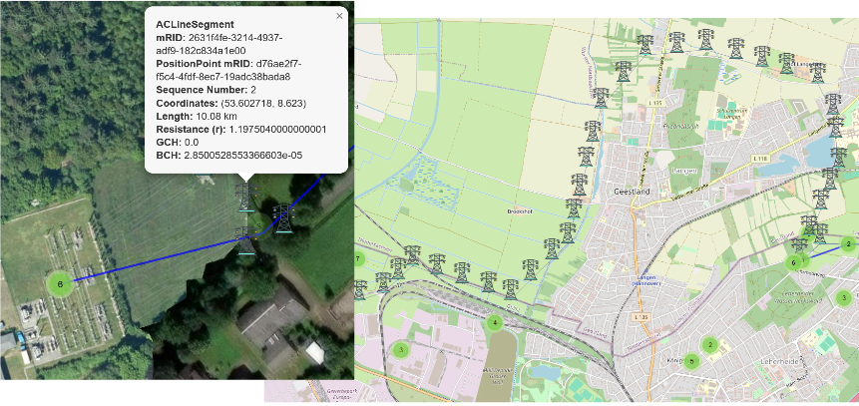
Key Achievements in the past year
OpenEnergyTwin (OET) – Phase 1
The human-machine interface auto-drawing topological data and visualizing key live parameter

Slide 16
Key Achievements in the past year
Workshops in ACS and FIT
A target picture for modular control systems development in Aachen
Workshops Objectives
Understanding core blockers in current SOGNO architecture.
Reviewing OET architecture for systematic integration and usage of the OET core and GUI.
Identifying problems related to overlapping platform (OET & SOGNO)
  Duplicated effort
  Integration problems
  Unclear Direction

Slide 17
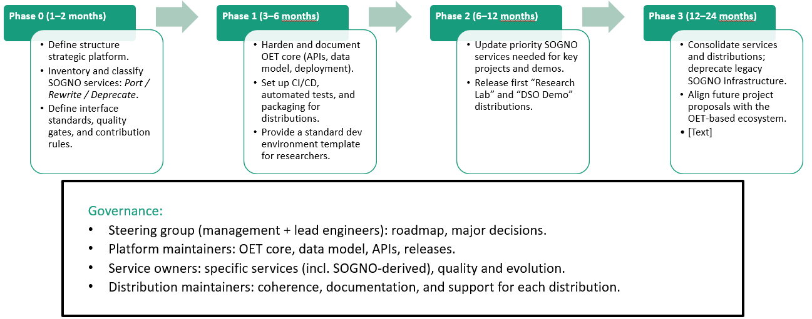
Key Achievements in the past year
Workshop Results:
Roadmap and Governance:

Slide 18
Key Achievements in the past year
Workshop Results:
Alignment on Architecture enhancement
Results obtained:
  Expectations from digitalization of SCADA Systems
  Architecture modules and improvement potentials
  Suggestions on Governance of Open-Source Software.
  Established tasks and roadmap align SONGO and OET efforts toward a unified platform.

Slide 19
New key project: OpenAIFlex
OpenAIFlex is a contract with the European Commission led by INESC-TEC. Fraunhofer is a sub-contractor.
Thanks to this project some key milestones will be achieved:
  Integration of the developments made in Rome back in the main line of the project
  Installation of the SOGNO platform in Vienna and in other DSO in Austria
  Replica of the experience also in one DSO in South America (negotiation in these days)
  Creation of a dedicated API for AI-based services
  Deployment of a first set of AI-driven services in all the active SOGNO locations including Rome

Slide 20
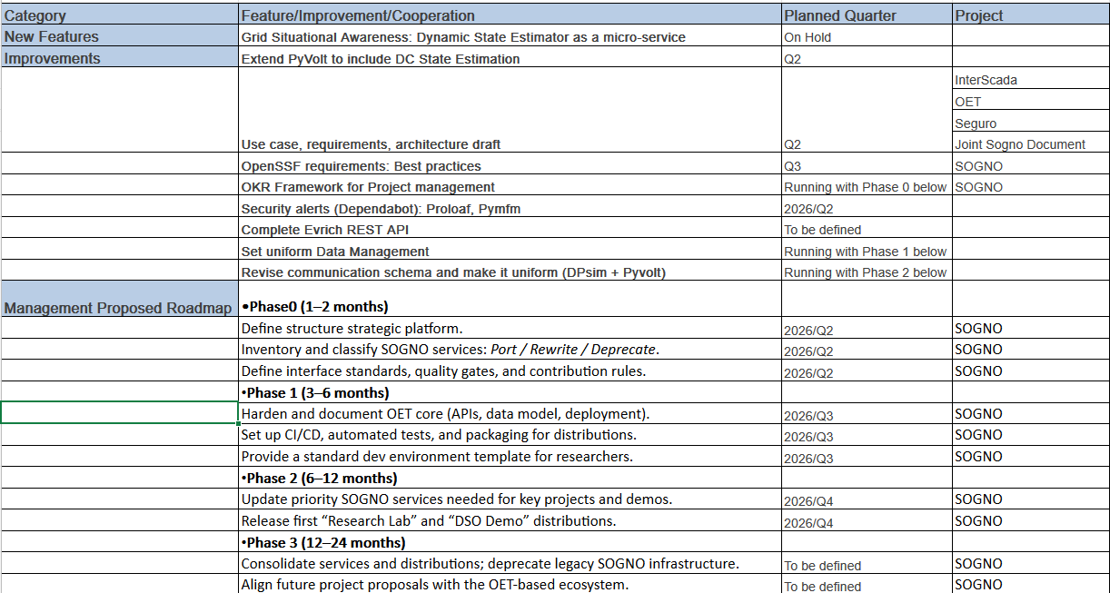
Roadmap 2026

Slide 21
Growth Plan: Projects
CreteValley: datafev will be utilized to calculate EV flexibility
HEDGE-IoT
  Utlize ProLoaF for demand forecasting as first step of congestion forecasting
  Update ProLoaF with SOTA algorithms(Transformer, TFT)

Slide 22
Areas the project could use help on
Enhance collaboration with other LF projects
  Exploring opportunities in the field of Data Spaces (OneNet).
  Connectors to interact with other platforms in the LFE ecosystem (EVerest).
Growth opportunities:
  Promoting existing SOGNO services to potential users.
  Jointly searching funding opportunities for future developments.
Guidance on management and quality assessment would be highly appreciated

Slide 23
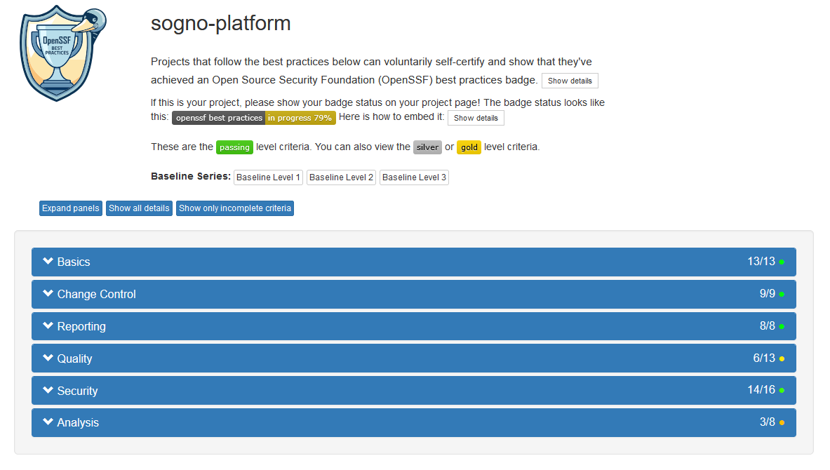
OpenSSF Best Practices
https://bestpractices.coreinfrastructure.org/en/projects/5627

Slide 24
Status of the OpenSSF Badge
OpenSSF’s certification is discussed in our regular internal meetings
SOGNO has several repositories and contributors to align
Verifying non-compliant repositories and disseminating the requirements among colleagues
We have more manpower now (RWHT+FIT), and we are refining our workflow
The Silver Badge is our final target for the whole SOGNO platform

Slide 25
Feedback on working with LF Energy
Helps to identify common elements that can then be used as a framework to expand the SOGNO suite more cleanly.
Motivates to produce reusable, open source, and well-documented code during research projects, thus also improving the transfer of learning.
Identification and alignment with the industry requirements thanks to the open community environment.
Automated tools are very helpful: License scan and Insights.
Reviewing the requirements for best practices gives us a new way of working

Slide 26
TAC Open Discussion

