Slide 1
Ch 1

Slide 2
Applications
(3rd Party Commercial / Proprietary)
Middleware
(3rd Party Commercial / Proprietary)
Operating System
(3rd Party Commercial / Proprietary)
Drivers
(3rd Party Commercial / Proprietary)
H/W Chips
(Multiple Vendors)

Slide 3
Open Source + 3rd
Party Commercial
3rd Party
Commercial
Open Source
Proprietary
Proprietary + Open
Source + 3rd Party
Commercial
Proprietary + 3rd
Party Commercial
Proprietary +
Open Source
Integration
Quality Assurance
Commercialization
Final Commercial
Product or
Software Stack

Slide 4
Applications
(3rd Party Commercial / Proprietary / Open Source)
Middleware
(3rd Party Commercial / Proprietary / Open Source)
Open Source Operating System
(Linux)
Drivers
(3rd Party Commercial / Proprietary / Open Source)
H/W Chips
(Multiple Vendors)

Slide 5
ch2

Slide 6
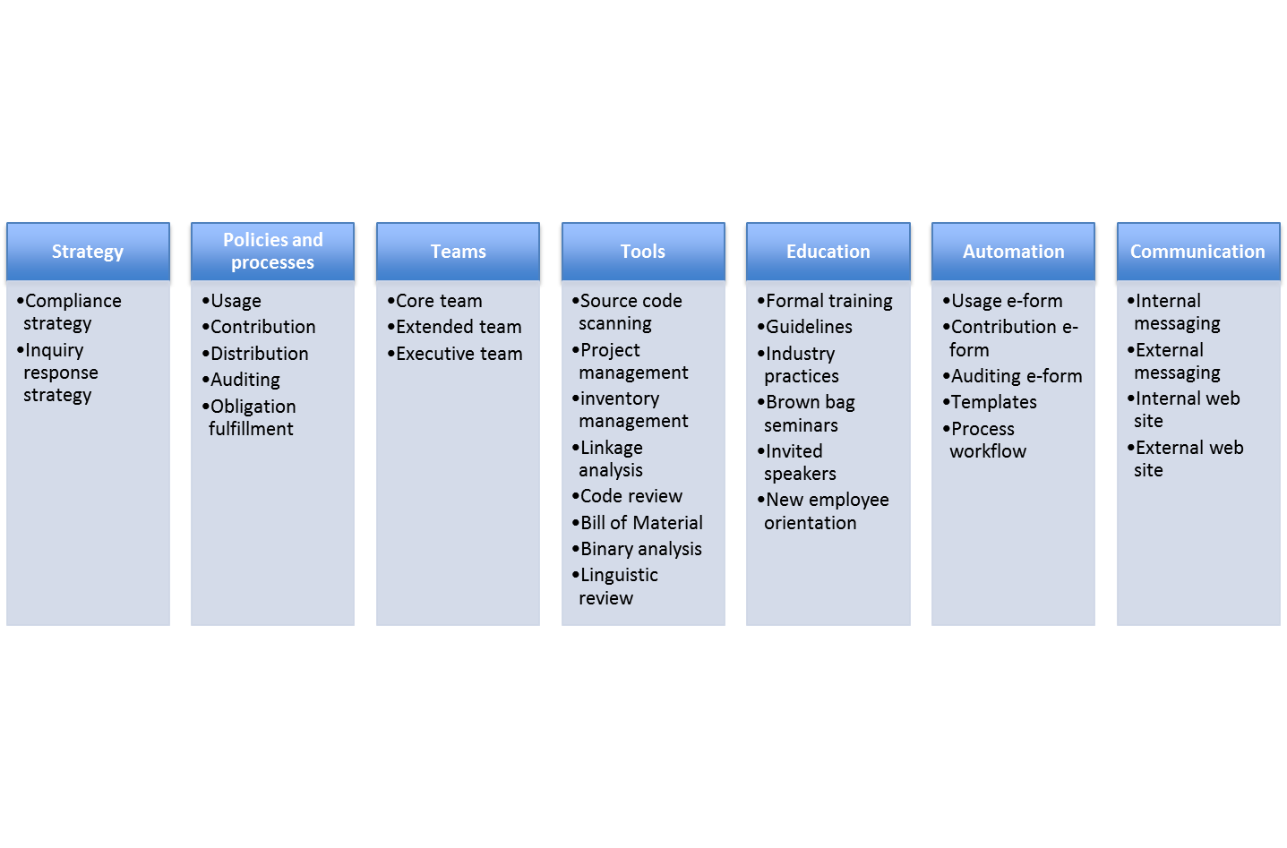

Slide 7
Identification
Audit
Resolve Issues
Reviews
Approvals
Registration
Notices
Verifications
Distribution
Verifications
Proprietary software
3rd party software
Open source software
Notices
Source code

Slide 8
Documentation
Engineering
Supply
Chain
Core Team
(OSRB)
IT
Compliance
Officer
Product
Team
Extended Team
Localization
Legal
Executive Committee (OSEC)
OSEC
Corporate
Development

Slide 9
v1.0
release
v 1.1
release
Start of product
development
Product v 1.0
Product v 1.1
Development of v 1.0.
Complete base line compliance of all
incoming source code.
Additional development over v 1.0.
Achieve incremental compliance:
Delta (v1.1, v1.0).

Slide 10
Ch 3

Slide 11
Documentation
Engineering
Supply
Chain
Core Team
(OSRB)
IT
Compliance
Officer
Product
Team
Extended Team
Localization
Legal
Executive Committee (OSEC)
OSEC
Corporate
Development

Slide 12
Compliance Officer
Legal Counsel
Prepares the draft notices document based on the final software bill of material in
addition to a proposal on where and how these notices should be presented.
Documentation Team
Reviews, edits and approves proposal from the Compliance Officer.
Update product documentation as approved by Legal.

Slide 13
Ch 4

Slide 14
Open Source Compliance Due Diligence Process
Proprietary software
3rd party software
Open source software
Notices
Source code

Slide 15
Identification
Audit
Resolve Issues
Reviews
Approvals
Registration
Notices
Verifications
Distribution
Verifications
Proprietary software
3rd party software
Open source software
Notices
Source code

Slide 16
Identified through:
Incoming request to use
open source software
Incoming OSRB request
Full platform scan
Routinely scheduled scan
Source code changes in a
previously approved
component
BoM difference tool
Open source received from
a 3rd party software vendor
3rd party acknowledgement
Automated full platform scan
Linkage dependency mapping
Source code downloaded
from the web (author
and/or license unknown)
Incoming usage request
Automated full platform scan
Linkage dependency mapping
Proprietary software
component added to the
build
BOM difference tool
Automated full platform scan
Usage form if proprietary
component includes open source
Linkage dependency mapping
Open Source added to the
code repository and does
not correspond to a usage
form
Commit email alert issued sent
to compliance officer
Previously approved open
source used in another
product
BoM difference tool

Slide 17
Software
Component
Owner
Evaluates component and submits a usage form requesting approval
to use the specific open source component in a product.
OSRB Chair
Receives the submitted usage form, reviews it, ensures all necessary
information is included and forwards the ticket to auditing.
Auditing
Personnel
Receives the compliance ticket with the source code scan request.
Performs auditing and works with OSRB chair and Engineering
representative to resolve any flagged issues.
OSRB Chair
Reviews the audit results, interacts with auditing personnel, package
owner and Engineering representative to resolve any pending issues
before forwarding ticket to Legal.
Linear Approval Path
Legal Counsel
Reviews all comments in the compliance tickets and decides on the
incoming and outgoing licenses.
OSRB Chair
Confirms linkages and work with Engineering and/or Legal to resolve
any pending items.
OSRB
Committee
Reviews the complete compliance record of the FOSS component
and a final decision is made approving or disapproving its usage.
OSEC
OSEC approval is needed only in the case the company will be releasing
IP or proprietary source code.

Slide 18
Ch 5

Slide 19
If Approved:
Fulfill
obligations
Source
Code
Scan
Identification
and
Resolution
of Issues
Legal
Review
Architectural
Review
Final
Review
Begin
End
If Rejected:
Explain why
and close ticket

Slide 20
Incoming request to use open
source software
Regularly scheduled scan for
the full software stack
Source code changes in a
previously approved component
Source
code
scan
Source code received from 3rd
party software provider
Source code received from the
web (license, author unknown)
Proprietary software component
added to the build system

Slide 21
Path to the source code.
List of issues flagged by the tool and the audit team.
Scan report, license information, and
comments from OSRB team.
Architectural diagram and linkage analysis.
All information collected in previous stages.
Source Code
Scan
Identification
and Resolution
Legal Review
Architectural
Review
Final Review
A scan report that identifies:
Bill of material
Origins of source code
Licenses in effect
Possible conflicts of licenses
A resolution for every flagged issue.
A new scan report showing that all issues have been resolved.
A legal opinion on license compliance.
Decision on incoming and outgoing licenses.
Approval of submission.
Identification of how the specific component interacts in the operating environment with other components.
Approval or rejection of the usage of the component.
If it is an approval, this triggers fulfillment of obligations upon product shipment.

Slide 22
Fast track: 100% proprietary code.
Identified linkages conflict.
Engineering to rework code.
1
3
Request a new scan to confirm
issues have been resolved.
Identified possible linkage
conflict. Legal to weight in.
6
Scan
Identification
Resolution
Legal
Review
Architecture
Review
Final
Review
Begin
2
5
Redo Legal review.
7
Identified license conflict.
Assign ticket to Engineering
to rework code then rescan
to confirm resolution and
produce a clean report.
Legal identified license conflict to be resolved by reworking code.
4
8
Approved
Legal disapproves
due to licensing issues.
Conflict can not be resolved.
Component will be rejected.
Rejected
4
Obligation
Fulfillment
Package is not in the build anymore, or
duplicate, or no action needed, etc.
End

Slide 23
Begin
Scan
License conflict;
Engineering reworks code. Rescan, produce
new report
2
Fast track:
100% proprietary code
Identify
1
Request new scan, confirm issues are resolved
6
Resolve
Identified license conflict resolved by re-working code
5
Legal
Review
Identified linkages conflict. Engineering
reworks code
Redo Legal review
based on possible
linkage concerns
3
Arch.
Review
Duplicate package or
no longer used or
or no action needed
Final
Review
4
4
8
7
Rejected
Approved
End

Slide 24
OLD
1
Fast track: 100% proprietary code.
Identified linkages conflict.
Assign ticket to Engineering
to rework code.
3
Request a new scan to ensure
all issues have been resolved.
6
Identified possible linkage
conflict. Legal to weight in.
Package is not used anymore.
Scan
Identification
Resolution
Legal Review
Architecture
Review
Final Review
Package is not used
anymore.
Begin
7
Redo Legal review.
Identified license conflict.
Assign ticket to Engineering
to rework code. Rescan and
start process after code is
Fixed.
Identified license conflict
to be resolved by
reworking code.
5
Legal disapproves.
Rejected
Approved
2
Conflict can not be resolved. Decision is to not approve the usage of this component.
8
Obligation
Fulfillment
End
Package is not in the build anymore, or
duplicate, or no action needed, etc.
4

Slide 25
Final Review:
Component is approved by OSRB
Update software inventory.
Issue ticket to Documentation
team to update notices in
product documentation.
Trigger the source code
distribution process when
product ships.

Slide 26
v1.0
release
v 1.1
release
Start of product
development
Product v 1.0
Product v 1.1
Development of v 1.0.
Complete base line compliance of all
incoming source code.
Additional development over v 1.0.
Achieve incremental compliance:
Delta (v1.1, v1.0).

Slide 27
Build Server
BoM a
BoM Difference
Tool
2
Compliance
Management
System
(JIRA, Bugzilla)
Issue scan
requests
Begin
BoM Delta
List of new and updated packages
1
BoM b
3
Source Code
Scan
Identification
and Resolution
of Issues
Legal Review
Architectural
Review
Final Review
OSRB f2f meeting
If Rejected:
Explain why
and close ticket
If Approved:
Fulfill
obligations
End

Slide 28
Legend
Proprietary
3rd Party Commercial
[Insert Components]
User Space
GPL
LGPL
[Insert interaction method]
Other open source (specify)
(fc)
Function call
Kernel Space
(si)
Socket interface
[Insert Components]
(sc)
System call
(sh)
Shared headers

Slide 29
Receive path to
the source code
from the usage
form
Perform source
code scan
Perform audit
analysis and
source code
identification
Produce audit
report
Move the
compliance ticket
to the next phase

Slide 30
Decide on publication model
Prepare source code packages
Complete the pre-publication checklist
(one-time) Initial decision
Publish source code
Complete the post-publication checklist
Repeat these steps every time
you are publishing source code

Slide 31
Decide on distribution method
Decide on distribution mode
Prepare source code packages
Initial decisions
Complete the pre-distribution checklist
Distribution
Complete the post-distribution checklist
Repetitive distribution
process with each new
release

Slide 32
Ch 6

Slide 33
Review and approve
compliance record
Compile notices
for publication
Post distribution
verifications
Identification
Audit
Resolve Issues
Reviews
Approvals
Registration
Notices
Verifications
Distribution
Verifications
Proprietary software
3rd party software
Open source software
Written offer
Notices
Source code
Identify source
code changes in the
build environment
(new, modified and
retired components)
Scan source code
and identify possible
code matches
+
Confirm source code
origin(s) and license(s)
Resolve any
Issues flagged by
the scanning tool
+
Ensure linkages
are in line with
company policies
Record approved
software/version
in inventory per
product and per
release
Verify source code packages for distribution
– and –
Verify appropriate notices are provided

Slide 34
Incoming Software
Outgoing Software
Distribution
Notices & Attributions
Proprietary Software
identification
Audit
Resolve Issues
Reviews
Approvals
Registration
Notices
Verifications
Verifications
Written Offer
3rd Party Software
FOSS
Identification
Audit
Resolve Issues
Reviews
Approvals
Registration
Notices
Verifications
Distribution
Verifications
Proprietary software
3rd party software
Open source software
Written offer
Notices
Source code

Slide 35
Review and approve
compliance record
Compile notices
for publication
Post distribution
verifications
Identification
Audit
Resolve Issues
Reviews
Approvals
Registration
Notices
Verifications
Distribution
Verifications
Proprietary software
3rd party software
Open source software
Notices
Source code
Identify source
code changes in the
build environment
(new, modified and
retired components)
Scan source code
and identify possible
code matches
+
Confirm source code
origin(s) and license(s)
Resolve any
issues flagged by
the scanning tool
+
Ensure linkages
are in line with
company policies
Record approved
software/version
in inventory per
product and per
release
Verify source code packages for distribution
– and –
Verify appropriate notices are provided

Slide 36
Acknowledge
Incoming
Inquiry
Inform
Investigate
Report
Rectify
These steps are taken
only if an issue was
found.
Improve
Close
Inquiry

Slide 37
Chapter 9

Slide 38
Permissive
License-A
License-B
License-C
License-D
Modifications
to be released
License-E
License-F
License-G
Patent Clause
License-H
License-I
License-K
Not Allowed
License-L
License-M
Notes:
Source code licensed
under these licenses
is pre-approved and
can be combined with
proprietary software.
Notes:
Modifications made
to source code
licensed under these
license must be
released back
Notes:
Due to patent clause,
you must discuss with legal counsel about your planned usage.
Notes:
Company policy
prohibits use of
source code available under these licenses.
Pre-approved
Requires approval
of engineering
manager
Requires approval of legal counsel
Not approved

Slide 39
End!

