Slide 1
Loss of large scales in SCUBA-2 Quick update on FFT transform tests
Lapo Fanciullo, Kate Pattle, Janik Karoly
Bistro DR Meeting, Nov 21 2023

Slide 2
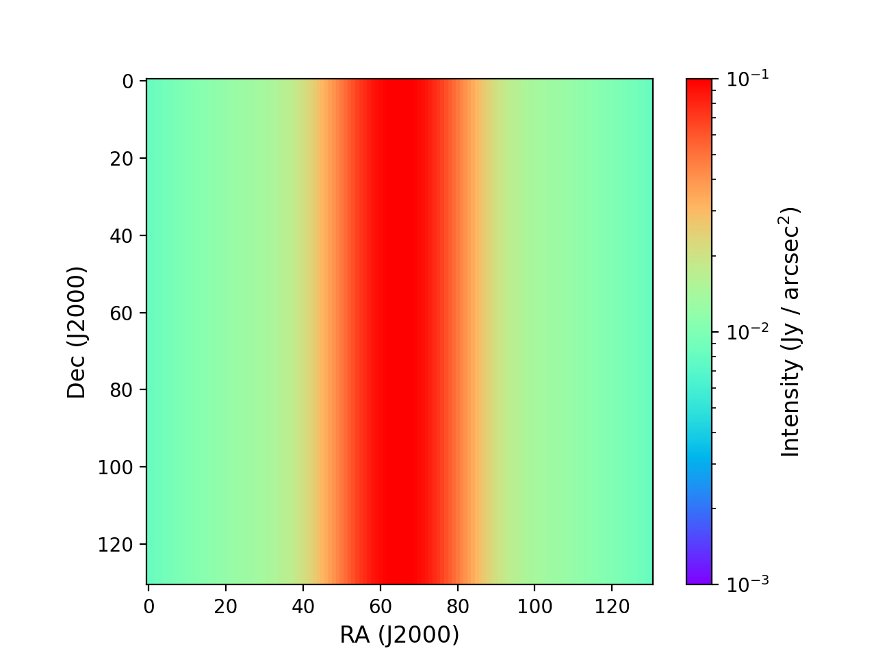
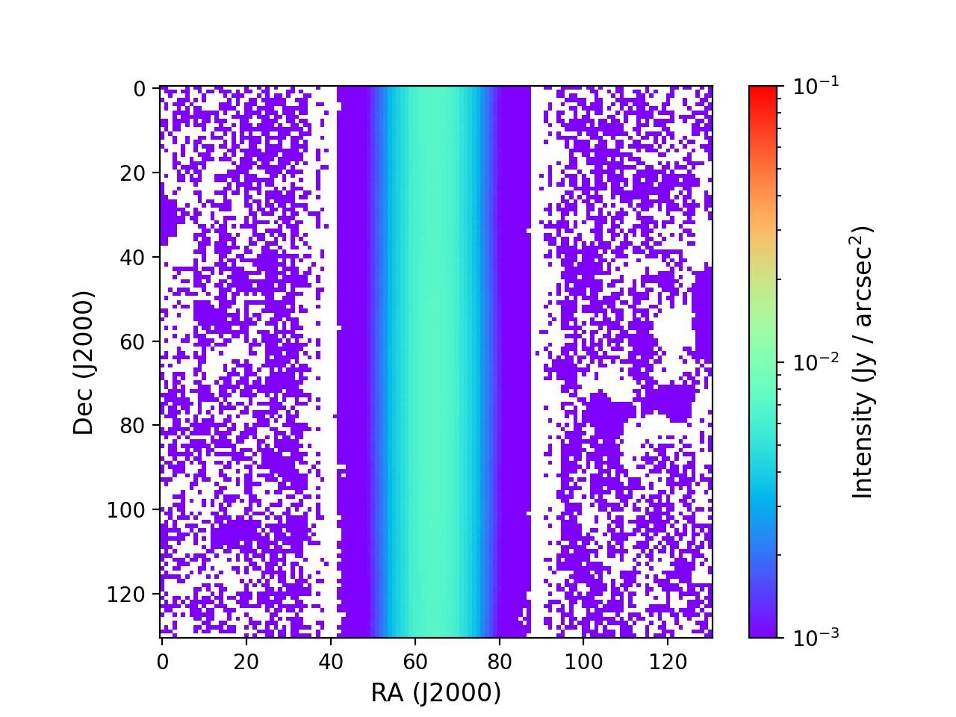
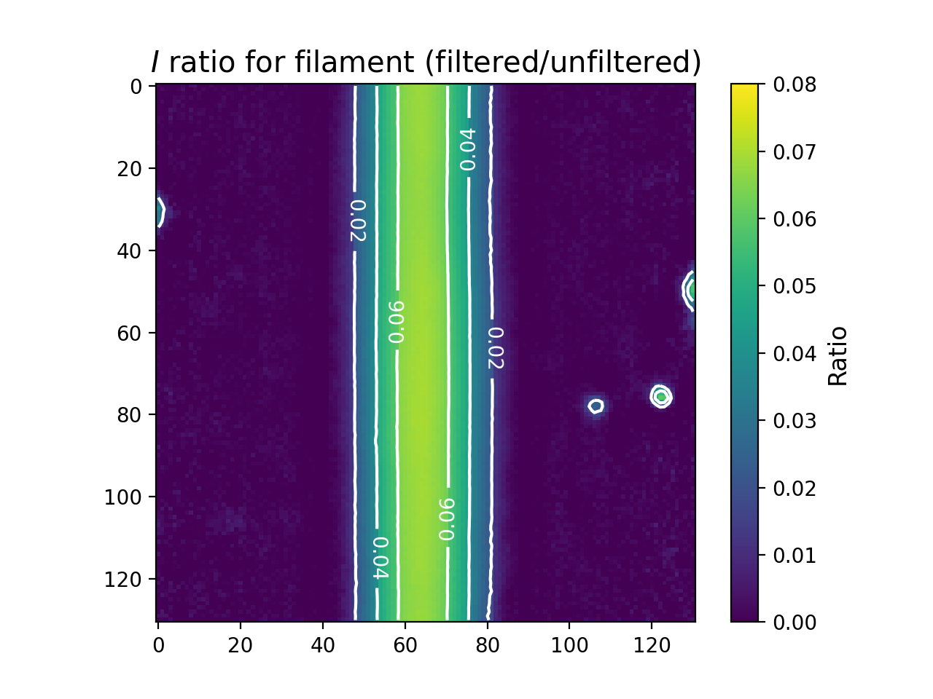
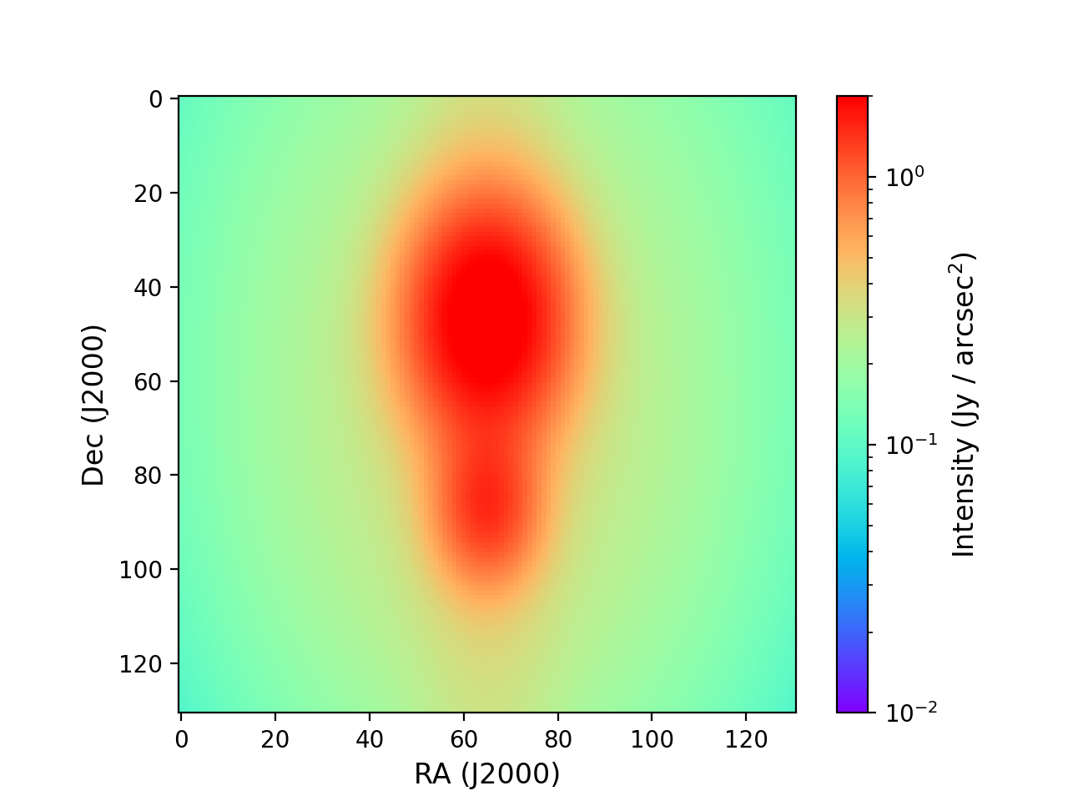
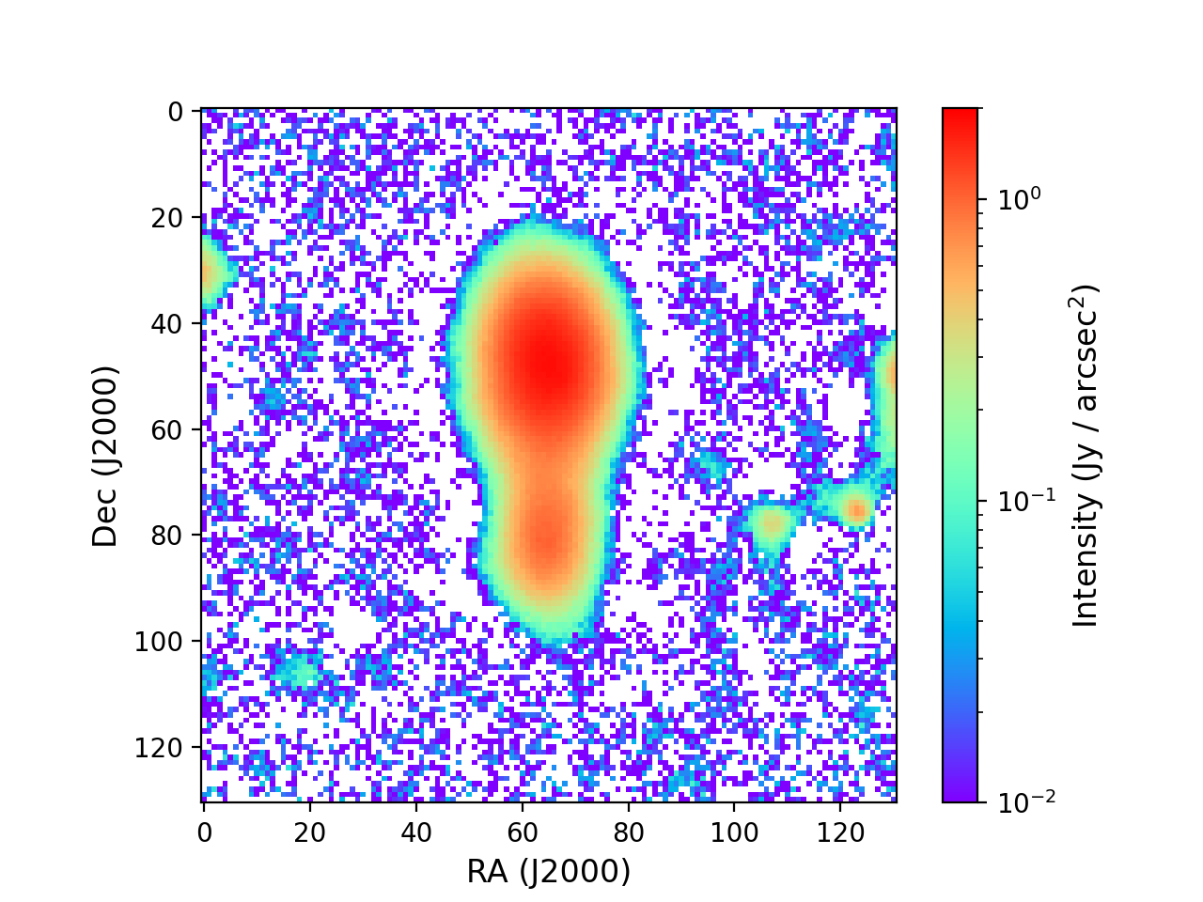
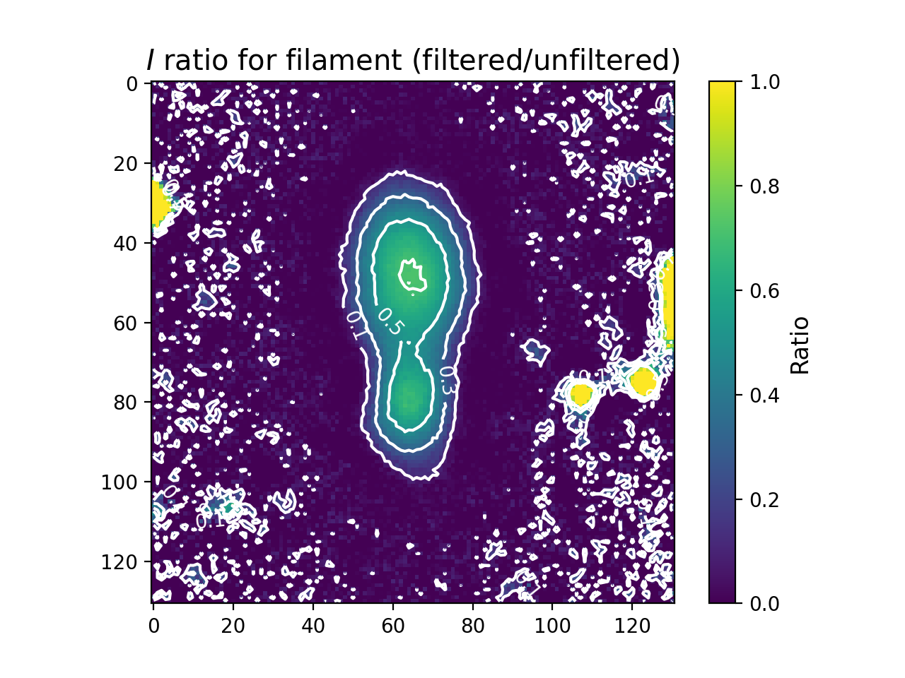
Recap: filament and filament + clumps
Original
Filtered
Ratio
Significant loss of flux
>90% in filament
>= 30% in filament+clumps
Fourier transforms:
“Spread” of power away from center
Real or noise effect?
Dealing with Serpens features:
Subtract features after filtering (missed last time!)
Window function

Slide 3
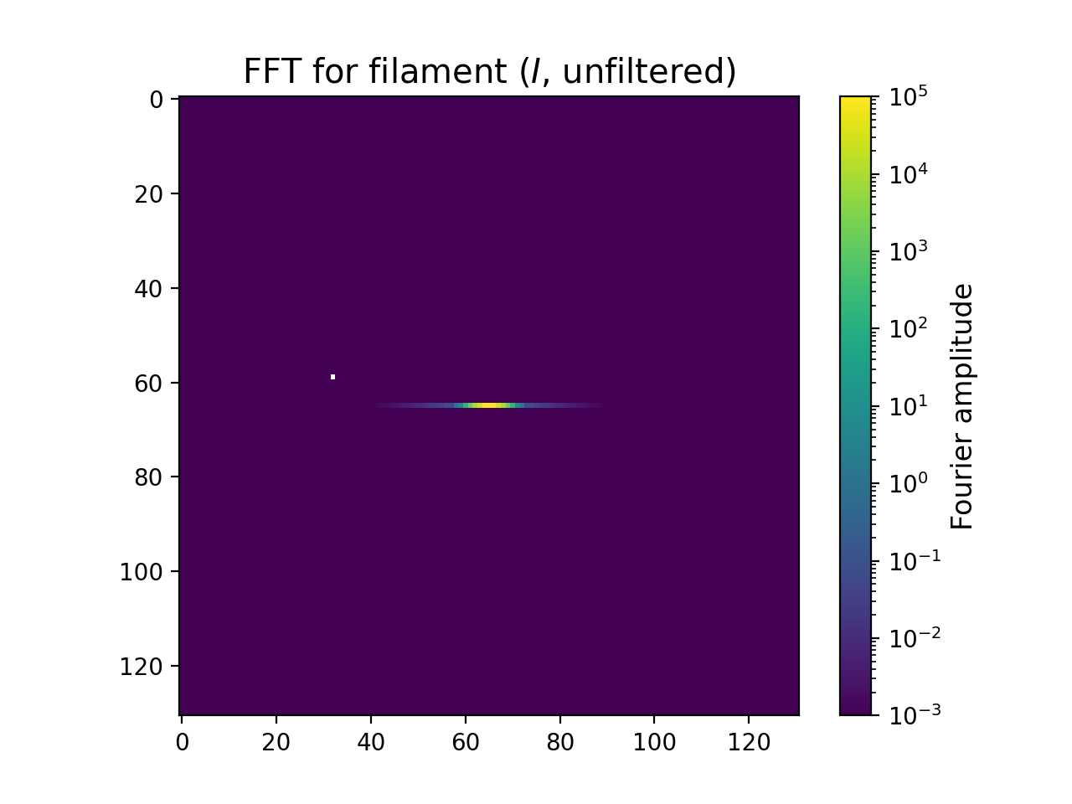
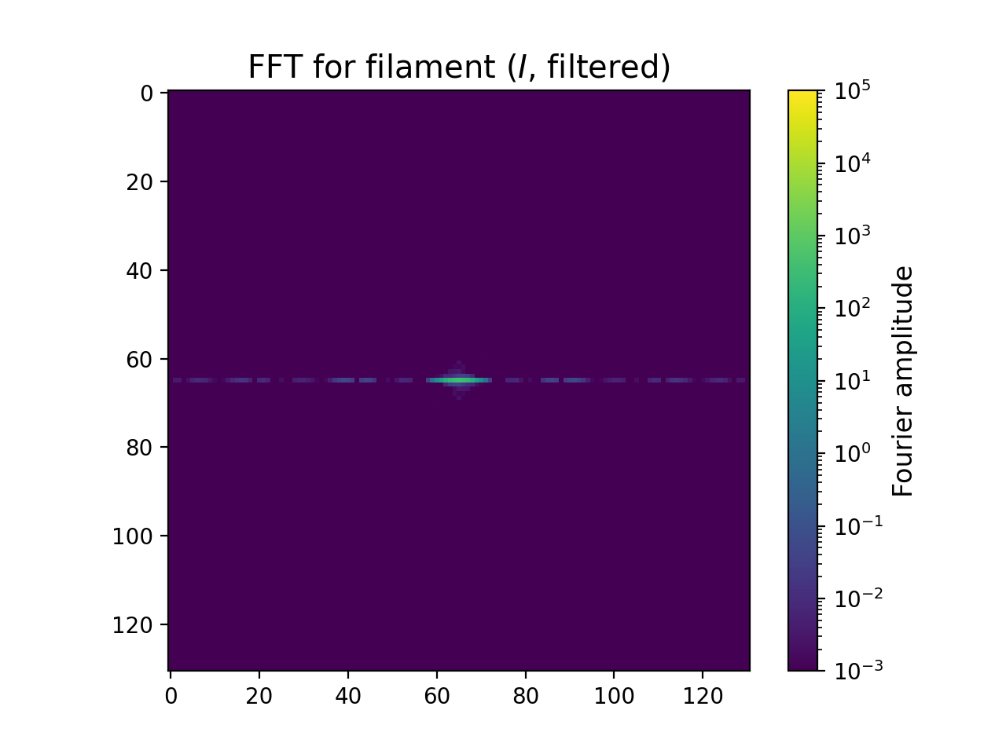
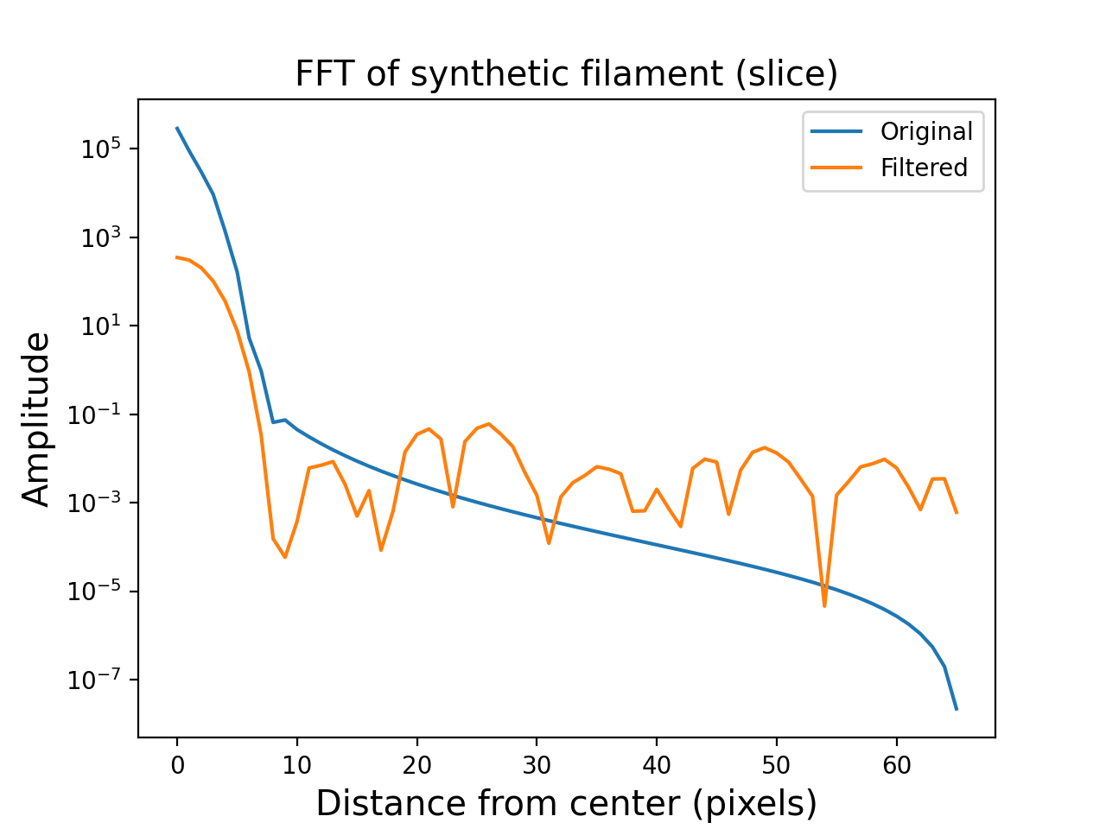
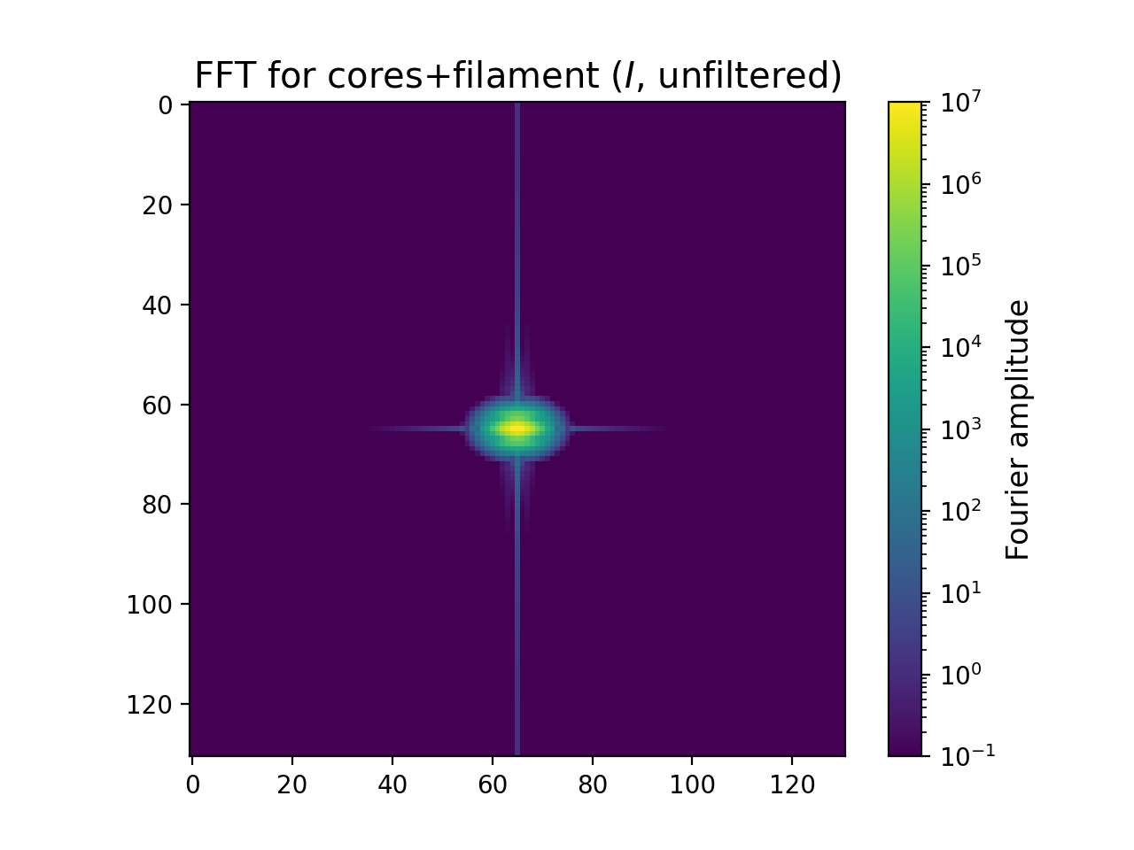
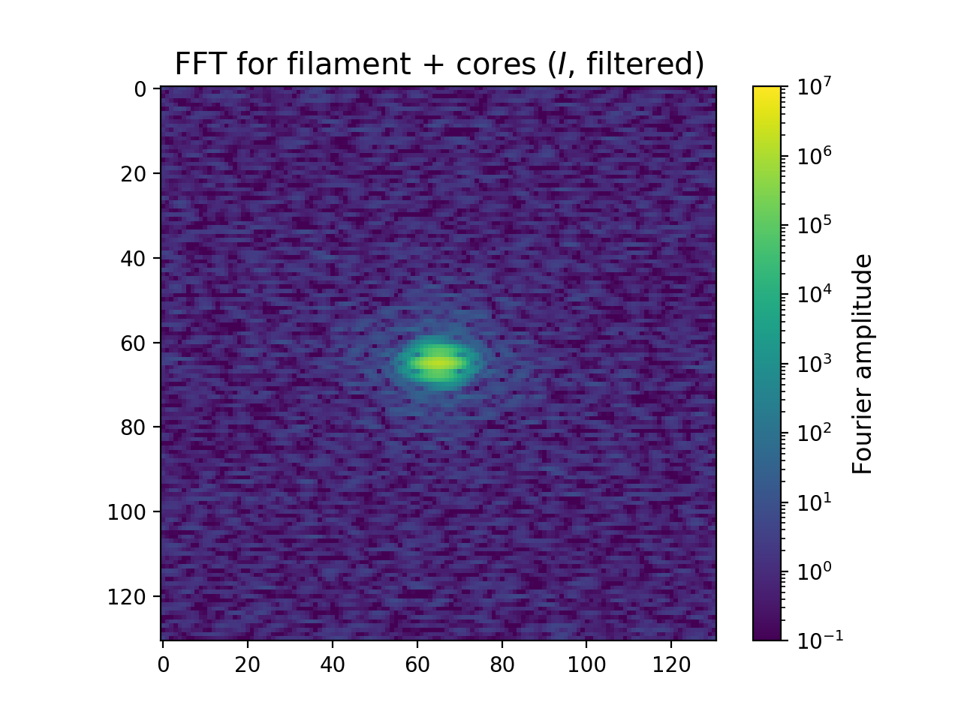
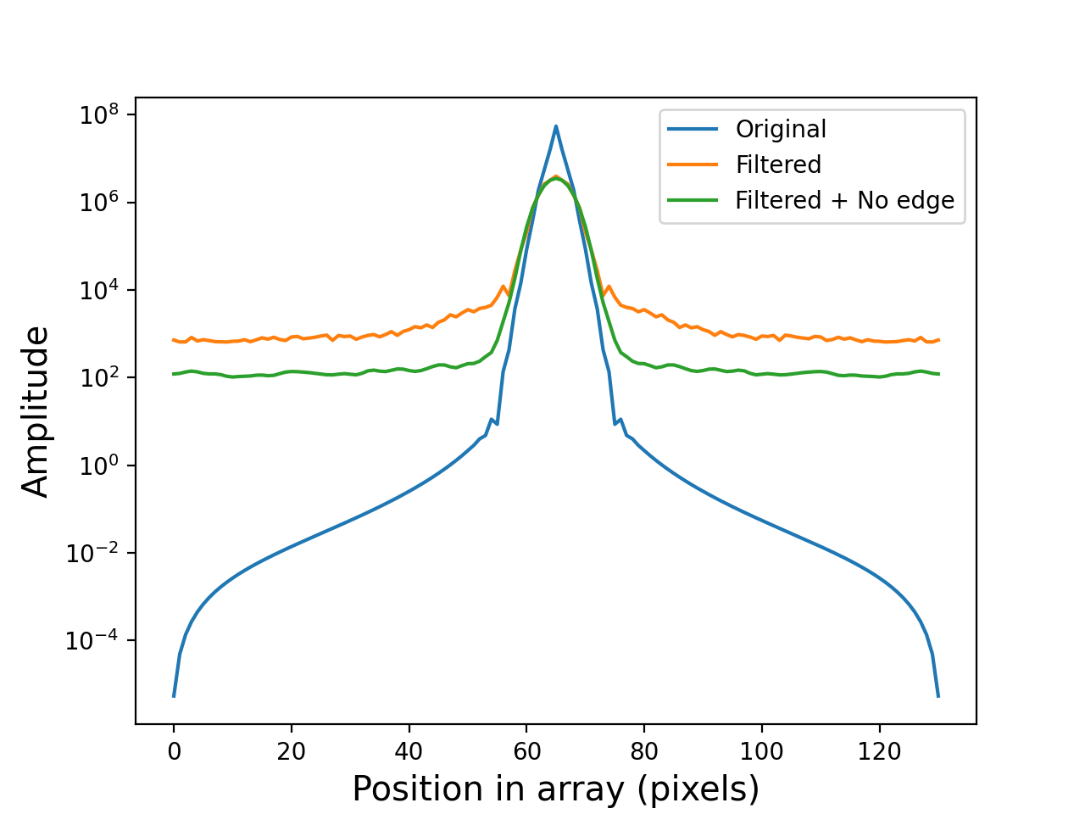
Recap: filament and filament + clumps
Original
Filtered
1D FFT
Significant loss of flux
>90% in filament
>= 30% in filament+clumps
Fourier transforms:
“Spread” of power away from center
Real or noise effect?
Dealing with Serpens features:
Subtract features after filtering (missed last time!)
Window function
“Homemade” window function applied

Slide 4
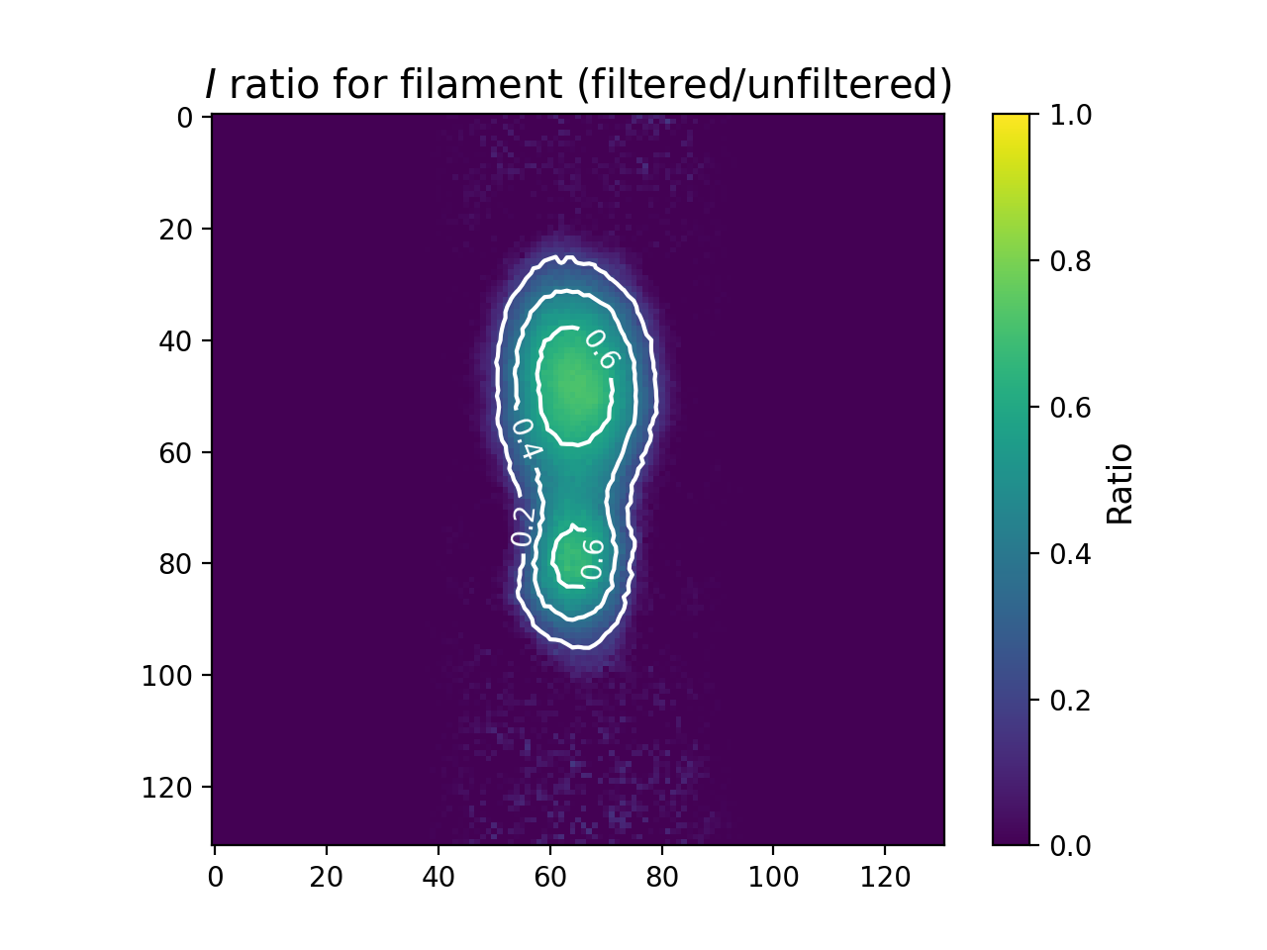
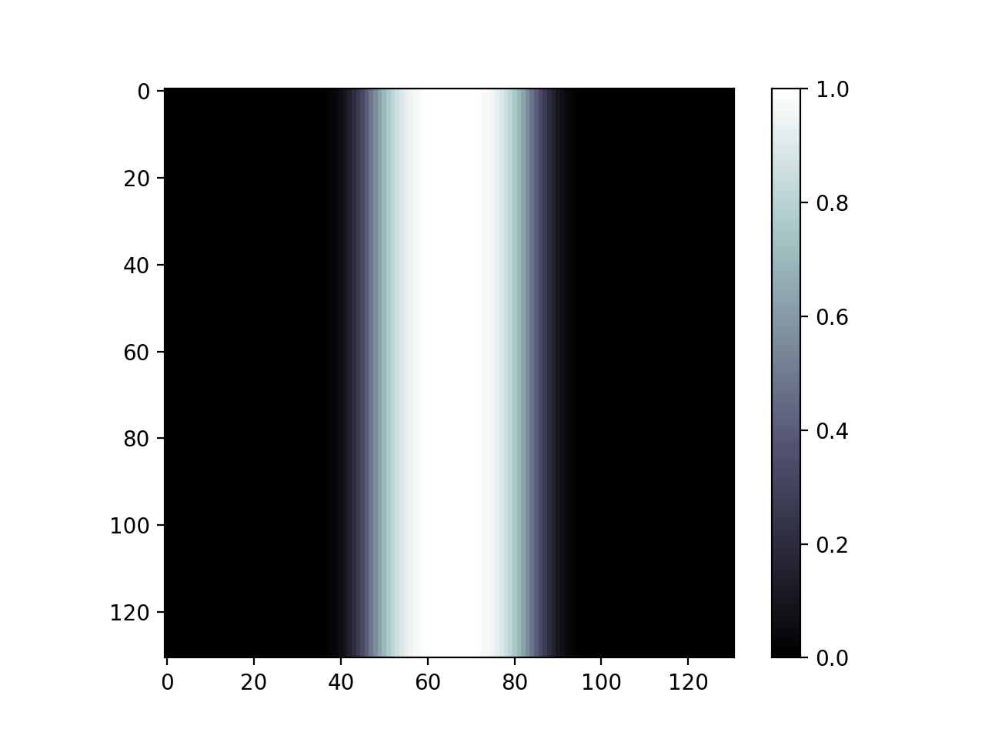
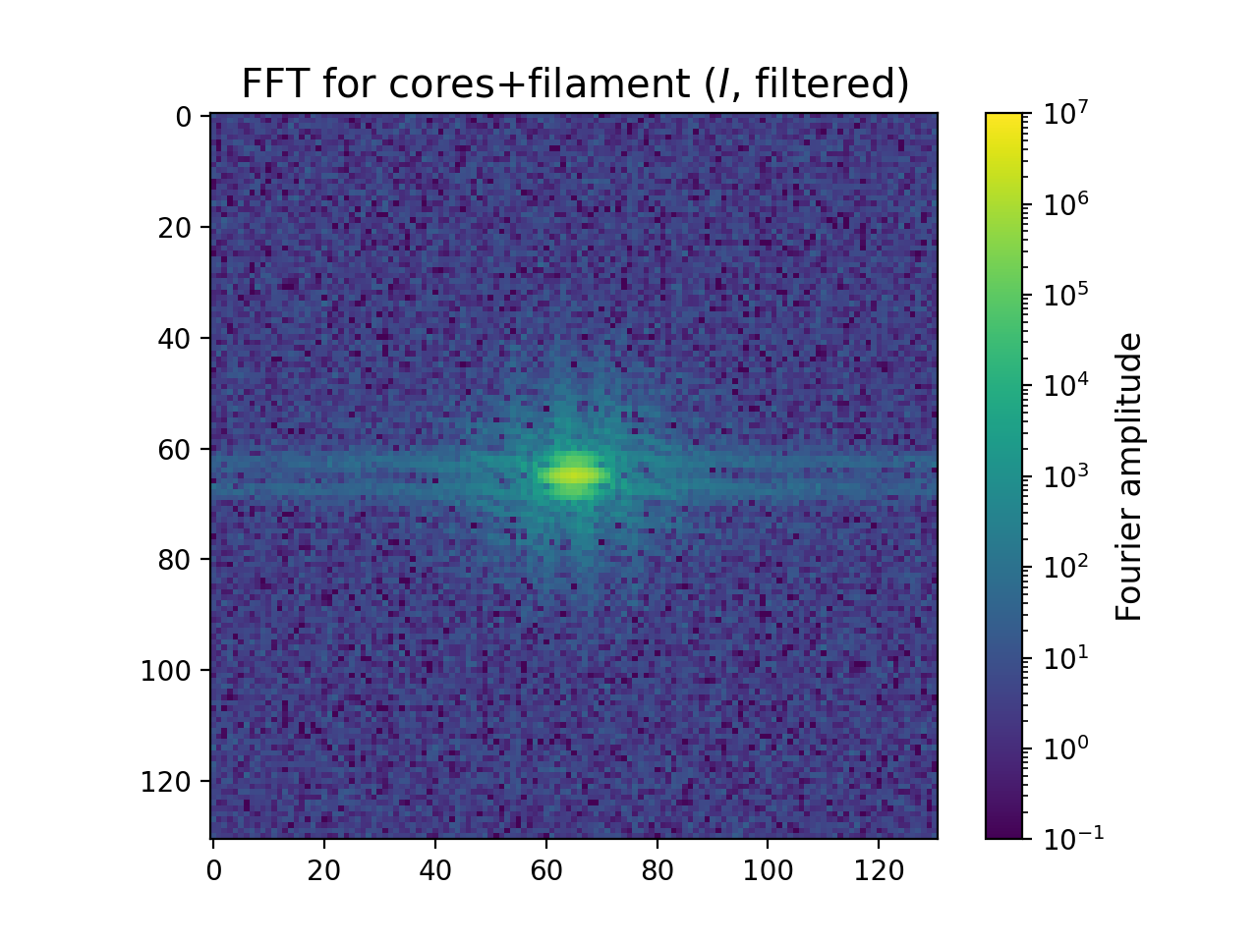
“Homemade” window function

Slide 5
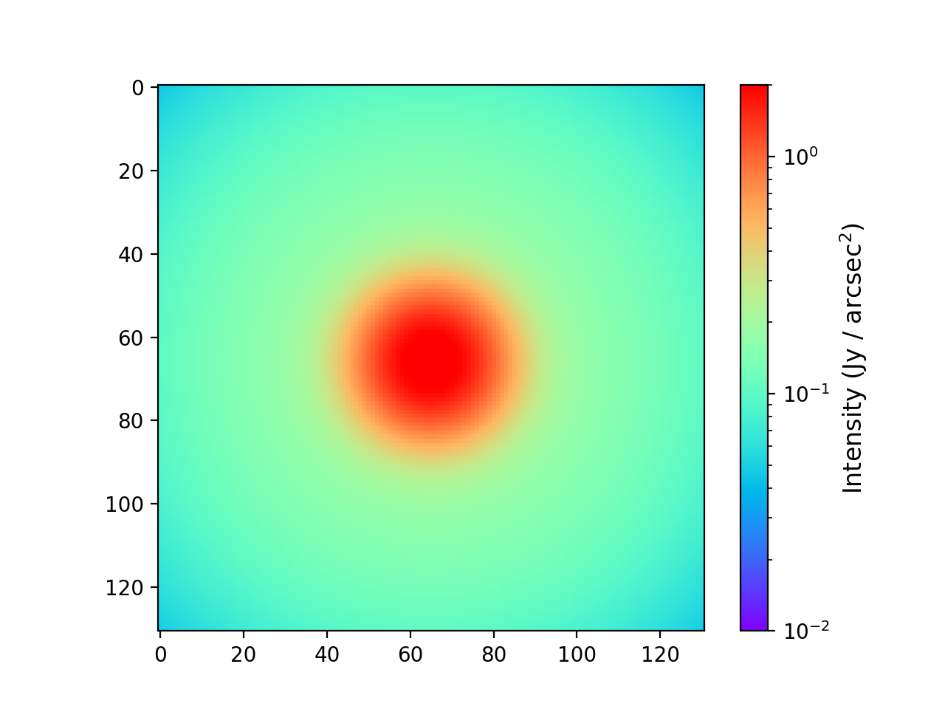
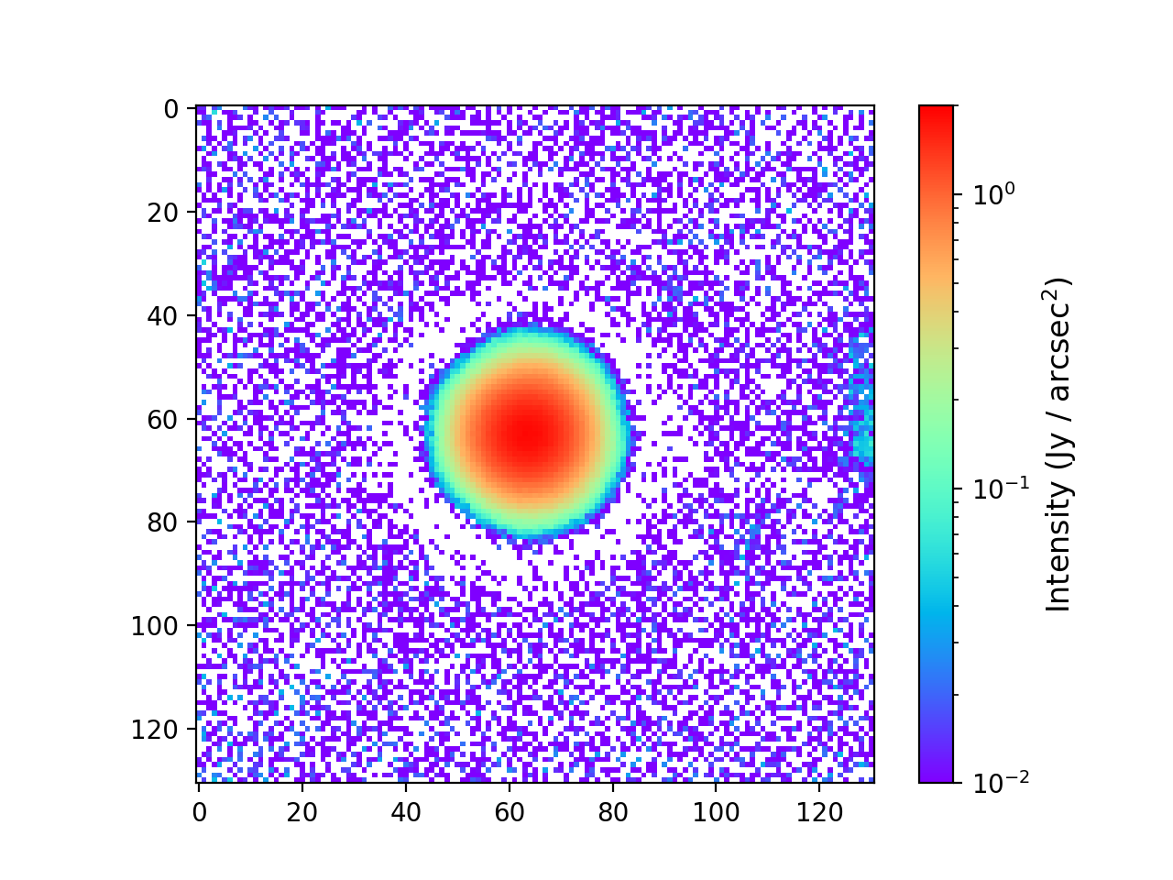
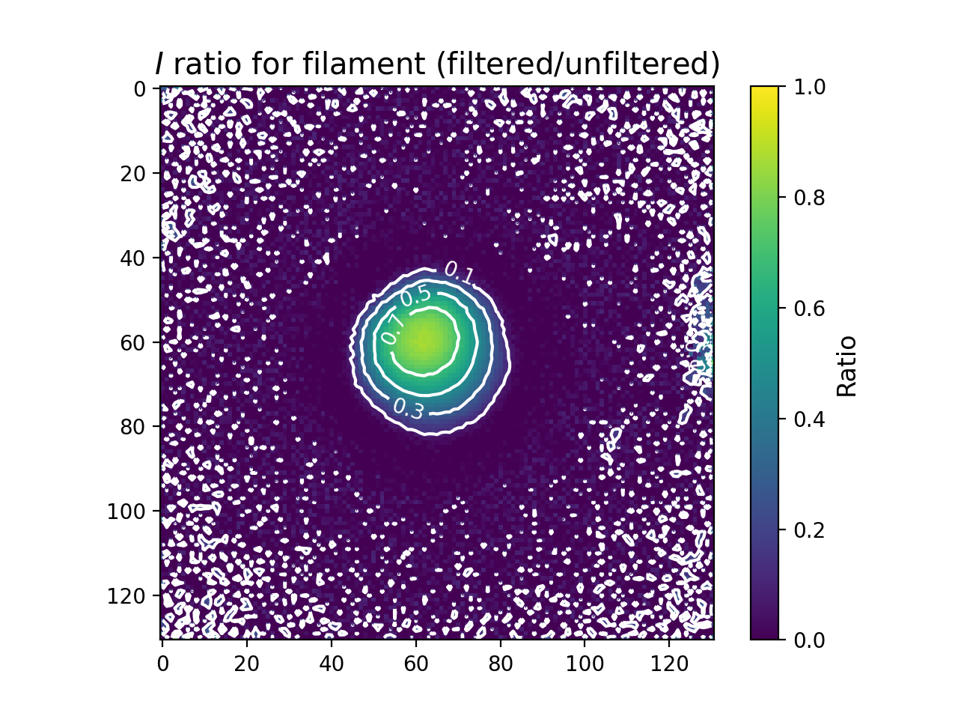
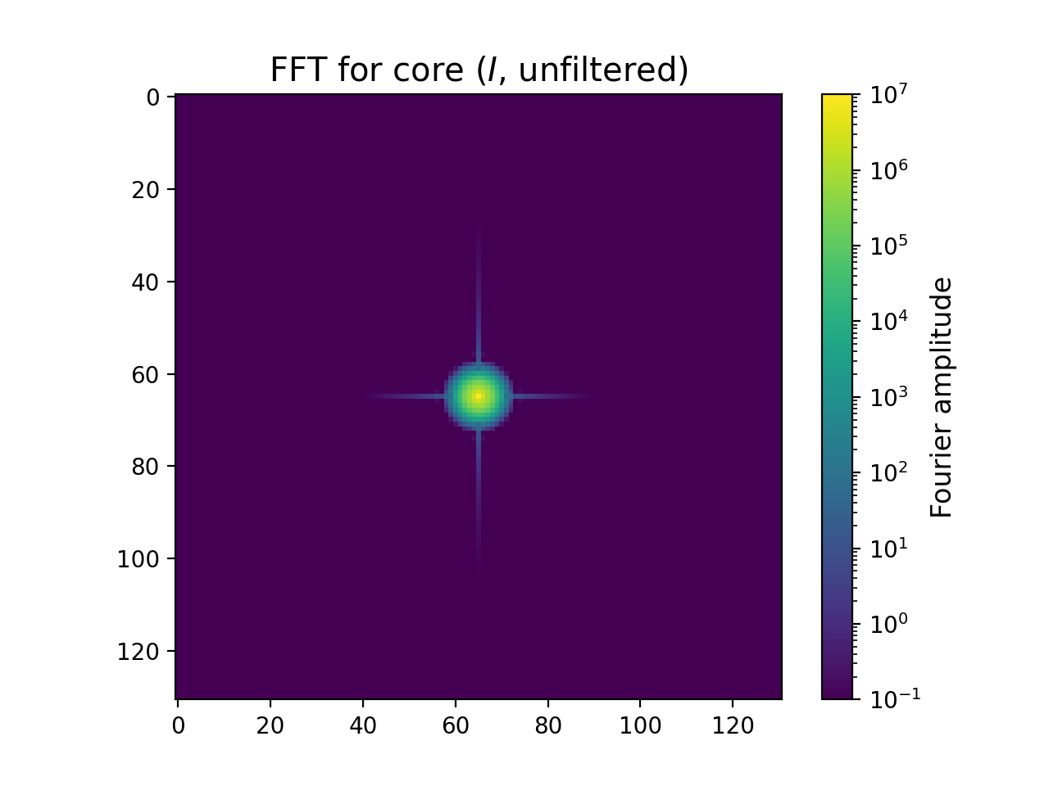
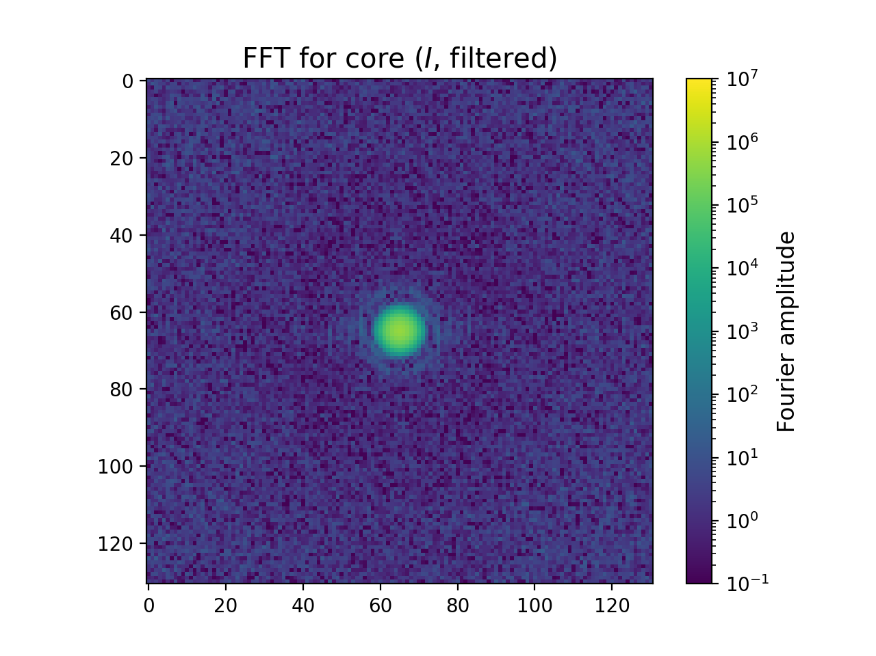
What’s new: core
Original
Filtered
Ratio
Remainder structure from Serpens field
Flux losses similar to filament+clumps case
(though slightly better)

Slide 6
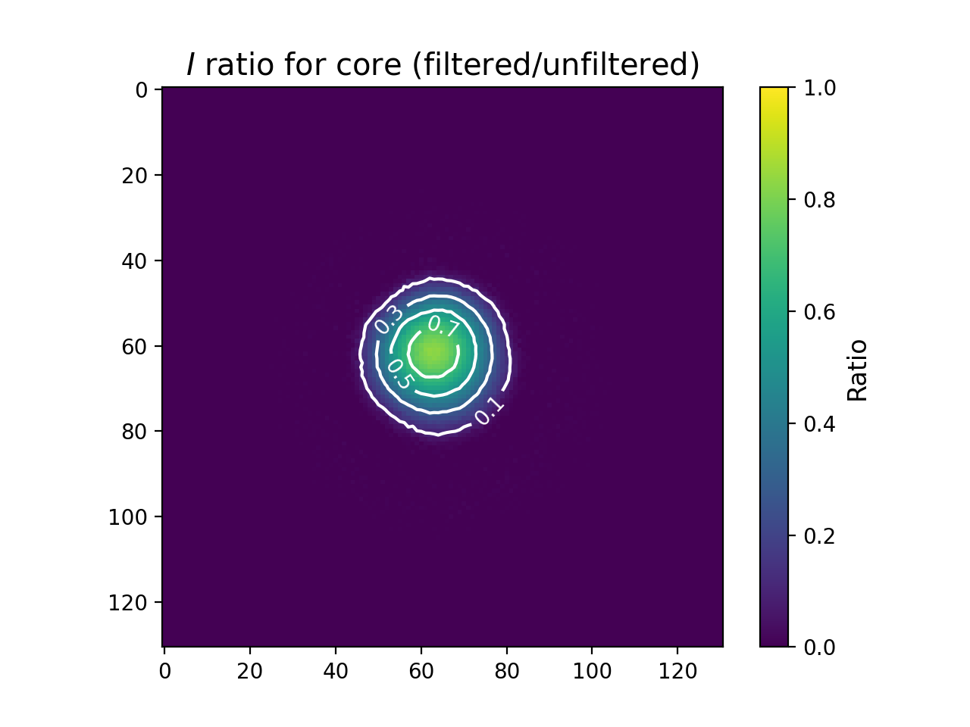
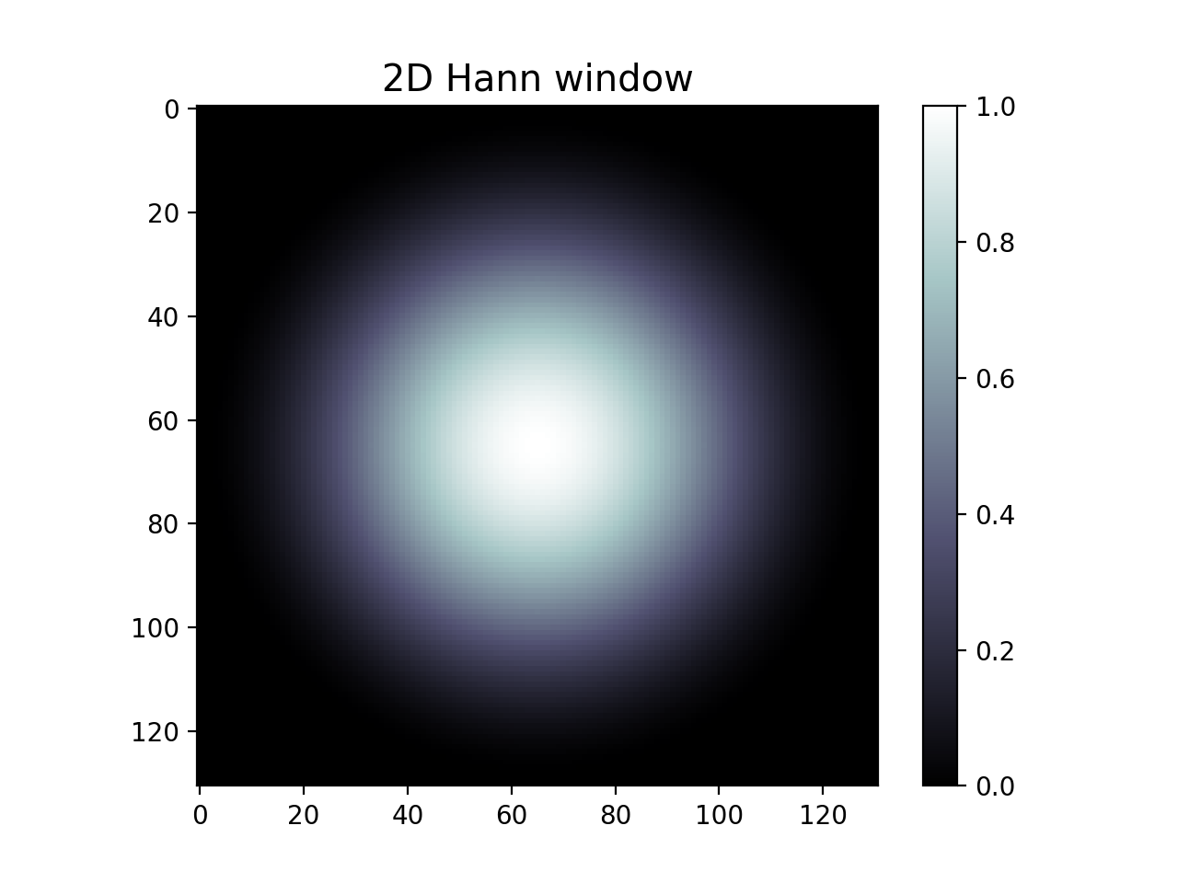

Hann window function
core

Slide 7
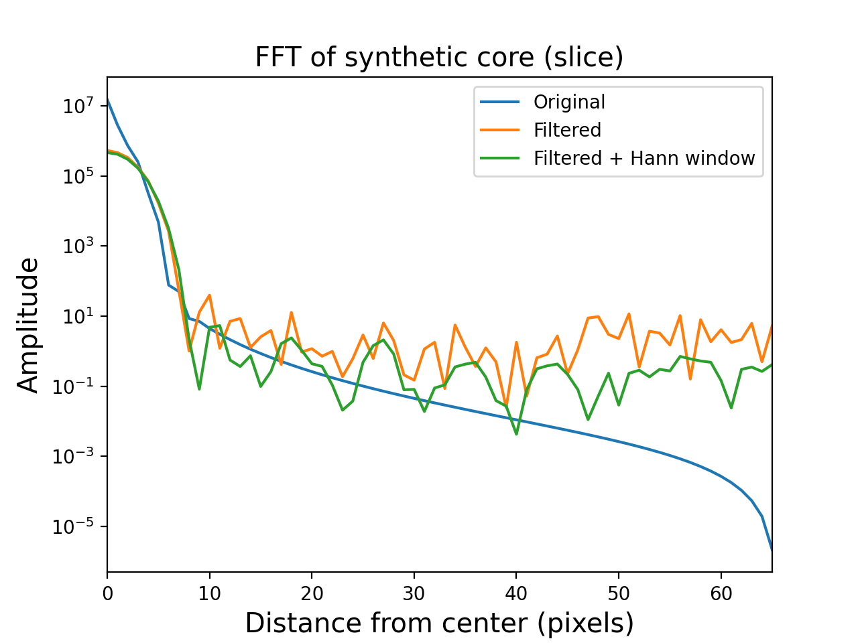
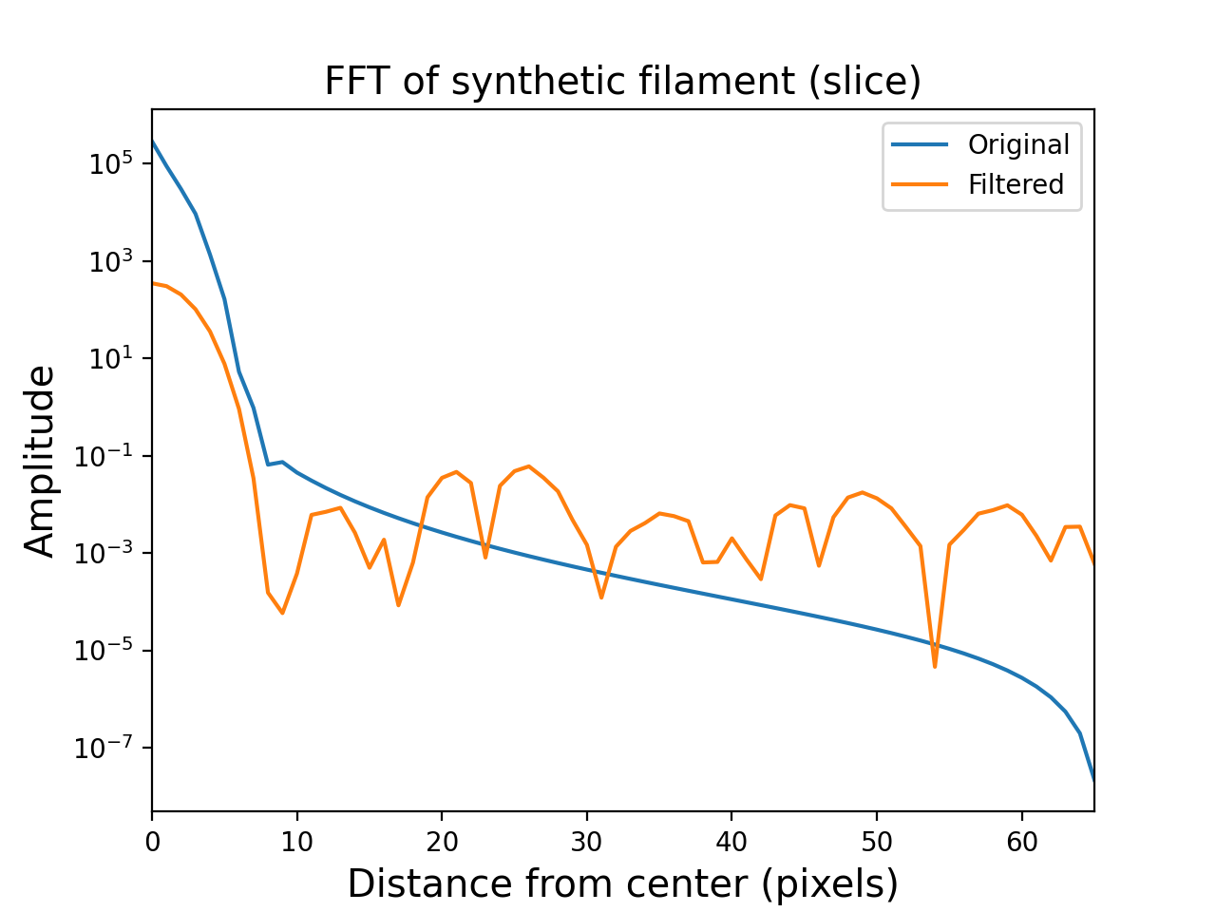
Radial distribution of FFT (slice)

Slide 8
Radial distribution of FFT (slice)
Loss of power at center (large scales)
Spread to smaller scales?

