Slide 1
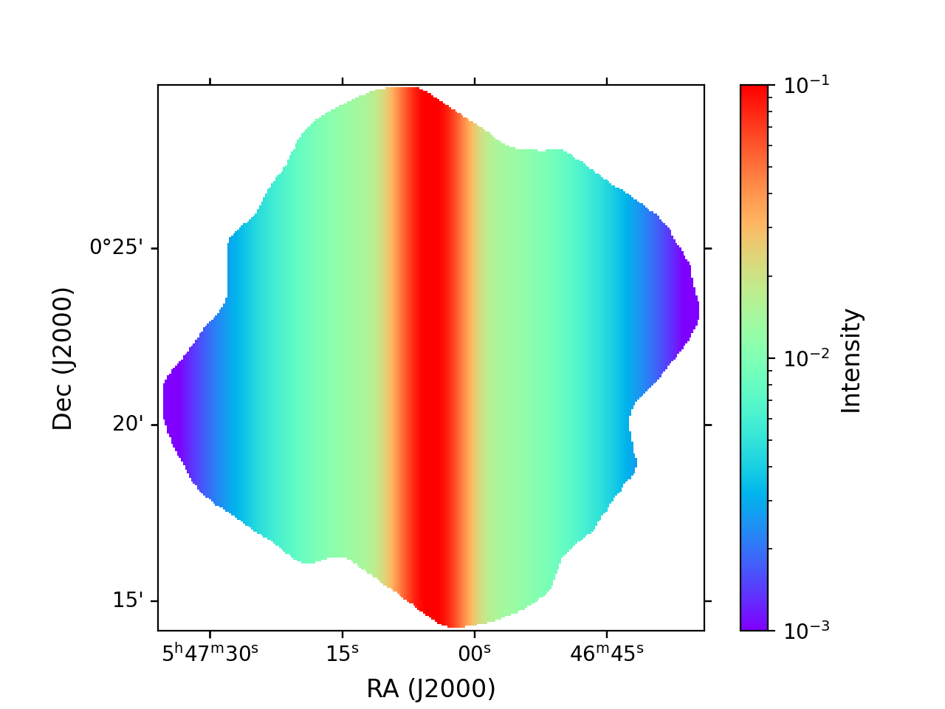
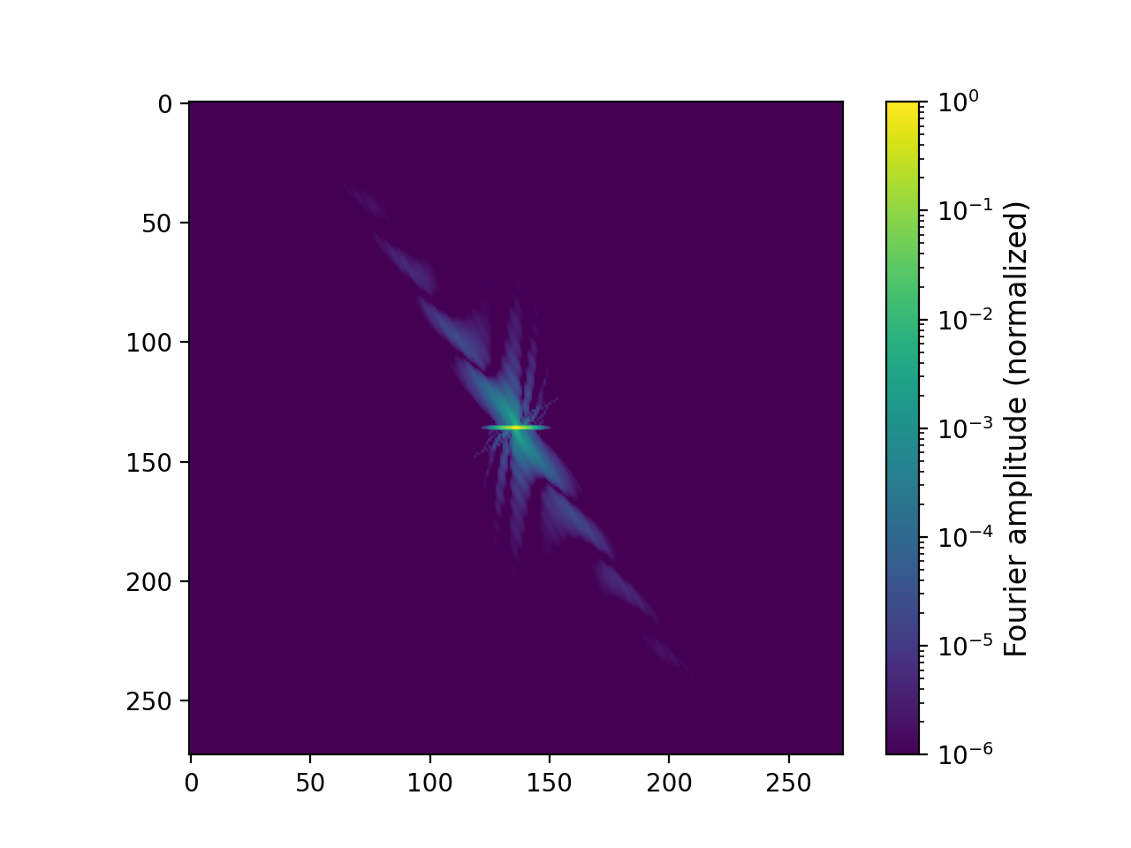
FFT of synthetic filament (I map)
Intensity map (synthetic filament)
FFT amplitudes
(shifted so low spatial frequencies are in center)
NOTA: NaNs in original map set to zero so I can use np.fft

Slide 2
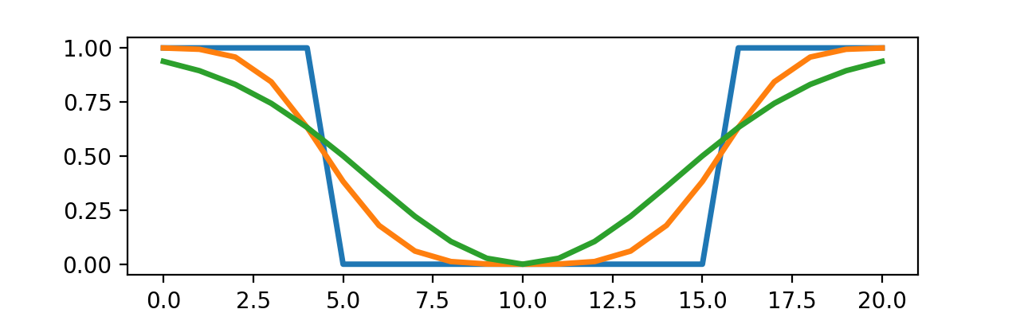
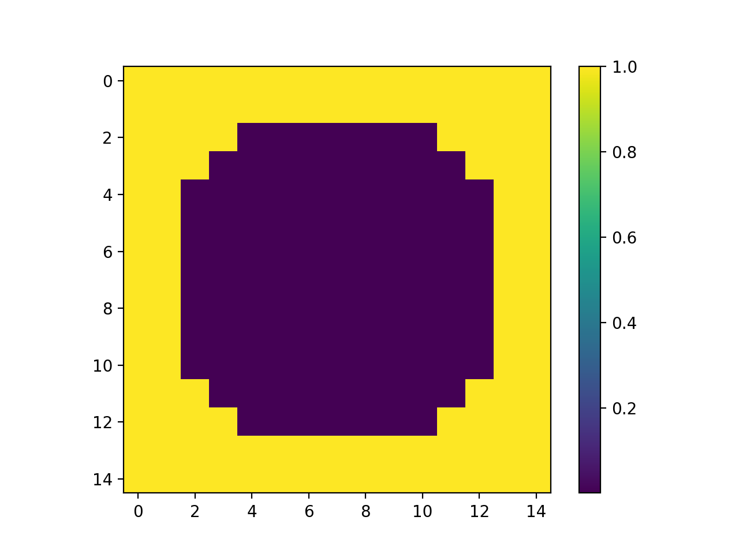
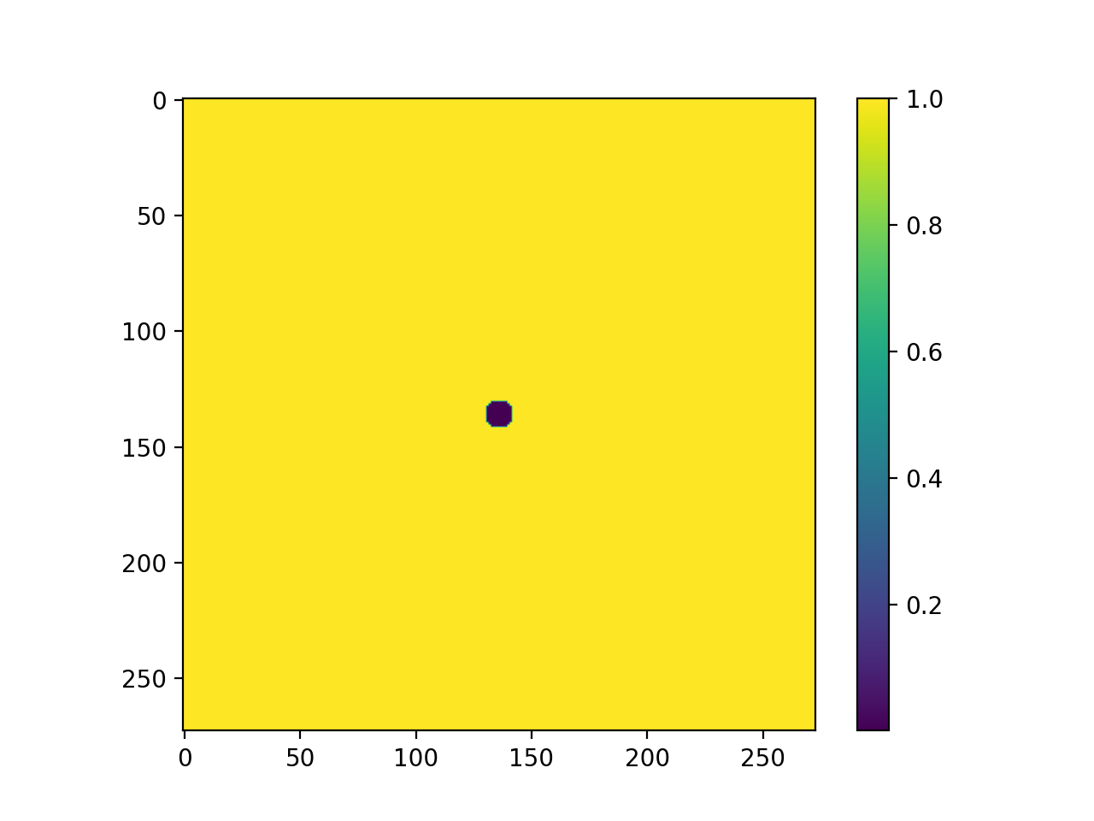
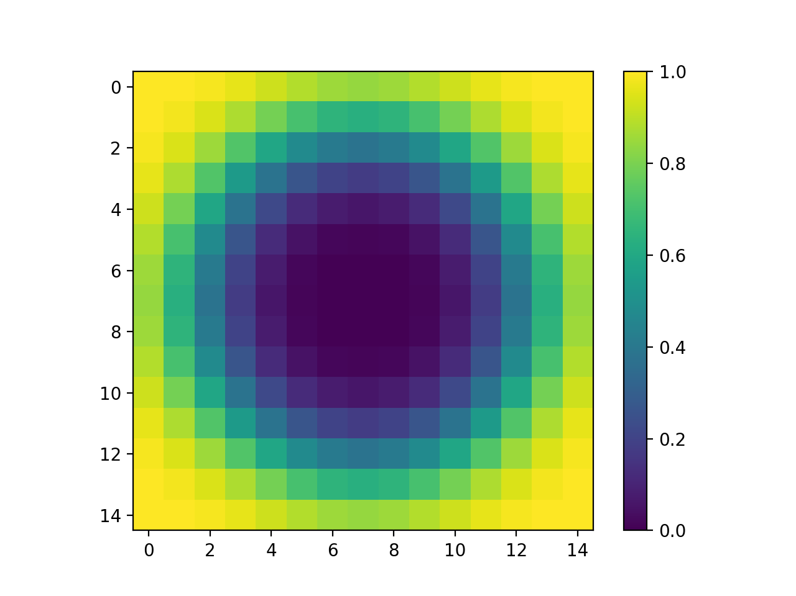
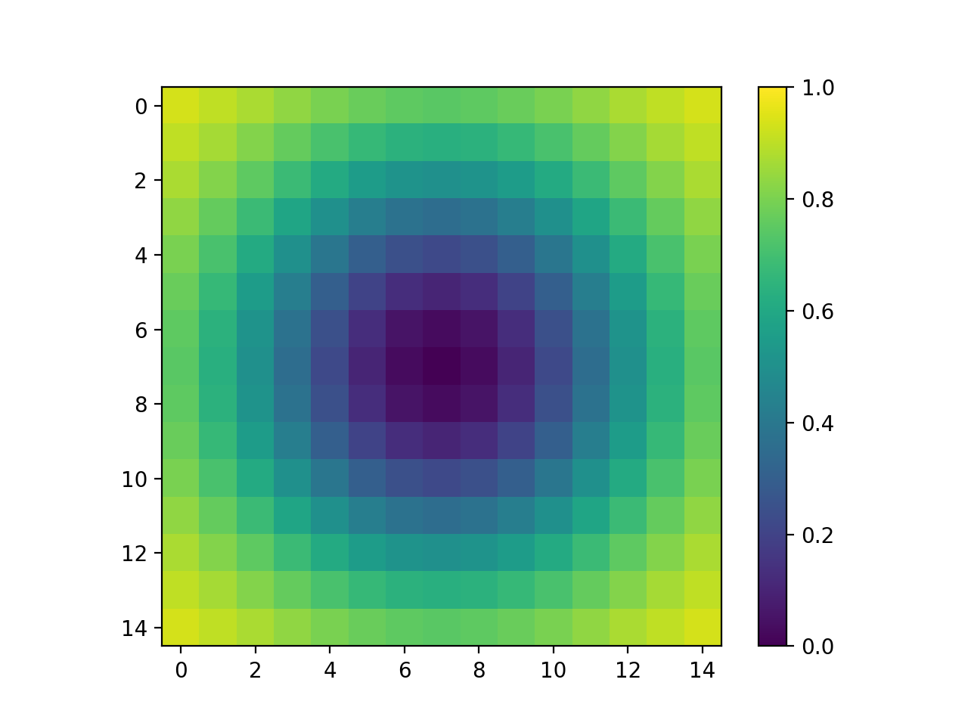
Low-spatial-frequency filter
3 versions of different “hardness”: Boxcar
“Quartic” (1 – e^{– x^4})
Gaussian

Slide 3
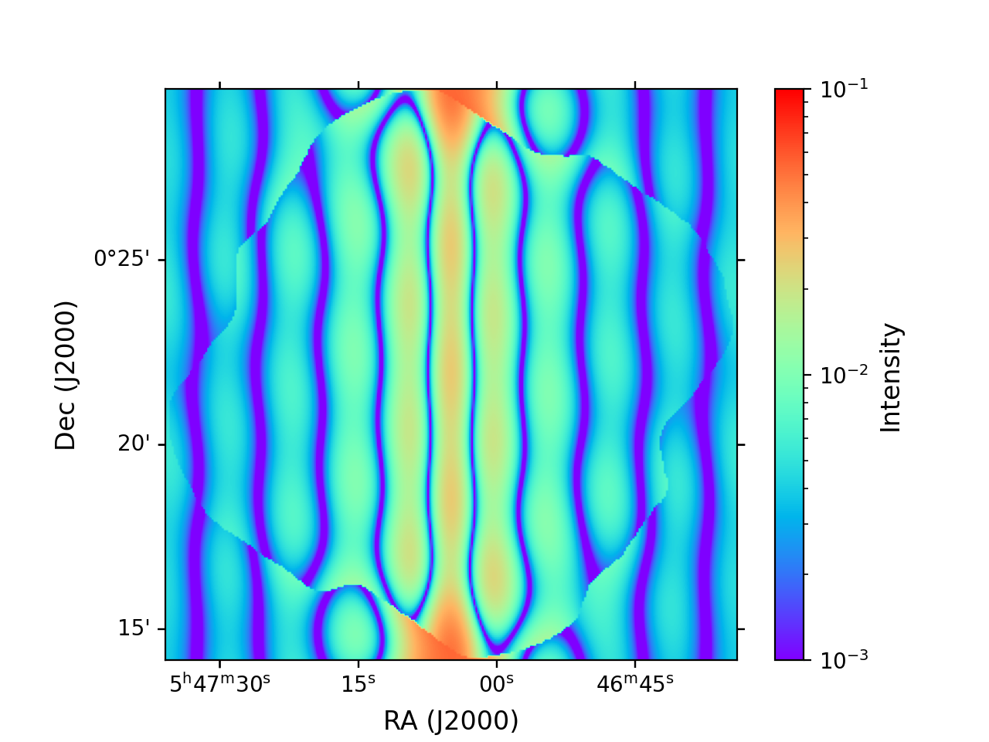
Filament, boxcar filter
Original
Filtered

Slide 4
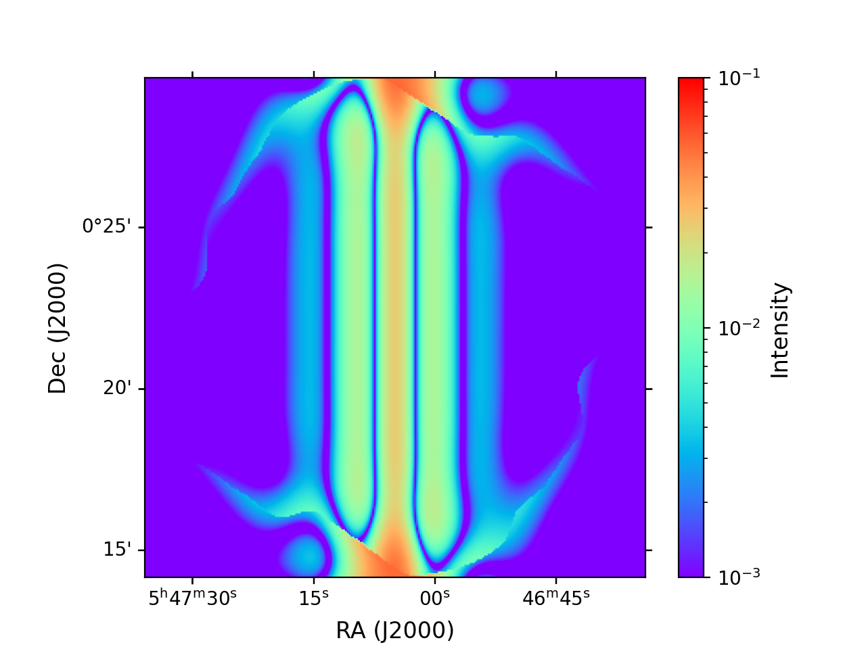
Filament, “quartic” filter
Original
Filtered

Slide 5
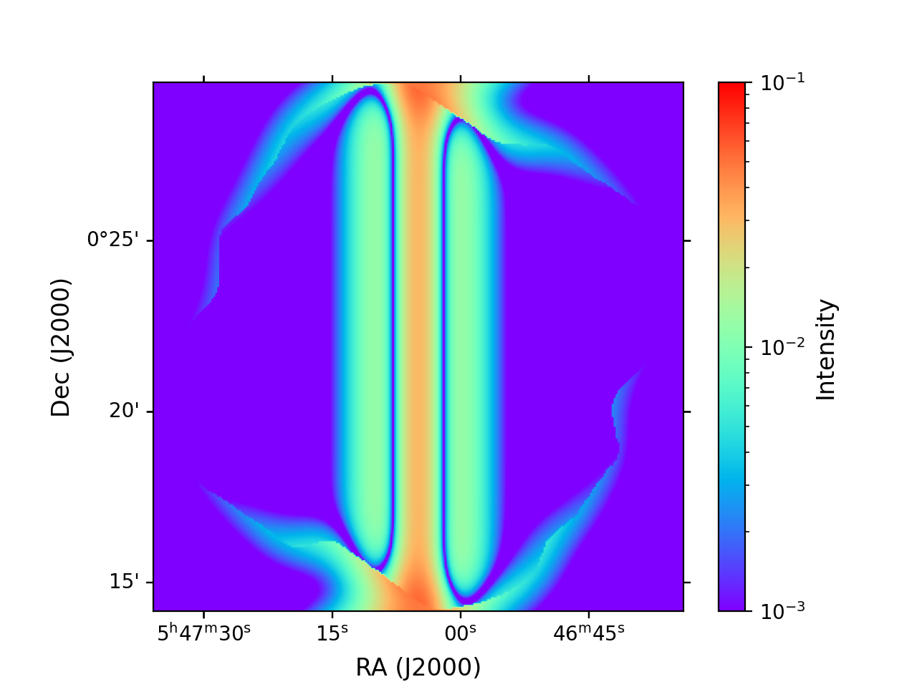
Filament, Gaussian filter
Original
Filtered

