Slide 1
Loss of large scales in SCUBA-2/POL-2: tests on synthetic maps and Fourier transforms
Lapo Fanciullo, Kate Pattle, Janik Karoly
Bistro DR Meeting, Oct 26 2023

Slide 2
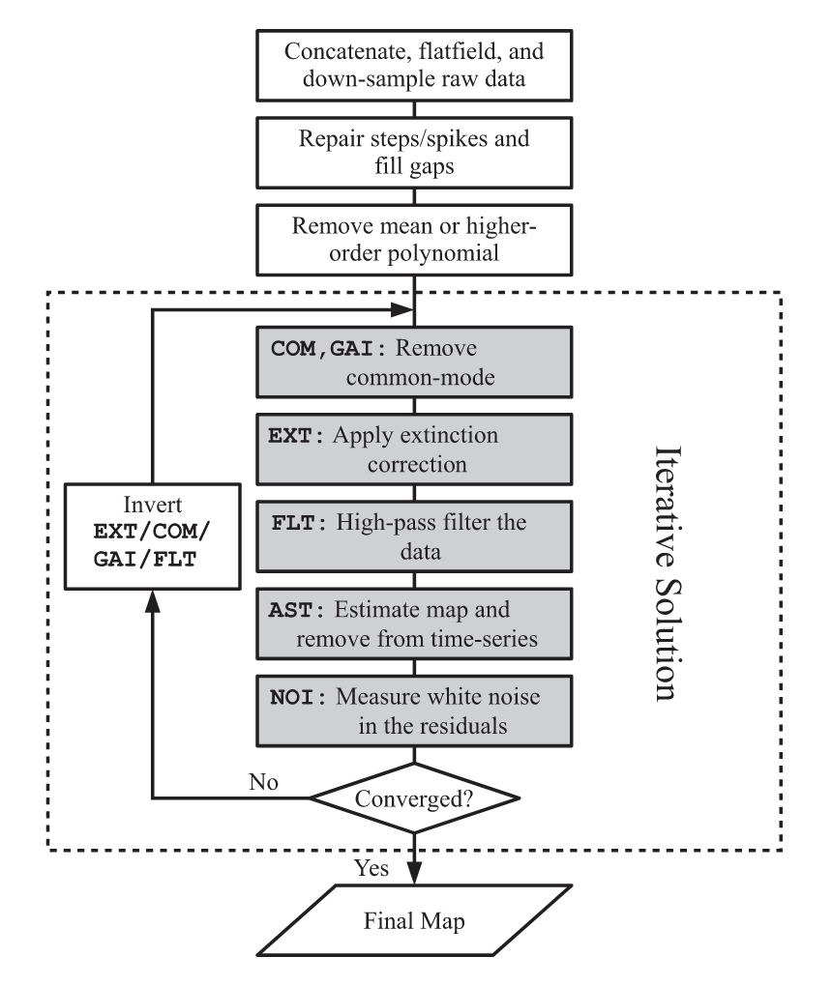
Driving question
How can we quantify the effect of large-scale filtering in the POL-2 pipeline?
i.e. “Where and how much does flux loss in POL-2 affect the BISTRO/HAWC+ comparison?”
Filter HAWC+ maps using POL-2 pipeline to see where flux is lost on those maps
Add (downscaled) HAWC+ map to POL-2
Process that through the pipeline
Separate the two maps again
Testing process on synthetic maps
Chapin et al. 2013

Slide 3
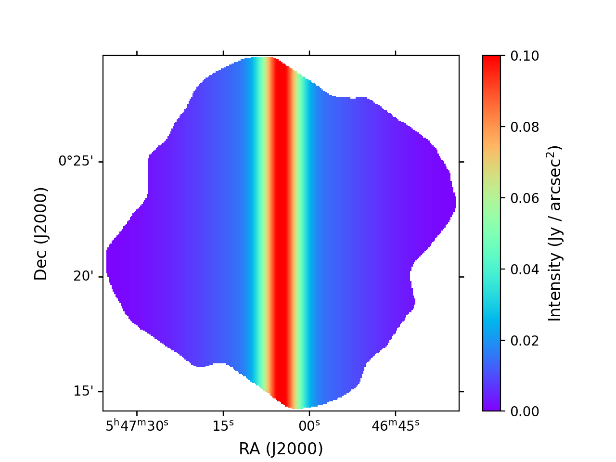
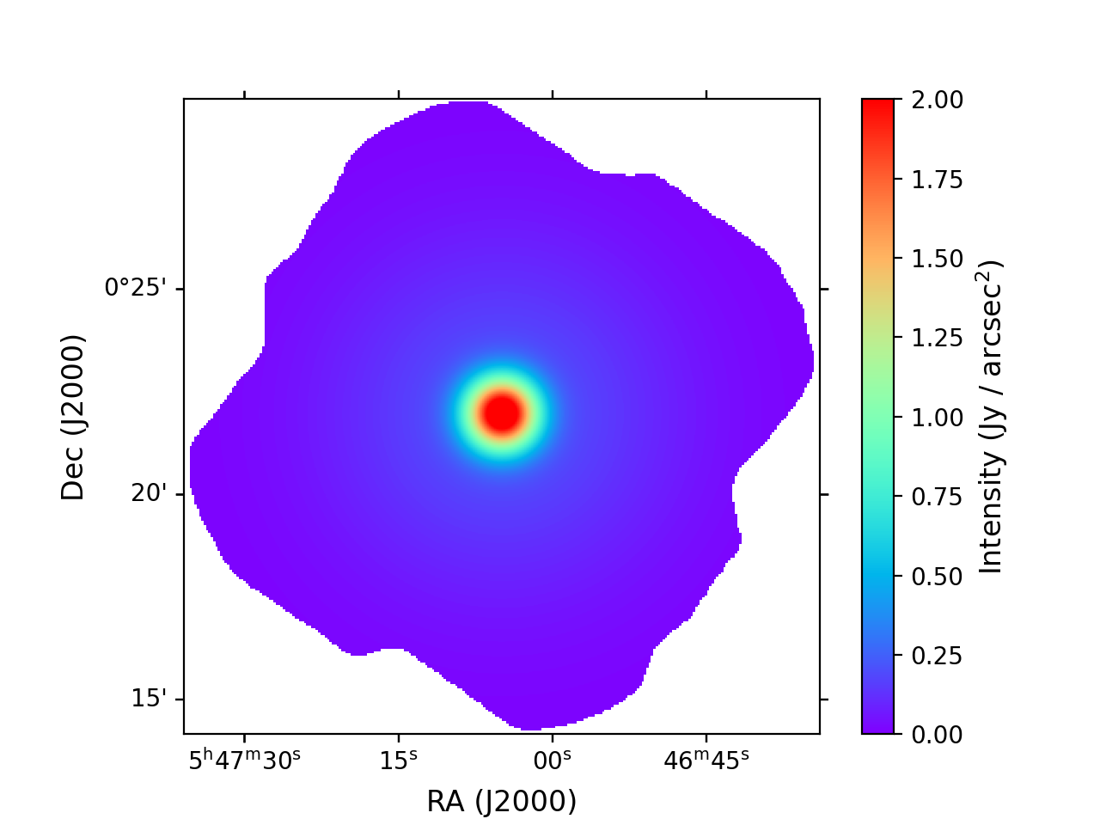
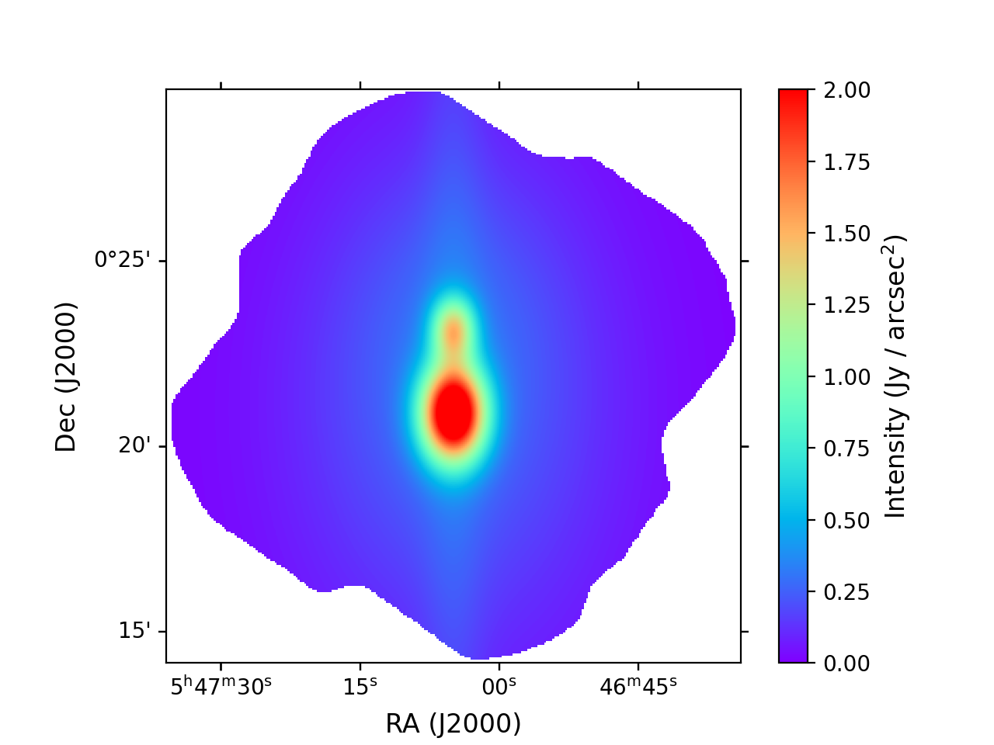
Synthetic maps
Filament
Core
Filament + Cores
Peak intensity ~ 0.1 – 1 Jy / arcsec² (filament/cores at 154 μm)
I, Q, U maps (shown: I)
Before/after comparison, Fourier transform

Slide 4
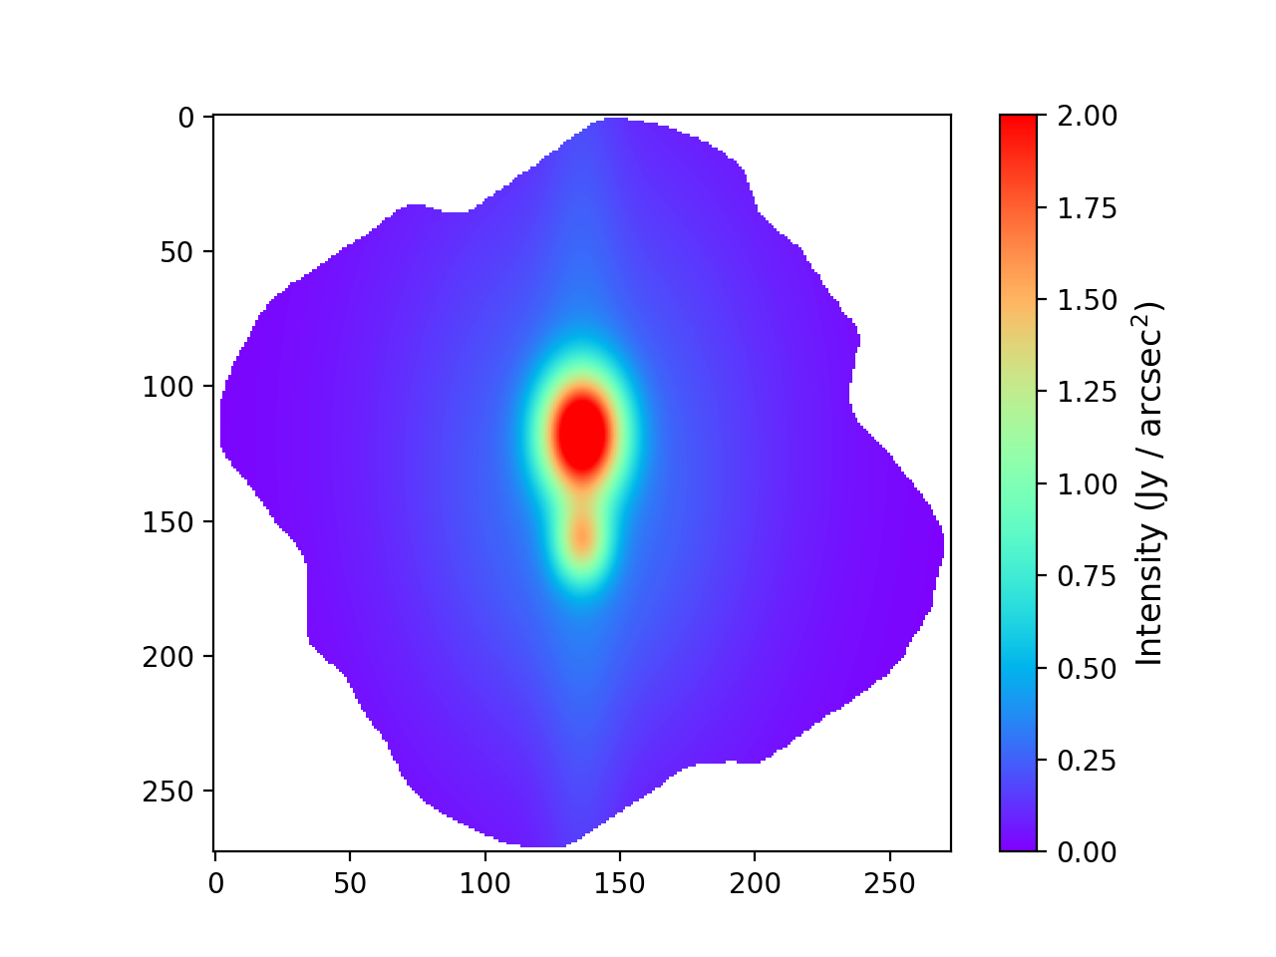
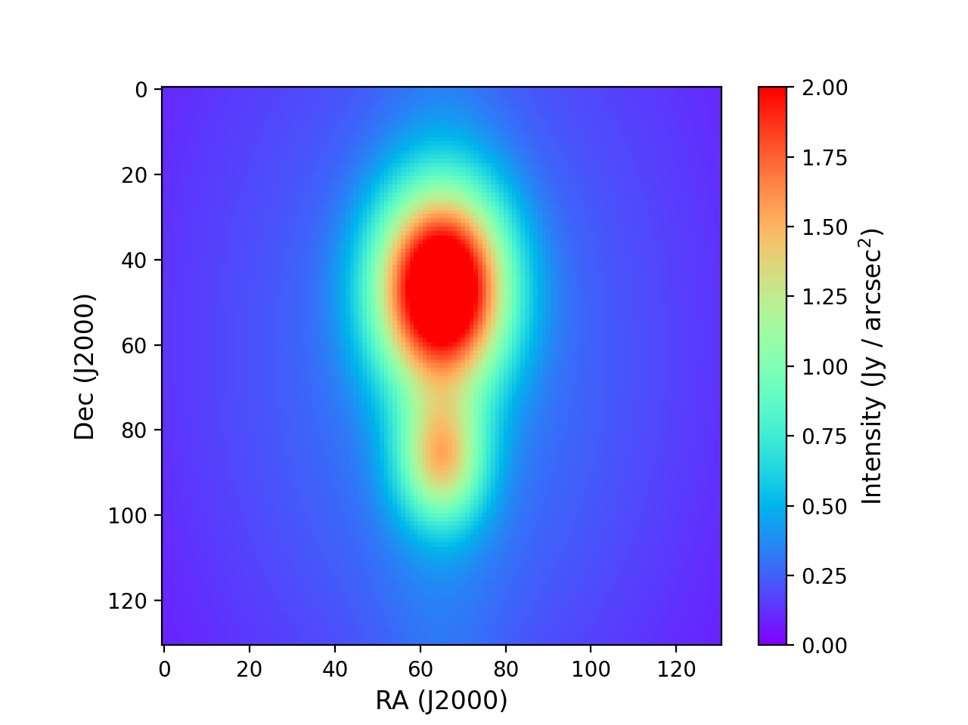
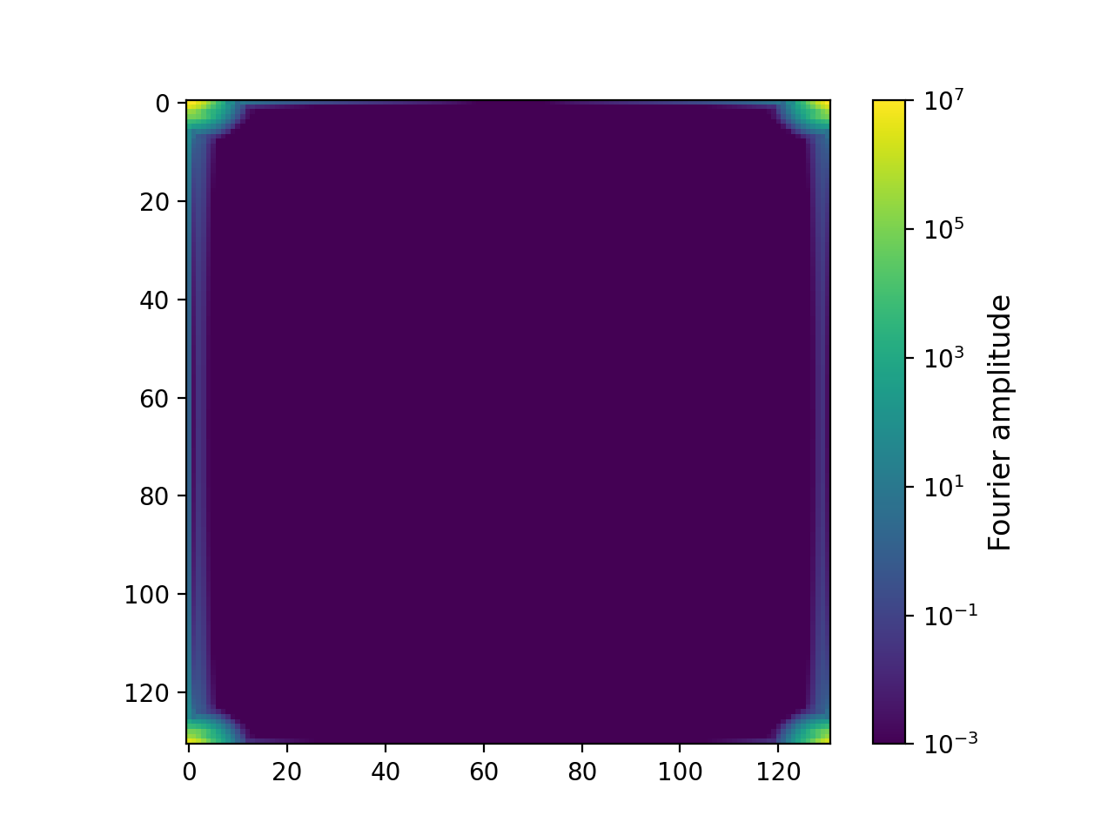
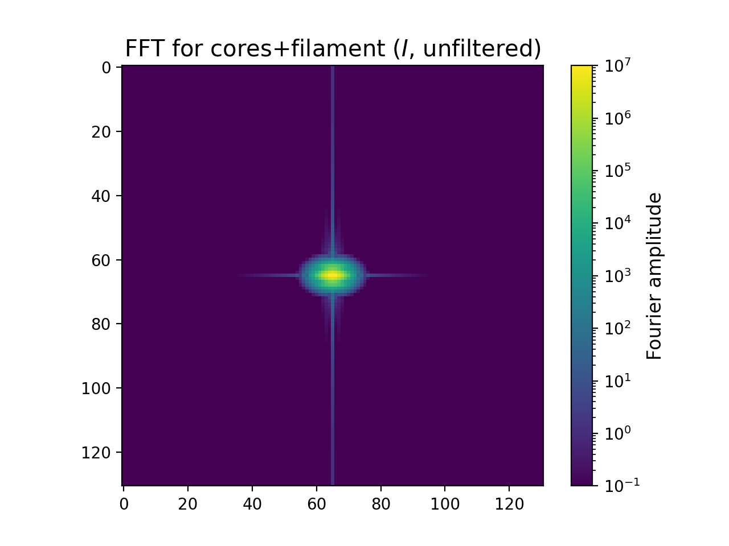
Fourier transform: procedure
Original (~ 270 x 270 pixels)
Cropped (131 x 131)
(to avoid issues with irregular map edge)
FFT
Shift
Low spatial frequencies are now at the center

Slide 5
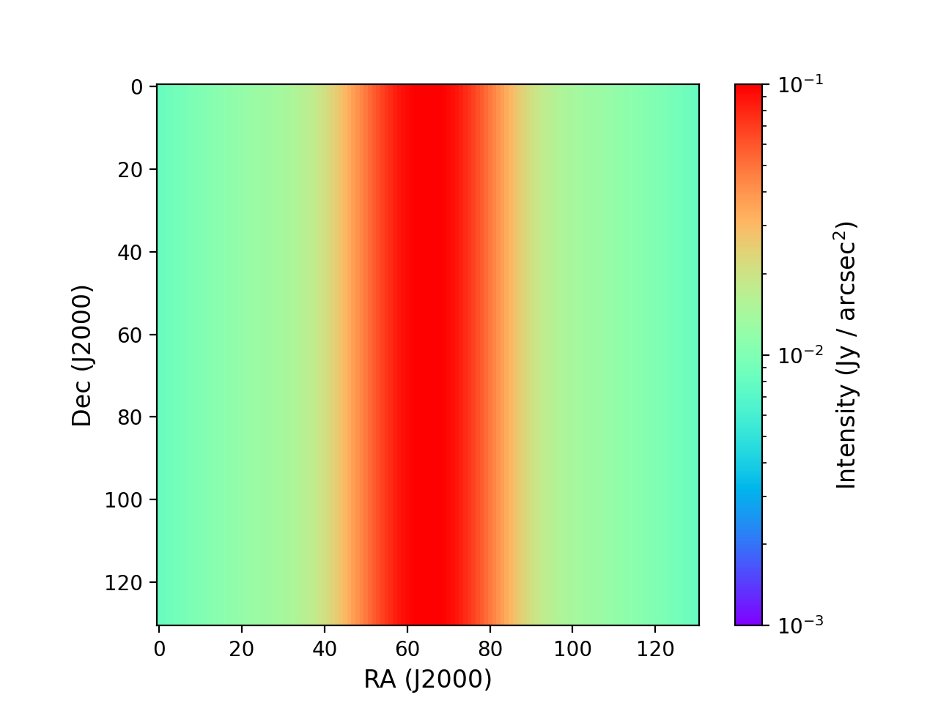
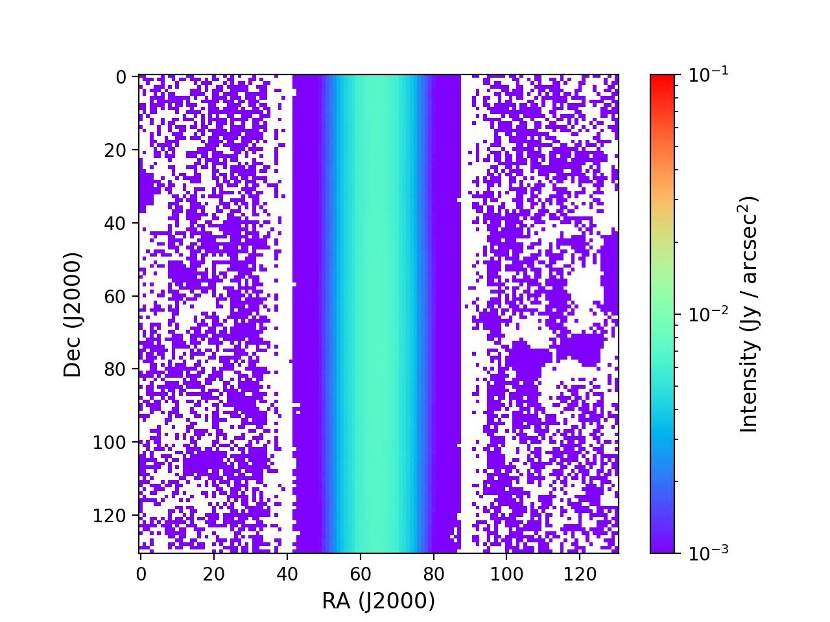
Filament: filtering (logscale)

Slide 6
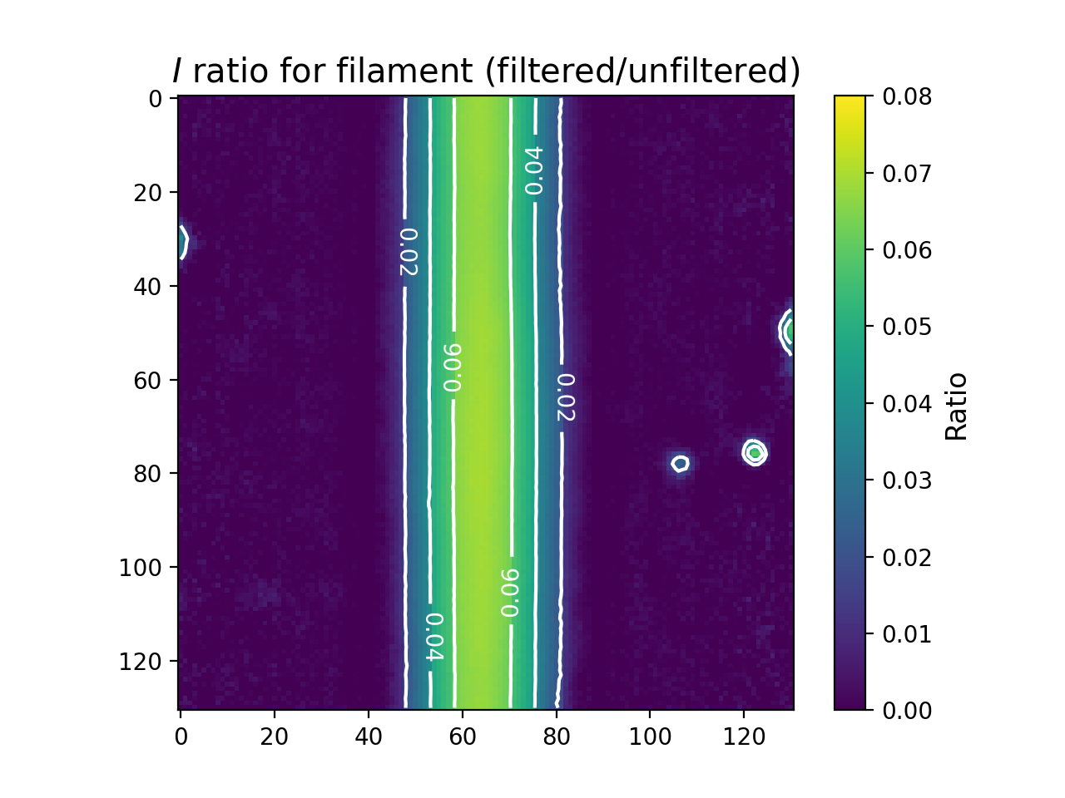
Filament: filtering (ratio)
Flux loss > 90 %
Features: emission in “empty” map?

Slide 7
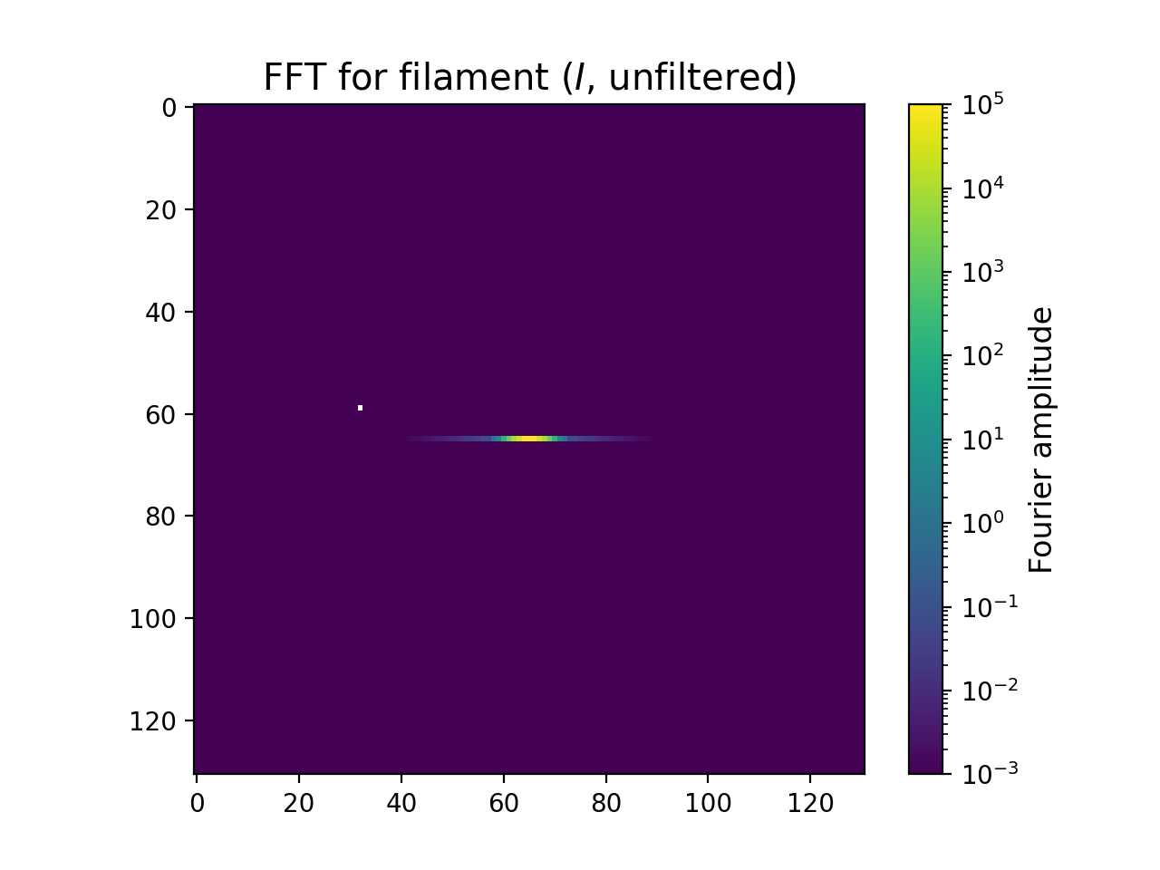
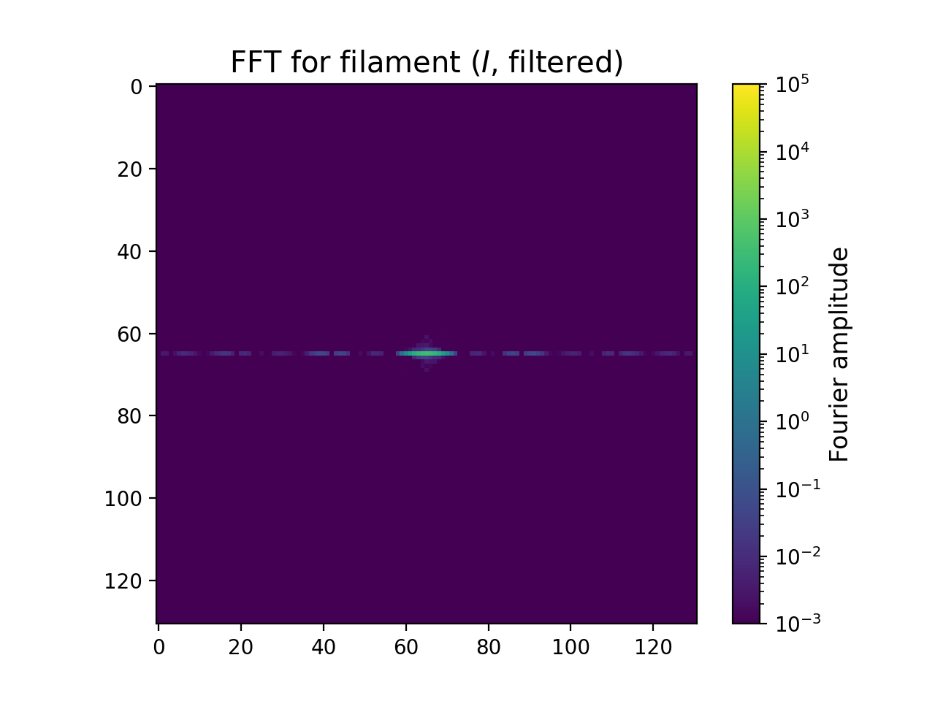
Filament: Fourier transform
Vertical structure in real space → horizontal structure in FFT
Loss of low spatial frequencies, gain in high spatial frequencies

Slide 8
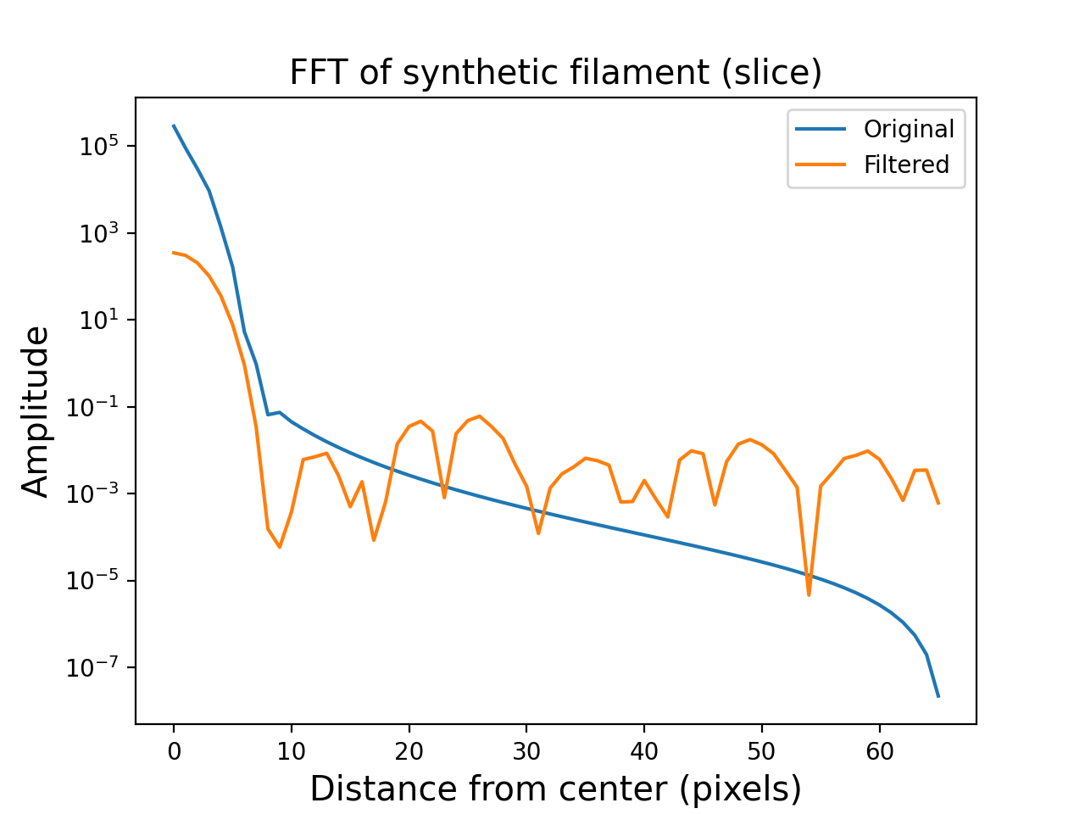
Filament: Fourier transform (1 D)

Slide 9
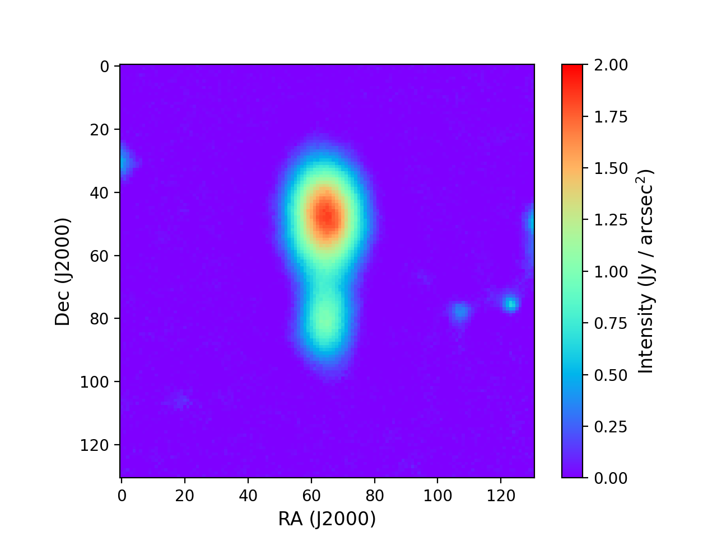
Filament + Cores: filtering

Slide 10
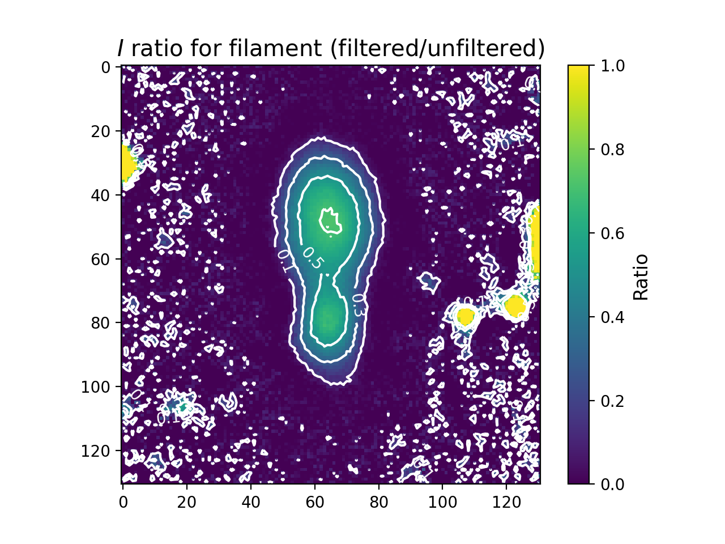
Filament + Cores: filtering (ratio)
Flux loss 30 - 70 %
Features: emission in “empty” map?
More prominent than in filament
→ effect of normalization?

Slide 11
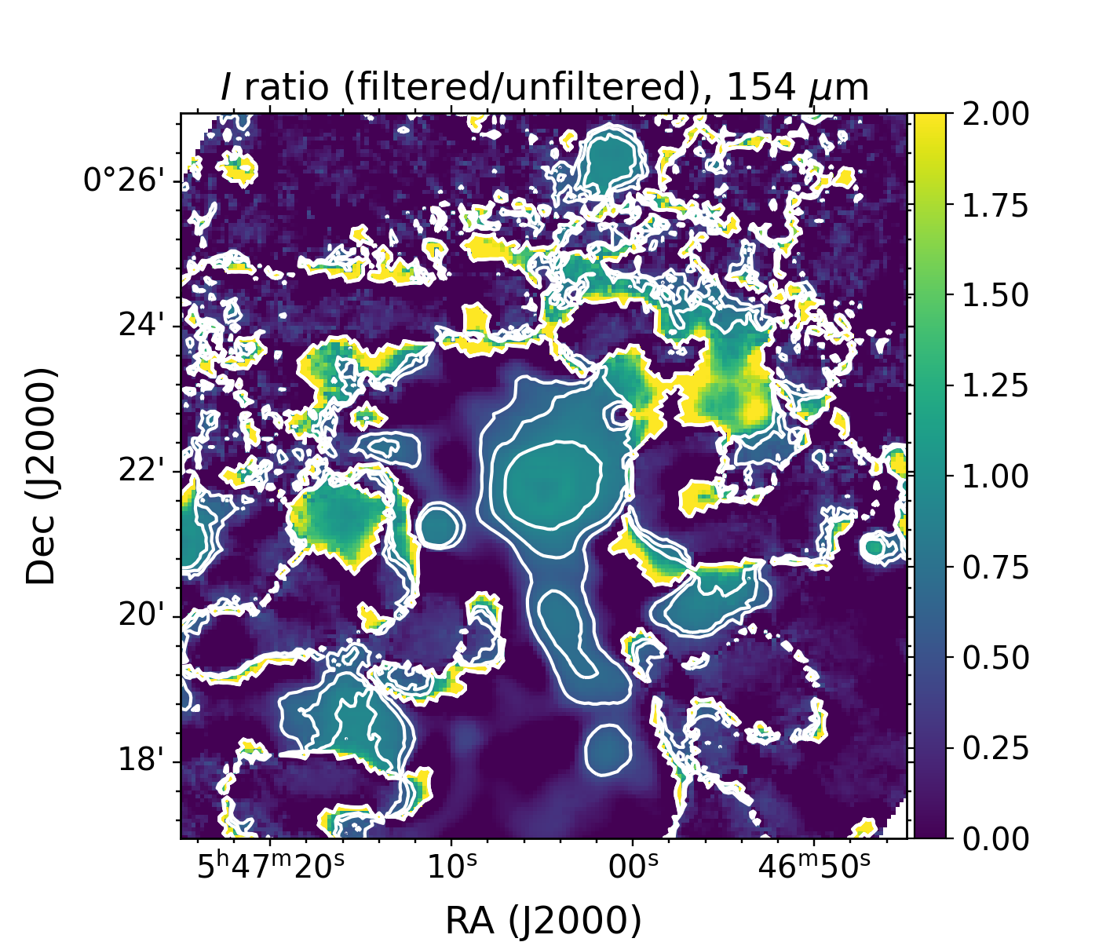
Can we expect to always lose so much flux?
N2071 filtering
(Fanciullo et al. 2022)
Preliminary filtering shown in appendix
Most flux recovered in compact region
Difference in methodology?
Extended background?
0.5
0.7
0.9

Slide 12
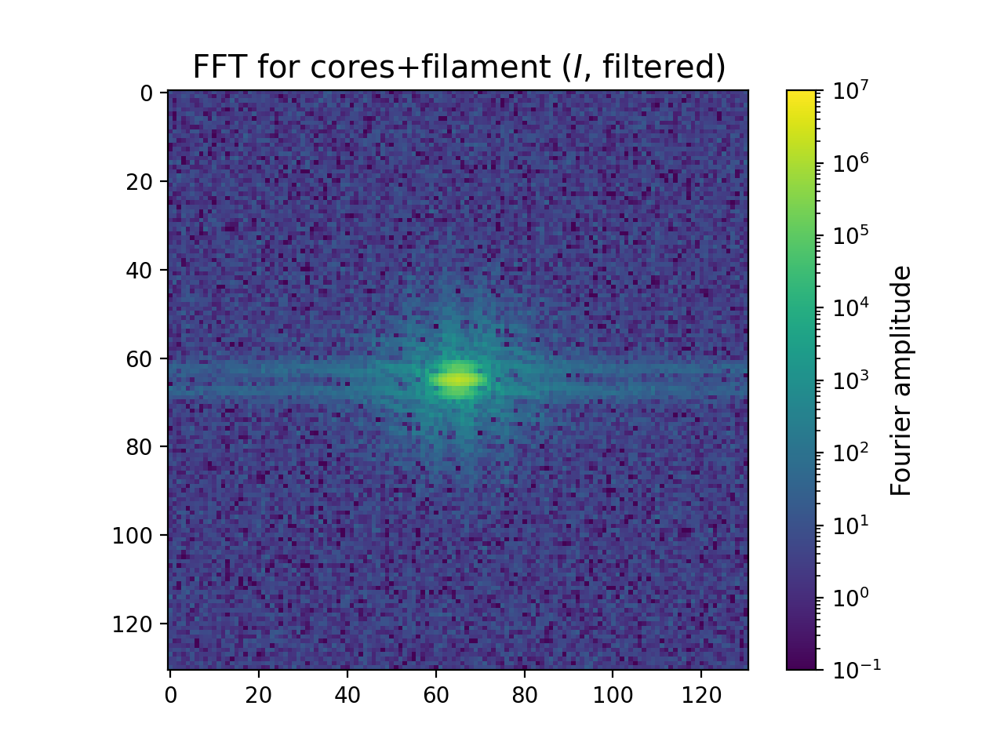
Filament + Cores: Fourier transform
Loss of low spatial frequencies, gain in high spatial frequencies
How much of it is from extraneous features?

Slide 13
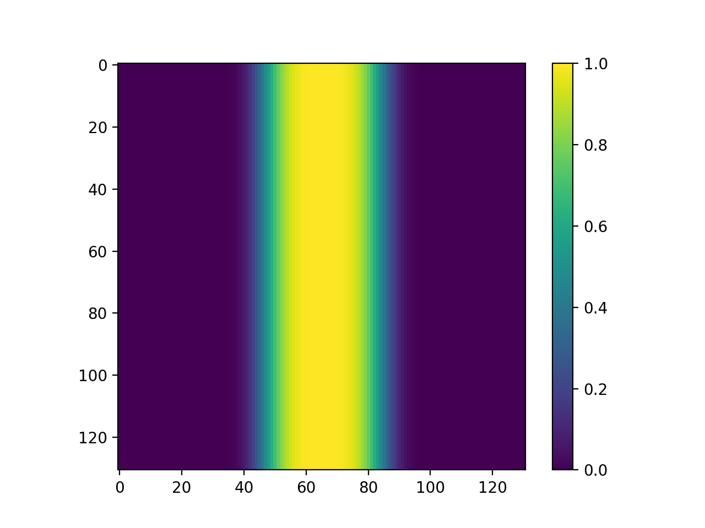
“Edge cleaning”
X

Slide 14
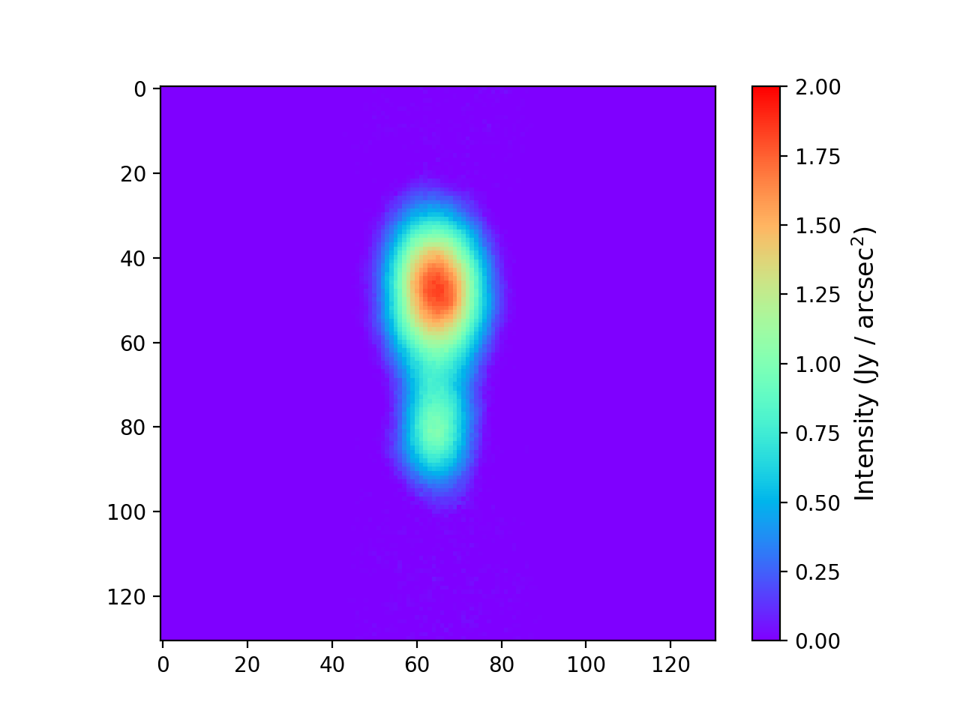
“Edge cleaning”
X
=

Slide 15
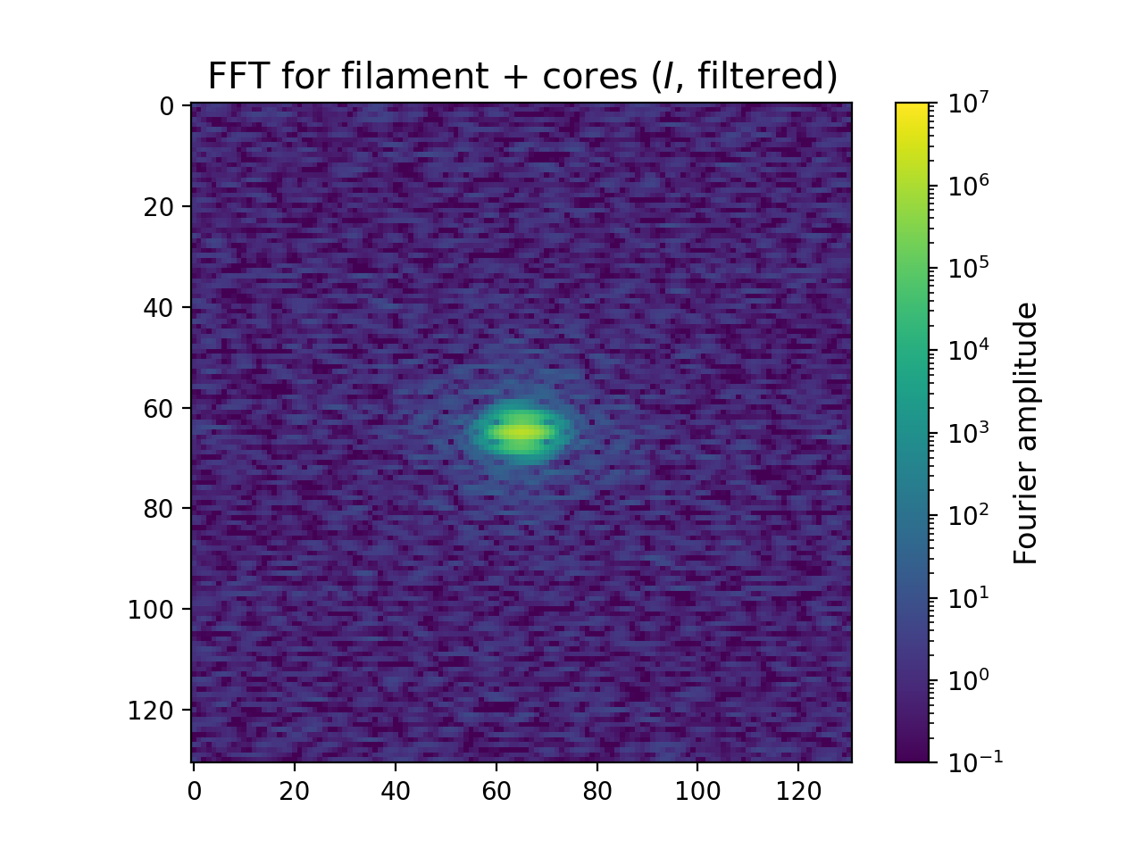
Filament + Cores: Fourier transform (edge-cleaned)
Loss of low spatial frequencies, gain in high spatial frequencies
How much of it is from extraneous features?

Slide 16
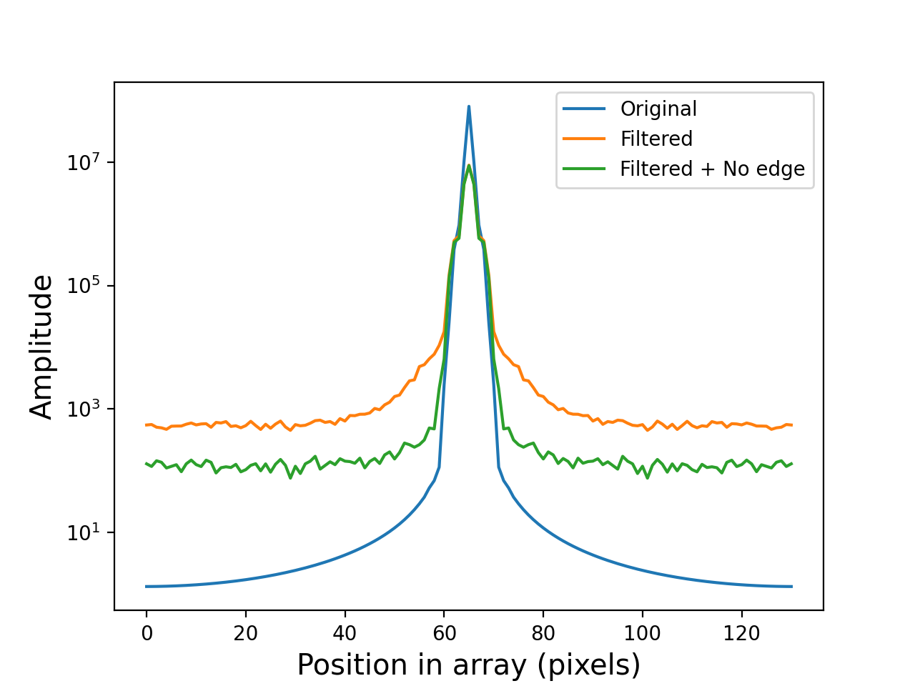
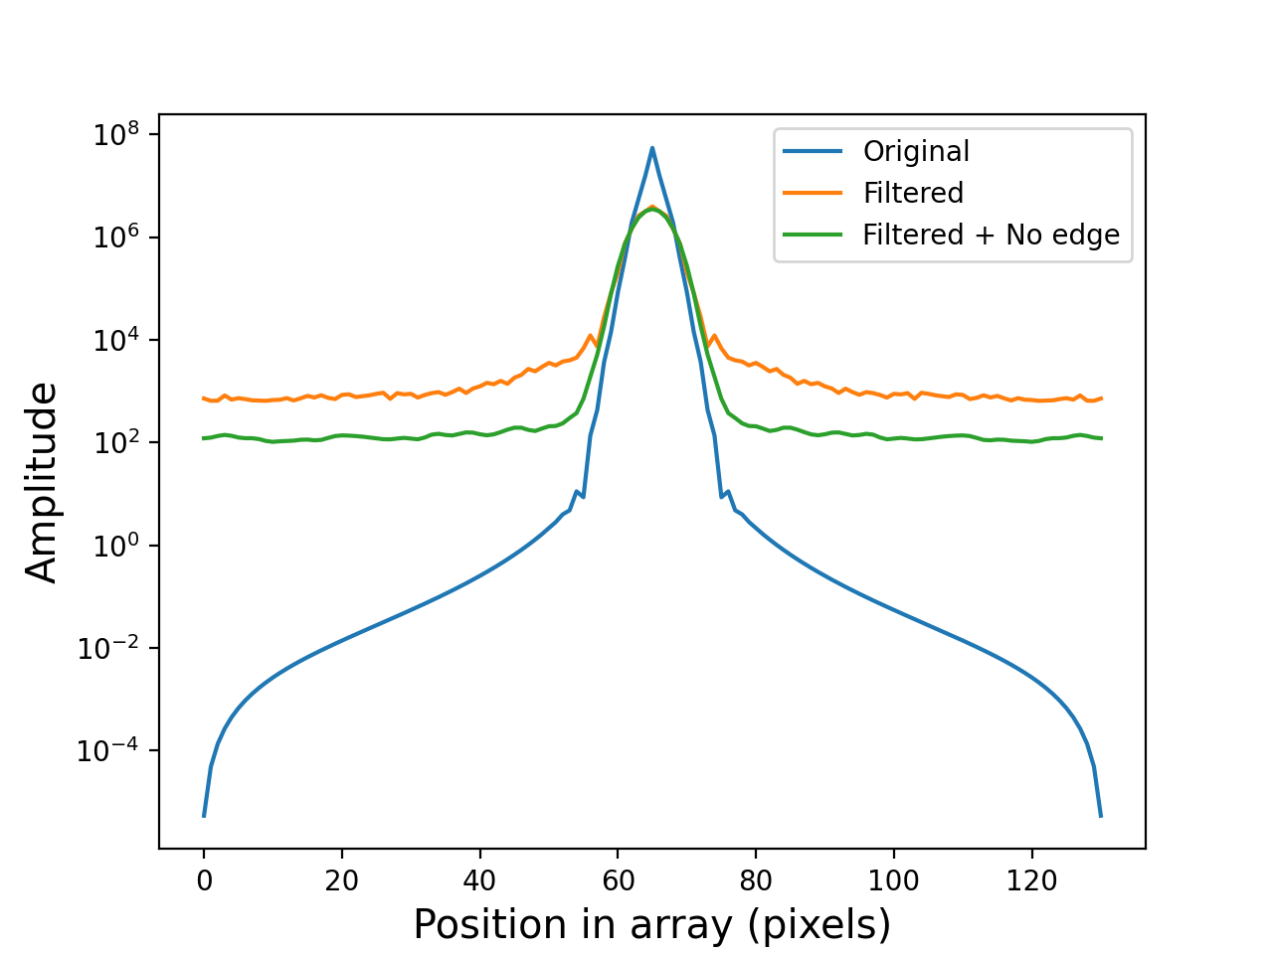
Filament + cores: Fourier transform (1 D)
Sum on X axis
Sum on Y axis

Slide 17
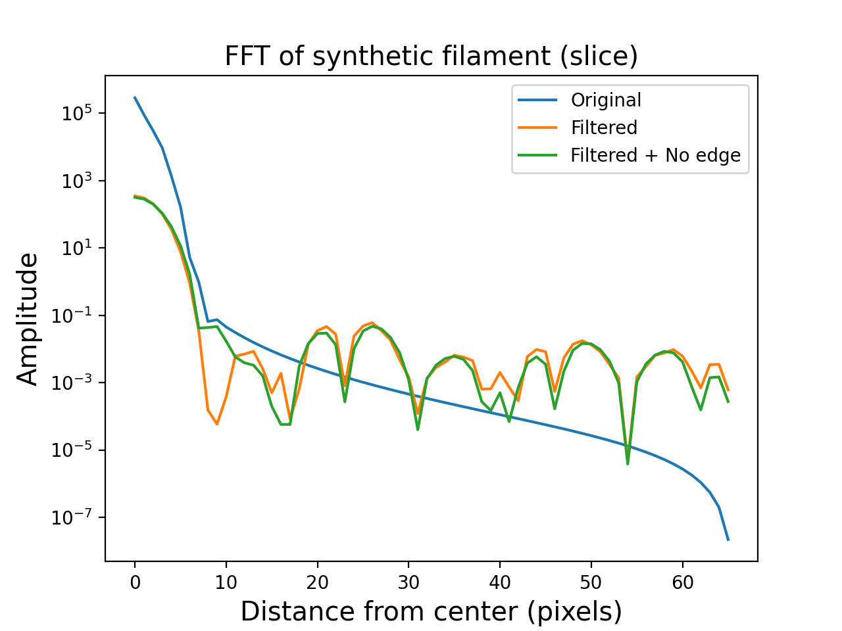
Filament: Fourier transform (1 D)

Slide 18
Conclusions and future directions
Flux loss is significant and strongly dependent on the structure examined, as expected
Filament + cores: significant flux loss even in compact region
How significant / worrying is this?
Effect of extended flux?
Fourier transform of unfiltered vs. filtered maps:
Not simple loss of small spatial frequencies, but “spread” of power spectrum
Noise? Prelimiary interpetation suggest it’s something more
Important to take contamination from “empty” field into account!
Significance may depend on scaling factor used

Slide 19
Additional slides

Slide 20
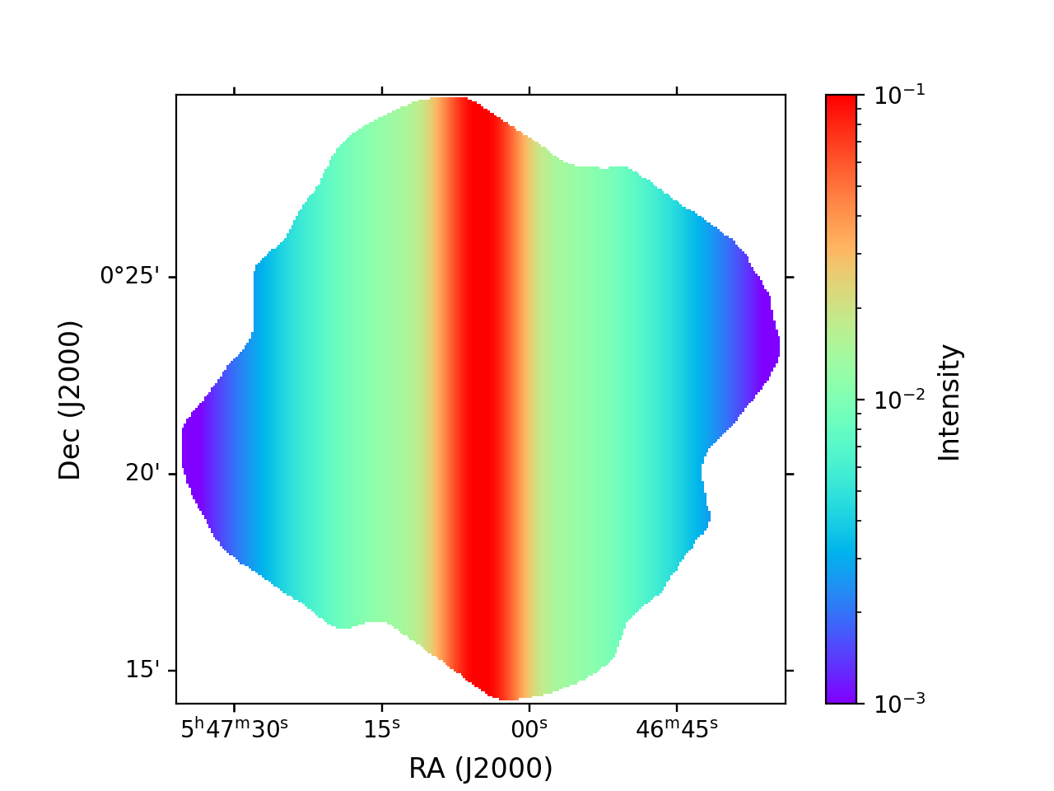
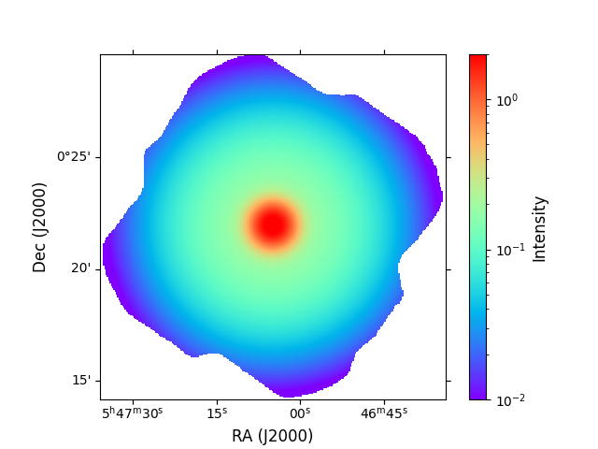
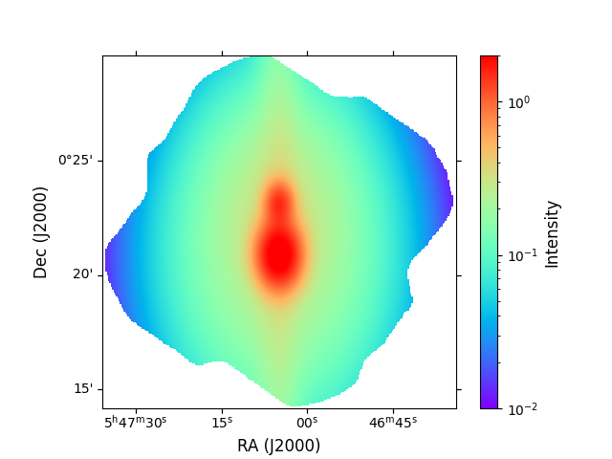
Synthetic maps (logscale)
Filament
Core
Filament + Cores
Peak intensity ~ 0.1 – 1 Jy / arcsec² (filament/cores at 154 μm)
I, Q, U maps (shown: I)
Before/after comparison, Fourier transform

Slide 21
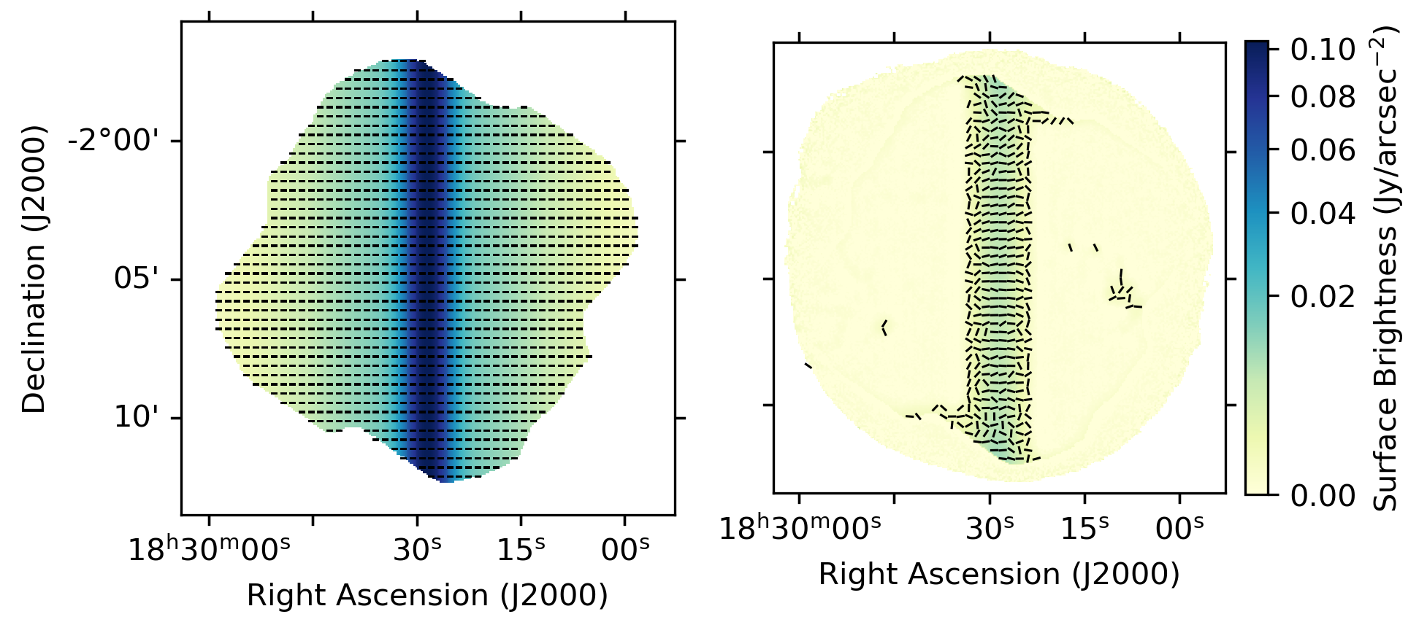
Polarization
Credit: Kate Pattle
Spurious
Vectors: magnetic field

Slide 22
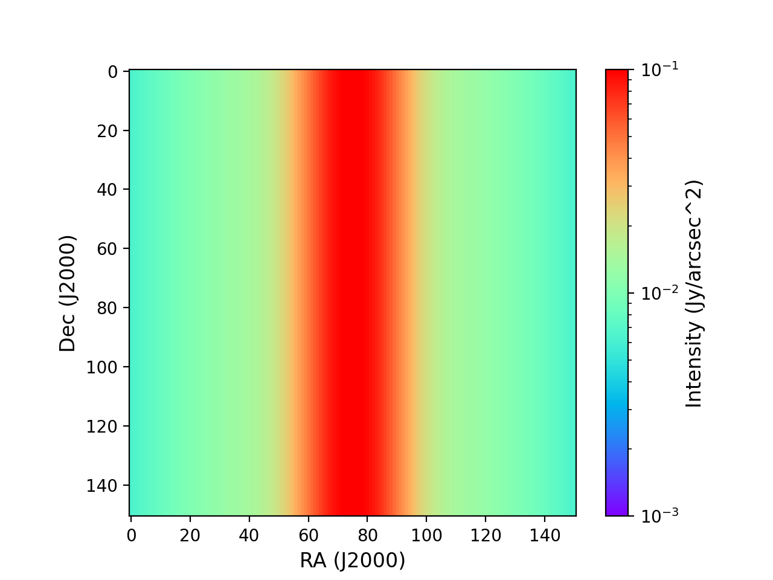
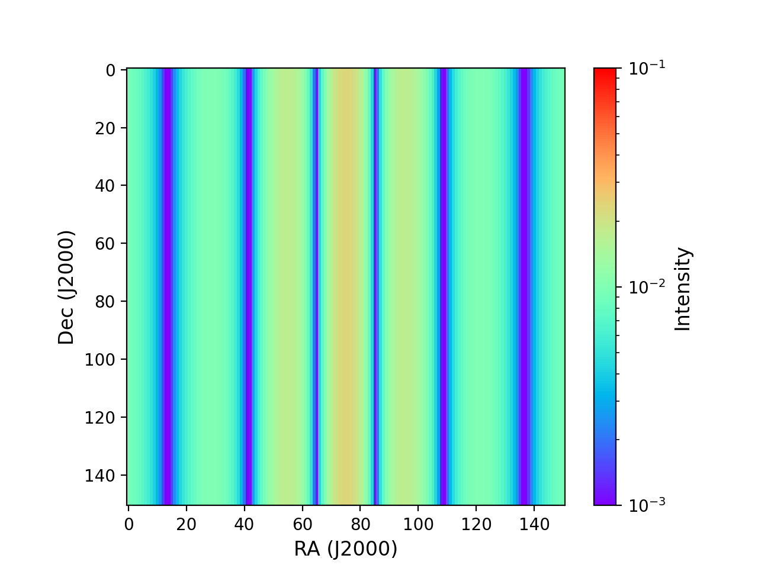
Filament Fourier transform (cont.)
Attempts to “filter” image by suppressing center of FFT image introduce spurious structure
→ Need for higher spatial frequencies
Hard (“boxcar”) filtering of central FFT image

Slide 23
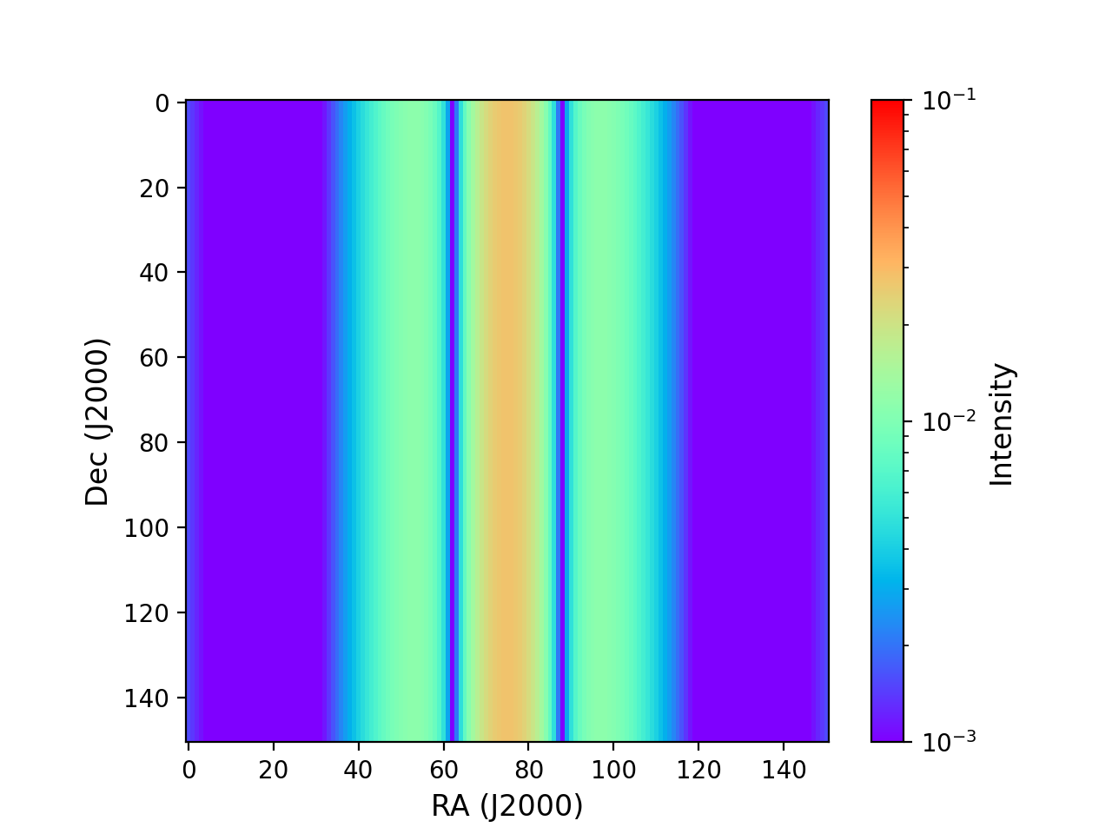
Filament Fourier transform (cont.)
Attempts to “filter” image by suppressing center of FFT image introduce spurious structure
→ Need for higher spatial frequencies
Smooth (Gaussian) filtering of central FFT image

