Slide 1
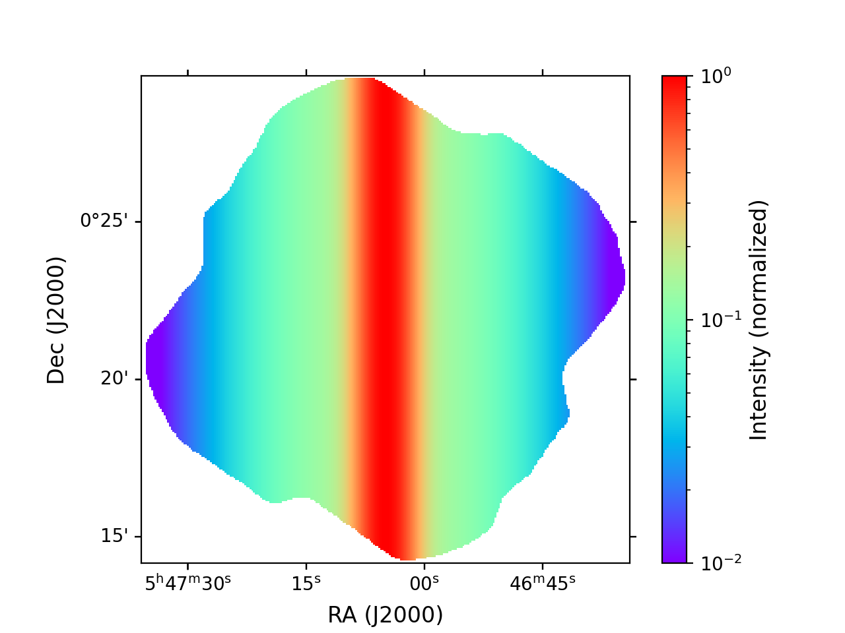
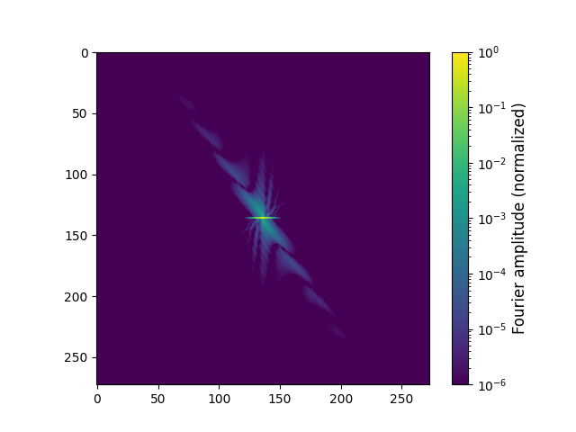
FFT of synthetic filament (I map)
Intensity map (synthetic filament)
FFT amplitudes
(shifted so low spatial frequencies are in center)

