Slide 1
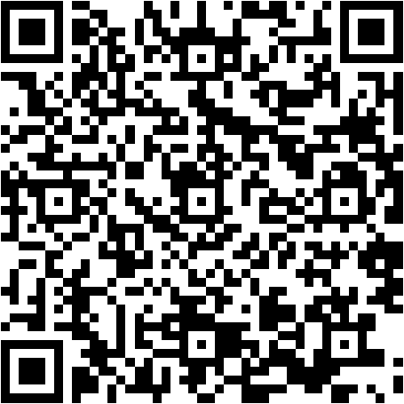
QR-Extraction using OpenCV in Python
Leonhard Feiner, Verena Röhrl

Slide 2
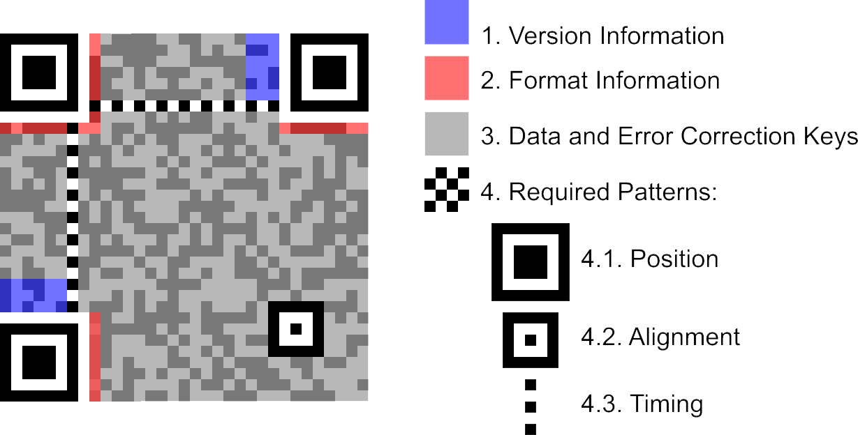
Components of QR Code
Finder Pattern
Notes:
Finder Patterns important for us!

Slide 3
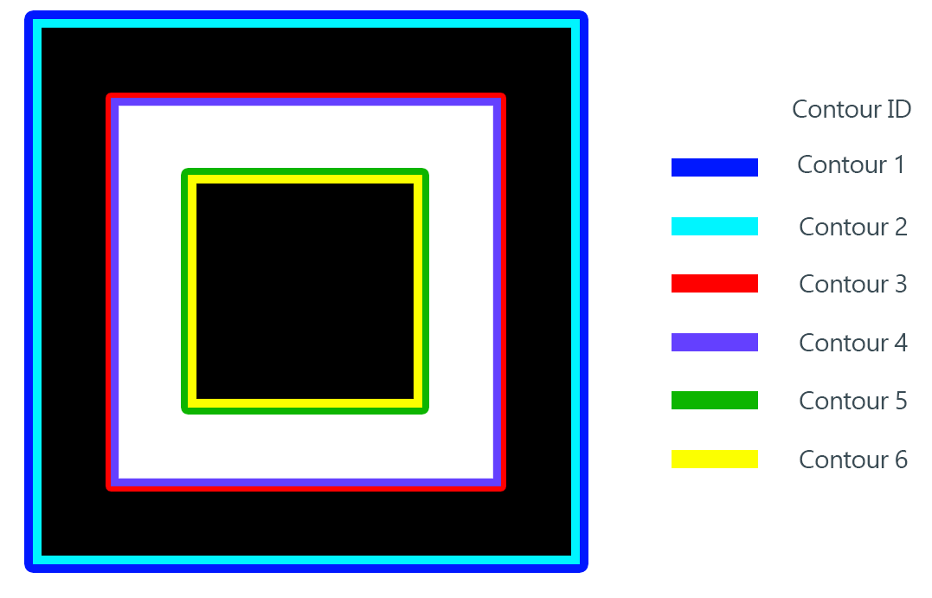
Detection of Finder Patterns
Grayscale
Canny
Contours
Finder Pattern = 5x nested Contours

Slide 4
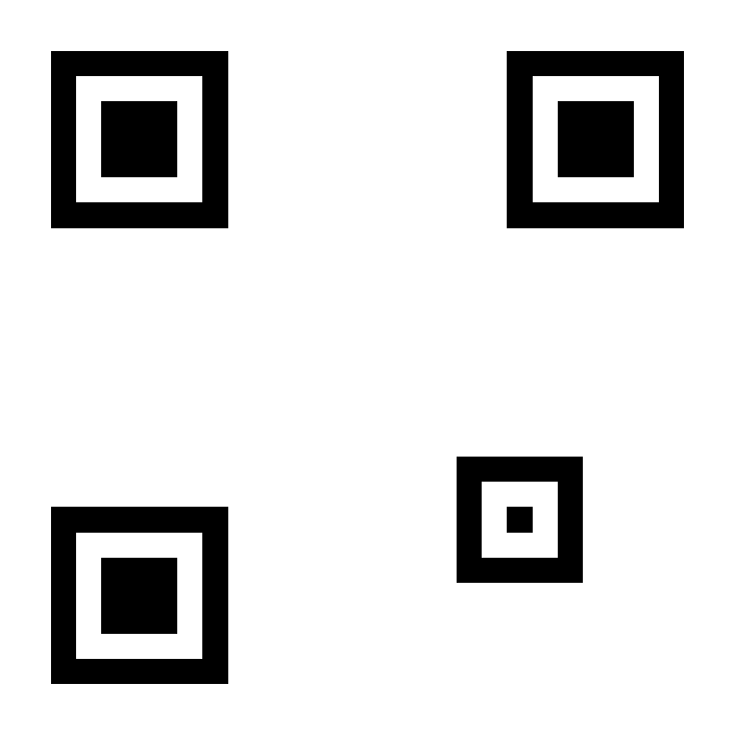
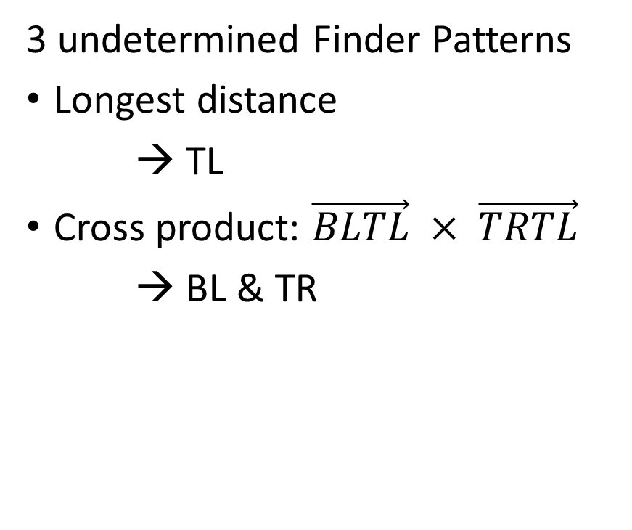
Matching of Finder Patterns
3 undetermined Finder Patterns
Longest distance
→ TL
Cross product: $\vec{BLTL} × \vec{TRTL}$
→ BL & TR
TR
TL
BL

Slide 5
Determining corners of Finder Patterns
Many contour points
Separate in 4 parts
Take each point with biggest distance to center

Slide 6
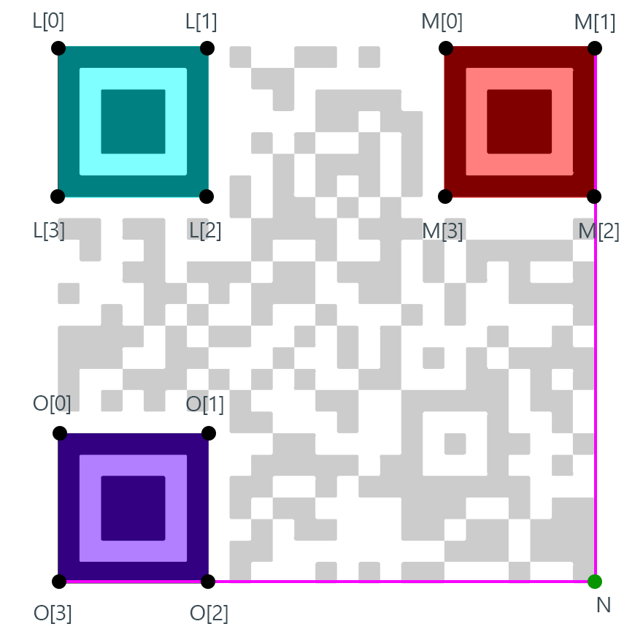
Determining 4th corner of QR
Extrapolation of edges of Finder Patterns
→ 4th corner
4th corner

Slide 7
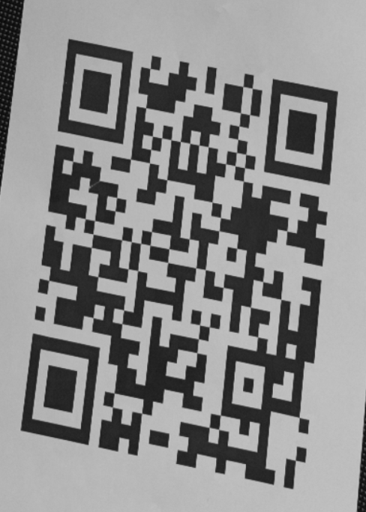
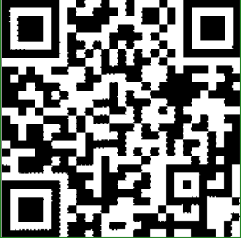
Warping the perspective
4 outer corner points
Warping to square
Thresholding
Artifacts
Notes:
Beispiel Bilder

Slide 8
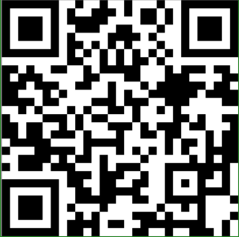
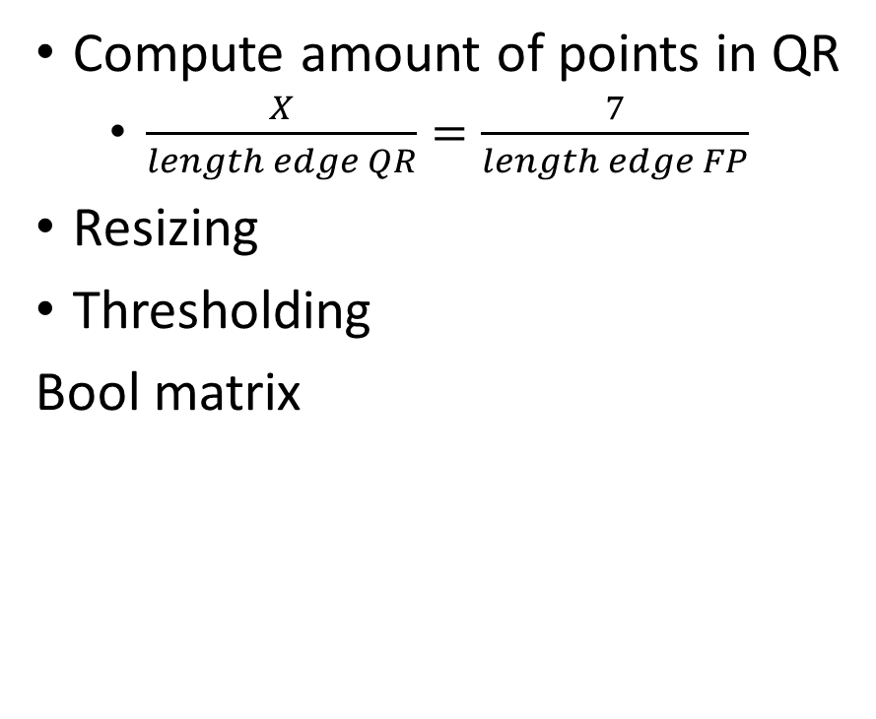
Bit extraction
7 pixels
Compute amount of points in QR
$\frac{X}{length edge QR}=\frac{7}{length edge FP}$
Resizing
Thresholding
Bool matrix

Slide 9
Limitations
Acute angles of camera
Problems with nested contours
Requires exactly three Finder Patterns
Extrapolation of 4th corner not accurate
Rule of three not accurate with big QR
Notes:
Only works with exactly three finder patterns (not two qr codes in picture; black and white pictures)

