Slide 1
World Weather Measurement
Florian Fritz, Verena Röhrl, Leonhard Feiner

Slide 2



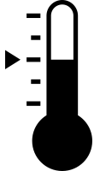
City
Simulates a weather measuring station
Real data from openweathermap.org (OWM)
MQTT client to Context Broker

Slide 3

City additional scripts
City creators
Provides IATA codes and OWM IDs
Creates / replaces IoT agents
City scheduler
Triggering updates
Several cities on one device
=> Scalability of the simulation

Slide 4


Watchdog
Subscribes city attributes
Detects missing updates
Pushes errors
Modifiable via Context Broker

Slide 5
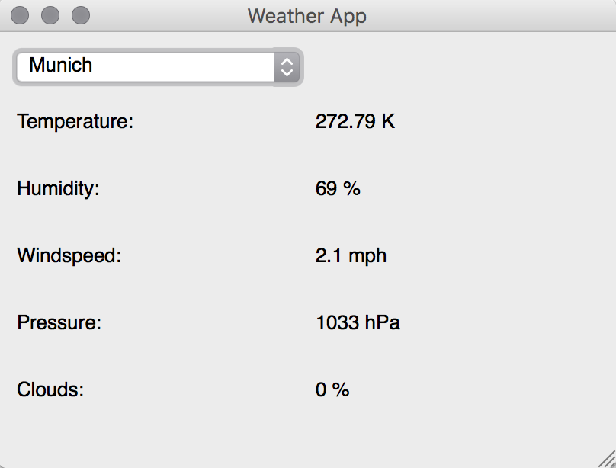
GUI
Ability to change desired city
Subscribes city attributes
Prints the values of last update

Slide 7
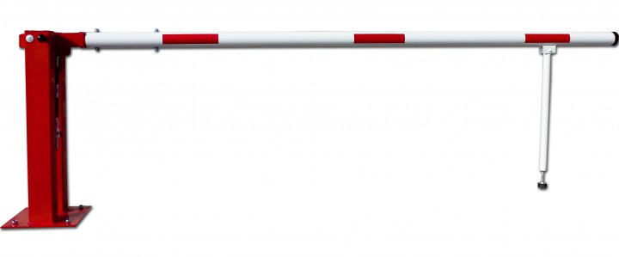
Limitations
Watchdog
not the job of an IoT device
MQTT
GUI
Long delays caused by subscriptions

Slide 8

Problems
Lack of Raspy hardware
Deleting entities in Context Broker
MQTT subscriptions require MQTT publisher
Using lazy values in MQTT
Using compounds in MQTT

