Slide 1


AI-Powered Collections Strategy
Leveraging Agentic AI for Scalable, Fair, and Effective Debt Management at Geldium
Luis Faria, December 2025

Slide 2







How the System Works
DECISION
ACTIONS
LEARNING
INPUT
Utilization
Missed payments
DTI
Ternure
Credit score
Logistic Model
+ Rules
Risk Tier (Low/Med/High)
Weekly Outcomes
Quarterly Retrains
A/B Winners Auto-Promoted
Cadence/Channel by Tier
(Email/SMS/Agent + Offers)

Slide 3


Role of Agentic AI
AI
HUMAN
Reminders
Timing optimization
Self-service routing
A/B Tests
Logging
Hardship approvals
Limit changes
Disputes
Edge-case overrides
Regulatory sign-off

Slide 4
Responsible AI Guardrails
Fairness
Explainability
Compliance
Oversight
Weekly demographic checks;
Flag >10% disparate impact;
Remove proxies
Plain-language reasons;
SHAP for compliance reviews
GDPR/FCA/FCRA alignment;
Audit trail (data, model, threshold,
action, override)
Uncertainty flags to human queue;
Customer appeal path
Principle: Governance is built-in, not bolted on.

Slide 5
Expected Business Impact
DELINQUENCY
COST PER CONTACT
16% → ≤14% (−12%)
$8 → ≤$5 (−37%)
RIGHT-PARTY CONTACT
MODEL RECALL
55% → ≥70%
70% → ≥80% (+10pp)
$
FINANCIAL IMPACT
~$5.4M annual benefit;
better customer experience via tailored outreach

Slide 6
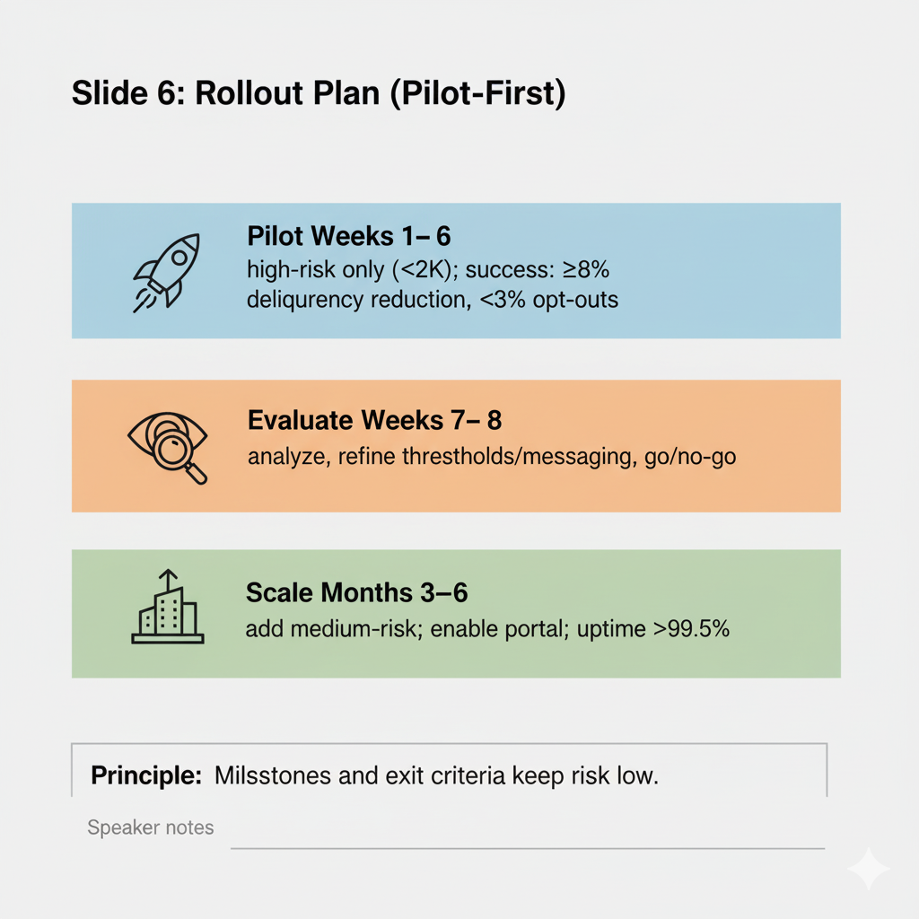
Rollout Plan (Pilot-First)
Pilot / Weeks 1–6:
high-risk only (~2K);
success: ≥8% delinquency reduction, <3% opt-outs
Evaluate / Weeks 7–8:
analyze, refine thresholds/messaging, go/no-go
Scale / Months 3–6:
add medium-risk; enable portal; uptime >99.5%

Slide 7
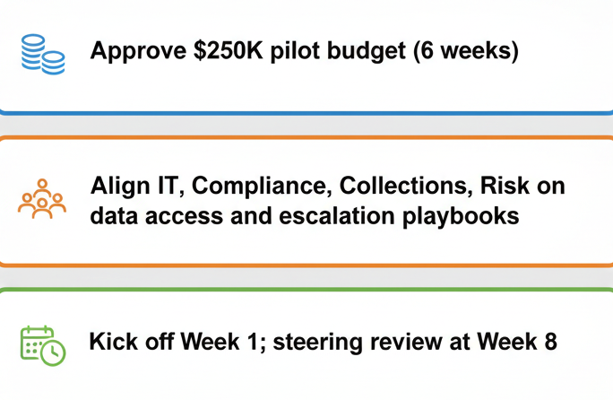
Ask & Next Steps
Approve $ 250K pilot budget (6 weeks)
Align IT, Compliance, Collections, Risk on data access and escalation playbooks
Kick off Week 1; steering review at Week 8

