Slide 1


Module 3
Big Data Integration
and Storage
From sourced data to trusted, enriched, retrieval-ready data assets
Data lake management tier
Integration • Quality • Enrichment • Storage
Lets wait for another 15 mins To allow more students join us Q&A session now!
BDA | Module 3 | 1
Notes:
Opening: connect Module 3 to Module 2. Module 2 covered sourcing and ingestion; Module 3 asks what happens next: we need to unify, clean, enrich and store data so it can support analytics and machine learning.

Slide 2
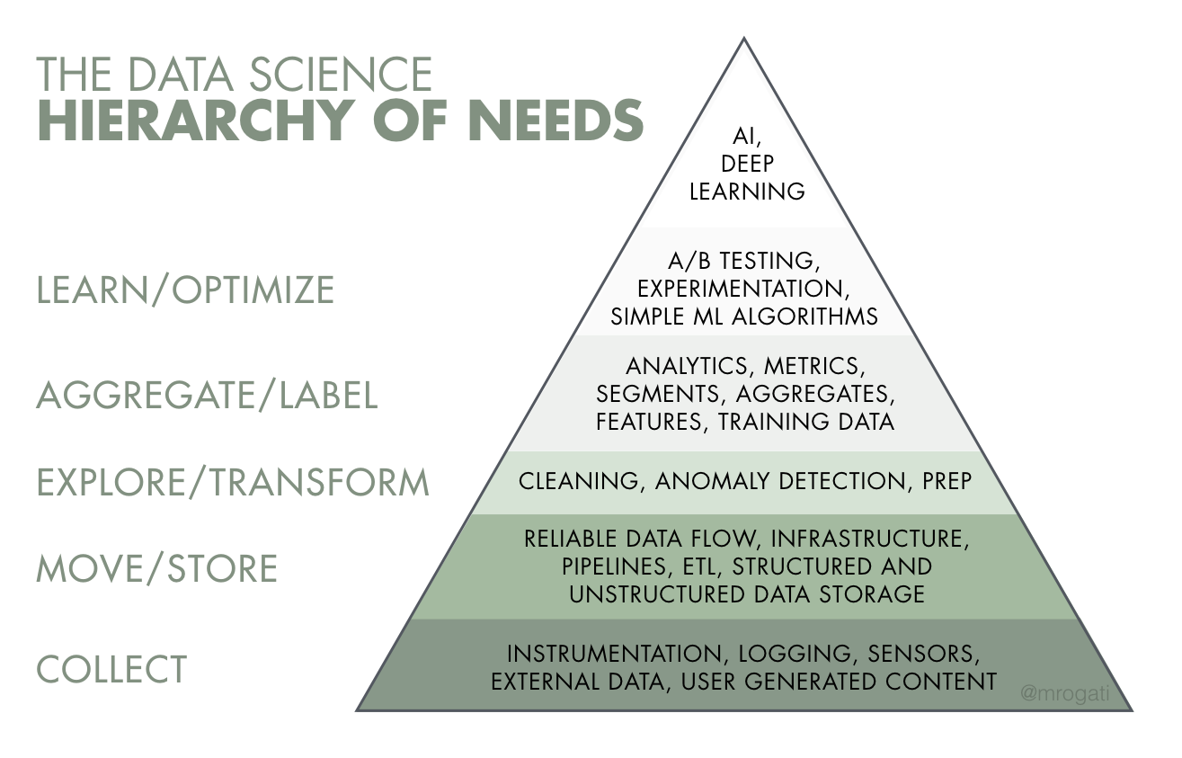
Today’s Learning Focus
Module 3 maps the management tier of the data lake to practical integration and storage decisions.
By the end, you should be able to:
Explain what big data integration means and why it is difficult.
Identify common data integration, quality and enrichment tasks.
Describe the role of the data hub/storage layer in a data lake.
Compare major big data storage technologies at a high level.
Connect these concepts to Assessment 1.
Key message: advanced AI/ML sits on top of reliable data collection, movement, storage, transformation and labelling.
BDA | Module 3 | 2
Notes:
Emphasise that AI and ML are not only algorithms; they depend on upstream data work. This module focuses on the layers below modelling: move/store, explore/transform, aggregate/label.

Slide 3
Where Module 3 Fits in the Data Lake Architecture
Module 2 focused on the intake tier; this module focuses on the management tier.
1. Intake tier
2. Management tier
3. Consumption tier
Source system zone
Transient zone
Raw zone
Integrate
Clean & validate
Enrich
Store & retrieve
BI dashboards
Analytics
ML/AI models
Applications
Module 3 = turning raw, heterogeneous data into reliable, reusable data assets.
BDA | Module 3 | 3
Notes:
Use this as a bridge: intake gets data in, management makes it coherent and trustworthy, consumption turns it into decisions.

Slide 4
The Integration Problem: Data Arrives in Silos
Big data integration is not just “copying files”; it is resolving meaning, structure, identity and quality.
CRM
Sales
Web logs
Unresolved
questions
IoT
Partner APIs
Support tickets
Examples of integration questions
Does “customer_id” mean the same thing across systems? Are timestamps in the same timezone? Are duplicates, missing values and outliers handled consistently? Which record is authoritative?
BDA | Module 3 | 4
Notes:
Introduce integration as semantic and operational. The technical issue is that each system may encode the same real-world entity differently; the business issue is that decisions can be wrong if these differences are not resolved.

Slide 5
Big Data Integration: What, Why and How
A practical framing for integration decisions.
What?
Why?
How?
Combining data from multiple heterogeneous sources into a coherent, usable view for analytics, reporting and applications.
To break down silos, improve data completeness, enable cross-source analysis and give decision-makers a more reliable version of reality.
Through schemas, metadata, transformation rules, data quality checks, entity matching, master data, governance and scalable storage.
Foote (2019) frames big data integration around these three fundamental questions.
BDA | Module 3 | 5
Notes:
This slide maps directly to the first resource. Keep the message simple: integration creates a usable view, matters because data is otherwise fragmented, and is implemented through technical and governance practices.

Slide 6
Traditional Integration Is Already Difficult
Dong & Srivastava use airline data to show integration challenges before “big data” even enters the picture.
Airline schedule
Airport data
Weather feed
Ticketing data
flight no.
departure time
arrival city
airport code
city
terminal
station id
timestamp
conditions
booking id
passenger
fare class
Goal: one analytical view
For example, understand delays by route, airport, weather and customer impact.
Even traditional systems require schema matching, entity resolution, conflict handling and provenance tracking.
BDA | Module 3 | 6
Notes:
Use the airline example to make integration concrete. Different datasets may describe the same flight but use different identifiers, granularities, times, locations and business rules.

Slide 7
Common Challenges in Big Data Integration
Big data expands the traditional integration problem through volume, velocity, variety, veracity, value and valence.
Schema heterogeneity
Entity resolution
Data quality
Same concept, different column names, data types or formats.
Identifying records that refer to the same real-world object.
Missingness, duplicates, outliers, inconsistent units and invalid values.
Velocity
Governance
Scale & cost
Batch files, event streams and APIs arrive at different speeds.
Access control, privacy, lineage and accountability must be preserved.
Storage, compute and retrieval must remain performant and affordable.
BDA | Module 3 | 7
Notes:
Ask students to think about which challenge they have personally seen in spreadsheets, business systems, research datasets or APIs.

Slide 8
Data Lake Management Tier: Core Components
The management tier converts raw ingested data into managed data assets.
Integrate
Quality
Enrich
Store
Join and reconcile data from multiple sources
Clean, validate and monitor fitness-for-use
Add context, metadata, labels or derived attributes
Persist data in scalable, secure, retrieval-ready form
Operational principle
Do not wait until modelling to discover integration or quality problems. Capture rules, metadata and lineage during the data management process.
BDA | Module 3 | 8
Notes:
This slide summarizes Chapter 3 of Pasupuleti and Purra. Clarify that these components are not always strictly sequential; many organisations iterate among them.

Slide 9
Integration Patterns: ETL, ELT, Virtualisation and Streaming
Different workloads require different integration approaches.
ETL
ELT
Extract → Transform → Load
Useful when data must be standardised before entering storage.
Extract → Load → Transform
Common in cloud data lakes/lakehouses where scalable storage is cheap.
Data virtualisation
Streaming ingestion
Query across sources without physically moving all data.
Useful for fast access, but can expose latency and governance issues.
Continuously process events as they arrive.
Useful for IoT, clickstreams, fraud detection and operational monitoring.
BDA | Module 3 | 9
Notes:
Distinguish ETL and ELT with simple language. In modern cloud data lakes, ELT is common because raw or lightly transformed data can be loaded first, then transformed with distributed compute.

Slide 10
Data Quality: “Fit for Purpose”
Quality is not abstract; it is measured against the business question and analytics use case.
Examples of quality controls
Accuracy
Type checks: date, numeric, category
Range checks: age > 0, price ≥ 0
Referential checks: customer exists
Duplicate detection and merge rules
Missing-value handling
Quality logs and exception reports
Uniqueness
Completeness
Trusted
Data Asset
Validity
Consistency
Timeliness
BDA | Module 3 | 10
Notes:
Position quality as a set of checks and documented decisions. For an analytics task, a dataset can be high quality for one purpose and inadequate for another.

Slide 11
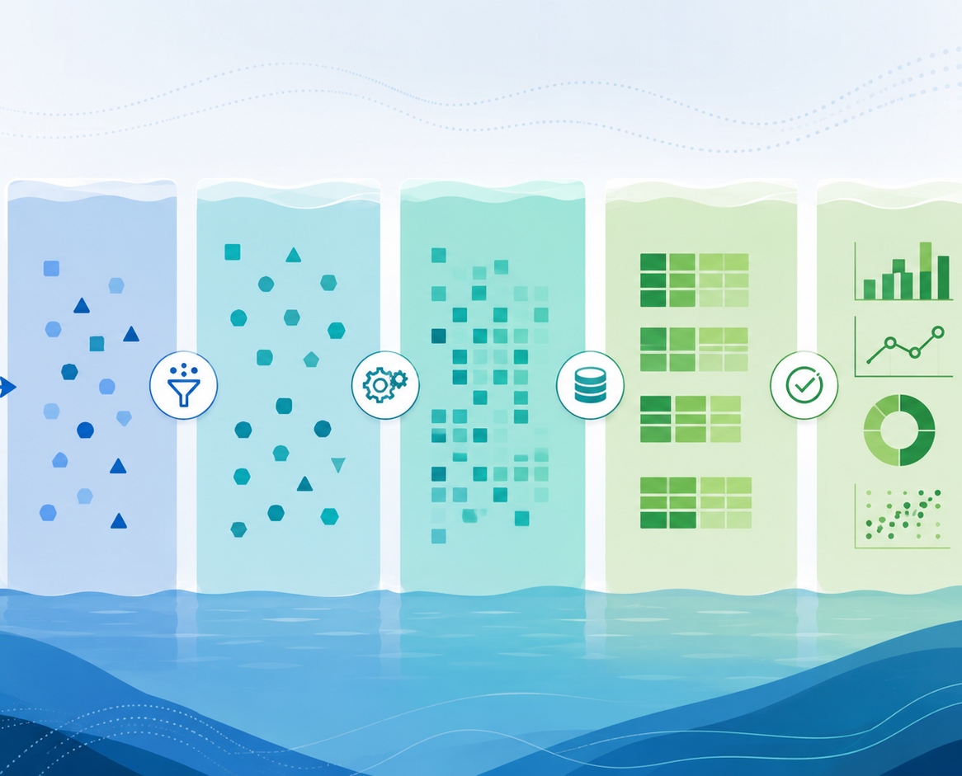
Data Enrichment: Adding Context and Analytical Value
Enrichment augments data with additional attributes that make later analysis more meaningful.
Internal enrichment
External enrichment
Customer segments, product hierarchy, department mapping, business rules.
Geographic, demographic, economic, weather or public datasets.
Derived features
Labels & metadata
Calculated measures such as lifetime value, churn risk or rolling averages.
Training labels, source lineage, quality scores and business definitions.
Important caution
Enrichment can introduce bias, privacy risks or misleading correlations if it is not governed.
BDA | Module 3 | 11
Notes:
Emphasise that enrichment is about adding useful context, not just adding more columns. More data is not automatically better.

Slide 12
Metadata, Lineage and Governance
In a data lake, unmanaged data becomes a “data swamp”. Governance keeps data findable, understandable and safe.
Metadata catalogue
Lineage
Access control
What data exists, what it means, who owns it
Where the data came from and how it changed
Who can read, write, transform or share it
Privacy & security
Retention & lifecycle
Protection of sensitive data and regulatory compliance
How long data is kept and when it is archived/deleted
BDA | Module 3 | 12
Notes:
Use data swamp metaphor carefully: a data lake only works when assets are discoverable, documented, governed and protected.

Slide 13
Data Lake Storage Requirements
The data hub/storage layer must support analytics at scale without losing control.
Technical requirements
Governance requirements
Business requirements
Scalable capacity for structured and unstructured data
High-throughput read/write performance
Support for batch and stream workloads
Integration with analytics and ML tools
Identity and access management
Encryption and key management
Audit logs and lineage
Policy-based data lifecycle management
Cost-effective storage tiers
Reliability and availability
Self-service data discovery
Alignment with compliance obligations
BDA | Module 3 | 13
Notes:
The storage decision is both technical and business-driven. A cheap storage layer is not enough if retrieval is slow, access is insecure, or data cannot be governed.

Slide 14
Cloud Object Storage Example: Amazon S3
Amazon S3 is widely used as a cloud data lake foundation because it combines elastic object storage with governance and analytics integration.
S3 data lake strengths
Object storage for structured and unstructured data
Elastic scale without provisioning capacity
Durability, availability, access control and encryption features
Storage classes and lifecycle policies to manage cost
Integrates with AWS analytics services and third-party engines
S3
Raw zone
Curated zone
Analytics zone
Source: AWS S3 and AWS data lake storage product pages.
BDA | Module 3 | 14
Notes:
Keep this vendor-neutral: S3 is an example of cloud object storage, not the only option. AWS describes S3 as object storage for data lakes with scalability, availability, security and performance, plus lifecycle management and integrations.

Slide 15
Cloud Data Lake Example: Azure Data Lake Storage Gen2
ADLS Gen2 combines Azure Blob Storage with data lake capabilities such as hierarchical namespace and analytics integration.
ADLS Gen2 data lake strengths
Designed for big data analytics workloads on Azure
Hierarchical namespace supports directory/file semantics
Works with Azure identity, RBAC and access-control models
Integrates with analytics platforms such as Azure Synapse and Databricks
Supports scalable storage for raw, curated and consumption-ready data
ADLS
Gen2
/raw
/curated
/trusted
/sandbox
Source: Microsoft Azure documentation and product information.
BDA | Module 3 | 15
Notes:
Use this as a second example, not a deep vendor comparison. Highlight hierarchical namespace as a concept that makes object storage behave more like a file system for analytics workflows.

Slide 16
Comparing Big Data Storage Technologies
The right storage architecture depends on data type, access pattern, latency, governance and cost.
Technology
Typical fit
Strength
Watch-outs
HDFS
On-prem distributed files
High-throughput batch processing
Cluster ops and scaling burden
Object storage
Cloud data lakes
Elastic, cheap, durable
Needs metadata/governance layer
NoSQL databases
Semi-structured/operational data
Flexible schema and scale-out
Query consistency varies by design
Data warehouses
Structured BI reporting
Fast SQL analytics
Less flexible for raw/unstructured data
Lakehouse/table formats
Unified analytics + ML
ACID tables on lake storage
Requires careful platform design
Teaching note: technology choice is rarely “best overall”; it is best for a workload and governance context.
BDA | Module 3 | 16
Notes:
This slide connects to the optional survey paper. Students do not need to memorise every technology; they need to learn how to reason about storage choices.

Slide 17
Reference Architecture: From Raw Data to Analytics-Ready Assets
A high-level mental model for Assessment 1 and later modules.
Sources
Ingestion
Raw zone
Management
Curated storage
Consumption
Internal DBs
External APIs
Logs / IoT
Batch
Streaming
APIs
Immutable landing
Original format
Integrate
Quality
Enrich
Trusted tables
Metadata
Security
BI
ML/AI
Apps
Metadata catalogue
Lineage
Access control
Quality monitoring
Lifecycle policy
Governance services cut across every stage of the pipeline.
BDA | Module 3 | 17
Notes:
This is the architecture students can use when explaining a big data pipeline. Encourage them to name zones, data movement, transformation tasks, storage decisions and governance controls.

Slide 18
References
Core and optional resources for Module 3.
Foote, K. (2019, 27 February). Big data integration 101: The what, why and how. DATAVERSITY.
Dong, X. L., & Srivastava, D. (2015). Big data integration. Synthesis Lectures on Data Management, 7(1), 1–198.
Pasupuleti, P., & Purra, B. S. (2015). Data lake development with big data. Packt Publishing.
AWS. (n.d.). Data lake storage on AWS; Amazon S3 product information.
Microsoft Azure. (n.d.). Azure Data Lake Storage / Azure storage documentation and product information.
Siddiqa, A., Karim, A., & Gani, A. (2017). Big data storage technologies: A survey. Frontiers of Information Technology & Electronic Engineering, 18(8), 1040–1070.
Rogati, M. (2017). Data Science Hierarchy of Needs.
BDA | Module 3 | 20
Notes:
References slide.

Slide 19
Case Study
Linear Programming – Transportation
CityFresh Markets is an emerging online platform based in Brisbane, Australia, focusing on delivering fresh farm produce and organic food products directly to households. The portal sees a steady traffic of around 50,000 health-conscious visitors every month. When it comes to completing an order, shoppers are given three alternatives: 1) signing in using an existing membership; 2) initializing a fresh membership if they're new to the platform; or 3) opting for a one-time purchase without the need for membership.
The account details of shoppers are fragmented across two internal systems - one managed by the customer relations team and the other by the health and nutrition outreach team. The procurement department, on the other hand, oversees the details of orders and supply chain data. In tandem, the digital operations unit is responsible for the platform's user experience and stability.
Bi-monthly, CityFresh Markets rolls out an e-magazine that encompasses articles about healthy living, showcases farm stories, highlights fresh arrivals, and offers exclusive discounts. This digital magazine is both displayed on the platform and dispatched to their community of registered shoppers. It's essential to note that as of now, the platform follows a one-size-fits-all model, implying every user, regardless of past interactions, location, or preferences, views the same content.
In the past few months, CityFresh Markets has encountered an unexpected plateau in its growth trajectory. Even with their unique selling proposition of farm-fresh products, the metrics reflecting site engagement and conversion rates (the fraction of users who move from browsing to purchasing) are not as promising as projected.
To counter this challenge and infuse momentum into sales, the top brass at CityFresh Markets envisions transitioning to a data-centric operational model. They're eager to explore the domain of data analytics to curate bespoke user journeys, which might include features like health-based product suggestions, personalized discount strategies, and insights into buying patterns.
Embarking on this data-centric journey necessitates the creation of an adept data pipeline. The primary objective of this pipeline would be to adeptly collate data from diverse touchpoints, harmonize it, and then deposit it into a 'data repository'. This centralized hub should facilitate seamless access for strategists, leaders, and data professionals.

Slide 20
Case Study
Linear Programming – Transportation
The information you can provide about data characteristics:
Type of Data: Whether the data is structured (like databases with defined fields), semi-structured (like JSON or XML files), or unstructured (like plain text or images).
Volume: How much data is produced and stored. For example, clickstream data from a website might be generated at a rate of gigabytes per day, while a sales database might only be a few megabytes.
Velocity: The speed at which new data is generated and needs to be processed. Real-time data, such as website interactions, has a high velocity.
Variability: How consistent is the data format? If a data source frequently changes its format, it has high variability.
Fields/Attributes: What are the specific pieces of information contained in the data? For instance, transactional data might have fields like TransactionID, UserID, ProductID, Timestamp, and Amount.
Format: How is the data formatted? Is it in CSV files, relational databases, logs, JSON files, etc.?
Quality: The accuracy, completeness, reliability, and consistency of the data. High-quality data has fewer missing values, errors, or inconsistencies.
Source: Where is the data coming from? Is it internal (like sales databases) or external (like social media analytics)?

Slide 21
Case Study
Linear Programming – Transportation
Example of external data: Market Research:
Farm Reports:
Source: Typically generated by farmers or agricultural experts overseeing the operations of a farm.
Content: Contains information about crop yields, soil health, usage of fertilizers and pesticides, machinery and equipment status, livestock health (if applicable), and other farming activities.
Structure: Can be both structured (numeric data about yields, equipment usage, etc.) and unstructured (observations, notes about crop health or any anomalies).
Frequency: Might be generated after specific farming cycles, seasons, or at regular intervals (monthly, quarterly).
Data Types:
Structured: Quantitative metrics like crop yield (in tons or other units), amount of fertilizer used (in kilograms or liters), number of equipment pieces used, etc.
Unstructured: Observations or notes about pest infestations, comments about soil health, remarks about any unusual weather conditions affecting crops, etc.
Relevance: Vital for understanding the agricultural output and any challenges faced during farming. It can influence decisions about what crops to prioritise, when to harvest, and how to deal with pests or diseases.
Assumptions: It's assumed that farm reports are provided immediately after the end of each farming cycle or season, allowing for timely decision-making. If receiving reports from multiple farms or suppliers, it's assumed that they all follow a standardized format or structure, aiding in easy comparison and aggregation.
2. Market Trend Data:
Source: Often generated by market research firms, industry experts, or gathered through surveys and data analytics tools.
Content: Contains insights about the popularity of certain products, changes in consumer preferences, market growth or decline rates, competitive analysis, and potential opportunities or threats.
Structure: Usually structured (data points, percentages, growth rates) but can also have unstructured elements (analyst observations, qualitative feedback from surveys).
Frequency: Can be updated periodically, such as monthly, quarterly, or annually. Special reports might be generated after significant market events.
Data Types:
Structured: Numeric data like market growth rate (%), sales volume of specific products, market share (%), etc.
Unstructured: Qualitative feedback from consumers, expert opinions, and narrative descriptions of market dynamics.
Relevance: Essential for strategic decision-making. Helps businesses understand where they stand in the market, what products or services are gaining traction, and how to position themselves against competitors.

Slide 22
Case Study
Linear Programming – Transportation
Big Data Challenges:
Data Volume: With both online transactions and potential in-person events like health workshops, CityFresh Markets is accumulating vast amounts of customer, transaction, and engagement data daily. Managing this magnitude, especially from diverse sources like the customer relations system, procurement logs, and digital operations, poses a significant challenge.
Data Variety: The platform's digital operations might produce structured logs, while feedback from health campaigns could be unstructured text. The mix of structured, semi-structured (like JSON from web interactions), and unstructured data (like customer feedback or reviews) requires versatile processing solutions.
Data Velocity: Real-time analytics from website interactions, combined with transactional data and feedback from bi-monthly e-magazines, means data is pouring in at high speeds. The company must be equipped to process this information promptly to make informed decisions.
Data Veracity: Ensuring that feedback from health campaigns is genuine and not manipulated, verifying the authenticity of …...
Data Integration: Merging data from the customer relations system with that of the health and nutrition outreach program, without causing data duplication or loss, is essential to …….
Data Privacy and Security: Given the nature of products – fresh produce and organic foods – understanding customer dietary habits and preferences can be sensitive. Additionally, protecting transactional data and personal customer information from potential breaches is paramount in maintaining trust and compliance with data protection regulations.

Slide 23
Case Study
Linear Programming – Transportation
Recommended Data pipeline:
Data Ingestion
Extract data from farm management systems, health and nutrition outreach records, procurement systems, and digital operations logs.
Utilise sensors, IoT devices, or manual data logging mechanisms from the farm fields to capture real-time data on crop health, soil conditions, and weather patterns.
Ingest data from external sources like weather forecast services, agricultural research bodies, and any collaborations with universities or agri-tech companies.
Data Transformation
Process data to ensure uniformity, especially if data is coming from diverse farm sources or different farming methodologies.
Handle missing data, outliers, or inconsistencies often found in sensor data or manual logs.
Integrate insights from market trend data to associate with actual farm outputs, leading to better demand-supply matching.
Data Storage
Use a hybrid storage system that combines relational databases for structured data (like farm reports) and NoSQL or data lakes for semi-structured and unstructured data (like sensor logs or images).
Leverage cloud platforms like AWS, GCP, or Azure for scalability, especially during harvesting seasons when data influx might be higher.
Maintain backup mechanisms considering the critical nature of the data.
Data Analytics
Implement frameworks such as Apache Spark for analytics that combine farm operations with market trends.
Apply advanced analytics for soil health prediction, crop yield forecasting, and pest/disease prediction using AI/ML models.
Integrate insights from health campaigns and nutrition webinars to align crop production with ongoing health trends.
Data Visualisation and Reporting
Utilize domain-specific visualization tools that cater to agriculture, like AgStudio or FarmLogs, along with mainstream tools like Tableau or Power BI.
Design dashboards that provide insights into farm productivity, crop health, inventory status, and correlation with market trends.
Make the data accessible to various stakeholders - from farm managers and field workers to supply chain personnel and market strategists.

Slide 24
Recommended Tools and Platforms
Pipeline stage
Possible tools / platforms
Why they fit
Ingestion
Kafka, NiFi, Fivetran, Airbyte, Azure Data Factory
Connect multiple sources; support batch + streaming intake.
Storage
AWS S3 or ADLS Gen2
Scalable, durable, cloud-native data lake storage.
Processing
Apache Spark, Databricks, AWS Glue, dbt
Distributed transformation, integration, and enrichment.
Governance
AWS Glue Data Catalog, Microsoft Purview
Metadata, lineage, cataloguing, and discovery.
Analytics / BI
Power BI, Tableau, Amazon QuickSight
Dashboards for leaders, strategists, and operations teams.
ML / personalisation
SageMaker, Azure ML, Databricks ML
Support recommendations, segmentation, and prediction.
Key principle: choose tools that match the organisation’s cloud strategy, team capability, governance requirements, and latency needs.
Big Data and Analytics
12

Slide 25
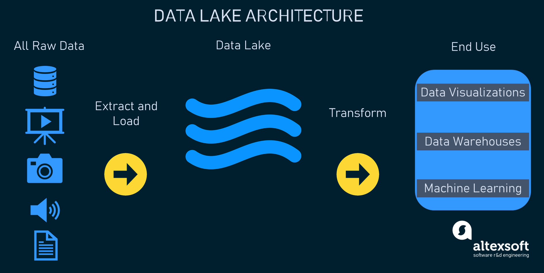
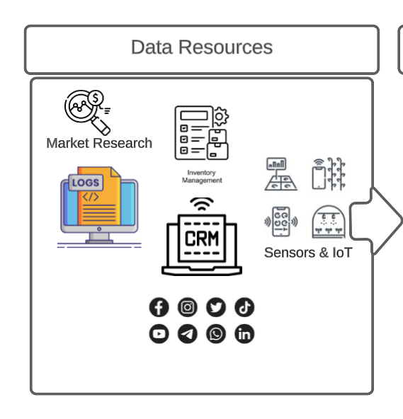
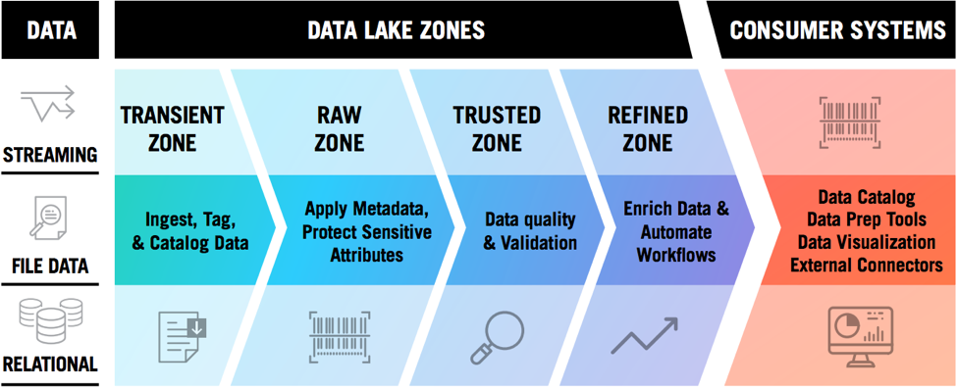
Case Study
Linear Programming – Transportation
Data pipeline Schema Sample:
https://www.altexsoft.com/blog/data-lakehouse/
Source:https://www.zaloni.com/resources/blogs/what-defines-an-effective-data-lake/

