Slide 1
Module 8 Notes

Slide 2
Support Vector Machines (SVM)

Slide 3
Motivation for Support Vector Machines
The problem to be solved is one of the supervised binary classification. That is, we wish to categorize new unseen objects into two separate groups based on their properties and a set of known examples, which are already categorized.
A good example of such a system is classifying a set of new documents into positive or negative sentiment groups, based on other documents which have already been classified as positive or negative.
Similarly, we could classify new emails into spam or non-spam, based on a large corpus of documents that have already been marked as spam or non-spam by humans. SVMs are highly applicable to such situations.

Slide 4
Motivation for Support Vector Machines
A Support Vector Machine models the situation by creating a feature space, which is a finite-dimensional vector space, each dimension of which represents a "feature" of a particular object. In the context of spam or document classification, each "feature" is the prevalence or importance of a particular word.
The goal of the SVM is to train a model that assigns new unseen objects into a particular category.
It achieves this by creating a linear partition of the feature space into two categories.
Based on the features in the new unseen objects (e.g. documents/emails), it places an object "above" or "below" the separation plane, leading to a categorization (e.g. spam or non-spam). This makes it an example of a non-probabilistic linear classifier. It is non-probabilistic, because the features in the new objects fully determine its location in feature space and there is no stochastic element involved.

Slide 5
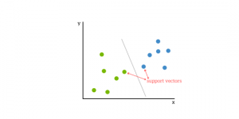
OBJECTIVES
Support vector machines (SVM) are supervised learning models with associated learning algorithms that analyze data used for classification and regression analysis.
It is a machine learning approach.
They analyze the large amount of data to identify patterns from them.
SVMs are based on the idea of finding a hyperplane that best divides a dataset into two classes, as shown in the image below.

Slide 6
Support Vectors
Support Vectors are simply the co-ordinates of individual observation. Support Vector Machine is a frontier which best segregates the two classes (hyper-plane/ line).
Support vectors are the data points that lie closest to the decision surface (or hyperplane)
They are the data points most difficult to classify
They have a direct bearing on the optimum location of the decision surface
Support vectors are the data points nearest to the hyperplane, the points of a data set that, if removed, would alter the position of the dividing hyperplane. Because of this, they can be considered the critical elements of a dataset.

Slide 7
What is a hyperplane?
As a simple example, for a classification task with only two features, you can think of a hyperplane as a line that linearly separates and classifies a set of data.
Intuitively, the further from the hyperplane our data points lie, the more confident we are that they have been correctly classified. We therefore want our data points to be as far away from the hyperplane as possible, while still being on the correct side of it.
So when new testing data are added, whatever side of the hyperplane it lands will decide the class that we assign to it.

Slide 8
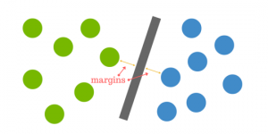
How do we find the right hyperplane?
How do we best segregate the two classes within the data?
The distance between the hyperplane and the nearest data point from either set is known as the margin. The goal is to choose a hyperplane with the greatest possible margin between the hyperplane and any point within the training set, giving a greater chance of new data being classified correctly. There will never be any data point inside the margin.

Slide 9
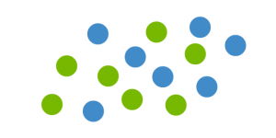
But what happens when there is no clear hyperplane?
Data are rarely ever as clean as our simple example above. A dataset will often look more like the jumbled balls below which represent a linearly non separable dataset.
In order to classify a dataset like the one above it’s necessary to move away from a 2d view of the data to a 3d view. Explaining this is easiest with another simplified example. Imagine that our two sets of colored balls above are sitting on a sheet and this sheet is lifted suddenly, launching the balls into the air. While the balls are up in the air, you use the sheet to separate them. This ‘lifting’ of the balls represents the mapping of data into a higher dimension. This is known as kernelling.

Slide 10
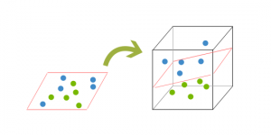
Because we are now in three dimensions, our hyperplane can no longer be a line. It must now be a plane as shown in the example above. The idea is that the data will continue to be mapped into higher and higher dimensions until a hyperplane can be formed to segregate it.

Slide 11
How does it work? How can we identify the right hyper-plane?
You need to remember a thumb rule to identify the right hyper-plane:
“Select the hyper-plane which segregates the two classes better”.

Slide 12
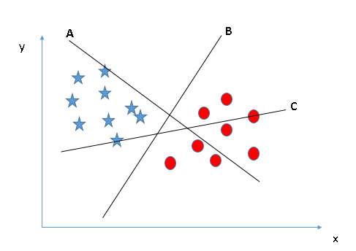
Identify the right hyperplane (Scenario-1):
Here, we have three hyperplanes (A, B and C). Now, identify the right hyperplane to classify star and circle.
Hyperplane “B” has excellently performed this job.

Slide 13
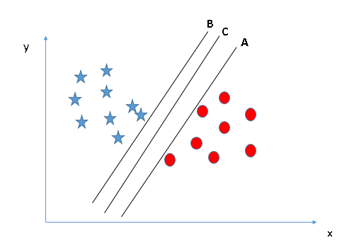
Identify the right hyperplane (Scenario-2):
Here, we have three hyperplanes (A, B and C) and all are segregating the classes well. Now, how can we identify the right hyperplane?
Here, maximizing the distances between nearest data point (either class) and hyperplane will help us to decide the right hyperplane.

Slide 14
Linear Separators
Binary classification can be viewed as the task of separating classes in feature space:
w^{T}x + b = 0
w^{T}x + b > 0
w^{T}x + b < 0
f(x) = sign(w^{T}x + b)

Slide 15
Training a linear SVM
To find the maximum margin separator, we have to solve the following optimization problem:
This is tricky but it’s a convex problem. There is only one optimum and we can find it without fiddling with learning rates or weight decay or early stopping.
Don’t worry about the optimization problem. It has been solved. Its called quadratic programming.
It takes time proportional to N^2 which is really bad for very big datasets
so for big datasets we end up doing approximate optimization!

Slide 16
Testing a linear SVM
The separator is defined as the set of points for which:

Slide 17
Linear Separators
Which of the linear separators is optimal?

Slide 18
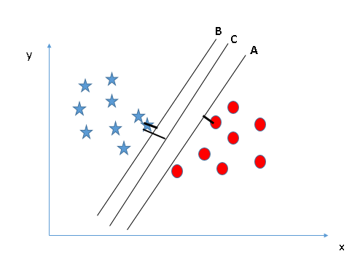
Scenario-2
This distance is called as Margin. Let’s look at the below snapshot:
We can see that the margin for hyperplane C is high as compared to both A and B. Hence, we name the right hyperplane as C. Another lightning reason for selecting the hyperplane with higher margin is robustness. If we select a hyperplane having low margin then there is high chance of missclassification.

Slide 19
Classification Margin
Distance from example x_{i} to the separator is
Examples closest to the hyperplane are support vectors.
Margin ρ of the separator is the distance between support vectors.
ρ
r

Slide 20
Maximum Margin Classification
Maximizing the margin is good according to intuition and probably approximately correct learning (PAC) theory.
Implies that only support vectors matter; other training examples are ignorable.

Slide 21
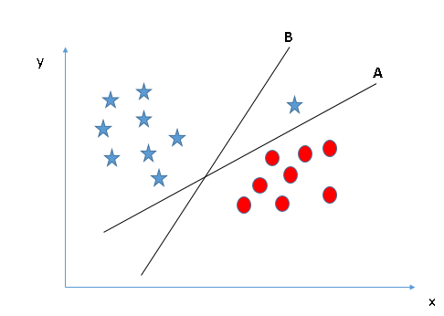
Identify the right hyperplane (Scenario-3)
Some of you may have selected the hyper-plane B as it has higher margin compared to A. But, here is the catch, SVM selects the hyperplane which classifies the classes accurately prior to maximizing margin. Here, hyperplane B has a classification error and A has classified all correctly. Therefore, the right hyperplane is A.

Slide 22
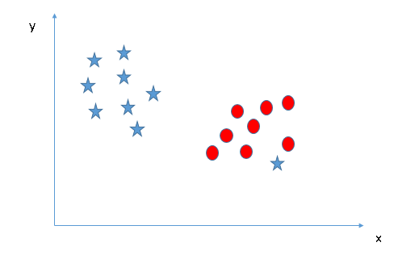
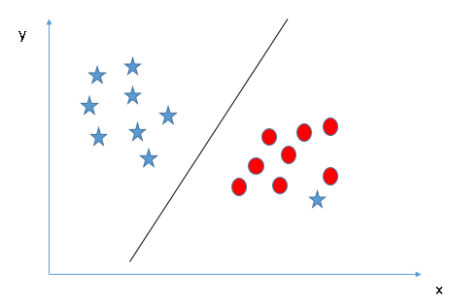
Can we classify two classes (Scenario-4)?
We are unable to segregate the two classes using a straight line, as one of star lies in the territory of other (circle) class as an outlier.
One star at other end is like an outlier for star class. SVM has a feature to ignore outliers and find the hyperplane that has maximum margin. Hence, we can say, SVM is robust to outliers.

Slide 23
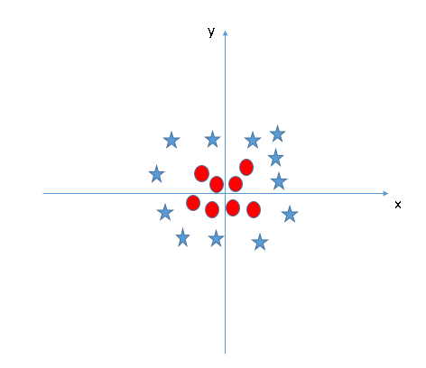
Find the hyperplane to segregate to classes (Scenario-5)
In the scenario below, we can’t have linear hyperplane between the two classes, so how does SVM classify these two classes? Till now, we have only looked at the linear hyperplane.
SVM can solve this problem. It solves this problem by introducing additional feature. Here, we will add a new feature z=x²+y².

Slide 24
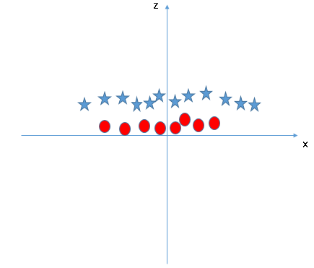
Scenario-5
Now, let’s plot the data points on axis x and z:
In above plot, points to consider are:
All values for z would be positive always because z is the squared sum of both x and y
In the original plot, red circles appear close to the origin of x and y axes, leading to lower value of z and star relatively away from the origin result to higher value of z.

Slide 25
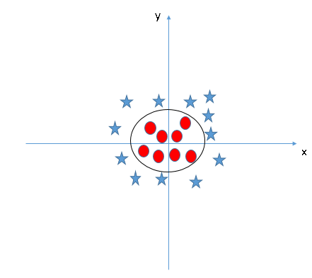
In SVM, it is easy to have a linear hyperplane between these two classes. But, another burning question which arises is, should we need to add this feature manually to have a hyperplane. No, SVM has a technique called the kernel trick. These are functions which takes low dimensional input space and transform it to a higher dimensional space i.e. it converts not separable problem to separable problem, these functions are called kernels. It is mostly useful in non-linear separation problem. Simply put, it does some extremely complex data transformations, then find out the process to separate the data based on the labels or outputs you’ve defined.
When we look at the hyperplane in original input space it looks like a circle:

Slide 26
What to do if there is no separating plane
Use a much bigger set of features.
This looks as if it would make the computation hopelessly slow, but in the next part of the lecture we will see how to use the “kernel” trick to make the computation fast even with huge numbers of features.
Extend the definition of maximum margin to allow non-separating planes.
This can be done by using “slack” variables

Slide 27
The story so far
If we use a large set of non-adaptive features, we can often make the two classes linearly separable.
But if we just fit any old separating plane, it will not generalize well to new cases.
If we fit the separating plane that maximizes the margin (the minimum distance to any of the data points), we will get much better generalization.
Intuitively, by maximizing the margin we are squeezing out all the surplus capacity that came from using a high-dimensional feature space.
This can be justified by a whole lot of clever mathematics which shows that
large margin separators have lower VC dimension.
models with lower VC dimension have a smaller gap between the training and test error rates.

Slide 28
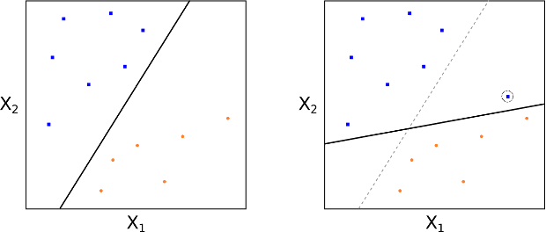
Support Vector Classifiers
Essentially we have to relax the requirement that a separating hyperplane will perfectly separate every training observation on the correct side of the line (i.e. guarantee that it is associated with its true class label), using what is called a soft margin. This motivates the concept of a support vector classifier(SVC).
MMCs can be extremely sensitive to the addition of new training observations.
If we add one point to the +1 class, we see that the location of the MMH changes substantially. Hence in this situation the MMH has clearly been over-fit.
MMH perfectly separating the two classes

Slide 29
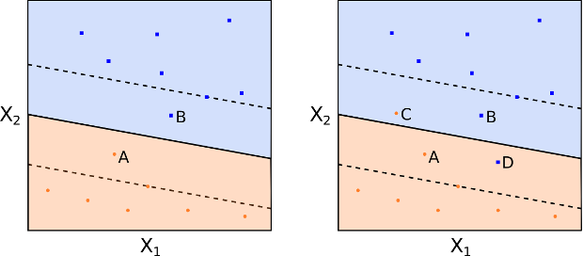
We could consider a classifier based on a separating hyperplane that doesn't perfectly separate the two classes, but does have a greater robustness to the addition of new individual observations and has a better classification on most of the training observations. This comes at the expense of some misclassification of a few training observations.
This is how a support vector classifier or soft margin classifier works. A SVC allows some observations to be on the incorrect side of the margin (or hyperplane), hence it provides a "soft" separation. The following figures demonstrate observations being on the wrong side of the margin and the wrong side of the hyperplane respectively:

Slide 30
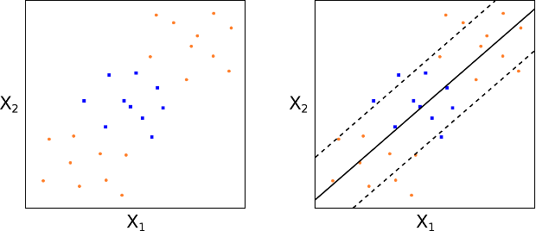
Support Vector Machines
The motivation behind the extension of a SVC is to allow non-linear decision boundaries. This is the domain of the Support Vector Machine (SVM). Consider the following figures. In such a situation a purely linear SVC will have extremely poor performance, simply because the data has no clear linear separation:

Slide 31
This is clearly not restricted to quadratic polynomials. Higher dimensional polynomials, interaction terms and other functional forms, could all be considered. Although the drawback is that it dramatically increases the dimension of the feature space to the point that some algorithms can become untractable.
The major advantage of SVMs is that they allow a non-linear enlargening of the feature space, while still retaining a significant computational efficiency, using a process known as the "kernel trick.
So what are SVMs? In essence they are an extension of SVCs that results from enlargening the feature space through the use of functions known as kernels. In order to understand kernels, we need to briefly discuss some aspects of the solution to the SVC optimization problem outlined above.

Slide 32
SVM Kernel Functions
SVM algorithms use a set of mathematical functions that are defined as the kernel. The function of kernel is to take data as input and transform it into the required form. Different SVM algorithms use different types of kernel functions. These functions can be different types. For example linear, nonlinear, polynomial, radial basis function (RBF), and sigmoid.
Introduce Kernel functions for sequence data, graphs, text, images, as well as vectors. The most used type of kernel function is RBF. Because it has localized and finite response along the entire x-axis.
The kernel functions return the inner product between two points in a suitable feature space. Thus by defining a notion of similarity, with little computational cost even in very high-dimensional spaces.

Slide 33
A potential problem and a magic solution
If we map the input vectors into a very high-dimensional feature space, surely the task of finding the maximum-margin separator becomes computationally intractable?
The mathematics is all linear, which is good, but the vectors have a huge number of components.
So taking the scalar product of two vectors is very expensive.
The way to keep things tractable is to use “the kernel trick”
The kernel trick makes your brain hurt when you first learn about it, but its actually very simple.

Slide 34
What the kernel trick achieves
All of the computations that we need to do to find the maximum-margin separator can be expressed in terms of scalar products between pairs of datapoints (in the high-dimensional feature space).
These scalar products are the only part of the computation that depends on the dimensionality of the high-dimensional space.
So if we had a fast way to do the scalar products we would not have to pay a price for solving the learning problem in the high-D space.
The kernel trick is just a magic way of doing scalar products a whole lot faster than is usually possible.
It relies on choosing a way of mapping to the high-dimensional feature space that allows fast scalar products.

Slide 35
Examples of Kernel Functions
Linear: K(x_{i},x_{j})= x_{i}^{T}x_{j}
Mapping Φ: x → φ(x), where φ(x) is x itself
Polynomial of power p: K(x_{i},x_{j})= (1+ x_{i}^{T}x_{j})^{p}
Mapping Φ: x → φ(x), where φ(x) has dimensions
Gaussian (radial-basis function): K(x_{i},x_{j}) =
Mapping Φ: x → φ(x), where φ(x) is infinite-dimensional: every point is mapped to a function (a Gaussian); combination of functions for support vectors is the separator.
Higher-dimensional space still has intrinsic dimensionality d (the mapping is not onto), but linear separators in it correspond to non-linear separators in original space.

Slide 36
Dealing with the test data
If we choose a mapping to a high-D space for which the kernel trick works, we do not have to pay a computational price for the high-dimensionality when we find the best hyper-plane.
We cannot express the hyperplane by using its normal vector in the high-dimensional space because this vector would have a huge number of components.
Luckily, we can express it in terms of the support vectors.
But what about the test data. We cannot compute the scalar product because its in the high-D space.

Slide 37
Dealing with the test data
We need to decide which side of the separating hyperplane a test point lies on and this requires us to compute a scalar product.
We can express this scalar product as a weighted average of scalar products with the stored support vectors
This could still be slow if there are a lot of support vectors .

Slide 38
The classification rule
The final classification rule is quite simple:
All the cleverness goes into selecting the support vectors that maximize the margin and computing the weight to use on each support vector.
We also need to choose a good kernel function and we may need to choose a lambda for dealing with non-separable cases.
The set of support vectors

Slide 39
Performance
Support Vector Machines work very well in practice.
The user must choose the kernel function and its parameters, but the rest is automatic.
The test performance is very good.
They can be expensive in time and space for big datasets
The computation of the maximum-margin hyper-plane depends on the square of the number of training cases.
We need to store all the support vectors.
SVM’s are very good if you have no idea about what structure to impose on the task.
The kernel trick can also be used to do PCA in a much higher-dimensional space, thus giving a non-linear version of PCA in the original space.

Slide 40
SVM applications
SVMs were originally proposed by Boser, Guyon and Vapnik in 1992 and gained increasing popularity in late 1990s.
SVMs are currently among the best performers for a number of classification tasks ranging from text to genomic data.
SVMs can be applied to complex data types beyond feature vectors (e.g. graphs, sequences, relational data) by designing kernel functions for such data.
SVM techniques have been extended to a number of tasks such as regression, principal component analysis, etc.
Most popular optimization algorithms for SVMs use decomposition to hill-climb over a subset of α_{i}’s at a time
Tuning SVMs remains a black art: selecting a specific kernel and parameters is usually done in a try-and-see manner.

Slide 41
Working Example of SVM
Working Example SVM
http://www.svms.org/tutorials/Berwick2003.pdf
http://blog.aylien.com/support-vector-machines-for-dummies-a-simple/
https://www.svm-tutorial.com/2014/11/svm-understanding-math-part-1/
https://data-flair.training/blogs/svm-support-vector-machine-tutorial/
https://www.quantstart.com/articles/Support-Vector-Machines-A-Guide-for-Beginners
https://eight2late.wordpress.com/2017/02/07/a-gentle-introduction-to-support-vector-machines-using-r/

Slide 42


