Slide 1
K-Means

Slide 2
Similarity and Dissimilarity Measures
Similarity measure
Numerical measure of how alike two data objects are.
Is higher when objects are more alike.
Often falls in the range [0,1]
Dissimilarity measure
Numerical measure of how different two data objects are
Lower when objects are more alike
Minimum dissimilarity is often 0
Upper limit varies
Proximity refers to a similarity or dissimilarity

Slide 3
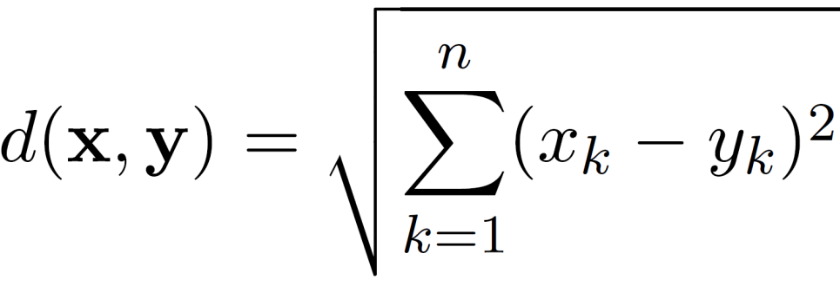
Euclidean Distance
Euclidean Distance
where n is the number of dimensions (attributes) and x_{k} and y_{k} are, respectively, the k^{th} attributes (components) or data objects x and y.

Slide 4
Euclidean Distance
Distance Matrix

Slide 5
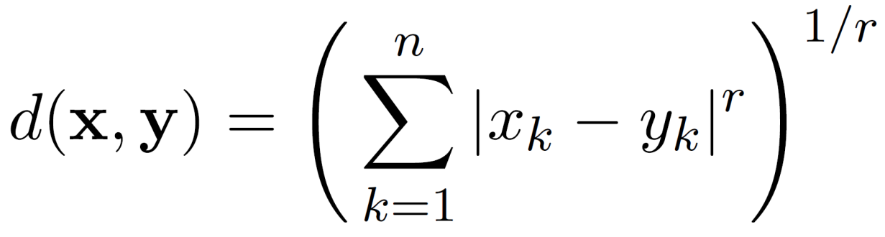
Minkowski Distance
Minkowski Distance is a generalization of Euclidean Distance
Where r is a parameter, n is the number of dimensions (attributes) and x_{k} and y_{k} are, respectively, the k^{th} attributes (components) or data objects x and y.

Slide 6
Minkowski Distance: Examples
r = 1. City block (Manhattan, taxicab, L₁ norm) distance.
A common example of this for binary vectors is the Hamming distance, which is just the number of bits that are different between two binary vectors
r = 2. Euclidean distance
r → ∞. “supremum” (L_{max} norm, L∞ norm) distance.
This is the maximum difference between any component of the vectors
Do not confuse r with n, i.e., all these distances are defined for all numbers of dimensions.

Slide 7
Minkowski Distance
Distance Matrix

Slide 8
Similarity Between Binary Vectors
Common situation is that objects, x and y, have only binary attributes
Compute similarities using the following quantities
f₀₁ = the number of attributes where x was 0 and y was 1
f₁₀ = the number of attributes where x was 1 and y was 0
f₀₀ = the number of attributes where x was 0 and y was 0
f₁₁ = the number of attributes where x was 1 and y was 1
Simple Matching Coefficients and Jaccard Coefficients
SMC = number of matches / number of attributes
= (f₁₁ + f₀₀) / (f₀₁ + f₁₀ + f₁₁ + f₀₀)
J = number of 11 matches / number of non-zero attributes
= (f₁₁) / (f₀₁ + f₁₀ + f₁₁)

Slide 9
SMC versus Jaccard: Example
x = 1 0 0 0 0 0 0 0 0 0
y = 0 0 0 0 0 0 1 0 0 1
f₀₁ = 2 (the number of attributes where x was 0 and y was 1)
f₁₀ = 1 (the number of attributes where x was 1 and y was 0)
f₀₀ = 7 (the number of attributes where x was 0 and y was 0)
f₁₁ = 0 (the number of attributes where x was 1 and y was 1)
SMC = (f₁₁ + f₀₀) / (f₀₁ + f₁₀ + f₁₁ + f₀₀)
= (0+7) / (2+1+0+7) = 0.7
J = (f₁₁) / (f₀₁ + f₁₀ + f₁₁) = 0 / (2 + 1 + 0) = 0

Slide 10
Cosine Similarity
If d₁ and d₂ are two document vectors, then
cos( d₁, d₂ ) = <d₁,d₂> / ||d₁|| ||d₂|| ,
where <d₁,d₂> indicates inner product or vector dot product of vectors, d₁ and d_{2,} and || d || is the length of vector d.
Example:
d₁ = 3 2 0 5 0 0 0 2 0 0
d₂ = 1 0 0 0 0 0 0 1 0 2
<d₁, d2> = 3*1 + 2*0 + 0*0 + 5*0 + 0*0 + 0*0 + 0*0 + 2*1 + 0*0 + 0*2 = 5
| d₁ || = (3*3+2*2+0*0+5*5+0*0+0*0+0*0+2*2+0*0+0*0)^{0.5} = (42) ^{0.5} = 6.481
|| d₂ || = (1*1+0*0+0*0+0*0+0*0+0*0+0*0+1*1+0*0+2*2) ^{0.5} = (6) ^{0.5} = 2.449
cos(d₁, d₂ ) = 0.3150

Slide 11
What is Cluster Analysis?
Given a set of objects, place them in groups such that the objects in a group are similar (or related) to one another and different from (or unrelated to) the objects in other groups
Inter-cluster distances are maximized
Intra-cluster distances are minimized

Slide 12
Applications of Cluster Analysis
Understanding
Group related documents for browsing, group genes and proteins that have similar functionality, or group stocks with similar price fluctuations
Summarization
Reduce the size of large data sets

Slide 13
Applications of Cluster Analysis
Customer Segmentation: Grouping customers with similar behaviors for targeted marketing strategies.
Image Segmentation: Dividing images into regions for object detection, medical imaging, and visual processing.
Document and Text Analysis: Organizing documents or topics based on similarity for content recommendation, news categorization, or sentiment analysis.
Anomaly Detection: Identifying unusual patterns in data, such as fraud detection or fault detection in systems.
Genomics and Bioinformatics: Classifying genes, proteins, or diseases based on biological data for insights into genetic relationships.
Recommender Systems: Clustering users or items to provide personalized recommendations.
Social Network Analysis: Discovering communities and patterns of interaction within social networks.
Market Basket Analysis: Grouping similar products to understand purchasing patterns and optimize inventory.

Slide 14
Notion of a Cluster can be Ambiguous
How many clusters?
Six Clusters
Two Clusters
Four Clusters

Slide 15
Types of Clusterings
A clustering is a set of clusters
Important distinction between hierarchical and partitional sets of clusters
Partitional Clustering
A division of data objects into non-overlapping subsets (clusters)
Hierarchical clustering
A set of nested clusters organized as a hierarchical tree

Slide 16
Partitional Clustering
Original Points
A Partitional Clustering

Slide 17
Hierarchical Clustering
Traditional Hierarchical Clustering
Traditional Dendrogram
Non-traditional Hierarchical Clustering
Non-traditional Dendrogram

Slide 18
Other Distinctions Between Sets of Clusters
Exclusive versus non-exclusive
In non-exclusive clustering, points may belong to multiple clusters.
Can belong to multiple classes or could be ‘border’ points
Partial versus complete
In some cases, we only want to cluster some of the data

Slide 19
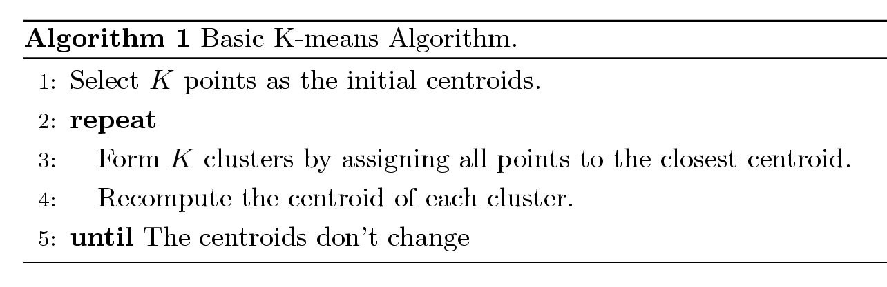
K-means Clustering
Partitional clustering approach
Number of clusters, K, must be specified
Each cluster is associated with a centroid (center point)
Each point is assigned to the cluster with the closest centroid
The basic algorithm is very simple

Slide 20
Example of K-means Clustering

Slide 21
Example of K-means Clustering

Slide 22
K-means Objective Function
A common objective function (used with Euclidean distance measure) is Sum of Squared Error (SSE)
For each point, the error is the distance to the nearest cluster center
To get SSE, we square these errors and sum them.
x is a data point in cluster C_{i} and m_{i} is the centroid (mean) for cluster C_{i}
SSE improves in each iteration of K-means until it reaches a local or global minima.

Slide 23
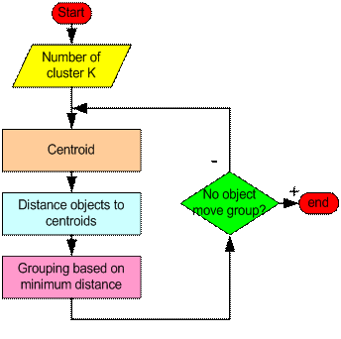
How the K-Mean Clustering algorithm works?

Slide 24
Step 1: Begin with a decision on the value of k = number of clusters .
Step 2: Put any initial partition that classifies the data into k clusters. You may assign the training samples randomly,or systematically as the following:
1.Take the first k training sample as single- element clusters
2. Assign each of the remaining (N-k) training sample to the cluster with the nearest centroid. After each assignment, recompute the centroid of the gaining cluster.

Slide 25
Step 3: Take each sample in sequence and compute its distance from the centroid of each of the clusters. If a sample is not currently in the cluster with the closest centroid, switch this sample to that cluster and update the centroid of the cluster gaining the new sample and the cluster losing the sample.
Step 4 . Repeat step 3 until convergence is achieved, that is until a pass through the training sample causes no new assignments.

Slide 26
A Simple example showing the implementation of k-means algorithm (using K=2)

Slide 27
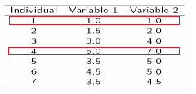
Step 1:
Initialization: Randomly we choose following two centroids (k=2) for two clusters.
In this case the 2 centroid are: m1=(1.0,1.0) and m2=(5.0,7.0).

Slide 28



Step 2:
Thus, we obtain two clusters containing:
{1,2,3} and {4,5,6,7}.
Their new centroids are:

Slide 29
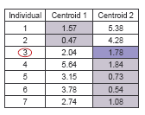
Step 3:
Now using these centroids we compute the Euclidean distance of each object, as shown in table.
Therefore, the new clusters are:
{1,2} and {3,4,5,6,7}
Next centroids are: m1=(1.25,1.5) and m2 = (3.9,5.1)

Slide 30
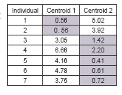
Step 4 :
The clusters obtained are:
{1,2} and {3,4,5,6,7}
Therefore, there is no change in the cluster.
Thus, the algorithm comes to a halt here and final result consist of 2 clusters {1,2} and {3,4,5,6,7}.

Slide 31
PLOT

Slide 32
Two different K-means Clusterings
Original Points
Optimal Clustering
Sub-optimal Clustering

Slide 33
Importance of Choosing Initial Centroids …

Slide 34
Importance of Choosing Initial Centroids …

Slide 35
Limitations of K-means
K-means has problems when clusters are of differing
Sizes
Densities
Non-globular shapes
K-means has problems when the data contains outliers.
One possible solution is to remove outliers before clustering

