Slide 1



TTRACK ACADEMIC PROGRESS TRACKER
Smartly matcher between
Student Curriculums x Course Requirements

Slide 2


PROBLEM STATEMENT
Advisors and Students lack real-time clarity on degree progress.
Student transcript
# 00000001
COURSE
REQUIREMENTS
REJECTED/ACCEPTED
backlog
Transcript checks are manual, slow, error-prone and lead to academic uncertainty.

Slide 3
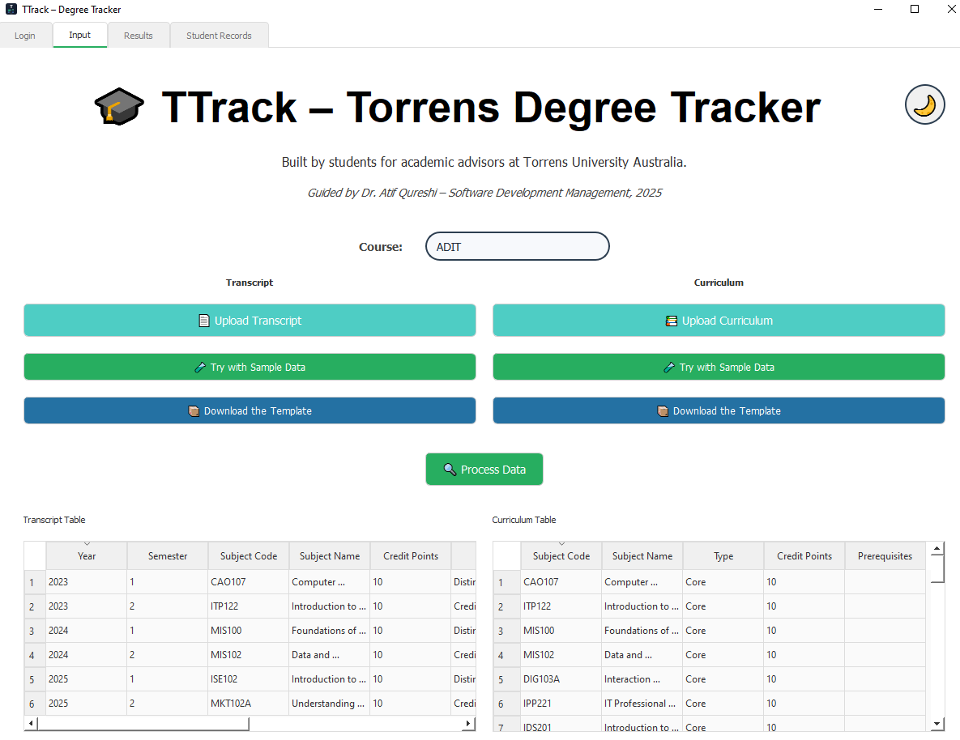
PROPOSED SOLUTION
FROM +30 MINUTES TO A FEW SECONDS!
We automated academic tracking by matching student transcripts to curriculums with precision & clarity, powered by intelligent data processing.

Slide 4
SYSTEM ARCHITECTURE
Academic Staff
UI Layer
File Parsers
Matching Engine
Results View
Database
Upload Curriculum
Upload Transcript
Send File
Validate Format
Trigger Match
Valid Data
Generate Results
Return Results
Save to DB
Display Results
View Saved Data
Academic Staff
UI Layer
File Parsers
Matching Engine
Results View
Database
Our modular, event-driven architecture follows SOLID principles:
— UI, logic and data isolated for testability, scalability and future cloud integrations.

Slide 5
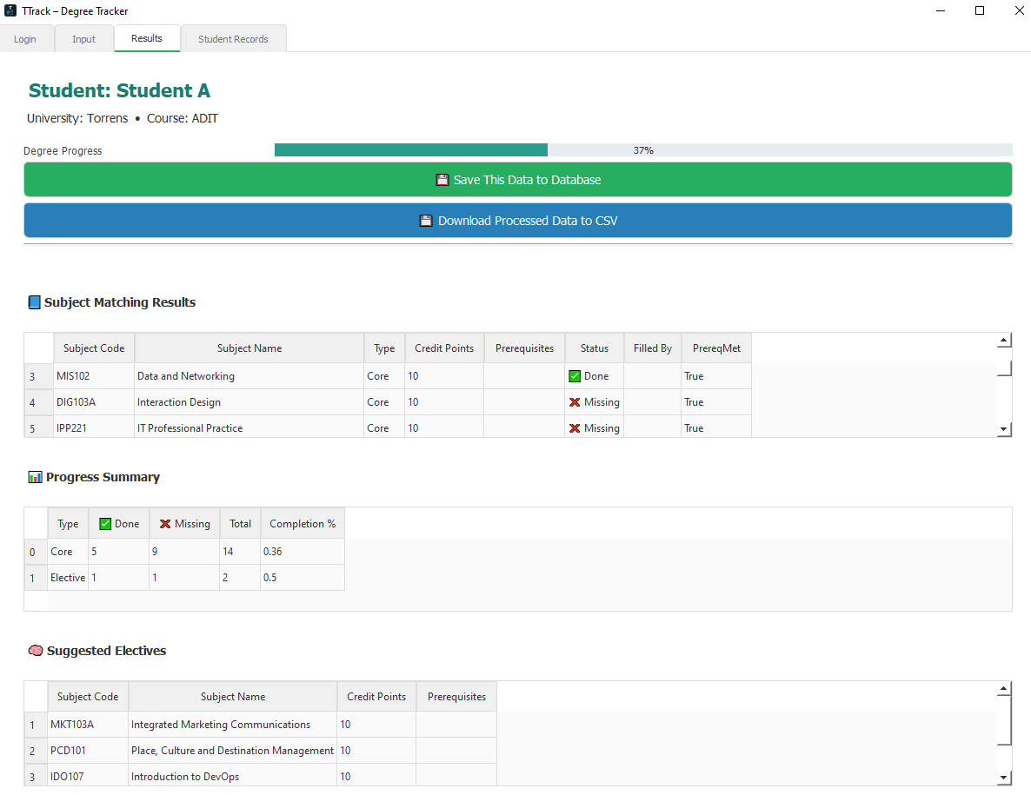
KEY FEATURES
Upload.
Match.
Visualize.
Export.
From matching engine to elective suggestions...
TTrack delivers actionable academic insights.

Slide 6
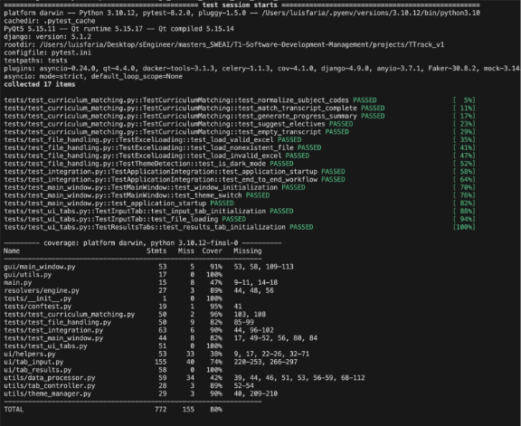
TESTING AND VALIDATION
Pytest-covered modules, edge case validation and live usability testing were used to ensured quality across transcript structures and curriculum formats.

Slide 7
OUTCOMES... FUTURE WORK
v1.0.0
PyQt5 + pandas integration
Light/dark mode support
v2.0.0
Electron version for testing
v3.0.0
Layered Architecture
File upload and preview with pandas
Matching engine: transcript x curriculum
Build scripts for Windows and macOs
Pytest setup
Database backend using PostgreSQL
User Authentication: Login/Register
Layered Architecture
Cloud Sync: Fallback and encryption
Pytest 2.0
v4.0.0
API integration: uni ecosystem
v5.0.0
Multi-tenant architecture institution-wide
Advanced analytics with BI dashboards
Integration APIs
Mobile application
Semantic matching: NLP based
Predictive analytics: forecasting
Recommendation engine
Machine Learning
Cloud Sync: Fallback and encryption
Pytest 2.0
Matching Engine 2.0
Web application
PyQt5 + pandas integration
Supabase BaaS
Integration
Distribution & Engine 2.0
AI
Enhancement
Enterprise
Scale

Slide 8

DEMO INSTRUCTIONS
In this live demo, we will:
1. Create an account and login
2. Upload a transcript
3. Match it to a curriculum
4. Explore results
5. Export insights
5. Save in database and locally
6. Retrieve saved data

Slide 9
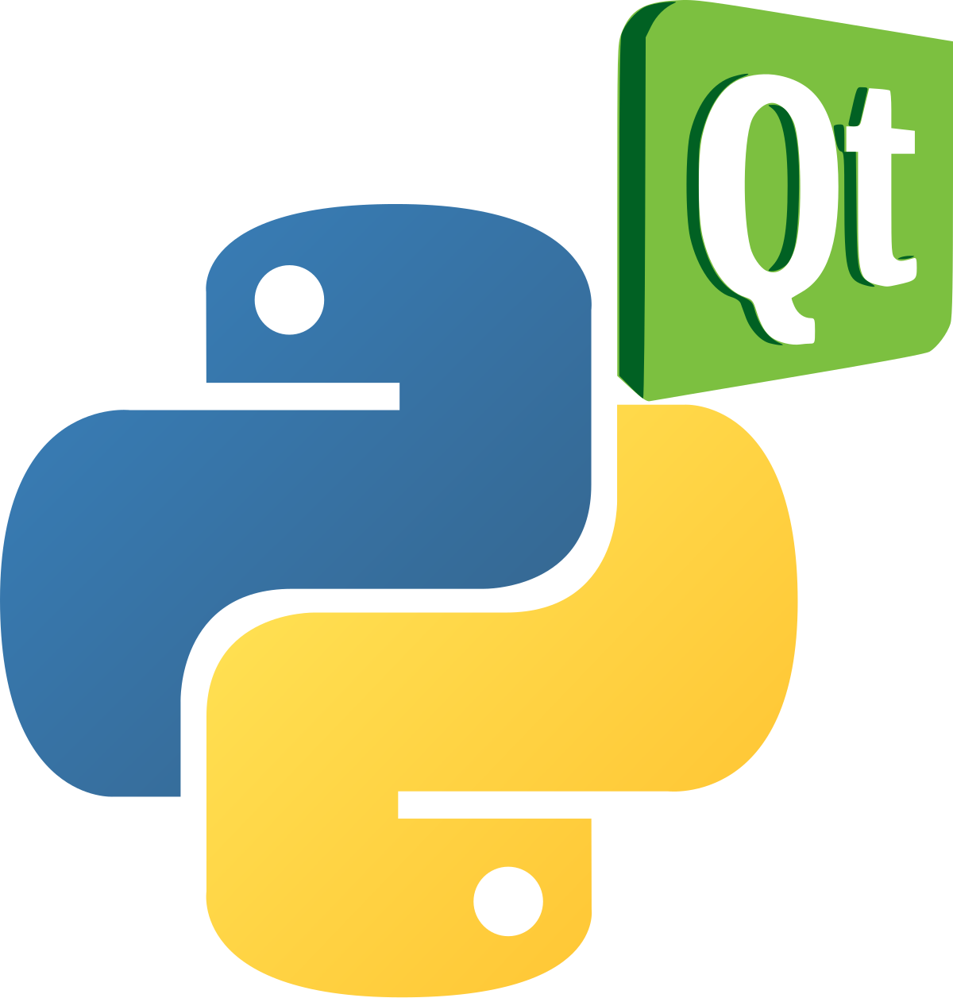




THANK YOU!
Shout Out to the Open-Source Community!
TTrack is built on top of these awesome libraries:
SCAN TO SHARE YOUR THOUGHTS!

