Slide 1

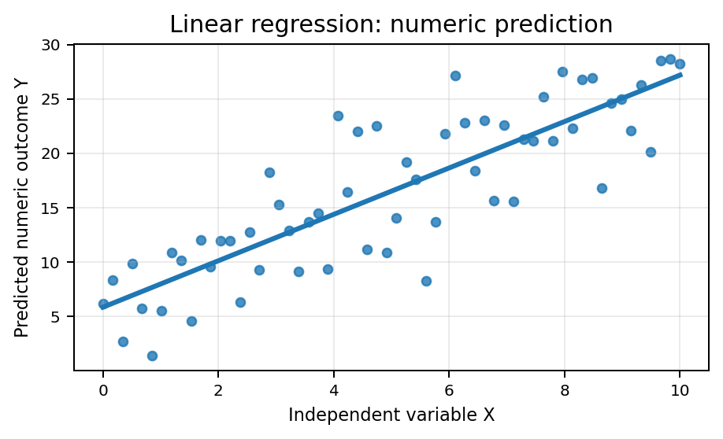
Module 8
Predictive Modelling
Using historical data to estimate future outcomes with statistical and machine-learning models.
Lets wait for another 15 mins To allow more students join us Q&A session now!
Focus: linear regression and logistic regression

Slide 2
Module 8 overview
Where this module fits in the subject
Understand predictive modelling as estimating future outcomes from historical data.
Distinguish regression tasks from classification tasks.
Explain linear regression for numeric prediction.
Explain logistic regression for binary classification.
Review and submit Assessment 2.
Subject Learning Outcome
Design analytical models based on given problems.
Assessment progression
Assessment 2 is due at the end of Module 8. Use this week to review, finalise, and submit.
Core message
Predictive modelling is not only coding — it is problem framing, feature selection, evaluation, and communication.

Slide 3
What is predictive modelling?
Predictive modelling estimates an unknown or future outcome from known historical patterns.
Historical data
Features
Model
Prediction
Past observations
with known outcomes
Independent variables
that may explain the outcome
Statistical / ML representation
of the relationship
Estimated value, class,
or probability
Example: a bank may use historical customer records to predict whether a new customer is likely to subscribe to a term deposit.

Slide 4
Why predictive modelling matters in business
Fraud detection
Risk management
Marketing campaigns
Estimate whether a transaction is suspicious before approving it.
Predict loan default, customer churn, insurance risk, or operational failure.
Estimate which customers are most likely to respond to an offer.
Resource planning
Healthcare / service
Important: prediction supports decision-making, but it does not replace human judgement, domain knowledge, or ethical review.
Forecast demand, staffing needs, stock levels, or delivery volume.
Estimate future need, triage risk, or likely outcomes.

Slide 5
Predictive modelling workflow
A clean workflow is more useful than a complicated model.
1. Define problem
2. Prepare data
3. Train model
4. Evaluate
5. Communicate
What do we want
to predict?
Clean, transform, and
select features
Fit model using
historical data
Measure performance
on unseen data
Explain findings, limits,
and decisions
This workflow connects Module 5 data preparation, Module 6 modelling, Module 7 evaluation, and Module 8 prediction.

Slide 6
Prediction problems: numeric value or category?
Question type
Target variable
Example
Typical model
Regression
Numeric / continuous
Predict house price or sales volume
Linear regression
Classification
Categorical / class label
Predict churn: yes/no
Logistic regression, decision tree
Probability prediction
Probability of a class
Probability of default or purchase
Logistic regression
Linear regression predicts values. Logistic regression predicts probabilities that can be converted into classes.

Slide 7
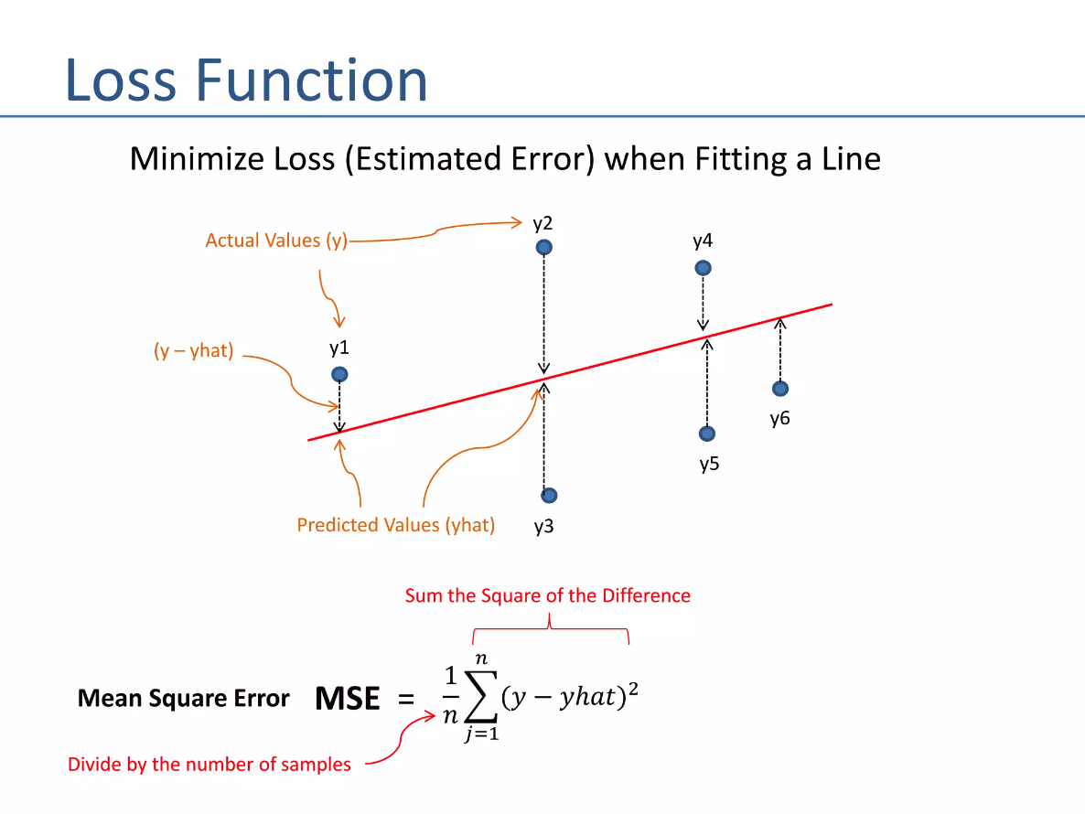
Linear regression: core idea
Fit a line that summarises the relationship between input feature(s) and a numeric outcome.
Goal
Find the best-fitting line that summarises the relationship between x and y, then use it to predict new numeric values.
Simple form: y = b₀ + b₁x
b₀ = intercept; b₁ = slope; x = independent variable; y = predicted outcome

Slide 8
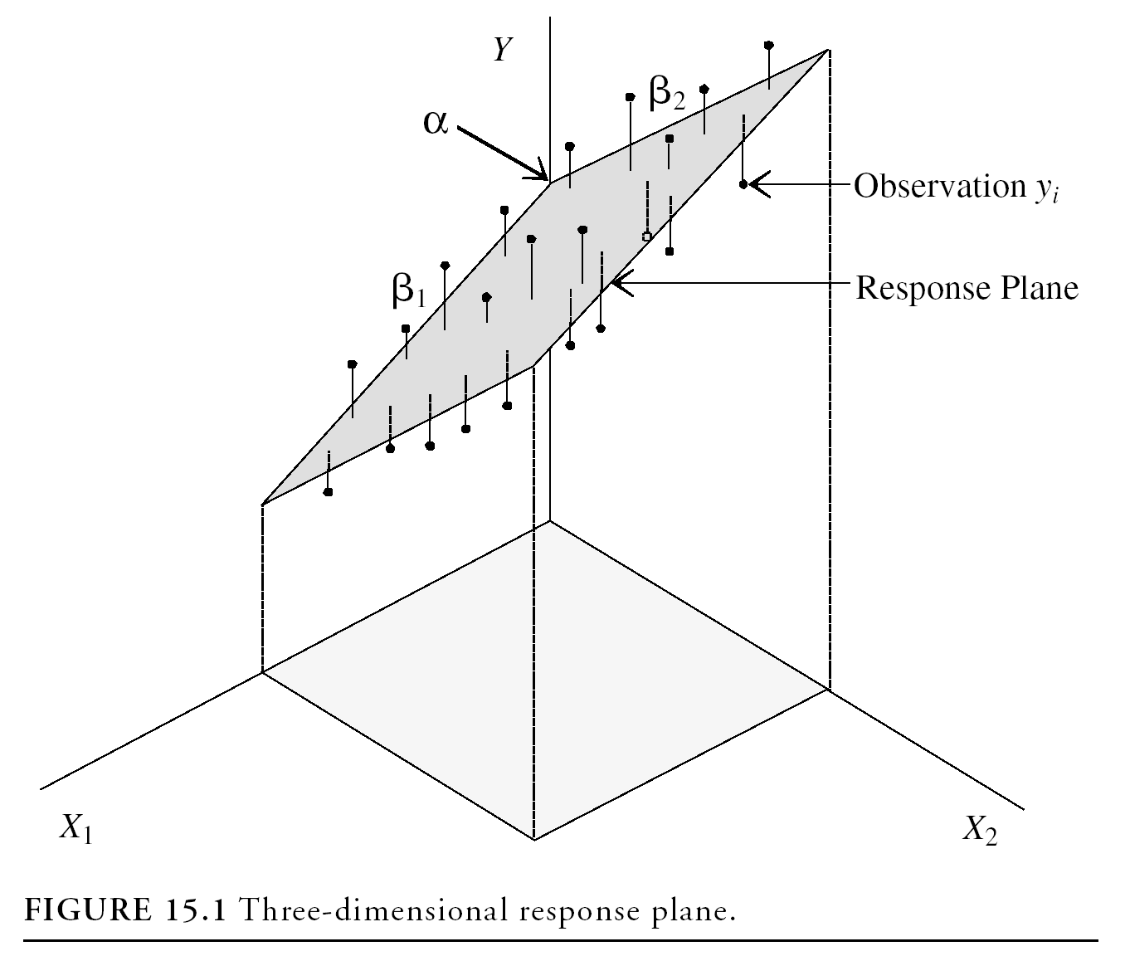
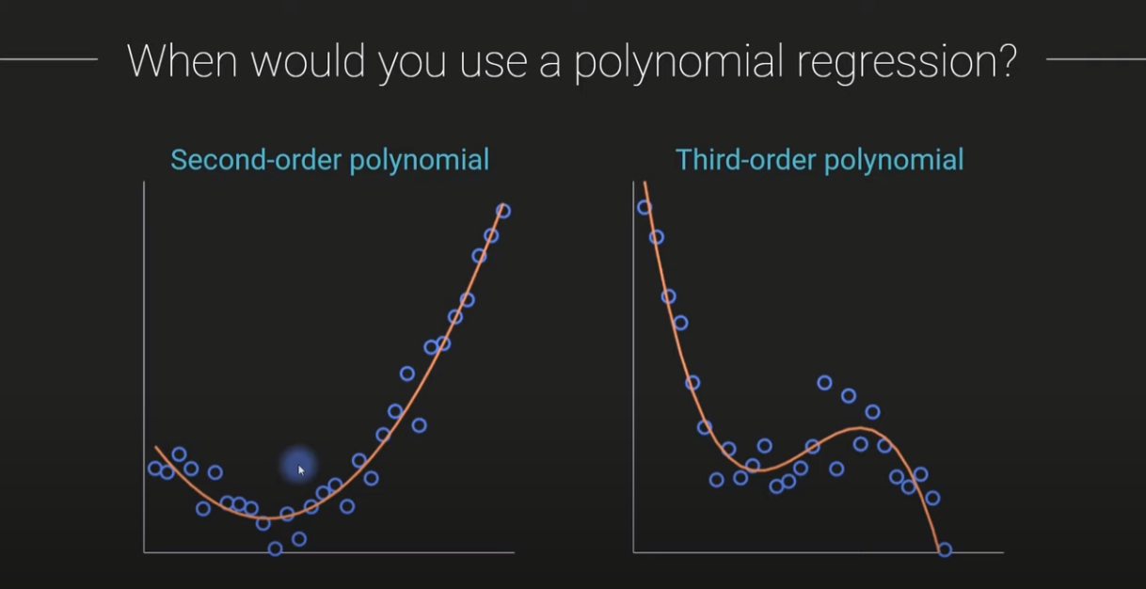
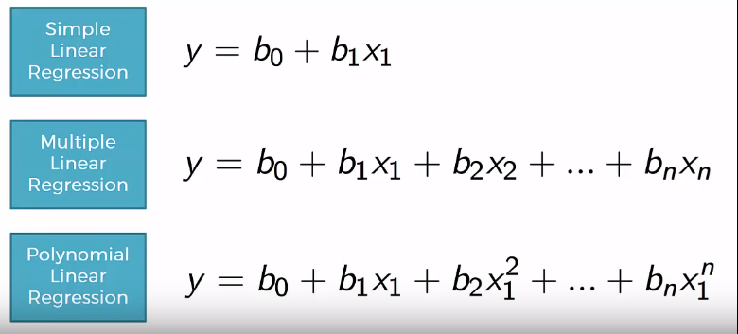
Linear models can increase in complexity
More flexibility can improve fit, but it can also increase overfitting risk.
Simple linear regression
Multiple linear regression
Polynomial regression
One independent variable predicts one numeric outcome.
Example: advertising spend → sales.
Multiple independent variables predict one numeric outcome.
Example: income, age, location → spending.
Curved relationships are represented by polynomial terms.
Example: age and risk may be non-linear.
It helps capture Non-linear relation between dependent and independent variables.
Trade-off: complex models may capture richer patterns, but can also overfit the training data.

Slide 9
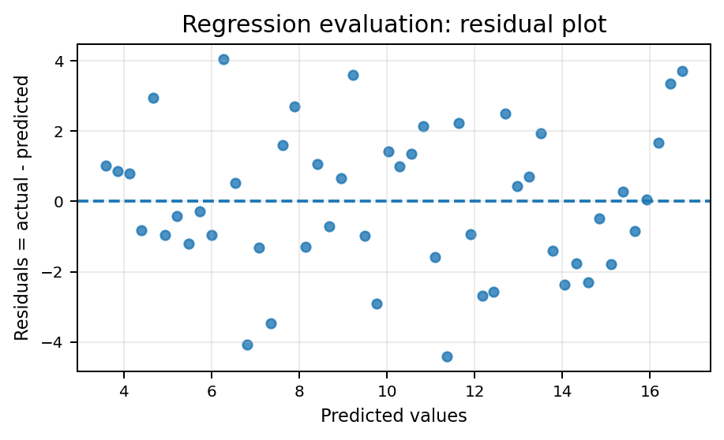
Evaluating regression predictions
Regression evaluation focuses on prediction error and residual patterns.
MAE
Mean absolute error: average size of errors.
RMSE
Root mean squared error: penalises larger errors more strongly.
R²
Proportion of outcome variation explained by the model.
Residual plots help reveal whether the model is missing structure in the data.

Slide 10
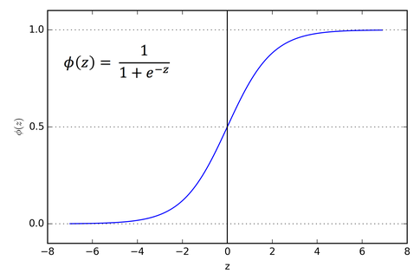
Logistic regression: predicting a probability
Logistic regression is commonly used for binary outcomes such as yes/no, default/no default, or malignant/benign.
Why not ordinary linear regression?
Linear regression can predict values below 0 or above 1. Probabilities must stay between 0 and 1.
p = probability of class 1
The sigmoid function maps any linear score into this probability range.
Where $z=a+b_{1}x_{1}+b_{2}x_{2}$

Slide 11
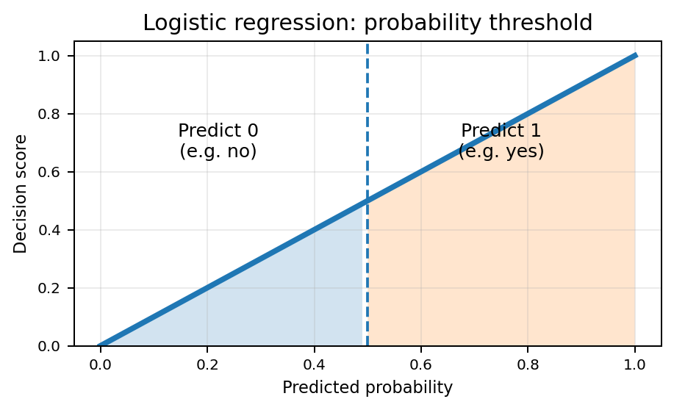
From probability to class label
A probability becomes a decision only after applying a threshold.
Common decision rule
If p ≥ 0.5 → predict class 1
If p < 0.5 → predict class 0
Thresholds are adjustable
A different threshold may be used when false positives and false negatives have different business or ethical costs.
This connects predictive modelling with Module 7 evaluation.

Slide 12
Linear vs logistic regression
Choose the model based on the type of target variable and decision context.
Feature
Linear regression
Logistic regression
Main use
Predict numeric values
Predict binary-class probabilities
Output
Continuous value
Probability between 0 and 1
Example target
House price, balance, sales
Yes/no, default/not default, malignant/benign
Typical evaluation
MAE, RMSE, R², residuals
Accuracy, precision, recall, F1, ROC-AUC
The model should match the problem: numeric prediction versus probability/class prediction.

Slide 13
Building reliable predictive models
A model is only useful if it generalises beyond the historical data.
Clear target variable
Relevant features
Train/test evaluation
Define exactly what you want to predict and when the prediction will be used.
Use inputs that are available at prediction time and are meaningful for the problem.
Estimate future performance using data not used to train the model.
Avoid leakage
Interpretability
Ethics and context
Do not include variables that indirectly reveal the answer.
Explain what the model output means and how it supports the decision.
Check fairness, privacy, and whether the prediction should be acted upon.

Slide 14
Benefits, challenges, and limitations
Benefits
Challenges
Limitations
• Forecast likely outcomes
• Prioritise resources
• Support faster decisions
• Personalise services
• Dirty data
• Biased samples
• Changing environments
• Feature leakage
• Correlation is not causation
• Predictions can be uncertain
• Models require monitoring
• Ethical risks remain
Predictive modelling is useful only when the problem is well-defined and the data are relevant.
The final report should explain not only what was predicted, but how reliable and appropriate the model is.

Slide 15
Assessment 2: final review checklist
Have you explored and cleaned the dataset before modelling?
Have you selected variables that make sense for the problem?
Have you trained the required model clearly and reproducibly?
Have you evaluated the model with appropriate metrics?
Have you interpreted the results in plain language for the target audience?
Have you checked formatting, references, screenshots/outputs, and submission requirements?
This week
Review and submit Assessment 2.
Report focus
Explain decisions, not only code outputs. Markers need to see your reasoning.
Reminder
Use the rubric as a checklist before submission.

Slide 16
Core learning resources
MicroStrategy: predictive modelling overview — definition, applications, benefits, challenges, and limitations.
LinkedIn Learning: essential elements of predictive analytics and data mining.
Lee (2019), Chapter 6: linear regression with Python examples.
Lee (2019), Chapter 7: logistic regression and the sigmoid function.
Reading strategy: focus on what each model predicts, what assumptions it makes, how outputs are interpreted, and how the model should be evaluated.

