Slide 1

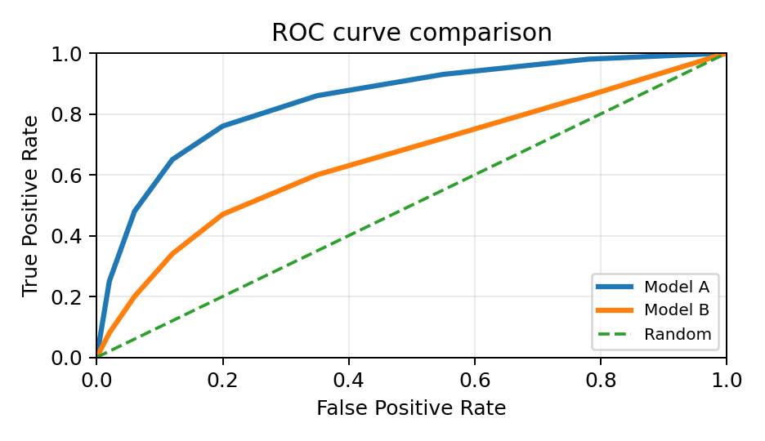
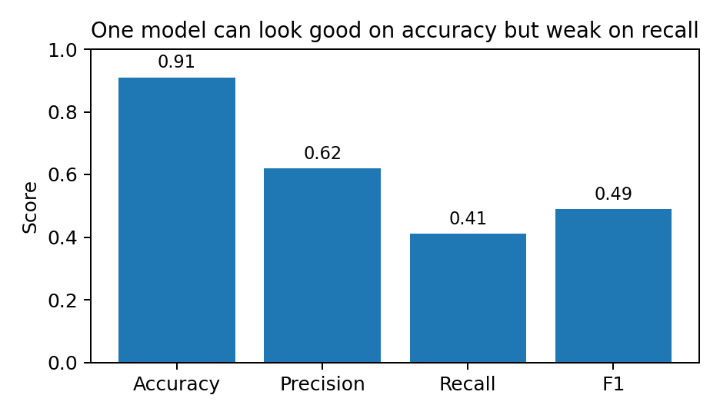
Module 7
Model Evaluation
How do we know whether a classifier will work on new data?
Train
Predict
Evaluate
Select
Training data → model → test data → metrics → decision
Lets wait for another 15 mins To allow more students join us Q&A session now!
Module 7 • Model Evaluation
1

Slide 2
From Model Building to Model Evaluation
Clean & prepare
Build model
Evaluate model
Report & improve
Module 5
Module 6
Module 7
Assessment 2
A model is useful only if it generalises to unseen data. Evaluation connects model output to evidence: accuracy, prediction error, ranking quality, cluster usefulness, and operational risk.
Good evaluation is transparent: same data split, same metric definitions, and clear justification for the chosen metric.
Module 7 • Model Evaluation
2

Slide 3
Three Evaluation Questions
1. Future performance
2. Model comparison
3. Decision value
How well will the model work on data it has not seen before?
Which model is better under the same problem, data split, and metrics?
Are the errors acceptable for the business, ethical, or safety context?
Key point: evaluation is not only a score. It is an argument that the model is reliable enough for a specific use case.
Module 7 • Model Evaluation
3

Slide 4
Evaluation Depends on Model Type
Classification
Numeric prediction
Clustering
Predicts a category. Example: churn / no churn. Main question: how many labels are correct, and which errors matter?
Predicts a number. Example: demand, price, delivery time. Main question: how far are predictions from true values?
Finds groups without known labels. Example: customer segments. Main question: are groups compact, separated, stable, and useful?
Module 7 • Model Evaluation
4

Slide 5
Classification: Confusion Matrix + Core Metrics
Accuracy
Precision
Recall
Predicted +
Predicted −
(TP + TN) / All Overall proportion correct
TP / (TP + FP) How reliable are positive predictions?
TP / (TP + FN) How many true positives did we find?
Actual +
TP
FN
Actual −
FP
TN
F1-score
Specificity
Error rate
Balances precision and recall
TN / (TN + FP) How many negatives are correctly rejected?
(FP + FN) / All Overall proportion incorrect
All classification metrics are different summaries of TP, FP, FN, and TN.
Module 7 • Model Evaluation
5

Slide 6
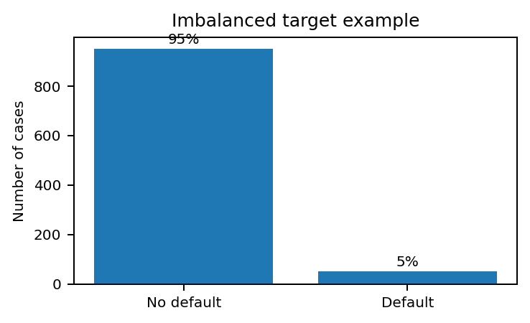
Choosing Classification Metrics Without Overloading the Report
Balanced classes
Accuracy + confusion matrix
When classes and error costs are similar
Imbalanced classes
Precision, recall, F1, PR-AUC
When rare cases matter
Ranking / thresholds
ROC-AUC, PR curve
When predictions are probability scores
Unequal error costs
Cost matrix / benefit analysis
When FP and FN have different consequences
Concise reporting rule: do not list every metric. Start with the confusion matrix, then choose 2–3 metrics that match the business cost of mistakes.
Module 7 • Model Evaluation
6

Slide 7
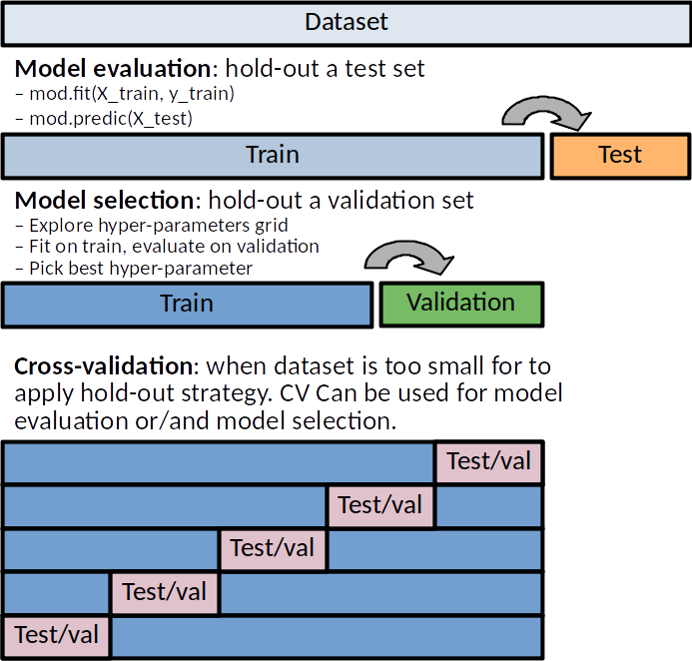
Reliable Estimates: Holdout and Cross-Validation
Holdout testing separates data used for learning from data used for evaluation. This reduces the risk of over-optimistic scores.
Cross-validation repeats training/testing across several folds, giving a more stable estimate when data is limited.
Avoid data leakage: do not let information from the test set influence preprocessing, feature selection, or model tuning.
Module 7 • Model Evaluation
7
Notes:
Split data into k folds. Train on k−1 folds and test on the remaining fold. Repeat until each fold has been used as test data once.

Slide 8
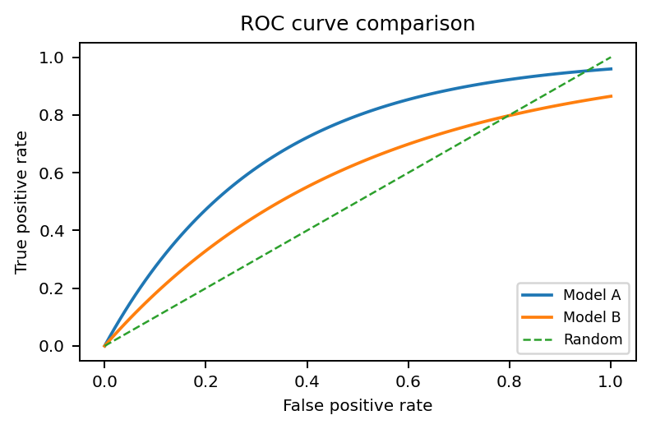
Thresholds, ROC Curves and Cost-Sensitive Evaluation
ROC curve
Plots true positive rate against false positive rate across different thresholds.
Cost-sensitive view
False positives and false negatives may not be equally costly.
Select thresholds based on practical consequences.
AUC
Area under the ROC curve. Higher AUC generally means better discrimination between classes.
Pred +
Pred −
Actual +
Low cost
High cost
Actual −
Medium cost
Benefit
Example: missing a cancer diagnosis may be more serious than asking a healthy person to do another test.
Module 7 • Model Evaluation
8

Slide 9
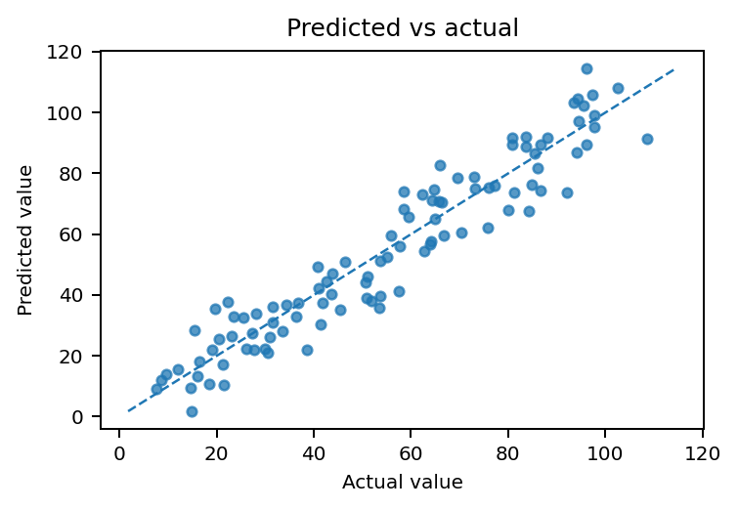
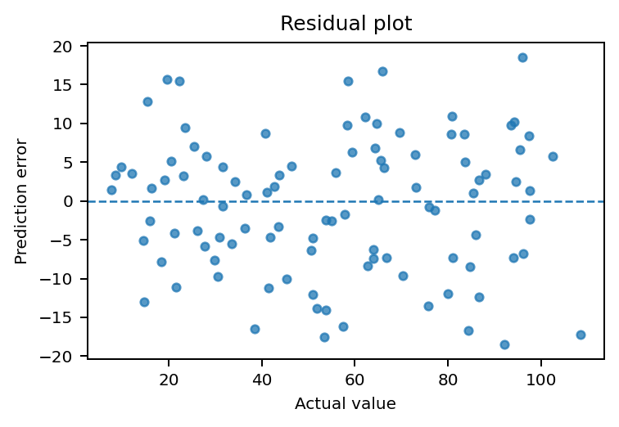
Numeric Prediction: Core Evaluation Metrics
MAE
Mean absolute error. Easy to interpret in the original unit.
RMSE
Root mean squared error. Penalises large errors more strongly.
For prediction models, a “good” result depends on the acceptable error size in the real context. A delivery-time model with MAE = 2 minutes may be useful; MAE = 2 days may not.
R²
Explains the proportion of variance captured by the model.
Module 7 • Model Evaluation
9

Slide 10
How to Evaluate Prediction Models in Practice
Use a baseline
Inspect residuals
Compare against a simple rule, e.g., predict the average or last known value.
Look for systematic bias, outliers, or larger errors for specific groups.
Choose meaningful units
Check generalisation
Report error in business terms: dollars, minutes, days, units sold.
Use train/test split or cross-validation; avoid tuning on the final test set.
Prediction evaluation is about error size, error pattern, and whether the model improves on a simple baseline.
Module 7 • Model Evaluation
10

Slide 11
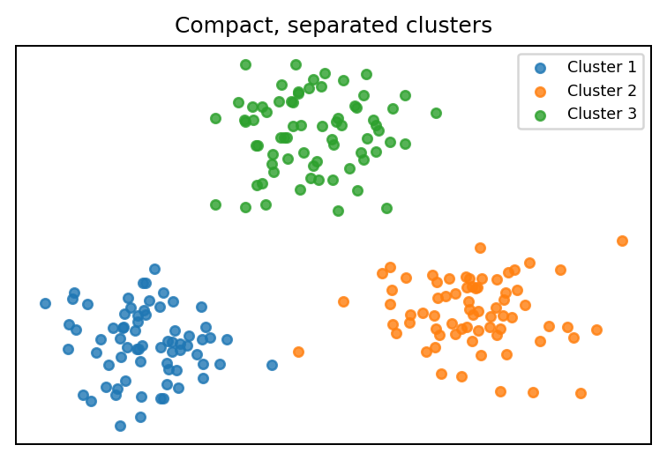
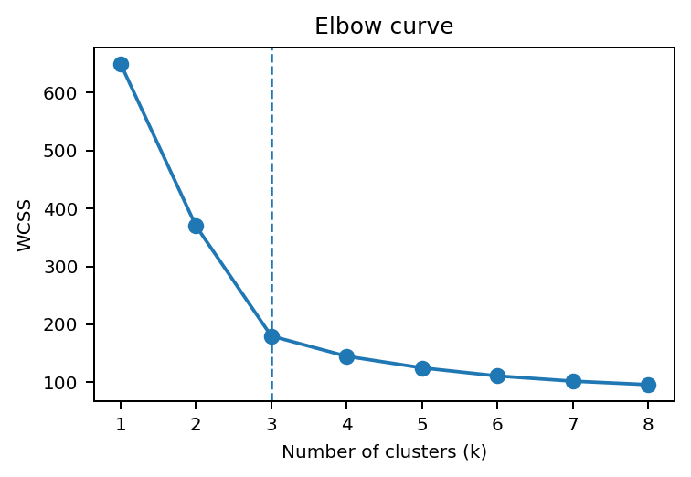
Clustering: What Does “Good” Mean Without Labels?
Internal validation
Practical validation
Silhouette score
Davies–Bouldin index
Calinski–Harabasz index
WCSS / elbow curve
Are clusters interpretable?
Are cluster sizes useful?
Are clusters stable across samples?
Do they support decisions?
A high clustering score is not enough. A segmentation is valuable only if stakeholders can understand, name, and act on the clusters.
Module 7 • Model Evaluation
11

Slide 12
Clustering Evaluation: Common Pitfalls
Too many clusters
One giant cluster
May look mathematically better, but becomes hard to interpret and act on.
Can hide important subgroups and reduce business usefulness.
Unstable clusters
No domain meaning
If clusters change dramatically with small data changes, decisions become risky.
A cluster must be explainable using variables that matter in the problem context.
Best practice: combine cluster metrics with profiling tables and domain interpretation.
Module 7 • Model Evaluation
12

Slide 13
Compact Metric Selection Guide
Problem type
Typical output
Useful metrics
Report focus
Classification
Class label / probability
Confusion matrix; accuracy; precision; recall; F1; ROC-AUC
Which errors matter?
Prediction
Numeric value
MAE; RMSE; R²; residual plots
How large are the errors?
Clustering
Group assignment
Silhouette; elbow/WCSS; cluster profiling; stability
Are groups useful and interpretable?
A strong report justifies why the chosen metric fits the analytical problem, not merely which metric is highest.
Module 7 • Model Evaluation
13

Slide 14
Assessment 2: How Module 7 Helps
In your analysis
In your report
In your reflection
Split data into training and testing sets.
Build candidate models.
Evaluate with suitable metrics.
Compare models fairly.
Define each metric briefly.
Interpret the score in context.
Include visual evidence where useful.
State limitations honestly.
Discuss imbalance, small samples, or noisy data.
Mention error costs and practical risk.
Explain why the final model is appropriate.
Minimum expectation: report the data split, model type, evaluation metrics, metric values, and interpretation.
Module 7 • Model Evaluation
14

Slide 15
Key Takeaways
Takeaways
Core learning resources
Evaluation estimates future performance, not memorisation.
Accuracy alone can be misleading, especially for imbalanced data.
Different model types need different evaluation metrics.
Use cross-validation or train/test split to make estimates credible.
Report results clearly and transparently.
Han, Pei & Kamber: classifier metrics and cost-sensitive evaluation.
Witten, Frank, Hall & Pal: training/testing and cross-validation.
Analytics Vidhya: overview of common evaluation metrics.
Evaluation is the bridge between “the model runs” and “the model is useful”.
Module 7 • Model Evaluation
15

