Slide 1

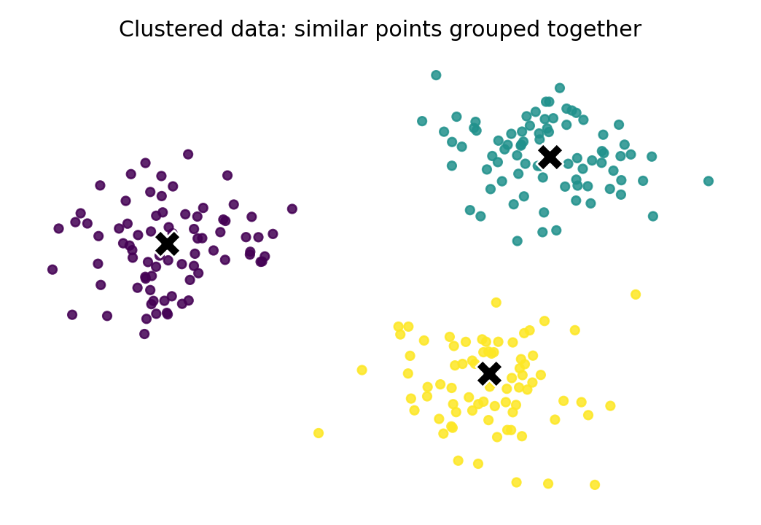
Module 9
Clustering
Finding structure in unlabelled data
Lets wait for another 15 mins To allow more students join us Q&A session now!
Clustering groups similar data points together — without a known response label.
Module 9 • Clustering
1

Slide 2
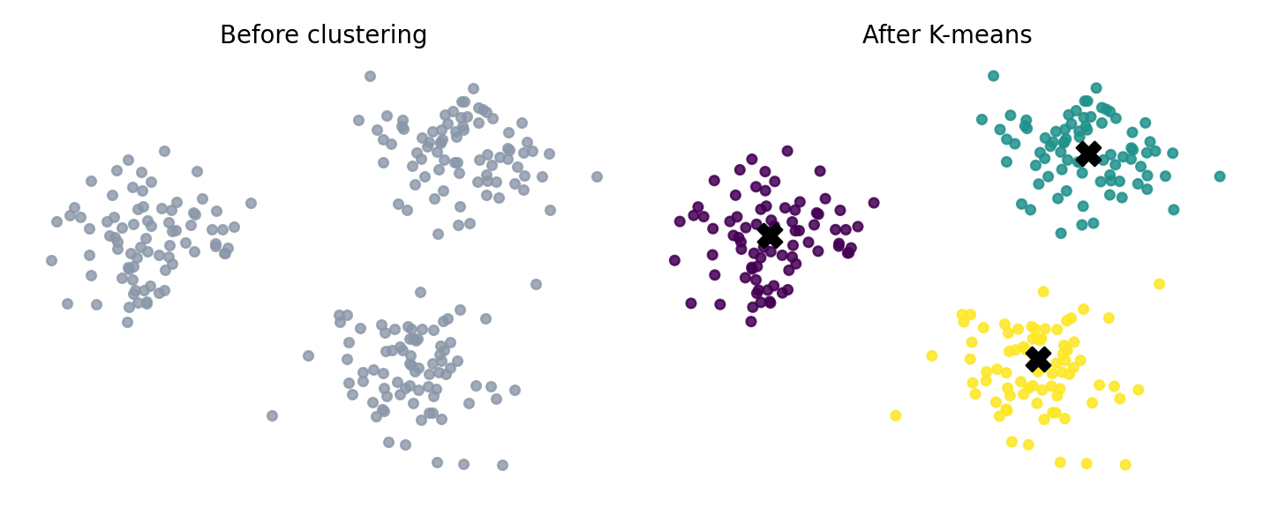
Why clustering matters
Exploratory modelling when we do not yet know the groups
Core idea
Data in the same cluster should be similar.
Data in different clusters should be dissimilar.
The algorithm proposes groups; humans still interpret them.
Common use cases
Customer segmentation
Product grouping
Gene expression pattern discovery
Document or image organisation
Clustering is not just prediction; it is discovery.
Module 9 • Clustering
2

Slide 3
Learning outcomes and Assessment 3 connection
Subject learning outcomes
Assessment 3 progression
Apply data science principles to data cleaning, manipulation and visualisation.
Design analytical models based on given problems.
Assessment 3 is due at the end of Module 12.
You will generate clusters based on a given dataset.
You need to explain what the clusters mean, not only run code.
This module prepares you to
understand the clustering problem;
use K-means as the required algorithm;
choose and justify a suitable K value;
interpret and visualise the resulting clusters.
Module 9 • Clustering
3

Slide 4
Cluster analysis is a workflow
Xu and Wunsch describe clustering as more than simply applying an algorithm
1. Feature selection
or extraction
2. Choose
algorithm
3. Validate
clusters
4. Interpret
results
Keep variables that reflect meaningful similarity.
Select K-means, hierarchical, DBSCAN or another method.
Check cohesion, separation, stability and practical sense.
Translate groups into business or scientific insight.
Weak feature choices can produce weak clusters, even when the algorithm runs correctly.
Module 9 • Clustering
4

Slide 5
Clustering vs classification and regression
Task
Target variable?
Typical question
Example
Classification
Yes — categorical
Which class does this record belong to?
Income <=50K or >50K
Regression
Yes — numeric
What value should we predict?
House price / sales / demand
Clustering
No response label
What groups naturally exist?
Customer segments
Clustering is unsupervised: we use patterns in the input variables to form groups.
Module 9 • Clustering
5

Slide 6
Applications: where clustering creates value
Retail and marketing
eCommerce products
Segment customers by purchasing habits, loyalty, price sensitivity and channel behaviour.
Group similar products to improve navigation, recommendations and inventory strategy.
Science and health
Operations and risk
Find clusters of genes, patients or samples with similar biological or clinical profiles.
Detect unusual behaviour by comparing observations against normal groups.
The output is only useful if the cluster profile can support a decision.
Module 9 • Clustering
6

Slide 7
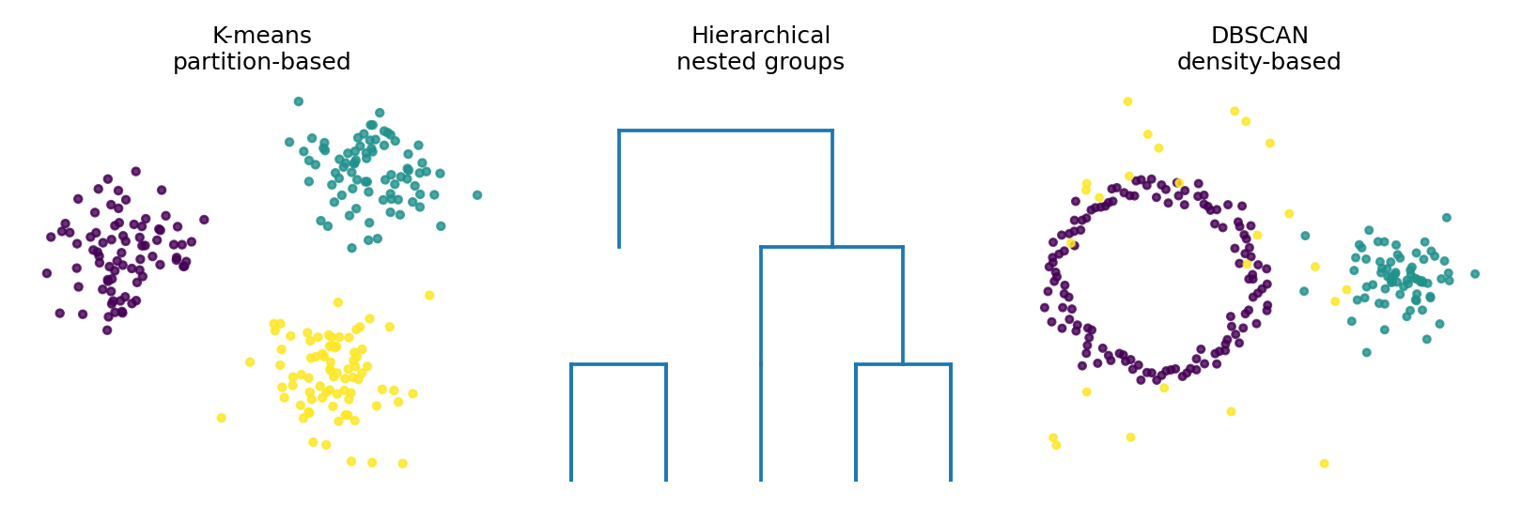
Types of clustering algorithms
Different methods define “similar” and “group” in different ways
K-means
Pre-set number of clusters K.
Works well for compact, roughly spherical clusters.
Sensitive to scaling and initialisation.
Hierarchical clustering
Builds nested clusters.
Can be visualised as a dendrogram.
Useful for exploring relationships.
DBSCAN
Finds dense regions and noise.
Does not require K.
Useful for irregular cluster shapes.
Module 9 • Clustering
7

Slide 8
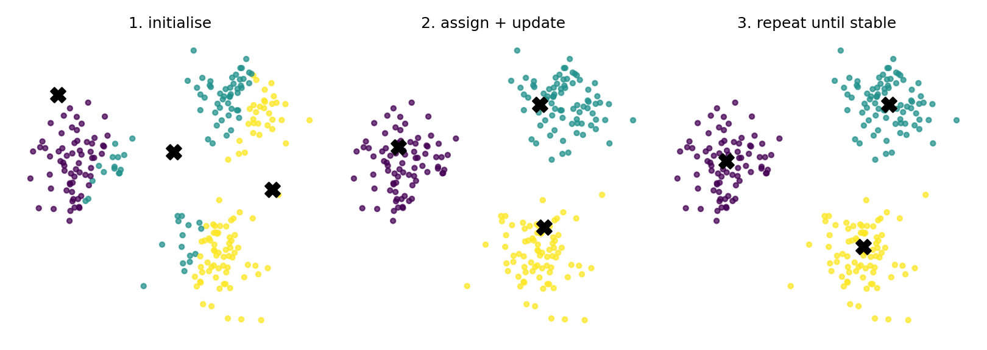
K-means clustering: the intuition
What K-means tries to do
Choose K cluster centres.
Assign each point to the nearest centre.
Move each centre to the average position of its assigned points.
Repeat until assignments stop changing or improvement becomes small.
minimise
within-cluster distance
Main assumption
Points in the same cluster should be close to the same centroid.
Module 9 • Clustering
8

Slide 9
K-means algorithm: step-by-step
Set K
Initialise centroids
Assign points
Decide how many clusters you want to create.
Start with K initial centre points.
Each point goes to its nearest centroid.
Update centroids
Repeat
Move each centroid to the average of assigned points.
Continue until cluster assignments stabilise.
In PySpark, we usually provide a feature vector and set K using the KMeans estimator.
Module 9 • Clustering
9

Slide 10
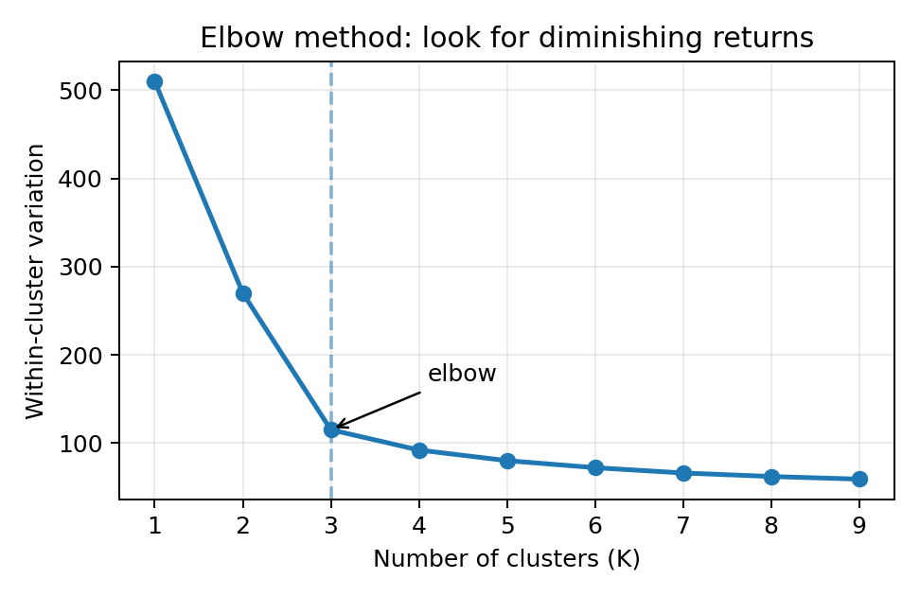
Choosing the number of clusters: K
Elbow method
Try several K values.
Plot within-cluster variation.
Look for the point where improvement slows down.
The elbow is a guide, not a rule.
Human interpretation still matters
Can the clusters be explained?
Do they support the business or research goal?
Are the cluster sizes useful?
Would a stakeholder act on this segmentation?
The “best” K is often a balance between statistical fit and practical interpretability.
Module 9 • Clustering
10

Slide 11
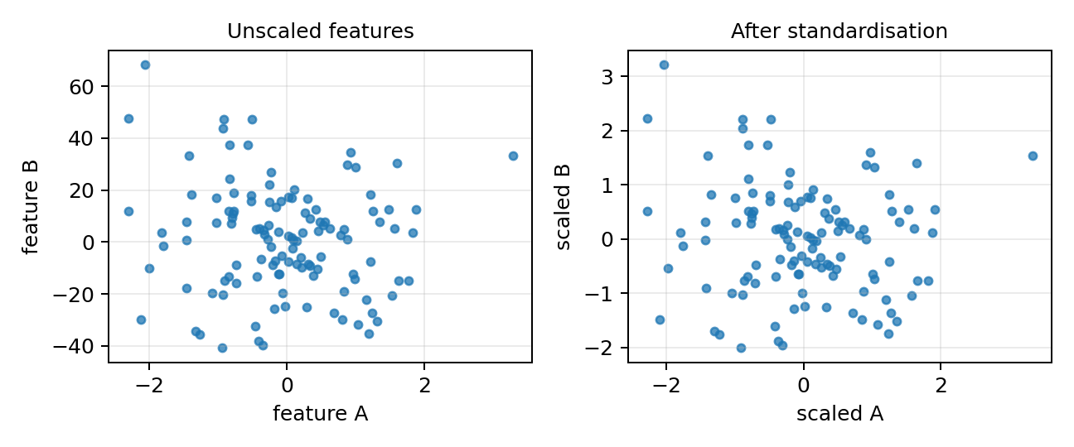
Feature scaling and feature selection matter
Why scaling matters
K-means uses distance.
Variables with larger numerical ranges can dominate the clustering.
Standardisation makes variables more comparable.
Feature selection question
Which variables actually represent similarity?
Do we include IDs or target labels? Usually no.
Can we explain clusters from the selected variables?
A technically correct K-means model can still be conceptually poor if the wrong features are used.
Module 9 • Clustering
11

Slide 12
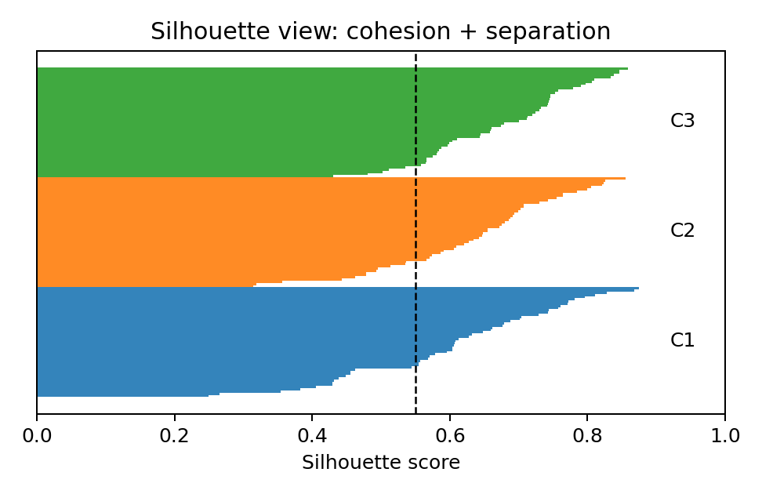
Validating clustering results
There is no true class label, so validation is different from classification accuracy
Internal validation
Cohesion: points in a cluster are close together.
Separation: different clusters are far apart.
Silhouette score combines both ideas.
Practical validation
Do cluster profiles make sense?
Are clusters stable across runs or samples?
Does the result support action or interpretation?
Can stakeholders understand the cluster names?
Module 9 • Clustering
12

Slide 13
Interpreting clusters: from labels to insight
Do not stop at “Cluster 0, Cluster 1, Cluster 2”.
Profile each cluster using summary statistics and visualisations.
Compare key variables across clusters.
Give clusters meaningful names only after inspecting them.
Explain what the cluster pattern means for the problem.
Example: retail customer clustering
Cluster A: frequent, high-value buyers
Cluster B: price-sensitive occasional buyers
Cluster C: new or low-engagement customers
A good interpretation connects
cluster behaviour
possible causes
recommended actions
limitations of the grouping
Module 9 • Clustering
13

Slide 14
Common pitfalls in clustering
Choosing K blindly
Ignoring scaling
Run multiple K values and justify your choice.
Standardise numeric features when distance is important.
Using irrelevant variables
Over-interpreting clusters
Remove IDs, leakage variables and unhelpful attributes.
Clusters are patterns, not guaranteed real-world categories.
Forgetting context
Weak visuals
The result must connect back to the business or research problem.
Use scatter plots, profile charts and cluster summaries.
Module 9 • Clustering
14

Slide 15
Assessment 3 preparation checklist
Before modelling
During modelling
Understand the dataset and variables.
Clean missing or incorrect values.
Select relevant features for clustering.
Scale numeric features where needed.
Try more than one K value.
Record parameter choices.
Use K-means as required.
Visualise and compare cluster outputs.
In your report
Explain why the selected K is reasonable.
Describe each cluster in plain language.
Connect findings to the case context.
Mention limitations and possible improvements.
Marks usually come from reasoning and interpretation, not just running the algorithm.
Module 9 • Clustering
15

Slide 16
Learning resources and wrap-up
Essential resources
Key takeaways
Xu & Wunsch (2009): cluster analysis workflow and applications.
Le (2019): clustering types — K-means, hierarchical, DBSCAN.
Sharma (2019): K-means concepts and implementation.
Sullivan (2017): PySpark K-means practical demonstration.
Clustering is unsupervised pattern discovery.
K-means requires a selected K and distance-based features.
Feature scaling and interpretation are central.
Good cluster analysis ends with useful explanations.
Next: practical K-means clustering using PySpark.
Module 9 • Clustering
16

