Slide 1

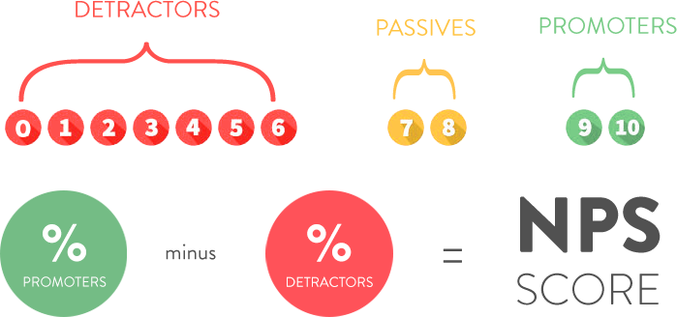

RESEARCH PROPOSAL | ASSESSMENT 3
RESEARCH METHODOLOGIES
Prof Dr. BUSHRA NAEEM
LUIS G. B. A. FARIA – ID A00187785
Exploring the relationship between
Net Promoter Score and Revenue Growth
in Healthcare Clinics
WHAT IS NET PROMOTER SCORE???
December, 2025

Slide 2


THE PROBLEM
NPS widely adopted → But never validated against revenue
RQ1: Can NPS predict revenue growth?
RQ2: How strong is this correlation?
$ ?

Slide 3
POSITIONING WORK IN THE FIELD
Patient Experience → Loyalty
(Godovykh & Pizam, 2023)
✓ Established
NPS → Intention to recommend (Reichheld, 2003; Dawes, 2024)
✓ Validated
AI Sentiment Analysis (technical) (Alkhnbashi et al., 2024)
✓ Feasible
NPS → Revenue in HEALTHCARE This Study fills this gap
✗ MISSING
Key Gap: Assumed correlation never tested empirically

Slide 4

KNOWLEDGE GAP & CONCEPTUAL FRAMEWORK
Patient
Feedback
NPS Score
Loyalty
Intent
Revenue
Growth
✓
✓
?
Research Gap: No one has tested if this pathway actually works in healthcare

Slide 5
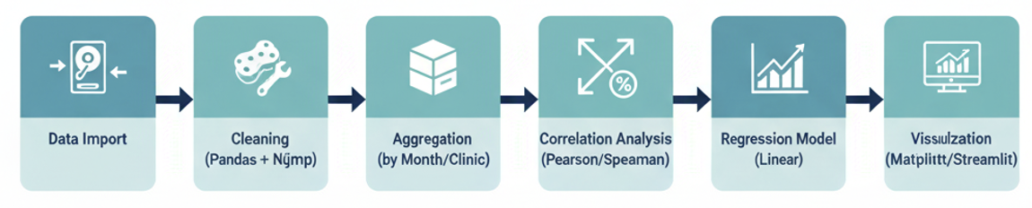
PROPOSED METHODOLOGY
Quantitative Correlational Design (Pragmatic-Positivist)
Data Import
Cleaning
(Pandas + Numpy)
Aggregation
(By Month/Clinic)
Correlation Analysis
(Pearson/Spearman)
Regression Model
(Linear)
Visualization
(Streamlit/Jinja2)
Triangulation: Temporal + Spatial + Methodological

Slide 6
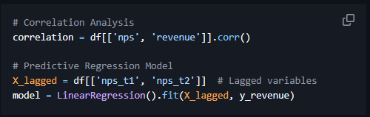
METHODS & TOOLS
Analytical Workflow:
• Descriptive Statistics (mean, SD, distribution)
• Pearson/Spearman Correlation (strength + direction)
• Linear Regression (predictive capacity with lags)
• K-means Clustering (clinic behavioral segmentation)
Ethics & Governance:
• Anonymized data (clinic-month aggregation)
• Institutional consent (Pro-Corpo Estética)
• Researcher reflexivity statement (former collaborator)
• LGPD + GDPR + Australian Privacy Act compliant

Slide 7

EXPECTED CONTRIBUTIONS & OUTCOMES
Three Possible Results:
Strong Correlation
Moderate Correlation
Weak Correlation
Validate NPS as strategic KPI
Simple tracking systems sufficient
Cost-effective patient monitoring
Partial validation (NPS provides some signal)
Justify AI sentiment enhancement investment
Richer feedback dimensions needed
Challenge NPS validity in healthcare
Redirect to NLP-based alternatives
Capture nuancedemotional/experiential data
Regardless of outcome, managers get evidence, not assumptions

Slide 8
SIGNIFICANCE & IMPACT
Healthcare Managers
Validated (or invalidated)
financial KPI.
Academic Research
First empirical NPS-revenue
study in healthcare context
Torrens "Here for Good" Ethos
Ethical data-driven decisions & sustainable healthcare practice
Broader Impact
• Replicable framework for service industries
• Bridge between patient experience and business outcomes
• Foundation for future mixed-methods research

Slide 9
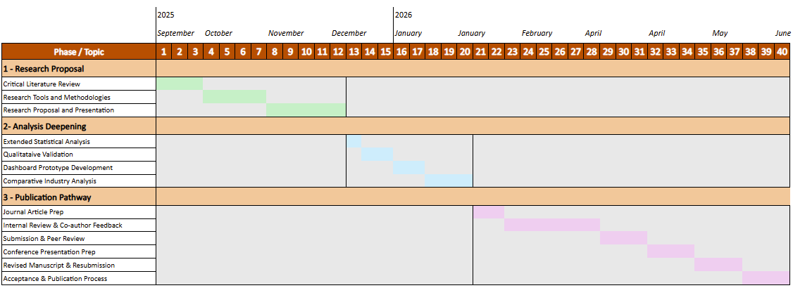
TIMELINE

Slide 10

STATEMENT OF ACKNOWLEDGEMENT
I acknowledge that I have used OpenAI’s ChatGPT (GPT-5) to assist in the planning, outlining, and refinement of my presentation for REM502 – Assessment 3. The tool supported me in structuring slide content, improving clarity of written explanations, and enhancing the overall flow of the presentation.
I confirm that the use of the AI tool has been in accordance with the Torrens University Academic Integrity Policy and TUA, Think, and MDS’s Position Paper on the use of AI. I confirm that the final presentation and its analysis are authored by me and represent my own understanding, research, and critical thinking. I take full responsibility for the final content of this presentation.

Slide 11
REFERENCES
Alkhnbashi, O. S., Mohammad, R., & Hammoudeh, M. (2024). Aspect-based sentiment analysis of patient feedback using large language models. Big Data and Cognitive Computing, 8(12). https://doi.org/10.3390/bdcc8120167
Angelis, J. N., Murthy, R. S., Beaulieu, T., & Miller, J. C. (2024). Better angry than afraid: the case of post data breach emotions on customer engagement. IEEE Transactions on Engineering Management, 71, 2593–2605. https://doi.org/10.1109/TEM.2022.3189599
Bryman, A. (2016). Social research methods (5th ed.). Oxford University Press.
Cahya, V. N. C., Setyanto, R., & Paradise, P. (2025). Analysis of the effectiveness of loyalty membership programs in increasing customer retention using net promoter score (NPS) with information system support. Eduvest-Journal of Universal Studies, 5(9), 10974-10983.
Chen, E. (2023). Growth product manager’s handbook. O’Reilly Media.
Cohen, J. (1988). Statistical power analysis for the behavioral sciences (2nd ed.). Routledge.
Creswell, J. W., & Plano Clark, V. L. (2023). Designing and conducting mixed methods research (4th ed.). SAGE Publications.
Dawes, J. G. (2024). The net promoter score: What should managers know? International Journal of Market Research, 66(2–3), 182–198. https://doi.org/10.1177/14707853231195003
Dawes, J. G. (2024). Net promoter and revenue growth: An examination across three industries. Australasian Marketing Journal, 32(1), 4-18.
Field, A. (2018). Discovering statistics using IBM SPSS Statistics (5th ed.). SAGE Publications.
Godovykh, M., & Pizam, A. (2023). Measuring patient experience in healthcare. International Journal of Hospitality Management, 112, 103405. https://doi.org/10.1016/j.ijhm.2022.103405
Mar, J., & Armaly, P. (2023). Mastering customer success. O’Reilly Media.
Morgan, D. L. (2014). Pragmatism as a paradigm for social research. Qualitative Inquiry, 20(8), 1045–1053. https://doi.org/10.1177/1077800413513733
Pallant, J. (2020). SPSS survival manual (7th ed.). Routledge.
Polonsky, M. J., & Waller, D. S. (2019). Quantitative data analysis. In Designing and managing a research project (4th ed., pp. 222-254). SAGE Publications. https://doi.org/10.4135/9781544316499
Shankar, R., & Yip, A. (2024). Transforming patient feedback into actionable insights through natural language processing: A knowledge discovery and action research study. JMIR Formative Research. https://doi.org/10.2196/69699
Wohlin, C., Runeson, P., Höst, M., Ohlsson, M. C., Regnell, B., & Wesslén, A. (2012). Experimentation in software engineering. Springer.
Wohlin, C., & Runeson, P. (2021). Guiding the selection of research methodology in industry–academia collaboration in software engineering. Information and Software Technology, 140, 106678. https://doi.org/10.1016/j.infsof.2021.106678
Xiao, Y., Li, C., Thürer, M., Liu, Y., & Qu, T. (2022). Towards lean automation: Fine-grained sentiment analysis for customer value identification. Computers and Industrial Engineering, 169. https://doi.org/10.1016/j.cie.2022.108186

Slide 12
RESEARCH PROPOSAL | ASSESSMENT 3
RESEARCH METHODOLOGIES
Prof Dr. BUSHRA NAEEM
LUIS G. B. A. FARIA – ID A00187785
Thank you!
December, 2025

