Slide 1


CLOUD COMPUTING FUNDAMENTALS (CCF501) ASSESSMENT 1 Prof Dr. DiVyA leekha LUIS G. B. A. FARIA – ID A00187785
Cloud Computing for ABC Enterprise
Key Contributions to Business Automation
March, 2026

Slide 2
WHAT IS CLOUD COMPUTING?
On-demand delivery of compute, storage and services over the internet (Mell & Grance, 2011).
On-demand
Self Service
Measured
Service
NIST
Broad
Network Access
Rapid
Elasticity
Resource
Pooling
Key shift: from owning capacity → renting capability

Slide 3
BENEFITS OF CLOUD COMPUTING
B1 – Cost Efficiency
Traditional IT (CapEx)
Cloud – ABC (OpEx)
Large upfront hardware purchase
No upfront servers
Idle capacity during low demand
Pay per compute hour + GB-month
Full ops team required
Provider manages infrastructure
Fixed costs regardless of usage
~80% reduction in start-up IT costs
COST SHIFT

Slide 4
BENEFITS OF CLOUD COMPUTING
B2 & B3 – Scale without Limit & Less Overhead
Rapid Elasticity: ABC’s 10x Growth absorbed by Auto Scaling
Auto scaled
Demand
ELB
Capacity
EC2
10x surge
No manual intervention
Customer Demand
Infra Capacity
Month 0
Month 1

Slide 5
CHALLENGES OF CLOUD MIGRATION
Challenge
Example
Mitigation
Security & Privacy
PII + payment data
IAM least-privilege, MFA, encryption, shared responsibility model
Cost Volatility
Pay-as-you-go can spiral without guardrails
FinOps: budget alerts, resource tagging, rightsizing, reserved pricing
Vendor Lock-in + Skills Gap
Migration cost + mindset shift
Portability-first (containers, standard DBs), targeted cloud upskilling

Slide 6
RECOMMENDED MODELS FOR ABC
Cloud Service Models
IaaS
Compute + Config
Flexibility
PaaS
Managed DB, load balancing, serverless
SaaS
Limited customization
Cloud Deployment Models
Private cloud
High cost, limited elasticity
Hybrid cloud
Premature complexity
Public cloud
Scalable, automated,
cost-effective

Slide 7
RECOMMENDED COST MODEL
SaaS
PaaS
IaaS
Spot capacity
background jobs + analytics pipelines
Pay-as-you-go
demand spikes via Auto Scaling
Hybrid Cost Model
Reserved
stable tiers (web/app servers, databases)

Slide 8


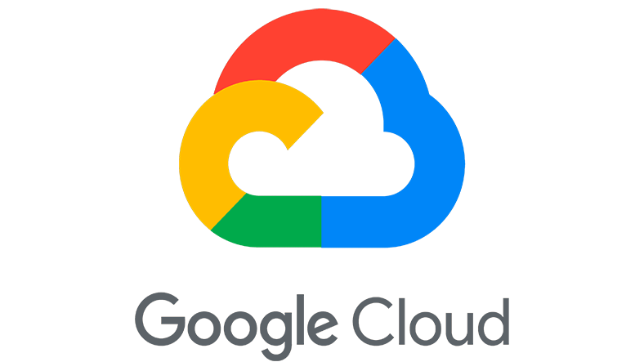
WHY AWS?
Provider
Ecosystem Fit
Load Balancing
Serverless
ABC Alignment
Broadest managed-service catalogue
ELB – native Route53 integration
Lambda – event-driven, zero idle cost
Best fit – Route 53 already in stack
Microsoft /
enterprise-aligned
Application gateway – extra config needed
Azure Functions – strong but separate ecosystem
No existing Azure signals in ABC
Analytics and ML-first
Cloud load balancing – GKE-oriented
Cloud Run / Functions – container first
No analytics-heavy workloads in ABC now

Slide 9






AWS IN ACTION
User/Browser
HTTPS request
Route 53 DNS
Route to endpoint
Elastic Load
balancer (ELB)
Distribute traffic
Query / Write
EC2 Instances
RDS
Managed DB
Return data
Event trigger (order placed / payment confirmed)
Store / Retrieve
AWS Lambda
S3 Storage
λ
Notification / Assignment
Return assets

Slide 10
CONCLUSION
Public cloud | IaaS+PaaS | Hybrid cost model | AWS
Key Outcomes Unlocked:
80% cost reduction (measured service)
10x surge absorbed (rapid elasticity)
Zero-headcount scaling (resource pooling + Auto Scaling)
Workflow automation (Lambda event triggers)

Slide 11
REFERENCES
Amazon Web Services. (n.d.-a). AWS Well-Architected Framework. https://aws.amazon.com/architecture/well-architected/
Amazon Web Services. (n.d.-b). AWS Pricing. https://aws.amazon.com/pricing/
Bittok, T. (2022, January 22). Cloud total cost of ownership. LinkedIn Pulse. https://www.linkedin.com/pulse/cloud-total-cost-ownership-theophilus-bittok-/
Carpenter, T. (2020, May 27). AWS Certified Solutions Architect – Associate (SAA-C02) Cert Prep 1: Cloud services overview. LinkedIn Learning. https://www.linkedin.com/learning/aws-certified-solutions-architect-associate-saa-c02-cert-prep-1-cloud-services-overview/benefits-of-cloud-computing
Eliaçık, E. (2022). Pros and cons of cloud computing. Dataconomy. https://dataconomy.com/2022/05/pros-and-cons-of-cloud-computing-2022/
IBM. (n.d.-a). SaaS, PaaS, IaaS explained. IBM Cloud. https://www.ibm.com/think/topics/iaas-paas-saas
IBM. (n.d.-b). What is a public cloud? IBM. https://www.ibm.com/think/topics/public-cloud
IBM. (n.d.-c). What is private cloud? IBM. https://www.ibm.com/think/topics/private-cloud
Linthicum, D. (2021, May 25). Learning cloud computing: Core concepts. LinkedIn Learning. https://www.linkedin.com/learning/learning-cloud-computing-core-concepts-13710481/
Manvi, S., & Shyam, G. K. (2021). Cloud computing: Concepts and technologies (Chapter 4). CRC Press. https://learning-oreilly-com.torrens.idm.oclc.org/library/view/cloud-computing/9781000338058/
McHaney, R. (2021). Cloud technologies: An overview of cloud computing technologies for managers. Wiley. https://ieeexplore-ieee-org.torrens.idm.oclc.org/servlet/opac?bknumber=9820907
Mell, P., & Grance, T. (2011). The NIST definition of cloud computing (Special Publication 800-145). National Institute of Standards and Technology. https://doi.org/10.6028/NIST.SP.800-145
Naved, M., Sanchez, D. T., Dela Cruz, A. P., Jr., Peconcillo, L. B., Jr., Peteros, E. D., & Tenerife, J. J. L. (2022). Identifying the role of cloud computing technology in management of educational institutions. Materials Today: Proceedings, 51(8), 2309–2312. https://doi.org/10.1016/j.matpr.2021.11.414
Nishimura, H. (2022, August 30). Introduction to AWS for non-engineers: 1 cloud concepts. LinkedIn Learning. https://www.linkedin.com/learning/introduction-to-aws-for-non-engineers-1-cloud-concepts-2/
Shore, J. (2020). Cybersecurity with cloud computing: Service models. LinkedIn Learning. https://www.linkedin.com/learning/cybersecurity-with-cloud-computing-2/

Slide 12
CLOUD COMPUTING FUNDAMENTALS ASSESSMENT 1 Prof Dr. DiVyA leekha LUIS G. B. A. FARIA – ID A00187785
Thank you!
March, 2026

