Slide 1

Module 6
A
Classification
?
B
From cleaned data to predictive models
C
predict one class from many possibilities
Lets wait for another 15 mins To allow more students join us Q&A session now!
Big Data and Analytics

Slide 2
Learning Outcomes and Assessment Progression
Subject Learning Outcome
Assessment 2 connection
d) Design analytical models based on given problems. In this module, that means translating a business or analytical question into a classification task, selecting a suitable algorithm, and justifying the modelling approach.
Assessment 2 is due at the end of Module 8. Start preparing now by understanding classification models, especially decision trees, because decision trees are commonly used for interpretable classification tasks in PySpark MLlib.
Practical direction: after today’s concepts, the next step is to implement a simple decision tree in Jupyter Notebook / PySpark.
Module 6 • Classification

Slide 3
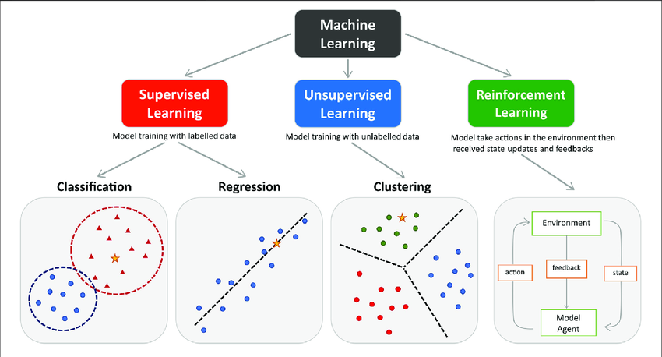
Supervised and Unsupervised Machine Learning
Supervised machine learning is generally used to classify data or make predictions, whereas unsupervised learning is generally used to understand relationships within datasets.
Supervised machine learning is much more resource-intensive because of the need for labelled data.
Module 6 • Classification
Notes:
Image source:https://www.researchgate.net/publication/354960266_Machine_Learning_Techniques_for_Personalised_Medicine_Approaches_in_Immune-Mediated_Chronic_Inflammatory_Diseases_Applications_and_Challenges

Slide 4
Why Classification Matters
Problem framing
Typical outputs
Many business questions ask for a decision category, not just a number.
A classification model learns patterns from examples that already have a known label.
The model can then classify new unseen cases.
Will a customer subscribe: yes or no?
Is this transaction fraud or genuine?
Which risk group does this customer belong to?
Which product category best matches this item?
→
Module 6 • Classification

Slide 5
A Simple Classification Workflow
1
2
3
4
5
6
Define classes
→
Prepare features
→
Split data
→
Train model
→
Evaluate model
→
Use model
Before modelling
After modelling
Check the label is meaningful and available.
Choose relevant and ethical features.
Assess performance on unseen data.
Communicate strengths, limits, and risks.
The workflow is repeatable: poor evaluation results often send you back to features, cleaning, or model choice.
Module 6 • Classification

Slide 6
Common Classification Algorithms
Rule-based classifiers
Naïve Bayes
Decision trees
Learn IF–THEN rules. Easy to explain, but may be too simple for complex data.
Probabilistic classifier using feature likelihoods. Fast and strong for text or simple baselines.
Split the data into branches. Intuitive, visual, and suitable for assignment-style explanation.
Logistic regression
Random forest
Gradient boosting
Linear decision boundary for binary or multiclass classification. Interpretable coefficients.
An ensemble of decision trees. Usually more accurate and robust than a single tree.
Sequentially improves weak trees. Powerful but less transparent and needs tuning.
Module 6 • Classification

Slide 7
Two Foundations: Rules and Probabilities
Rule-based classification
Naïve Bayes classification
A rule classifier predicts a class using human-readable logic. Example: IF balance > 2000 AND previous contact = yes THEN predicted class = likely subscriber Strength: very interpretable Limitation: may not capture complex interactions
Naïve Bayes estimates the probability of each class given the observed features. It is “naïve” because it assumes features are conditionally independent given the class. Strength: fast and scalable Limitation: independence assumption can be unrealistic
Both are useful baselines. A baseline helps you judge whether a more complex model is actually worth using.
Module 6 • Classification

Slide 8
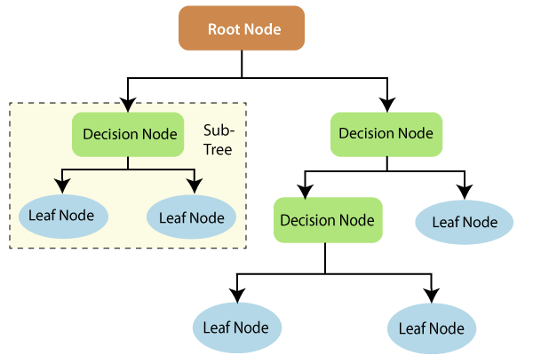
Decision Trees: Divide-and-Conquer Classification
Structure of a Decision Tree:
Root Node: It represents the entire population or sample. It further gets divided into two or more homogeneous sets.
Decision Node: When a sub-node splits into further sub-nodes, then it is called the decision node.
Leaf/Terminal Node: Nodes that do not split are called Leaf or Terminal nodes.
Pruning: The process of removing the unwanted branches from the tree.
Source: Imakash3011.medium.com
Module 6 • Classification
10

Slide 9
How a Decision Tree Learns Splits
Learning objective
Numeric attributes
At each node, the tree searches for a feature split that makes child nodes more “pure”.
A pure node contains mostly one class.
Common split criteria include information gain, entropy, and Gini impurity.
The process repeats until a stopping rule is reached.
For a numeric feature, the tree tests threshold splits such as age < 35, balance > 1000, or duration ≤ 120.
Categorical attributes
For categorical features, the tree tests category groups such as job in {student, retired} or housing = yes.
Good splits reduce uncertainty: after the split, the model should be more confident about the predicted class.
Module 6 • Classification
11

Slide 10
Decision Tree: Practical Considerations
Numeric attributes
Missing values
Choose threshold splits and avoid arbitrary manual binning unless needed for interpretation.
Decide whether to impute, keep an “unknown” category, or drop records depending on meaning and scale.
Overfitting
Pruning / stopping
A fully grown tree can memorise training data and perform poorly on unseen data.
Control tree depth, minimum records per leaf, or post-prune weak branches to improve generalisation.
Practical modelling includes assumptions, parameter choices, and evidence that the model generalises.
Module 6 • Classification
12

Slide 11
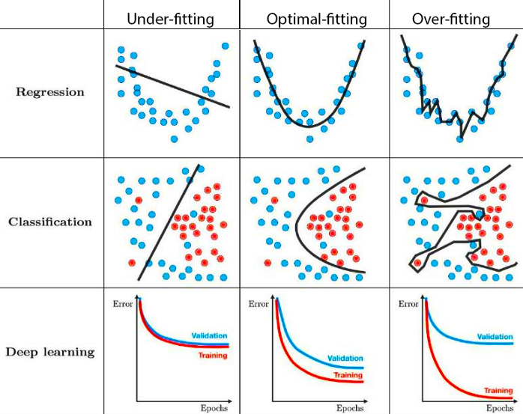
Overfitting: When the tree is too complex and captures noise rather than the underlying pattern. This means it may perform well on the training data but poorly on unseen data.
Module 6 • Classification

Slide 12
Evaluating Classification Models
Metric
Question it answers
Confusion matrix
Predicted yes
Predicted no
Accuracy
What proportion of predictions are correct?
Actual yes
True positive
False negative
Precision
When the model predicts positive, how often is it right?
Actual no
False positive
True negative
Recall
How many true positive cases did the model find?
F1 score
How well does it balance precision and recall?
Key warning
Accuracy can be misleading when classes are imbalanced.
Choose metrics based on business risk.
Module 6 • Classification
13

Slide 13
Classification at Big Data Scale: Spark MLlib
Raw data
Cleaned DataFrame
Feature engineering
MLlib classifier
Predictions
→
→
→
→
Why Spark?
PySpark MLlib ideas
Distributed processing for larger-than-memory datasets.
DataFrame API integrates with Spark SQL and ML pipelines.
Same workflow can scale from local practice to cluster execution.
Transform columns into feature vectors.
Fit classifiers such as decision trees.
Evaluate predictions with standard metrics.
Concept first, code next: the practical session will turn this workflow into PySpark steps.
Module 6 • Classification
14

Slide 14
Preparing for Assessment 2
What to start now
What a strong answer shows
Read the Assessment 2 brief carefully.
Identify the target variable: what class will be predicted?
Check which variables are numeric, categorical, missing, or noisy.
Think about how to encode features for PySpark MLlib.
Plan how you will explain the decision tree result.
Clear problem framing and model choice.
Clean preprocessing and train/test split.
Appropriate evaluation metrics.
Interpretation of important splits or features.
Limitations and practical implications.
Reminder: a classification model is only useful if the result is both technically valid and meaningful for the given problem.
Module 6 • Classification
15

Slide 15
Module 6 Takeaways
1
Classification predicts categorical outcomes using labelled data.
2
Supervised learning requires known labels; unsupervised learning finds structure without labels.
3
Decision trees are interpretable divide-and-conquer models, but need controls against overfitting.
4
Evaluation must match the business risk; accuracy alone is often not enough.
5
PySpark MLlib supports scalable model building for big-data classification tasks.
Discussion prompt: What classification problem could your organisation solve, and what label would you need?
Module 6 • Classification
16

Slide 16
Core Readings
Reference 1
Kelleher, J. D., & Tierney, B. (2018). Data science. MIT Press. Chapter 4: Machine Learning 101.
Reference 2
Witten, I. H., Frank, E., Hall, M. A., & Pal, C. J. (2017). Data mining: Practical machine learning tools and techniques (4th ed.). Morgan Kaufmann. Sections 4.1–4.3 and 6.1.
Reference 3
Koturwar, P., Girase, S., & Mukhopadhyay, D. (2015). A survey of classification techniques in the area of big data.
Use the readings to deepen your understanding before the coding practical and Assessment 2 work.
Module 6 • Classification
17

