Slide 1
Information Extraction – why Google doesn’t even come close
Diana Maynard
Natural Language Processing Group
University of Sheffield, UK
BCS meeting, 25 September 2003

Slide 2
Outline
Information Extraction and Information Retrieval
The MUSE system for Named Entity Recognition
Multilingual MUSE
Future directions

Slide 3
IE is not IR
IE pulls facts and structured information from the content of large text collections (usually corpora). You analyse the facts.
IR pulls documents from large text collections (usually the Web) in response to specific keywords or queries. You analyse the documents.

Slide 4
IE for Document Access
With traditional query engines, getting the facts can be hard and slow
    Where has the Queen visited in the last year?
    Which places on the East Coast of the US have had cases of West Nile Virus?
Which search terms would you use to get this kind of information?
IE would return information in a structured way
IR would return documents containing the relevant information somewhere (if you were lucky)

Slide 5
IE as an alternative to IR
IE returns knowledge at a much deeper level than IR
Constructing a database through IE and linking it back to the documents can provide a valuable alternative search tool.
Even if results are not always accurate, they can be valuable if linked back to the original text

Slide 6
When would you use IE?
For access to news
    identify major relations and event types (e.g. within foreign affairs or business news)
For access to scientific reports
    identify principal relations of a scientific subfield (e.g. pharmacology, genomics)

Slide 7
Application 1 – HaSIE
Aims to find out how companies report about health and safety information
Answers questions such as:
“how many members of staff died or had accidents in the last year?”
“is there anyone responsible for health and safety”
“what measures have been put in place to improve health and safety in the workplace?”

Slide 8
HASIE
Identification of such information is too time-consuming and arduous to be done manually
IR systems can’t cope with this because they return whole documents, which could be hundreds of pages
System identifies relevant sections of each document, pulls out sentences about health and safety issues, and populates a database with relevant information

Slide 9
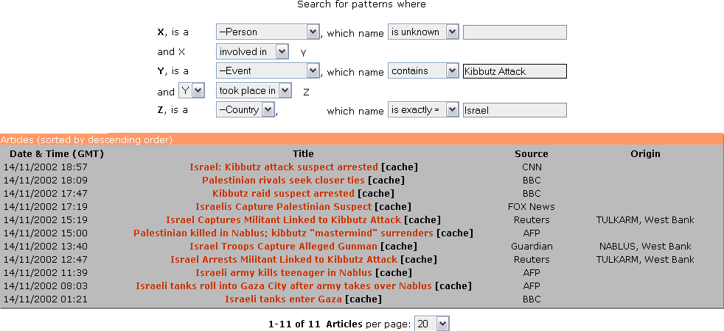
Application 2: KIM
Ontotext’s KIM query and results

Slide 10
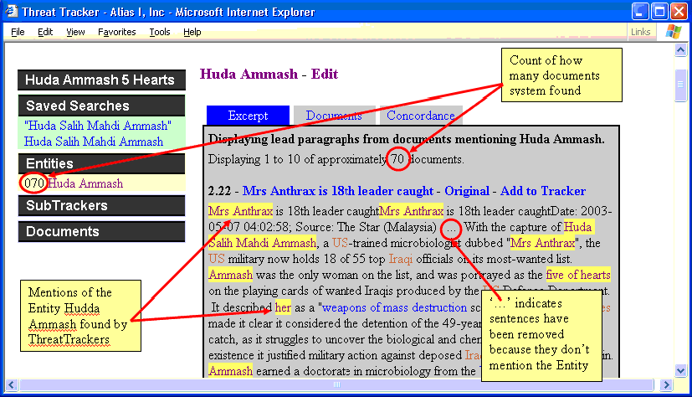
Application 3: Threat tracker

Slide 11
What is Named Entity Recognition?
Identification of proper names in texts, and their classification into a set of predefined categories of interest
Persons
Organisations (companies, government organisations, committees, etc)
Locations (cities, countries, rivers, etc)
Date and time expressions
Various other types as appropriate

Slide 12
Why is NE important
NE provides a foundation from which to build more complex IE systems
Relations between NEs can provide tracking, ontological information and scenario building
Tracking (co-reference) “Dr Head, John, he”
Ontologies “Manchester, CT”
Scenario “Dr Head became the new director of Shiny Rockets Corp”

Slide 13
Two kinds of approaches
Knowledge Engineering
rule based
developed by experienced language engineers
make use of human intuition
require only small amount of training data
development can be very time consuming
some changes may be hard to accommodate
Learning Systems
use statistics or other machine learning
developers do not need LE expertise
require large amounts of annotated training data
some changes may require re-annotation of the entire training corpus

Slide 14
Basic Problems in NE
Variation of NEs – e.g. John Smith, Mr Smith, John.
Ambiguity of NE types: John Smith (company vs. person)
  June (person vs. month)
  Washington (person vs. location)
  1945 (date vs. time)
Ambiguity between common words and proper nouns, e.g. “may”

Slide 15
More complex problems in NE
Issues of style, structure, domain, genre etc.
Punctuation, spelling, spacing, formatting
Dept. of Computing and Maths
Manchester Metropolitan University
Manchester
United Kingdom
> Tell me more about Leonardo
> Da Vinci

Slide 16
List lookup approach - baseline
System that recognises only entities stored in its lists (gazetteers).
Advantages - Simple, fast, language independent, easy to retarget (just create lists)
Disadvantages - collection and maintenance of lists, cannot deal with name variants, cannot resolve ambiguity

Slide 17
Shallow Parsing Approach
(internal structure)
Internal evidence – names often have internal structure. These components can be either stored or guessed, e.g. location:
Cap. Word + {City, Forest, Center, River}
e.g. Sherwood Forest
Cap. Word + {Street, Boulevard, Avenue, Crescent, Road}
e.g. Portobello Street

Slide 18
Problems with the shallow parsing approach
Ambiguously capitalised words (first word in sentence)
[All American Bank] vs. All [State Police]
Semantic ambiguity
"John F. Kennedy" = airport (location)
"Philip Morris" = organisation
Structural ambiguity
[Cable and Wireless] vs.
[Microsoft] and [Dell]
[Center for Computational Linguistics] vs.
message from [City Hospital] for [John Smith]

Slide 19
Shallow Parsing Approach with Context
Use of context-based patterns is helpful in ambiguous cases
"David Walton" and "Goldman Sachs" are indistinguishable
But with the phrase "David Walton of Goldman Sachs" and the Person entity "David Walton" recognised, we can use the pattern "[Person] of [Organization]" to identify "Goldman Sachs“ correctly.

Slide 20
Identification of Contextual Information (1)
Use KWIC index and concordancer to find windows of context around entities
Search for repeated contextual patterns of either strings, other entities, or both
Manually post-edit list of patterns, and incorporate useful patterns into new rules
Repeat with new entities

Slide 21
Examples of semantic patterns
[PERSON] earns [MONEY]
[PERSON] joined [ORGANIZATION]
[PERSON] left [ORGANIZATION]
[PERSON] joined [ORGANIZATION] as [JOBTITLE]
[ORGANIZATION]'s [JOBTITLE] [PERSON]
[ORGANIZATION] [JOBTITLE] [PERSON]
the [ORGANIZATION] [JOBTITLE]
part of the [ORGANIZATION]
[ORGANIZATION] headquarters in [LOCATION]
price of [ORGANIZATION]
sale of [ORGANIZATION]
investors in [ORGANIZATION]
[ORGANIZATION] is worth [MONEY]
[JOBTITLE] [PERSON]
[PERSON], [JOBTITLE]

Slide 22
Contextual Patterns (2)
Automatic collection of context words with particular features
Collect e.g. all verbs preceding a Person annotation (from training data)
Sort verb list by frequency and use cut off threshold (optional)
Verbs can then be used to search for new Persons
Repeat procedure with newly identified Persons

Slide 23
MUSE – MUlti-Source Entity Recognition
An IE system developed within GATE
Performs NE and coreference on different text types and genres
Uses knowledge engineering approach with hand-crafted rules
Performance rivals that of machine learning methods
Easily adaptable

Slide 24
MUSE Modules
Document format and genre analysis
Tokenisation
Sentence splitting
POS tagging
Gazetteer lookup
Semantic grammar
Orthographic coreference
Nominal and pronominal coreference

Slide 25
Switching Controller
Rather than have a fixed chain of processing resources, choices can be made automatically about which modules to use
Texts are analysed for certain identifying features which are used to trigger different modules
For example, texts with no case information may need different POS tagger or gazetteer lists
Not all modules are language-dependent, so some can be reused directly

Slide 26
Multilingual MUSE
MUSE has been adapted to deal with different languages
Currently systems for English, French, German, Romanian, Bulgarian, Russian, Cebuano, Hindi, Chinese, Arabic
Separation of language-dependent and language-independent modules and sub-modules
Annotation projection experiments

Slide 27
IE in Surprise Languages
Adaptation to an unknown language in a very short timespan
Cebuano:
  Latin script, capitalisation, words are spaced
  Few resources and little work already done
  Medium difficulty
Hindi:
  Non-Latin script, different encodings used, no capitalisation, words are spaced
  Many resources available
  Medium difficulty

Slide 28
What does multilingual NE require?
Extensive support for non-Latin scripts and text encodings, including conversion utilities
  Automatic recognition of encoding
  Occupied up to 2/3 of the TIDES Hindi effort
Bilingual dictionaries
Annotated corpus for evaluation
Internet resources for gazetteer list collection (e.g., phone books, yellow pages, bi-lingual pages)

Slide 29
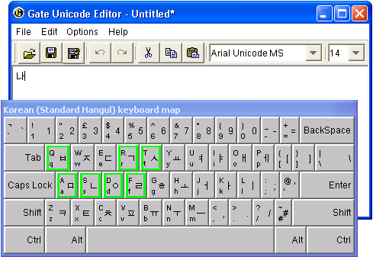
Editing Multilingual Data
GATE Unicode Kit (GUK)
  Complements Java’s facilities
Support for defining
Input Methods (IMs)
currently 30 IMs
for 17 languages
Pluggable in other
applications (e.g.
JEdit)

Slide 30
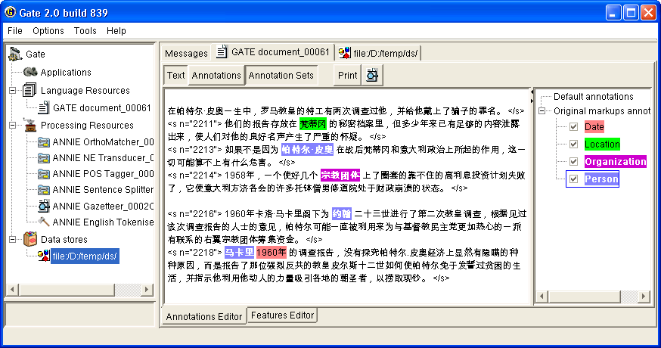
Processing Multilingual Data
All processing, visualisation and editing tools use GUK

Slide 31
State of the art in IE research
ML methods and robust IE systems mean high quality results can be achieved fast
Fast adaptation to new languages is the focus of much current work – especially languages such as Arabic, Chinese, Japanese…
So what does the future hold for IE?

Slide 32
The future of IE
Tools for semantic web
Hierarchical NE recognition
Need for IE in bioinformatics and medicine is becoming increasingly evident
Cross fertilisation of IE and IR , eg. For Question Answering
Collaboration between fields of IE and computational terminology

