Slide 1
Financial tweets project
Leonard box

Slide 2
Overall Goal / Research
The objective of this research is to extract meaningful stock market content that may have influenced investor’s stockholdings.

Slide 3
Dataset Selection
The data that was selected for this project was extracted from Kaggle and can be found at: https://www.kaggle.com/davidwallach/financial-tweets. This data was collected by David Wallach’s StockerBot, found at: https://github.com/dwallach1/StockerBot, which scraped various stock market personality’s tweets. This data contains the text of the tweet, extracted stock ticker symbols, and hyperlinks.

Slide 4
Abstract
We are seeking to explore the relationship between stock market-related sentiment and movements within the US stock market, we collected a sample of 28,000 tweets using the key hashtag, #stockmarket during a 3-day period. Since the advent of the Internet and near-real time information to the layman, an industry of day traders have cropped up as they use this and new technology tools in an attempt to stay one-step ahead in the game. We intend to answer the following questions to determine if Twitter is one of these research tools: How much, if at all, does Twitter influence day trading? Of the myriad of tweets that used the hashtag: #stockmarket, which tweets may have influenced day trading? Do any particular users have more influence in moving the market than other users? After processing our data, we intend to match this information up with the actual movements of the market and more specifically, the stock ticker symbols that were found within the tweets to determine if there is a cause and effect where the tweet potentially moved the market or that the tweet was in response to a market movement.

Slide 5
Research Questions
With over 28,000 samples of unstructured text within this dataset, the main questions for these datasets are:
How much, if at all, does Twitter influence day trading?
Of the myriad of tweets that used the hashtag: #stockmarket, which tweets may have influenced day trading?
Do any particular users have more influence in moving the market than other users?

Slide 6
Introduction
Stock market trends have been influenced for years by the big money moving of private equity funds and other major players, however with the advent of the Internet and ability for anyone to easily access market research and trends, the concept of the day trader began to flourish. This day trader uses various tools to conduct their research. Given the vast amount of information at their fingertips, including Twitter feeds from brokerage firms as well as cable financial news talking heads are filled with information that may have important information that may influence the day trader or even large firms positions in certain companies. Given the vast amount of information that investors can find on companies, what influence do these mainstream Twitter actors have on day trader investors.

Slide 7
Cleaning and preprocessing

Slide 8
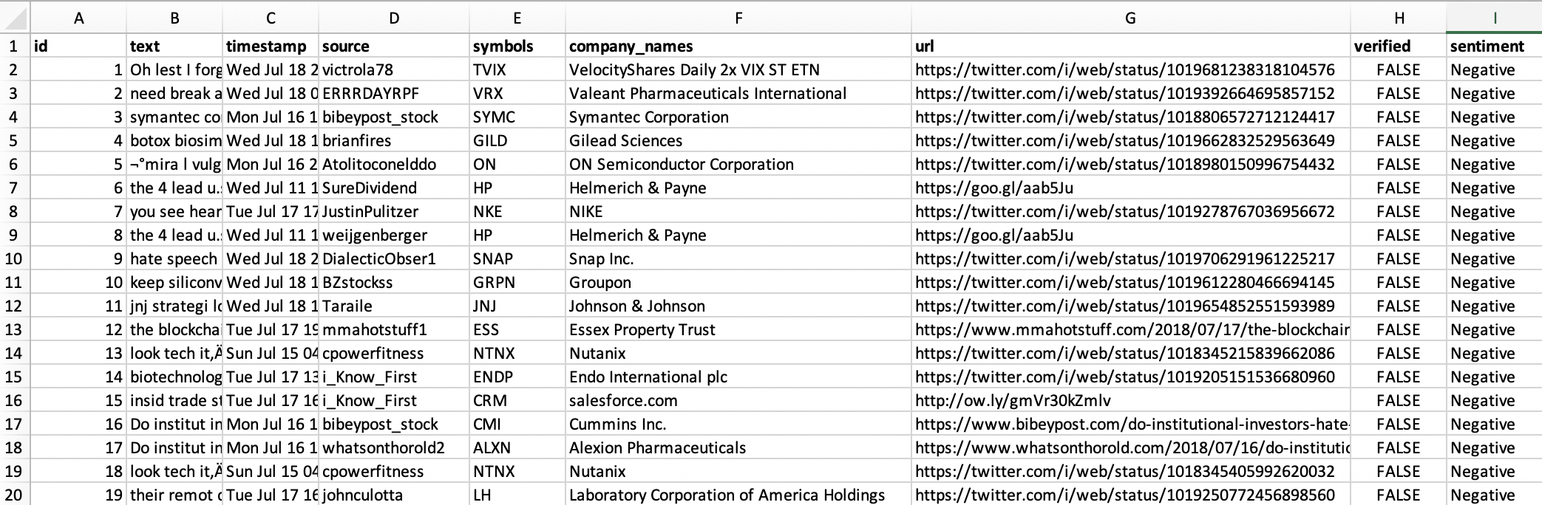
Data set used in project

Slide 9
Data Preprocessing and Cleaning
Created word clouds
Extracted FAANG stock ticker symbols and split data frame based on tweets mentioning FAANG stock ticker symbols or names
Discerned VADER and text blob sentiments
Stemmed, lemmatized, and cleaned tweet content
Created bigrams, trigrams, and bag of words and TF-IDF’d each

Slide 10
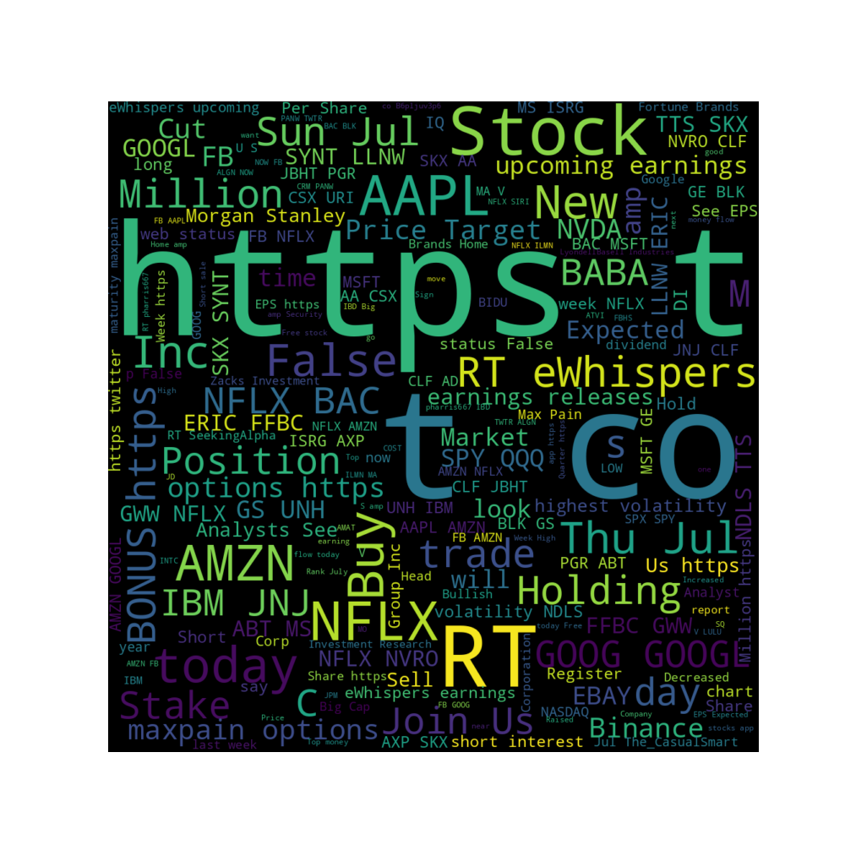
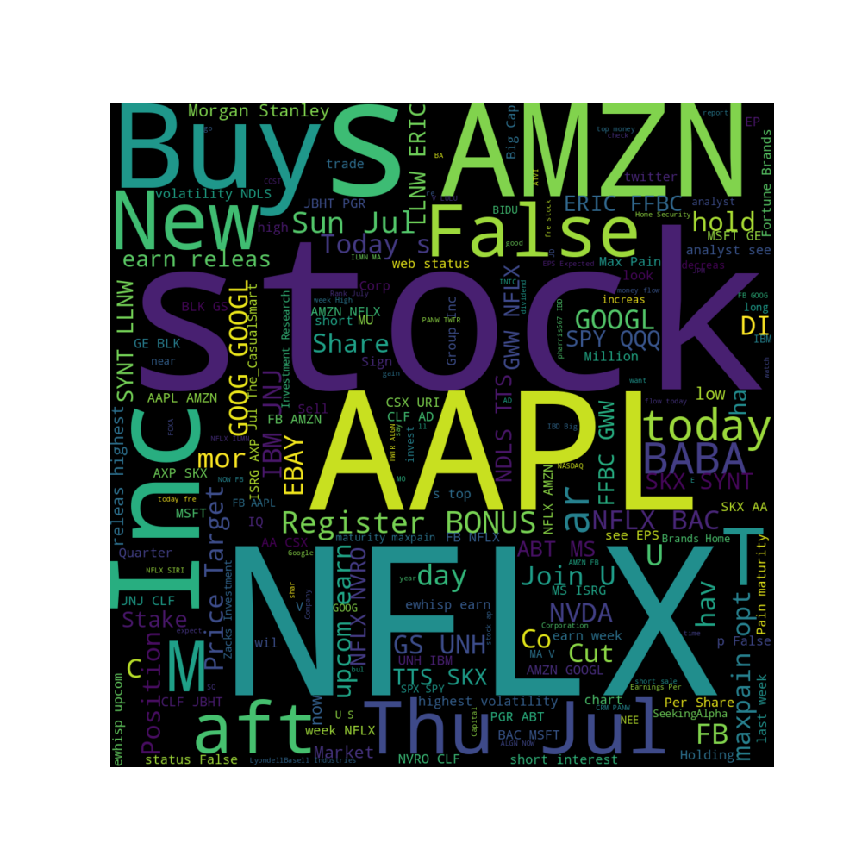
Word cloud prior to cleaning data

Slide 11
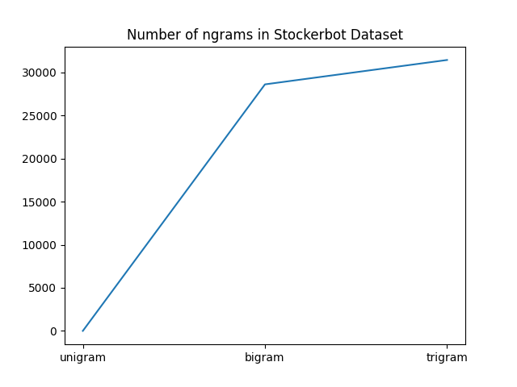
Bigram and trigram totals

Slide 12
Implemented features
Number of unique words
Number of characters
Number of punctuations
Number of uppercase words
Number of words using title case
Mean length of words
Number of special characters
Number of numberics
Number of uppercase characters
Number of lowercase characters

Slide 13
Extracted features for sma analysis
Used sentiment scores to create new data frames (VADER and text blob)
Extreme data frame (max and min scores) was further divided by company and by sentiment classifier (10 total)
Processed FAANG company stock prices into separate data frames (5 total)
Combined VADER and text blob data frames for classification

Slide 14
Built training and testing data
Attempted to split data frame into training and testing sets utilizing:
Bigram TF-IDF results
Trigram TF-IDF results
Bag of words TF-IDF results
Settled on Bag of words TF-IDF with 1113 features
Provided (2637, 1131) and (1131, 1131) for training and testing respectively
Tried used Random over sampling to increase small training set
(5856, 1131) and (2480, 1131)

Slide 15
Analysis challenges
Data set only covers 9 days during July 2018
Extremely unbalanced data
Sentiment skews heavily Positive
95% of the tweets are from unverified users
No retweet, comment, or like data
Only 15% of the tweets contain FAANG-related tweets

Slide 16
analysis

Slide 17
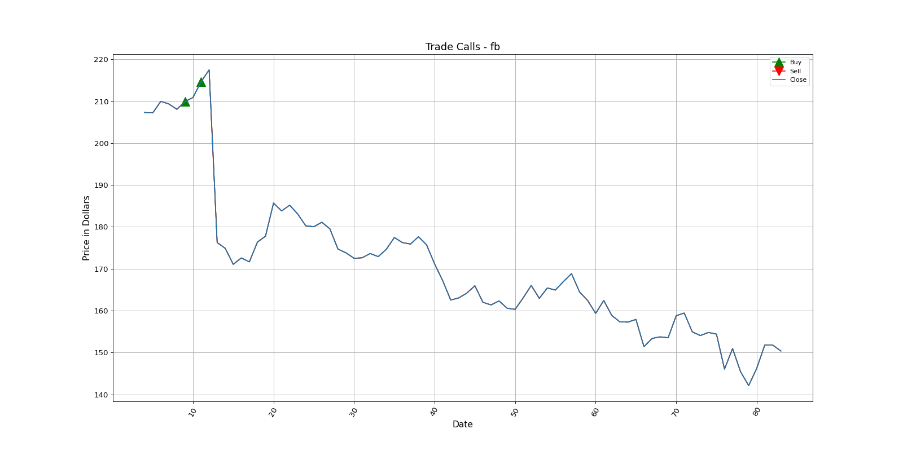
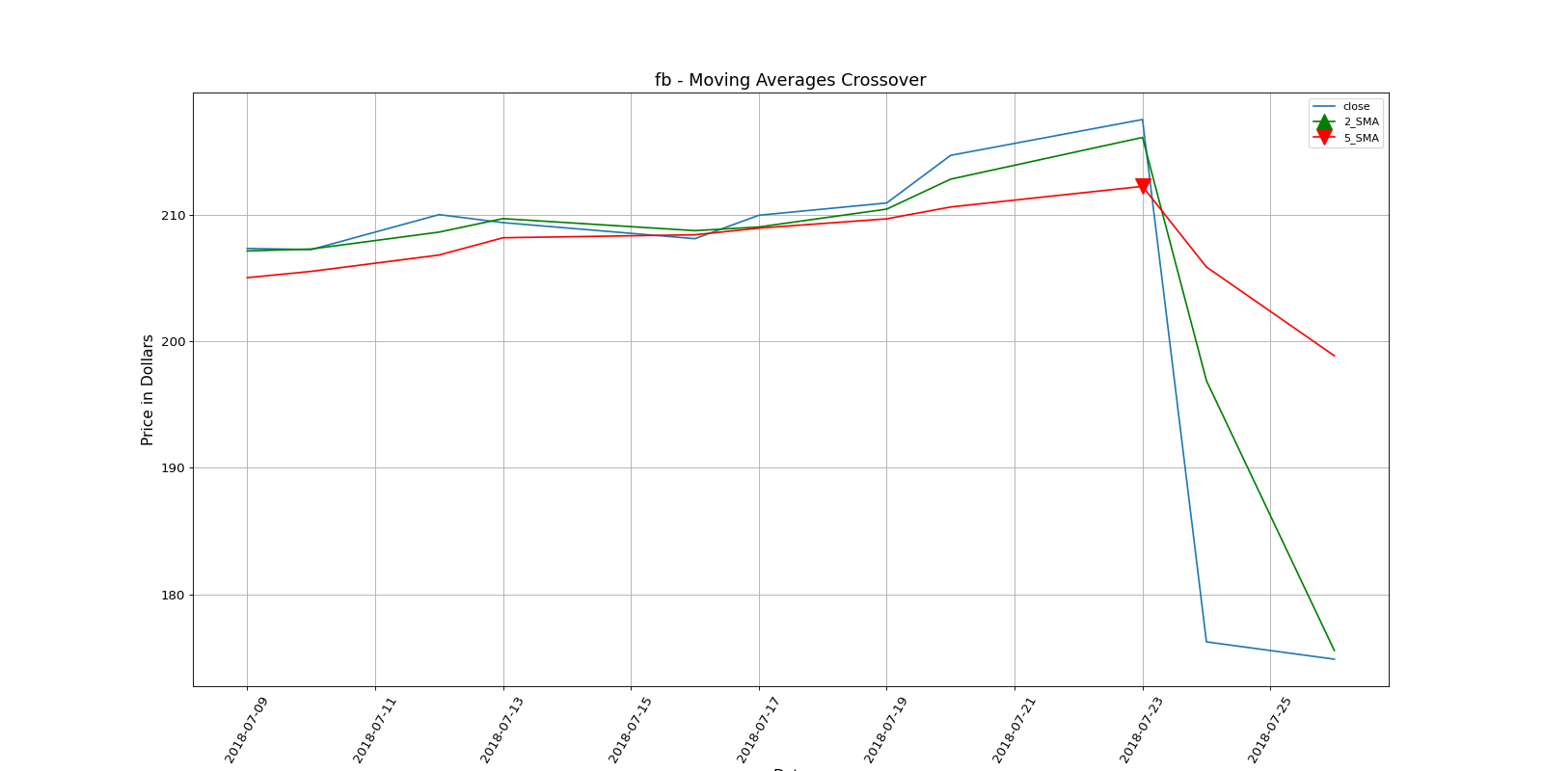
Calculating simple moving averages
Trade calls (July 2018)
2 / 5 day SMA (9–18 July 2018)

Slide 18
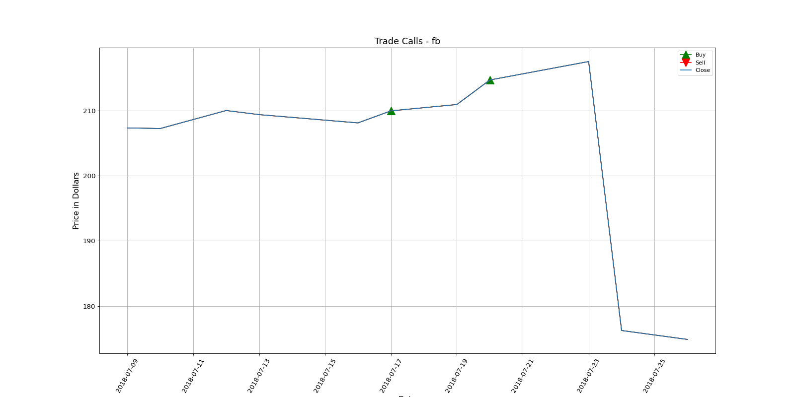
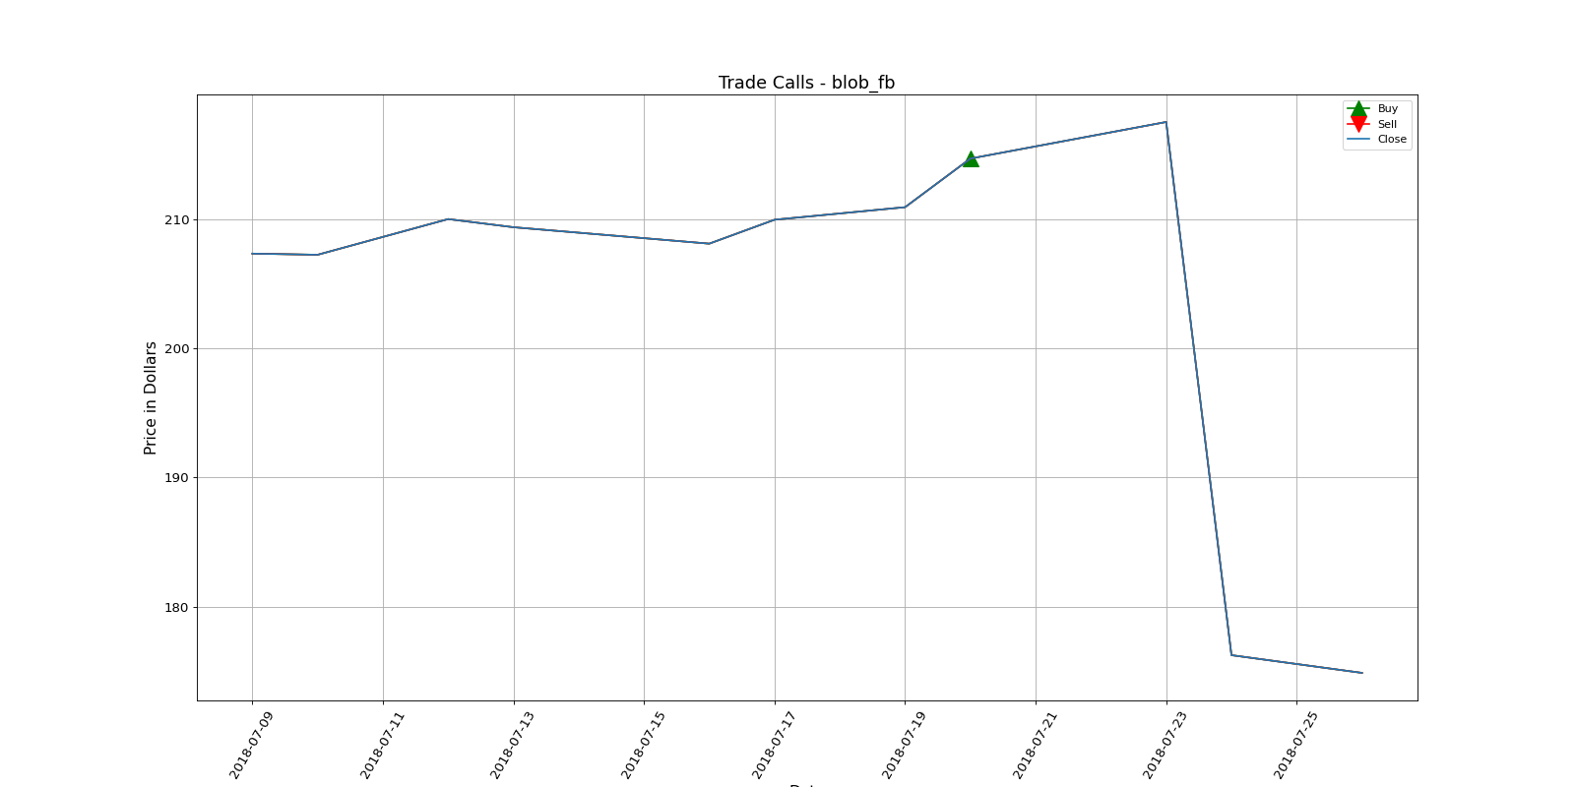
Calculating simple moving averages
Vader sentiment sma
Text blob sentiment sma

Slide 19
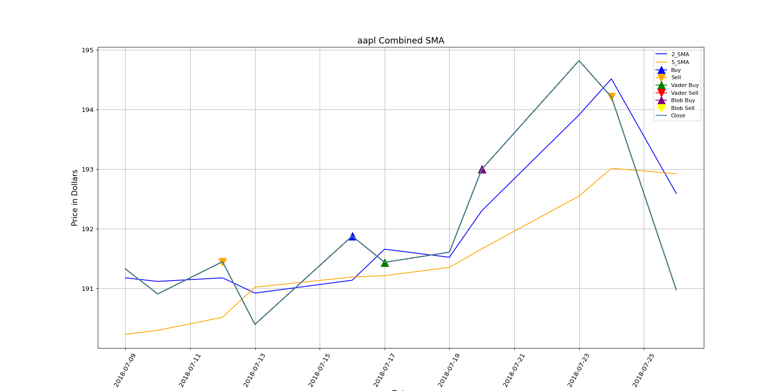
Combined apple sma

Slide 20
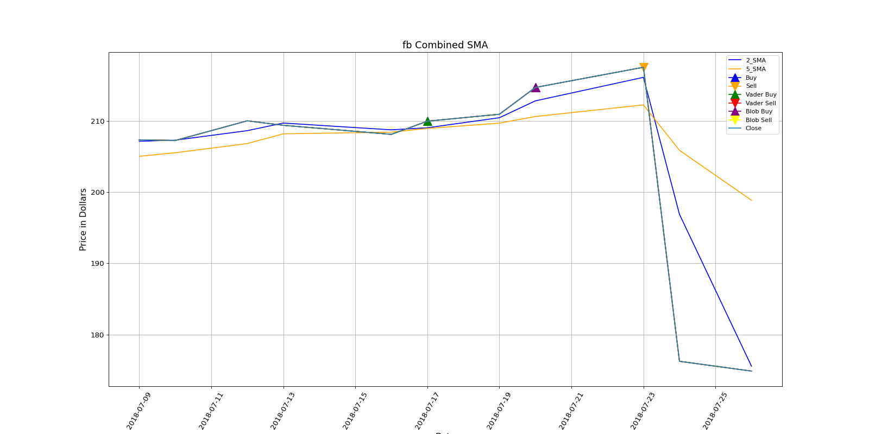
Combined Facebook sma

Slide 21
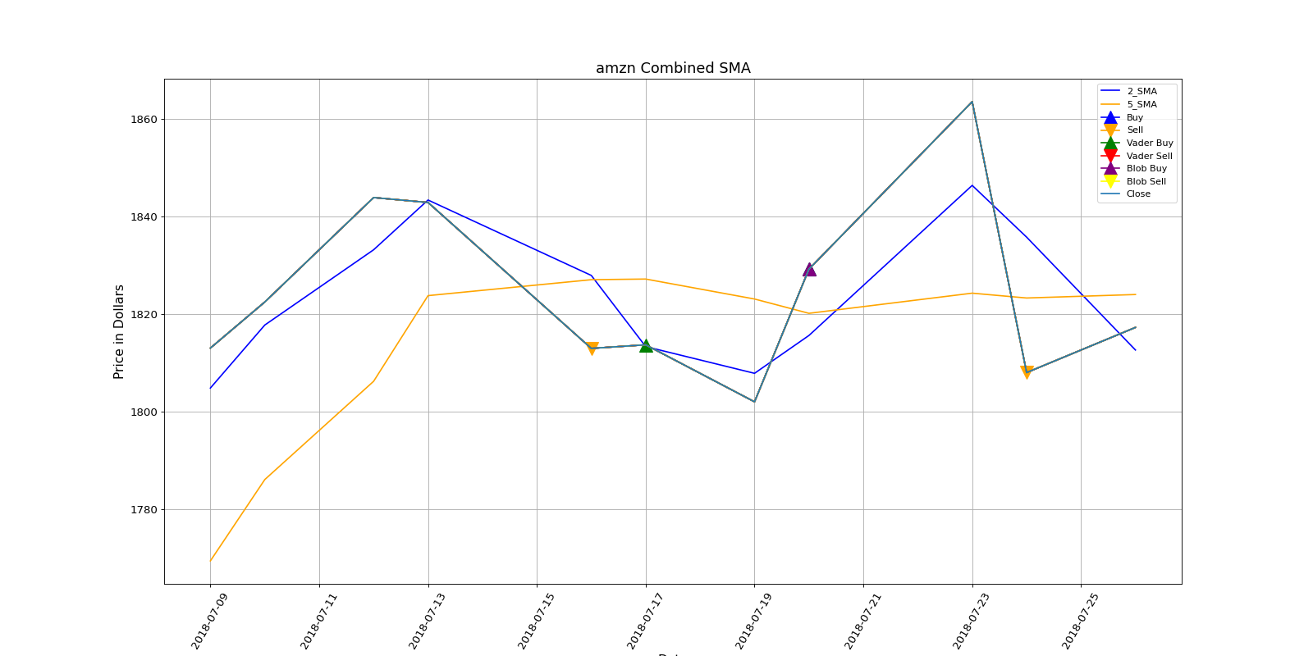
Combined amazon sma

Slide 22
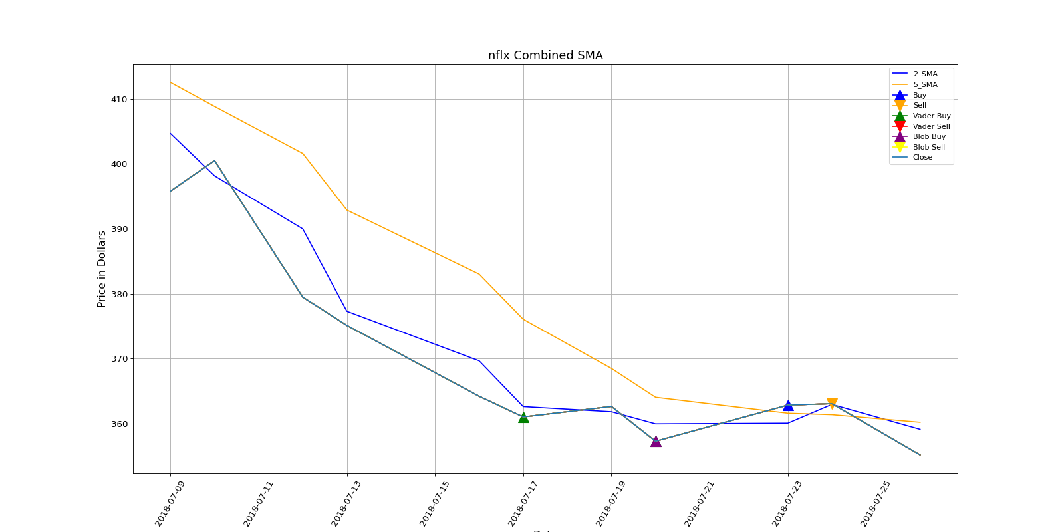
Combined Netflix sma

Slide 23
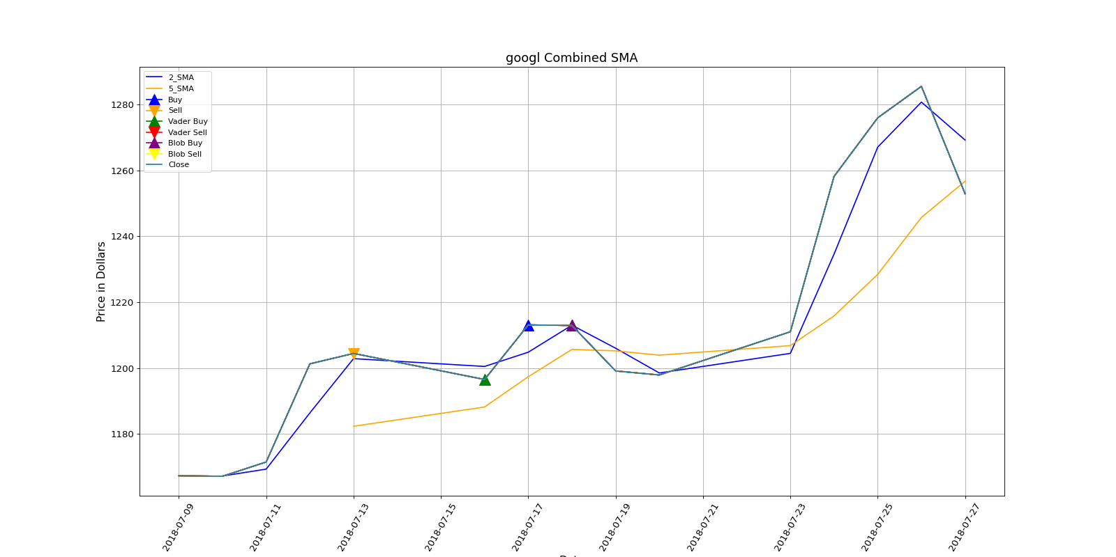
Combined GooGLE sma

Slide 24
Learning

Slide 25
Final preprocessing
Attempted to use a linear regressor for my data set as it is the most recommended means to classify tweets
Even after utilizing over sampling and rebalancing algorithms against the training set there was still no convergence
Settled on a support vector and decision tree classifiers
Ran 100 simulations of each classifier with multiple parameters to find the optimized attributes for each based on my data frame

Slide 26
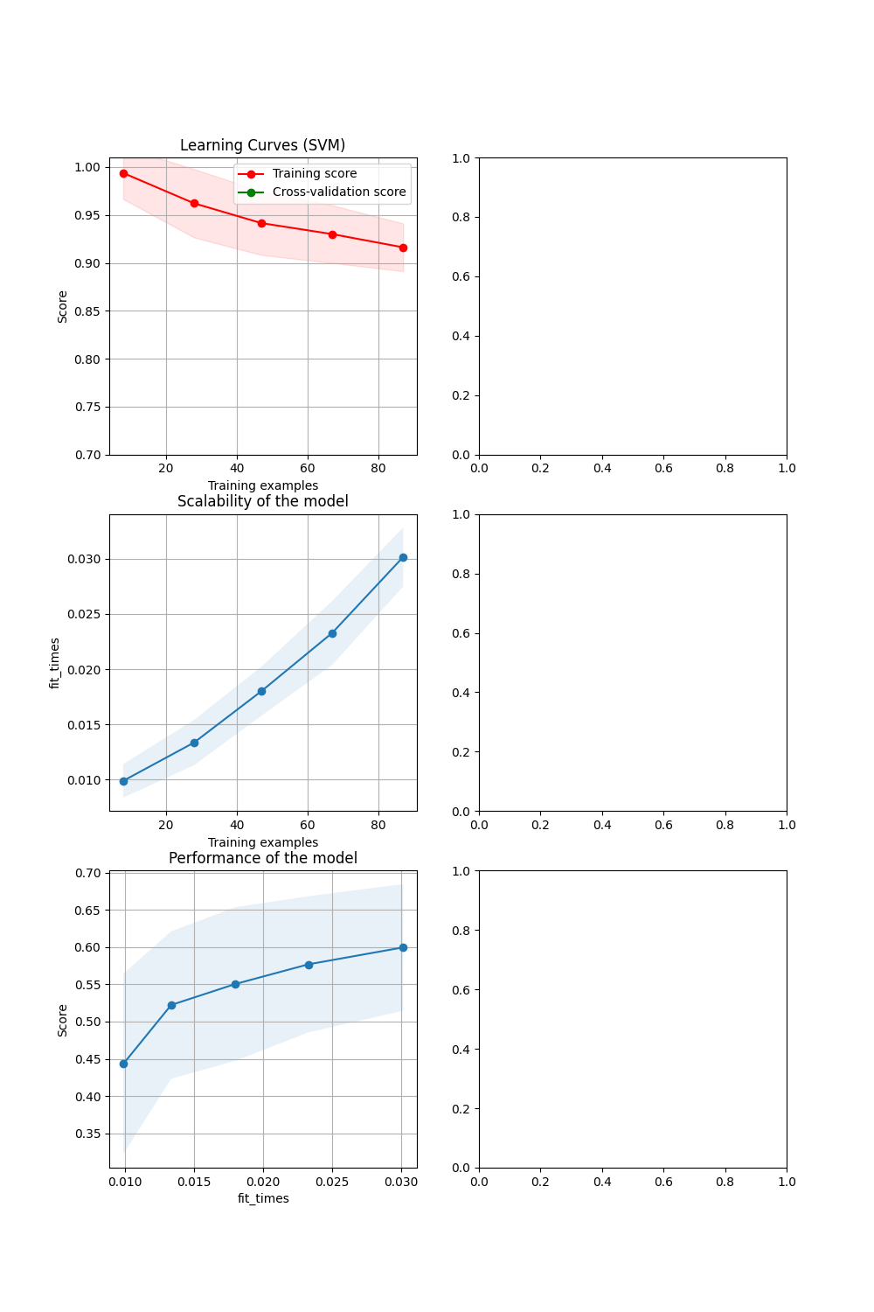
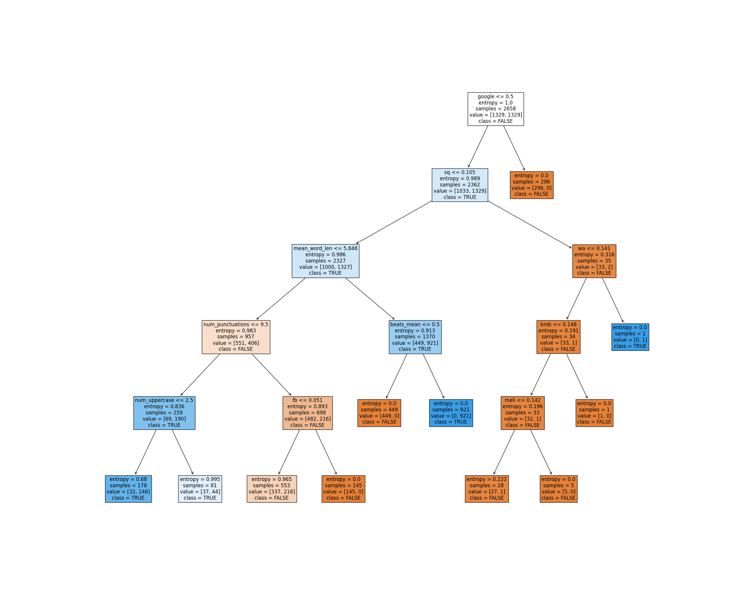
Learning results
SVC 65% Precision
65% Accuracy
DCT 87.6% precision
87% Accuracy

