Slide 1
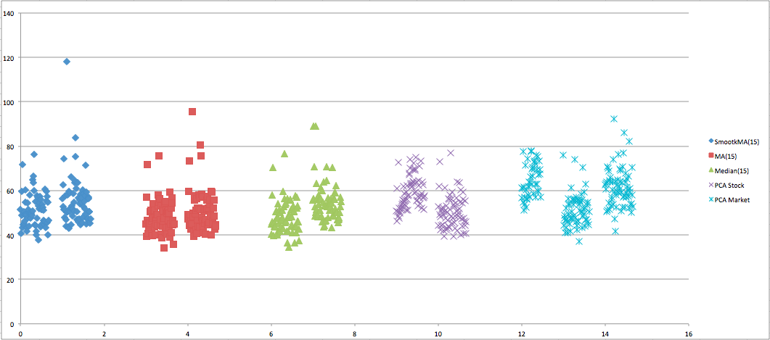
TEF.MC
2011
Total errors. Without differencing days of week (Left) and Differencing days of week (Right) and
PCA Market explaining 70% of variance (the last on the right)

Slide 2
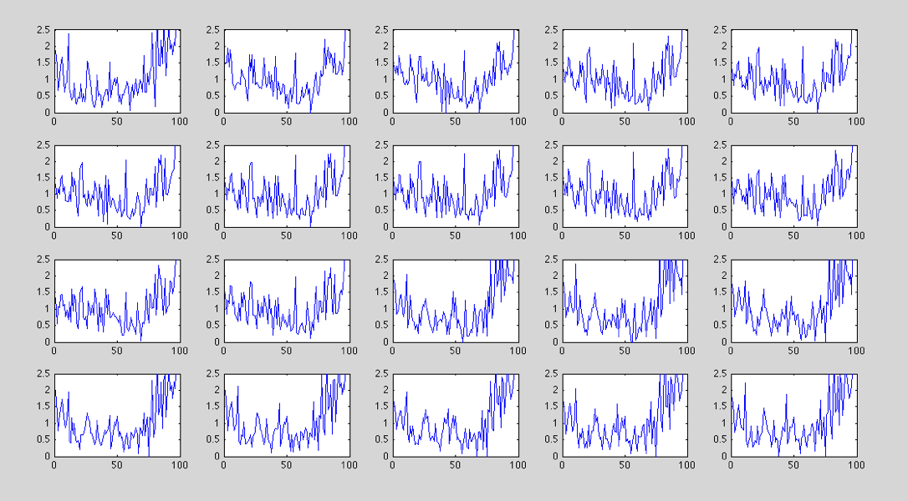
TEF.MC october 2011
PCA using stock data from previous days

Slide 3
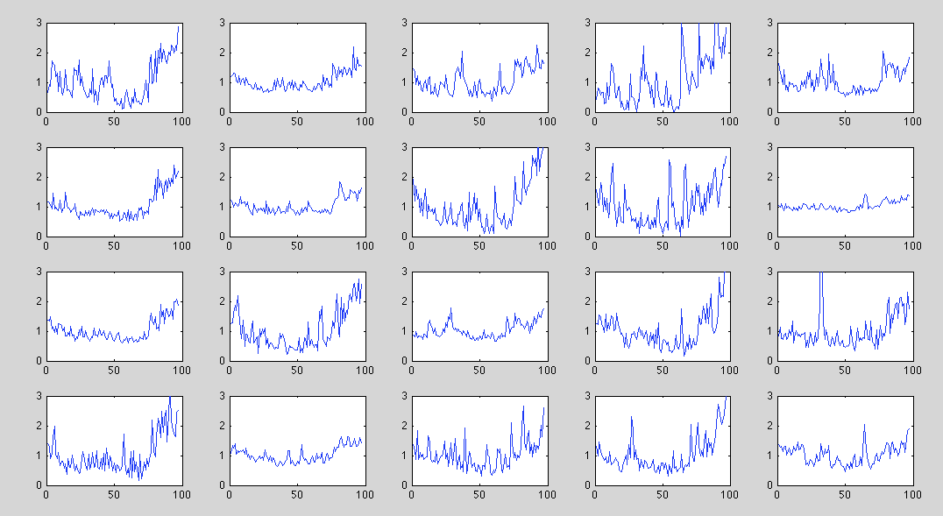
TEF.MC october 2011
PCA using market data of previous same day of week

Slide 4
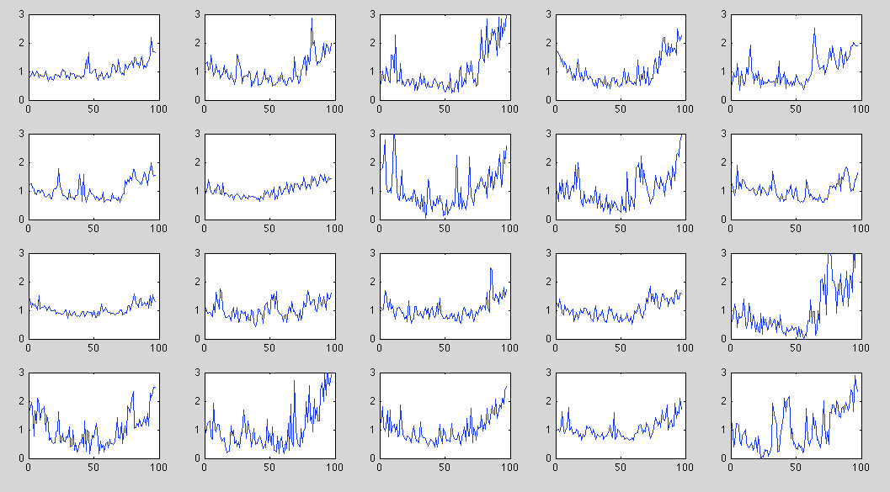
TEF.MC september 2011
PCA using market data of previous same day of week

Slide 5
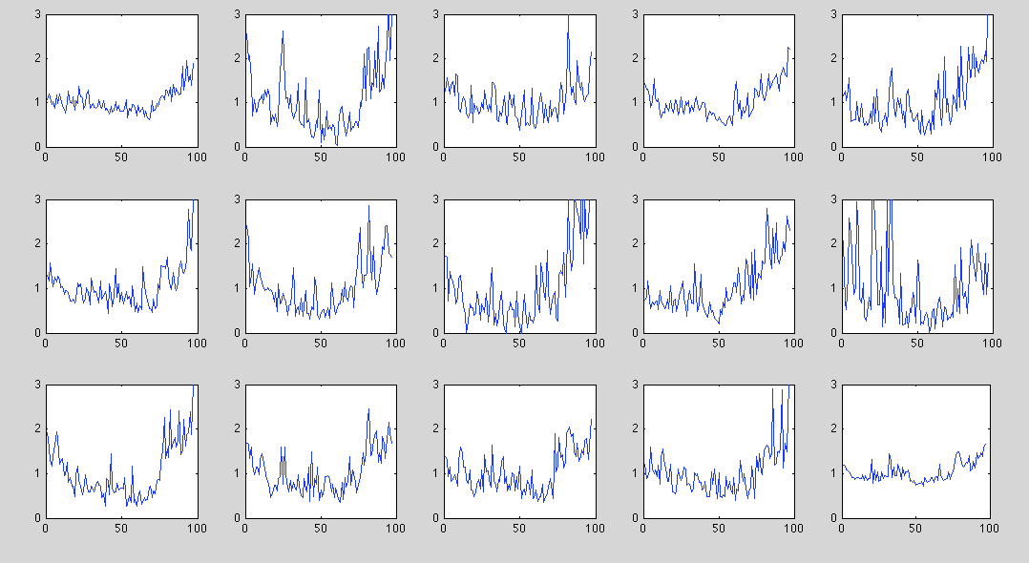
TEF.MC
sep-aug-oct 2011
PCA using stock data of 5 previous same day of week
1-5 Aug
3rd Friday
12-16 Sep
24-28 oct

Slide 6
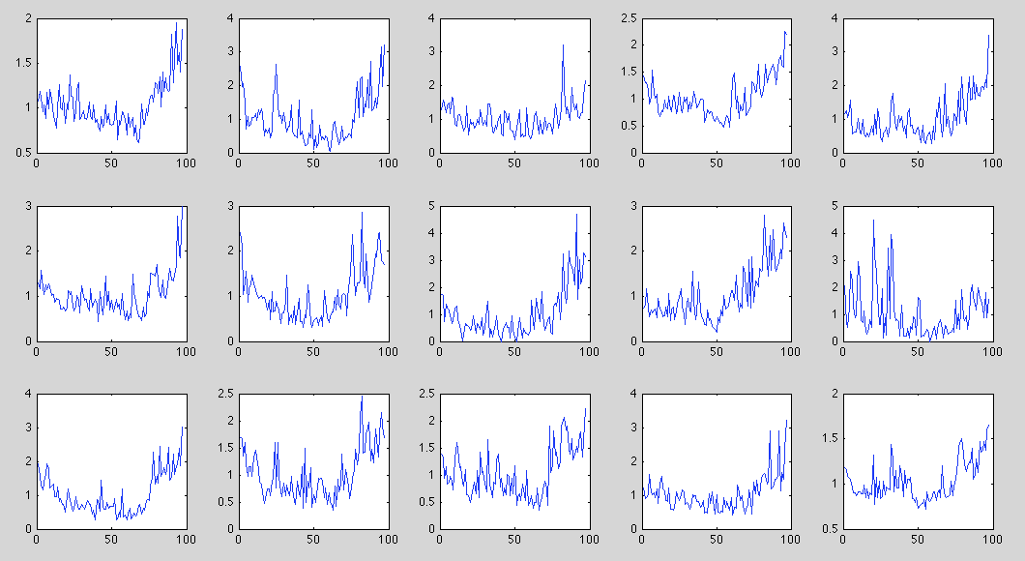
TEF.MC
sep-aug-oct 2011
PCA using stock data of 5 previous same day of week
The same as before, but with different scales
1-5 Aug
3rd Friday
12-16 Sep
24-28 oct

Slide 7
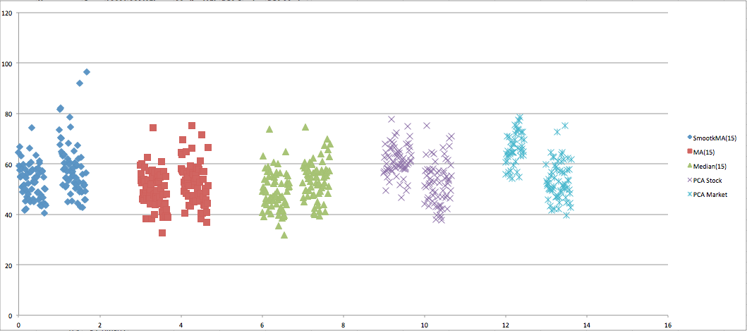
BBVA.MC
May 2011
Total errors. Without differencing days of week (Left) and Differencing days of week (Right)

Slide 8
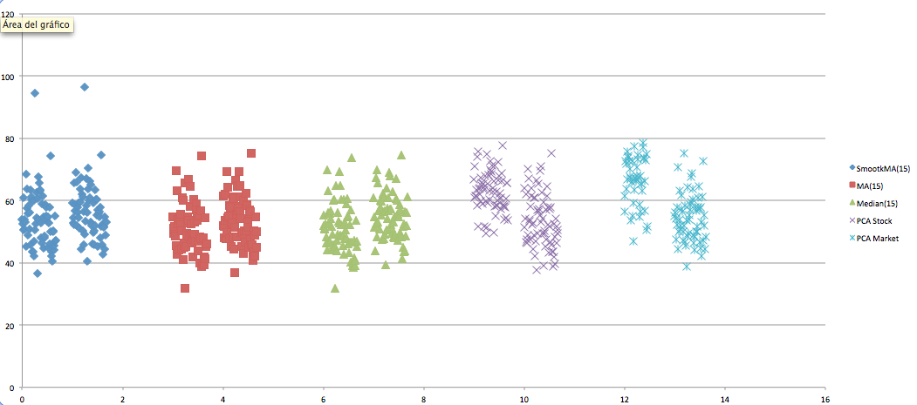
BBVA.MC
Oct 2011
Total errors. Without differencing days of week (Left) and Differencing days of week (Right)

Slide 9
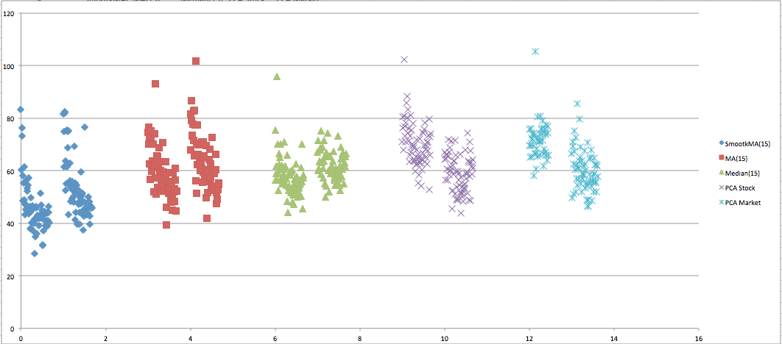
EBRO.MC
May 2011
Total errors. Without differencing days of week (Left) and Differencing days of week (Right)

Slide 10
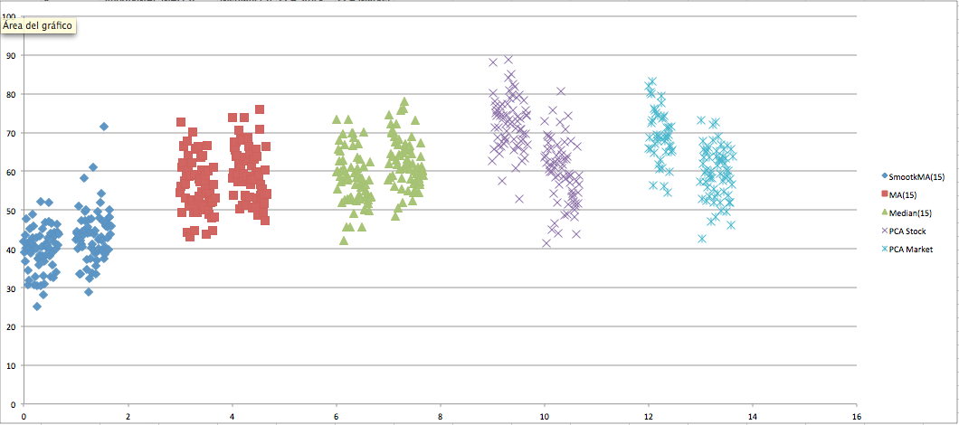
EBRO.MC
Oct 2011
Total errors. Without differencing days of week (Left) and Differencing days of week (Right)

Slide 11
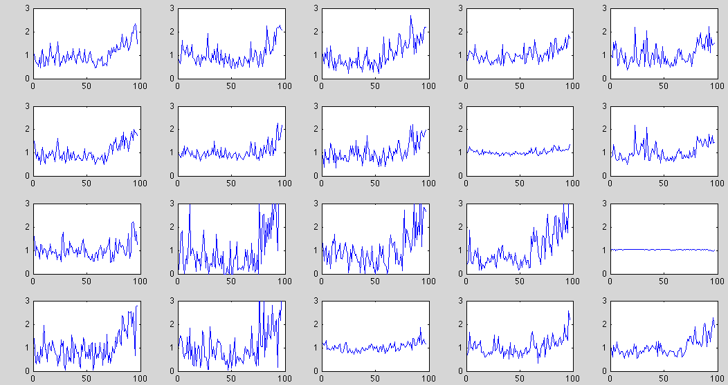
EBRO.MC
sep-aug-oct 2011
PCA using stock data of 5 previous same day of week
8-12 Aug
25-29 Jul
19-23 Sep
10-14 Oct

Slide 12
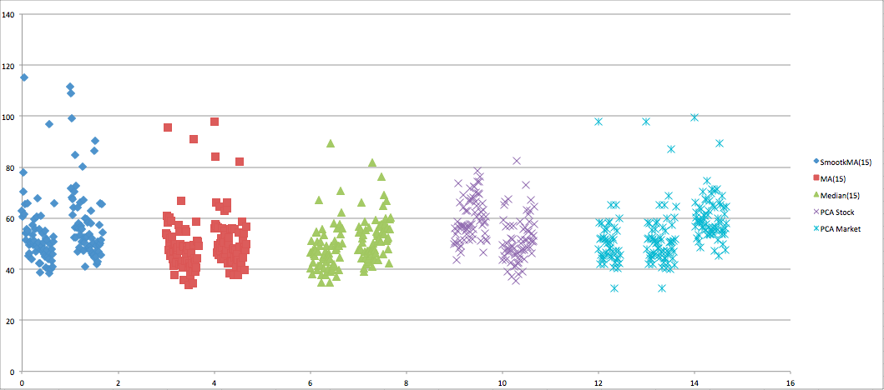
SAN.MC
May 2011
Total errors. Without differencing days of week (Left) and Differencing days of week (Right)

Slide 13
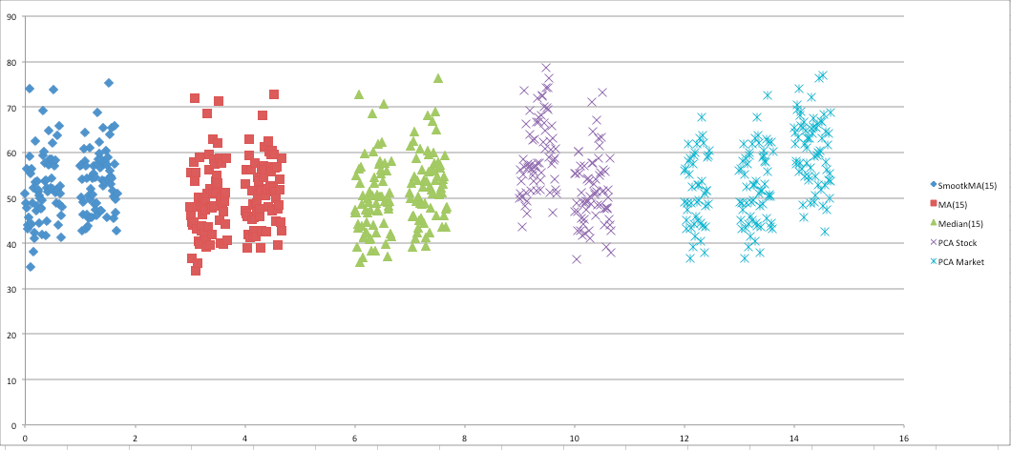
SAN.MC
Oct 2011
Total errors. Without differencing days of week (Left) and Differencing days of week (Right)

Slide 14
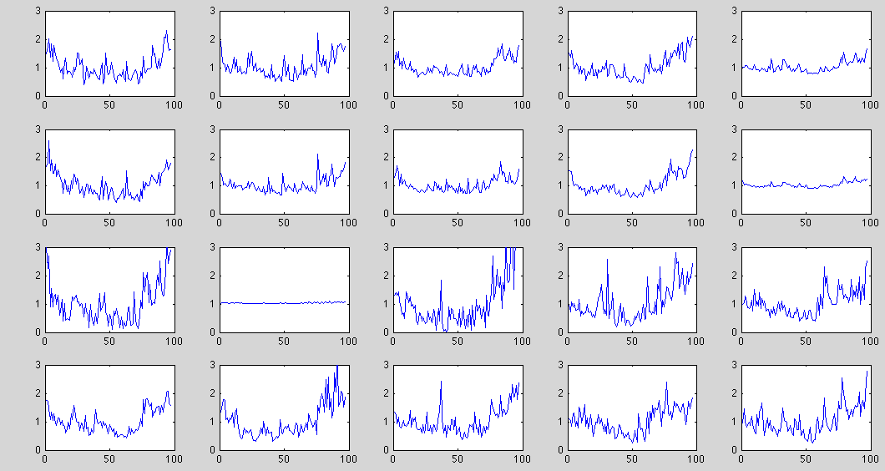
SAN.MC
sep-aug-oct 2011
PCA using stock data of 5 previous same day of week
8-12 Aug
25-29 Jul
19-23 Sep
10-14 Oct

Slide 15
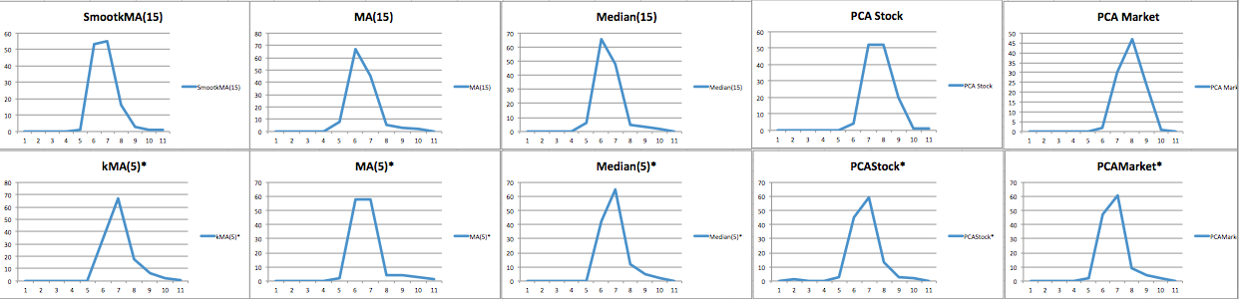
TEF.MC
2011
Errors distribution for different methods

Slide 16
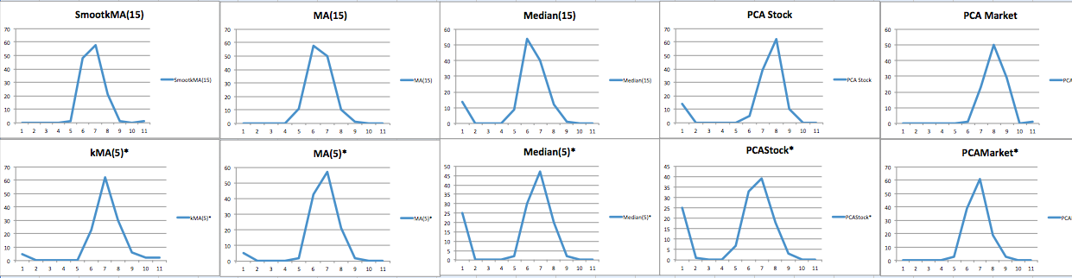
BBVA.MC
2011
Errors distribution for different methods

Slide 17
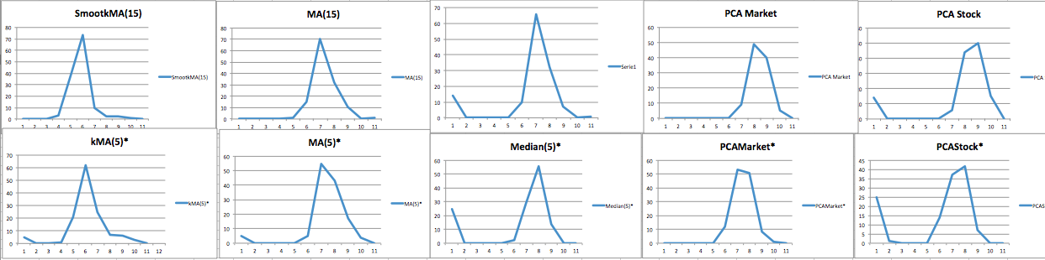
EBRO.MC
2011
Errors distribution for different methods

Slide 18
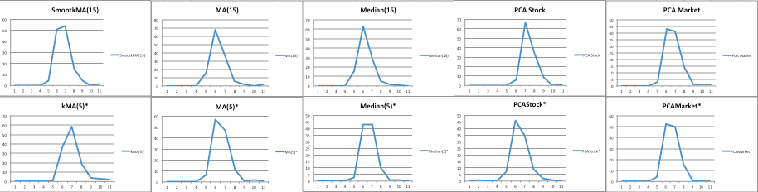
SAN.MC
2011
Errors distribution for different methods

Slide 19
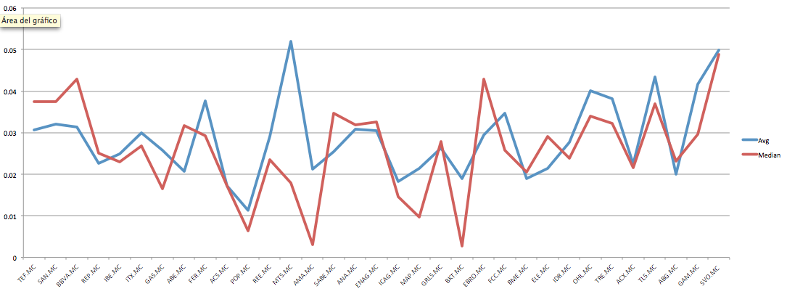
May-Oct2011
Difference between avgs and medians of daily average error MarketPCA and MovingAverage

Slide 20
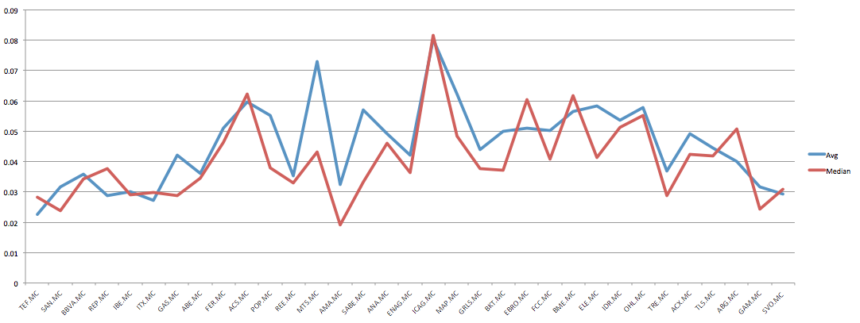
May-Oct2011
Difference between avgs and medians of daily average error StockPCA and MovingAverage

Slide 21
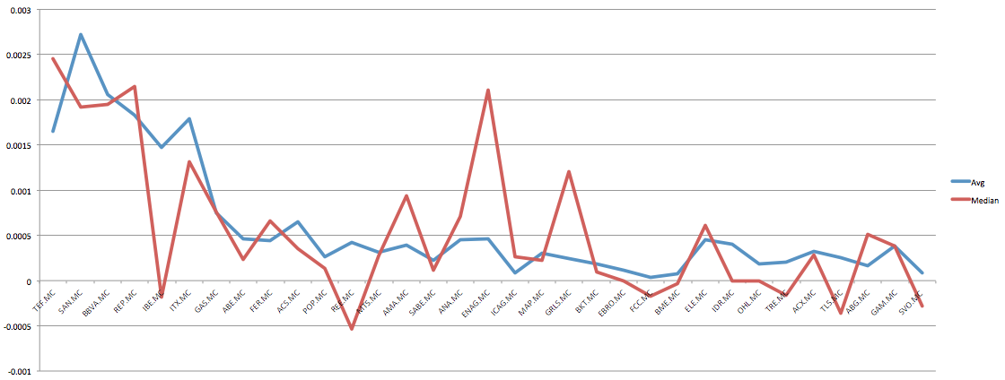
May-Oct2011
Difference between avgs and medians of daily average error SmoothedKernelMA and MovingAverage

Slide 22
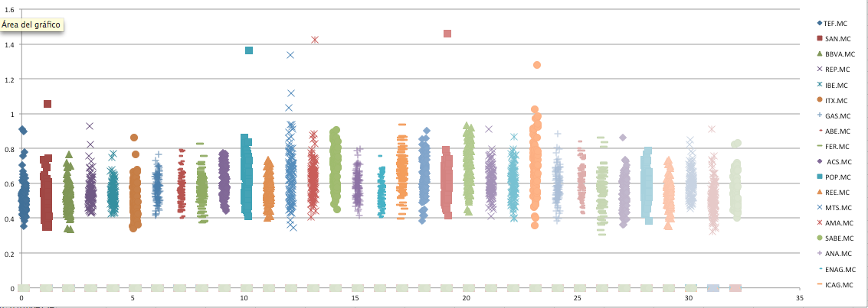
May-Oct2011
Average daily errors for MovingAverage

