Slide 1
Data Science API - Space X
Produced by: Fernando Cisneros
Late Updated: 2024-10-26

Slide 2
TABLE OF CONTENTS
Introduction
Executive Summary
Business Goal
Business Task
Methodology
Conclusion
Index

Slide 3
INTRODUCTION
Project Background and Context.
Space X has developed reusable rockets with a high success rate of landing the boosters for re-use.
Each Falcon 9 Rocket costs 62 million dollars. However, not all landings are successful.
This information is available to anyone, including Space X competitors.
Problem to solve.
We will predict if the Falcon 9 first stage will land successfully

Slide 4
EXECUTIVE SUMMARY
The focus is on the Falcon 9 rocket.
The assessment is to determine if the rocket’s first stage will land successfully.
To identify the success rate of each launch, we used Space X’s API and web-scraped Wikipedia to perform exploratory data analysis, created interactive visuals, and utilized machine learning algorithms.

Slide 5
Business Goal – Find Answers
Will the Falcon 9 first stage land successfully?

Slide 6
BUSINESS TASK
Collect Data Overview.
API provided by Space X.
Web Scrape Wikipedia.org .
Wrangle Data.
Exploratory Analysis Using SQL.
EDA with SQL
EDA with Visualizations
Create Interactive Visuals.
Create Visuals
Create Dashboard
Build a Machine Learning Pipeline for classification
Preprocessing
Split Data for Training and Testing
Test the Model
Grid Search to locate the best accuracy

Slide 7
DATA COLLECTION - API
Send GET Request to API
Filter Data for Falcon 9
Manage Outliers
Send GET Request to Space X’s API
Booster Version.
Launch Site.
Payload.
Core Data.
Normalize Data
Perce Data.
Filter Data.
Create Data Frames.
Manage Null or Missing Values
Calculate the mean.
Replace missing values with the mean.
https://github.com/lfcexpress/SpaceX_Landing_Predictions/blob/main/1_SpaceX-data-collection-api_2024_10_25.ipynb

Slide 8
Collect Collection - Web scrape
Request URL Data
Extract HTML Data
Create Data Frame
Extract Falcon 9 Launch Records HTML table.
https://en.wikipedia.org/wiki/List_of_Falcon_9_and_Falcon_Heavy_launches
Use an HTTP Method.
Create “Beautifulsoup” Object.
Parse the data.
Convert it into a Pandas data frame.
https://github.com/lfcexpress/SpaceX_Landing_Predictions/blob/main/2_SpaceX-labs-webscraping_2024_10_05.ipynb

Slide 9
DATA WRANGLING
Read CSV file
Count
“LaunchSite”
Count
“Orbit”
Count “Outcome”
Create Output Column
“Class”
Determine Success Rate
“mean”
https://github.com/lfcexpress/SpaceX_Landing_Predictions/blob/main/3_SpaceX-Data_Wrangling_2024_10_25.ipynb

Slide 10
EDA & DATA VISUALIZATION
Exploratory Data Analysis with Visualizations.
Flight number and launch site.
Payload and launch site.
Success rate of each orbit type.
Flight number and orbit type.
Pay load and obit type.
Trend of average launch success.
https://github.com/lfcexpress/SpaceX_Landing_Predictions/blob/main/5_SpaceX_edadata_viz.ipynb

Slide 11
EDA WITH SQL
Exploratory Data Analysis with SQL
1. Display the Names of the launch sites in the space mission.
2. Display five records where launch sites begin with the string ‘CCA”.
3. Display the total payload mass carried by the NASA (CRS) booster.
4. Display average payload mass carried by booster version F9V1.1.
5. List the date when the first successful landing outcome in the ground pad was achieved.
6. List the name of the booster that has succeeded in drone ships and has a payload mass greater than 40000 but less than 6000.
7. List the names of the booster_version which have carried the maximum payload mass. Use subquery.
8. List the records that will display the month names, failed landing_outcomes in drop ship, booster versions, and lauch_site for the months in 2015.
9. Rank the count of landing outcomes(such as Failure (drone ship) or Success (Ground pd)) between date 2010-06-04 and 2017-03-20, in descending order.
10 Total number of successful and failed mission outcomes.
11 Booster Versions which have carried the maximum payload mass.
https://github.com/lfcexpress/SpaceX_Landing_Predictions/blob/main/4_SpaceX-SQL-sqllite.ipynb

Slide 12
Interactive Map with Folium
Task 1: Mark all launch sites on a map
Task 2: Mark the success/fail launches for each site on the map
Task 3: Calculate the distances between a launch site to its proximities
https://github.com/lfcexpress/SpaceX_Landing_Predictions/blob/main/6_Interactive_Visual_w_Folium.ipynb

Slide 13
DASHBOARD PLOTLY DASH
Task 1: Add a launch Site Drop-Down Input Component
Task 2: Add a callback function to render a success-pie-chart.
Task 3. Add a Range Slider to Select Payload
Task 4. Add a callback function to render the success-payload-scatter-chart plot

Slide 14
PREDICTIVE ANALYSIS & CLASSIFICATION
Create columns for the class.
Standardize the data.
Split the data for training and test data
Use logistic regression for best-fit parameters.
Regression test score.
Create “GridsearchCV” Object
Calculate accuracy using the method score
Repeat
Create NumPY Array from the column Class in Data. Assign it to Y.
Standardize the data in X.
Split the data X and Y into training and test data.
Create a “GridSearchCV” object for each model.
Calculate the accuracy and plot the confusion matrix.
Compare the performance.
https://github.com/lfcexpress/SpaceX_Landing_Predictions/blob/main/8_SpaceX_Machine_Learning_Prediction_.ipynb

Slide 15
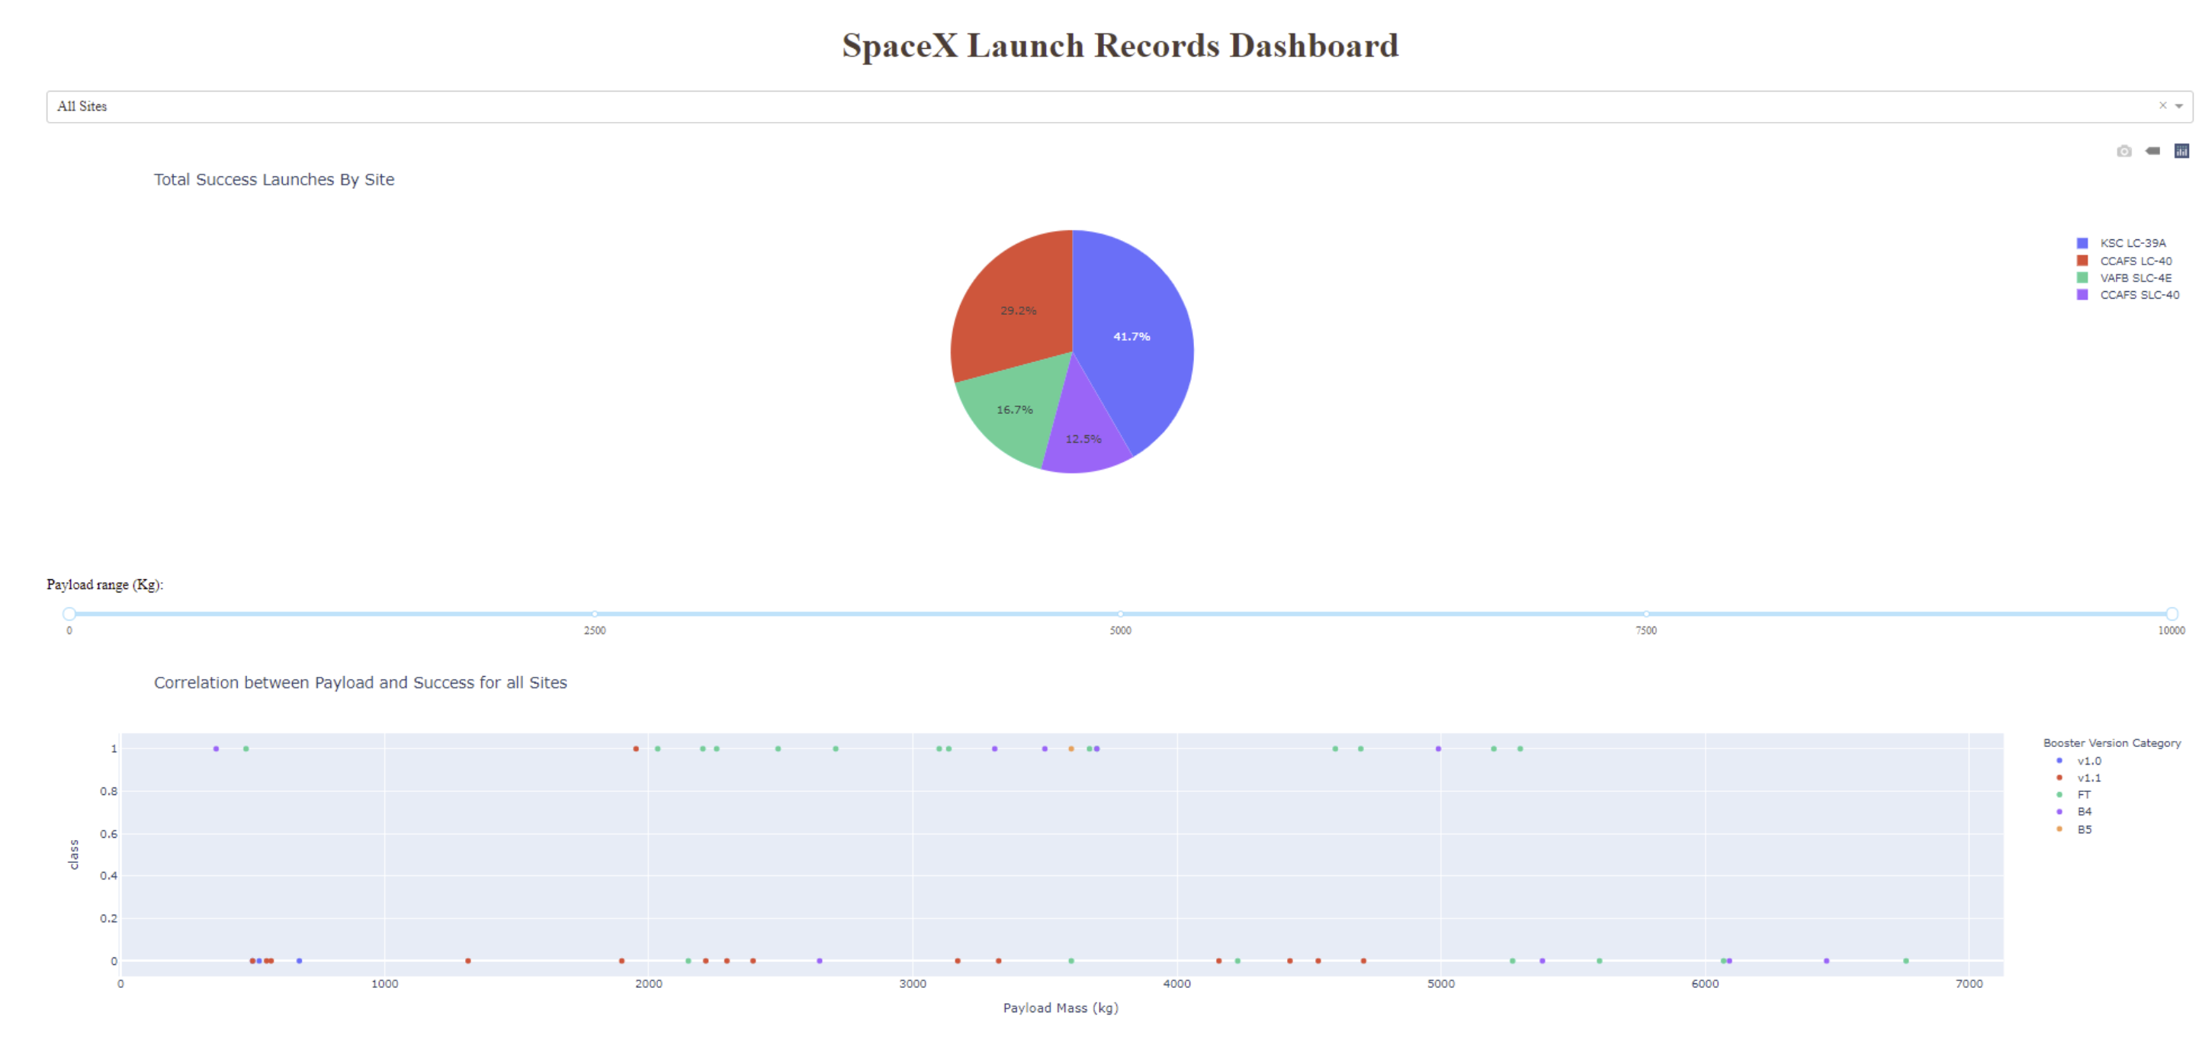
RESULTS
Exploratory analysis with the interactive dashboard.
https://github.com/lfcexpress/SpaceX_Landing_Predictions/blob/main/7_spacex_dash_app.py

Slide 16
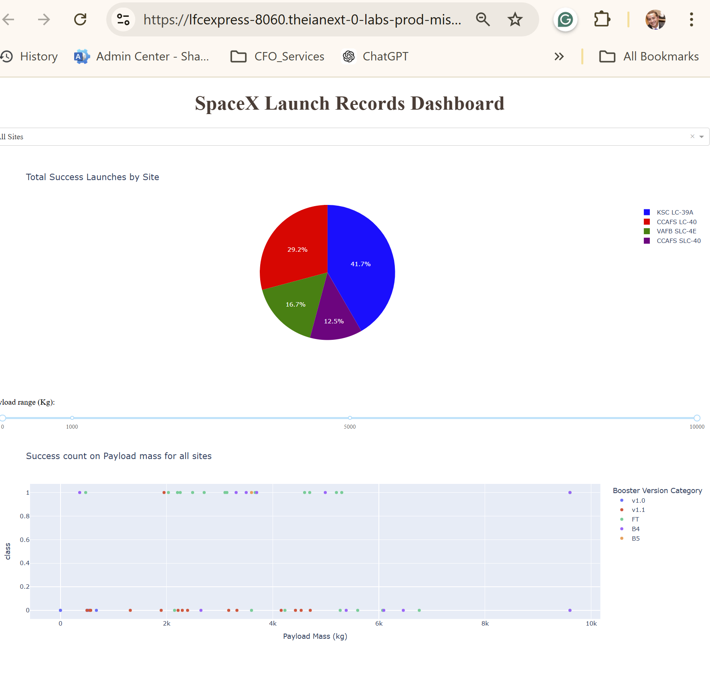
Dashboard
Success rate steadily increased till 2017.
https://github.com/lfcexpress/SpaceX_Landing_Predictions/blob/main/7_Launch_Success_Dash_APP.py

Slide 17
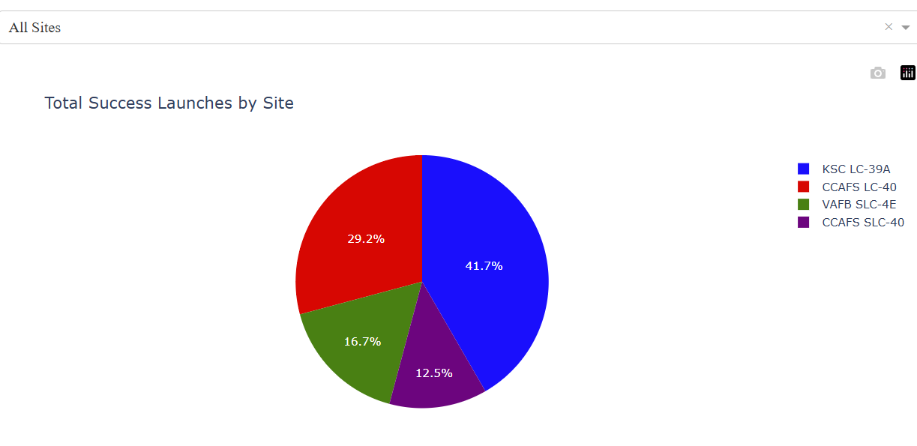
RESULTS – ALL SITES
https://github.com/lfcexpress/SpaceX_Landing_Predictions/blob/main/7_Launch_Success_Dash_APP.py

Slide 18
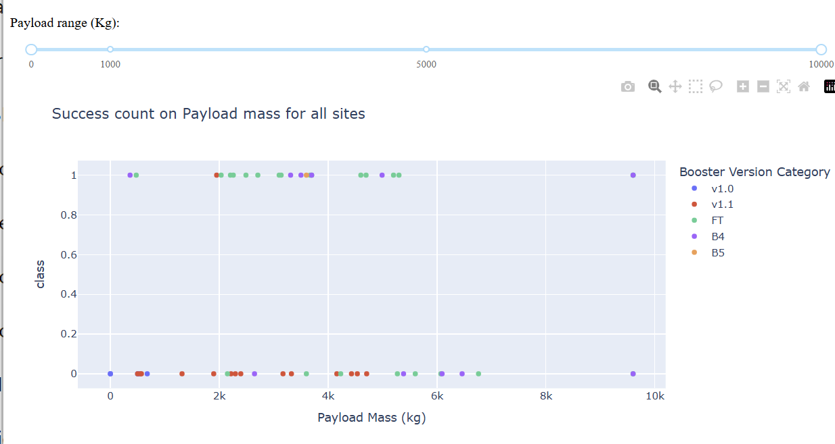
RESULTS – ALL SITES
https://github.com/lfcexpress/SpaceX_Landing_Predictions/blob/main/7_Launch_Success_Dash_APP.py

Slide 19
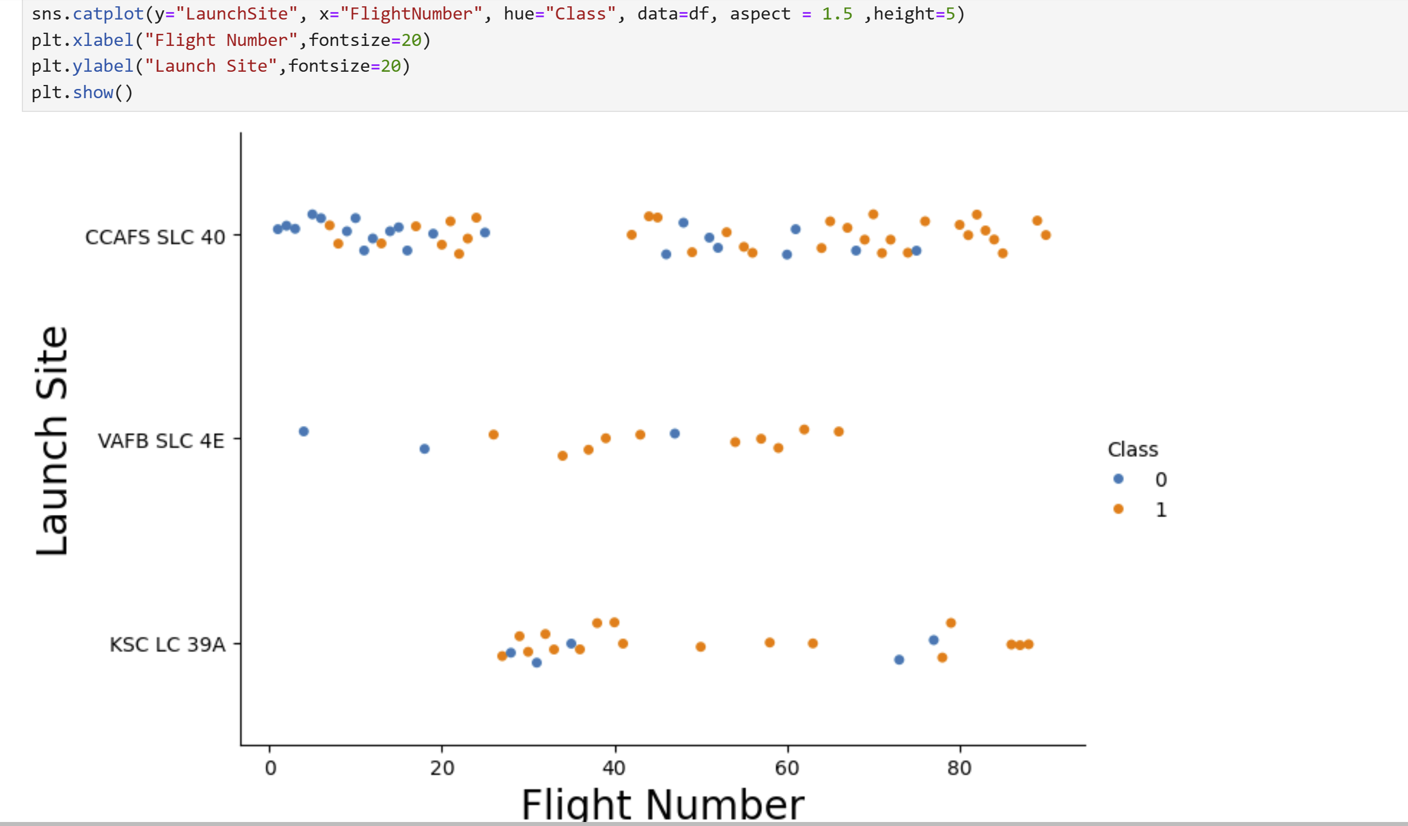
Flight Numbers vs Launch Site
Plot: Flight Number vs. Launch Site
CCAFS SLC 40 has the widest range of flight numbers
https://github.com/lfcexpress/SpaceX_Landing_Predictions/blob/main/5_SpaceX_edadata_viz.ipynb

Slide 20
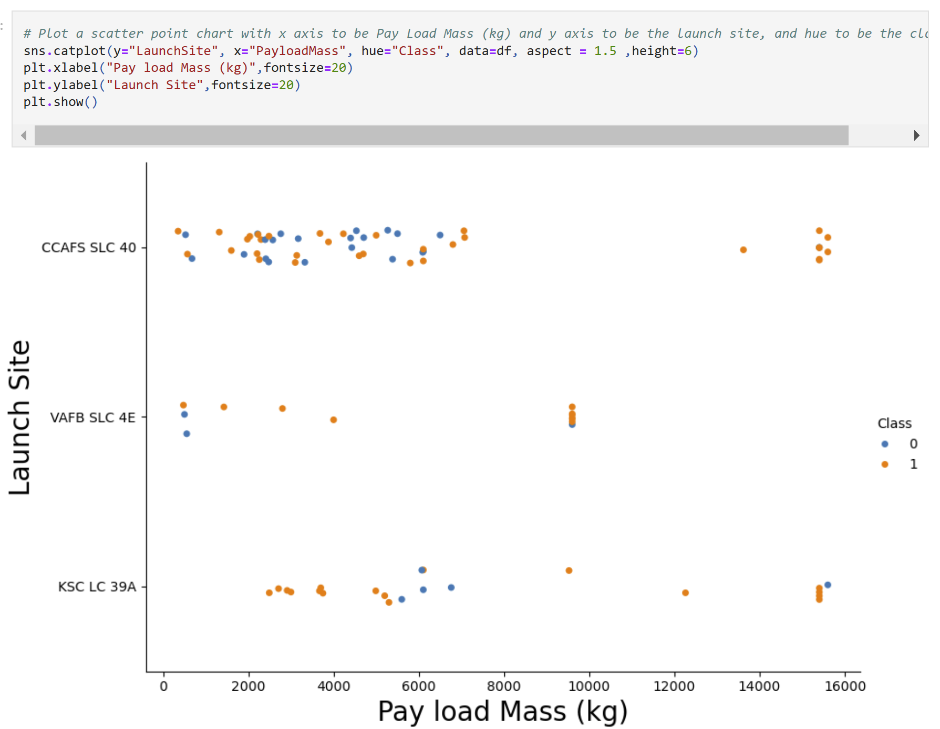
Payload Mass and Launch Site
The most successful launches with the highest payload goes to launch site:
CCAFS SLC 40

Slide 21
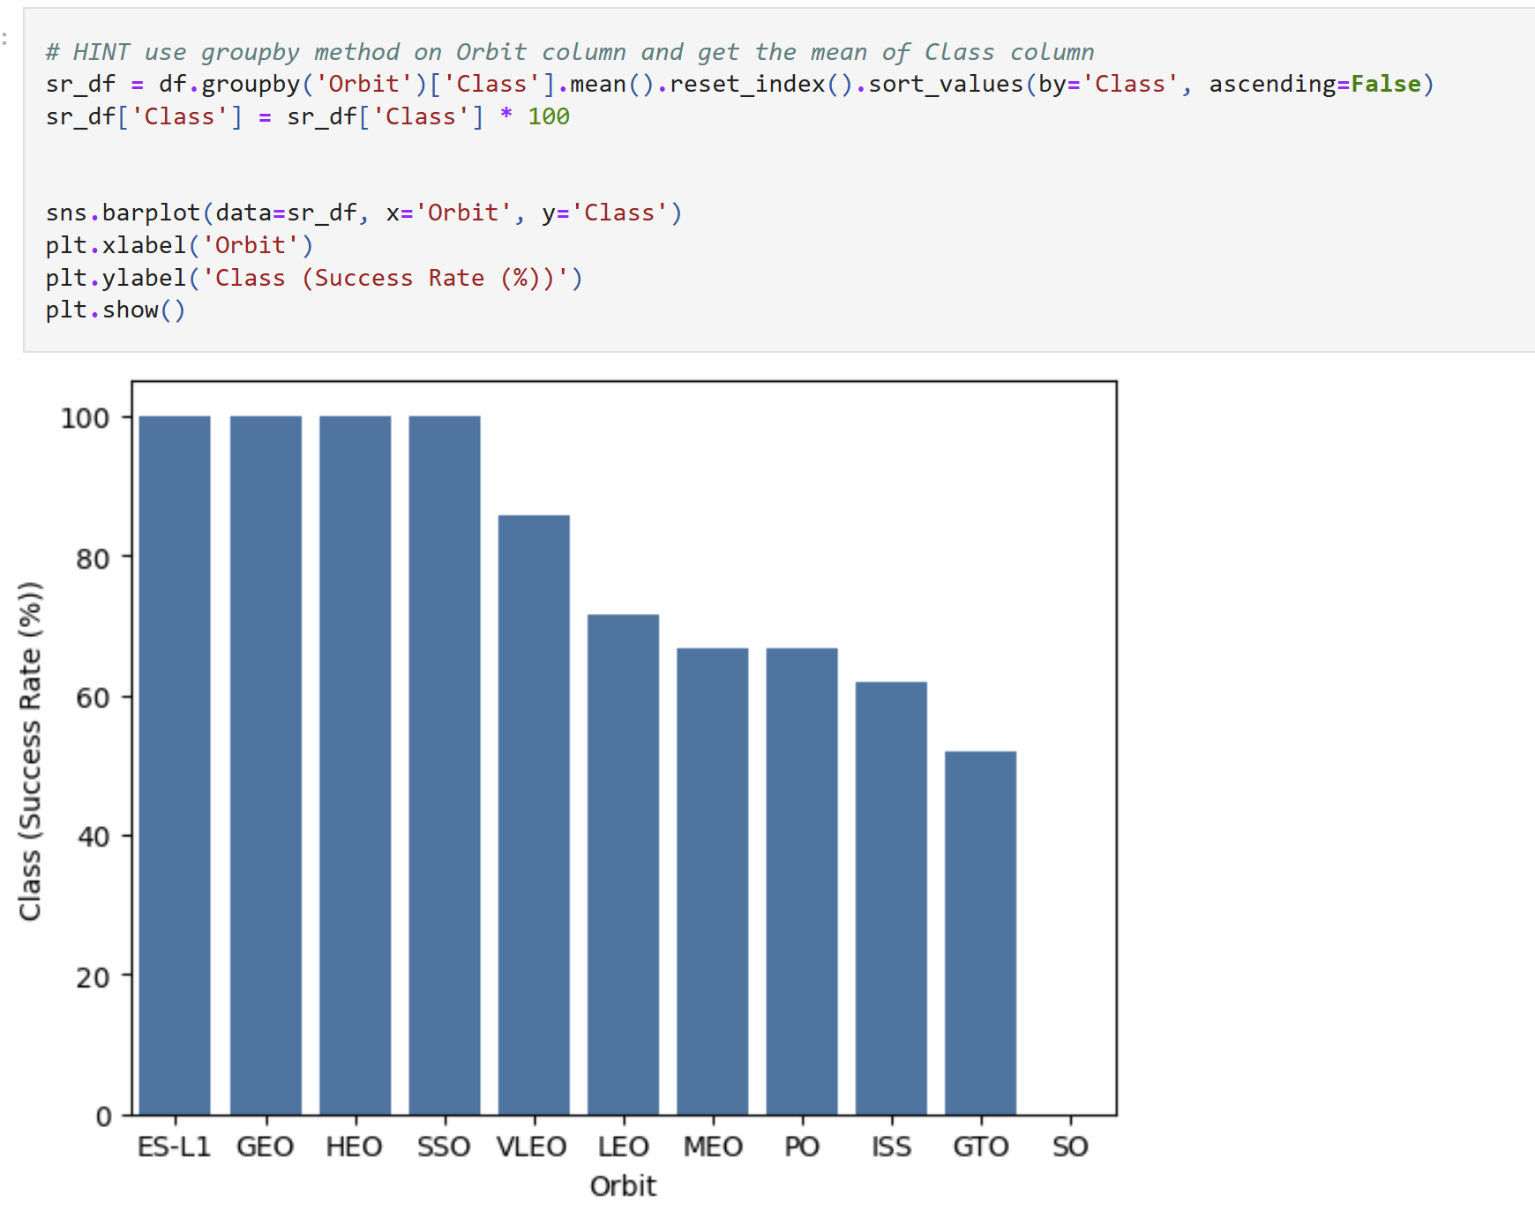
SUCCESS RATE VS. ORBIT TYPE
Highest success rates
ES-LS
GEO
HEO
SSO
Low
Zeros success
SO
https://github.com/lfcexpress/SpaceX_Landing_Predictions/blob/main/5_SpaceX_edadata_viz.ipynb

Slide 22
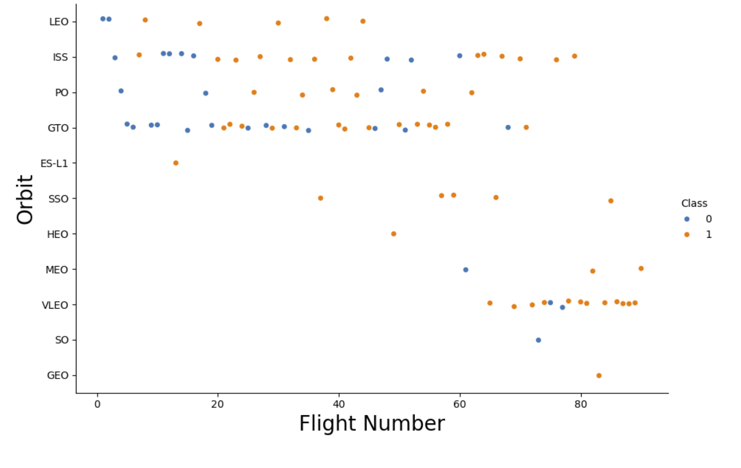
FLIGHT NUMBER vs. ORBIT
ISS had the most flights.
https://github.com/lfcexpress/SpaceX_Landing_Predictions/blob/main/5_SpaceX_edadata_viz.ipynb

Slide 23
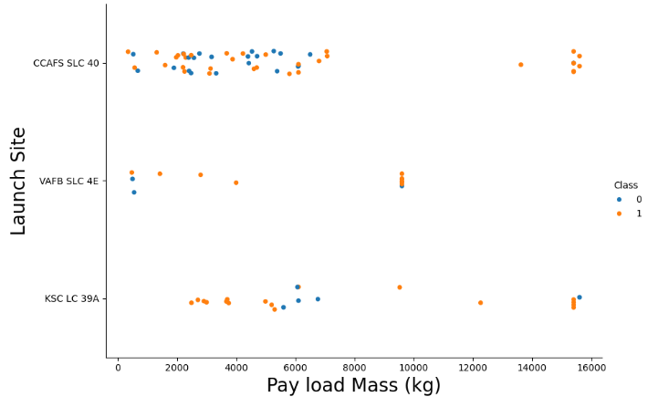
PAY LOAD MASS vs. LAUNCH SITE.
The heaviest payloads are sent from launch sites:
CCAFS SLC 40
KSC LC 39A
https://github.com/lfcexpress/SpaceX_Landing_Predictions/blob/main/5_SpaceX_edadata_viz.ipynb

Slide 24
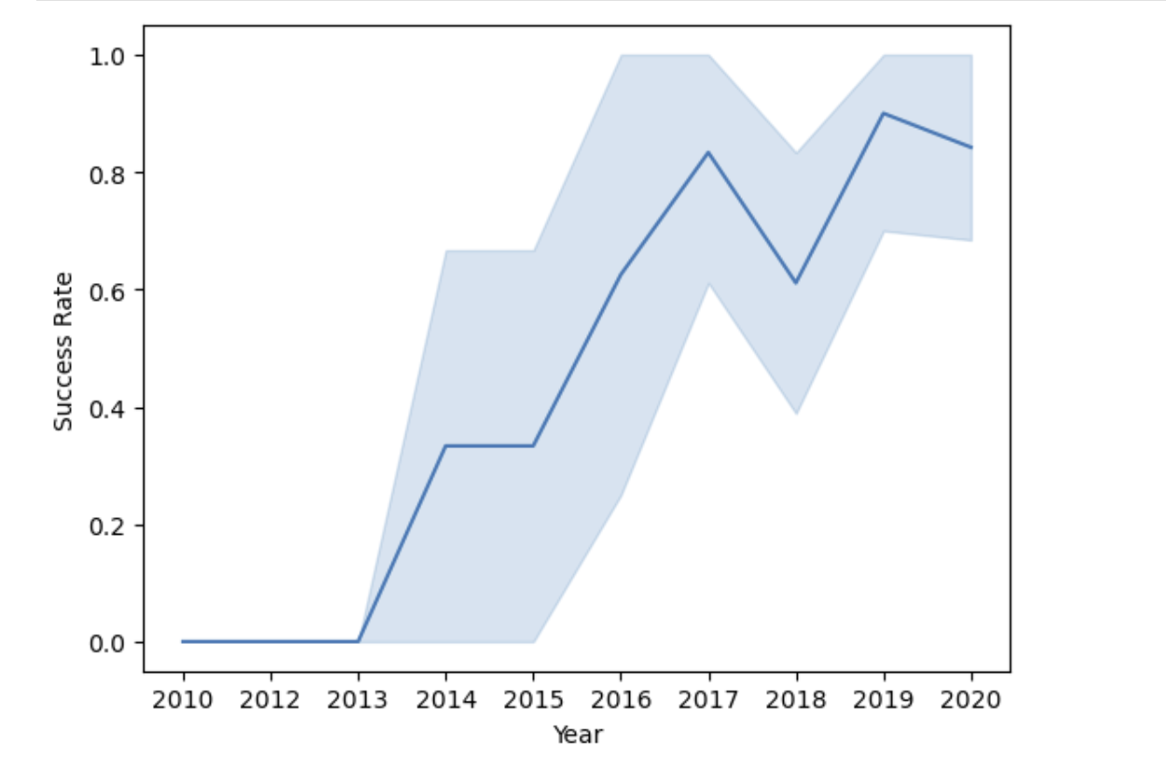
LAUNCH SUCCESS – YEARLY TRENDS
Success rates were steady through the end of 2016.
Space X had a rough year in 2017
Things improved beginning in 2018
https://github.com/lfcexpress/SpaceX_Landing_Predictions/blob/main/5_SpaceX_edadata_viz.ipynb

Slide 25
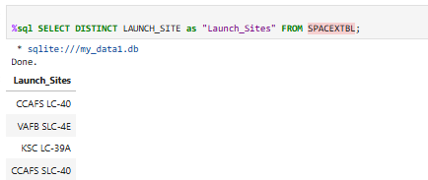
All Launch Site Names
There are four unique launch sites in total
CCAFS LC-40
VAFB SLC-4E
KSC LC-39A
CCAFS SLC-40
https://github.com/lfcexpress/SpaceX_Landing_Predictions/blob/main/4_SpaceX-SQL-sqllite.ipynb

Slide 26
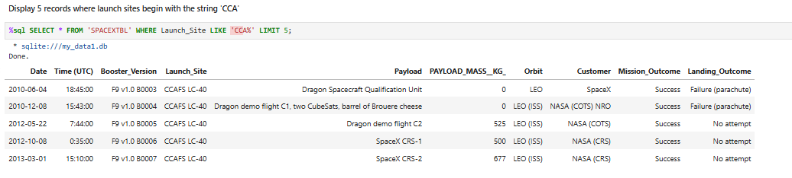
LAUNCH SITE NAMES BEGIN WITH ‘CCA’
https://github.com/lfcexpress/SpaceX_Landing_Predictions/blob/main/4_SpaceX-SQL-sqllite.ipynb

Slide 27
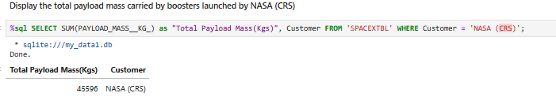
TOTAL PAYLOAD MASS
Total payload carried by booster from NASA = 45,596 Kgs
https://github.com/lfcexpress/SpaceX_Landing_Predictions/blob/main/4_SpaceX-SQL-sqllite.ipynb

Slide 28
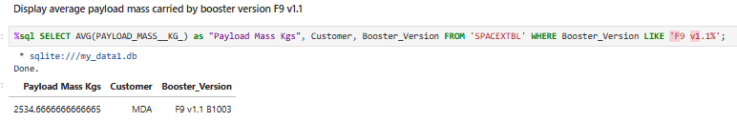
AVERAGE PAYLOAD MASS
The average payload mass for the Falcon 9 v1.1
2,534.67 (kg)
https://github.com/lfcexpress/SpaceX_Landing_Predictions/blob/main/4_SpaceX-SQL-sqllite.ipynb

Slide 29
FIRST SUCCESSFUL GROUND LANDING DATE
Min(Date)
2015-12-12

Slide 30
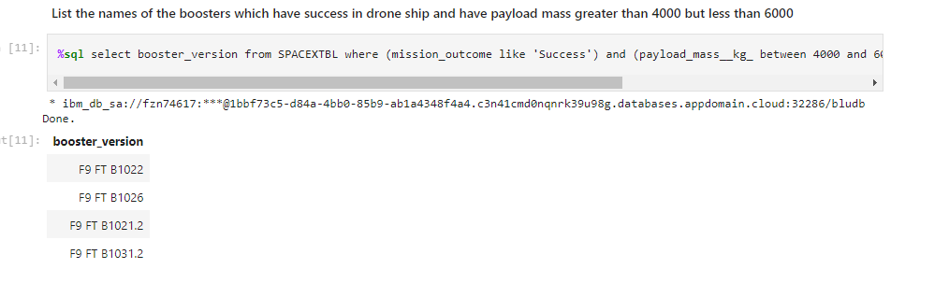
SUCCESSFUL DRONE SHIP LANDING
Payload between 4,000 and 6,000 kg
https://github.com/sugatagh/SpaceX-Falcon-9-First-Stage-Landing-Prediction/blob/main/EDA%20with%20SQL.ipynb

Slide 31
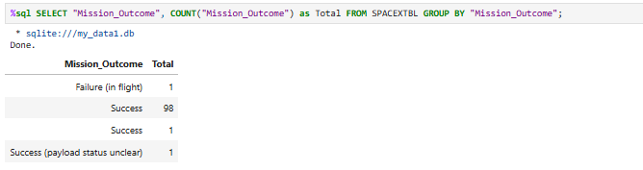
TOTAL NUMBER SUCCESSFUL AND FAILED MISSIONS
Total Number of Failed mission outcomes: 1
Total number of successful mission outcomes 99
https://github.com/lfcexpress/SpaceX_Landing_Predictions/blob/main/4_SpaceX-SQL-sqllite.ipynb

Slide 32
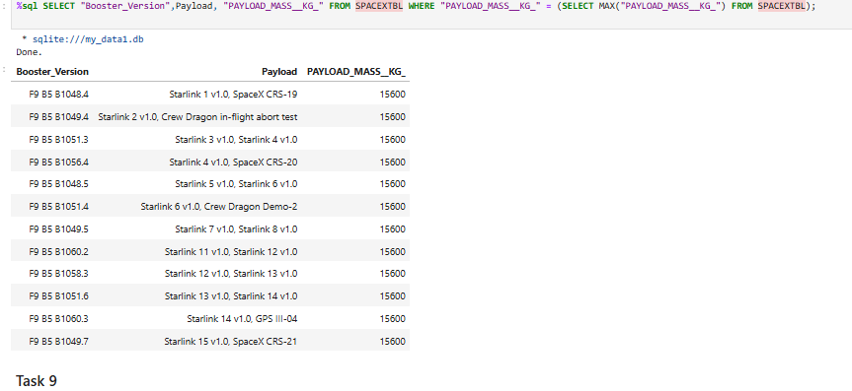
BOOSTER CARRIED MAXIMUM PAYLOAD
https://github.com/lfcexpress/SpaceX_Landing_Predictions/blob/main/4_SpaceX-SQL-sqllite.ipynb

Slide 33
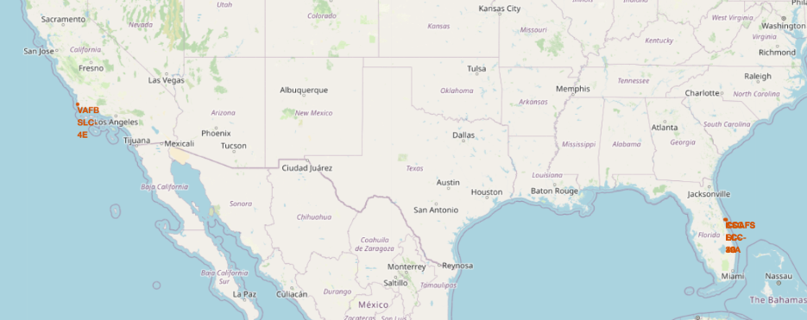
LAUNCH SITES

Slide 34
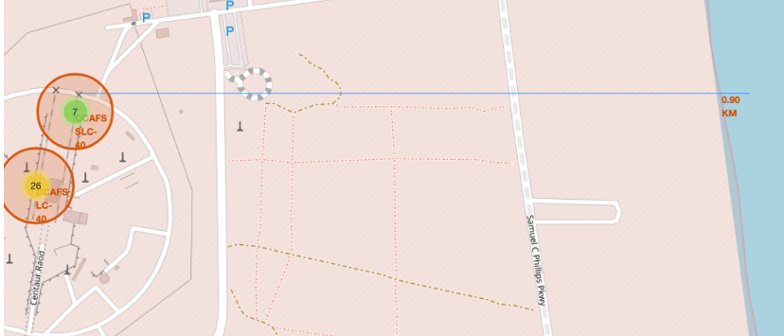
PROXIMITIES
The distance from CCAFS SLC-40 to the coastline is 0.90 km.
https://github.com/lfcexpress/SpaceX_Landing_Predictions/blob/main/6_Interactive_Visual_w_Folium.ipynb

Slide 35
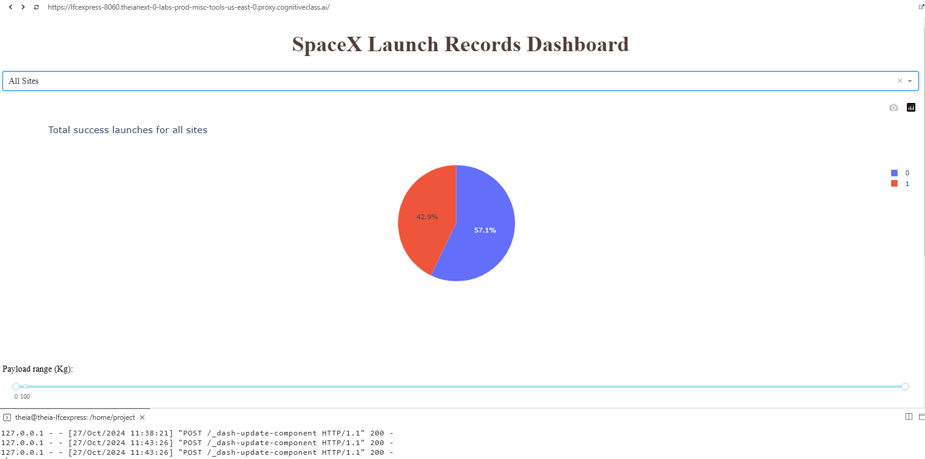
TOTAL SUCCESS LAUNCHES FOR ALL SITES
SUCCESS 42.9%
FAILED 57.1%
https://github.com/lfcexpress/SpaceX_Landing_Predictions/blob/main/7_Launch_Success_Dash_APP.py

Slide 36
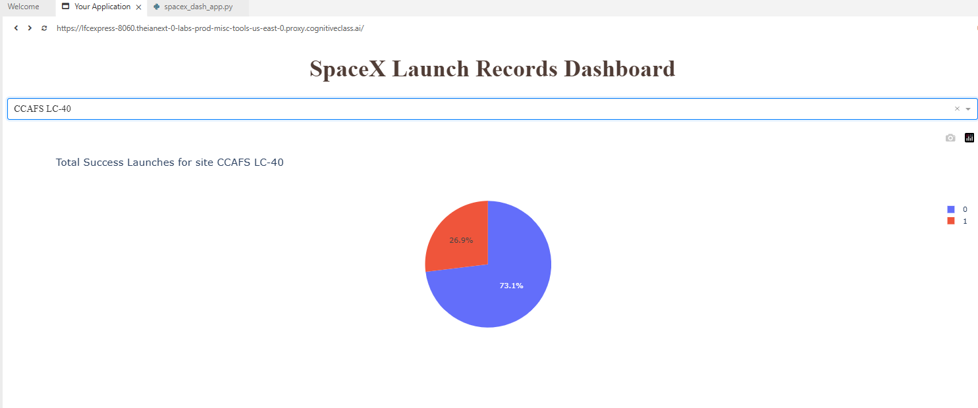
HIGHEST LAUNCH SUCCESS RATION
CCAFS SLC-40 has the best success ratio (42.9%)
https://github.com/lfcexpress/SpaceX_Landing_Predictions/blob/main/7_Launch_Success_Dash_APP.py

Slide 37
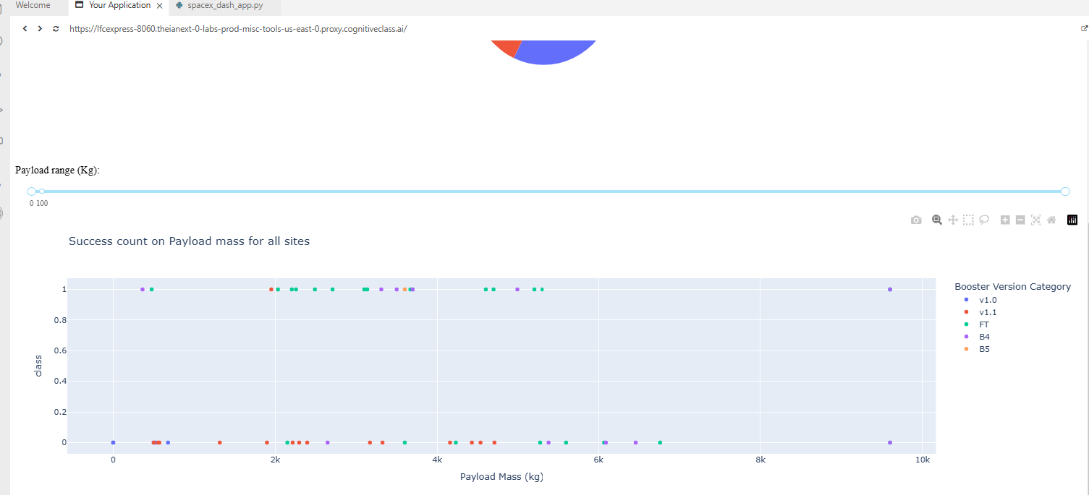
PAYLOAD vs. LAUCH OUTCOME
After 5kgs, the success rate decreases.
https://github.com/lfcexpress/SpaceX_Landing_Predictions/blob/main/7_Launch_Success_Dash_APP.py

Slide 38
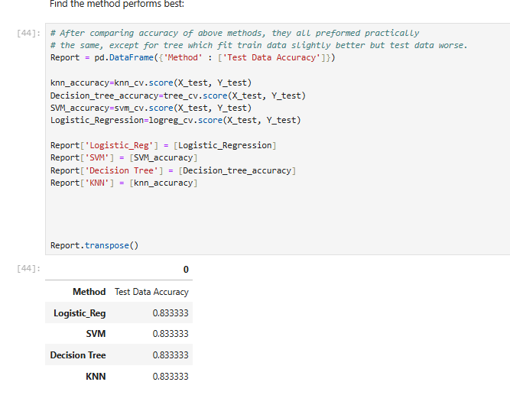
METHODS ACCURACY
Machine learning Scores
Logistic Regression = 83.3%
SVM = 83.33 %
Decision = 83.33%
KNN = 83.33%
https://github.com/lfcexpress/SpaceX_Landing_Predictions/blob/main/8_SpaceX_Machine_Learning_Prediction_.ipynb

Slide 39
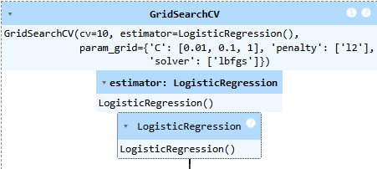
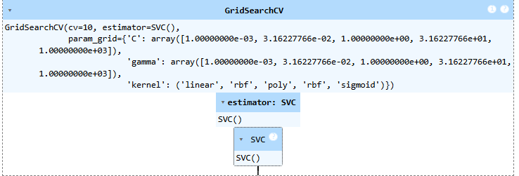
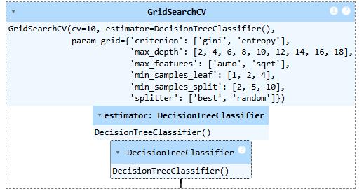
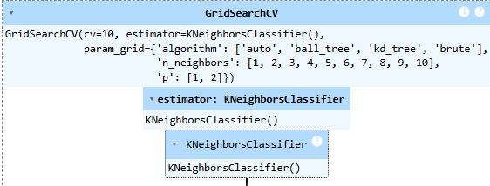
TRAIN MODEL- “GridSearchCV”
Logistic Regression ()
SV
Decision Tree Classifier ()
KNeighborsClassifier()
https://github.com/lfcexpress/SpaceX_Landing_Predictions/blob/main/8_SpaceX_Machine_Learning_Prediction_.ipynb

Slide 40
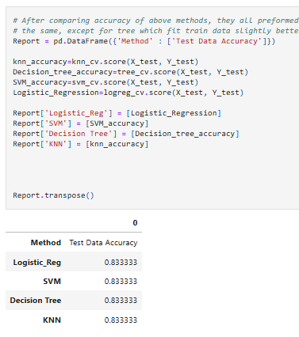
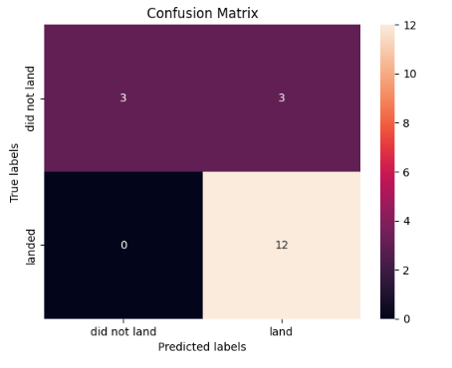
CONFUSION MATRIX
The confusion metrics are the same for all four

Slide 41
CONCLUSION
Exploratory Data Analysis (EDA) by visualization provided an understanding of the details
Geographic launch site data is visualized with Folium
Plotly Dash enables interactive plots
The classification model for predictive analysis achieved 83% accuracy at best to the test data.

Slide 42
INDEX
Collect Data | < https://github.com/lfcexpress/SpaceX_Landing_Predictions/blob/main/1_SpaceX-data-collection-api_2024_10_25.ipynb >
2.) Web Scrape | < https://github.com/lfcexpress/SpaceX_Landing_Predictions/blob/main/2_SpaceX-labs-webscraping_2024_10_05.ipynb >
3.) Data Wrangling | < https://github.com/lfcexpress/SpaceX_Landing_Predictions/blob/main/3_SpaceX-Data_Wrangling_2024_10_25.ipynb >
4.) SQL in Python | < https://github.com/lfcexpress/SpaceX_Landing_Predictions/blob/main/4_SpaceX-SQL-sqllite.ipynb>
5.) EDA Visualization | < https://github.com/lfcexpress/SpaceX_Landing_Predictions/blob/main/5_SpaceX_edadata_viz.ipynb >
6. ) Geographic Interactive Visualization with Folium | < https://github.com/lfcexpress/SpaceX_Landing_Predictions/blob/main/6_Interactive_Visual_w_Folium.ipynb >
7.) Dashboard with DASH | < https://github.com/lfcexpress/SpaceX_Landing_Predictions/blob/main/7_Launch_Success_Dash_APP.py >
8.) Machine Learning & Predictive Analysis | < https://github.com/lfcexpress/SpaceX_Landing_Predictions/blob/main/8_SpaceX_Machine_Learning_Prediction_.ipynb >

