Slide 1
Part II : Waits Events
Kyle Hailey
kylelf@gmail.com
http://oraclemonitor.com

Slide 2
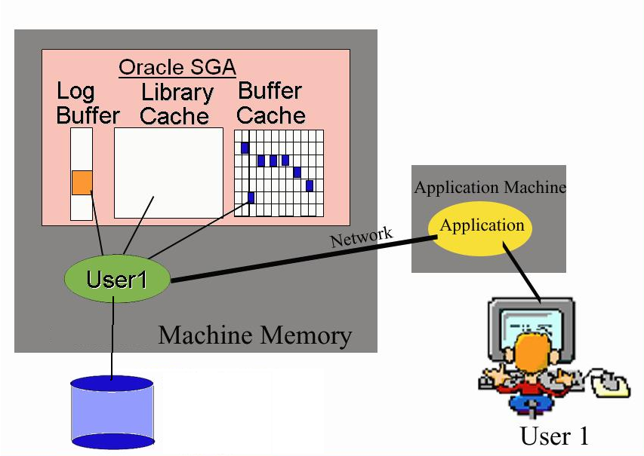
Oracle Instrumentation
Database
CPU
Lib Cache
Buffer Cache
Redo
Locks
Network
*$%@!!
IO
Copyright 2006 Kyle Hailey

Slide 3
Wait Tree
Write IO
Commit
Read IO
Rollback
Administrative
Application
Other
IO
Buffer Busy
Free lists
SQL*Net break/reset to client
enq: KO - fast object checkpoint
enq: RO - fast object reuse
enq: TM - contention
enq: TX - row lock contention
enq: UL - contention
Network
Application
Cache Latches
IO Read
Other
Buffer Cache
Network
SQL*Net message to client
SQL*Net more data to client
SQL*Net more data from client
buffer exterminate
enq: CF - contention
enq: CI - Cross Instance
enq: TX - contention
kksfbc child completion
latch: cache buffers handles
latch: cache buffers lru chain
latch free
Library Cache
Administrative
Concurrency
Library Cache
Concurrency
buffer busy wait
latch: cache buffers chains
os thread startup
enq: TX - index contention
cursor: pin S
cursor: pin X
cursor: pin S wait on X
latch: library cache
latch: library cache lock
latch: library cache pin
latch: row cache objects
latch: shared pool latch
library cache load lock
library cache lock
library cache pin
row cache lock
Shared Pool
Configuration
Waits
Administrative
Lock
Configuration
TX Row Lock
Configuration
Commit
enq: HW - contention
enq: SQ - contention
enq: ST - contention
enq: TX - allocate ITL entry
free buffer wait
sort segment request
write complete wait
log buffer space
log file switch (archiving needed)
log file switch (checkpoint incomplete)
log file switch (private strand flush incomplete)
log file switch completion
User I/O
Redo
TX ITL Lock
data file init write
db file parallel read
db file scattered read
db file sequential read
direct path read
direct path read temp
direct path write
direct path write temp
local write wait
read by other session
Network
Application
SQL Net
HW Lock
Concurrency
Other
Log File
User I/O
Log Buffer
Log File Sync
Copyright 2006 Kyle Hailey

Slide 4
Waits beyond OEM
OEM identifies Wait problems
Provides solutions with ADDM sometimes but …
  What do you do when ADDM isn’t sufficient?
  What do you do if you don’t have OEM 10g?
Then have to analyze the Waits
  Need to know about waits
  How they work
  How to analyze them
Copyright 2006 Kyle Hailey

Slide 5
v$active_session_history
When ADDM fails or we don’t have ADDM we can collect the necessary information from
v$active_session_history
  Session (user, service, client, package, procedure, etc)
  SQL statement
  Wait
    P1
    P2
    P3
  Blocking_Session (sometimes)
Copyright 2006 Kyle Hailey

Slide 6
What are P1,P2,P3 ?
Each Wait has a 3 parameters P1,P2,P3
Give detailed information
Meaning different for each wait
Meaning definitions in V$event_name
col parameter1 for a10
col parameter2 for a10
col parameter3 for a10
select parameter1 ,parameter2 , parameter3
from v$event_name
where name = '&1';
Copyright 2006 Kyle Hailey

Slide 7
Wait Arguments Example
select parameter1 ,parameter2 , parameter3
from v$event_name;
NAME PARAMETER1 PARAMETER2 PARAMETER3
------------------------------ ----------- --------------- ---------------
latch: cache buffers chains address number tries
free buffer waits file# block# set-id#
buffer busy waits file# block# class#
latch: redo copy address number tries
log buffer space
switch logfile command
log file sync buffer#
db file sequential read file# block# blocks
enq: TM - contention name|mode object # table/partition
undo segment extension segment#
enq: TX - row lock contention name|mode usn<<16 | slot sequence
row cache lock cache id mode request
library cache pin handle address pin address 100*mode+namesp
library cache load lock object address lock address 100*mask+namesp
pipe put handle address record length timeout
Copyright 2006 Kyle Hailey

Slide 8
Wait Analysis requires p1,p2,p3
Of the top 30 wait events 8 can be solved without ASH
The rest need
  SQL
  P1,P2,P3
  Statspack , AWR fail
free buffer waits
log buffer space
log file switch (archiving needed)
log file switch (checkpoint incomplete)
log file switch completion
log file sync
switch logfile command
write complete waits
Example “hard” waits
Buffer busy wait
Row cache lock
Latch free
row lock contention
Latch: cache buffers chains
Copyright 2006 Kyle Hailey

Slide 9
Wait Analysis
SQL
  Most often the tuning answer lies in looking at what the application is doing, and changing it
Parameters
  Find extended wait information
  Parameter1, Parameter2, Parameter3
  Defined in v$event_name
Guess Work
  Sometimes the wait events that are found are not in the documentation and it takes some educated guesswork to figure out the problem

Slide 10
Waits we will Ignore
One thing that makes waits difficult is knowing which ones to look at and which ones to ignore.
Background
Idle
Resource Manager
Parallel Query
RAC
  Good stuff, but not covered in this seminar
Copyright 2006 Kyle Hailey

Slide 11
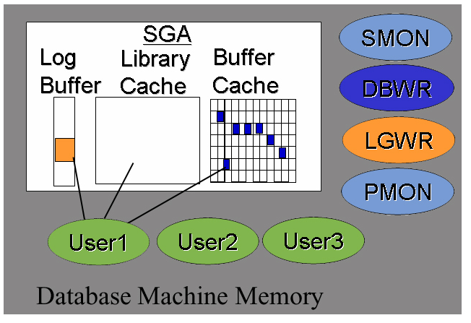
Background & Foreground
Background Processes
  DBWR
  LGWR
  PMON
  SMON
  Etc
Foreground Processes
  SQL*Plus
  Pro*C
  SQL*Forms
  Oracle applications
Only interested in Foreground waits
Copyright 2006 Kyle Hailey

Slide 12
Background Waits
ASH
  Avoid Background waits in ASH with
V$session_wait joined to v$session
Select …from v$active_session_history where SESSION_TYPE='FOREGROUND'
select …
from v$session s,
v$session_wait w
where w.sid=s.sid
and s.type='USER'
Copyright 2006 Kyle Hailey

Slide 13
Idle Waits
Filtered Out of ASH by default
10g
  where wait_class != ‘Idle’
  Create a list
9i
  Create a list with
    Documentation
    List created from 10g
    Stats$idle_events from statspack
Select name from v$event_name where wait_class=‘Idle’;
SQL*Net message from client
Copyright 2006 Kyle Hailey

Slide 14
PQO and Resource Manager
Resource manager throttles user
  Creates wait
  Obfuscates problems
Parallel Query Wait events are unusable
  Save waits are both idle and waits
  Parallel Query Waits start with ‘PX’ or ‘KX’
    PX Deq: Par Recov Reply
    PX Deq: Parse Reply
select name from v$event_name where wait_class='Scheduler';
Copyright 2006 Kyle Hailey

Slide 15
RAC Waits
RAC waits are certainly interesting but will be covered outside of this presentation.
You are on your own
Check documentation
If you are not using RAC then no worries
10g
9i
  RAC and OPS waits usually contain the word “global”
Select event from v$event_name where wait_class=‘Cluster’;
Copyright 2006 Kyle Hailey

Slide 16
Additional Support
AWR Tables – on disk for 7 days by default
  DBA_HIST_ACTIVE_SESS_HISTORY
    1 in 10 ASH samples
  DBA_HIST_SEG_STAT
    Sometimes make analysis of ITL and buffer busy wait easier
  DBA_HIST_SYSTEM_EVENT
    Important for getting avg wait times
  DBA_HIST_SQLSTAT
    sql execution deltas
  DBA_HIST_SYSMETRIC_SUMMARY
    Statistics avg, max, min
Metric Tables – in memory deltas
  V$EVENTMETRIC
Copyright 2006 Kyle Hailey

Slide 17
All Events over 7 days
Union of 7 day history with in memory buffer :
select count(*), event from
( select event from DBA_HIST_ACTIVE_SESS_HISTORY
where sample_time < ( select min(sample_time) from
v$active_session_history)
union all
select event from v$active_session_history
)
group by event
order by event
/
Copyright 2006 Kyle Hailey
Notes:
COUNT(*) EVENT
---------- -------------------------------------------------------
342 Data file init write
3 L1 validation
3 LGWR wait for redo copy
4 Log file init write
200 PX Deq Credit: send blkd
22 SGA: allocation forcing component growth
3 SQL*Net break/reset to client
1 SQL*Net more data to client
14 Streams AQ: qmn coordinator waiting for slave to start
3284 buffer busy waits
2 buffer deadlock
74 buffer exterminate
780 control file parallel write
9 control file sequential read
12674 db file parallel write
1537 db file scattered read
3831 db file sequential read
41 db file single write
8 direct path read
31 direct path write
47 direct path write temp
5 enq: CF - contention
3 enq: CI - contention
805 enq: FB - contention
944 enq: HW - contention
1 enq: IM - contention for blr
476 enq: RO - fast object reuse
32 enq: SQ - contention
34 enq: TC - contention
18972 enq: TM - contention
1851 enq: TX - allocate ITL entry
90 enq: TX - contention
402 enq: TX - index contention
11587 enq: TX - row lock contention
2278 enq: UL - contention
1962 free buffer waits
31 inactive session
4 kksfbc child completion
1069 latch free
1 latch: In memory undo latch
1071 latch: cache buffers chains
241 latch: cache buffers lru chain
43 latch: library cache
9 latch: library cache pin
1 latch: shared pool
7 library cache load lock
94 library cache lock
93 library cache pin
99 local write wait
555 log buffer space
879 log file parallel write
340 log file switch (checkpoint incomplete)
98 log file switch completion
453 log file sync
50 null event
121 os thread startup
53 rdbms ipc reply
1236 read by other session
2 reliable message
12 row cache lock
180 wait for a undo record
28 wait for stopper event to be increased
127 wait list latch free
25 write complete waits

Slide 18
Avg Wait times now
select
en.name,
(time_waited)/nullif(wait_count,0) avg_ms,
wait_count
from
v$eventmetric e,
v$event_name en
where
e.event# = en.event#
and en.name like '%&1%‘;
NAME AVG_MS WAIT_COUNT
------------------------- ---------- ----------
db file sequential read .658863707 6420
db file scattered read .549427419 186
db file parallel write .089073438 64
Copyright 2006 Kyle Hailey

Slide 19
Object Translation
Current fields in v$active_session_history
    CURRENT_OBJ#
    CURRENT_FILE#
    CURRENT_BLOCK#
    Called “ROW_WAIT_%” in v$session
Only apply to
    Buffer Busy Waits
    IO Waits
    Enqueue TX
Ignore these fields for other wait events

Slide 20
Wait interface Weaknesses
Logons
  EM 10g shows these on perf page
  Time model helps
    V$SYS_TIME_MODEL
      connection management call elapsed time (I’ve had problems)
Paging/Memory issues
CPU starvation
Null Events
Bugs – read external table reports CPU
  http://blog.tanelpoder.com/
Copyright 2006 Kyle Hailey
Notes:
From Tanel Poder http://blog.tanelpoder.com/
Advanced Oracle Troubleshooting Guide: When the wait interface is not enough [part 1]
Filed under: Unix/Linux, Troubleshooting, Internals, Oracle — tanelp @ 9:38 pm
Welcome to read my first real post on this blog!
If I ever manage to post any more entries, the type and style of content will be pretty much as this one: some Oracle problem diagnosis and troubleshooting techniques with some OS and hardware touch in it. Mmm… internals ;-)
Nevertheless I am also a fan of systematic approaches and methods so I plan to propose some less known OS and Oracle techniques for reducing guesswork in advanced troubleshooting even further.
Ok, to the topic.
Troubleshooting. Troubleshooting = finding out what is going on.
This post covers one unexplained issue I once had with Oracle external tables - which eventually turned out to be a problem with Oracle wait interface instrumentation. I used some of these “what’s going on” techniques to find out… what’s going on. Solaris 10 x64 / Oracle 10.2.0.2.
________________________________________
I worked on a project for which I needed to read data through an external table from an Unix pipe ( ever wanted to load compressed flat file contents to Oracle on-the-fly? ;-)
I created a Unix pipe:
$ mknod /tmp/tmp_pipe p
I created an Oracle external table, reading from that pipe:
Connected to:
Oracle Database 10g Enterprise Edition Release 10.2.0.2.0 - Production
With the Partitioning, OLAP and Data Mining options
USERNAME INSTANCE_NAME HOST_NAME VER STARTED SID SERIAL# SPID
------------ ---------------- ------------------------- ---------- -------- ------- ------- -------
TANEL SOL01 solaris01 10.2.0.2.0 20070618 470 14 724
Tanel@Sol01> CREATE DIRECTORY dir AS '/tmp';
Directory created.
Tanel@Sol01> CREATE TABLE ext (
2 value number
3 )
4 ORGANIZATION EXTERNAL (
5 TYPE oracle_loader
6 DEFAULT DIRECTORY dir
7 ACCESS PARAMETERS (
8 FIELDS TERMINATED BY ';'
9 MISSING FIELD VALUES ARE NULL
10 (value)
11 )
12 LOCATION ('tmp_pipe')
13 )
14 ;
Table created.
Tanel@Sol01> select * from ext;
So far so good… unfortunately this select statement never returned any results. As it turned out later, the gunzip over remote ssh link which should have fed the Unix pipe with flat file data, had got stuck.
Without realizing that, I approached this potential session hang condition with first obvious check - a select from V$SESSION_WAIT:
Tanel@Sol01> select sid, event, state, seq#, seconds_in_wait, p1,p2,p3
2 from v$session_wait
3 where sid = 470;
SID EVENT STATE SEQ# SECONDS_IN_WAIT P1 P2 P3
------- ------------------------------ ------------------- ---------- --------------- ---------- ---------- ----------
470 db file sequential read WAITED KNOWN TIME 164 7338 1 1892 1
Tanel@Sol01> /
SID EVENT STATE SEQ# SECONDS_IN_WAIT P1 P2 P3
------- ------------------------------ ------------------- ---------- --------------- ---------- ---------- ----------
470 db file sequential read WAITED KNOWN TIME 164 7353 1 1892 1
Tanel@Sol01> /
SID EVENT STATE SEQ# SECONDS_IN_WAIT P1 P2 P3
------- ------------------------------ ------------------- ---------- --------------- ---------- ---------- ----------
470 db file sequential read WAITED KNOWN TIME 164 7374 1 1892 1
Tanel@Sol01>
The STATE and SECONDS_IN_WAIT columns in V$SESSION_WAIT say we have been crunching the CPU for last two hours, right? (as WAITED… means NOT waiting on any event, in this case the EVENT just shows the last event on which we waited before getting on CPU)
Hmm.. let’s check it out:
$ prstat -p 724
PID USERNAME SIZE RSS STATE PRI NICE TIME CPU PROCESS/NLWP
724 oracle 621M 533M sleep 59 0 0:00:00 0.0% oracle/1
prstat reports that this process is currently in sleep state, is not using CPU and has used virtually no CPU during its 2-hour “run” time!
Let’s check with ps (which is actually a quite powerful tool):
$ ps -o user,pid,s,pcpu,time,etime,wchan,comm -p 724
USER PID S %CPU TIME ELAPSED WCHAN COMMAND
oracle 724 S 0.0 00:01 02:18:08 ffffffff8135cadc oracleSOL01
ps also confirms that the process 724 has existed for over 2 hours 18 minutes (ELAPSED), but has only used roughly 1 second of CPU time (TIME). The state column “S” also indicates the sleeping status.
So, either Oracle V$SESSION_WAIT or standard Unix tools are lying to us. From above evidence it is pretty clear that it’s Oracle who’s lying (also, in cases like that, lower-level instrumentation always has a better chance to know what’s really going on at the upper level than vice versa).
So, let’s use truss (or strace on Linux, tusc on HP-UX) to see if our code is making any system calls or is sleeping within a system call…
$ truss -p 724
read(14, 0xFFFFFD7FFD6FDE0F, 524273) (sleeping…)
Hmm, as no followup is printed to this line, it looks like the process is waiting for a read operation on a file descriptor 14 to complete.
Which file is this fd 14 about?
$ pfiles 724
724: oracleSOL01 (LOCAL=NO)
...snip...
14: S_IFIFO mode:0644 dev:274,2 ino:4036320452 uid:100 gid:300 size:0
O_RDONLY|O_LARGEFILE
/tmp/tmp_pipe
…snip…
So from here it’s already pretty obvious where the problem is. There is no data coming from the tmp_pipe. This led me to check what was my gunzip doing on the other end of the pipe and it was stuck, in turn waiting for ssh to feed more data into it. And ssh had got stuck due some network transport issue.
The baseline is that you can rely on low-level (OS) tools to identify what’s really going on when higher level tools (like Oracle wait interface) provide weird or contradicting information, in this case the Oracle wait interface was not recording external table read wait events. I reported this info to Oracle people and I think it has been filed as a bug by now.
________________________________________
This was only a simple demo, identifying a pretty clear case of a session hang, however with use of a pretty intrusive tool ( I would not attach truss to a busy production instance process without thinking twice ).
However there are other options. In the next part of this guide ( when I manage to write it ) I will deal with more complex problems like what to do when the session is not reporting significant waits and is spinning heavily on CPU. Using Oracle and Unix tools it is quite easy to figure out the execution profile of a spinning server process, even without connecting to Oracle at all ( do I hear pstack, mdb and stack tracing? ;-)
As I’ve just started blogging, I would appreciate any feedback, including about things like blog layout, font sizes, readability, understandability etc. Also I think it will take few days before I manage to post the Part 2 of this troubleshooting guide.
Thank you for your patience reading through this :-)

Slide 21
Summary
Host
CPU
Memory
Waits make Tuning Easy
  Check Machine Health
  Tune Waits
  Tune CPU
    Tune SQL
    Change Application Architecture
Use
  OEM10g
  Statspack/AWR,
  S/ASH
Ignore Background, Idle, Resmgr, PQO
Use ASH if OEM fails
See http://oraclemonitor.com for more info
Oracle Load
(AAS)
AAS > #CPU
AAS > 1
Waits > CPU
CPU > Waits
Top Session
Top Wait
Top SQL
Object Detail
SQL Detail
Wait Detail
Session Detail
File Detail
ADDM
SQL Tuning Advisor
Copyright 2006 Kyle Hailey
Notes:
s

