Slide 1
Practical Use of
Active Session History
David Kurtz
Go-Faster Consultancy Ltd.
david.kurtz@go-faster.co.uk
www.go-faster.co.uk
Notes:
Row Migration can Aggravate Contention on Cache Buffer Chains Latch
©2011 Go-Faster Consultancy Ltd. www.go-faster.co.uk

Slide 2
You probably don’t (often) need event 10046
David Kurtz
Go-Faster Consultancy Ltd.
david.kurtz@go-faster.co.uk
www.go-faster.co.uk
Notes:
Row Migration can Aggravate Contention on Cache Buffer Chains Latch
©2011 Go-Faster Consultancy Ltd. www.go-faster.co.uk

Slide 3



Who Am I?
Oracle Database Specialist
  Independent consultant
Performance tuning
  PeopleSoft ERP
  Oracle RDBMS
Book
  www.psftdba.com
UKOUG Director
Server Tech & PeopleSoft
Oak Table
Practical ASH
©2011 www.go-faster.co.uk
Notes:
Row Migration can Aggravate Contention on Cache Buffer Chains Latch
©2011 Go-Faster Consultancy Ltd. www.go-faster.co.uk
©2011 Go-Faster Consultancy Ltd. www.go-faster.co.uk
Row Migration can Aggravate Contention on Cache Buffer Chains Latch

Slide 4
Agenda: Active Session History
What is it? What does it do?
  Most examples based on 10gR2.
Enterprise Manager & ASH Report
Compare and contrast SQL*Trace
Instrumentation
Using SQL to Analyse ASH
  Top SQL, Locking, Changing Plans, I/O, Limitations
Practical ASH
©2011 www.go-faster.co.uk

Slide 5
Resources
If you can’t hear me say so now.
Please feel free to ask questions as we go along.
The presentation is available from
    http://www.go-faster.co.uk/ukougpres.htm #Practical_ASH.ppt
  Tip: Print in this presentation in ‘black and white’ for white background.
Practical ASH
©2011 www.go-faster.co.uk
Notes:
Row Migration can Aggravate Contention on Cache Buffer Chains Latch
©2011 Go-Faster Consultancy Ltd. www.go-faster.co.uk

Slide 6
Further Reading
This presentation started out as a document, you might find it easier to work with that than this presentation.
  Not everything in the document appears in the presentation.
  http://www.go-faster.co.uk/Practical_ASH.pdf
Practical ASH
©2011 www.go-faster.co.uk

Slide 7
Background Reading
Sifting through the ASHes, Graham Wood
  http://www.oracle.com/technology/products/manageability/database/pdf/twp03/PPT_active_session_history.pdf
The ASHes of (DB) Time, Graham Wood
  UKOUG 2009
    http://www.ukoug.org/lib/show_document.jsp?id=11472
  Video of presentation at MOW2010
    http://www.oaktable.net/media/mow2010-graham-wood-ashes-time-part1
    http://www.oaktable.net/media/mow2010-graham-wood-ashes-time-part-2
Doug Burns’ Oracle Blog
  http://oracledoug.com/serendipity/index.php?/plugin/tag/ASH
Introduction to DBMS_XPLAN
  http://www.go-faster.co.uk/Intro_DBMS_XPLAN.ppt
Practical ASH
©2011 www.go-faster.co.uk
Notes:
Row Migration can Aggravate Contention on Cache Buffer Chains Latch
©2011 Go-Faster Consultancy Ltd. www.go-faster.co.uk
Sifting through the ASHes, Graham Wood, Oracle (http://www.oracle.com/technology/products/manageability/database/pdf/twp03/PPT_active_session_history.pdf)
The ASHes of (DB) Time, Graham Wood at UKOUG2009 (and other conferences).
Introduction to DBMS_XPLAN (http://www.go-faster.co.uk/Intro_DBMS_XPLAN.ppt), UKOUG2008

Slide 8
Your Mileage May Vary
Throughout this presentation I will be showing you examples from PeopleSoft systems.
  If you have a different package or you own application, you are likely to face similar challenges.
  Don’t worry about the PeopleSoft specifics.
  Focus on the kind of information I am using to filter my ASH data.
Practical ASH
©2011 www.go-faster.co.uk

Slide 9
A Brief Overview
Samples active sessions every second
Circular buffer in memory
  v$active_Session_history
  It should hold about 1 hour of data
1 in 10 samples stored in database
  DBA_HIST_ACTIVE_SESS_HISTORY
  Flushed out during AWR snapshot
Practical ASH
©2011 www.go-faster.co.uk
Notes:
Row Migration can Aggravate Contention on Cache Buffer Chains Latch
©2011 Go-Faster Consultancy Ltd. www.go-faster.co.uk
Active Session History (ASH) was introduced in Oracle 10g. It samples the activity of each active database session every second. The data is held in a buffer in memory in the database. The design goal is to keep about an hour (your mileage will vary). If a session is not active it will not be sampled. The in-memory buffer is exposed via a view called v$active_session_history.
You could sort of simulate some of ASH by taking a snapshot of v$session every session, but the overhead would be prohibitive. ASH is built into the Oracle kernel, so its overhead is minimal.
When an AWR snapshot is taken, 1 row in 10 from the ASH buffer is copied down into the AWR repository. It can also be flushed to disk between snapshots when the buffer reaches 66% full, so there is no missed data.The data is stored in WRH$_ACTIVE_SESSION_HISTORY and it is exposed via DBA_HIST_ACTIVE_SESS_HISTORY.

Slide 10
Licensing
ASH is a part of the Diagnostics Pack
  That’s means it costs money.
  I don’t like it either, but that is how it is!
Practical ASH
©2011 www.go-faster.co.uk
Notes:
Row Migration can Aggravate Contention on Cache Buffer Chains Latch
©2011 Go-Faster Consultancy Ltd. www.go-faster.co.uk
ASH is enabled by default, but before you rush off to use it, be aware that it is a licenced feature. It is part of the Diagnostic Pack, so you have to pay for it. I don’t like that either, but that’s how it is.

Slide 11
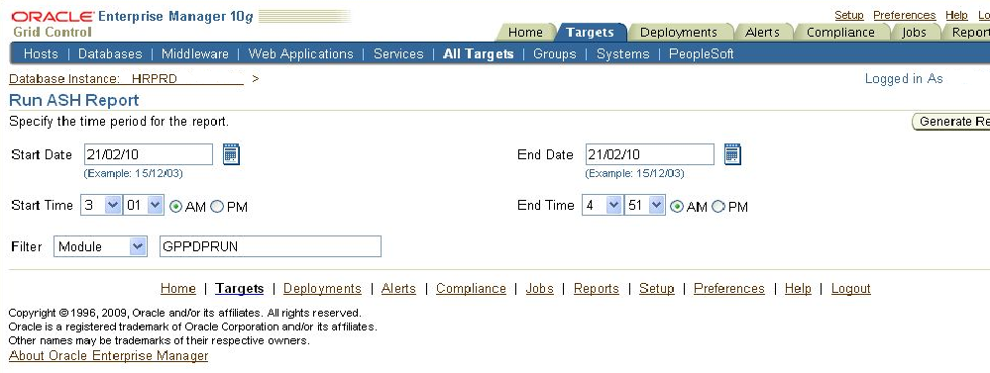
ASH in OEM
You can run ASH reports via EM
Practical ASH
©2011 www.go-faster.co.uk
Notes:
Row Migration can Aggravate Contention on Cache Buffer Chains Latch
©2011 Go-Faster Consultancy Ltd. www.go-faster.co.uk
Of course, OEM provides a way to run ASH reports, and here you see I have picked a particular time window, and I have specified a module name – in this case the main payroll calculation process.

Slide 12
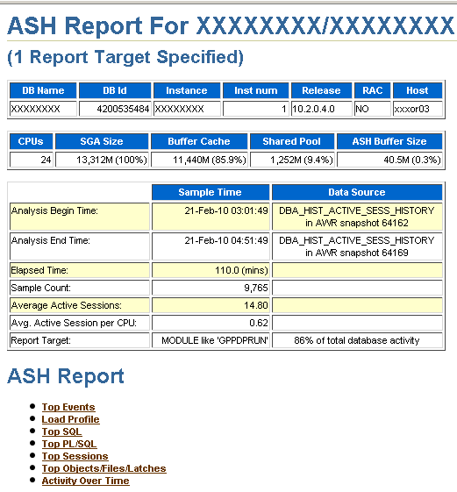
Example ASH Report
These processes were responsible for 86% of total DB activity
Average 14.8 active sessions (out 32 processes)
If I go on I get SQL statements
But I don’t get execution plans.
Practical ASH
©2011 www.go-faster.co.uk
Notes:
Row Migration can Aggravate Contention on Cache Buffer Chains Latch
©2011 Go-Faster Consultancy Ltd. www.go-faster.co.uk
And this is great. The report is easy to produce, and it tells you lots of things. Which SQL statements are consuming the most time, which objects have the most I
You can see in this example I picked a module that was responsible for 86% of the total, and there were an average of 14.8 active sessions (I know there were 32 concurrent processes).
But, you don’t get execution plans, and for that you will need to dig deeper yourself, and learn to use the DBMS_XPLAN package.

Slide 13
What does ASH retain?
Most of the columns are on v$session
  Session
    Session ID and serial, query coordinator
  Wait
    event id, name and parameters
  SQL
    SQL_ID, plan hash, opcode
  Object
    object, file and block numbers
    row numbers from 11g
  Application
    module, action …
Practical ASH
©2011 www.go-faster.co.uk
Notes:
Row Migration can Aggravate Contention on Cache Buffer Chains Latch
©2011 Go-Faster Consultancy Ltd. www.go-faster.co.uk
Most of the columns on v$active_session_history are taken directly from column of the same name on v$session, some have different name, and there is some additional information that is not available elsewhere.

Slide 14
What does ASH retain?
Column on v$active_session_history | Correspondence to v$session
SAMPLE_ID | ID of ASH Sample
SAMPLE_TIME | Time of ASH Sample
SESSION_ID | V$SESSION.SID
SQL_ID | √
SQL_CHILD_NUMBER | √
SQL_PLAN_HASH_VALUE | V$SQL.PLAN_HASH_VALUE
EVENT | √
PROGRAM | √
MODULE | √
ACTION | √
… | …
Practical ASH
©2011 www.go-faster.co.uk
Notes:
Row Migration can Aggravate Contention on Cache Buffer Chains Latch
©2011 Go-Faster Consultancy Ltd. www.go-faster.co.uk
Most of the columns on v$active_session_history are taken directly from column of the same name on v$session, some have different name, and there is some additional information that is not available elsewhere.

Slide 15
New in 11gR1
SQL_PLAN_LINE_ID, SQL_PLAN_OPERATION, SQL_PLAN_OPTIONS
SQL_EXEC_ID, SQL_EXEC_START
TOP_LEVEL_SQL_ID, TO_LEVEL_SQL_OPCODE
QC_SESSION_SERIAL#
REMOTE_INSTANCE#
CURRENT_ROW#
CONSUMER_GROUP_ID
IN_PARSE, IN_HARD_PARSE, IN_SQL_EXECUTION …
Practical ASH
©2011 www.go-faster.co.uk

Slide 16
New in 11gR2
IS_AWR_SAMPLE
IS_SQL_ID_CURRENT
CAPTURED_OVERHEAD, REPLAY_OVERHEAD, IS_CAPTURED, IS_REPLAYED
MACHINE, PORT, ECID
TM_DELTA_TIME, TM_DELTA_CPU_TIME, TM_DELTA_DB_TIME, DELTA_TIME
DELTA_READ_IO_REQUESTS, DELTA_WRITE_IO_REQUESTS, DELTA_READ_IO_BYTES, DELTA_WRITE_IO_REQUESTS
PGA_ALLOCATED
TEMP_SPACE_ALLOCATED
Practical ASH
©2011 www.go-faster.co.uk

Slide 17
ASH –v- SQL*Trace
ASH
  Licensed
  Always there
  No marginal cost
  Real Time
  Who is blocking me?
  Statistical data
  SQL ID
  Plan if captured by AWR
  Estimate of duration
    Per wait event
    Operation in 11gR2
SQL*Trace
  Free
  Enable, File, Profile
  Run-time overhead
  Reactive
  Being Blocked
  Every SQL & event
  SQL HASH up to 10g
  Actual execution plan
  Exact duration
    Operations in Plan
Practical ASH
©2011 www.go-faster.co.uk
Notes:
Row Migration can Aggravate Contention on Cache Buffer Chains Latch
©2011 Go-Faster Consultancy Ltd. www.go-faster.co.uk
ASH and SQL*Trace are not the same thing, but both are valuable tools for finding out about where processes spend time.
SQL*Trace (or event 10046 as we used to call it) has been my weapon of choice for solving performance issues for a very long time, and it is extremely effective, and there is still a place for it.
There are difficulties with using SQL trace, especially in a production environment.
Firstly, it does have a run time overhead. You could afford to trace a single process, but you certainly couldn’t trace the entire database.
You have to work with trace in a reactive way. You will probably not already be tracing a process when you experience a performance problem, so you need to run the process again and reproduce the poor performance with trace.
Trace will tell you if a session is blocked waiting on a lock. However, it will not tell you who is blocking you. ASH will do this (although there are limitations).
A trace file records everything that happens in a session, whereas ASH data samples the session every seconds. Short-lived events will be missed, so the data has to be handled statistically (see page 11).
There are problems with both approaches if you have the kind of application where you have lots of different SQL statements because the application uses literal values rather than bind variables (and cursor sharing is EXACT).
Oracle TKPROF trace file profilers cannot aggregate these statements, but I have found another called ORASRP (www.oracledba.ru/orasrp) that can. With ASH, you will see different SQL_IDs, but it can be effective to group statements with the same execution plan.
You may have trouble finding the SQL text in the SGA (or via the DBMS_XPLAN package) because it has already been aged out of the library cache. You may have similar problems with historical ASH data because the statement had been aged out when the AWR snapshot was taken.
Through the rest of this document you will see SQL_IDs. However, in a SQL trace the statements are identified by hash_value. Those hash values do not show up if you profile your trace file with tkprof, but they do if you use OraSRP. SQL_ID is just a fancy representation of hash value, so you can convert from a SQL_ID to a hash_value. Oracle supply function DBMS_UTILITY.SQLID_TO_SQLHASH(), but as the comment on the blog says Tanel’s script is much cooler[1].
You can’t get the whole of the SQL_ID back from the hash values (because it is trimmed off), but you can get the last 5 or 6 characters it help you find or match SQL statements[2]
[1] See Tanel Poder’s blog: http://blog.tanelpoder.com/2009/02/22/sql_id-is-just-a-fancy-representation-of-hash-value/
[2] And I could never have written this without seeing Tanel’s code!
CREATE OR REPLACE FUNCTION h2i (p_hash_value NUMBER) RETURN VARCHAR2 IS
l_output VARCHAR2(10) := '';
BEGIN
FOR i IN (
select substr('0123456789abcdfghjkmnpqrstuvwxyz',1+floor(mod(p_hash_value/(POWER(32,LEVEL-1)),32)),1) sqlidchar
FROM dual CONNECT BY LEVEL <= LN(p_hash_value)/LN(32) ORDER BY LEVEL DESC
) LOOP
l_output := l_output || i.sqlidchar;
END LOOP;
RETURN l_output;
END;
/

Slide 18
ASH –v- SQL*Trace
ASH can be used to resolve many of your performance issues.
Sometimes, you will still need SQL*Trace
Practical ASH
©2011 www.go-faster.co.uk

Slide 19
Application Instrumentation
It is essential to be able to match
  database sessions
  application processes
DBMS_APPLICATION_INFO
  set_module, set_action
  Calls in application
    Not all packaged application vendors do this
Practical ASH
©2011 www.go-faster.co.uk
Notes:
Row Migration can Aggravate Contention on Cache Buffer Chains Latch
©2011 Go-Faster Consultancy Ltd. www.go-faster.co.uk
Application Instrumentation
Oracle has provided a package called DBMS_APPLICATION_INFO since at least Oracle 8. This allows you to set two attributes; MODULE and ACTION for a session. That value then appears in v$session, and can be very useful to help you identify what database sessions relate to what part of an application. These values are also captured by ASH, and without sensible values in these columns you may struggle to identify ASH data for the sessions which are of interest.
These values are not set by default. Instead DBAs are dependent on developers to include them in their code. For example, Oracle E-Business Suite has built this into the application.

Slide 20
DIY Instrumentation
You may need to be creative!
  PeopleSoft: When a process starts (and sets its own status), I have a trigger that sets module and action
CREATE OR REPLACE TRIGGER sysadm.psftapi_store_prcsinstance
BEFORE UPDATE OF runstatus ON sysadm.psprcsrqst FOR EACH ROW
WHEN ((new.runstatus IN('3','7','8','9','10') OR old.runstatus IN('7','8')) AND new.prcstype != 'PSJob')
BEGIN
…
psftapi.set_action(p_prcsinstance=>:new.prcsinstance
,p_runstatus=>:new.runstatus, p_prcsname=>:new.prcsname);
…
EXCEPTION WHEN OTHERS THEN NULL; --do not crash the scheduler
END;
/
Practical ASH
©2011 www.go-faster.co.uk
Notes:
Row Migration can Aggravate Contention on Cache Buffer Chains Latch
©2011 Go-Faster Consultancy Ltd. www.go-faster.co.uk
PeopleSoft Specific Instrumentation
However, other application vendors have not. PeopleSoft, for example, only write the name of the executable into the module. This is really no help at all because the executable name is held in another column.
For batch processes, I have developed a trigger which is fired by batch processes as they start and which sets a meaningful process name, and puts the unique process instance number into the action.
Later, you will see the value of this instrumentation as I use it to join a combination of data in the application about batch processes with the ASH repository to identify where a given process spent time.

Slide 21
Statistical Analysis of ASH data
Recent
SELECT …
, SUM(1) ash_secs
FROM v$active_session_history
WHERE …
GROUP BY …
Historical
SELECT …
, SUM(10) ash_secs
FROM dba_hist_active_sess_history
WHERE …
GROUP BY …
Practical ASH
©2011 www.go-faster.co.uk
Notes:
Row Migration can Aggravate Contention on Cache Buffer Chains Latch
©2011 Go-Faster Consultancy Ltd. www.go-faster.co.uk
ASH data is a sample and so must be handled statistically. If something happens that lasts 10 seconds, then it will be sampled about 10 times.
However, not everything that happens is captured. If something happens that last less than a second, but it happens very frequently, some of them will be captured. For example, if something happens which lasts for 1/10th of a second, but happens 100 times then you would expect to capture it about 10 times. In all, the 100 occurences lasted 10 times. So by counting each ASH row as worth 1 seconds of wait time you come out at the right answer. This is what I mean by taking a statistical approach.
So, if you are looking at a current or recent process you the raw ASH data, and the query that you have to construct when working with is something along these lines
SELECT …
, SUM(1) ash_secs
FROM v$active_session_history
WHERE …
GROUP BY …
And if you are going further back in time then you have to work with the historical data, only 1 in 10 rows are kept, so now each row is worth 10 seconds
SELECT …
, SUM(10) ash_secs
FROM dba_hist_active_sess_history
WHERE …
GROUP BY …
And of course, you won’t see recent data in this view until there is an AWR snapshot or the ASH buffer fills to 2/3 and flushes

Slide 22
Querying ASH Repository
DBA_HIST_ACTIVE_SESS_HISTORY
  WRH$_ACTIVE_SESSION_HISTORY partitioned on DBID and SNAP_ID
DBA_HIST_SNAPSHOT
  WRM$_SNAPSHOT
Practical ASH
©2011 www.go-faster.co.uk
Notes:
Row Migration can Aggravate Contention on Cache Buffer Chains Latch
©2011 Go-Faster Consultancy Ltd. www.go-faster.co.uk
ASH History is exposed by the view DBA_HIST_ACTIVE_SESSION_HISTORY. It is stored in the table SYS. WRH$_ACTIVE_SESSION_HISTORY which is range partitioned on DBID and SNAP_ID.
To make the SQL work efficiently you need to specify the snap ID, for that I use DBA_HIST_SNAPSHOTS to identify the range of snapshots that you want to use, and the partitions first so that you eliminate unwanted partitions.

Slide 23
Querying ASH Repository
SELECT /*+LEADING(x) USE_NL(h)*/
…
, SUM(10) ash_secs
FROM dba_hist_active_sess_history h
, dba_hist_snapshot x
WHERE x.snap_id = h.snap_id
AND x.dbid = h.dbid
AND x.instance_number = h.instance_number
AND x.end_interval_time >= …
AND x.begin_interval_time <= …
AND h.sample_time BETWEEN … AND …
AND …
GROUP BY …
Practical ASH
©2011 www.go-faster.co.uk
Notes:
Row Migration can Aggravate Contention on Cache Buffer Chains Latch
©2011 Go-Faster Consultancy Ltd. www.go-faster.co.uk
You may need the LEADING hint to force Oracle to start with the snapshot view, and then the USE_NL hint to force it to work through each snapshot, which will guarantee a single partition access. Otherwise your queries could run for ever!

Slide 24
What are you looking for?
You need a clear idea of the question you are asking of the ASH data.
What are you interested in?
  Time Window
    Recent –v- Historical
  Single Session / Group of Sessions / Whole Database
  All ASH Data / One Event / One SQL ID / One Plan
  Related ASH data (sessions blocked by lock)
Practical ASH
©2011 www.go-faster.co.uk
Notes:
Row Migration can Aggravate Contention on Cache Buffer Chains Latch
©2011 Go-Faster Consultancy Ltd. www.go-faster.co.uk
Ask yourself what you are trying to find out.
Are you interested in a single database session, or a group of sessions, or the whole database?
All ASH Data –v- One Wait Event
Time Window

Slide 25
Example: A Batch Process
In PeopleSoft: a process request table
  one row per scheduled process.
Process Attributes
  Process Instance
  Operator
  Process Type & Name
  Begin Date/Time
  End Date/Time
Practical ASH
©2011 www.go-faster.co.uk

Slide 26
Example: A Batch Process
Hint to guarantee sensible join order, and partition elimination
SELECT /*+LEADING(r x h) USE_NL(h)*/
r.prcsinstance
, h.sql_id, h.sql_plan_hash_value
, (r.enddttm-r.begindttm)*86400 exec_secs
, SUM(10) ash_secs
FROM dba_hist_snapshot x
, dba_hist_active_sess_history h
, sysadm.psprcsrqst r
WHERE x.end_interval_time >= r.begindttm
AND x.begin_interval_time <= r.enddttm
AND h.sample_time BETWEEN r.begindttm AND r.enddttm
AND h.snap_id = x.snap_id
AND h.dbid = x.dbid
AND h.instance_number = x.instance_number
AND h.module like r.prcsname
AND h.action LIKE 'PI='||r.prcsinstance||'%‘
AND r.prcsinstance = 1956338
GROUP BY r.prcsinstance, r.prcsname, r.begindttm, r.enddttm
, h.sql_id,h.sql_plan_hash_value
ORDER BY ash_secs DESC
Process Request Table
One Row per Process
Snapshots for Period for which process was running
Specifc Process by ID
ASH Data for period for which process was running
Filter ASH data by MODULE and ACTION
Practical ASH
©2011 www.go-faster.co.uk

Slide 27
Example: On-Line
Snapshots for Period for which process was running
SELECT /*+LEADING(x h) USE_NL(h)*/
h.sql_id
, h.sql_plan_hash_value
, SUM(10) ash_secs
FROM dba_hist_snapshot x
, dba_hist_active_sess_history h
WHERE x.end_interval_time
>= TO_DATE('201002010730','yyyymmddhh24mi')
AND x.begin_interval_time
<= TO_DATE('201002010830','yyyymmddhh24mi')
AND h.sample_time BETWEEN TO_DATE('201002010730','yyyymmddhh24mi')
AND TO_DATE('201002010830','yyyymmddhh24mi')
AND h.SNAP_id = X.SNAP_id
AND h.dbid = x.dbid
AND h.instance_number = x.instance_number
AND h.module like 'PSAPPSRV%'
GROUP BY h.sql_id, h.sql_plan_hash_value
ORDER BY ash_secs DESC
/
ASH Data for period for which process was running
Application not instrumented
Can Only Filter by Module
Practical ASH
©2011 www.go-faster.co.uk

Slide 28
Top SQL
SQL Plan
SQL_ID Hash Value ASH_SECS
------------- ---------- ----------
7hvaxp65s70qw 1051046890 1360
fdukyw87n6prc 313261966 760
8d56bz2qxwy6j 2399544943 720
876mfmryd8yv7 156976114 710
bphpwrud1q83t 3575267335 690
Practical ASH
©2011 www.go-faster.co.uk
Notes:
Row Migration can Aggravate Contention on Cache Buffer Chains Latch
©2011 Go-Faster Consultancy Ltd. www.go-faster.co.uk
At least most of the SQL in the on-line application uses bind variables (except for certain bits of dynamically generated code), so it does aggregate properly in the ASH data.

Slide 29
Get the Execution Plan from AWR
SELECT * from table( dbms_xplan.display_awr( '7hvaxp65s70qw', 1051046890, NULL, 'ADVANCED'));
Practical ASH
©2011 www.go-faster.co.uk

Slide 30
Example: A Running Batch Process
The process has been running for a long time.
  It appears to have ground to a halt.
Practical ASH
©2011 www.go-faster.co.uk

Slide 31
Example: A Running Batch Process
Current Data rather than Historical ASH repository
SELECT /*+LEADING(r)*/
r.prcsinstance
, h.sql_id
, h.sql_child_number
, h.sql_plan_hash_value
, (NVL(r.enddttm,SYSDATE)-r.begindttm)*86400 exec_secs
, SUM(1) ash_secs
, max(sample_time) max_sample_time
FROM v$active_session_history h
, sysadm.psprcsrqst r
WHERE h.sample_time BETWEEN r.begindttm AND NVL(r.enddttm,SYSDATE)
AND h.module LIKE r.prcsname
AND h.action LIKE 'PI='||r.prcsinstance||'%'
AND r.prcsinstance = 1561519
GROUP BY r.prcsinstance, r.prcsname, r.begindttm, r.enddttm
, h.sql_id, h.sql_plan_hash_value, h.sql_child_number
ORDER BY max_sample_time DESC
Process Request Table
One Row per Process
Specific Process by ID
Latest ASH sample for statement
ASH Data for period for which process was running
Filter ASH data by MODULE and ACTION
Practical ASH
©2011 www.go-faster.co.uk

Slide 32
Example: A Running Batch Process
Process Child SQL Plan Exec ASH
Instance SQL_ID No. Hash Value Secs Secs Last Running
---------- ------------- ------ ---------- ------ ------ -------------------------
1561509 9yj020x2762a9 0 3972644945 18366 17688 19-FEB-10 04.24.41.392 PM
1561509 9yj020x2762a9 0 799518913 18366 1 19-FEB-10 11.26.29.096 AM
1561509 b5r9c04ck29zb 1 149088295 18366 1 19-FEB-10 11.26.28.085 AM
1561509 5vdhh2m8skh86 1 0 18366 1 19-FEB-10 11.26.27.075 AM
1561509 gyuq5arbj7ykx 0 3708596767 18366 1 19-FEB-10 11.26.26.065 AM
1561509 0 0 18366 1 19-FEB-10 11.26.25.055 AM
1561509 5jkh8knvxw7k2 0 1549543019 18366 1 19-FEB-10 11.26.24.043 AM
1561509 9pz262n5gbhmk 0 1935542594 18366 1 19-FEB-10 11.26.23.033 AM
1561509 6qg99cfg26kwb 1 3610545376 18366 1 19-FEB-10 11.26.22.035 AM
1561509 gpdwr389mg61h 0 672996088 18366 422 19-FEB-10 11.26.21.014 AM
1561509 gpdwr389mg61h 0 3588911518 18366 1 19-FEB-10 11.19.13.931 AM
1561509 fmbbqm351p05q 0 2548875690 18366 1 19-FEB-10 11.19.12.916 AM
1561509 dwfwa9bsgsnv3 0 2495151791 18366 14 19-FEB-10 11.19.11.912 AM
1561509 d0wu61901pbx4 0 3123499903 18366 9 19-FEB-10 11.18.57.771 AM
1561509 g7psub9favw54 0 2314801731 18366 10 19-FEB-10 11.18.48.679 AM
1561509 cbppam9ph5bu8 0 0 18366 1 19-FEB-10 11.18.38.571 AM
1561509 cbppam9ph5bu8 0 3488560417 18366 1 19-FEB-10 11.18.37.551 AM
1561509 3cswz2x9ubjm3 0 504495601 18366 1 19-FEB-10 11.18.36.541 AM
This Statement has been running for a while
Practical ASH
©2011 www.go-faster.co.uk

Slide 33
Same Process, a little later
Process Child SQL Plan Exec ASH
Instance SQL_ID No. Hash Value Secs Secs Last Running
---------- ------------- ------ ---------- ------ ------ -------------------------
1561509 5zq8mtxp0nfn8 0 1505304026 38153 1 19-FEB-10 09.28.52.628 PM
1561509 b023ph16myv5d 0 1416307094 38153 30 19-FEB-10 09.28.51.618 PM
1561509 b023ph16myv5d 0 51594791 38153 1 19-FEB-10 09.28.21.300 PM
1561509 14k7bqan2vfh8 0 1620828024 38153 1 19-FEB-10 09.28.20.280 PM
1561509 d2498j5x025rq 0 3746253366 38153 82 19-FEB-10 09.28.19.270 PM
1561509 fsywq5xqn66nf 0 3232283327 38153 43 19-FEB-10 09.26.54.280 PM
1561509 4z29htzn27cct 0 763665386 38153 14 19-FEB-10 09.24.54.853 PM
1561509 4z29htzn27cct 0 3569720797 38153 1 19-FEB-10 09.24.27.533 PM
1561509 a4zg5sgfc23kt 0 1936785589 38153 78 19-FEB-10 09.24.26.523 PM
1561509 8x1u4hd6jq6pg 0 2692129132 38153 42 19-FEB-10 09.23.07.685 PM
1561509 amakpc5aqxvh4 0 3033962754 38153 3 19-FEB-10 09.22.25.207 PM
1561509 8za7232u5pnrf 0 3717166321 38153 13296 19-FEB-10 09.22.21.167 PM
1561509 8za7232u5pnrf 0 2937741215 38153 1 19-FEB-10 05.38.13.085 PM
1561509 8msvfudz3bc1w 0 1444355751 38153 24 19-FEB-10 05.38.11.939 PM
1561509 5fvtbncfpkbuu 0 1444355751 38153 32 19-FEB-10 05.37.47.615 PM
1561509 59sdxn718fs8w 0 1746491243 38153 11 19-FEB-10 05.37.13.236 PM
1561509 g0by0mj1d6dy2 0 2128929267 38153 1 19-FEB-10 05.37.02.049 PM
1561509 7sx5p1ug5ag12 1 2873308018 38153 1 19-FEB-10 05.37.01.033 PM
1561509 9yj020x2762a9 0 3972644945 38153 13295 19-FEB-10 05.36.59.620 PM
Same Statement as before, but shows less run time.
ASH Buffer has flushed some data
Practical ASH
©2011 www.go-faster.co.uk

Slide 34
Obtain Execution Plan from Library Cache
SELECT * from table( dbms_xplan.display_cursor( '9yj020x2762a9', 0, 'ADVANCED'));
Practical ASH
©2011 www.go-faster.co.uk

Slide 35
Use SQL Query to Generate Code to Obtain Execution
SELECT DISTINCT 'SELECT * from table( dbms_xplan.display_cursor( ''' ||sql_id ||''',' ||sql_child_number ||',''ADVANCED''));'
FROM (
…
)
Practical ASH
©2011 www.go-faster.co.uk

Slide 36
Bind Variables
Developers Should Use Them!
Unfortunately…
Practical ASH
©2011 www.go-faster.co.uk

Slide 37
Different SQL, Same Plan
P.I. SQL_ID SQL_PLAN_HASH_VALUE EXEC_SECS ASH_SECS
-------- ------------- ------------------- ---------- ----------
1949129 0uj7k70z1s76y 2239378934 619 210
1949819 0sd03jvun7us6 2239378934 336 20
1953197 22kn2sb7vttnp 2239378934 753 150
1956338 0xkjtywub2861 2602481067 19283 18550
1956338 998wf4g84dk8z 1041940423 19283 10
1956805 7c7dzavm70yku 2602481067 16350 15690
1956925 1knvx57dnrz29 2602481067 15654 15010
1956925 a9mw8hjxfwczm 338220129 15654 10
1957008 9s2jct0jfmwgy 2602481067 15077 14430
1957008 9s2jct0jfmwgy 3265949623 15077 10
1957087 cwarnq7kv4d84 2602481067 14638 14000
1957691 9nv93p134xjb0 2602481067 13477 12980
1958659 9s2jct0jfmwgy 2602481067 9354 9140
1958697 1bd0fg0fvsfyp 2602481067 9176 8950
Practical ASH
©2011 www.go-faster.co.uk
Notes:
Row Migration can Aggravate Contention on Cache Buffer Chains Latch
©2011 Go-Faster Consultancy Ltd. www.go-faster.co.uk
This is what happens when developers do not use Bind Variables. It happens in PeopleSoft Application Engine programs if developers do not use the ReUse statement option, which is not enabled by default. It can also happen when a process uses dynamically generated SQL.
I got lots of SQL statements with the same execution plan. That is going to happen when the statements are very similar, and/or when the only differences are the values of literals in the SQL.
SQL*Trace profiled TKPROF has the same problem. This is a challenge that I face very frequently, and ORASRP is a better profiling tool.

Slide 38
Non-Shareable SQL
SQL_ID djqf1zcypm5fm
--------------------
SELECT ...
FROM PS_TL_EXCEPTION A,
PS_PERSONAL_DATA B,
PS_PERALL_SEC_QRY B1,
…
WHERE B.EMPLID = B1.EMPLID
AND B1.OPRID = '12345678'
…
Practical ASH
©2011 www.go-faster.co.uk

Slide 39
Same Problem in One Process
PRCSINSTANCE SQL_ID SQL_PLAN_HASH_VALUE EXEC_SECS ASH_SECS
------------ ------------- ------------------- ---------- ----------
50002824 0 10306 50
50002824 2ybtak62vmx58 2262951047 10306 20
50002824 ck3av6cnquwfc 2262951047 10306 20
50002824 gvys6kd9fqn7u 2262951047 10306 20
50002824 7ymcbn6q8utj8 2262951047 10306 10
50002824 9qud2n3qq7nzr 2262951047 10306 10
50002824 6pxvns97m1fua 2262951047 10306 10
50002824 5ngqj5zg8vbz8 2262951047 10306 10
50002824 9zp6nndfvn66b 2262951047 10306 10
50002824 15kfs3c3005xm 2262951047 10306 10
50002824 4qvhpygc7cq2t 2262951047 10306 10
50002824 23yc8dcz9z4yj 2262951047 10306 10
50002824 bn8xczrvs2hpr 2262951047 10306 10
50002824 9g6k9dnrjap08 2262951047 10306 10
50002824 1art8dhzbvpwt 2262951047 10306 10
50002824 6gqj337xnr5y4 2262951047 10306 10
…
Practical ASH
©2011 www.go-faster.co.uk

Slide 40
Aggregate by SQL_PLAN_HASH_VALUE
PRCSINSTANCE SQL_PLAN_HASH_VALUE EXEC_SECS ASH_SECS
------------ ------------------- ---------- ----------
50002824 2262951047 10306 2300
50002824 0 10306 60
50002824 3085938243 10306 20
50002824 563410926 10306 10
50002824 1068931976 10306 10
Practical ASH
©2011 www.go-faster.co.uk

Slide 41
Can you find the SQL in AWR?
Now Find the SQL with that plan.
If it was captured by AWR
  Lots of parsing causes statements to be aged out of library cache before they get stored in AWR by a snapshot
Practical ASH
©2011 www.go-faster.co.uk

Slide 42
Can you find the SQL in AWR?
Outer Join SQLTEXT
SELECT h.sql_id, h.sql_plan_hash_value
, SUM(10) ash_secs
, 10*COUNT(t.sql_id) awr_secs
FROM dba_hist_snapshot X
, dba_hist_active_sess_history h
LEFT OUTER JOIN dba_hist_sqltext t
ON t.sql_id = h.sql_id
WHERE …
GROUP BY h.sql_id, h.sql_plan_hash_value
Practical ASH
©2011 www.go-faster.co.uk
Notes:
Row Migration can Aggravate Contention on Cache Buffer Chains Latch
©2011 Go-Faster Consultancy Ltd. www.go-faster.co.uk
By outer joining the ASH data to DBA_HIST_SQLTEXT we can check whether the statement was captures by AWR

Slide 43
Can you find the SQL in AWR?
SELECT ROW_NUMBER() OVER (PARTITION BY x.sql_plan_hash_value
ORDER BY x.awr_secs desc) ranking
,x.sql_id, x.sql_plan_hash_value
,SUM(x.ash_secs) OVER (PARTITION BY x.sql_plan_hash_value) ash
,SUM(x.awr_secs) OVER (PARTITION BY x.sql_plan_hash_value) awr
,COUNT(DISTINCT sql_id) OVER
(PARTITION BY x.sql_plan_hash_value) sql_ids
FROM ( SELECT h.sql_id, h.sql_plan_hash_value
, SUM(10) ash_secs
, 10*COUNT(t.sql_id) awr_secs
FROM dba_hist_snapshot X
, dba_hist_active_sess_history h
LEFT OUTER JOIN dba_hist_sqltext t ON t.sql_id = h.sql_id
WHERE …
GROUP BY h.sql_id, h.sql_plan_hash_value ) x ) y
WHERE y.ranking = 1
ORDER BY tot_ash_secs desc, ranking
Practical ASH
©2011 www.go-faster.co.uk
Notes:
Row Migration can Aggravate Contention on Cache Buffer Chains Latch
©2011 Go-Faster Consultancy Ltd. www.go-faster.co.uk
This query groups the SQL by SQL_ID and SQL PLAN hash plan, but reports the total amount of time for each plan in ASH, it ranks the statements within each plan by the amount of time recorded against statements captured by AWR.

Slide 44
Can you find the SQL in AWR?
SQL_PLAN TOTAL TOTAL
RNK SQL_ID HASH_VALUE ASH_SECS AWR_SECS SQL_IDS
--- ------------- ---------- -------- -------- -------
1 8mkvraydrxycn 0 38270 480 74¹
1 027qsfj7n71cy 1499159071 4230 4230 1²
1 cxwz9m3auk4y7 1898065720 4190 4190 198³
1 9513hhu1vucxz 2044891559 3590 3590 1
1 95dx0mkjq38v5 1043916244 3450 3450 23
Special case. There is no plan because it’s the dbms_stats function. There were 74 statements, but in reality they were all totally different
One SQL, one plan, this is a shareable SQL_ID, or it did just execute once.
This is many statements with the same plan, at least 198.
Practical ASH
©2011 www.go-faster.co.uk

Slide 45
Graphing AWR
Use Excel to Query AWR and Graph the results
  http://blog.go-faster.co.uk/2008/12/graphing-awr-data-in-excel.html
Practical ASH
©2011 www.go-faster.co.uk

Slide 46
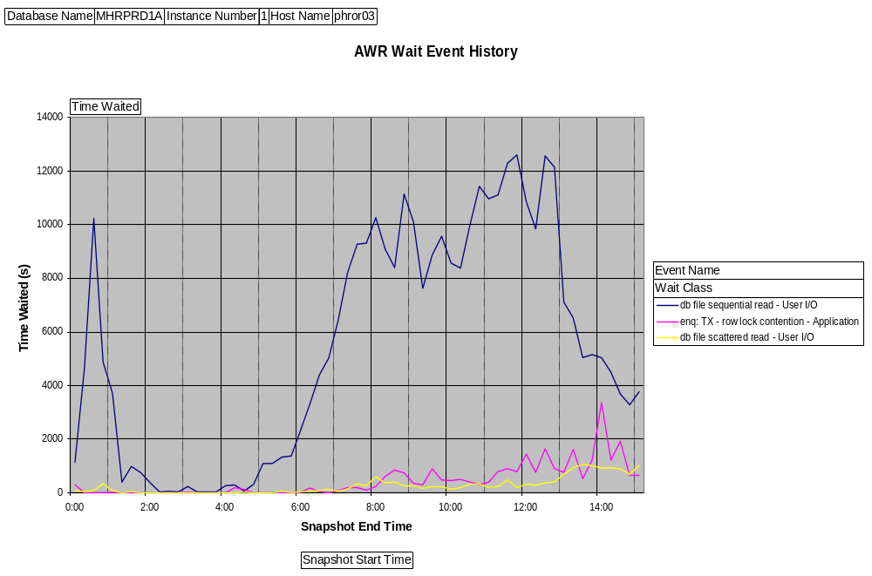
I/O Spike in AWR Metrics
Practical ASH
©2011 www.go-faster.co.uk

Slide 47
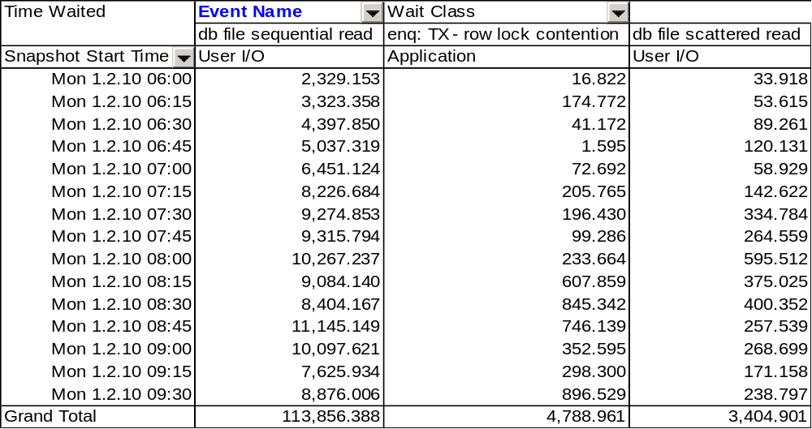
I/O Spike in AWR Metrics
Practical ASH
©2011 www.go-faster.co.uk
Notes:
Row Migration can Aggravate Contention on Cache Buffer Chains Latch
©2011 Go-Faster Consultancy Ltd. www.go-faster.co.uk
According to AWR, we have as many of 12 concurrent sessions waiting on this event.

Slide 48
ASH for Single Wait Event
SELECT /*+LEADING(x h) USE_NL(h)*/
h.sql_id
, h.sql_plan_hash_value
, SUM(10) ash_secs
FROM dba_hist_snapshot x
, dba_hist_active_sess_history h
WHERE x.end_interval_time <=TO_DATE('201002010830','yyyymmddhh24mi')
AND x.begin_interval_time >=TO_DATE('201002010730','yyyymmddhh24mi')
AND h.sample_time BETWEEN TO_DATE('201001261100','yyyymmddhh24mi')
AND TO_DATE('201001261300','yyyymmddhh24mi')
AND h.SNAP_id = X.SNAP_id
AND h.dbid = x.dbid
AND h.instance_number = x.instance_number
AND h.event = 'db file sequential read'
GROUP BY h.sql_id, h.sql_plan_hash_value
ORDER BY ash_secs desc
/
Practical ASH
©2011 www.go-faster.co.uk
Notes:
Row Migration can Aggravate Contention on Cache Buffer Chains Latch
©2011 Go-Faster Consultancy Ltd. www.go-faster.co.uk
A simple variant on the usual query, and we can look for the statement with the highest I/O overhead.

Slide 49
Statements with Highest I/O
SQL Plan
SQL_ID Hash Value ASH_SECS
------------- ---------- ----------
90pp7bcnmz68r 2961772154 2490
81gz2rtabaa8n 1919624473 2450
7hvaxp65s70qw 1051046890 1320
7fk8raq16ch0u 3950826368 890
9dzpwkff7zycg 2020614776 840
…
Practical ASH
©2011 www.go-faster.co.uk
Notes:
Row Migration can Aggravate Contention on Cache Buffer Chains Latch
©2011 Go-Faster Consultancy Ltd. www.go-faster.co.uk
So, here at the top statements

Slide 50
What Kind of Single Block Read?
For I/O wait events ASH reports
  File number
  Block number
  Object number
    Beware – Not always cleared from previous operation
Practical ASH
©2011 www.go-faster.co.uk

Slide 51
Categorise Tablespaces/Data Files
CREATE TABLE dmk_data_files as
SELECT tablespace_name
, file_id
, CASE
WHEN f.tablespace_name LIKE 'SYS%' THEN 'SYSTEM'
WHEN f.tablespace_name LIKE 'UNDO%' THEN 'UNDO'
WHEN f.tablespace_name LIKE '%IDX%' THEN 'INDEX'
WHEN f.tablespace_name LIKE '%INDEX%' THEN 'INDEX'
ELSE 'TABLE'
END AS tablespace_type
FROM dba_data_files f
ORDER BY tablespace_name
/
Working storage table performs better than DBA_DATA_FILES
Practical ASH
©2011 www.go-faster.co.uk
Notes:
Row Migration can Aggravate Contention on Cache Buffer Chains Latch
©2011 Go-Faster Consultancy Ltd. www.go-faster.co.uk
I created a temporary working storage table with a classification for each tablespace. Here my classification is by object type in the tablespace. This is relatively easy if you have a reasonable tablespace naming convention.

Slide 52
ASH Data by Tablespace Type
SELECT /*+LEADING(x h) USE_NL(h f)*/
f.tablespace_type
, SUM(10) ash_secs
FROM dba_hist_snapshot x
, dba_hist_active_sess_history h
, dmk_data_files f
WHERE x.end_interval_time <=TO_DATE('201002161300','yyyymmddhh24mi')
AND x.begin_interval_time
>=TO_DATE('201002161100','yyyymmddhh24mi')
AND h.sample_time BETWEEN TO_DATE('201001261100','yyyymmddhh24mi')
AND TO_DATE('201001261300','yyyymmddhh24mi')
AND h.SNAP_id = X.SNAP_id
AND h.dbid = x.dbid
AND h.instance_number = x.instance_number
AND h.event LIKE 'db file%'
AND h.p1text = 'file#'
AND h.p2text = 'block#'
AND f.file_id = h.p1
GROUP BY f.tablespace_type
ORDER BY ash_secs desc
/
Practical ASH
©2011 www.go-faster.co.uk

Slide 53
ASH Data by Tablespace Type
TABLES ASH_SECS
------ ----------
INDEX 30860
TABLE 26970
UNDO 1370
SYSTEM 490
Most time spent on index read
  Includes index maintenance during DML
Not much undo, so not much consistent read.
Practical ASH
©2011 www.go-faster.co.uk
Notes:
Row Migration can Aggravate Contention on Cache Buffer Chains Latch
©2011 Go-Faster Consultancy Ltd. www.go-faster.co.uk
Of course, you could classify your tablespaces differently. You might have different applications all in one database. You might want to know how much of the load comes from which application.
I suppose you could look go down to each individual object being accessed, but that will be more involved, and I haven’t tried that.

Slide 54
Which Tables Account for the I/O?
Need own copy of DBA_OBJECTS
CREATE TABLE dmk_objects
(object_id NUMBER NOT NULL
,owner VARCHAR2(30) NOT NULL
,object_name VARCHAR2(128) NOT NULL
,subobject_name VARCHAR2(30)
,PRIMARY KEY (OBJECT_ID))
/
INSERT INTO dmk_objects
SELECT object_id, owner, object_name, subobject_name
FROM dba_objects
WHERE object_type LIKE 'TABLE%'
UNION ALL
SELECT o.object_id, i.table_owner, i.table_name, o.subobject_name
FROM dba_objects o, dba_indexes i
WHERE o.object_type like 'INDEX%'
AND i.owner = o.owner
AND i.index_name = o.object_name
/
Practical ASH
©2011 www.go-faster.co.uk
Notes:
Row Migration can Aggravate Contention on Cache Buffer Chains Latch
©2011 Go-Faster Consultancy Ltd. www.go-faster.co.uk
ASH holds object number data. But I want to work in terms of tables. So, I am going to produce my own version of DBA_OBJECTS. I want to be able to easily group all the objects in a table, its indexes, their partitions and sub-partitions

Slide 55
Which Objects are Used?
SELECT /*+LEADING(x h) USE_NL(h)*/
o.owner, o.object_name
, SUM(10) ash_secs
FROM dba_hist_snapshot x
, dba_hist_active_sess_history h
, dmk_objects o
WHERE x.end_interval_time >= SYSDATE-7
AND x.begin_interval_time <= SYSDATE
AND h.sample_time >= SYSDATE-7
AND h.sample_time <= SYSDATE
AND h.Snap_id = X.snap_id
AND h.dbid = x.dbid
AND h.instance_number = x.instance_number
AND h.event LIKE 'db file%'
AND h.current_obj# = o.object_id
GROUP BY o.owner, o.object_name
HAVING SUM(10) >= 3600
ORDER BY ash_secs DESC
Practical ASH
©2011 www.go-faster.co.uk

Slide 56
Which Objects are Used?
ASH
OWNER OBJECT_NAME Secs
-------- -------------------- -------
SYSADM PS_TL_RPTD_TIME 800510
SYSADM PS_TL_PAYABLE_TIME 327280
SYSADM PS_GP_RSLT_ACUM 287870
SYSADM PS_SCH_DEFN_DTL 161690
SYSADM PS_SCH_DEFN_TBL 128070
SYSADM PS_GP_RSLT_PIN 124560
SYSADM PS_GP_PYE_PRC_STAT 92410
SYSADM PS_SCH_ADHOC_DTL 88810
…
Practical ASH
©2011 www.go-faster.co.uk

Slide 57
Which Processes Read This Table?
SELECT /*+LEADING(x) USE_NL(h)*/
o.owner, o.object_name
, h.module
, SUM(10) ash_secs
FROM dba_hist_snapshot x
, dba_hist_active_sess_history h
, dmk_objects o
WHERE x.end_interval_time >= SYSDATE-7
AND x.begin_interval_time <= SYSDATE
AND h.sample_time >= SYSDATE-7
AND h.sample_time <= SYSDATE
AND h.Snap_id = X.snap_id
AND h.dbid = x.dbid
AND h.instance_number = x.instance_number
AND h.event LIKE 'db file%'
AND h.current_obj# = o.object_id
AND o.object_name = 'PS_GP_RSLT_ACUM'
GROUP BY o.owner, o.object_name
, h.module
HAVING SUM(10) >= 900
ORDER BY ash_secs desc
Practical ASH
©2011 www.go-faster.co.uk

Slide 58
Which Processes Read This Table?
ASH
OWNER OBJECT_NAME MODULE Secs
-------- -------------------- ---------------- -------
SYSADM PS_GP_RSLT_ACUM XXX_HOL_MGMT 79680
SYSADM PS_GP_RSLT_ACUM DBMS_SCHEDULER 37810
SYSADM PS_GP_RSLT_ACUM SQL*Plus 37060
SYSADM PS_GP_RSLT_ACUM GPGBHLE 30710
SYSADM PS_GP_RSLT_ACUM GPPDPRUN 27440
SYSADM PS_GP_RSLT_ACUM XXX_AE_AB007 21440
SYSADM PS_GP_RSLT_ACUM SQL Developer 11210
SYSADM PS_GP_RSLT_ACUM GPGBEPTD 7240
SYSADM PS_GP_RSLT_ACUM XXX_CAPITA 5850
SYSADM PS_GP_RSLT_ACUM GPGB_PSLIP_X 5030
SYSADM PS_GP_RSLT_ACUM GPGB_EDI 4880
Practical ASH
©2011 www.go-faster.co.uk

Slide 59
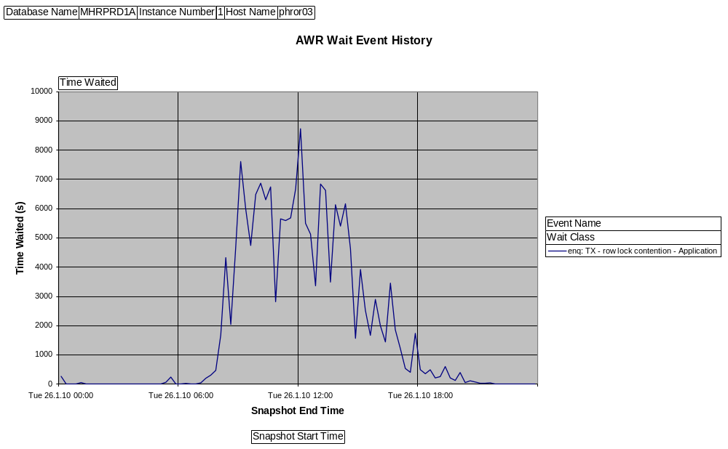
AWR Data indicates locking
Practical ASH
©2011 www.go-faster.co.uk
Notes:
Row Migration can Aggravate Contention on Cache Buffer Chains Latch
©2011 Go-Faster Consultancy Ltd. www.go-faster.co.uk
This graph is derived from AWR data[1], and it shows a period of time when a system exhibited a lot of time lost to row level wait. We lost 13 hours of user time in the two hour period from 11am to 1pm.
[1] This blog extra explains how to produce such a graph: http://blog.go-faster.co.uk/2008/12/graphing-awr-data-in-excel.html

Slide 60
Where did we wait on a lock?
SELECT /*+LEADING(x h) USE_NL(h)*/
h.sql_id
, h.sql_plan_hash_value
, SUM(10) ash_secs
FROM dba_hist_snapshot x
, dba_hist_active_sess_history h
WHERE x.end_interval_time <=TO_DATE('201001261300','yyyymmddhh24mi')
AND x.begin_interval_time >=
TO_DATE('201001261100','yyyymmddhh24mi')
AND h.sample_time BETWEEN TO_DATE('201001261100','yyyymmddhh24mi')
AND TO_DATE('201001261300','yyyymmddhh24mi')
AND h.snap_id = x.snap_id
AND h.dbid = x.dbid
AND h.instance_number = x.instance_number
AND h.event = 'enq: TX - row lock contention'
GROUP BY h.sql_id, h.sql_plan_hash_value
ORDER BY ash_secs desc
/
Practical ASH
©2011 www.go-faster.co.uk
Notes:
Row Migration can Aggravate Contention on Cache Buffer Chains Latch
©2011 Go-Faster Consultancy Ltd. www.go-faster.co.uk
Lets take a look at the historical ASH data in the AWR snapshots, and see where we lost time to row level locking in that period across the whole database.b

Slide 61
Where did we wait on a lock?
SQL Plan
SQL_ID Hash Value ASH_SECS
------------- ---------- ----------
7qxdrwcn4yzhh 3723363341 26030
652mx4tffq415 1888029394 11230
c9jjtvk0qf649 3605988889 6090
artqgxug4z0f1 8450529 240
gtj7zuzy2b4g6 2565837323 100
Practical ASH
©2011 www.go-faster.co.uk
Notes:
Row Migration can Aggravate Contention on Cache Buffer Chains Latch
©2011 Go-Faster Consultancy Ltd. www.go-faster.co.uk
And rather reassuringly the ASH total agrees quite well with AWR. The top statement alone is costing us nearly 5 hours.

Slide 62
Statements Blocked by TX Locks
SQL_ID 7qxdrwcn4yzhh
--------------------
UPDATE PSIBQUEUEINST SET QUEUESEQID=QUEUESEQID+:1
WHERE QUEUENAME=:2
SQL_ID 652mx4tffq415
--------------------
UPDATE PSAPMSGPUBSYNC SET LASTUPDDTTM=SYSDATE
WHERE QUEUENAME=:1
SQL_ID c9jjtvk0qf649
--------------------
UPDATE PSAPMSGSUBCSYNC SET LASTUPDDTTM=SYSDATE
WHERE QUEUENAME=:1
Practical ASH
©2011 www.go-faster.co.uk
Notes:
Row Migration can Aggravate Contention on Cache Buffer Chains Latch
©2011 Go-Faster Consultancy Ltd. www.go-faster.co.uk
Let’s look at the statements involved. They all come from the PeopleSoft Publish and Subcribe Servers.
The first statement shows a homemade sequence. PeopleSoft is a platform agnostic development, so it doesn’t use Oracle sequence objects. The other two statements show an update to a queue management table.
There is nothing I can do about any of these because the code is deep inside PeopleTools and cannot be changed. This is the way that the Integration Broker works.
I cannot find the statement that is blocking these statements. Oracle doesn’t hold that information. It is probably another instance of the same statement, but that it isn’t the question. The real question is ‘what is the session that is holding the lock doing while it is holding the lock, and can I do something about that?’

Slide 63
The real question about locking:
What is the session that is holding the lock doing while it is holding the lock?
  and can I do something about that?
Home-made sequences are not scalable. Should really be using an Oracle Sequence.
  Not possible in a PeopleSoft Application
Practical ASH
©2011 www.go-faster.co.uk
Notes:
Row Migration can Aggravate Contention on Cache Buffer Chains Latch
©2011 Go-Faster Consultancy Ltd. www.go-faster.co.uk
I cannot find the statement that is blocking these statements. Oracle doesn’t hold that information. It is probably another instance of the same statement, but that it isn’t the question. The real question is ‘what is the session that is holding the lock doing while it is holding the lock, and can I do something about that?’.

Slide 64
Resolve the Lock Chain
Session A
SESSION_ID
SESSION_SERIAL#
BLOCKING_SESSION
BLOCKING_SESSION_SERIAL#
Navigating the lock chain only works within a single instance.
The may not be any ASH data for session C because it is not active on the database.
Session B
SESSION_ID
SESSION_SERIAL#
BLOCKING_SESSION
BLOCKING_SESSION_SERIAL#
Session C
SESSION_ID
SESSION_SERIAL#
Practical ASH
©2011 www.go-faster.co.uk

Slide 65
Extract ASH data for period in question
CREATE TABLE my_ash AS
SELECT /*+LEADING(x) USE_NL(h)*/ h.*
FROM dba_hist_snapshot x
, dba_hist_active_sess_history h
WHERE x.end_interval_time >=
TO_DATE('201001261100','yyyymmddhh24mi')
AND x.begin_interval_time <=
TO_DATE('201001261300','yyyymmddhh24mi')
AND h.sample_time BETWEEN TO_DATE('201001261100','yyyymmddhh24mi')
AND TO_DATE('201001261300','yyyymmddhh24mi')
AND h.Snap_id = X.snap_id
AND h.dbid = x.dbid
AND h.instance_number = x.instance_number;
CREATE UNIQUE INDEX my_ash ON my_ash (dbid, instance_number, snap_id, sample_id, session_id, sample_time, session_serial#) COMPRESS 4;
CREATE INDEX my_ash2 ON my_ash (event, dbid, instance_number, snap_id) COMPRESS 3;
Practical ASH
©2011 www.go-faster.co.uk
Notes:
Row Migration can Aggravate Contention on Cache Buffer Chains Latch
©2011 Go-Faster Consultancy Ltd. www.go-faster.co.uk
The queries that I need to write don’t perform well on the ASH views, so I am going to extract them to a temporary working storage table.

Slide 66
What are the blocking sessions doing?
SELECT /*+LEADING(x w) USE_NL(h w)*/
h.sql_id
, h.sql_plan_hash_value
, SUM(10) ash_secs
FROM my_ash w
LEFT OUTER JOIN my_ash h
ON h.snap_id = w.snap_id
AND h.dbid = w.dbid
AND h.instance_number = w.instance_number
AND h.sample_id = w.sample_id
AND h.sample_time = w.sample_time
AND h.session_id = w.blocking_session
AND h.session_serial# = w.blocking_session_serial#
WHERE w.event = 'enq: TX - row lock contention'
GROUP BY h.sql_id, h.sql_plan_hash_value
ORDER BY ash_secs desc
/
Practical ASH
©2011 www.go-faster.co.uk
Notes:
Row Migration can Aggravate Contention on Cache Buffer Chains Latch
©2011 Go-Faster Consultancy Ltd. www.go-faster.co.uk
The queries that I need to write don’t perform well on the ASH views, so I am going to extract them to a temporary working storage table.

Slide 67
What are the blocking sessions doing?
SQL_ID SQL_PLAN_HASH_VALUE ASH_SECS
------------- ------------------- ----------
29210¹
5st32un4a2y92 2494504609 10670²
652mx4tffq415 1888029394 7030
artqgxug4z0f1 8450529 580
7qxdrwcn4yzhh 3723363341 270
This SQL_ID is blank. May not be able to find ASH sample for blocking session because it is idle – busy on the client not the database.
This statement is running while the session holds a lock that is blocking another session.
Practical ASH
©2011 www.go-faster.co.uk

Slide 68
Execution Plan captured by AWR: Correct Plan, Old Costs, Old Binds
DISPLAY_AWR()
SQL_ID 5st32un4a2y92
--------------------
SELECT 'X' FROM PS_CDM_LIST WHERE CONTENTID = :1
Plan hash value: 2494504609
------------------------------------------------------------------------------------
| Id | Operation | Name | Rows | Bytes | Cost (%CPU)| Time |
------------------------------------------------------------------------------------
| 0 | SELECT STATEMENT | | | | 22 (100)| |
| 1 | INDEX FAST FULL SCAN| PS_CDM_LIST | 1 | 5 | 22 (10)| 00:00:01 |
------------------------------------------------------------------------------------
Query Block Name / Object Alias (identified by operation id):
-------------------------------------------------------------
1 - SEL$1 / PS_CDM_LIST@SEL$1
Peeked Binds (identified by position):
--------------------------------------
1 - :1 (NUMBER): 17776
Practical ASH
©2011 www.go-faster.co.uk

Slide 69
Fresh Execution Plan generated by execute explain plan
Note increase of cost of full scan.
Plan hash value: 2494504609
------------------------------------------------------------------------------------
| Id | Operation | Name | Rows | Bytes | Cost (%CPU)| Time |
------------------------------------------------------------------------------------
| 0 | SELECT STATEMENT | | 1 | 6 | 3178 (9)| 00:00:05 |
|* 1 | INDEX FAST FULL SCAN| PS_CDM_LIST | 1 | 6 | 3178 (9)| 00:00:05 |
------------------------------------------------------------------------------------
Predicate Information (identified by operation id):
---------------------------------------------------
1 - filter("CONTENTID"=TO_NUMBER(:1))
Practical ASH
©2011 www.go-faster.co.uk

Slide 70
Same Plan, Old Costs
DISPLAY_AWR()
Plan hash value: 2494504609
------------------------------------------------------------------------------------
| Id | Operation | Name | Rows | Bytes | Cost (%CPU)| Time |
------------------------------------------------------------------------------------
| 0 | SELECT STATEMENT | | | | 22 (100)| |
| 1 | INDEX FAST FULL SCAN| PS_CDM_LIST | 1 | 5 | 22 (10)| 00:00:01 |
------------------------------------------------------------------------------------
EXPLAIN PLAN FOR
Plan hash value: 2494504609
------------------------------------------------------------------------------------
| Id | Operation | Name | Rows | Bytes | Cost (%CPU)| Time |
------------------------------------------------------------------------------------
| 0 | SELECT STATEMENT | | 1 | 6 | 3178 (9)| 00:00:05 |
|* 1 | INDEX FAST FULL SCAN| PS_CDM_LIST | 1 | 6 | 3178 (9)| 00:00:05 |
------------------------------------------------------------------------------------
Practical ASH
©2011 www.go-faster.co.uk

Slide 71
Did My Execution Plan Change?
Can see change in execution plan and performance
SQL_PLAN
PRCSINSTANCE BEGINDTTM SQL_ID HASH_VALUE EXEC_SECS ASH_SECS
------------ ------------------- ------------- ---------- --------- ---------
1964975 08:30:52 22/01/2010 46smbgcfcrb8d 2602481067 20379 20080
1965250 09:08:51 22/01/2010 fpftdx2405zyq 2602481067 20983 20690
1968443 16:42:51 22/01/2010 3rxad5z3ccusv 3398716340 105 80
1968469 16:47:21 22/01/2010 3rxad5z3ccusv 3398716340 90 70
1968485 16:50:19 22/01/2010 3rxad5z3ccusv 3398716340 62 40
1968698 17:40:01 22/01/2010 0ku8f514k3nt0 3398716340 76 50
1968866 18:19:19 22/01/2010 cbmyvpsxzyf5n 3398716340 139 120
1968966 18:34:24 22/01/2010 5jb1sgmjc7436 3398716340 187 170
Practical ASH
©2011 www.go-faster.co.uk
Notes:
Row Migration can Aggravate Contention on Cache Buffer Chains Latch
©2011 Go-Faster Consultancy Ltd. www.go-faster.co.uk
We were experiencing a problem with a query in a particular report. We fixed it by adding a hint. I wanted to prove that when the hint was put into production, the execution plan changed. This query is very similar to the one described in Batch Processes (see page 13), but here I want to list all the queries run by all instances of a named report, and see if the exection plan changed.
And we can see that after the fix was applied and the users were told they could start to run this report again, the execution plan changed and the run time was much better.
So, not only have I diagnosed a problem with ASH, I have also proven that the fix, when applied to production has successfully resolved the issue.

Slide 72
Effect of Stored Outlines
Three scenarios
Large payroll – collecting stored outlines
Small payroll – no outlines
Small payroll – with outlines applied
Practical ASH
©2011 www.go-faster.co.uk

Slide 73
Effect of Stored Outlines
SELECT /*+ LEADING(@q1 r1@q1 x1@q1 h1@q1) USE_NL(h1@q1)
LEADING(@q2 r2@q2 x2@q2 h2@q2) USE_NL(h2@q2)
LEADING(@q3 r3@q3 x3@q3 h3@q3) USE_NL(h3@q3) */
q1.sql_id
, q1.sql_plan_hash_value, q1.ash_secs
, DECODE(q1.sql_plan_hash_value,q2.sql_plan_hash_value,'**SAME**',
q2.sql_plan_hash_value) sql_plan_hash_value2, q2.ash_secs
, DECODE(q1.sql_plan_hash_value,q3.sql_plan_hash_value,'**SAME**',
q3.sql_plan_hash_value) sql_plan_hash_value3, q3.ash_secs
FROM (
...
) Q1
LEFT OUTER JOIN (
...
) Q2 ON q1.sql_id = q2.sql_id
INNER JOIN (
...
) Q3 ON q1.sql_id = q3.sql_id
ORDER BY q3.ash_secs desc, q1.sql_id
/
Usual Query in each of three
in-line views
Practical ASH
©2011 www.go-faster.co.uk

Slide 74
Effect of Stored Outlines
SQL_ID SCENARIO 1 ASH_SECS SCENARIO 2 ASH_SECS SCENARIO 3 ASH_SECS
------------- ---------- -------- ---------- -------- ---------- --------
4uzmzh74rdrnz 2514155560 280 3829487612 >28750 **SAME** 5023¹
4n482cm7r9qyn 1595742310 680 869376931 140 **SAME** 889²
2f66y2u54ru1v 1145975676 630 **SAME** 531
1n2dfvb3jrn2m 1293172177 150 **SAME** 150
652y9682bqqvp 3325291917 30 **SAME** 110
d8gxmqp2zydta 1716202706 10 678016679 10 **SAME** 32
2np47twhd5nga 3496258537 10 **SAME** 27
4ru0618dswz3y 2621940820 10 539127764 22³
4ru0618dswz3y 539127764 100 **SAME** 22
4ru0618dswz3y 3325291917 10 539127764 22
4ru0618dswz3y 1403673054 110 539127764 22
gnnu2hfkjm2yd 1559321680 80 **SAME** 19
Better with outline, but not great, but it did run
A little worse
4 execution plans, now just 1, probably better.
Practical ASH
©2011 www.go-faster.co.uk
Notes:
Row Migration can Aggravate Contention on Cache Buffer Chains Latch
©2011 Go-Faster Consultancy Ltd. www.go-faster.co.uk
[1] On the small payroll calculation, without outlines, this statement move than 100 times longer. It had not completed by this stage – the process was cancelled. With outlines enabled this statement used the same execution plan as in scenario 1. It didn’t perform that well compared to the large payroll calculation; clearly more work is required for this statement. However, at least it did complete and it did result in improved performance for the small payroll.
[2] This is an example of a statement that performed better on the small payroll without an outline. So, sometimes it is better to let the optimiser change the plan!
[3] This statement executed with 4 different execution plans during the large payroll, but once the outline was applied only one was used, and this seems to be

Slide 75
How Many Transactions
SELECT /*+leading(r h) use_nl(h)*/ h.xid
, h.sql_plan_hash_value
, (NVL(r.enddttm,SYSDATE)-r.begindttm)*86400 exec_secs
, sum(1) ash_secs
, MIN(sample_Time) first_sample_time
, MAX(sample_Time) last_sample_time
FROM gv$active_session_history h
, sysadm.psprcsrqst r
WHERE h.sample_time BETWEEN r.begindttm AND NVL(r.enddttm,SYSDATE)
AND h.module like r.prcsname
AND h.action LIKE 'PI='||r.prcsinstance||'%'
AND r.prcsinstance = 10026580
AND h.sql_id = 'dungu07axr0z5'
GROUP BY r.prcsinstance, r.prcsname, r.begindttm, r.enddttm
, h.sql_id, h.sql_plan_hash_value, h.xid
ORDER BY last_sample_time, ash_secs desc
/
Practical ASH
©2011 www.go-faster.co.uk

Slide 76
How Many Transactions?
3 transactions + 1, so at least 4 executions
SQL_PLAN EXEC ASH
XID HASH_VALUE SECS SECS FIRST_SAMPLE_TIME LAST_SAMPLE_TIME
---------------- ---------- ---- ---- ---------------------- ----------------------
00080026000185A7 461068291 4774 943 23-APR-10 11.13.50.548 23-APR-10 11.29.33.546
000100250001861A 461068291 4774 906 23-APR-10 11.30.16.590 23-APR-10 11.45.22.487
000700280001CC47 461068291 4774 783 23-APR-10 11.46.06.543 23-APR-10 11.59.09.286
461068291 4774 775 23-APR-10 11.59.51.325 23-APR-10 12.12.46.056
Can’t tell how many executions until 11g.
Practical ASH
©2011 www.go-faster.co.uk

Slide 77
When did the Transaction Begin?
SQL Plan ASH Exec
SQL_ID Hash Value XID Secs Secs First Running
------------- ---------- ---------------- ------ ------ -------------------------
7uj72ad03k13k 3087414546 82 1124 28-APR-10 04.42.48.662 PM
7uj72ad03k13k 3087414546 000A001400044C6D 1 1124 28-APR-10 04.44.11.672 PM
1ng9qkc0zspkh 3423396304 104 1124 28-APR-10 04.44.12.682 PM
1ng9qkc0zspkh 3423396304 0007002D0004116E 5 1124 28-APR-10 04.45.57.971 PM
Transaction ID only created when first row deleted
Practical ASH
©2011 www.go-faster.co.uk

Slide 78
When did the Transaction Begin?
DELETE /*GPPCANCL_D_ERNDGRP*/ FROM PS_GP_RSLT_ERN_DED
WHERE EMPLID BETWEEN :1 AND :2
AND CAL_RUN_ID= EMPLID IN (
SELECT EMPLID FROM PS_GP_GRP_LIST_RUN
WHERE RUN_CNTL_ID=:4 AND OPRID=:5)
AND EXISTS (
SELECT 'X' FROM PS_GP_PYE_RCLC_WRK RW
WHERE RW.CAL_ID = PS_GP_RSLT_ERN_DED.CAL_ID
AND RW.CAL_RUN_ID = PS_GP_RSLT_ERN_DED.CAL_RUN_ID
AND RW.GP_PAYGROUP = PS_GP_RSLT_ERN_DED.GP_PAYGROUP
AND RW.EMPLID BETWEEN :6 AND :7
AND RW.CAL_RUN_ID = :8
AND RW.EMPLID = PS_GP_RSLT_ERN_DED.EMPLID
AND RW.EMPL_RCD = PS_GP_RSLT_ERN_DED.EMPL_RCD)
Depending on data, it could be a while before this statement found something to delete.
Practical ASH
©2011 www.go-faster.co.uk

Slide 79
How Many Executions (from 11g)
SELECT /*+LEADING(x h) USE_NL(h)*/ h.program
, h.sql_id, h.sql_plan_hash_value
, SUM(10) ash_secs
, COUNT(DISTINCT h.sql_exec_id) execs
, COUNT(DISTINCT xid) XIDs
FROM DBA_HIST_SNAPSHOT x
, DBA_HIST_ACTIVE_SESS_HISTORY h
WHERE X.END_INTERVAL_TIME >= …
AND x.begin_interval_time <= …
AND h.sample_TIME >= …
AND h.sample_time <= …
AND h.SNAP_id = X.SNAP_id
AND h.dbid = x.dbid
AND h.instance_number = x.instance_number
GROUP BY h.program, h.sql_id, h.sql_plan_hash_value
ORDER BY ash_secs desc
/
Practical ASH
©2011 www.go-faster.co.uk

Slide 80
How Many Executions?
SQL Plan ASH
PROGRAM SQL_ID Hash Value Secs EXECS XIDS USERS
----------- ------------- ---------- ------ ------- ----- ------
t_async.exe 7q90ra0vmd9xx 2723153562 3020 297 0 20
t_async.exe 6mw25bgbh1stj 1229059401 320 32 0 17
…
Samples ≈ Executions
  Based on DBA_HIST_ACTIVE_SESS_HISTORY
  1 sample / 10 seconds.
  Each sample is worth 10 seconds.
  Probably underestimates number of executions.
Practical ASH
©2011 www.go-faster.co.uk

Slide 81
How Many Executions?
Samples ≈ Executions
  ASH says there were at least 297 executions of first statement.
  Likely were more executions that ASH data suggests.
  Would need session trace to get accurate number.
SQL ID | Seconds | Samples | Executions
7q90ra0vmd9xx | 3020 | 302 | 297
6mw25bgbh1stj | 320 | 32 | 32
Practical ASH
©2011 www.go-faster.co.uk

Slide 82
Things That Can Go Wrong
DISPLAY_AWR
  Correct plan, old costs & binds
  ORA-6502 – very large SQL
  ORA-44002 – short-lived objects(?)
  ORA-1422 – duplicate SQL from cloning
Statement not in Library Cache
  Only Some Statements in Library Cache
Lots of short-lived non-shareable SQL
Practical ASH
©2011 www.go-faster.co.uk

Slide 83
Statement not in Library Cache
SELECT * FROM table(dbms_xplan.display_cursor('gpdwr389mg61h',0,'ADVANCED'));
PLAN_TABLE_OUTPUT
-----------------------------------------------SQL_ID: gpdwr389mg61h, child number: 0 cannot be found
Practical ASH
©2011 www.go-faster.co.uk

Slide 84
Some Statements in AWR Repository
SQL Plan
RANKING SQL_ID Hash Value TOT_ASH_SECS TOT_AWR_SECS SQL_IDS
---------- ------------- ---------- ------------ ------------ ----------
1 1wfhpn9k2x3hq 0 7960 4600 13
1 2wsan9j1pk3j2 1061502179 4230 4230 1
1 bnxddum0rrvyh 918066299 2640 1200 179
1 02cymzmyt4mdh 508527075 2070 0 45
1 5m0xbf7vn8490 2783301143 1700 0 49
1 0jfp0g054cb3n 4135405048 1500 0 47
1 11bygm2nyqh0s 3700906241 1370 0 27
1 6qg99cfg26kwb 3058602782 1300 1300 1
207 samples, representing 2070 seconds of SQL
45 distinct SQL_IDs, we don’t know how many executions
  probably one per SQL_ID, but I don’t know that until 11g.
Often associated with non-shareable SQL
Practical ASH
©2011 www.go-faster.co.uk

Slide 85
Lots of Short-lived SQL Statements
SQL_PLAN
PRCSINSTANCE NUM_SQL_ID HASH_VALUE EXEC_SECS ASH_SECS
------------ ---------- ---------- --------- ---------
50007687 169 953836181 3170 1690
50007687 50 807301148 3170 500
50007687 22 4034059499 3170 220
50007687 14 2504475139 3170 140
50007687 2 0 3170 70
50007687 1 1309703960 3170 20
50007687 1 3230852326 3170 10
…
Probably more than 169 statements that took about 1690 seconds, but we only sampled 169.
169 SQLs
1690 Secs
Practical ASH
©2011 www.go-faster.co.uk

Slide 86
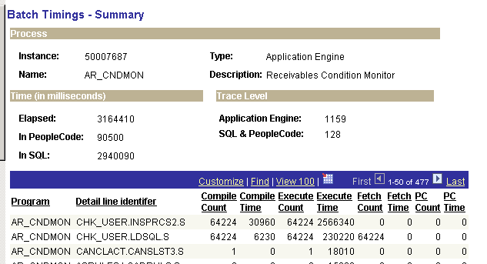
Lots of Compiles
Practical ASH
©2011 www.go-faster.co.uk

Slide 87
ORA-06502
This seems to be associated with very large SQL statements
SQL_ID 9vnan5kqsh1aq
--------------------
An uncaught error happened in prepare_sql_statement : ORA-06502: PL/SQL: numeric or value error
Plan hash value: 2262951047
---------------------------------------------------------------------------------------------------------------
| Id | Operation | Name | Rows | Bytes | Cost (%CPU)| Time |
---------------------------------------------------------------------------------------------------------------
| 0 | SELECT STATEMENT | | | | 1 (100)| |
| 1 | HASH GROUP BY | | 1 | 164 | 1 (100)| 00:00:01 |
…
Practical ASH
©2011 www.go-faster.co.uk

Slide 88
ORA-44002
I have seen this with Global Temporary Tables and with direct path mode (the APPEND hint).
PLAN_TABLE_OUTPUT
------------------------------------------------------
ERROR: cannot get definition for table 'BZTNCMUX31XP5'
ORA-44002: invalid object name
Practical ASH
©2011 www.go-faster.co.uk

Slide 89
ORA-01422
This happens on a database that has been cloned, often from production to test.
An uncaught error happened in prepare_sql_statement : ORA-01422: exact fetch returns more than requested number of rows
Practical ASH
©2011 www.go-faster.co.uk

Slide 90
ORA-01422
Workaround
DELETE FROM sys.wrh$_sqltext t1
WHERE t1.dbid != (
SELECT d.dbid FROM v$database d)
AND EXISTS(
SELECT 'x'
FROM sys.wrh$_sqltext t2
WHERE t2.dbid = (
SELECT d.dbid FROM v$database d)
AND t2.sql_id = t1.sql_id)
Practical ASH
©2011 www.go-faster.co.uk

Slide 91
Conclusion
ASH data
  Recent: V$ACTIVE_SESSION_HISTORY
  History: DBA_HIST_ACTIVE_SESS_HISTORY
Application Instrumentation is essential
Lots of ways to query the data
  Be imaginative!
Understand the pitfalls.
Practical ASH
©2011 www.go-faster.co.uk

Slide 92
Questions?
Notes:
Row Migration can Aggravate Contention on Cache Buffer Chains Latch
©2011 Go-Faster Consultancy Ltd. www.go-faster.co.uk

Slide 93
Conclusion
ASH data
  Recent: V$ACTIVE_SESSION_HISTORY
  History: DBA_HIST_ACTIVE_SESS_HISTORY
Application Instrumentation is essential
Lots of ways to query the data
  Be imaginative!
Understand the pitfalls.
Practical ASH
©2011 www.go-faster.co.uk

