Slide 1


Slide 2

Practical Active Session History (ASH)
John Beresniewicz
Technical Staff, Oracle America

Slide 3
The following is intended to outline our general product direction. It is intended for information purposes only, and may not be incorporated into any contract. It is not a commitment to deliver any material, code, or functionality, and should not be relied upon in making purchasing decisions.
The development, release, and timing of any features or functionality described for Oracle’s products remains at the sole discretion of Oracle.

Slide 4
Background and Credits
Enterprise Manager and Average Active Sessions
Graham Wood
Kyle Hailey
David Kurtz
Doug Burns

Slide 5


Agenda
<Insert Picture Here>
Understand ASH
Use ASH

Slide 6
<Insert Picture Here>
Understand ASH

Slide 7
Topics
Mechanics
  ASH design is elegant, efficient, effective
Meaning
  ASH is the key to multi-scope DB Time analysis
  ASH as activity trace
  ASH outliers

Slide 8

ASH Mechanics
Indexed
on time
V$SESSION
V$SESSION_WAIT
V$ACTIVE_SESSION_HISTORY
DBA_HIST_ACTIVE_SESS_HISTORY
Readers go
unlatched
Session
state
objects
Write
1 out of 10
samples
Readers go the
opposite way
AWR
MMON Lite
(MMNL)
Circular buffer
in SGA
(2MB per CPU)
Every second
Every hour
(or flush)
Writer goes
one direction
Direct-path
INSERTS
Variable
length rows

Slide 9
ASH In-memory
“Active” sessions sampled every 1 second
  Direct session state access and callbacks
  Active = on CPU or in non-idle Wait
  Sampler not visible in ASH
Circular memory buffer
  Fixed footprint => variable time range
  Design goals: one hour activity and <5% of memory
Non-latching queries
  Readers/writer go in opposite directions
Wait times are “fixed up”
  But don’t be tempted to use them incorrectly!

Slide 10
ASH Buffer Size and “Length”
select bytes/(1024*1024) MB from v$sgastat where name like 'ASH buffers';
MB
----------------------
29
select
EXTRACT(HOUR FROM (MAX(sample_time) - MIN(sample_time)))||' hours '||
EXTRACT(MINUTE FROM (MAX(sample_time) - MIN(sample_time)))||' mins'
ASH_window
from
v$active_session_history;
ASH_WINDOW
-----------------------------------------------------------
12 hours 59 mins

Slide 11
ASH On-disk
1-in-10 samples persisted with AWR snapshots
DBA_HIST_ACTIVE_SESS_HISTORY
  Partitioned by DBID, SNAP_ID
  Emergency flush under buffer pressure
AWR retention 7 days by default
  At least 35 days recommended
Query snapshot ranges from DBA_HIST_SNAPSHOT
  For partition elimination, not always needed

Slide 12
Meaning: ASH is DB Time
Each sample represents a second of session activity
Sum the seconds to compute DB Time
  What I like to call ASH MATH
Average Active Sessions = DB Time/Elapsed Time
  Both load metric and performance indicator

Slide 13
ASH as Activity Trace
ASH covers much of SQL trace usage
  Except where every call and cpu tick must be counted
  Very good for long operations – SQL Monitoring
Accuracy improves when things get “stuck”
  Longer waits means higher sampling probability
Enqueue chain dynamics
  Cannot do with SQL trace
  Inactive holders problem
  Should blockers be active?

Slide 14
<Insert Picture Here>
Using ASH

Slide 15
ASH Use Cases
DB Time performance analysis
  Aggregation and analytic functions
Activity tracking
  Real-time SQL Monitoring
Performance event forensics
  What happened? In what sequence?
  Contention analysis, e.g. enqueue blockages
Event prediction
  In general too hard
  Outliers may be useful for some event types

Slide 16
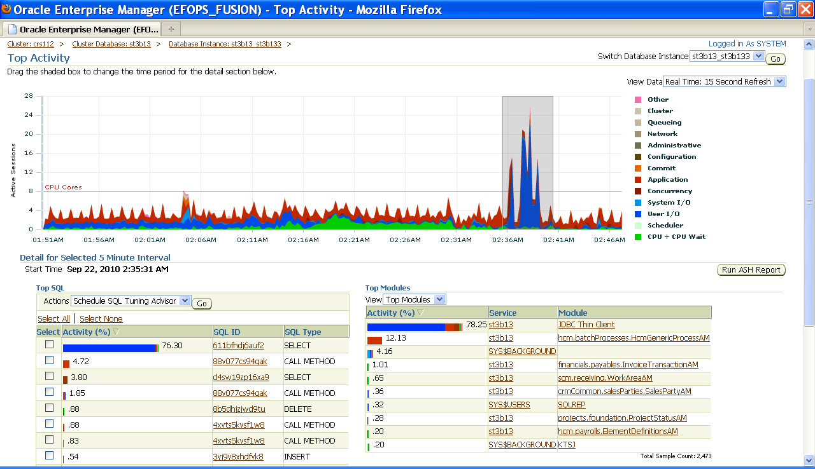
Using ASH Simplified

Slide 17
Top Activity Performance Analysis
DB Time sourced from ASH
  Real-time only, history uses time model data (bug)
Average Active Sessions by waitclass
  15-second bucketing
5-minute time selector
  Focus on events of interest
Top lists for skew analysis and drill-down
Access to tools
  ASH report, SQL Tune, STS

Slide 18
DB Time Performance Analysis
ASH Math: COUNT(*) = DB Time (seconds)
  GROUP BY dimensions of interest
  Multiply by 10 for on-disk queries
SUM(1) and SUM(10) nicer
  Reference: David Kurtz
Do not use MIN, AVG, MAX
  Sampling is biased to longer events

Slide 19
ASH Dimensions
desc v$active_session_history
Name Null Type
------------------------------ -------- -------------------------------
SAMPLE_ID NUMBER
SAMPLE_TIME TIMESTAMP(3)
IS_AWR_SAMPLE VARCHAR2(1)
SESSION_ID NUMBER
SESSION_SERIAL# NUMBER
SESSION_TYPE VARCHAR2(10)
FLAGS NUMBER
USER_ID NUMBER
.
.
.
93 rows selected

Slide 20
SQL Dimensions
SQL Analysis
-------------------------
SQL_ID VARCHAR2(13)
IS_SQLID_CURRENT VARCHAR2(1)
SQL_CHILD_NUMBER NUMBER
SQL_OPCODE NUMBER
SQL_OPNAME VARCHAR2(64)
FORCE_MATCHING_SIGNATURE NUMBER
TOP_LEVEL_SQL_ID VARCHAR2(13)
TOP_LEVEL_SQL_OPCODE NUMBER
SQL_PLAN_HASH_VALUE NUMBER
SQL_PLAN_LINE_ID NUMBER
SQL_PLAN_OPERATION VARCHAR2(30)
SQL_PLAN_OPTIONS VARCHAR2(30)
SQL_EXEC_ID NUMBER
SQL_EXEC_START DATE
PLSQL_ENTRY_OBJECT_ID NUMBER
PLSQL_ENTRY_SUBPROGRAM_ID NUMBER
PLSQL_OBJECT_ID NUMBER
PLSQL_SUBPROGRAM_ID NUMBER
QC_INSTANCE_ID NUMBER
QC_SESSION_ID NUMBER
QC_SESSION_SERIAL# NUMBER

Slide 21
Wait Event Dimensions
Wait Event Analysis
--------------------------------------------------
EVENT VARCHAR2(64)
EVENT_ID NUMBER
EVENT# NUMBER
SEQ# NUMBER
P1TEXT VARCHAR2(64)
P1 NUMBER
P2TEXT VARCHAR2(64)
P2 NUMBER
P3TEXT VARCHAR2(64)
P3 NUMBER
WAIT_CLASS VARCHAR2(64)
WAIT_CLASS_ID NUMBER
WAIT_TIME NUMBER
SESSION_STATE VARCHAR2(7)
TIME_WAITED NUMBER

Slide 22
Blocking and Object Dimensions
Locking/Blocking Analysis
--------------------------------------------------
BLOCKING_SESSION_STATUS VARCHAR2(11)
BLOCKING_SESSION NUMBER
BLOCKING_SESSION_SERIAL# NUMBER
BLOCKING_INST_ID NUMBER
BLOCKING_HANGCHAIN_INFO VARCHAR2(1)
Object Analysis
--------------------------------------------------
CURRENT_OBJ# NUMBER
CURRENT_FILE# NUMBER
CURRENT_BLOCK# NUMBER
CURRENT_ROW# NUMBER
TOP_LEVEL_CALL# NUMBER
TOP_LEVEL_CALL_NAME VARCHAR2(64)
CONSUMER_GROUP_ID NUMBER
XID RAW(8)
REMOTE_INSTANCE# NUMBER
TIME_MODEL NUMBER

Slide 23
Bit Vector Dimensions
Bitvec and Replay
---------------------------------------------------
IN_CONNECTION_MGMT VARCHAR2(1)
IN_PARSE VARCHAR2(1)
IN_HARD_PARSE VARCHAR2(1)
IN_SQL_EXECUTION VARCHAR2(1)
IN_PLSQL_EXECUTION VARCHAR2(1)
IN_PLSQL_RPC VARCHAR2(1)
IN_PLSQL_COMPILATION VARCHAR2(1)
IN_JAVA_EXECUTION VARCHAR2(1)
IN_BIND VARCHAR2(1)
IN_CURSOR_CLOSE VARCHAR2(1)
IN_SEQUENCE_LOAD VARCHAR2(1)
CAPTURE_OVERHEAD VARCHAR2(1)
REPLAY_OVERHEAD VARCHAR2(1)
IS_CAPTURED VARCHAR2(1)
IS_REPLAYED VARCHAR2(1)

Slide 24
Application Dimensions
Application Dimensions
------------------------------------------------
SERVICE_HASH NUMBER
PROGRAM VARCHAR2(48)
MODULE VARCHAR2(48)
ACTION VARCHAR2(32)
CLIENT_ID VARCHAR2(64)
MACHINE VARCHAR2(64)
PORT NUMBER
ECID VARCHAR2(64

Slide 25
Session Statistics
Session Statistics
---------------------------------------------------
TM_DELTA_TIME NUMBER
TM_DELTA_CPU_TIME NUMBER
TM_DELTA_DB_TIME NUMBER
DELTA_TIME NUMBER
DELTA_READ_IO_REQUESTS NUMBER
DELTA_WRITE_IO_REQUESTS NUMBER
DELTA_READ_IO_BYTES NUMBER
DELTA_WRITE_IO_BYTES NUMBER
DELTA_INTERCONNECT_IO_BYTES NUMBER
PGA_ALLOCATED NUMBER
TEMP_SPACE_ALLOCATED NUMBER

Slide 26
Top SQL Over Last 5 Minutes
select NVL(sql_id,'NULL') as sql_id
,count(*) as DB_time
,ROUND(100*count(*) /
SUM(count(*)) OVER (), 2) as Pct_load
from
v$active_session_history
where
sample_time > sysdate - 5/24/60
and session_type <> 'BACKGROUND'
group by sql_id
order by count(*) desc
/

Slide 27
Top SQL Over Last 5 Minutes
SQL_ID DB_TIME PCT_LOAD
------------- ---------------------- ----------------------
88v077cs94gak 136 43.17
4xvts5kvsf1w8 89 28.25
8pcw7z5vvhfj0 7 2.22
dbm33sd7kv9s3 5 1.59
572fbaj0fdw2b 5 1.59
6gm349ccd40ty 5 1.59
daq0x8y99dz8f 4 1.27
adfpkwrb7pn7f 4 1.27
d7fgysa7gr9nr 4 1.27
3ugqynb1w2q5a 3 0.95
NULL 3 0.95

Slide 28
Events With NULL SQL_ID
select NVL(event,'NULL') as event
,count(*) as samples
,ROUND(count(*)/600,4) as AvgActiveSess
from v$active_session_history
where sql_id IS NULL
and sample_time > sysdate - 10/24/60
and session_type <> 'BACKGROUND'
group by event;

Slide 29
Events With NULL SQL_ID
EVENT SAMPLES AVGACTIVESESS
-------------------------------- ---------------------- ----------------------
NULL 6 0.01
cursor: pin S wait on X 1 0.0017
log file sync 1 0.0017
db file sequential read 1 0.0017
IPC send completion sync 1 0.0017
library cache lock 1 0.0017
direct path read 1 0.0017
7 rows selected

Slide 30
User I/O DB Time by Instance
select inst_id as instance
,event
,COUNT(distinct current_obj#) as objcount
,SUM(1) as dbtime_secs
from gv$active_session_history
where sample_time > sysdate - 1/24/60 -- pick up last minute only
and wait_class = 'User I/O'
group by inst_id,event
order by event,instance;
select * from table(dbms_xplan.display_cursor());

Slide 31
Not Much I/O
INSTANCE EVENT OBJCOUNT DBTIME_SECS
---------- ------------------------ ----------- -----------
1 db file sequential read 4 5
2 db file sequential read 3 3
3 db file sequential read 1 1
1 direct path read 1 1
2 direct path read 1 1
1 direct path write 1 1
2 direct path write 1 1
7 rows selected

Slide 32
XPLAN Output
| Id | Operation | Name |
| 0 | SELECT STATEMENT | |
| 1 | SORT GROUP BY | |
| 2 | VIEW | VW_DAG_0 |
| 3 | HASH GROUP BY | |
|* 4 | PX COORDINATOR | |
| 5 | PX SEND QC (RANDOM) | :TQ10000 |
|* 6 | VIEW | GV$ACTIVE_SESSION_HISTORY |
| 7 | NESTED LOOPS | |
|* 8 | FIXED TABLE FULL | X$KEWASH |
|* 9 | FIXED TABLE FIXED INDEX| X$ASH (ind:1) |
Predicate Information (identified by operation id):

Slide 33
Compare Time Model and ASH
alter session set nls_date_format='YYYY:MM:DD:HH24:MI:SS';
select M.end_time
,ROUND(M.value / 100,3) as Metric_AAS
,ROUND(SUM(DECODE(A.session_type,'FOREGROUND',1,0)) /
((M.end_time - M.begin_time) * 86400 ),3)
as ASH_AAS
,COUNT(1) as ASH_count
from
v$active_session_history A
,v$sysmetric_history M
where
A.sample_time between M.begin_time and M.end_time
and M.metric_name = 'Database Time Per Sec' -- 10g metric
and M.group_id = 2
group by M.end_time,M.begin_time, M.value
order by M.end_time
/

Slide 34
ASH Report

Slide 35
ASH Report

Slide 36
Instrument Applications
Separate major workloads by Service
  Can be externally controlled at connection layer
Module, Action instrumented apps benefit
Client_ID
ECID (end-to-end tracking)

Slide 37
ASH Dumps
Dump ASH samples into text file on disk
Load into tables or spreadsheet
May need reference tables
Capture performance events for forensic analysis

Slide 38
Dumping ASH to file
>oradebug setmypid
>oradebug dump ashdump 10
>alter session set events 'immediate trace name ashdump level 10';
10 => minutes of history you want to dump
File can be loaded into database using loader control file rdbms/demo/ashldr.ctl

Slide 39
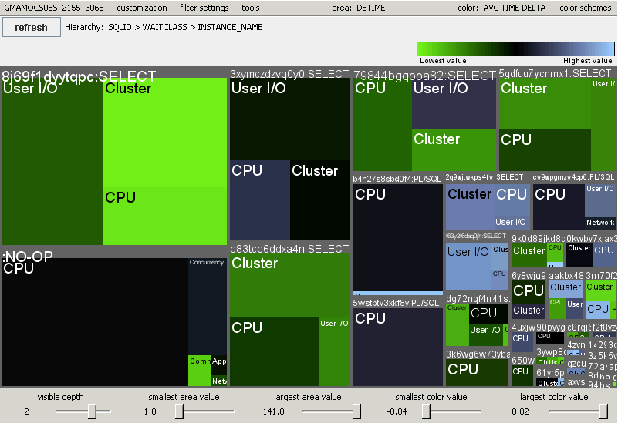
ASH Dump Treemaps

Slide 40
Conclusions
ASH can answer many questions
  DB Time analysis at many scoping levels
  Session activity over time
  Workload characterization
Understand the mechanism for best results
  Sampling is not tracing but is often good enough
  ASH estimates DB Time quite accurately

Slide 41


