Slide 1
Git Basics
A Modern Version Control System
Notes:
Version control systems are a category of software tools that help a software team manage changes to source code over time.
Track every modification
Concurrent working from conflicting

Slide 2
Outline
What is Git?
Why should we learn Git?
How to get start?

Slide 3




40 Years of version control
Subversion (2001)
SCCS & RCS (1970s)
Git (2005)
Image © TheSun.au
CVS (1986)
Notes:
SCCS: source code control system
RCS: revision control system
CVS: concurrent version system
Rather than have only one single place for the full version history of the software, every developer’s working copy of the code is also a repository that can contain full history of all changes.

Slide 4
Git
It is the super popular version control tool developed by Linus Torvalds.
It has to be installed on our computer and usually uses command-line.
It helps us manage our project’s files.

Slide 5
Great Features of Git
It tracks every change in the project.
It makes collaboration among distributed co-worker much easier.
Git way: feature branches
Notes:
Git’s history = relax (change one file and later find out it is wrong and want to go back)
Collaboration: multiple access and update to same file
Feature branch: working on different features simultaneously and not interference

Slide 6
Git Terminology
Project -> Repository (repo)
Working directory
Staging: prepare, get ready
Commit: save
Notes:
Repo: save all the files, changes of a project

Slide 7
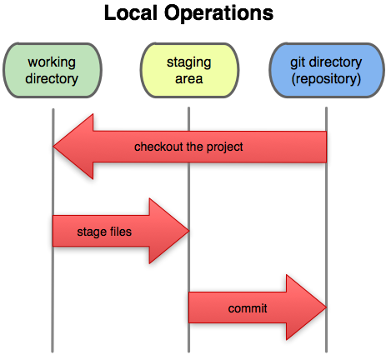
Staging

Slide 8
Staging
When preparing a commit, a file goes through 4 stages:
1) Same as original (the file is unchanged)
2) User editing
3) Staged for commit
(2 and 3 can be repeated many times, the last staged version is committed)
4) Committed.
git add stages a file for commit, or adds a new file to the version control system.
Notes:
The git add command moves changes from the working directory to the Git staging area. The staging area is where you prepare a snapshot of a set of changes before committing them to the official history

Slide 9
Setup
Git installation and check:
https://git-scm.com
git –-version
Config git installation (register yourself):
git config -–global user.name [name]
git config -–global user.email [email]
Notes:
In order to track each user that make changes
Ubuntu: sudo apt-get install git

Slide 10
Setting up a local repository
Create a new folder and navigate to the folder
Eg. Create a simple html file
git init
OR: git init [project-name]
Notes:
Repository: Collection of commits, branches, and tags (named commits).
Can be local or remote (ex. Github).
Can have different branches
branches can have a different commit history from the local version

Slide 11
Git Demo
Navigate to the folder of project
Make some change of the file
git status
git add –A
git commit –m “Message”
Some intended/accidental change or deletion
git checkout -- .
Notes:
Git stores data in a hidden system folder on your hard drive repository (locally)

Slide 12
git status
tell you what branch you are on
> git status
# On branch master
# nothing to commit (working dir. clean)
show you how your working directory has changed since your last commit

Slide 13
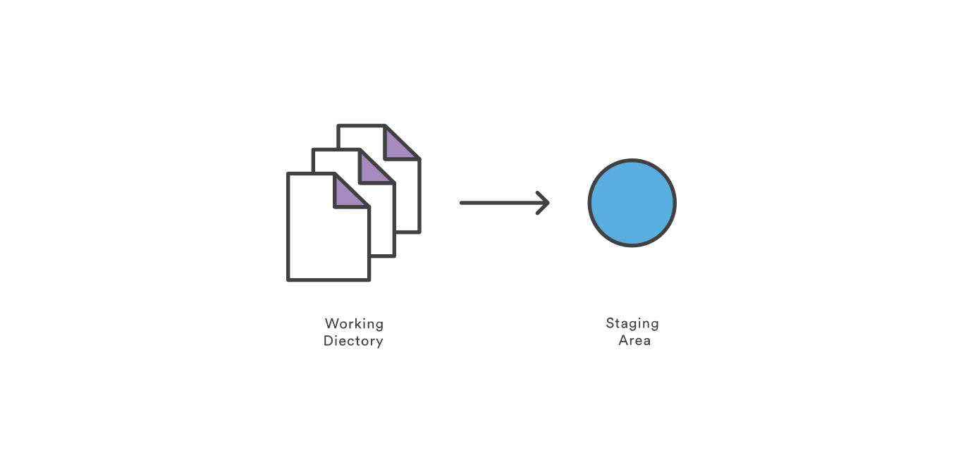
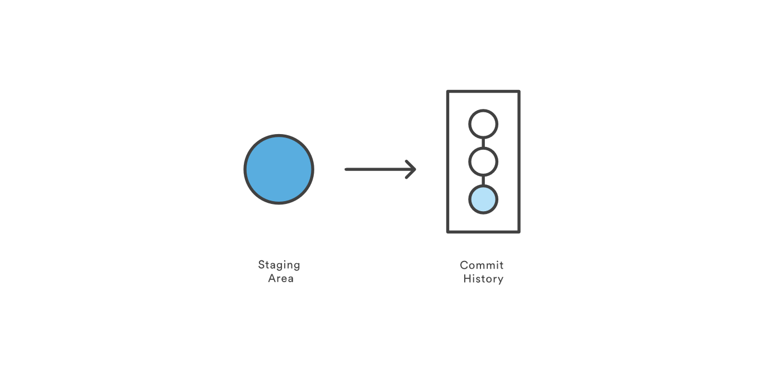
Saving Changes
git add
git commit
Notes:
The git add command adds a change in the working directory to the staging area. However, git add doesn't really affect the repository in any significant way—changes are not actually recorded until you run git commit.
Working directory - The branch that is currently checked out.
Commit - A snapshot of source code & other files for a project

Slide 14
Making The Commit
git commit –m “Message about the changes”
git commit
Will open up an editor* to let you write a commit message describing what you changed. Commit is only made if the message is not empty.

Slide 15
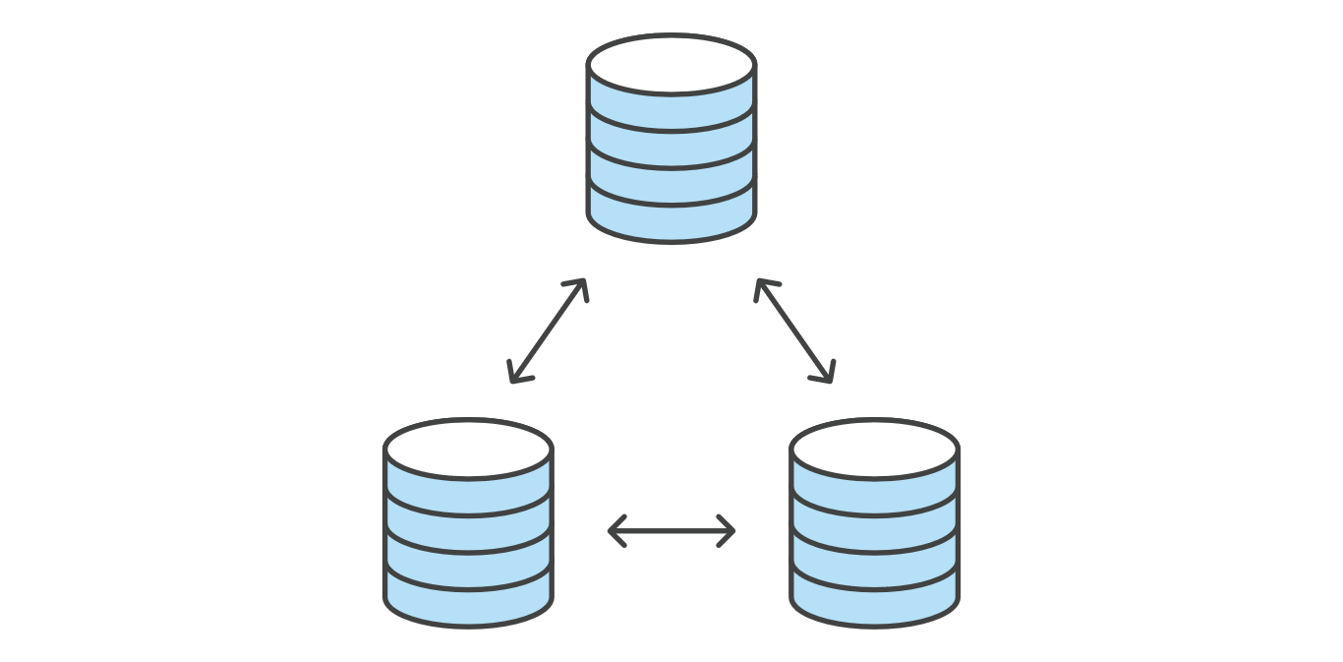
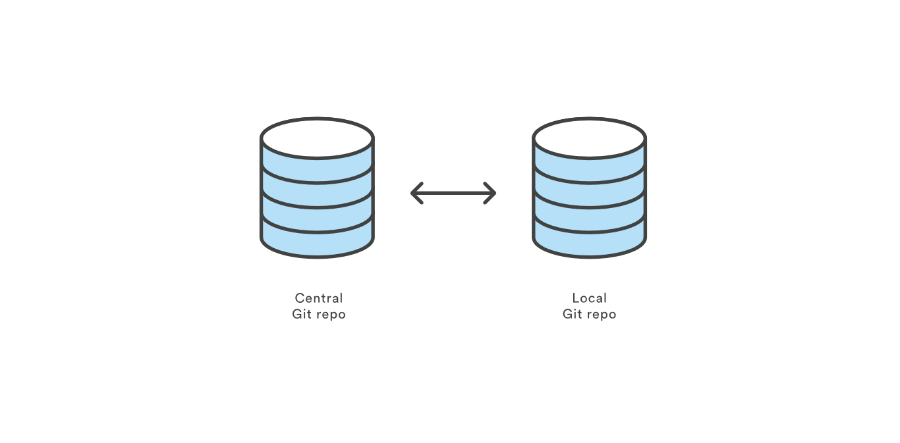
Git Repo Hosting:
Notes:
Information only in your hard drive (hidden folder in your repo)
Computer is dead, only you can log in your computer
Communicate with remote repo
Collaboration with each developer: own entire copy of the repo, its local history and branch structure
Connection with other by pushing and pulling

Slide 16
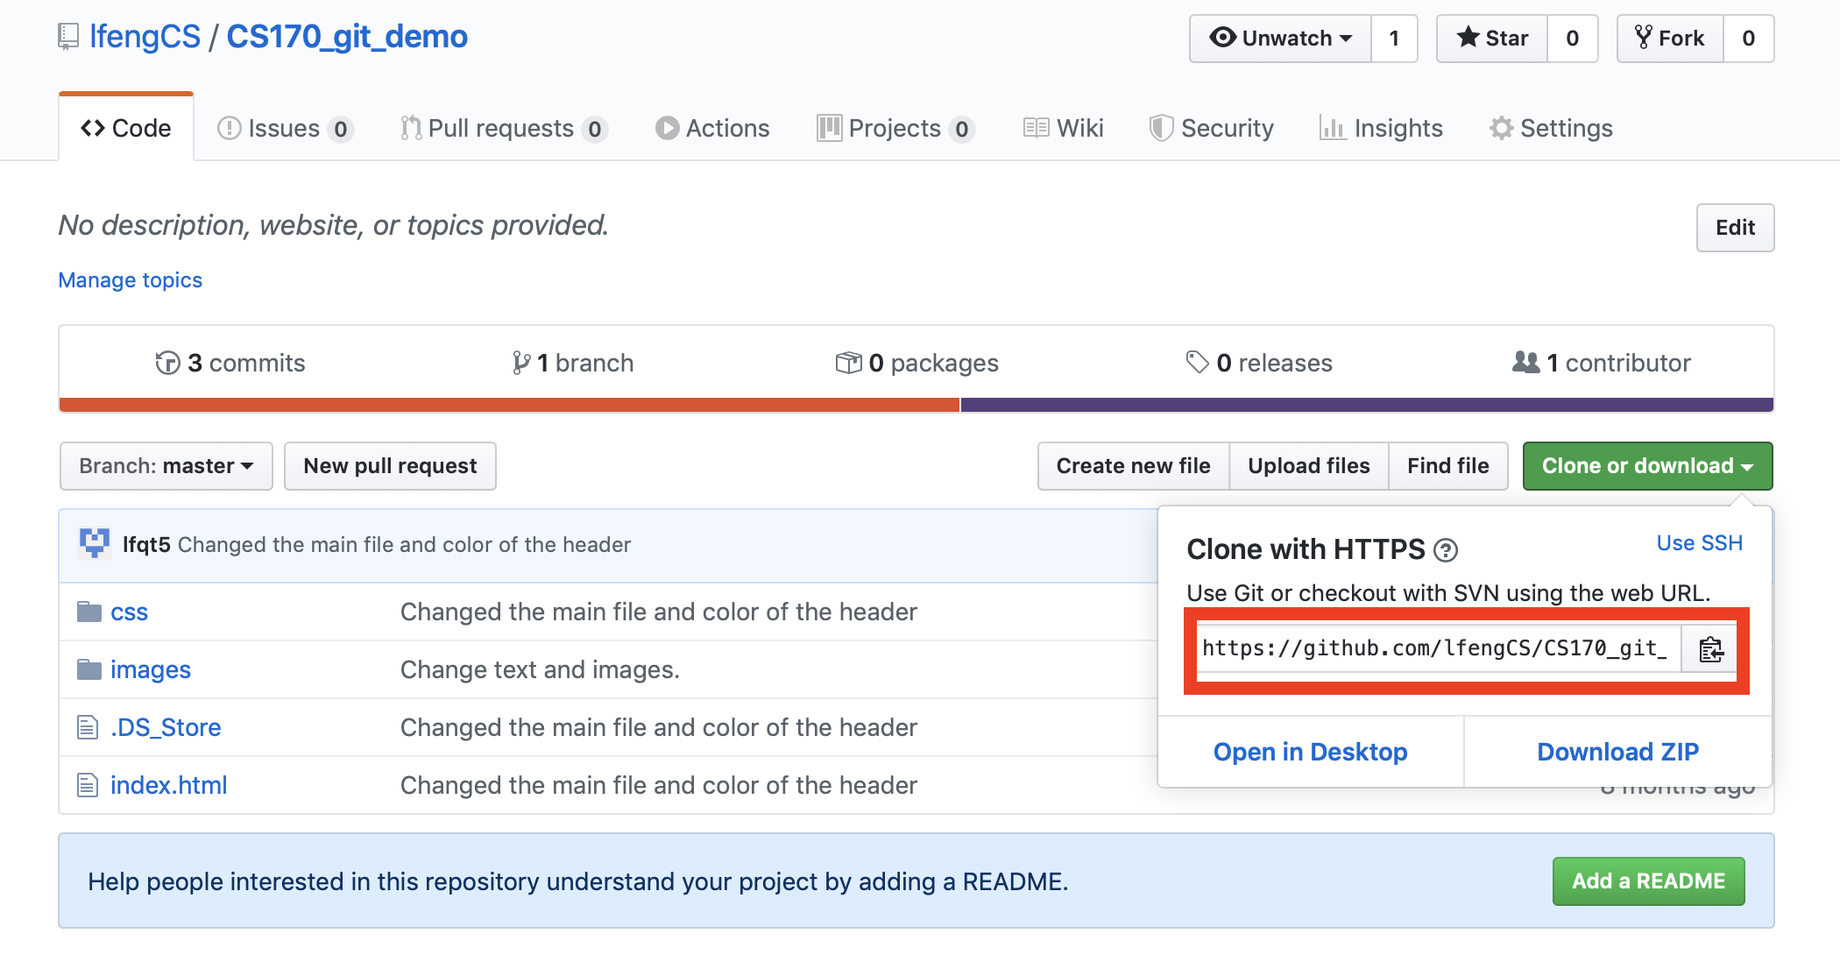
Clone the remote repository to your machine
git clone https://github.com/lfengCS/CS170_git_demo.git

Slide 17
GitHub Hands-on
Create a GitHub account
https://github.com
Free account
Create a new repo on github by creating a name
Push your repo on local computer to remote server
Check remote server: git remote -v

Slide 18
git push
Share your local commits with the rest of the team
Transfer commits from your local repository to a remote repo.
git push origin master
Notes:
Publish your local changes to a central repository
Remotes/Origin - Remote sites (ex. Github) that store branches. Origin is the default name for the first remote site.

Slide 19
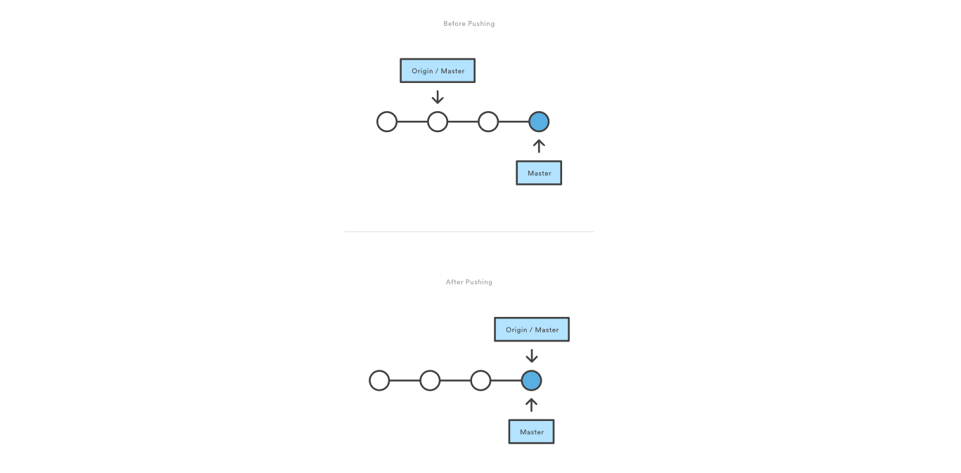
git push
Notes:
Git prevents you from overwriting the central repository’s history by refusing push requests when they result in a non-fast-forward merge.
If the remote history has diverged from your history, you need to pull the remote branch and merge it into your local one, then try pushing again.

Slide 20
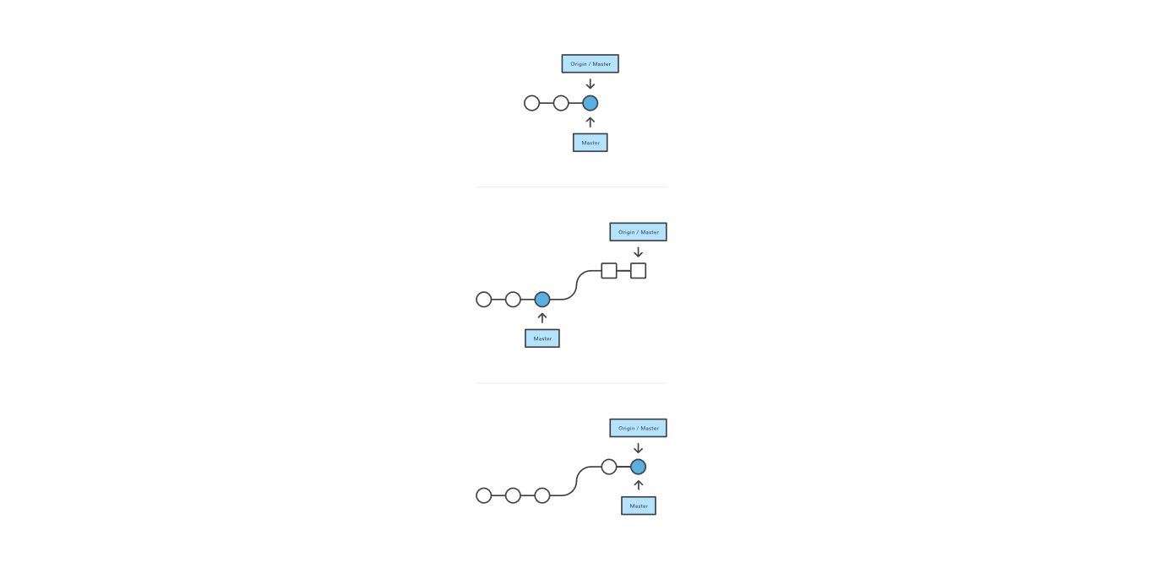
git pull
One single command to merge upstream changes into your local repository

Slide 21
Commands
git init
Setup an empty repo locally
git clone
Copy remote repo locally
git status
Reminds you what’s going on
git add
Add to the staging state
git commit
Makes a commit

Slide 22
Commands
git push
Copies local changes to the remote repository.
git pull
Copies remote changes to the local repository.

Slide 23
Acknowledgement
These slides contain material developed and copyright by:
https://www.atlassian.com/git/tutorials/

