Slide 1
Welcome to CS170 Introduction to Unix
Instructor: Li Feng
Capital University

Slide 2
Course Information
Instructor: Li Feng
117A Battelle Hall
lfeng@capital.edu
Office hour:
Monday 1:30pm-2:30pm
Tuesday 8:30am – 9:30am
Wednesday 8:30am – 9:00am
Thursday 8:30am – 9:30am , 1:30pm-2:00pm
Friday 8:30am – 9:00am
Or by appointment

Slide 3
Introduce yourself: name, what year are you in, your hobby, anything you want to share…

Slide 4
Contents covered in this course:
A subset of Unix commands
Common Unix editors
Shell scripting
Git

Slide 5
Course Grading
35%: in-lecture quizzes
40%: Lab and Assignments
20%: final exam (comprehensive)
5%: attendance and participation

Slide 6
Academic Integrity:
If you wouldn't want fellow students, parents, or professors to know about it, it's probably cheating
If it feels like cheating, it probably is

Slide 7
The Myth of Multitasking
https://youtu.be/PriSFBu5CLs @ 7:50-10:00 (Clifford Nass, Stanford)
Allowing yourself to respond to distraction (incoming email, IM, etc.) triggers small dopamine release
Over time, you get addicted to it
Result: Multitaskers waste far more brainpower than monotaskers when actually distracted
Long-term effects can be hard to reverse

Slide 8
Introduction: What is Unix?
An operating system
Developed at AT&T (Bell Labs) in the 1960’s
Command Line Interface (CLI)
Notes:
Operating system: middle level between hardware and software. It schedules tasks, allocates storage and handles the interfaces to peripheral hardware (printers, disk drives…)

Slide 9
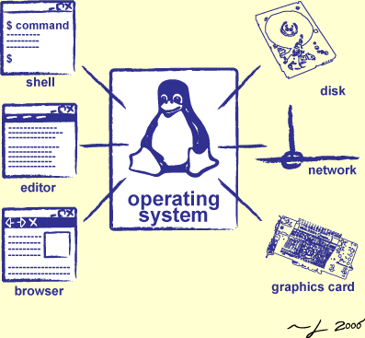
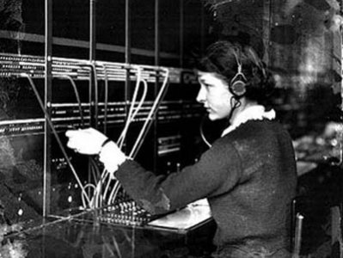
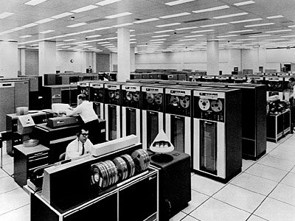
Operator …
Switchboard Operator
Computer Operators

Slide 10
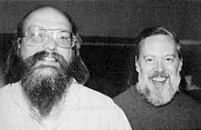
The 1983 Turing Award: Ken Thompson and Dennis Ritchie
UNIX: Making Computers Easier To Use -- AT&T Archives film from 1982, Bell Laboratories
Notes:
Multics: OS on main frame
Cool stuff: Daemons (log in, pixel in screen) and dynamic linking
C language: 1971
For their development of generic operating systems theory and specifically for the implementation of the UNIX operating system
ACM: Association for Computer Machinery. Highest distinction in computer science. Nobel prize in computing.

Slide 11
Introduction: Features
Multiuser
Both command line interface and window environment
Designed by programmer for programmer
Very customizable
Combine small program easily to do complex tasks
You don’t need to worry about “crashing the system” by formatting the disk or deleting system files. (superuser)
Notes:
Multiuser systems divide computer resources among multiple users, allowing for more efficient use of these resources

Slide 12
Introduction: Types of Unix
Many different versions of Unix:
Sun Solaris
GNU/Linux
Mac OS X
All the Unix versions are mostly the same:
Same command works (slightly different syntax)
Complied program on one can usually be compiled without any changes or minor changes in the other
The location of system files varies but the differences are usually transparent to the end-users

Slide 13
Introduction: Unix vs. Linux
Unix was the predecessor of Linux
Linux is developed by a grad student (Linus Torvalds) in Finland in 1991
Linux is a variant of Unix
Linux is open source
Linux distributions: Ubuntu, Fedora, Red Hat, Debian, Arch, CentOS…
Android is also a Linux based OS for mobile device.
Linus Torvalds
Source: wikipedia
Notes:
Torvalds also developed version control tool: git

Slide 14
Introduction: Why Unix/Linux?
Linux is free
It’s portable
It’s fully customizable
It’s stable (i.e. it almost never crashes)
A rich selection of applications is available for Linux
A mount of software is also available.
These characteristics make it an ideal OS for programmers and scientists

Slide 15
Introduction: Linux is made up of 3 parts
The kernel: the hub of the OS
The shell: the command line interpreter (CLI), the interface between the user and the kernel
The program

Slide 16
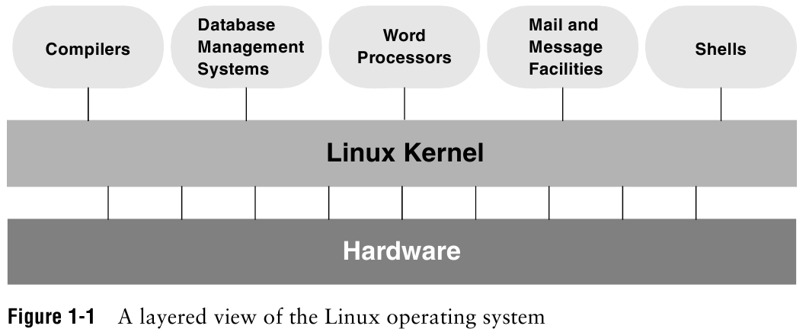
Introduction: Linux
Notes:
Kernel: most frequently used functions: scheduling user jobs, allocating computer resources, interface with program

Slide 17
Introduction: Overview of Linux
Kernel programming interface
Multiuser
Multitask OS
Secure hierarchical filesystem
Shell
A family of utility program (commands)
Interprocess communication (several utility together)
System administration
Notes:
Everything in UNIX is either a file or a process
Shell: command interpreter, interface between you and kernel (the OS)
Interprocess communication: pipeline and filter

Slide 18
Connecting to a Unix/Linux system
Windows user (for details, see setup pdf in iLearn):
Download and Install Virtual Box
Download and Install Ubuntu
Open a terminal in Ubuntu

