Slide 1
CS170 Introduction to Unix
Instructor: Li Feng
Capital University

Slide 2
Introduction: Linux is made up of 3 parts
The kernel: the hub of the OS
The shell: the command line interpreter (CLI), the interface between the user and the kernel
The program

Slide 3
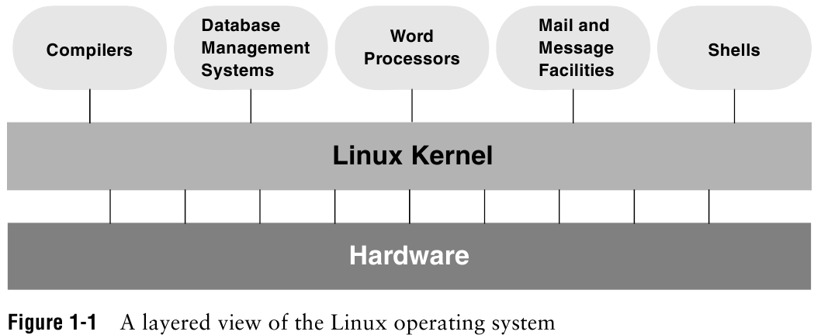
Introduction: Linux
Notes:
Kernel: most frequently used functions: scheduling user jobs, allocating computer resources, interface with program

Slide 4
Review: Overview of Linux
Kernel programming interface
Multiuser
Multitask OS
Secure hierarchical filesystem
Shell
A family of utility program (commands)
Interprocess communication (several utility together)
System administration
Notes:
Everything in UNIX is either a file or a process
Shell: command interpreter and programming language, interface between you and kernel (the OS), textural interface
Interprocess communication: pipeline and filter
Server usually is Linux machine.

Slide 5
Connecting to a Unix/Linux system
Windows user (for details, see setup pdf in iLearn):
Download and Install Virtual Box
Download and Install Ubuntu
Open a terminal in Ubuntu

Slide 6
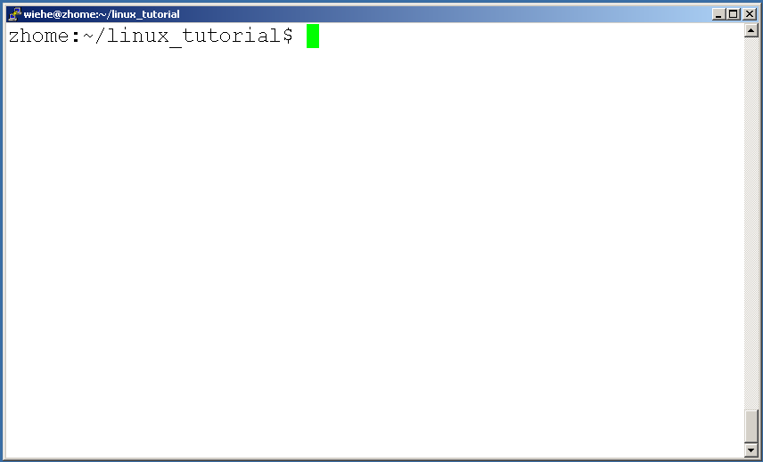
Connecting to a Unix/Linux system
Mac user:
Open up a terminal:
Notes:
Applications/accessories menu: Terminal icon

Slide 7
Connecting to a Unix/Linux system
Open up a terminal:
The “prompt”
The current directory (“path”)
The host
Notes:
Prompt could be a dollar sign($), or a hashmark(#) or a percentage sign(%)

Slide 8
What exactly is a “shell”?
After logging in, Unix/Linux starts the shell
The shell interprets commands the user types and manages their execution
The shell is the interface between you and the kernel
The most popular shells are: tcsh, csh, korn, and bash (which shell are you running?)
The adept user can customize his/her own shell, and users can use different shells on the same machine
The differences are most times subtle
Shell commands are CASE SENSITIVE!
Notes:
Enter “echo $0” and press ENTER

Slide 9
Get Help!
Whenever you need help with a command type “man” and the command name

Slide 10
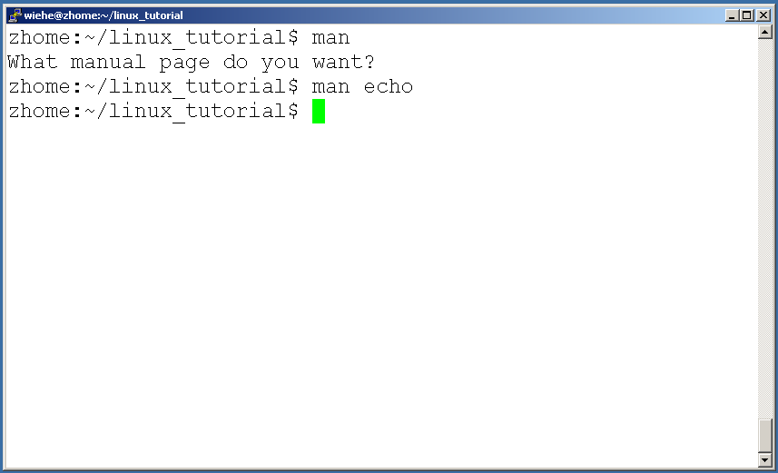
Get Help!

Slide 11
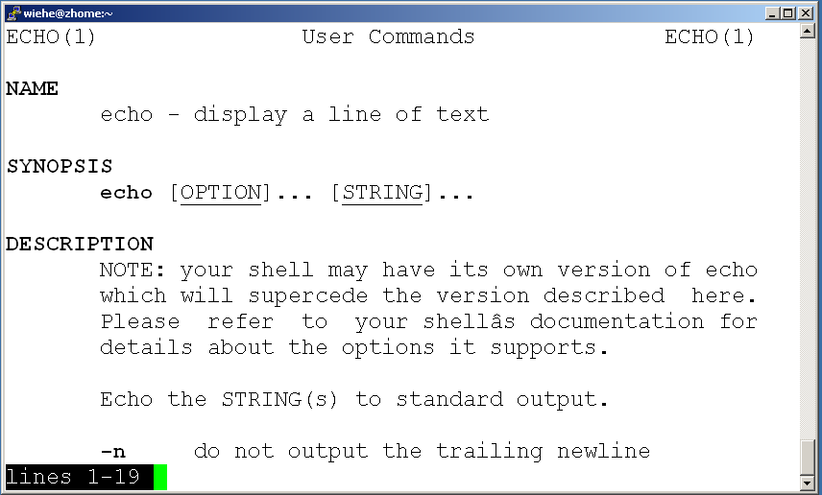
Get Help!

Slide 12
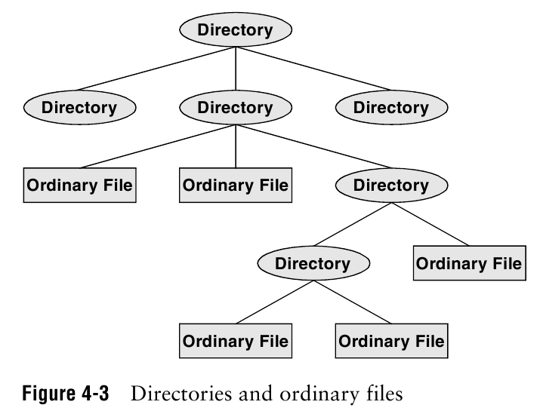
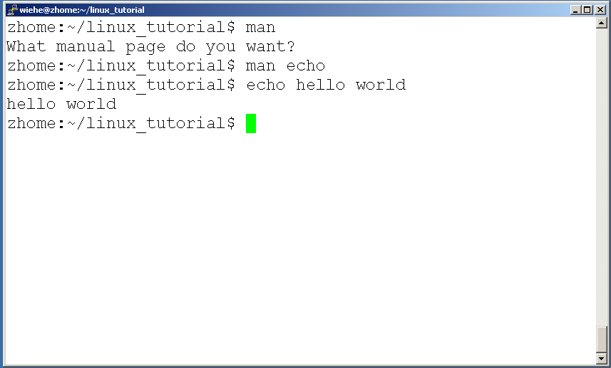
Get Help!
Notes:
Echo: display text

Slide 13
Unix/Linux File System
Notes:
/: root directory
~: your home directory
File are arranged under directories.
The Linux file system is a hierarchy in which the root directory appears at the top of the system and branches come off the root, with each branch supporting
one or more plain or directory files.

Slide 14
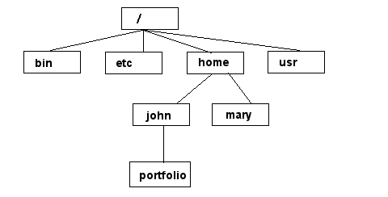
Unix/Linux File System
NOTE: Unix file names
are CASE SENSITIVE!
/home/mary/
/home/john/portfolio/
The Path
Notes:
/: root directory
~: your home directory
Bin: essential command binaries
Etc: configuration files (password)
Home: user home directory.
In mac OS: /Users
File are arranged under directories.
The Linux file system is a hierarchy in which the root directory appears at the top of the system and branches come off the root, with each branch supporting
one or more plain or directory files.

Slide 15
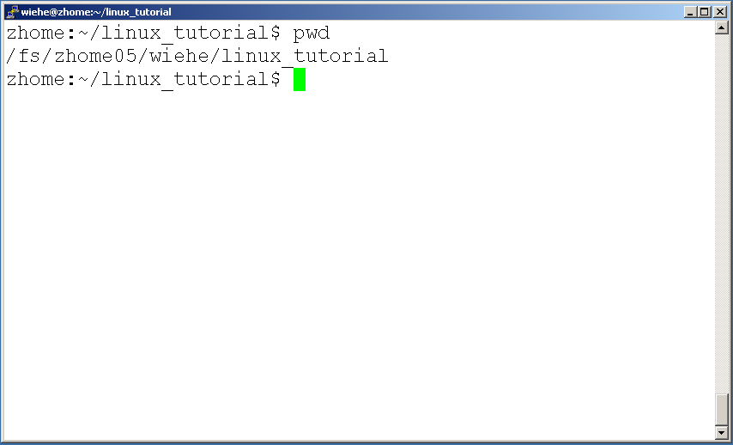
Command: pwd
To find your current path use “pwd”
Notes:
Pwd: print working directory
Pathnames enable you to work out where you are in relation to the whole file-system. Find out the absolute pathname of your home-directory

Slide 16
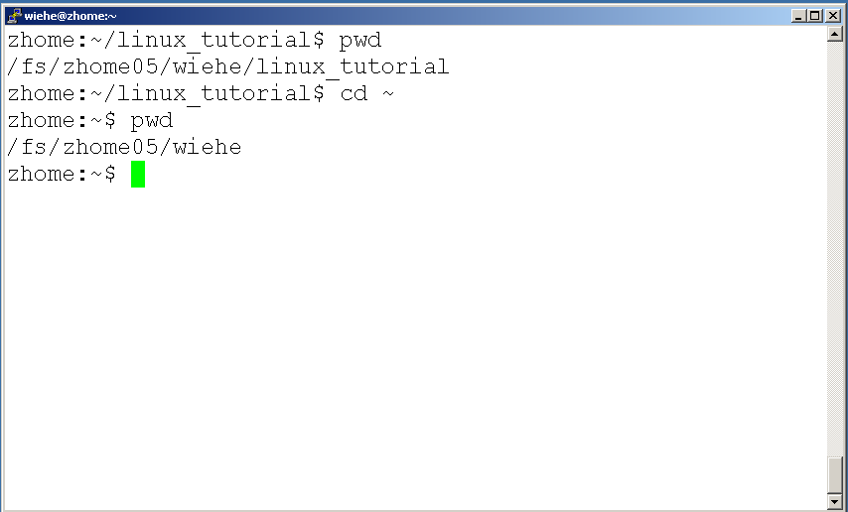
Command: cd
“~” is the location of your home directory
Notes:
Cd: change directory
Shortcut to your home directory: cd /home/li (absolute path), cd ~,
cd (space) Typing cd with no argument always returns you to your home directory. This is very useful if you are lost in the file system.

Slide 17
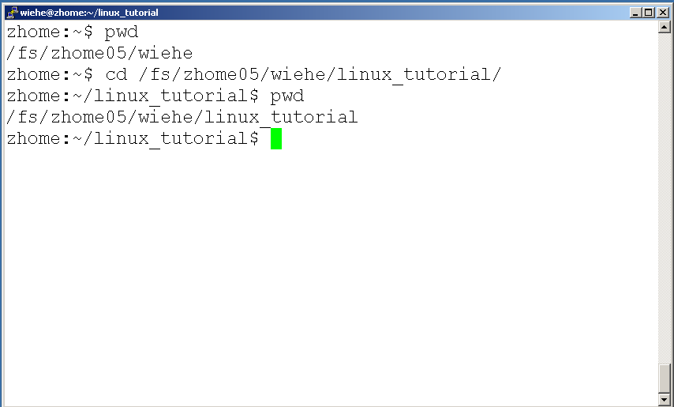
Command: cd
To change to a specific directory use “cd”

Slide 18
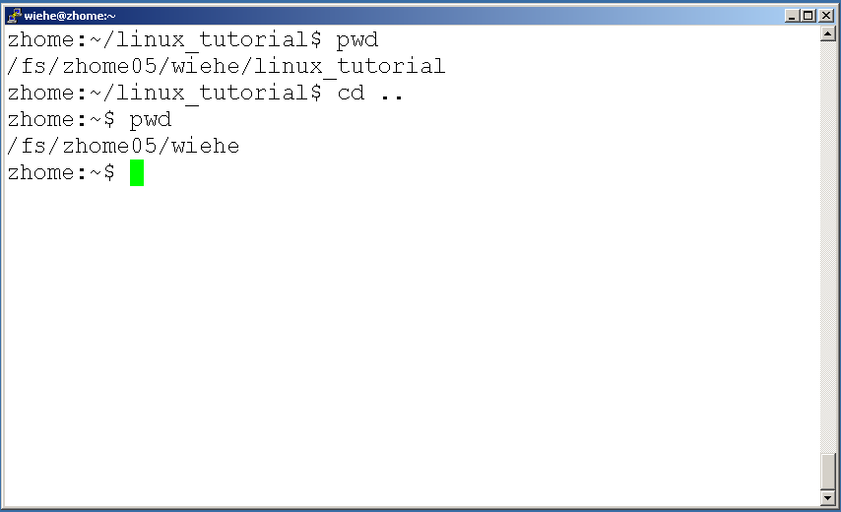
Command: cd
“..” means the parent of the current directory; it will take you one directory up the hierarchy.
Notes:
(.) means the current directory, so typing “cd .” (space between cd and the dot)
Cd - : previous directory

Slide 19
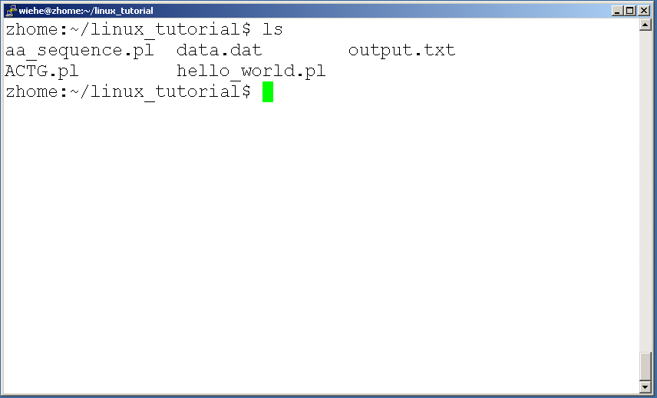
Command: ls
To list the files in the current directory use “ls”

Slide 20
Command: ls
ls has many options
-l long list (displays lots of info)
-t sort by modification time
-S sort by size
-h list file sizes in human readable format
-r reverse the order
-a list all files including those whose names begin with a dot type
“man ls” for more options
Options can be combined: “ls -ltr”
Notes:
Files beginning with a dot(.) are know as hidden files and usually contains important program configuration information.

Slide 21
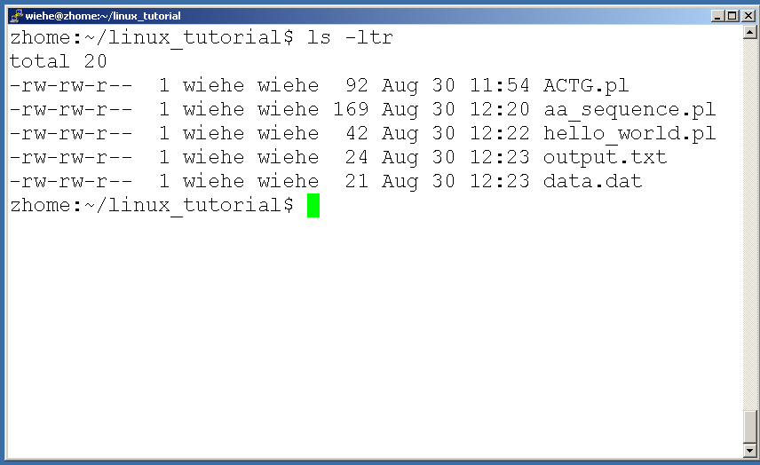
Command: ls -ltr
List files by time in reverse order with long listing

Slide 22
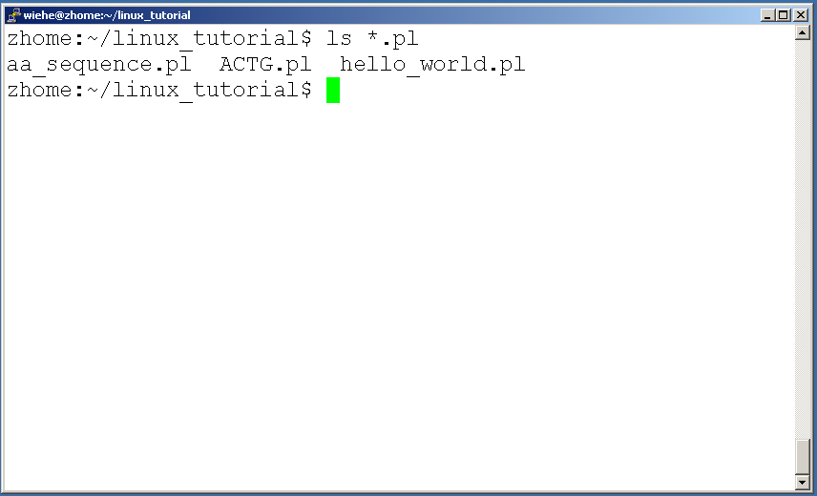
General Syntax: *
“*” can be used as a wildcard in Unix/Linux
“*”: match against none or more characters in a file or directory name
“?”: match exactly one character.
Notes:
*: match against none or more characters in a file or directory name
?: match exactly one character.

Slide 23
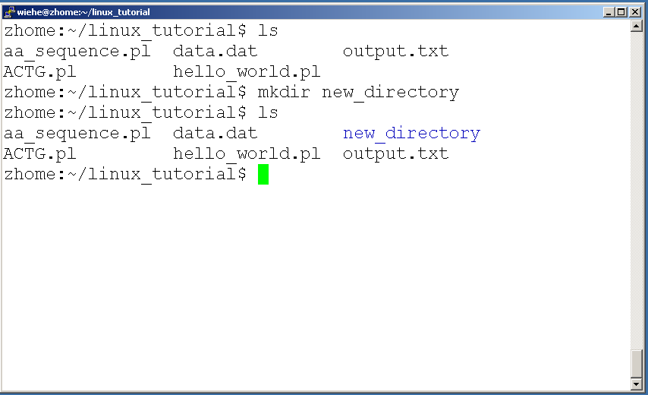
Command: mkdir
To create a new directory use “mkdir”
Notes:
mkdir: make directory

Slide 24
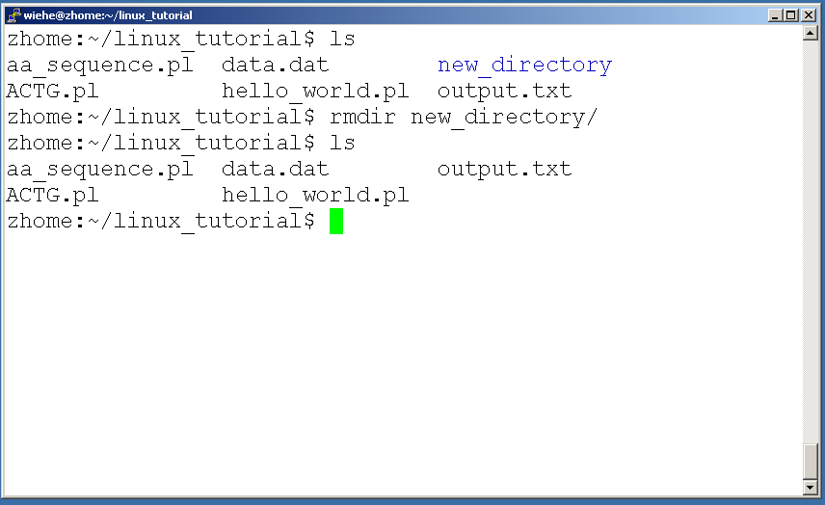
Command: rmdir
To remove and empty directory use “rmdir”

Slide 25
Tips:
Filename completion: By typing part of the name of a command, filename, pathname or variable and press TAB key, the shell will complete the rest of the name automatically (if it is unique).
History: The shell keeps a list of the commands you have typed in. If you need to repeat a command, use the cursor keys to scroll up and down the list or type history for a list of previous commands.
Notes:
Type completion:

Slide 26
Tips:
Delete a word: control-w. A word is any sequence of characters that does not contain a SPACE or TAB.
Delete a line: control-u.

Slide 27
Assignment 1: Handwritten Hardcopy is Due 22nd in class
Read chapter 1.
Page 18-19: Exercises 4, 5, 6, 7, 10
Read chapter2.
Page 46-47: Exercises 6, 7, 8, 9, 13
Try all the commands in slides and record using “script” command in next slide

Slide 28
Command "script”
Command ”script” is used to recording a shell session
Before you start all the commands :
script command (create a file named command)
…
…
exit (terminate the script session)
You will obtain command in the current directory, submit command file in iLearn

