Slide 1
Vim Editor and Simple Shell Script
Instructor: Li Feng
Capital University

Slide 2
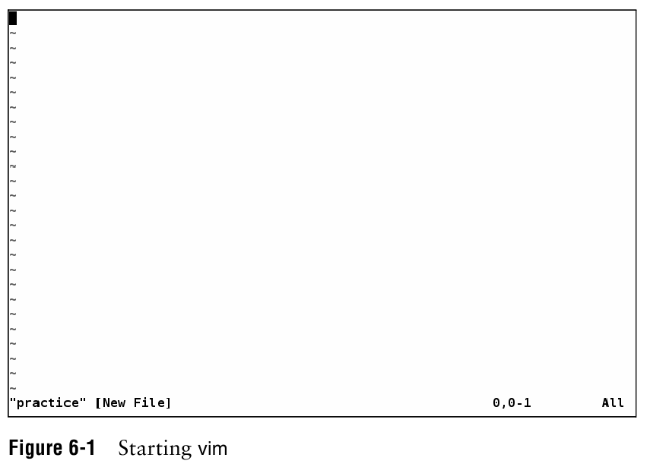

Slide 3
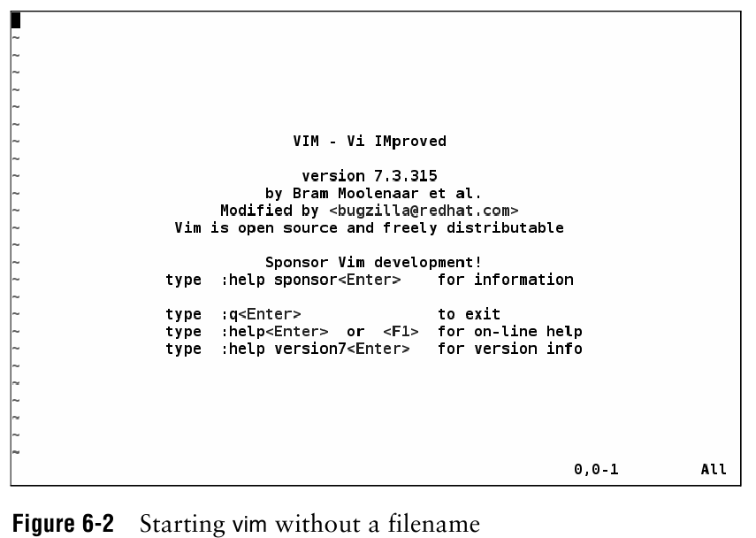

Slide 4
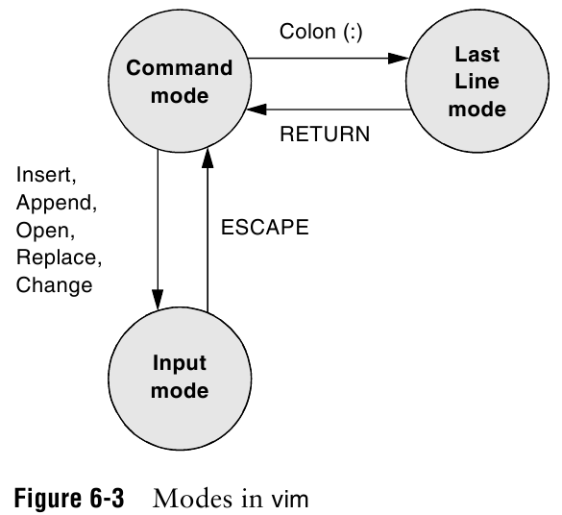

Slide 5
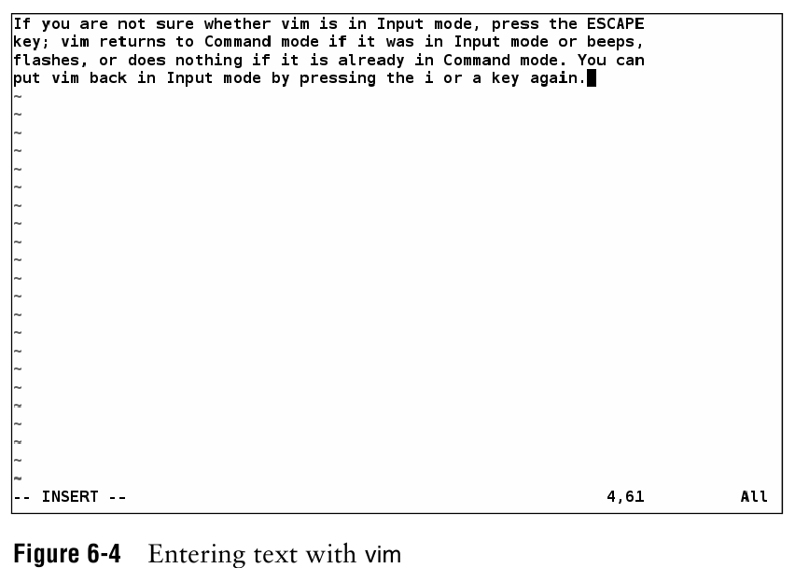

Slide 6
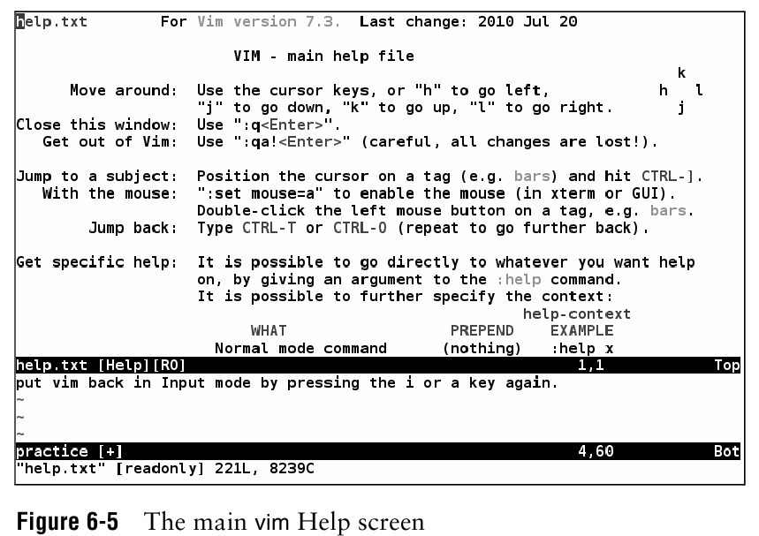
Notes:
:help

Slide 7
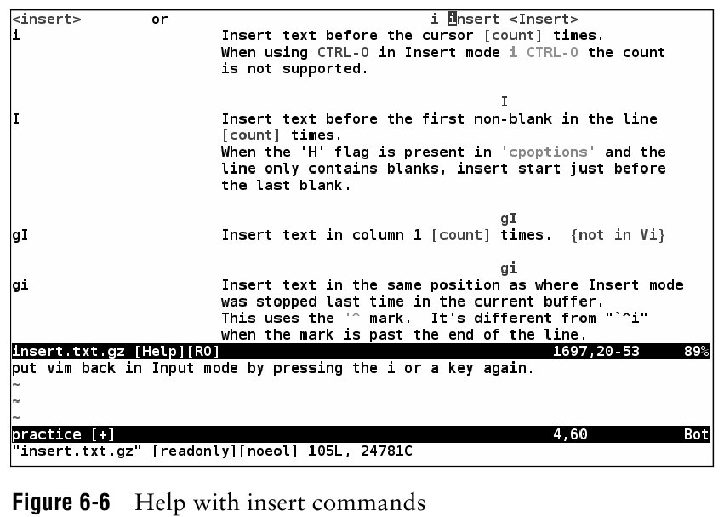
Notes:
:help insert
:q to quit from help

Slide 8
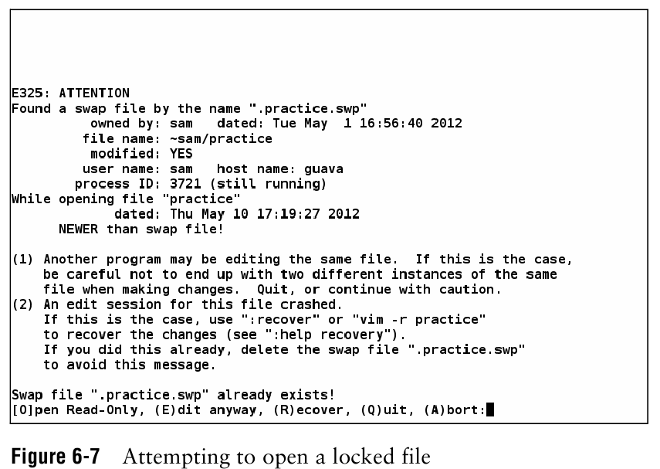
Notes:
Open a file to edit, it is locked.
If file is opened again, this will show up.

Slide 9
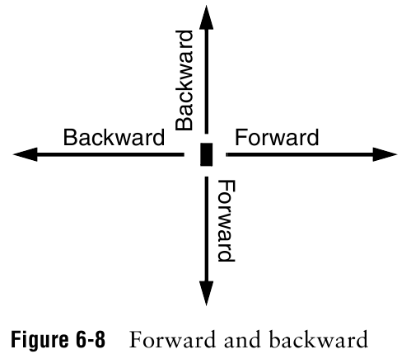

Slide 10
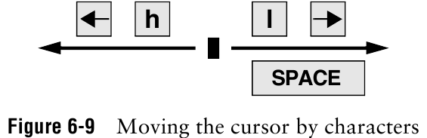
Notes:
Space: forward
h: backward

Slide 11
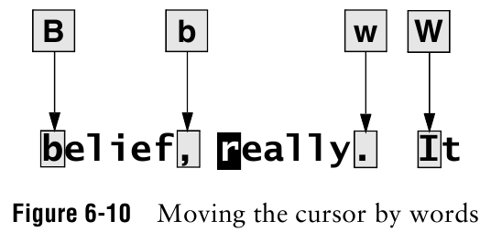
Notes:
b and w: punctuation as word
B and W: blank delimited words

Slide 12
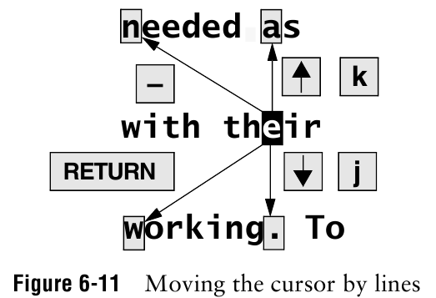
Notes:
- is similar to RETURN but work in the opposite way.

Slide 13
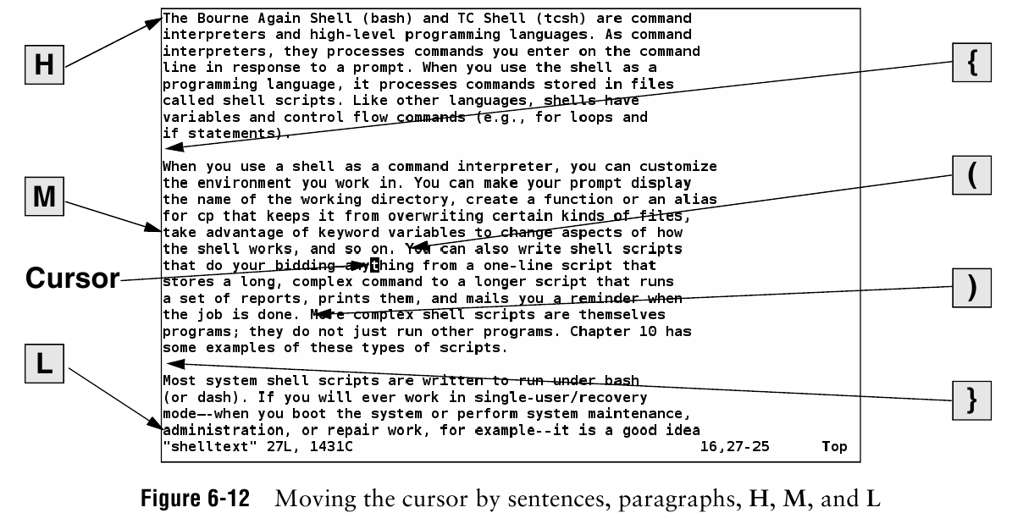
Notes:
H: home
M: middle
L: lower

Slide 14
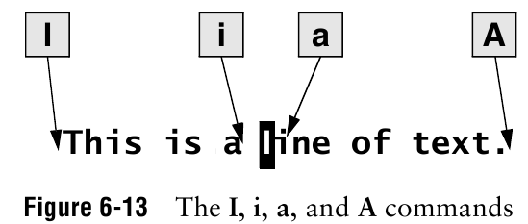

Slide 15
Setting Parameters
:set number
display the numbers of lines
:syntax on
highlight syntax
:set tabstop=2
spaces in tab
:set autoindent
indent new lines
Save above in your ~/.vimrc file
Notes:
Cd ~ or cd space will go to your home directory
/home/lfeng or /Users/lfeng

Slide 16
Useful Hot keys
0 : Move to start of line
$ : Move to end of line
G : Jump to last line
V : Visual view, then using arrow up and down to choose multiple lines
D: delete
y: copy
P: paste

Slide 17
Shell Script
A simple program for shell to run
The first line in your script should be:
#!/bin/sh
This says that regardless of the shell the user is running, run this script in bash (the interpreter)
# Comment

Slide 18
Example: Simple shell script
vim hello
#!/bin/sh
echo “Hello $USER”
echo “You are in $PWD”
echo “It has files:”
ls

Slide 19
Running the script “hello”
Running the sample script “hello”
Make sure the script is executable, if not using chmod u+x hello
./hello

Slide 20
Assignment:
Lab4: vim practice is due next class (Wednesday, Feb 12th)

