Slide 1
The Shell
Instructor: Li Feng
Capital University

Slide 2
Shell
The shell interprets commands user entered and manages their executions.
Command line:
Simple command
Pipeline
Notes:
Command [arg1] [arg2] RETURN

Slide 3
Simple commands:
Token: each sequence of nonblank characters.
Argument: a token that a command acts on (eg. a filename, a string of character, a number)
Option: an argument that modifies the effects of a command.

Slide 4
Simple commands:
Zero argument:
pwd, ls, hostname
One argument:
cat, cd, echo, less
Two arguments:
cp, mv, grep
One option: cat --help
One option and one argument: ls -l file
Notes:
Cat: join and display files
Less: displays text files, one screen at a time
Grep: search for a pattern in a file

Slide 5
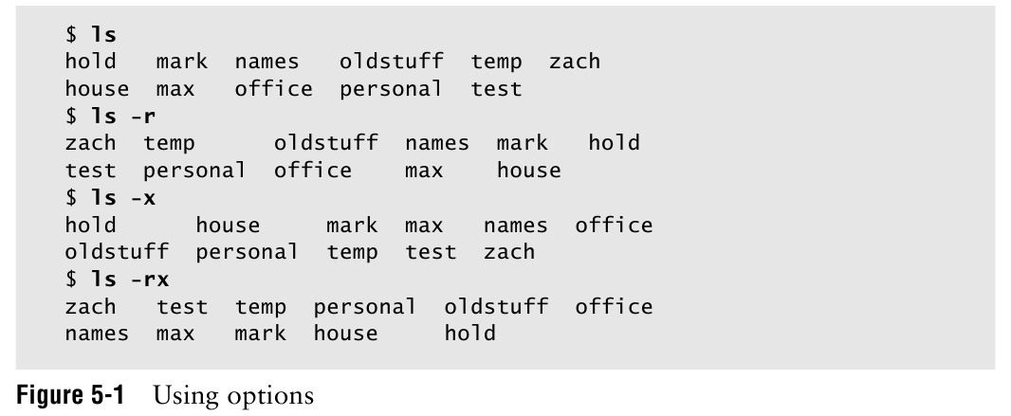
Notes:
-r: reverse order
-x: in horizontally sorted rows
Combine options

Slide 6
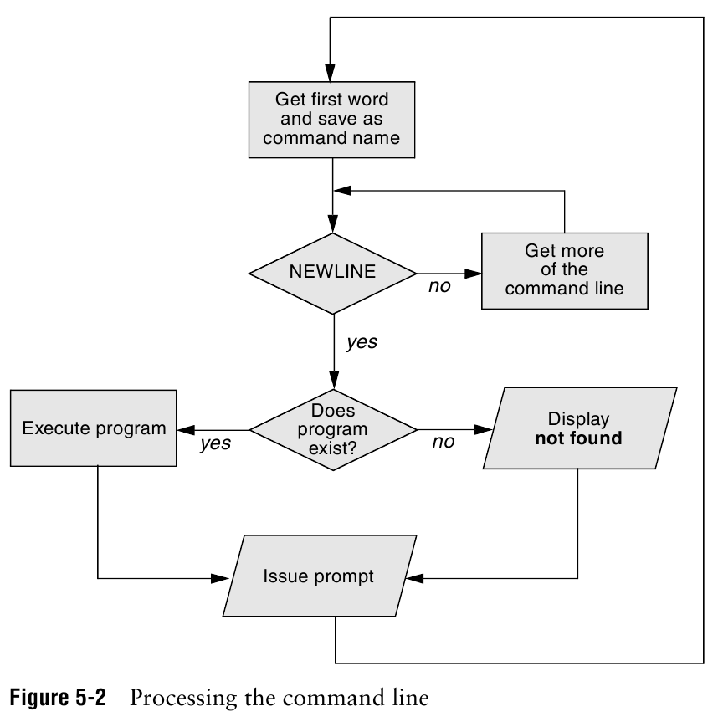
Parsing the command line
Notes:
Commandname [arg1] [arg2] …[argn] RETURN
Looks at the line as a whole and parse (break) it into its component parts. Look for the name of the command.
The name of the command is the first item on the command line after the prompt (argument zero)

Slide 7
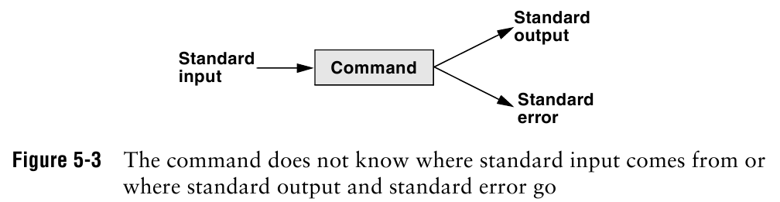
Execute a command
Notes:
Everything in Unix is either a process or a file.
A process is an execution of a command.
While the command is executing, the shell waits for the process to finish.
When the program finishes execution, it passes its exit status to the shell.

Slide 8
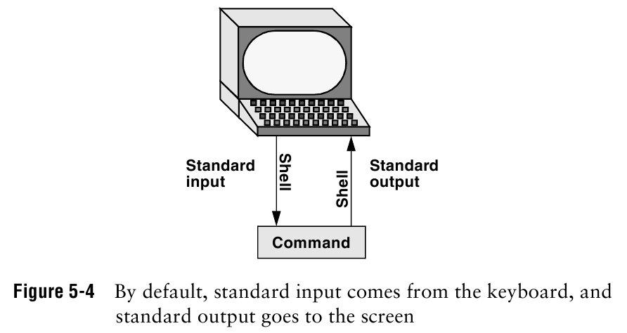
Standard Input and Standard Output
Notes:
Standard output: printer, file, screen
Standard error goes to the screen

Slide 9
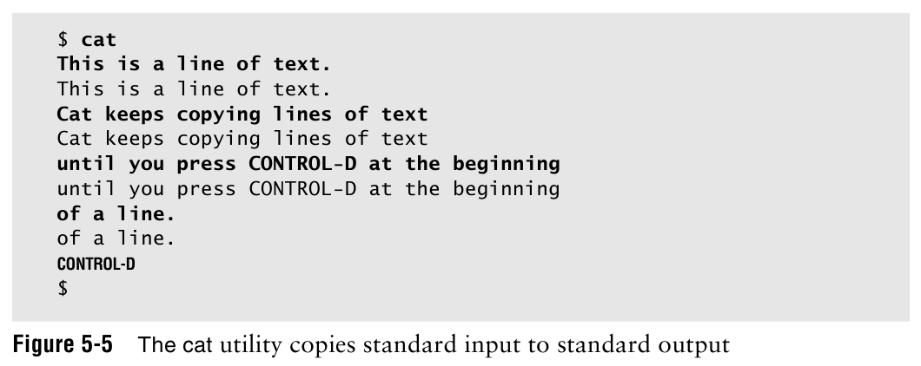
The Screen as a file

Slide 10
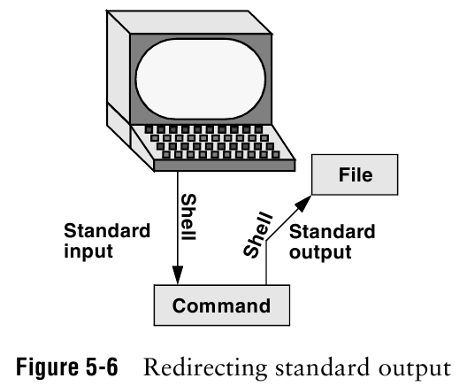
Redirection
Notes:
Cause the shell to alter where standard input of a command comes form and where standard output goes to.

Slide 11
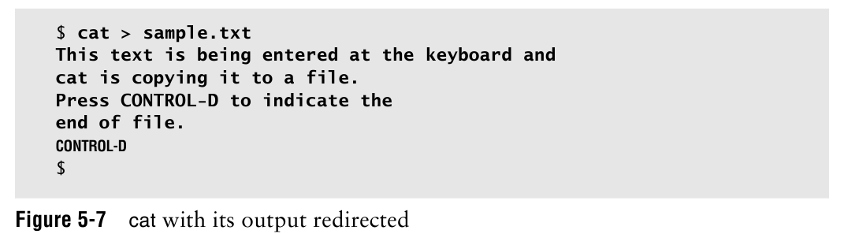
Redirecting Standard Output
Notes:
Use caution when you redirect output to a file. If the file exists, the shell will overwrite it and destroy its contents.

Slide 12
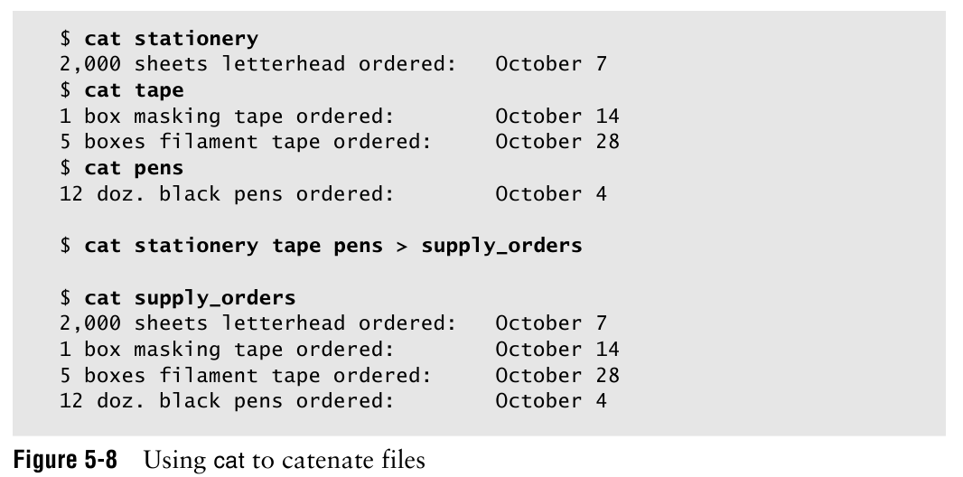
Notes:
Redirecting output can destroy a file.
Prevents overwriting files: set –o noclobber

Slide 13
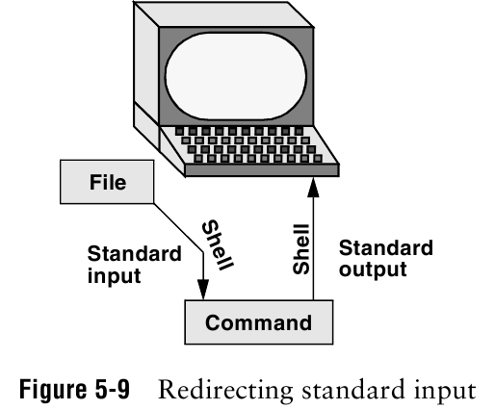
Redirect Standard Input

Slide 14
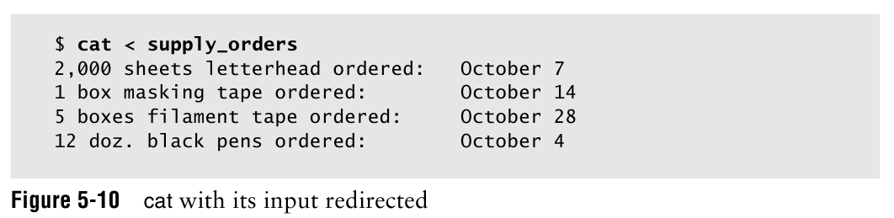
Utilities that take input from a file or standard input: cat, lpr, sort, grep

Slide 15
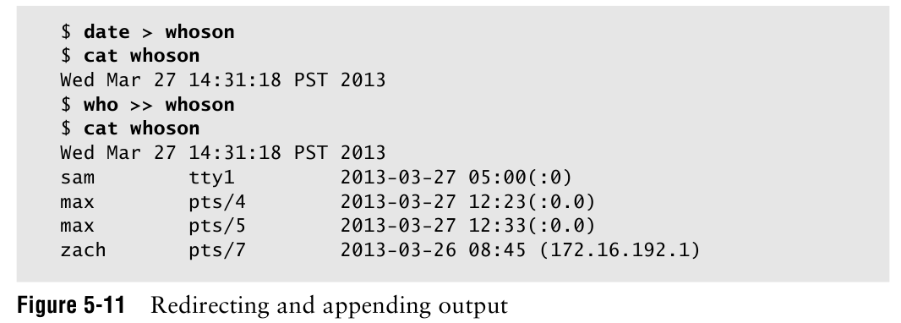
Redirecting and Appending Output

Slide 16
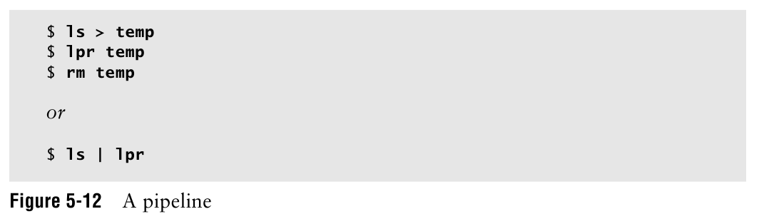
Pipe
Consists of one or more commands separated by a pipe symbol (|)

Slide 17
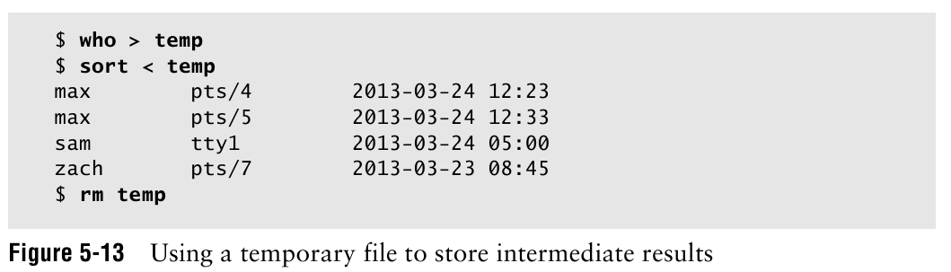

Slide 18
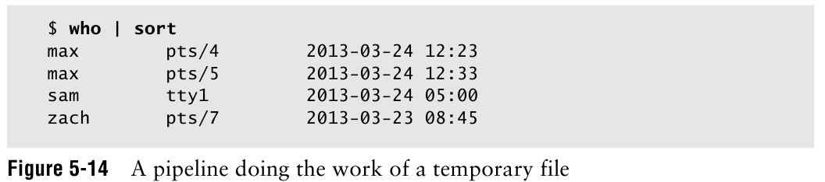
Notes:
Ls | less
Who | grep sam

Slide 19
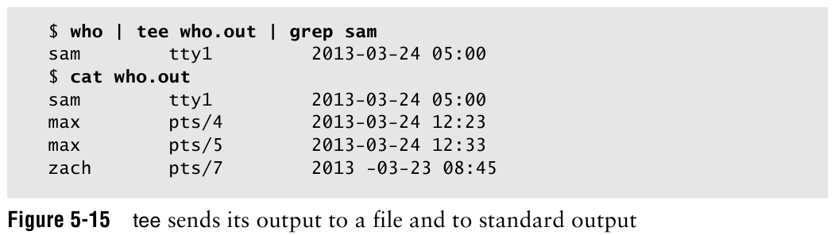
Filters
A command that processes an input stream of data to produce an output stream of data.
Notes:
Tee: copies its standard input both to a file and to a standard output
File extension: followed by a period after the name of the file.
Who | sort | lpr : sort is a filter

Slide 20
Shell Script
A simple program for shell to run
The first line in your script should be:
#! /bin/sh
This says that regardless of the shell the user is running, run this script in bash

Slide 21
Example: Simple shell script
vim hello
#! /bin/sh
echo “Hello $USER”
echo “You are in $PWD”
echo “It has files:”
ls
Notes:
$User and $PWD: system variable build into bash the shell

Slide 22
Running a program: an example
Running the sample script “hello”
Make sure the file is executable (chmod)
./hello
Running a command in the foreground (on the window screen)
Running a command in the background – type an ampersand “&”
Notes:
Foreground: shell will waits for it to finish before displaying another prompt for you to continue.
Background: you do not have to wait for the command to finish.

Slide 23
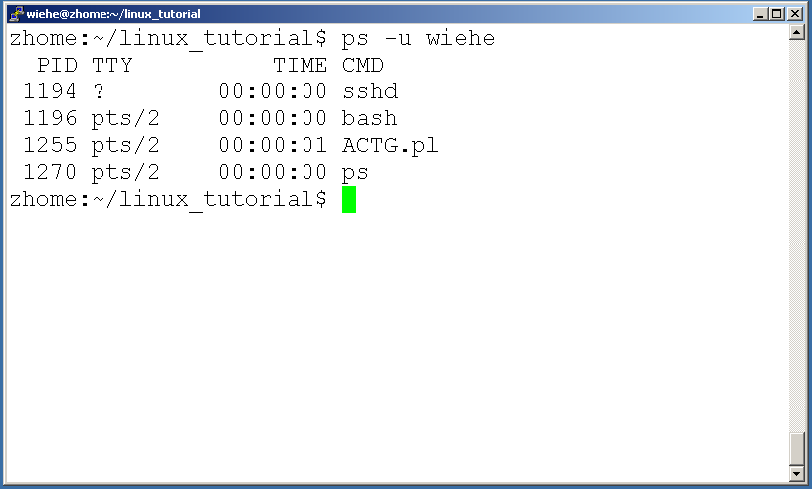
Command: ps
To view the processes that you’re running:
ps

Slide 24
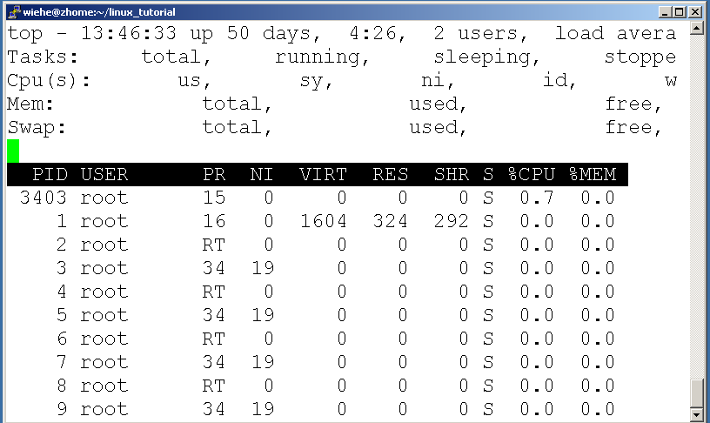
Command: top
To view the CPU usage of all processes:
top

Slide 25
Ending a program
Suspend key – “ctrl-z” can suspend a foreground job (stop it from running)
Interrupt key -“ctrl-c” can stop a foreground job but cannot abort a background process.
“kill” could terminate a background process.

Slide 26
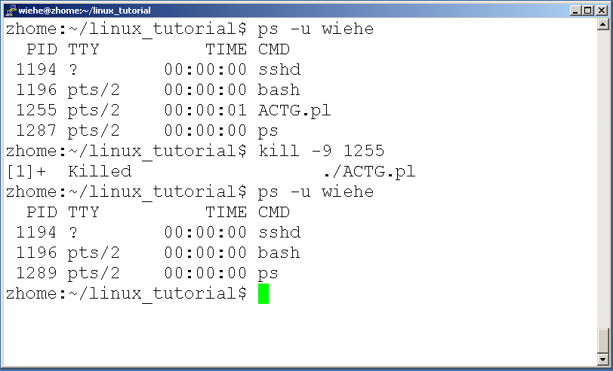
Command: kill
kill PID
kill -9 PID

Slide 27
Filename generation/pathname expansion
Shell will help to generate filenames that match the abbreviated filename which contains the special character
Ambiguous file reference can refer to a group of files with similar names

Slide 28
The ? Special Character
It matches any single character in the name of the existing file.
Example: Page 149

Slide 29
The * Special Character
It matches any number of characters, including zero character.
Example: Page 150

Slide 30
The [ ] Special Characters
A pair of brackets surrounding one or more characters causes the shell to match filenames containing the individual characters within the brackets.
A hyphen within the brackets defines the range of characters within a character-class definition.
Eg. [6-9] is [6789], [a-z] is all lower case letters

Slide 31
Assignment3 and Lab5 Due Feb 19th
Quiz3 (10 minutes) on Feb19th in class
Read chapter 5
Assignment 3 is due a hardcopy in class on Feb 19th.
Chapter5: Page 155: Q1, Q2, Q3, Q4, Q5, Q9, Q16
Lab5 is in iLearn.

