Slide 1
Shell Script Programming
Instructor: Li Feng
Capital University

Slide 2
Configure the vim
Open vim, in the command mode, type :echo $MYVIMRC
Under the home directory, opem .vimrc using vim .vimrc
Enter The following commands:
set number
syntax on
set tabstop=2
set autoindent
Save it

Slide 3
Basic Shell Programming
#![path to shell you want to use]
eg. #!/bin/bash: current script should be run by the Bourne Again shell
#: begins a comment
Variables:
Assignment: variablename=5 (no space between)
Usage: $variablename
Reading from the keyboard
read –p “…” variablename

Slide 4
Demo
#!/bin/bash
# You can use read to receive input which is stored in name
# The p option says that we want to prompt with a string
read -p "What is your name? " name
echo "Hello $name"

Slide 5
Basic Shell Programming
Arithmetic operation:
Num1=5
Constant number declaration: declare -r NUM=6
$(( )): arithmetic expansion (not for use with an enclosed equal sign)
(( )): arithmetic evaluation (use when the enclosed value contains an equal sign)

Slide 6
Demo
#!/bin/bash
num1=5
num2=4
num3=$((num1+num2))
num4=$((num1-num2))
num5=$((num1*num2))
num6=$((num1/num2))
num7=$((num1**num2))
num8=$((num1%num2))
echo "5 + 4 = $num3"
echo "5 - 4 = $num4"
echo "5 * 4 = $num5"
echo "5 / 4 = $num6"
echo "5 ** 4 = $num7"
echo "5 % 4 = $num8"

Slide 7
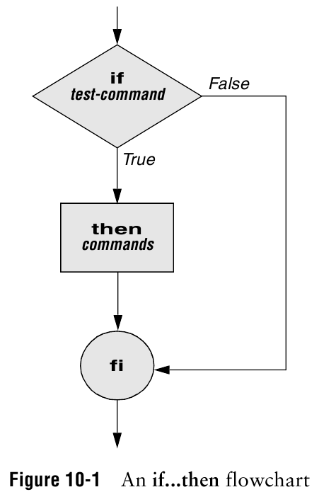
Conditionals
if [ conditional ]
then
fi
Make sure to surround the brackets with spaces (the shell parser requires it)

Slide 8
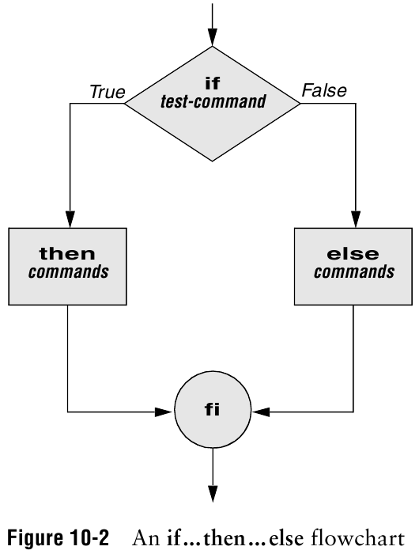
Conditionals
if [ conditional ]
then
else
fi
Notes:
A selection statement provides the means of choosing between two or more paths of execution.

Slide 9
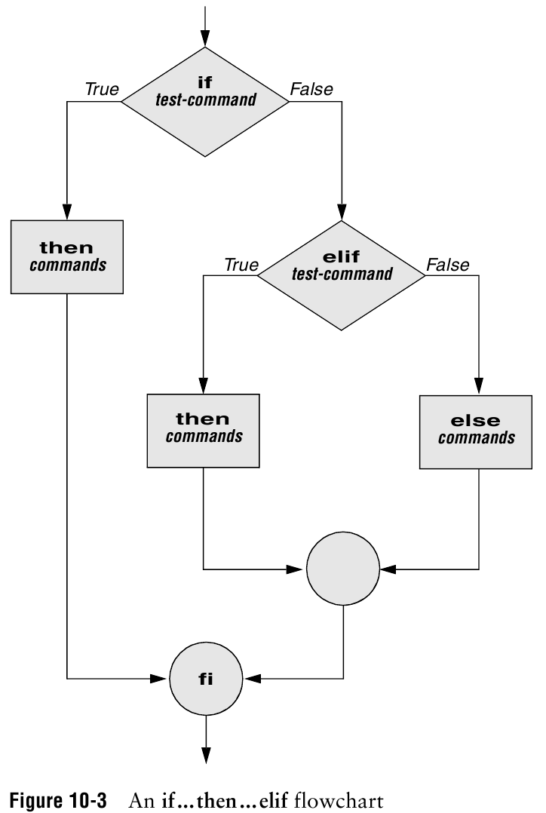
Conditionals
if [ conditional ]
then
elif [ conditional ]
then
else
fi

Slide 10
Integer Comparison
eq: equal
ne: not equal
le: less than and equal to
lt: less than
ge: greater than and equal to
gt: greater than
==
!=
<=
<
>=
>

Slide 11
Demo
read -p "How old are you? " age
# You place your condition with in []
# Include a space after [ and before ]
# Integer Comparisons: eq, ne, le, lt, ge, gt
if [ $age -ge 16 ]
then
echo "You can drive"
# Check another condition
elif [ $age -eq 15 ]
then
echo "You can drive next year"
# Executed by default
else
echo "You can't drive”
# Closes the if statement
fi

Slide 12
Testing String
#!/bin/bash
str1=""
str2="Sad"
str3="Happy"
# Test if a string is null
if [ $str1 ]; then
echo "$str1 is not null"
fi
# Test if a string exists
if [ -z $str1 ]; then
echo "str1 has no value"
fi
# Check for equality
if [ $str2 == $str3 ]; then
echo "$str2 equals $str3"
elif [ $str2 != $str3 ]; then
echo "$str2 is not equal to $str3"
fi
# Check for alphabetic order of string
if [ $str2 > $str3 ]; then
echo "$str2 is greater then $str3"
elif [ $str2 < $str3 ]; then
echo "$str2 is less then $str3"
fi

Slide 13
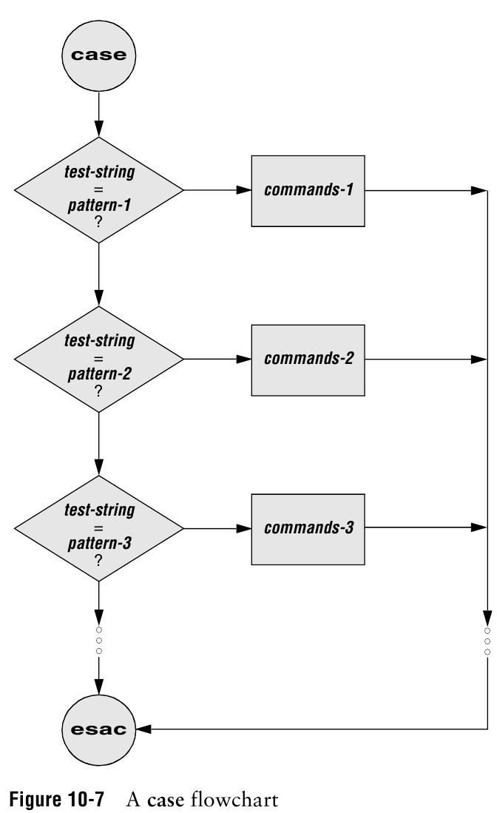
Case Statement
case $variableName in
pattern1)
command
;;
pattern2)
command
;;
*)
command
;;
esac

Slide 14
Demo
#!/bin/bash
read -p "How old are you : " age
# Check the value of age
case $age in
# Match numbers 0 - 4
[0-4])
echo "Too young for school"
;; # Stop checking further
# Match only 5
5)
echo "Go to kindergarten"
;;
# Check 6 - 18
[6-9]|1[0-8])
grade=$((age-5))
echo "Go to grade $grade"
;;
# Default action
*)
echo "You are to old for school"
;;
esac
# End case

Slide 15
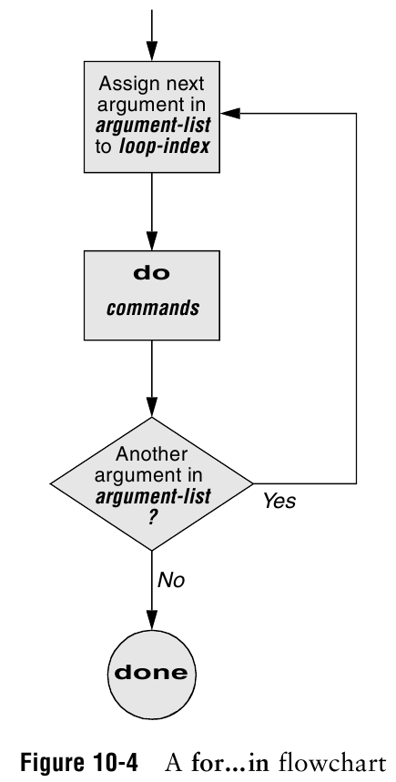
Looping
for (( i=0; i<=10; i=i+1)); do
#body
done
Eg.
#!/bin/bash
for (( i=0; i <= 10; i=i+1 )); do
echo $i
done

Slide 16
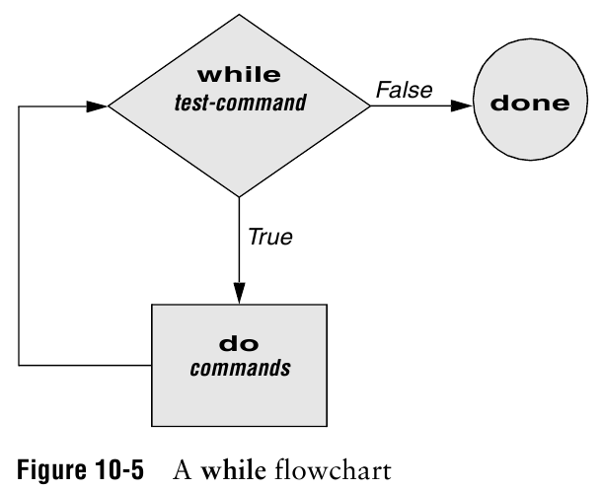
Looping
while [ conditional ]; do
#body
Done
Eg.
#!/bin/bash
num=1
while [ $num -le 10 ]; do
echo $num
num=$((num + 1))
done

Slide 17
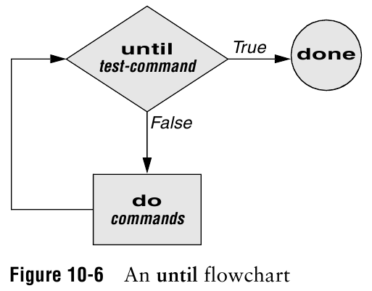
Looping
until [ conditional ]; do
#body
done
Eg.
#!/bin/bash
num=1
until [ $num -gt 10 ]; do
echo $num
num=$((num + 1))
done

Slide 18
Positional parameters:
variables that can store data on the command line
$0: Name of the script
$x: command line argument or the script (x is a number)
$4: the fifth argument (including script name)
${10}: the eleventh argument
$#: the number of arguments

Slide 19
Example:
#!/bin/bash
echo "This is $0"
echo "first argument: $1"
echo "second argument: $2"

