Slide 1
The Byzantine Problem and Blockchain
Taylor Manivanh
Advisor: Dr. Feng

Slide 2
Outline
Introduction: What is the Byzantine Problem?
Distributed Systems
The Byzantine Generals Problem
Oral vs. Written Messages
BFT and Blockchain
Blockchain and How It Works
Blockchain Example in Python
Future Work
References

Slide 3
The Byzantine Generals Problem
The Byzantine Problem occurs within distributed computer systems, or systems that are comprised of several computers.

Slide 4

Distributed Systems
A distributed system allows computers to work in sync.
If one computer were to malfunction, the productivity of the other computers does not stop.

Slide 5
Byzantine Faults in Distributed Systems
Traditional failure detection can be tricked by Byzantine failures.
A corrupted node can appear to be functioning
By presenting arbitrary information
Byzantine Fault Tolerance cannot be reached until a consensus is reached
Can be caused by human interaction or electrical shortage or inaccuracy

Slide 6
The Generals Problem
An army has several troops surrounding an enemy fortress
The army can decide to attack or retreat
If attacking: All troops must agree to attack
If retreating: All troops must retreat
Else: If no agreement, the army will face major losses

Slide 7
Conditions of the Byzantine Problem
Oral Messages:
The Traitorous General:
A general who says he will attack to one general and retreat to another.
Involves two conditions:
Oral messages
Written and signed messages
Written and Signed Messages:
Two cases:
When a commanding general’s signature can and cannot be forged.

Slide 8
Oral Messages
With the assumptions:
Every message sent is delivered correctly
The receiver knows who sent the message
The absence of a message can be detected
Solution:
A consensus can be reached with only 3 generals.
For m number of traitors, there must be 2m+1 generals with m+1 chances to exchange information.

Slide 9
Written and Signed Messages
With additional assumptions:
4. A loyal general’s signature cannot be forged
5. Anyone can verify the authenticity of a signature
Solution:
A consensus can be reached with only 3 generals.
For m traitors there needs to be 2m+1 generals with m+1 chances to exchange information.

Slide 10
Written and Signed Messages Cont.
Assume a general’s signature can be forged and communication between generals happens in real-time.
Solution:
For m number of generals and t number of traitors in m, then m>3t must be true for a consensus.

Slide 11
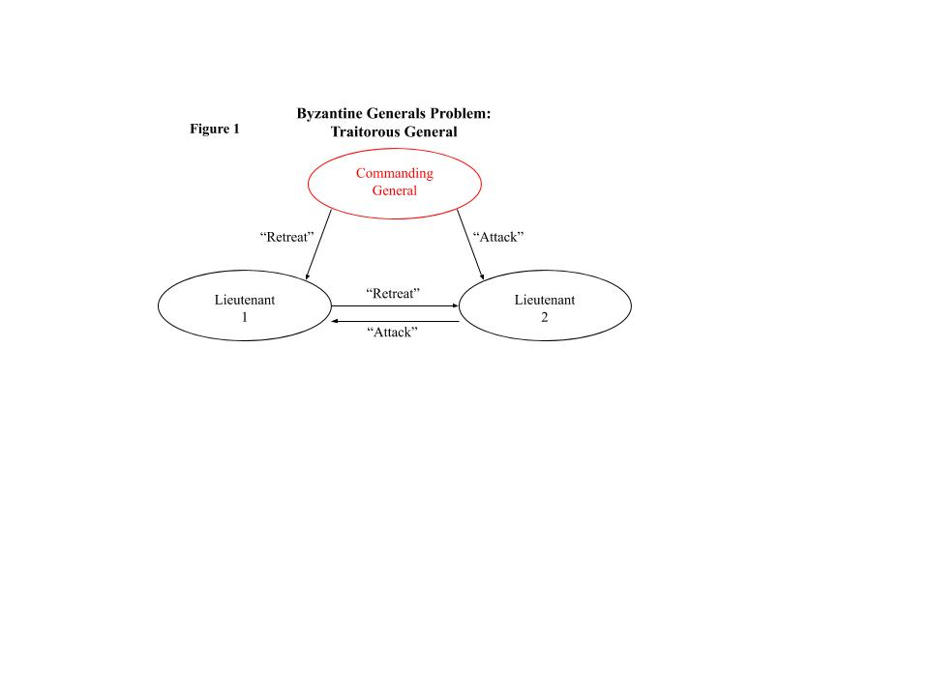
Written and Signed Messages Example
Example:
Commanding general is a traitor
Tells Lieutenant 1 to retreat
Tells Lieutenant 2 to attack
Lieutenant 1 and 2 cannot determine who the traitor is when they exchange information

Slide 12
Blockchain
What is Blockchain?
A blockchain is a component of state machine replication. This means that a service has the ability to maintain a state and allow clients to send operations.

Slide 13
Blockchain cont.
Blockchain imitates a trusted service.
Nodes on the Internet run the distributed protocol
An asset is created by the service
All nodes work to reach a consensus but do not trust each other

