Slide 1
RSA Encrypted communication
By ethan ave

Slide 2
outline
Introduction
Why do we want to encrypt things?
Symmetric encryption
Asymmetric encryption
Brief look into RSA and how it works
Combining symmetric and asymmetric encryption
Encrypted communication demo
Future work

Slide 3
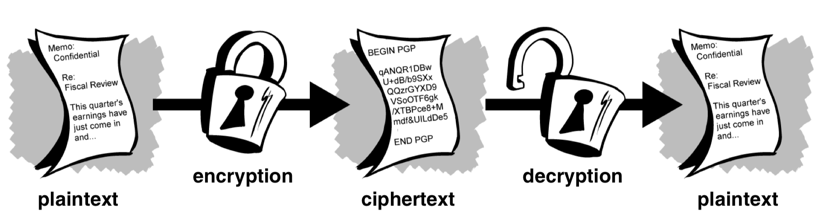
INTRODUCTION
Math and Computer Science background
Interested in encryption
More specifically for means of communication
Examine a method of encryption
Focusing more on computer science aspect
Create a working example of encrypted communication

Slide 4
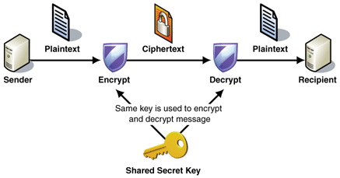
Symmetric/Private key encryption
Cryptography has historically been concerned with communicating secret information
Notes:
Introduction to modern cryptography page 5
Applied Cryptography 2nd ed page 24
Two parties securely share some secret key in advance
The secret key is used to encrypt the plaintext by the sender
Now the ciphertext can be freely sent without worry
The secret key is also used to decrypt the ciphertext by the receiver
Doesn’t necessarily need to be the same key, but the encryption key can be calculated from the decryption key and vice versa

Slide 5
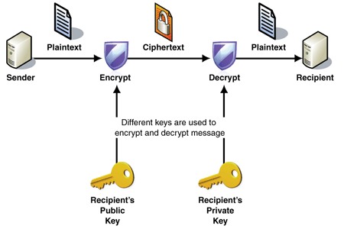
What if we cannot safely trade keys?
Asymmetric cryptographic algorithm as opposed to symmetric
Also called public key encryption
Involve problems that are very difficult to solve in order to safely transmit data
Notes:
Intro to modern cryptography page 317
Applied Cryptography 2nd ed page 25
Each party generates a pair of keys called the public and private keys
The public key can be shared freely but the private key must be kept secret
The sender can then use the recipient’s public key to encrypt a message
Now the ciphertext can be freely sent without worry
Then recipient can then decrypt the ciphertext with their private key

Slide 6

What is RSA?
Factoring large prime numbers is very difficult
If we have two primes $φ\left(pq)=(p−1)(q−1\right)$
Otherwise $φ\left(n\right)$ is as hard to calculate as factoring
Named after Rivest, Shamir, and Adleman who first published the algorithm
Notes:
Intro to modern 279
Applied Cryptography 2nd ed page 619
No efficient algorithm found in hundreds of years

Slide 7

WHAT IS RSA?
Generate two large and distinct primes p and q
Then n=p*q, $φ\left(n\right)=(p−1)(q−1)$
We choose a public exponent e such that is coprime to $φ\left(n\right)$ and $1<e<φ\left(n\right)$
Find a private exponent d that is $e^{−1} mod φ\left(n\right)$
We can encrypt a value t with $c=t^{e} mod n$
Then we can decrypt our value t with $t=c^{d} mod n$

Slide 8

Quick example
Let p=3 and q=11, then n=p*q=33, $φ\left(n\right)=20$
Public exponent: e=3
Private exponent: $d=3^{−1} mod 20=7$
Lets say we want to encrypt the value 2
Encrypt: $c=2^{3} mod 33=8$
Decrypt: $t=8^{7} mod 33=2$

Slide 9
RSA CODE DEMO

Slide 10
Safe to use?
RSA requires padding to be secure
Pad the rest of the message up to the desired bit-size with random data
Convert the message to a number that can be used with RSA
Prevents against a multitude of attack
Notes:
http://crypto.stanford.edu/~dabo/papers/RSA-survey.pdf
Possible attacks without padding
Factoring, most obvious
Many many more
Several of them use Coppersmith’s theorem which finds roots of a polynomial modulo N

Slide 11
Implementing padding
It is dangerous to attempt to implement your own padding
Best to use standardized padding and use a high level library
Too easy to make mistakes or implement something wrong
For my demo I chose to use the standard encryption library java provides

Slide 12
PROBLEM WITH USING RSA ALONE
Decrypting RSA is much slower than encrypting
Asymmetric algorithms are generally much slower than symmetric methods
RSA has a fixed message size limited by the size of our primes
Notes:
Message size no longer limited by RSA bit size
Much faster
Applied Cryptography 2nd ed page 58-62
Symmetric algorithms are generally at least 1000 times faster than public-key algorithms

Slide 13
Hybrid encryption
Combining AES (symmetric) with RSA (asymmetric)
First generate a random secret key and encrypt with AES (symmetric to encrypt data)
Then we encrypt our secret key with our recipients RSA public key (asymmetric to exchange the key)
Notes:
Introduction to modern cryptography 330
RSA can be combined with a symmetric algorithm such as AES to provide encryption at least as secure as RSA alone

Slide 14
Chat server
Very simple design
Accept multiple users
Send packets of information to and from a basic client
Not designed for handling a lot of information or connections at once

Slide 15
CHAT SERVER DEMO
Notes:
http://tutorials.jenkov.com/java-cryptography/cipher.html
https://www.geeksforgeeks.org/multi-threaded-chat-application-set-1/

Slide 16
Future development
Encrypt the usernames/everything being sent to/from the server
Proper login system and private key storage system
Chat with multiple users at the same time in different chat windows

Slide 17
References
Schneier, Bruce. Applied Cryptography, Second Edition: Protocols, Algorithms and Source Code in C. Wiley, 1996.
An Introduction to Cryptography. PGP Corporation.
Katz, Jonathan, and Yehuda Lindell. Introduction to Modern Cryptography: Principles and Protocols. Chapman & Hall, 2007.
http://crypto.stanford.edu/~dabo/papers/RSA-survey.pdf
http://tutorials.jenkov.com/java-cryptography/cipher.html
https://www.geeksforgeeks.org/multi-threaded-chat-application-set-1/
http://sachi73blog.wordpress.com/2013/11/21/symmetric-encryption-vs-asymmetric-encryption/ Images only!

