Slide 1
A Primer on Zero Knowledge Proof
Li Feng
Ph.D.
Computer Science
Missouri University of Science and Technology

Slide 2
Biography
Education:
Ph.D., Computer Science, Missouri University of Science and Technology, Nov 2015
Master and Bachelor, Computer Technology and Information Engineering, Beijing University of Chemical Technology, China
Teaching & Research Assistant:
Lab Lecturer for operating system, computer security, software engineering, numerical method
Research interests: computer security, information flow quantification, distributed system, interdisciplinary programming
Industry:
Software Test Engineer in Beyondsoft, Beijing

Slide 3
Publications
Li Feng, Bruce McMillin, Tamal Paul, Thomas Roth and Jonathan Kimball, “Information Flow Quantification in Cyber Physical Systems,” prepare for submit to Dependable and Secure Computing, IEEE Transactions on
Li Feng and Bruce McMillin, “Information Flow Quantification Framework for Cyber Physical System with Constrained Resources,” Computer Software and Applications Conference (COMPSAC), 2015 IEEE 38th International, 1-5 July 2015, pp. 50-59, (Acceptance Rate: 20%)
Li Feng, Bruce McMillin, Anthony Perez Santiago, and Ziang Zhang, “Incremental Cost Consensus (ICC) and Leaderless ICC Implementations in FREEDM,” Sixth Conference on Innovative Smart Grid Technologies (ISGT2015), February 17-20, 2015, pp. 1-5
Li Feng and Bruce McMillin, “Quantification of Information Flow in a Smart Grid,” Computer Software and Applications Conference Workshops (COMPSACW), 2014 IEEE 38th International, 21-25 July 2014, pp.140-145
Li Feng and Bruce McMillin, “A Survey on Zero-Knowledge Proofs,” Book Chapter, Advances in Computers, 2014, pp. 25-69

Slide 4
Agenda
Computer Security
Zero Knowledge Proof
Zero Knowledge Proof Examples
Zero Knowledge Proof Applications
Future Direction

Slide 5




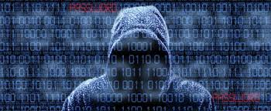

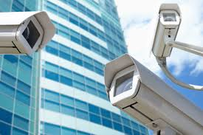
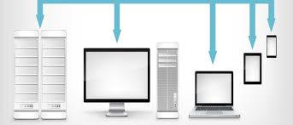
Computer Security
Medical Record
Financial Information
Surveillance Photos
Social Media Actions

Slide 6
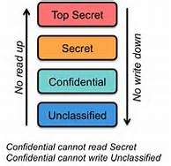
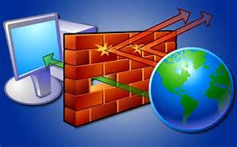
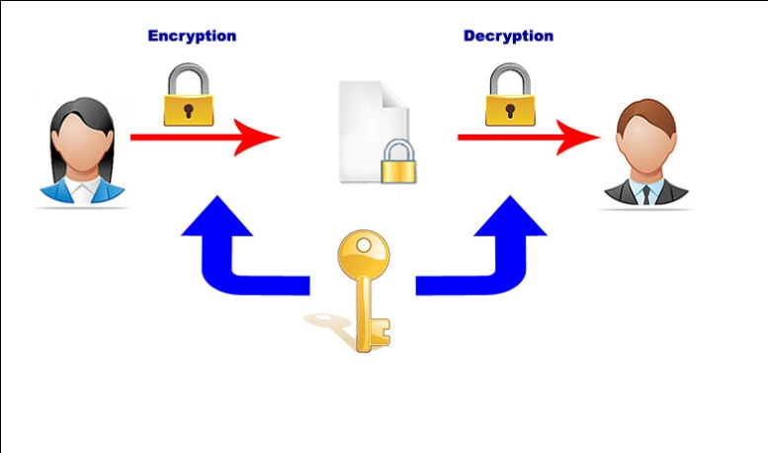

Standard Security Mechanisms
Access control
Firewall
Encryption
Antivirus software
……
Notes:
Access control: define different security level to prevent secret from sending to lower level user. However, it only places restrictions on the release of the information but on its propagation.
Firewall: prevent secret communication with outside. However, permit some communication in both direction whether communication violate is out of range.
Encryption: only the communication end could access the secret. However, once the data is decrypted, no insurance of the confidentiality of information.
Antivirus Software: use some known pattern to detect malicious behavior. However, very limited protection against new attack.
Authentication, digit signature, cryptography

Slide 7
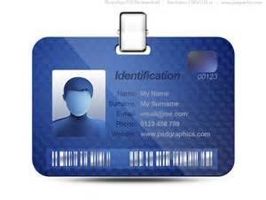
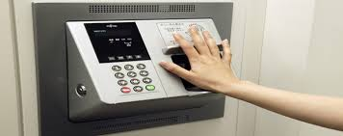

Challenge and Motivation
Authentication:
Something that you have
Something that you know
Something that you are
For any reasonably complex protocol, what happens if the applicants misbehave?
Notes:
Authentication: is a process of determining whether someone or something is, in fact, who or what it is declared to be.
Three factors are important: ownership factor, knowledge factor and inherence factor.
Research in zero-knowledge proofs has been motivated by authentication systems where one party wants to prove its identity to a second party via some secret information (such as a password) but doesn't want the second party to learn anything about this secret.

Slide 8
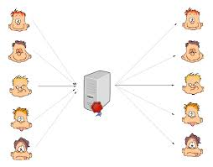
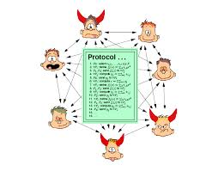
Challenge and Motivation
Secure Multi-party computation:
How to share information while maintaining your advantage (privacy)
How to enforce correct behavior
Notes:
Multiparty computation (MPC) is a fundamental problem in cryptography and distributed computing. It allows a set of mutually distrusting parties to jointly compute on private information without revealing any of that information.

Slide 9
Agenda
Computer Security
Zero Knowledge Proof
Zero Knowledge Proof Examples
Zero Knowledge Proof Applications
Future Direction

Slide 10

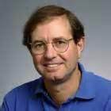

Zero Knowledge Proof (ZKP)
ZKPs were first conceived in 1985 by Shafi Goldwasser, Silvio Micali, and Charles Rackoff
In cryptography, a zero-knowledge proof is an interactive method for one party to prove to another that a statement is true, without revealing anything other than the veracity of the statement.
Notes:
Zero-knowledge proofs were first conceived in 1985 by Shafi Goldwasser, Silvio Micali, and Charles Rackoff .
Participant proves through interactive method.
The proof must not reveal any extra knowledge on the secrets of a participant to another one
In general, I will convince you that I know something without you getting to know anything else but that I know this something.
Seemly contradictory definition: both convincing and yet yield nothing beyond the validity of the assertion being proven.

Slide 11

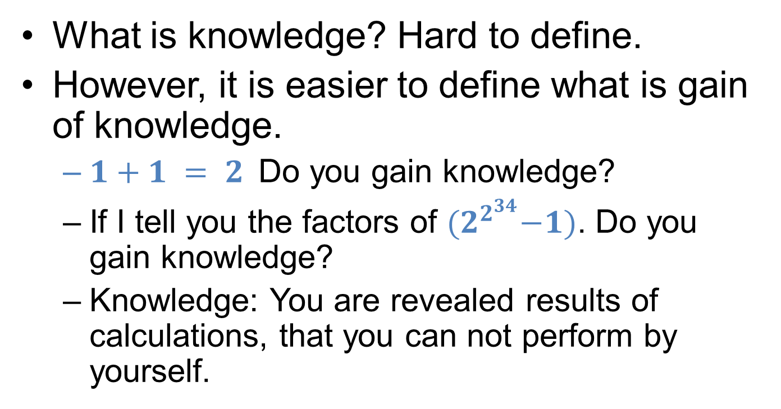
Knowledge
What is knowledge? Hard to define.
However, it is easier to define what is gain of knowledge.
$1+1 = 2$Do you gain knowledge?
If I tell you the factors of ${(2}^{2^{34}}−1)$. Do you gain knowledge?
Knowledge: You are revealed results of calculations, that you can not perform by yourself.
Notes:
Knowledge is a familiarity, awareness or understanding of someone or something, such as facts, information, descriptions, or skills, which is acquired through experience or education byperceiving, discovering, or learning.

Slide 12
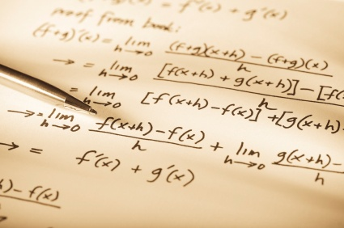
Proof
Proof: mathematical concept of a proof.
E.g. Prove n is a product of 2 primes.
Proof has “interactive” nature.
Prove a statement by convincing someone
ZKP: dynamic process, exchange of information, probabilistic rather than absolute.
Notes:
A proof is a method for ascertaining the truth. (Establish and verify truth).
A mathematical proof a verification of a proposition by a chain of logical deduction from a set of axioms.
A sequence of statements.
Based on axioms.
Each statement is derived via the derivation rules.
The proof is fixed, strict. i.e, in any time, anyone can read it, and get convinced.
Prover sends the p and q to verifeir. The verifier could check if p and q are both prime and if n equals to p product q. This is non-zero knowledge. The verifier will know the claim is true and also learn the knowledge.
However, in many situations, we “prove” a statement by convincing someone. For example, in court the prosecutor tries to convince the judge that the defendant is guilty. The prosecutor challenges the defendant. In case he fails to answer in a consistent manner, we say that the prosecutor proved his point. This kind of “proof” has an interactive nature.
A new notion of proof, is not static, but interactive back and forth and with acceptable error.

Slide 13

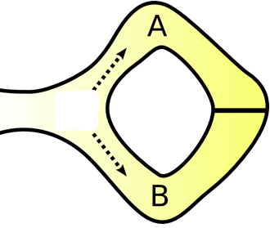

A very simple ZKP: AliBaba’s Cave
Prove it!
I will pay for it.
Victor
Magic Cave
I know a secret word to open a magic door in the cave.
Peggy

Slide 14
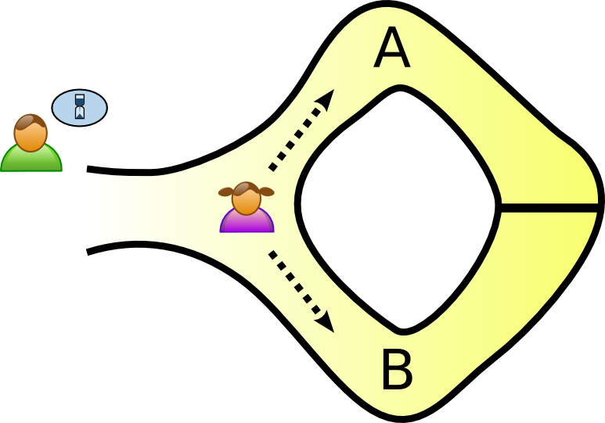
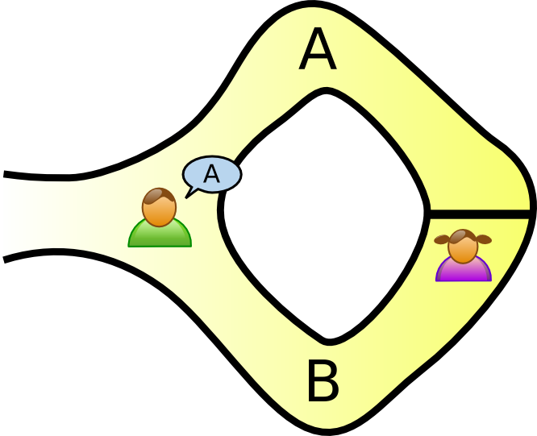
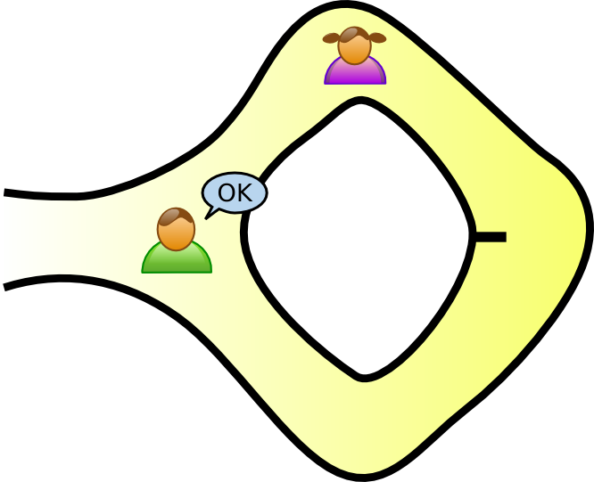
A very simple ZKP: AliBaba’s Cave
Completeness
Soundness
Zero Knowledge
Notes:
Victor waits outside the cave as Peggy goes in. Peggy takes either path A or B; Victor is not allowed to see which path she takes.
If claim is true, Peggy can always convince Victor.
If claim is false, Prob(Victor catches mistake) >= ½.
As the iteration goes on 100, the Prob(Victor catches mistake) >= 1- (1/2)^100
Completeness: If the statement is true, the verifier will accept it.
Soundness: If the statement is false, the verifier will reject it or accept it with a very small probability.
Zero knowledge: No knowledge except the statement is true.

Slide 15
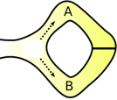
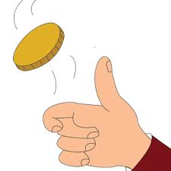
New Ingredients
Interactive Proofs:
Two-party Game: prover and verifier
Same input in the beginning
Contains a specified number of rounds
Challenge and response in each round.
At the end, verifier either accepts or rejects the prover’s proof.
Randomization: verifier can “toss coin”
Allow verifier to error in a small probability
Notes:
Both prover and verifier perform a private computation.

Slide 16
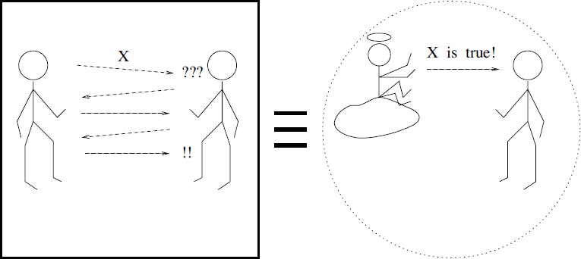
ZKP Illustration
Notes:
Prover and verifier share common inputs (functions or values)
Challenge – response
Prover will “interact” with verifier and try to “convince” it that assertion is true.
Allow error with small probability.
The protocol yields Accept if every Response is accepted by the Verifier
Otherwise, the protocol yields Reject

Slide 17
Agenda
Computer Security
Zero Knowledge Proof
Zero Knowledge Proof Examples
Zero Knowledge Proof Applications
Future Direction

Slide 18
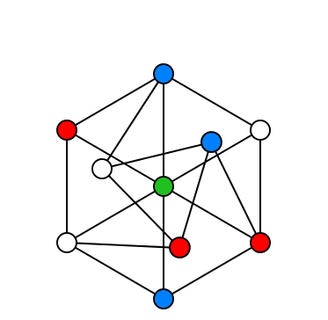
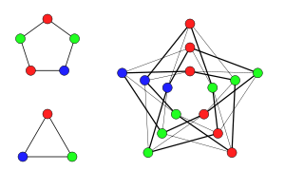
Graph 3-Colorability
3 Colorable Graphs
A non-3 Colorable Graph
Notes:
There are many problems for which there is no known efficient algorithm. Those problems are called NP (Non-deterministically Polynomial) complete problem.
They are hard to solve (required exponential time to prove to find a solution) but validity of the solution is very easy (polynomial time) to be tested.
An algorithm is said to be of polynomial time if its running time is upper bounded by a polynomial expression in the size of the input for the algorithm, i.e., T(n) = O(n^{k}) for some constantk.^{[1][8]} Problems for which a deterministic polynomial time algorithm exists belong to the complexity class P, which is central in the field of computational complexity theory.
Here's a graph. Using only three colors, can you color the vertices such that adjacent vertices have different colors?
Application: scheduling (jobs at slot time, conflict)

Slide 19
ZKP for G3C
I know how to color this graph in 3 colors.
Prove it!
Prover
Verifier
1
6
2
5
3
Y
4
R
B
B
R
R
Notes:
Common Input: graph G
Prover wants to prove that he knows to coloring G in three colors with the constraint that each pair of adjacent vertices has different colors.
Prover’s claim: I know how to color the graph in three colors.

Slide 20
ZKP for G3C
Verifier
Prover
1
6
2
5
3
B
4
Y
R
R
Y
1 2 3 4 5 6
Y
B
R
Y
Y
R
Y
1. Randomly permute coloring & send in locked boxes with
the corresponding
vertices.
Notes:
Prover choose a random permutation of colors. She encrypts the color for each vertex. Prover sends to Verifier all ciphertexts together with the correspondence between them and the vertices.
Verifier chooses a random edge and sends edge to Prover.
Prover sends the decryption keys to Verifier.
Verifier decrypts and verifies that they are different color.

Slide 21
ZKP for G3C
Verifier
Prover
1
6
2
5
3
4
1 2 3 4 5 6
Randomly permute coloring & send in locked boxes with
the corresponding
vertices.
2. Pick random edge.
(1,4)
4. Accept if colors different.
3. Send keys for endpoints.

Slide 22
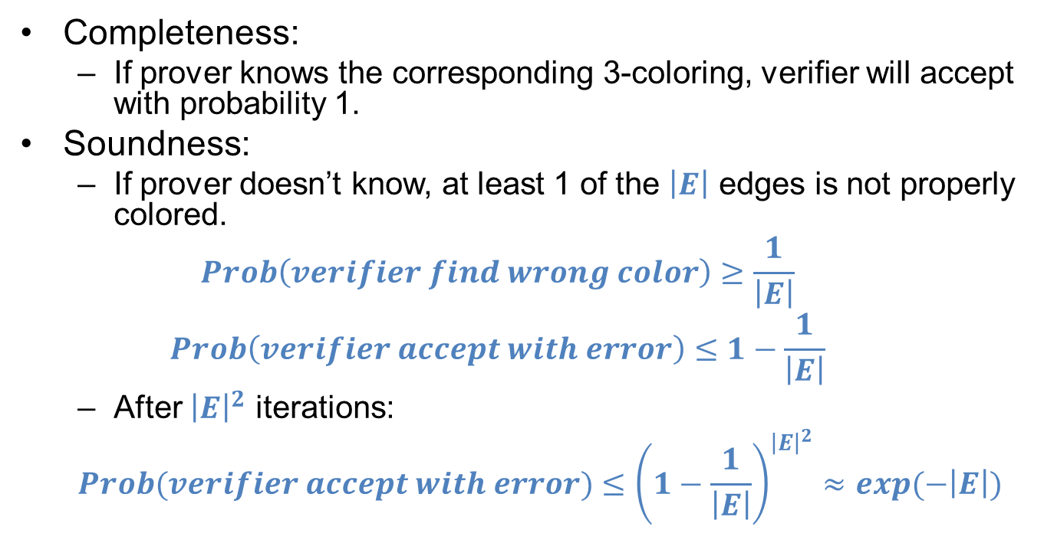
ZKP Properties for G3C
Completeness:
If prover knows the corresponding 3-coloring, verifier will accept with probability 1.
Soundness:
If prover doesn’t know, at least 1 of the $\left|E\right|$ edges is not properly colored.
$$Prob\left(verifier find wrong color\right)≥\frac{1}{\left|E\right|}$$
$$Prob\left(verifier accept with error\right)≤1−\frac{1}{\left|E\right|}$$
After ${\left|E\right|}^{2}$ iterations:
$$Prob(verifier accept with error)≤{\left(1−\frac{1}{\left|E\right|}\right)}^{{\left|E\right|}^{2}}≈exp(−\left|E\right|)$$
Notes:
Therefore, an honest verifier will find the wrong color with probability at least $\frac{1}{\left|E\right|}$ in each iteration
After ${\left|E\right|}^{2}$ iterations, the probability that verifier will accept is exponentially small. verifier will detect an incorrectly colored in high probability.

Slide 23
ZKP Properties for G3C
Zero knowledge (minimal disclosure):
Verifier only sees two vertices on one edge and could tell whether they are different colors or not.
This single edge does not reveal how to color the whole graph.
What's more, accumulated pieces of vertices information does not reveal how to color the graph.
Notes:
The verifier can tell whether that piece is constructed properly or not. And the verifier would accept the proof is valid if all the pieces are properly constructed.

Slide 24
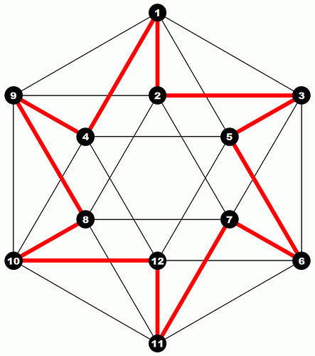
Hamiltonian Cycle
Notes:
A Hamiltonian cycle in graph G is a cycle that passes through all the nodes of G exactly once. This graph has Hamiltonian cycle labeled by the red line. (closed loop)
Hamiltonian cycle is a NP hard problem: it is hard to find an efficient algorithm to solve this
problem, but it is very easy to verify if a sequence of nodes is a Hamiltonian cycle.

Slide 25
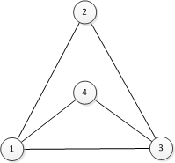
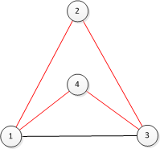
ZKP for Hamiltonian Cycle
I know this graph has a Hamiltonian Cycle.
Well,
Prove it!
Prover
Verifier
A B C D
3 1 2 4
AB AC AD
1 1 1
BC BD
1
1
CD
0
Notes:
1. Prepare 4 boxes A, B, C, D to contain one permutation of vertices 1, 2, 3, 4. For each pair of Boxes from A to D, prepare a box to contain adjacency matrix of the graph.
Apply key to encrypt each cell.

Slide 26
ZKP for Hamiltonian Cycle
Prover
Verifier
A B C D
AB AC AD BC BD CD
3
1
2
4
1
1
1
1
1
1
1
1
1
0
Two challenges: (open graph, open cycle)
(open graph or open cycle)
Either an original graph or
only edges constituting the cycle (AC, CB, BD, DA).
Send keys to open the box.
Notes:
Prover encrypts the Adjacency matrix using separate keys for each cell and commits it
As per verifier’s request, Prover does one of the following for each of the encrypted graph H:
Supply verifier all the decryption keys and show its isomorphism to G without giving out the cycle
Decrypt only the edges constituting the cycle without revealing the structure of the graph
Open all boxes
Open a cycle from adjacent matrix
4. Accept if pass the verification:
All boxes contains the description of the graph without cycle.
4 boxes for edge (AC, CB, BD, DA - cycle) all contain 1 without graph.
Prover cannot cheat Verifier. If Prover does not know the proof, the chances of convincing Verifier that he knows the proof are negligible.
Verifier cannot cheat or impersonate Prover. He does not get the slightest hint of the proof, other than the fact that Prover knows the proof.
In particular, Verifier cannot demonstrate the proof to anyone else without proving it himself.

Slide 27
Agenda
Computer Security
Zero Knowledge Proof
Zero Knowledge Proof Examples
Zero Knowledge Proof Applications
Future Direction

Slide 28
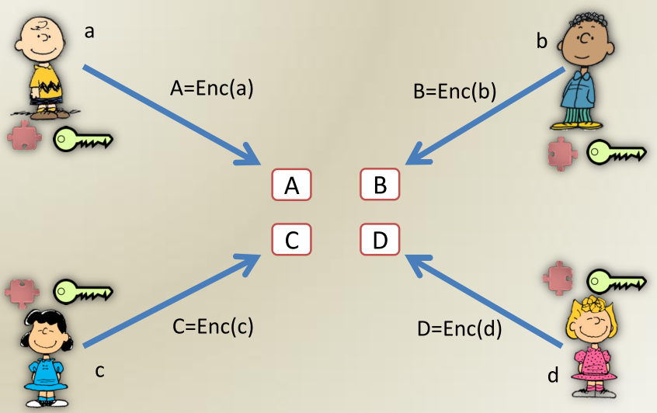
ZKP Application
Enforce honest behavior while maintaining privacy
Each party has a secret key and a public key
Notes:
One of the most fascinating uses of zero-knowledge proofs within cryptographic protocols is to enforce honest behavior while maintaining privacy. Roughly, the idea is to force a user to prove, using a zero-knowledge proof, that its behavior is correct according to the protocol.
Because of soundness, we know that the user must really act honestly in order to be able to provide a valid proof. Because of zero knowledge, we know that the user does not compromise the privacy of its secrets in the process of providing the proof.
Zero knowledge proofs can be used to cryptographically identify parties. Each party has a secret key and a public key. The prover convinces the verifier that he knows his secret key, without revealing any information on his secret key that the verifier could not know otherwise (except that the proven claim holds).

Slide 29
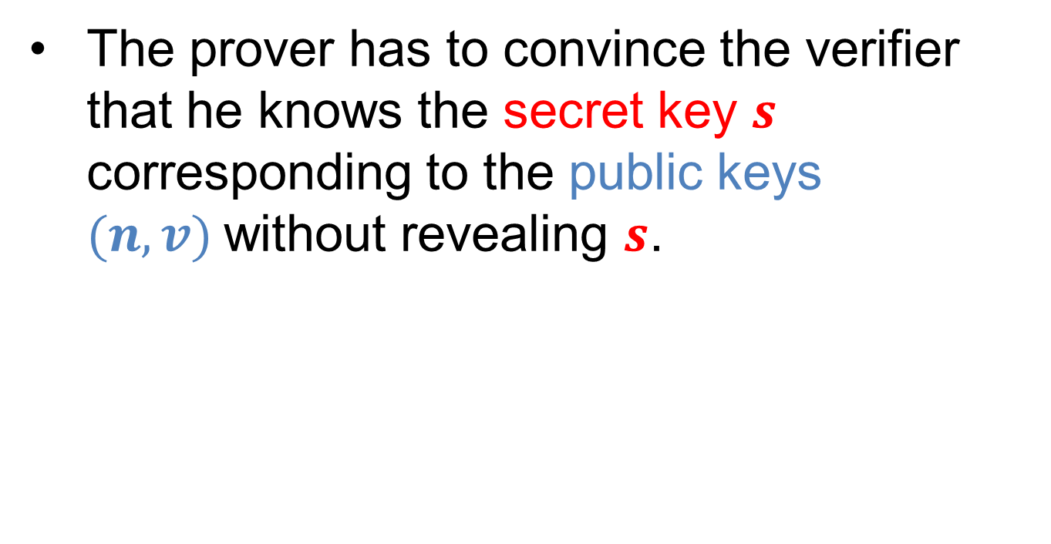
Fiat-Shamir ZK Identification Protocol
The prover has to convince the verifier that he knows the secret key $s$ corresponding to the public keys $(n, v)$without revealing $s$.
Notes:
Identification:
The purpose of the protocol: The prover has to convince the verifier that he knows the secret key s corresponding to the public key (n, v), (i.e., to prove that he knows a modular square root of v modulo n), without revealing s.
The verifier wishes to authenticate the identity of the prover, which is claimed to have a public key v. Thus, he requests the prover to convince him that he knows the secret key s corresponding to v.
discrete logarithms and integer factorization
Factorization of n is possible (n is very big). Factorization of n is secret. The factors p and q themselves are not used in the protocol.
Finding Square Root mod n as hard as factoring n
difficulty of extracting square roots modulo large composite integers of unknown factorization.

Slide 30
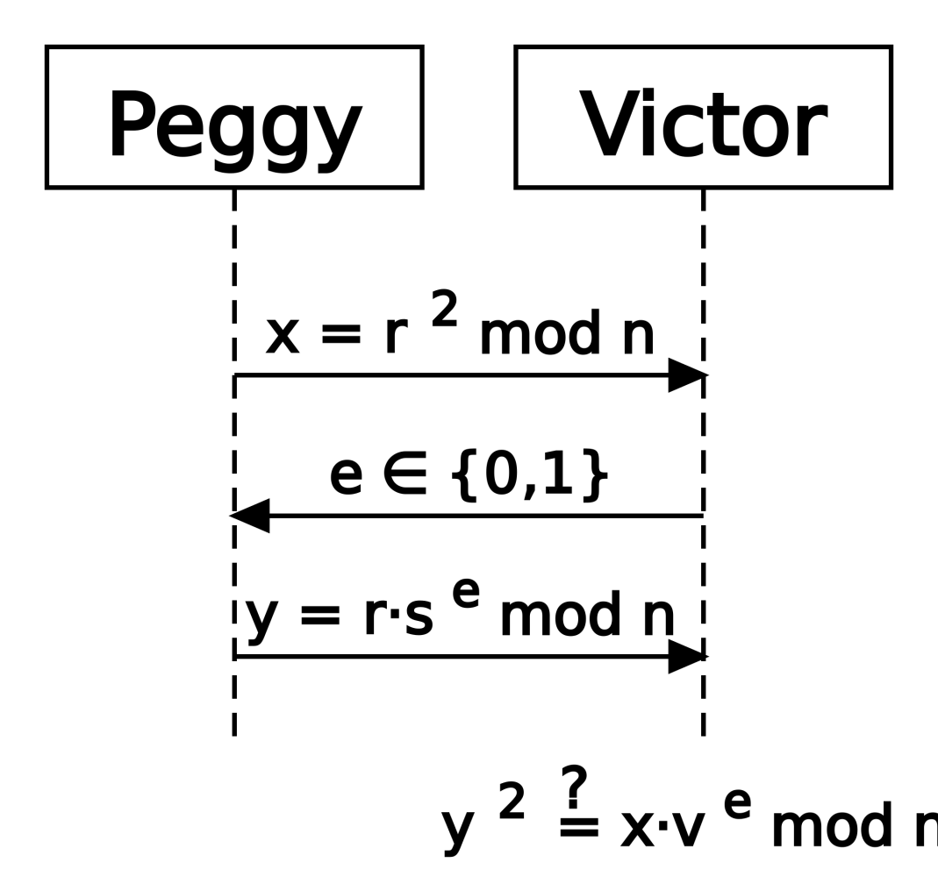
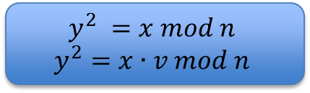
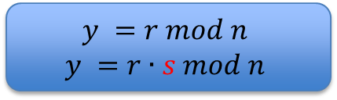
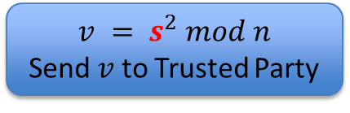
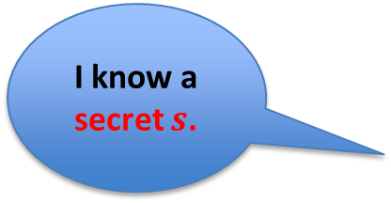
Fiat-Shamir ZK Identification Protocol
Trusted Party:
Private: p, q Public: n = p*q
I know a secret $s$.
v
n,v
$$v = s^{2} mod n$$
Send $v$ to Trusted Party
x
e
$$y =r mod n$$
$$y =r∙s mod n$$
y
$$y^{2} =x mod n$$
$$y^{2}=x∙v mod n$$
Notes:
A trusted center T selects and publishes an RSA-like modulus n=pq but keeps the primes p and q secret.(p, q are not used in the protocol.)
The prover selects a secret s coprime to n, 1 ≤ s ≤ n-1, computes v=s^2 mod n, and registers v with T as her public key
Clearly, if the prover knows S, the verifier is convinced in his identity.
If the prover does not know S, he can either
1. know R, but not RS mod n, as he is choosing R, but cannot multiply it by the unknown value S,
or 2. choose RS mod n, and thus can answer the second question RS mod n, but in this case he cannot answer the first question R, since he needs to divide by the unknown value S.
In any case, he cannot answer both questions, since then he can compute S as the ratio between the two answers. But it is assumes that computing S is difficult, actually the difficulty is equivalent to that of factoring n. Since the prover does not know in advance (when he chooses R or RS mod n) which question the verifier will ask, he cannot choose the required choice. He can succeed in guessing the verifiers question with probability 1/2 for each question, and thus the verifier can catch him in half of the times, and fails to catch him half of the times. The protocol is repeated t times, and thus the probability that the verifier fails to catch the prover in all the times is only 2−t, which is exponentially reducing with t.
In particular, for t = 20, the prover succeeds to cheat less than once in a million trials, and for t = 30, the prover succeeds to cheat less than once in a billion trials. Verifiers wishing a smaller probability of error, can use larger t’s. The verifier cannot use the information he received in the protocol to convince others that he is the original prover, since he cannot answer both questions R and RS mod n for any R. If he could, he would know S.

Slide 31
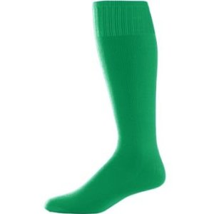
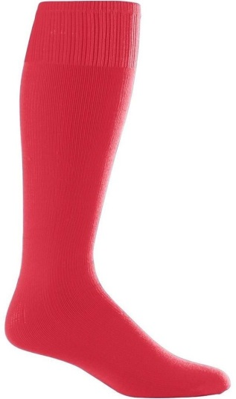
ZKP Application
Watermark Verification, e-voting, e-cash, etc.
Question for fun: Can you design a ZKP for convincing a color-blind friend that two socks are different colors without revealing the colors?
Notes:
In e-Voting it is vital to produce a correct tally whilst ensuring the secrecy of the individual votes.

Slide 32
Agenda
Computer Security
Zero Knowledge Proof
Zero Knowledge Proof Examples
Zero Knowledge Proof Applications
Future Direction

Slide 33


Future Direction
Migrating data in the cloud
Delegating computation in the cloud
Verify correctness of remote storage and computation
Program can work on encrypted data
Encryption[Data]
Encryption[Result of program on data]

Slide 34


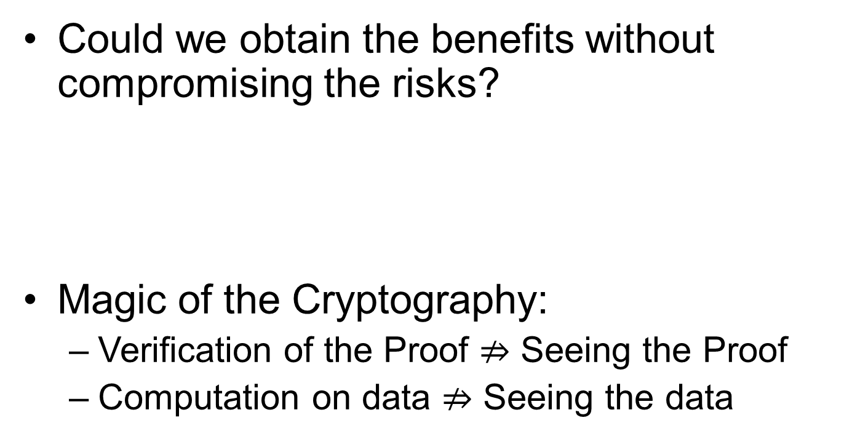
Future Direction
Could we obtain the benefits without compromising the risks?
Magic of the Cryptography:
Verification of the Proof $⇏$ Seeing the Proof
Computation on data $⇏$ Seeing the data
Notes:
Globalization of knowledge
Migration of data and computation in the cloud
Cryptography is the practice and study of techniques for secure communication in the presence of third parties called adversaries.

Slide 35
Future Direction
If a zero knowledge proof is not applicable, then we need a way to measure, bound and prove the bound on the amount of knowledge released in the system: Quantify Information Leakage.
Notes:
Some system need to reveal information: password checker, election protocol.
Execution of an algorithm (cache behavior, running time, power consumption) can lead to information leakage.
Quantify information leakage.

Slide 36
Questions?
Thanks

