Slide 1
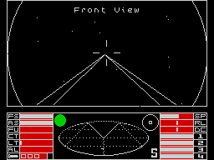
Create everything with nothing
PHP Berkshire, by Luis Ferro

Slide 2
What is nothing
Null

Slide 3
What is everything
Any data you can imagine of

Slide 4
Why not use random
Because it is random
Is not predictable
Is not replicable

Slide 5
Faker
Great tool for random data generation
Uses random in it’s core
Is not predictable if your code also uses random

Slide 6
Example
$faker = Faker\Factory::create();
$faker->seed(1234);
echo 'faker 1: ' .$faker->name . "\n";
Output:
faker 1: Miss Lorna Dibbert

Slide 7
But...
$faker = Faker\Factory::create();
$faker→seed(1234);
mt_rand(0,255);
echo 'faker 2: ' .$faker->name . "\n";
Output:
faker 2: Carolyne Luettgen

Slide 8
How to solve this issue
With procedural generation

Slide 9
From nothing
class genNext {}

Slide 10
Start out engines
private static function seedRandom() {
self::$seed = self::$original =
md5(random_bytes(50));
echo 'Seed: ' . self::$seed . "\n";
}

Slide 11
And then generate everything
public function getRand($min,$max) {
$this->index++;
$this->seed =
md5($this->index . $this->seed);
$interval = $max - $min;
return (crc32($this->seed) % $interval) +
$min;
}

Slide 12

mt_rand

Slide 13

GenNext (b04dc4ff134863cfb729f704f1057f01)

Slide 14
Thank you
@lferro9000
Code and slides in GitHub:
lferro9000/procedural-generation

