Slide 1


Topic Analysis on
Portions of the Bible
CS 484-002
Final Project
Luis Ferrufino

Slide 2
Background
Bible is the holy book of Christianity
  66 books
  1184 chapters
  31103 verses

Slide 3
Our Goal
Find Recurring Topics Across the Bible

Slide 4
The dataset
Link: https://www.kaggle.com/oswinrh/bible
I went with the ASV (American Standard Version)
A . S . V .

Slide 5
Key Ideas
Latent Features: unobserved variables whose values are statistically inferred from other, observed variables.
Dirichlet Distribution: “multidimensional generalization of the Beta distribution where each dimension is governed by an alpha-parameter.”
  “Dirichlet.” Rdocumentation. URL: https://www.rdocumentation.org/packages/DirichletReg/versions/0.6-3/topics/Dirichlet
Put these two ideas together...
  And you get LDA (Latent Drichlet Allocation)!
L D A

Slide 6
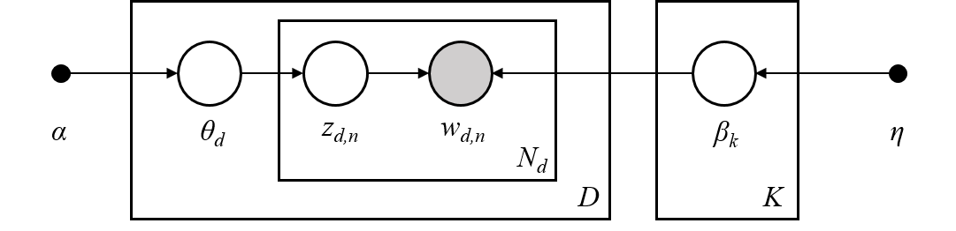
LDA
In essence, a “three-level hierarchical Bayesian model.”
  “Latent Dirichlet Allocation” D. Blei, A. Ng, M. Jordan, 2003. pg. 1
L D A

Slide 7
Process
Preprocessing (feature extraction, trimming whitespace and removing punctuation and converting to all-lowercase)
Try to tune the parameter (number of topics)
  Vectorise as a tf matrix
  Fit into an LDA model
  Maximise log-likelihood and minimise the perplexity
Analyse results i.e. postprocessing

Slide 8

What we’ll need
Python3
Numpy
Scikit-learn

Slide 9
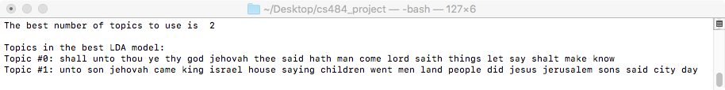
Results!
This model had a log likelihood of -1530264.318963924
and perplexity of 392.0503785214204

Slide 10
Time to go further…
Repeat the process for different granularities
  Verses (done :])
  Chapters
  Books

Slide 11
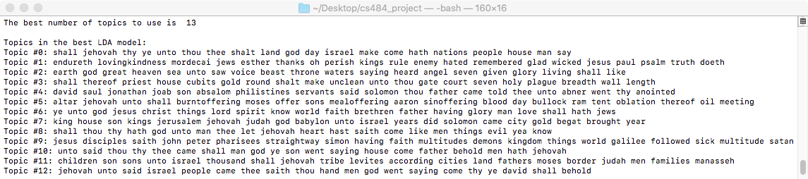
Results for Chapters
This model had a log likelihood of -1474580.3878700077
and a perplexity of 315.4817292314834

Slide 12
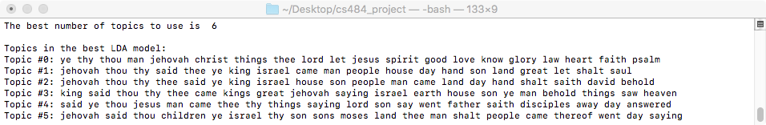
Results for Books
This model had a log likelihood of -1378996.2824640663
and a perplexity of 420.6787366265977

Slide 13
Findings
2 topics for Verses
13 topics for Chapters
6 topics for Books
Observation: the longer the document, the quicker the LDA model is built and the higher the log likelihood

Slide 14

Thanks for watching!!

