Slide 1
Shougi
By Luis Ferrufino

Slide 2








How to Play
Pawns move 1 square up.
Rooks move horizontally/vertically any number of squares
Silvers can move 1 square in any direction, except directly left, right, or backwards.
Kings move 1 square in any direction.
Bishops move any number of squares diagonally.
Lances move any number of squares forward.
Knights move 2 squares forward, then 1 square left or right.
Golds can move 1 square in any direction, except the back-diagonals.

Slide 3






How to Play (cont.)
Promoted pawns, silvers, knights, and lances move like golds.
Promoted rooks move like normal rooks, except they can move diagonally 1 square.
Promoted bishops move like normal bishops, except they can move horizontally/vertically 1 square.

Slide 4
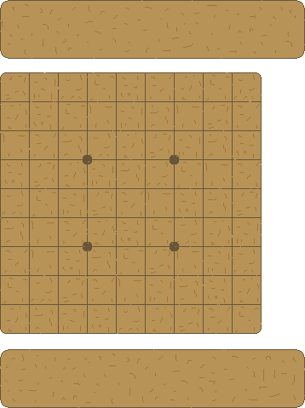
How to Play (cont.)
9 by 9 board:
When a piece gets captured, it gets put in the captor’s tray so they can drop them unto the board for their side.
When a piece gets to the last 3 rows, it can promote (press *).

Slide 5
How to Play (cont.)
If a position is repeated four times, it is a draw (sennichite).
If a king is stalemated or in checkmate, he loses (tsumi).

Slide 6
Demonstration

Slide 7
UML Diagrams

Slide 8
UML Diagrams (cont.)

Slide 9
UML Diagrams (cont.)

Slide 10
UML Diagrams (cont.)

Slide 11
Use of Classes
Piece represents a game piece.
Promotable is a piece that can promote.
King, gold, silver, knights, lances, rooks, bishops, and pawns are specific pieces.
Player is a player; has a tray for captured pieces and keeps track of army.
Snapshot represents a photo or record of a position (for sennichite).
Board is where all pieces are on.

Slide 12
Class Interaction
Board has a 2D array of Pieces. It detects sennichite and tsumi. It moves Pieces around and displays the board.
Player keeps track of its pieces on board and in its tray.

Slide 13
Inheritance
Piece interface
Promotable extends interface.
Silver, Knight, Lance, Rook, Bishop, and Pawn all extend promotable.
King and Gold extend Piece.
Only pieces that promote extend Promotable, so that the Board class can tell if they can promote.

Slide 14
Polymorphism
A lot of polymorphism is used in the board class.
boolean isCheck(boolean isB) { int kR = -1, kF = -1; for ( int i = 0; i < 9; i++ ) { for ( int j = 0; j < 9; j++ ) { if ( shougi[i][j] != null && shougi[i][j].getName().indexOf("K") > -1 && shougi[i][j].isBlack() == isB ) { kR = i; kF = j; } } }

Slide 15
Special Features
Each class in the Piece hierarchy has a getMoves() method for the Board class’ canMove() method’s reference.
“111” + “101” + “010”
The Board class has an Arraylist of Snapshots, to which it adds another after every move, and goes over it to look for duplicates. If there are 4 duplicates, the game ends.

Slide 16
Bugs
Game crashes if King is captured.

Slide 17
Second-party Code
PImage img; void setup() { // Images must be in the "data” // directory to load correctly
img = loadImage("laDefense.jpg");
}
void draw() {
image(img, 0, 0);
}
Load image and later display it.

Slide 18
Questions?

Slide 19
Conclusion
Pretty hard—especially the Board class.
It was fun to start, but got a little dreary when I got in the middle of making the Board class. Overall, kind-of fun to write.
The program is very good, but needs some fine-tuning.
I learned how to play shougi, to always be on the look out for possible null pointer exceptions, and that programming board games is a laborious task.

