Slide 1
HSC 6055 Survival Analysis Spring 2018
Estimating Progression to Plasma Cell Malignancy in Individuals with Monoclonal Gammopathy of Undetermined Significance
Lindsey J. Fiedler, M.Sc.
HSC6055 Survival Analysis
University of South Florida
College of Public Health

Slide 2
Introduction
Disease Background
MGUS is a condition where there is an abnormal protein (M protein) in the blood
The accumulation can lead to the inhibition of healthy cells
Of greater severity, it can lead to a plasma cell malignancy (PCM)
MGUS occurs mostly in older adults
3.2% prevalence in adults >= 50 years
5.3% prevalence in adults >= 70 years

Slide 3
Introduction
Disease Background
Since 2003, the International Myeloma Working Group has defined a set of criteria used to diagnose MGUS
Serum creatinine (Normal range: 0.6-1.3 mg/dL): Chemical waste product. High levels indicate abnormal kidney function.
Hemoglobin (Normal range: male: 13.5-17.5 g/dL; female: 12.0-15.5 g/dL): Protein in red blood cells. Low levels show an accumulation of myeloma cells.
Serum monoclonal protein: Abnormal protein (IgM) produced by plasma cells.

Slide 4
Introduction
Objective
To model the progression of individuals with monoclonal gammopathy of undetermined significance to a plasma cell malignancy and
To identify the significant predictors of a plasma cell malignancy
Time origin is when the individual started being followed and time to event is measured in months.

Slide 5
Materials and Methods
Data
Donated courtesy of Dr. Robert Kyle of the Mayo Clinic
Total of 1384 de-identified patient records diagnosed with MGUS between 1960 and 1994. 115 developed PCM.
Baseline characteristics:
Age at diagnosis
Gender
Serum M protein levels
Hemoglobin (Hgb)
Serum creatinine levels
Inclusion limited to those with serum M values <= 3g/dL
Notes:
Patients were then followed for a median of 15.4 years. If a plasma cell malignancy developed, the time at which it was detected was reported as time of event occurrence.

Slide 6
Materials and Methods
Data
46 records presented a missing value (Hgb = 13, Creatinine = 30, M spike = 11)
Multiple Imputations by Chained Equations with predictive mean matching was used to impute values
Generates multiple datasets with imputed values
Results of any statistical analysis need to be pooled
An evaluation was performed to ensure validity based on the distribution of the original data (See Appendix A)
Notes:
MICE: a strategy that imputes missing data by estimating the value based on the observations for that record as well as similar records
PMM: it imputes a value randomly from a set of observed values whose predicted values are closest to the predicted value for the missing value from the simulated regression model

Slide 7
Materials and Methods
Statistical Analysis
Kaplan-Meier was used to obtain a crude analysis of survivorship
Prevalence of MGUS differs between sexes. Stratification by gender was performed to assess survivorship
Logrank test was used to evaluate if any significant differences
Predictors of progression to a plasma cell malignancy were identified by fitting a Cox proportional hazards model

Slide 8
Results
Table 1. Univariate analysis of patient characteristics
 | N = 1384 Median (q1, q3)
Age | 72 (63, 79)
Gender
Male (%) | 54.41%
Hgb | 13.5 (12.2, 14.7)
Creatinine | 1.1 (0.9, 1.3)
Serum M Spike | 1.2 (0.6, 1.5)
PCM event (%) | 8.31%
Time to PCM (months) | 81 (37, 136.25)

Slide 9
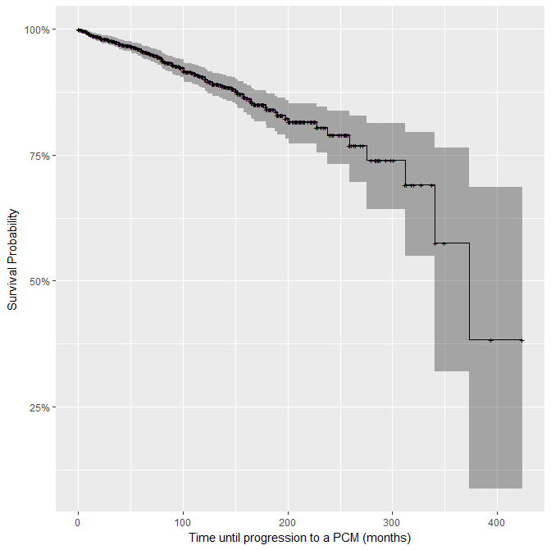
Results
Median survival time was 31 years with a 95% CI:(340, NA)
81 months: 93.7% survival with a 95% CI: (91.5, 95)
20 years: 79% survival with a 95% CI: (73.2, 83.8)
35 years (study end): 38.3% survival with a 95% CI: (8.74, 68.6)
Figure 1. Survival curve for MGUS with no explanatory variables
Notes:
By visual inspection, it is clear that no difference exists in the survival probability between genders.
The log rank tests with equal weights confirms no statistical significant differences.

Slide 10
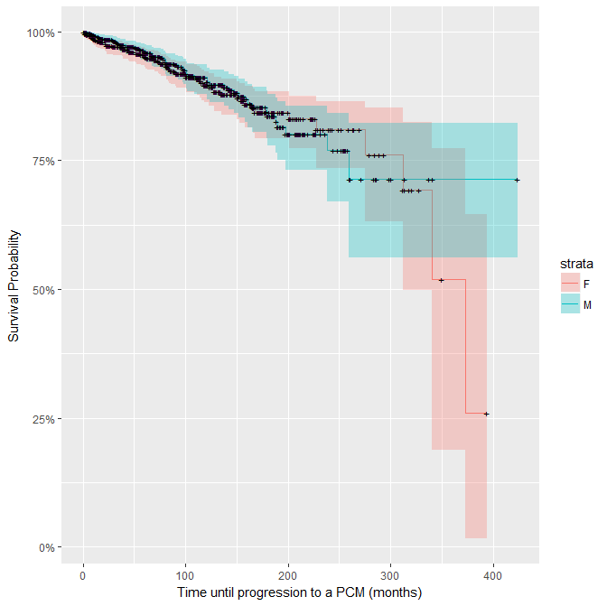
Results
Visual inspection reveals no apparent difference.
The Mantel-Haenszel logrank test concludes no significant difference (p-value of 0.751) in progression to PCM for men vs. women.
Figure 2. Survival curve for MGUS stratified by gender
Notes:
By visual inspection, it is clear that no difference exists in the survival probability between genders.
The log rank tests with equal weights confirms no statistical significant differences.

Slide 11
Results
Initial Cox PH model included all covariates
Model assessment found no covariate to be in violation of the PH assumption (See Appendix B)
Backwards stepwise variable selection resulted in a reduced model that included only 3 covariates
The reduced model was rebuilt using the original data set with missing values. No significant differences were seen.
$$λ_{0}\left(t\right)\exp\left(β_{1}(age)+β_{2}(gender)+β_{3}(creat)+β_{4}(Hgb)+β_{5}(Mspike)\right)$$
$$λ_{0}\left(t\right)\exp\left(β_{1}(age)+β_{4}(Hgb)+β_{5}(Mspike)\right)$$

Slide 12
Results
The serum monoclonal spike is the most significant predictor of a PCM with a HR of 2.48 per unit increase.
Hgb levels were found to be protective of PCM with an 11% reduction in hazard per unit increase.
Age was not found to be a significant predictor and its removal results in no meaningful difference.
Table 2. Hazard ratios for selected cox proportional hazards model
 | Hazard ratio | 95% CI lower | 95% CI upper
Age | 1.011 | 0.995 | 1.028
Hgb | 0.889 | 0.804 | 0.983
Serum M Spike | 2.48 | 1.793 | 3.429

Slide 13
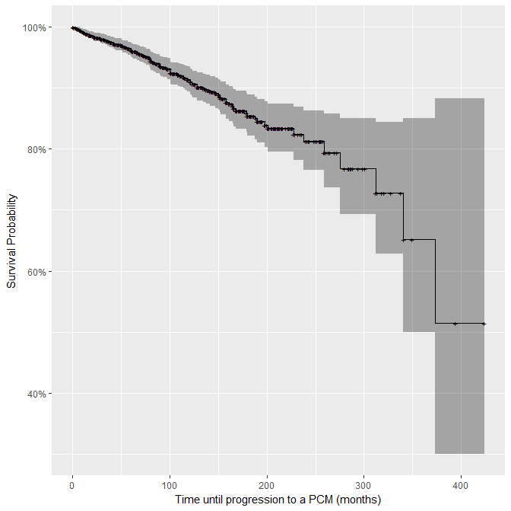
Results
Median survival time was 31 years with a 95% CI:(340, NA)
81 months: 94.4% survival with a 95% CI: (92.7, 95.7)
20 years: 80% survival with a 95% CI: (73.6,85)
35 years (study end): 45.6% survival with a 95% CI: (15.3, 72)
Figure 3. Survival curve for reduced Cox proportional hazards model
Notes:
By visual inspection, it is clear that no difference exists in the survival probability between genders.
The log rank tests with equal weights confirms no statistical significant differences.

Slide 14
Discussion
High survival rates
MGUS has a low prevalence in the general population with even fewer progressing to a PCM.
Limitations
Low power
Stale data (collected between 1960 – 1994)
International Myeloma Working Group has since changed the criteria for diagnosing MGUS and PCM.
Possible differential misclassification with bias towards the null
Other risk factors for MGUS have since been identified (e.g., race, family history of MGUS). These were not available as covariates to evaluate risk of progressing to PCM.
Notes:
up to 2 percent of persons 50 years of age or older and about 3 percent of those older than 70 years.

Slide 15

Questions

Slide 16
Reference List
Monoclonal gammopathy of undetermined significance (MGUS). Mayo Clinic. http://www.mayoclinic.org/diseases-conditions/mgus/symptoms-causes/syc-20352362. Published July 29, 2017. Accessed April 15, 2018.
Van de Donk NWCJ, Palumbo A, Johnsen HE, et al. The clinical relevance and management of monoclonal gammopathy of undetermined significance and related disorders: recommendations from the European Myeloma Network. Haematologica. 2014;99(6):984-996. doi:10.3324/haematol.2013.100552.
International Myeloma Working Group (IMWG) Criteria for the Diagnosis of Multiple Myeloma. International Myeloma Working Group. http://imwg.myeloma.org/international-myeloma-working-group-imwg-criteria-for-the-diagnosis-of-multiple-myeloma/. Published November 9, 2015. Accessed April 15, 2018.
Kyle RA, Therneau TM, Rajkumar SV, et al. A Long-Term Study of Prognosis in Monoclonal Gammopathy of Undetermined Significance. New England Journal of Medicine. 2002;346(8):564-569. doi:10.1056/nejmoa01133202.
Azur MJ, Stuart EA, Frangakis C, Leaf PJ. Multiple Imputation by Chained Equations: What is it and how does it work? International journal of methods in psychiatric research. 2011;20(1):40-49. doi:10.1002/mpr.329.

Slide 17
Reference List
R: A language and environment for statistical computing [computer program]. Version 3.4.4. Vienna, Austria: R Foundation for Statistical Computing; 2018.
Buuren SV, Groothuis-Oudshoorn K. mice: Multivariate Imputation by Chained Equations inR. Journal of Statistical Software. 2011;45(3). doi:10.18637/jss.v045.i03.
A Package for Survival Analysis in S [computer program]. Version 2.38. Therneau T; 2015.
Borgan Ø. Modeling Survival Data: Extending the Cox Model. Terry M. Therneau and Patricia M. Grambsch, Springer‐Verlag, New York, 2000. No. of pages: xiii 350. Price: $69.95. ISBN 0‐387‐98784‐3. Statistics in Medicine. 2001;20(13):2053-2054. doi:10.1002/sim.956.abs.
Kyle RA, Therneau TM, Rajkumar SV, et al. Prevalence of monoclonal gammopathy of undetermined significance. N Engl J Med. 2006;354(13):1362-9.
Understanding your MULTIPLE MYELOMA LAB TESTS. Takeda Oncology. http://www.velcade.com/files/PDFs/Understand_your_Lab_Tests_Resource_(MM). Accessed April 20, 2018.
Kyle RA, Larson DR, Therneau TM, et al. Long-Term Follow-up of Monoclonal Gammopathy of Undetermined Significance. N Engl J Med. 2018;378(3):241-249.

Slide 18
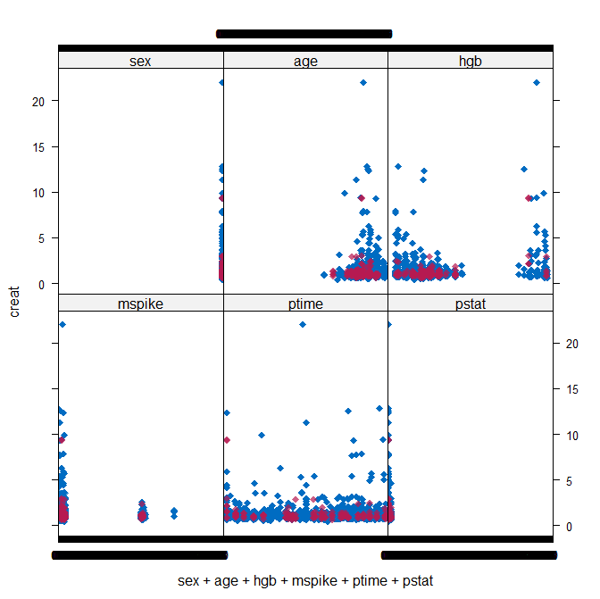
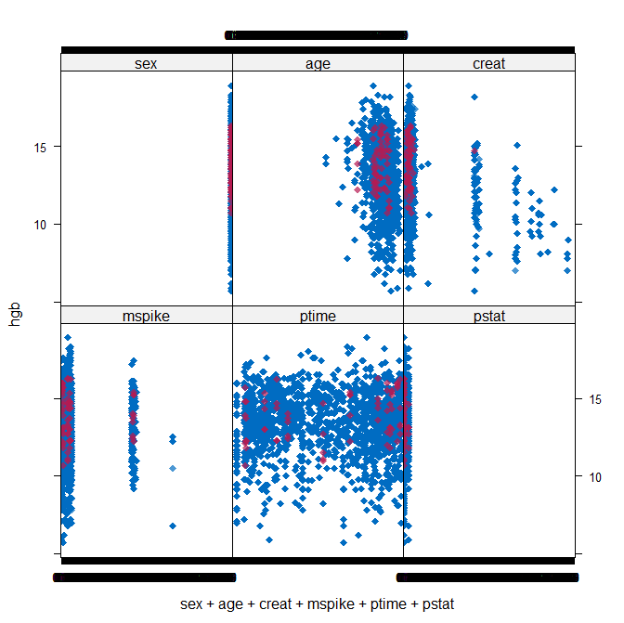
Appendix A: Imputed Data Validation
Return

Slide 19
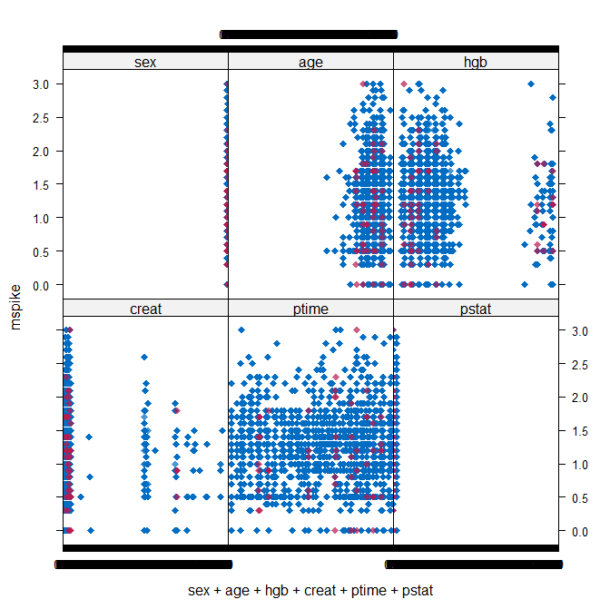
Appendix A: Imputed Data Validation
Return

Slide 20
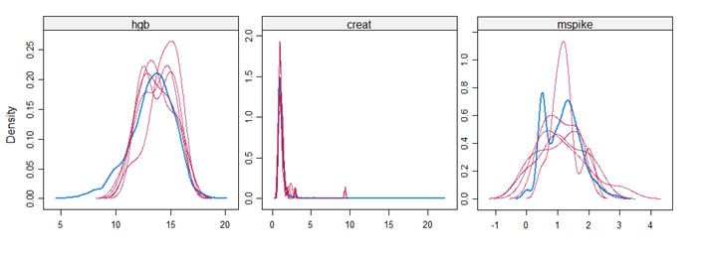
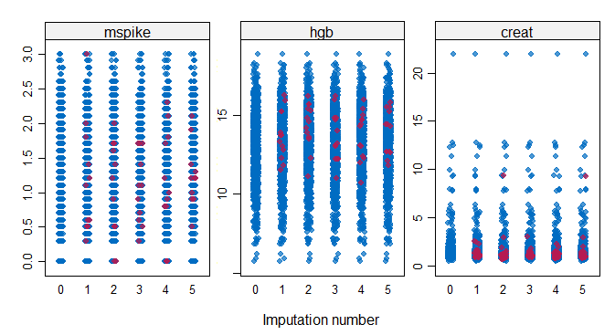
Appendix A: Imputed Data Validation
Return

Slide 21
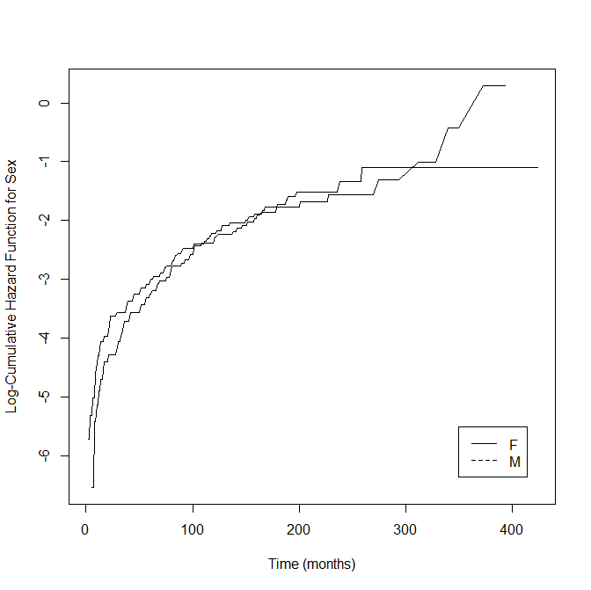
Appendix B: Model Validation
Return
Notes:
PH assumptions do not seem to be valid for gender. The curves cross several times.

Slide 22
Appendix B: Model Validation
Table 3. Cox proportional hazards full model estimates coefficient estimates
 | Est. | SE | DF | Pr(>|t|) | 95% CI lower | 95% CI upper
Sex (M) | 0.186 | 0.204 | 914310.340 | 0.360 | -0.213 | 0.585796
Age | 0.012 | 0.008 | 698499.190 | 0.139 | -0.004 | 0.028893
Hgb* | -0.142 | 0.055 | 155117.100 | 0.009 | -0.250 | -0.03496
Creatinine | -0.187 | 0.208 | 22020.350 | 0.368 | -0.594 | 0.22011
Serum M Spike* | 0.862 | 0.164 | 980751.780 | < 0.001 | 0.541 | 1.182819
* Coefficient found to be statistically significant
Return
Notes:
Sex and age do not appear to be significant predictors of progression to plasma cell malignancy. This could explain why in the previous two plots the proportional hazards assumption was not evidenced.

Slide 23
Appendix B: Model Validation
Table 4. Results of covariate correlation tests with time for a single imputed data set
 | rho | χ² | p
Sex (M) | 0.069 | 0.52935 | 0.467
Age | -0.16858 | 2.27376 | 0.132
Hgb | -0.08885 | 0.96138 | 0.327
Creatinine | -0.02335 | 0.06438 | 0.8
Serum M Spike | -0.00469 | 0.00258 | 0.959
GLOBAL | NA | 3.07841 | 0.688
Return

Slide 24
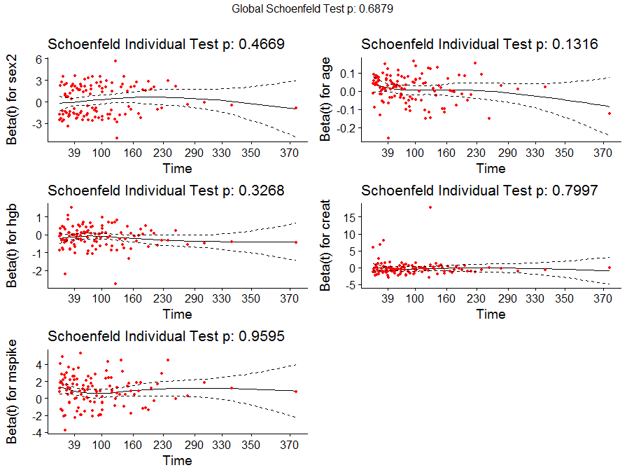
Appendix B: Model Validation
Return
Notes:
There are no consistent trends for any of the covariates that would indicate a correlation with time. Age shows a slight downward trend.

Slide 25
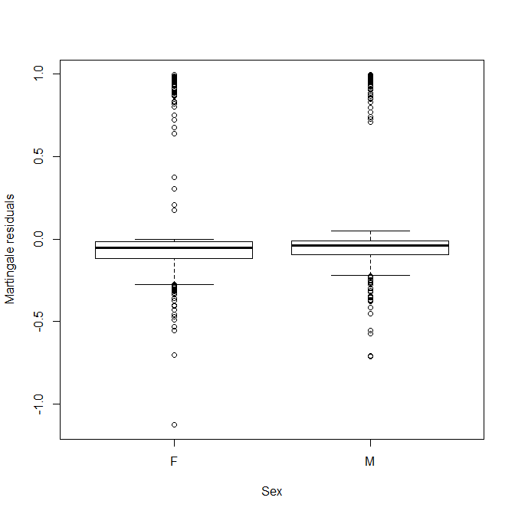
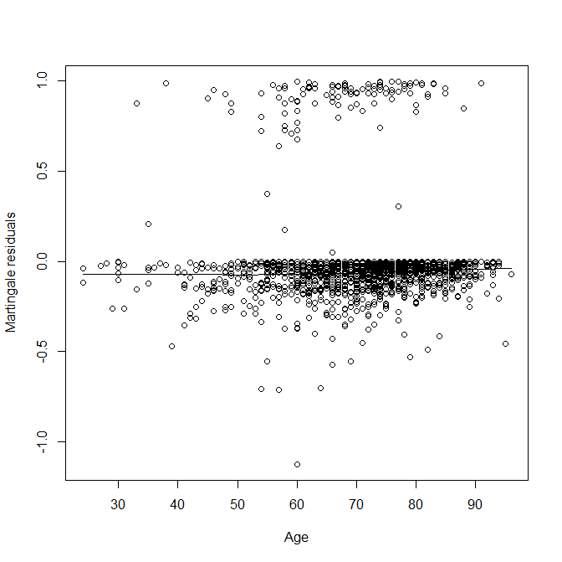
Appendix B: Model Validation
Return

Slide 26
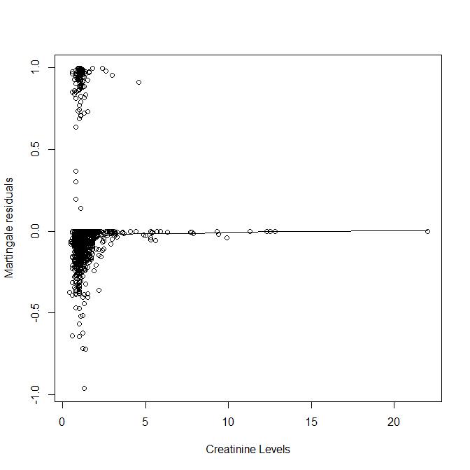
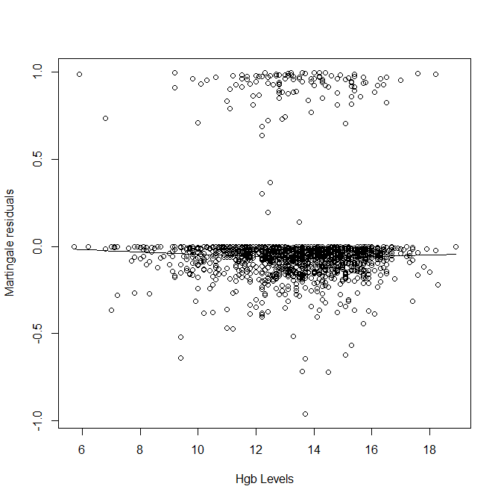
Appendix B: Model Validation
Return

Slide 27
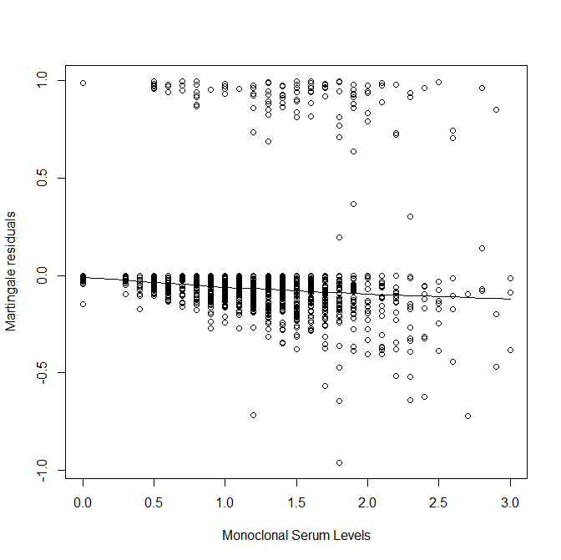
Appendix B: Model Validation
Return
Notes:
There is a slight downwards trend with the Monoclonal Serum Levels.

Slide 28
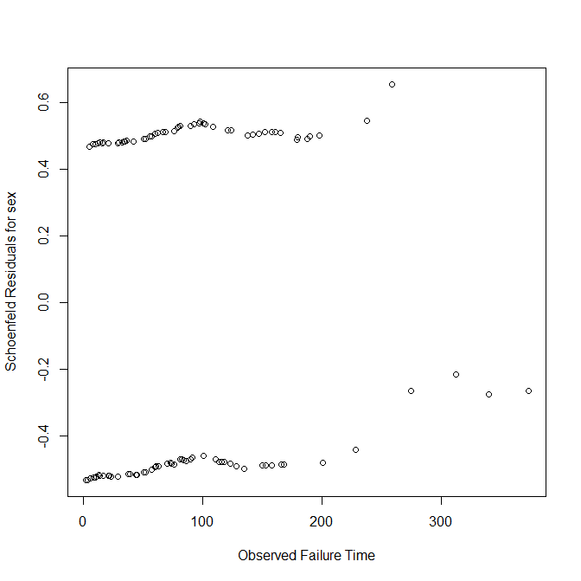
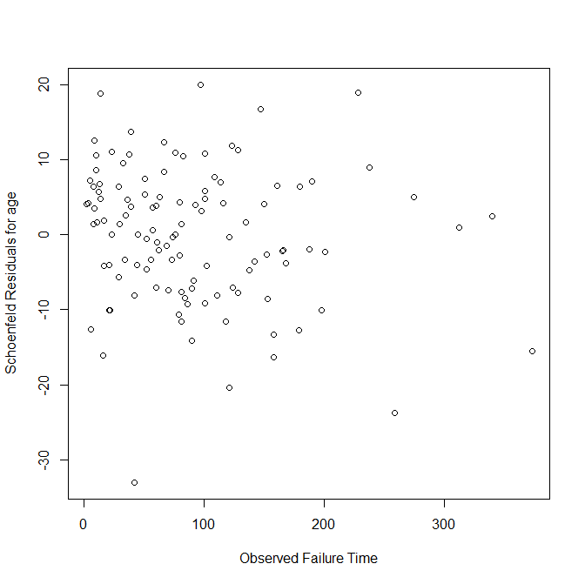
Appendix B: Model Validation
Return
Notes:
Residuals for sex appear uniformly distributed around zero. However, for age there is a slight pattern. We will investigate it further by including its continuous form in the model.

Slide 29
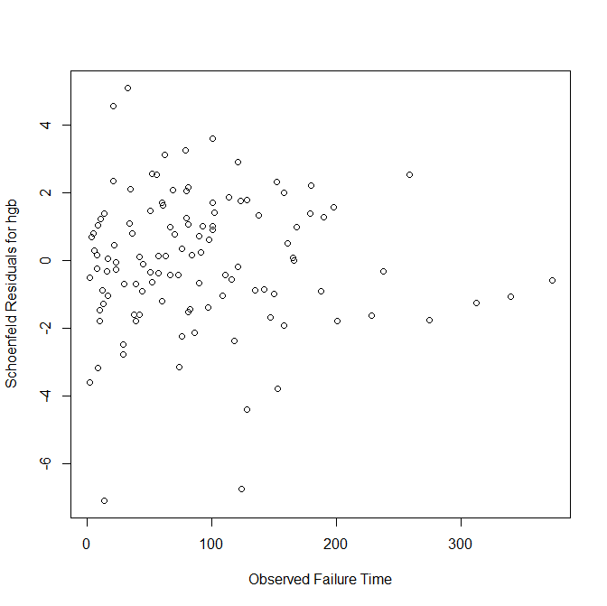
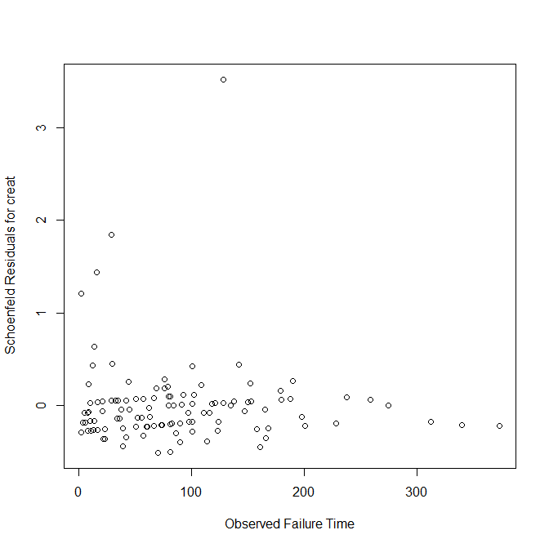
Appendix B: Model Validation
Return
Notes:
Schoenfield residuals for hgb appear to converge to zero over time. For creatinine, the residuals also converge to zero, but a few outliers are observed.

Slide 30
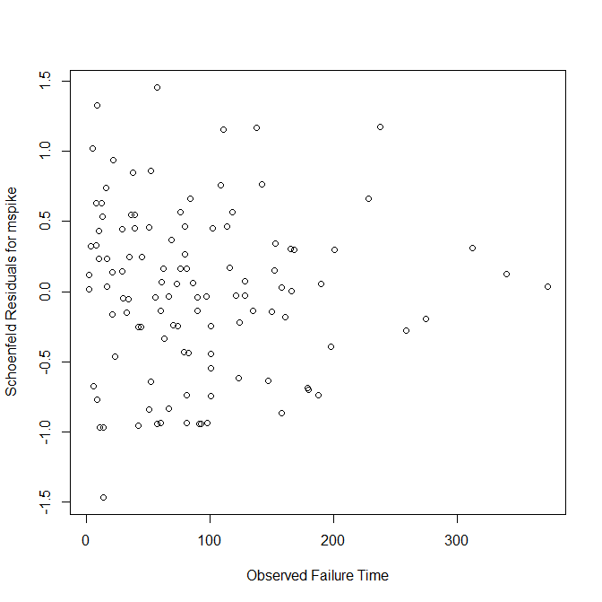
Appendix B: Model Validation
Return
Notes:
Schoenfield residuals for monoclonal serum levels converge to zero over time.

Slide 31
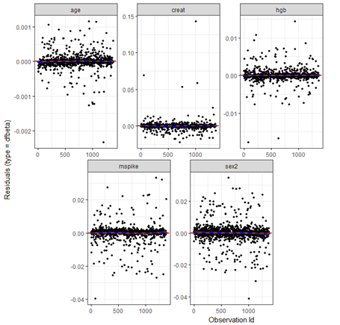
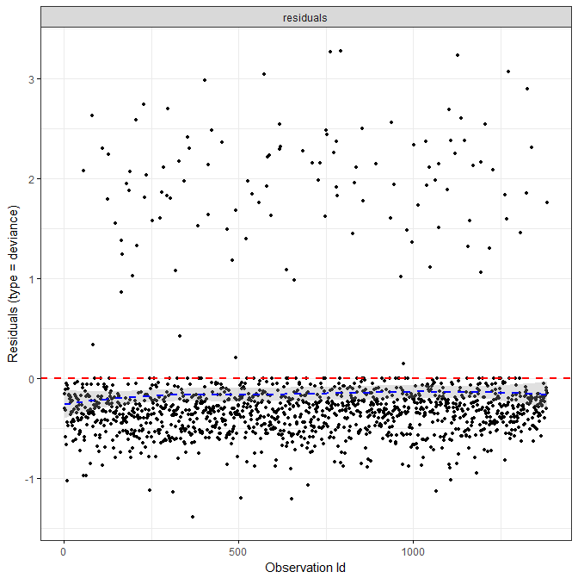
Appendix B: Model Validation
Return
Notes:
Mostly the data points are distributed around zero and no single point appears to be influential.
Check to see if they have standardized residuals

