Slide 1
May 31
Today Is Web Designer Day
Here is where your presentation begins

Slide 2
Contents of this template
Here’s what you’ll find in this Slidesgo template:
A slide structure based on a multi-purpose presentation, which you can easily adapt to your needs. For more info on how to edit the template, please visit Slidesgo School or read our FAQs.
An assortment of graphic resources that are suitable for use in the presentation can be found in the alternative resources slide.
A thanks slide, which you must keep so that proper credits for our design are given.
A resources slide, where you’ll find links to all the elements used in the template.
Instructions for use.
Final slides with:
The fonts and colors used in the template.
A selection of illustrations. You can also customize and animate them as you wish with the online editor. Visit Storyset to find more.
More infographic resources, whose size and color can be edited.
Sets of customizable icons of the following themes: general, business, avatar, creative process, education, help & support, medical, nature, performing arts, SEO & marketing, and teamwork.
You can delete this slide when you’re done editing the presentation.

Slide 3
Table of contents
01
02
03
04
Our work
Formation
You can describe the topic of the section here
You can describe the topic of the section here
Skills
Our team
You can describe the topic of the section here
You can describe the topic of the section here

Slide 4
Whoa!
This can be the part of the presentation where you introduce yourself, write your email…

Slide 5
—Someone Famous
“This is a quote, words full of wisdom that someone important said and can make the reader get inspired.”

Slide 6
Introduction
You can give a brief description of the topic you want to talk about here. For example, if you’re going to talk about Mercury, you can say that it’s the closest planet to the Sun and the smallest one in the Solar System

Slide 7
01
Our work
You can enter a subtitle here if you need it

Slide 8
What we’re doing
Do you know what helps you make your point clear?
Lists like this one:
They’re simple
You can organize your ideas clearly
You’ll never forget to buy milk!
And the most important thing: the audience won’t miss the point of your presentation

Slide 9
Work environment
Collaborative
Mercury is the closest planet to the Sun and the smallest of them all
Community
Venus has a beautiful name and is the second planet from the Sun

Slide 10
9h 55m 23s
333,000
386,000 km
Jupiter's rotation period
The Sun’s mass compared to Earth’s
Distance between Earth and the Moon

Slide 11
Web design specialties
 | UI/UX | Apps |  | Web
Application | Pluto is now a dwarf planet | Venus is a terribly hot planet |  | Mercury is close to the Sun
Focus | Jupiter is the biggest planet | The Moon is Earth’s satellite |  | Ceres is in the asteroid belt
Creation | Earth is a planet that has life | Saturn is the ringed planet |  | Mars is full of iron oxide dust
Innovation | Neptune is far away from us | Mars is a very cold place |  | Saturn has several rings

Slide 12
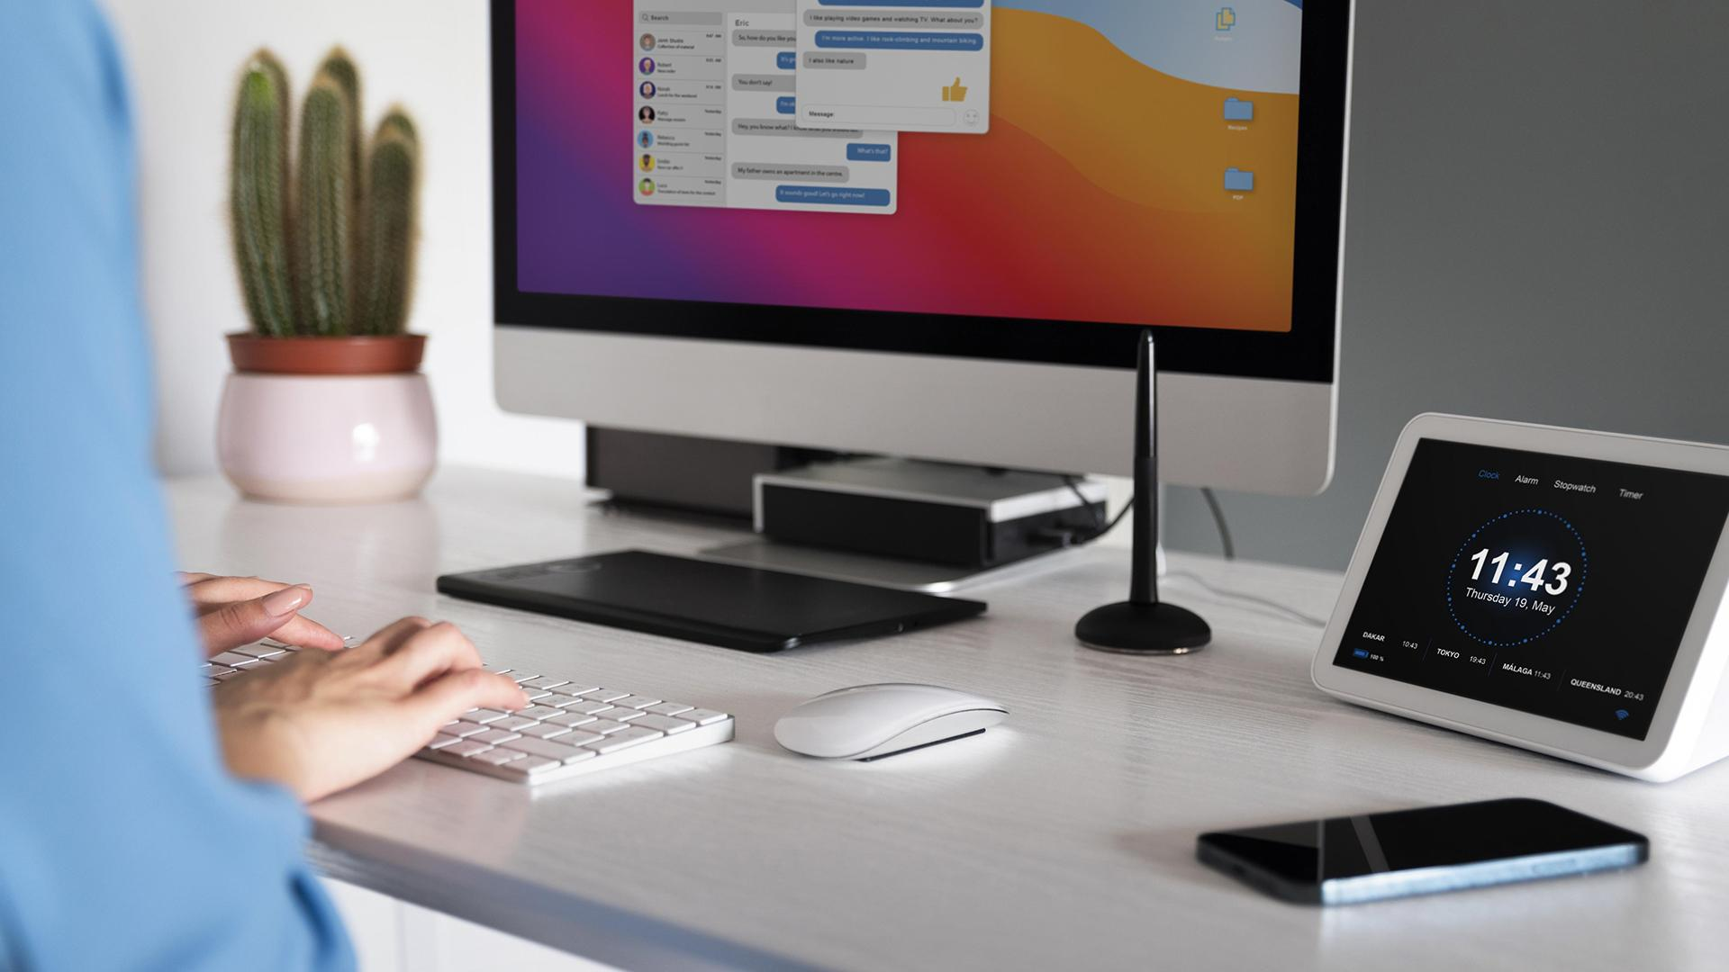
A picture is worth a thousand words

Slide 13
02
Formation
You can enter a subtitle here if you need it

Slide 14
Evolution of web design
2018
2020
2022
Saturn
Mars
Earth
Saturn is a gas giant and has several rings
Despite being red, Mars is actually a cold place
It’s the only planet that harbors life

Slide 15
Awesome
words

Slide 16
Learning web design
Designing tools
Mercury is a small planet
Programing
Mars is actually a cold place
Website security
Earth is a planet that has life
Marketing
Neptune is far away from us

Slide 17
Elements of web design
Graphics
Mercury is the closest planet to the Sun
Layout
Saturn is composed of hydrogen and helium
Font
Jupiter is the biggest planet of them all
Color
Content
Neptune is the farthest planet from the Sun
Venus is the second planet from the Sun

Slide 18
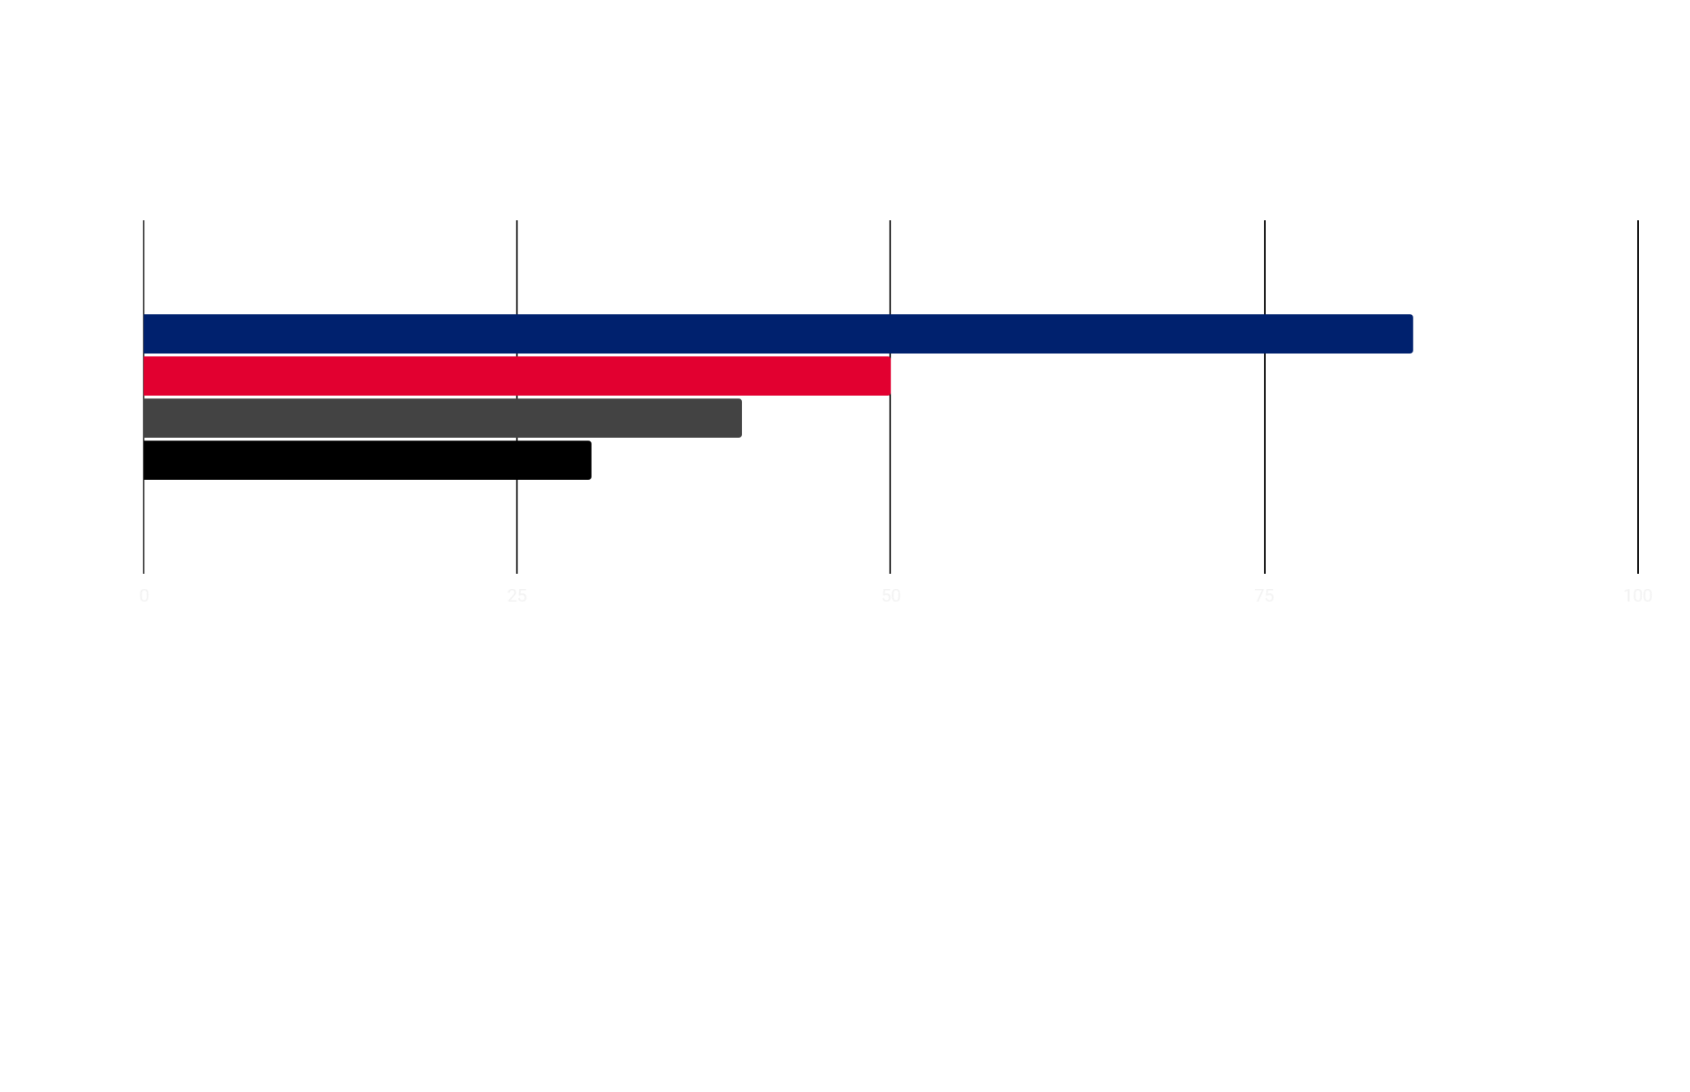
Web design cost
0
25%
50%
75%
100%
85%
50%
40%
30%
Features
Security
UX/UI
Managing
Saturn has several rings
Mars is a very cold place
Venus has a beautiful name
Earth harbors lots of life
Follow the link in the graph to modify its data and then paste the new one here. For more info, click here

Slide 19
Web design anatomy
Design scheme
Mercury is a small planet
UI/UX
Mars is actually a cold place
Security
Earth is a planet that has life
Content
Neptune is far away from us

Slide 20
Web design principles
Balance
Contrast
Emphasis
Mercury is the closest planet to the Sun
Venus is the second planet from the Sun
Mars is actually a very cold place
Movement
Unity
White space
Jupiter is the biggest planet of them all
Saturn is a gas giant and has rings
Neptune is very far away from us

Slide 21
Effective web design
UI/UX
Layout
Mercury is the smallest planet
Mars is actually a cold place
Typography
Design
Venus is the second planet from the Sun
Earth is the third planet from the Sun

Slide 22
School locations
Italy
Earth is a planet that has life
Venezuela
Mars is actually a cold place
USA
Mercury is a very small planet

Slide 23
03
Skills
You can enter a subtitle here if you need it

Slide 24
Skills of a web designer
Web tools
Business
Pluto is now a dwarf planet
Mercury is a small planet
Design
Content
Earth is a planet that has life
Mars is actually a cold place

Slide 25
Good web designer needs
25%
Good presentation
Venus has a beautiful name
50%
Call to action
Mars is actually a cold place
90%
Good impression
Earth is a planet that has life

Slide 26
Most wanted skills for jobs
75%
50%
65%
UI/UX
Business
Web security
Mercury is the closest planet to the Sun
Neptune is the farthest planet from the Sun
Despite being red, Mars is a cold place

Slide 27

A picture always reinforces the concept
Images reveal large amounts of data, so remember: use an image instead of a long text. Your audience will appreciate it

Slide 28
Extra skills
Coding
Mercury is the closest planet to the Sun and the smallest one in the Solar System
Editing
Venus has a beautiful name and is the second planet from the Sun
Managing
Despite being red, Mars is actually a cold place. It's full of iron oxide dust

Slide 29
356,000
Big numbers catch your audience’s attention

Slide 30
04
Our team
You can enter a subtitle here if you need it

Slide 31


Our team
John Doe
Susan Bones
You can speak a bit about this person here
You can speak a bit about this person here

Slide 32
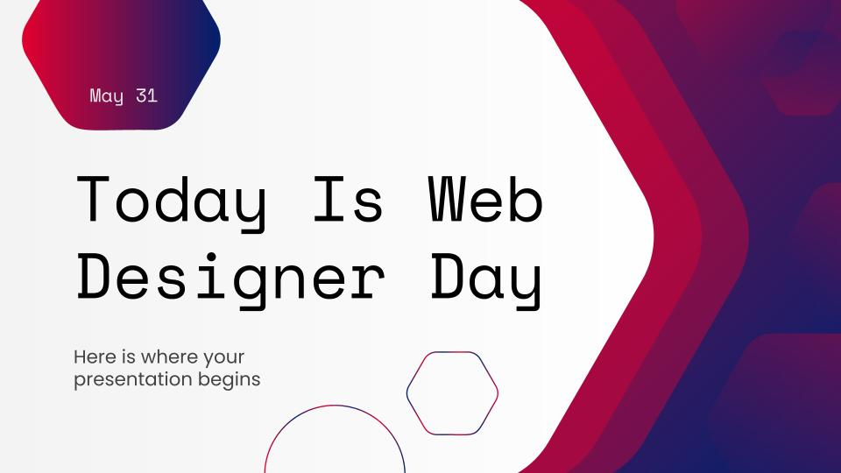
Desktop software
You can replace the image on the screen with your own work. Just right-click on it and select “Replace image”

Slide 33
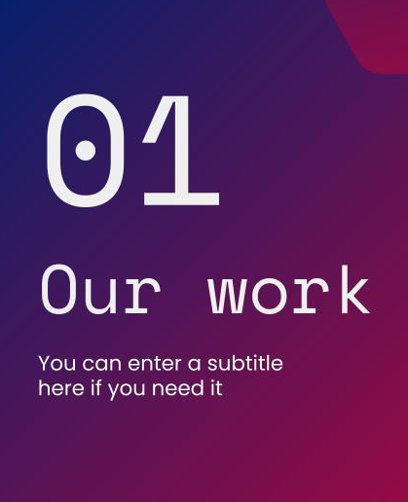
Tablet app
You can replace the image on the screen with your own work. Just right-click on it and select “Replace image”

Slide 34
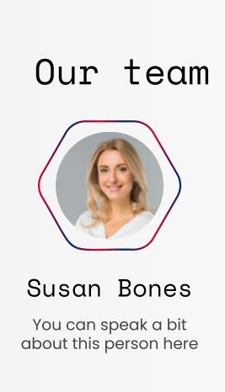
Mobile app
You can replace the image on the screen with your own work. Just right-click on it and select “Replace image”

Slide 35
Thanks!
Do you have any questions?
youremail@freepik.com
+91 620 421 838 yourwebsite.com
Please keep this slide for attribution

Slide 36
Web design linear icon pack

Slide 37
Alternative resources
Here’s an assortment of alternative resources whose style fits that of this template:
Vectors
Start up company landing page design

Slide 38
Resources
Vectors
Abstract slide collection
Icons
Web Design Linear Icon Pack
Photos
Close up hands typing at desk
Crop coworkers using modern devices at desk
Man smiling after applying anti aging treatment
Portrait of a young businesswoman holding eyeglasses in hand against gray backdrop

